Slide 1
LASER PHYSICS
Optics 464
PAIS or CHTM?
TexPoint fonts used in EMF.
Read the TexPoint manual before you delete this box.: AAAAAAAA

Slide 2
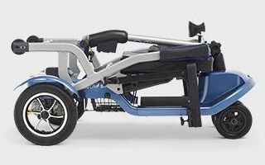
PROLOGUE
Why the scooter
and the cane???
?
It is not COVID, but the UNM Provost for Research Tom Turner. In March 2020, I was ordered to move my lab out of the old physucs building. The old building was to be bulldozed within a week. At the same time, the administration close the buildings to students. Associate Provost for Research refused to make an exception by allowing one student to help me with the move.
That forced me to move a whole optics lab by myself resulting in spinal injury. This is consistent with UNM motto: RULE first! Feed faculty to COVID!
In view of the great vision of UNM administrators, their mascot should not be the lobo
but the MOLE
…with blinders

Slide 3
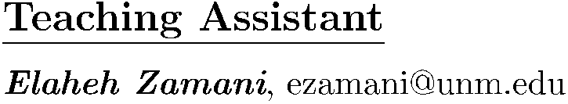
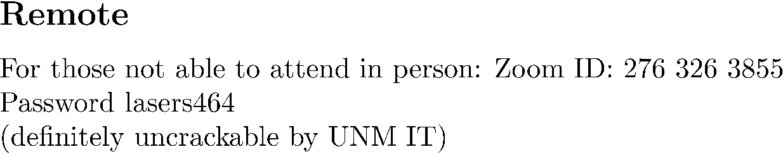
LASER PHYSICS
Optics 464
PAIS or CHTM?
Jean-Claude Diels
Physics & Astronomy room PAIS 2236, phone 277 4026
CHTM, room 114A, phone 272 7830 Do not send text messages– these are landlines! DO LEAVE VOICE messages.
email: jcdiels@unm.edu
LASERS, by Anthony E. Siegman, University Press.
Laser electronics, J.Y Verdeyen, Prentice Hall
Solid state laser engineering, W. Koechner, Springer verlag
Photonics, Saleh
Homework problems will be assigned on a regular base, due generally on Wednesdays. They will count for 40% of the final grade.
Some problems will be treated in class.
Exams
One midterm and one final; 30% of grade each.

Slide 4
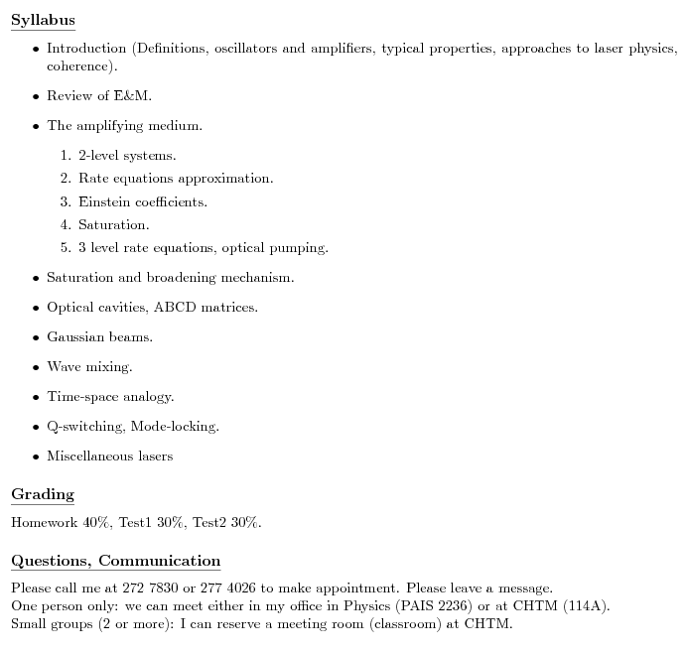

Slide 5
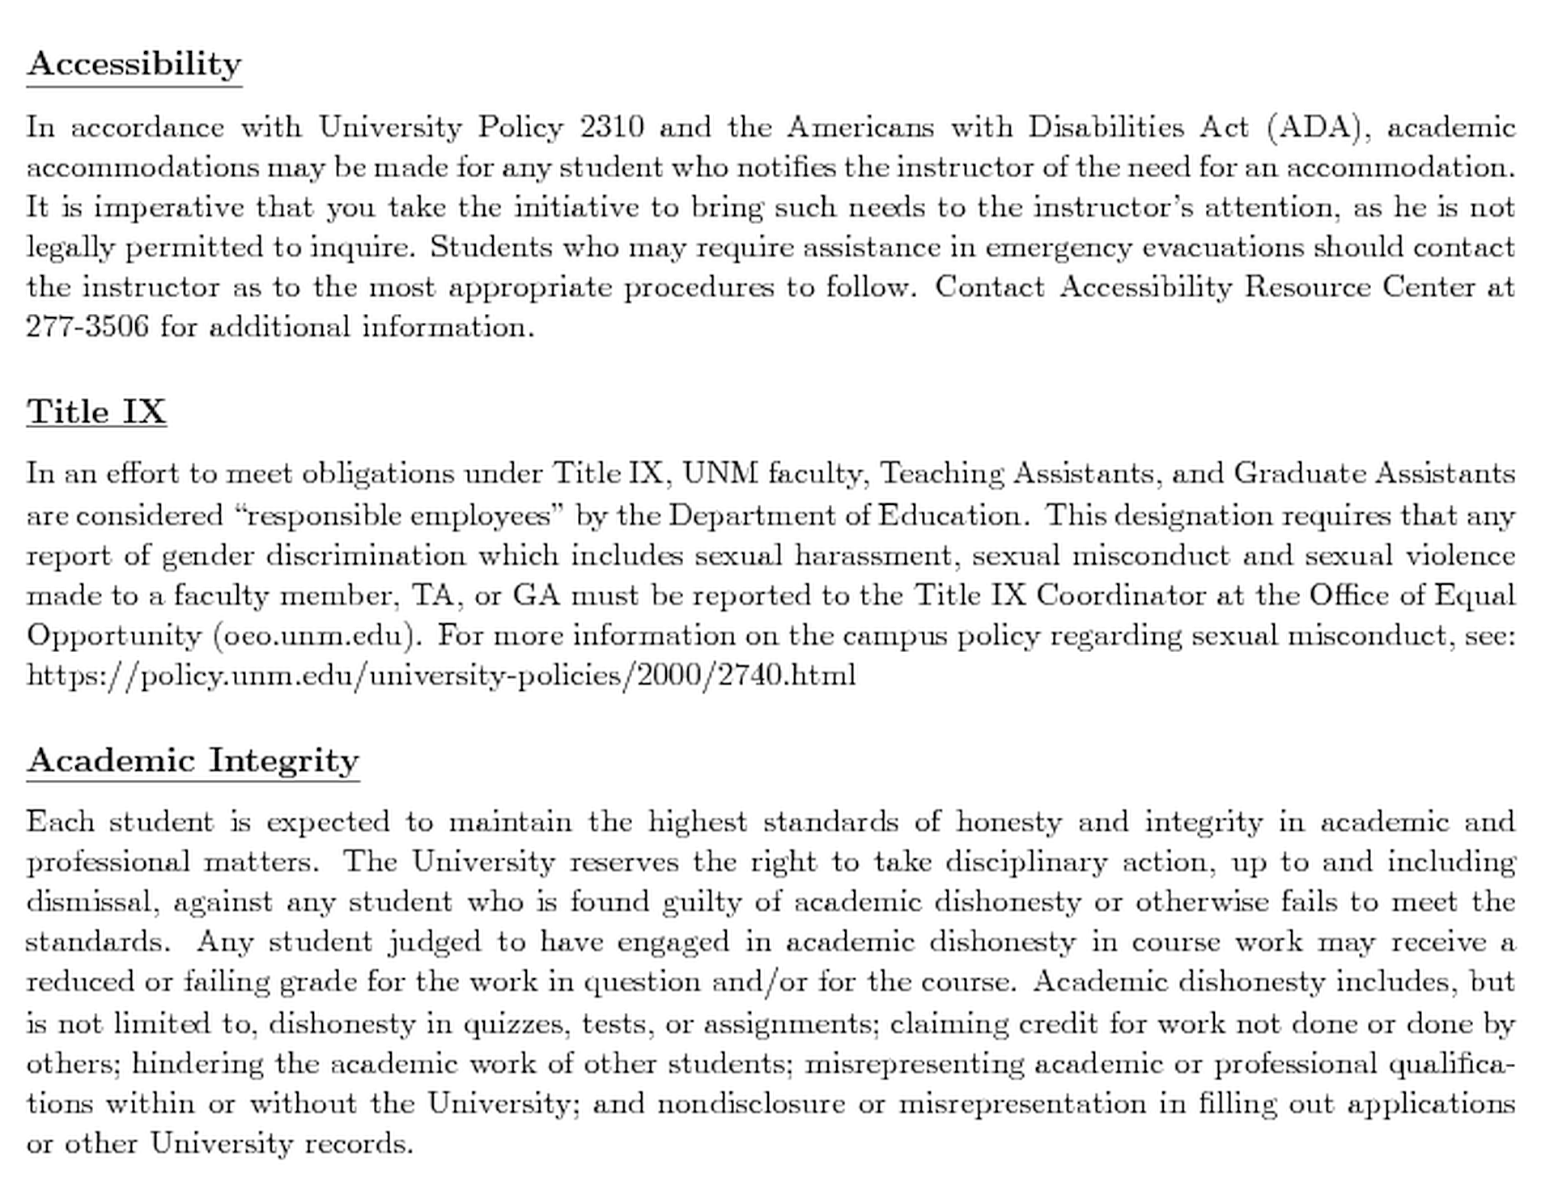
H Y P O C R I S Y

Slide 6
Introduction to light
Wave aspect
Light wave: electric-magnetic field oscillating transverse to the propagation direction
What is a wave? There is always a pattern and motion associated to the wave; the ripples of a
stone thrown in a pond. If you take a picture from the ripples on the pond you realize that there are regular patterns that repeat in water, and you can possibly count the number of peaks on the water surface, that are separated by “wavelength". You can also only consider a fixed point on the surface, and monitor its motion as it goes up and down, or oscillates. It takes a “period" for each point on the pond to repeat its position. The pattern on the wave (for example the peaks) have a certain “speed“ or “wave velocity"

Slide 7
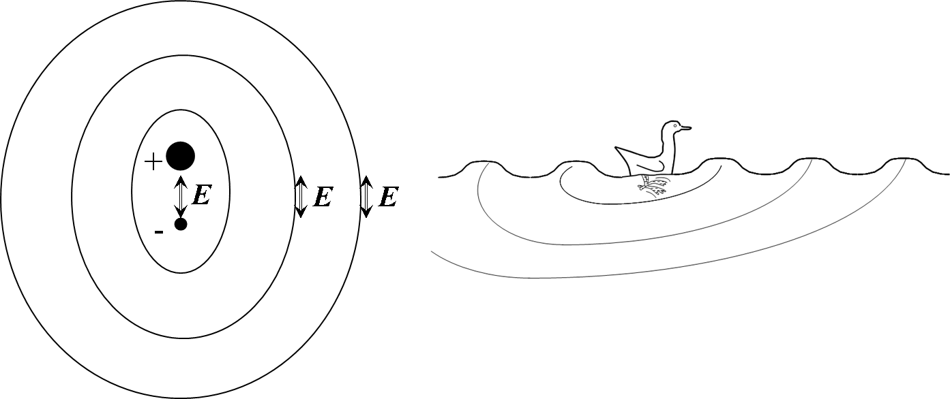
When a wave goes through a medium it does not mean that the medium is necessarily moving with it.. The wave propagate for huge distances, while each particle responsible for the
wave motion stays at the same average position, just inducing the motion of the next particle. In most cases, the wave starts from a local oscillation , and propagates radially from there, like rings produced by a duck paddling on a pond. In the case of light, it is the electric field produced
by a charge oscillating up and down that starts off the wave.
The electric field produces a magnetic field that produces an electric field, and that is essentially
how light waves propagate. The velocity of a wave is a property of the medium in which the wave
propagates. Sound waves propagate at 343 m/s in dry air at room temperature, and faster
in denser media. It is the opposite for the light waves which usually travel faster in air or vacuum.
dispersion

Slide 8

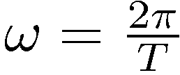
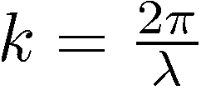
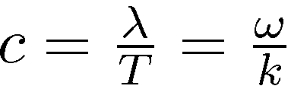
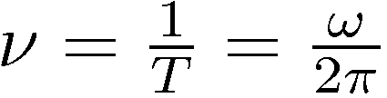
Wave propagation
E
c
c
Wave velocity:
T = period λ = wavelength
Light frequency (Hz):

Slide 9
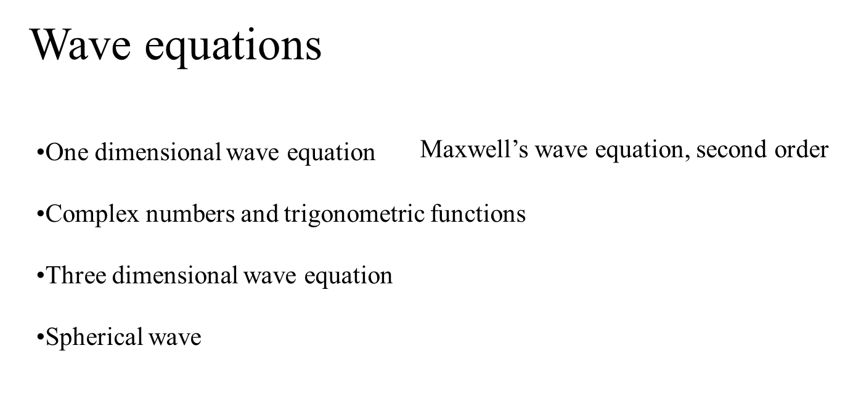
Making Waves

Slide 10
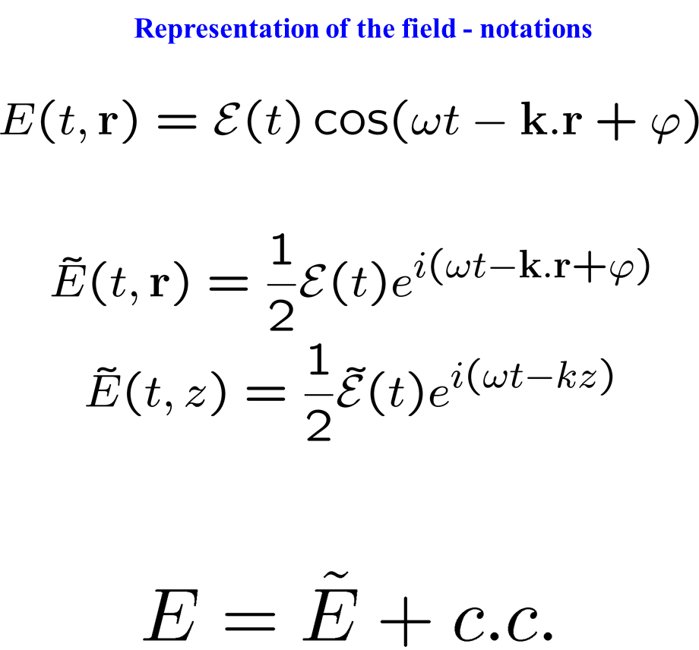

Slide 11
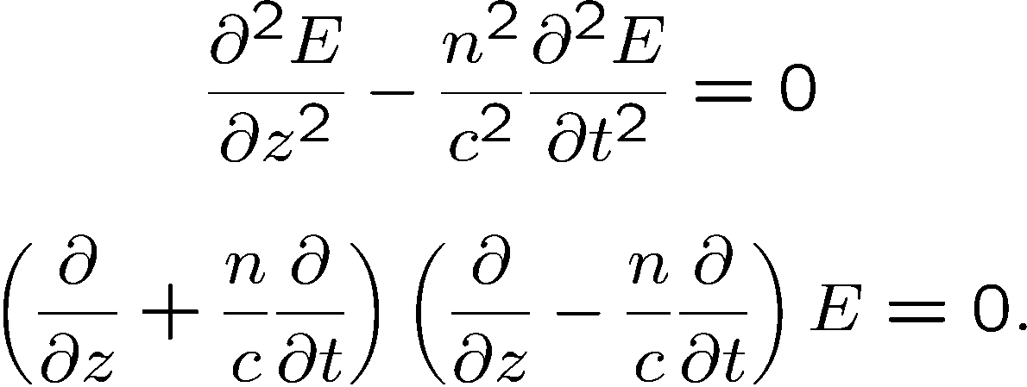
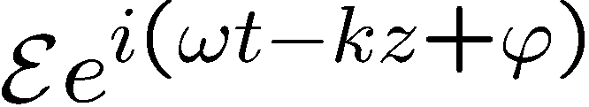
Maxwell’s second order wave equation
forward
backward
SOLUTIONS?
Principle of superposition: all solutions can be written as a linear combination of
(complex numbers)
Substitute in wave equation to find the wave velocity

Slide 12
Study of propagation from second to first order
apply this first, to give (– 2 i k E)

Slide 13
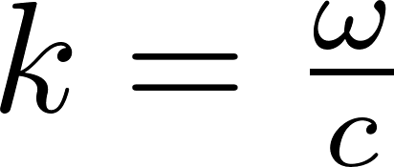
From Second order to first order (the tedious way)
(Polarization envelope)

Slide 14
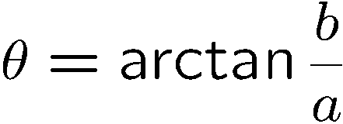
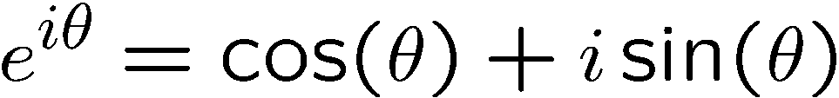
Making Waves: waves add like complex numbers
Complex number
Im
Z = a + i b
a = Re (z)
b = Im (z)
Z* = a - i b
b
z
θ
Re
a
Add and subtract exponentials and trigonometric functions
Plane waves, spherical waves

Slide 15
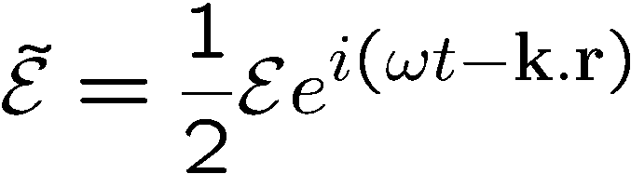
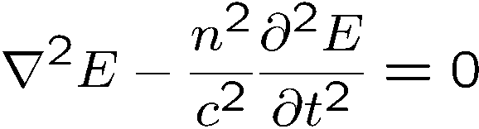
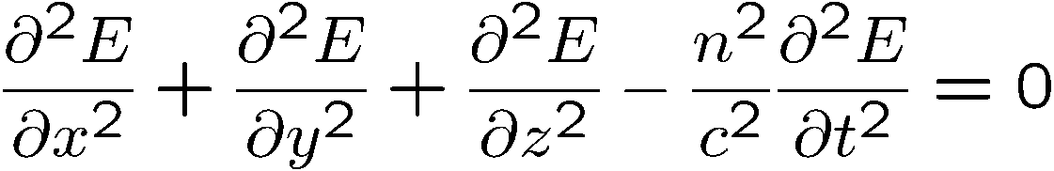
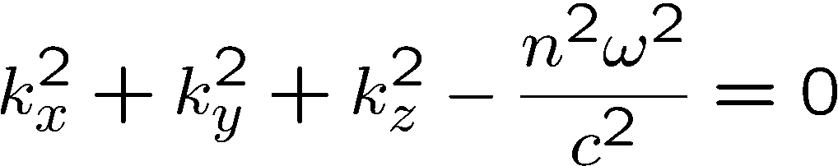
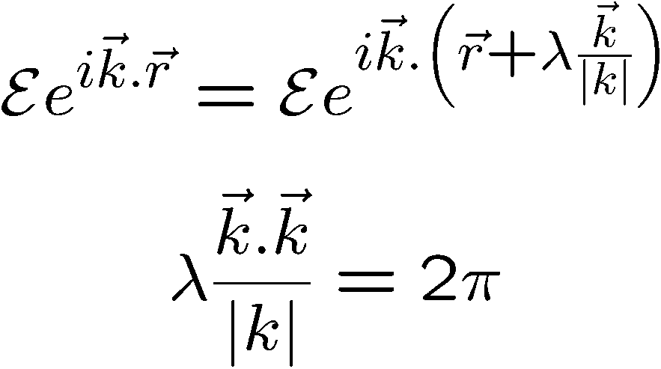
Plane waves
Solution of:
Substitute:
Surfaces of constant phase perpendicular to the vector k
Relation between k and λ
At t = cst, the field repeats itself
after λ

Slide 16
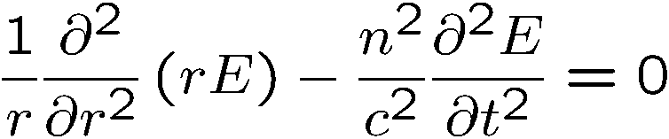
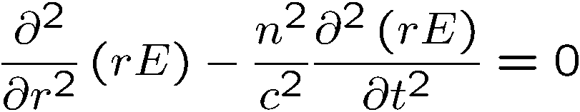
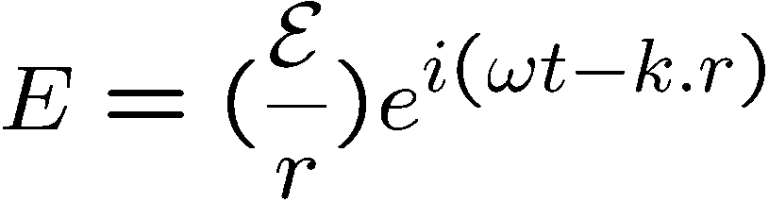
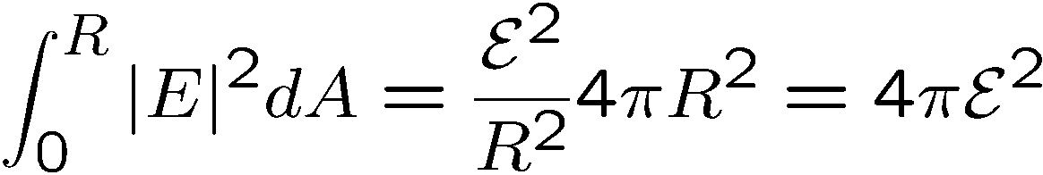
2. Spherical waves
Wave equation:
Write in spherical coordinates, assuming spherical symmetry:
c
c
Conservation of energy

Slide 17

SUPERPOSITION OF WAVES
Waves of the same k vector,same frequency
Waves of the same k vector, different frequencies
Beat note
Creation of an arbitrary
Group velocity
Waves mixing (AOM)
Waves of different k vector, same frequency
Counter-propagating waves
Co-propagating, random phase
Intersecting waves

Slide 18
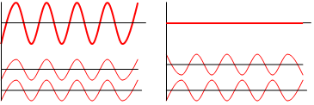
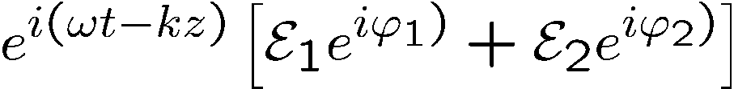
Waves of the same k vector,same frequency
Constructive and destructive
Constructive and destructive
y
Superposition
is just like adding two
vectors ,
x

Slide 19
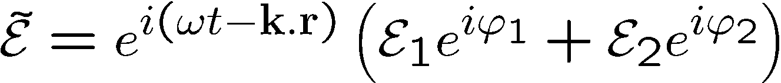





Interferences
Waves of the same k vector, same frequency
Constructive and destructive
constructive
destructive
Superposition
is just like adding two
vectors ,

Slide 20
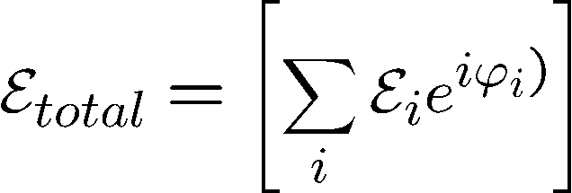
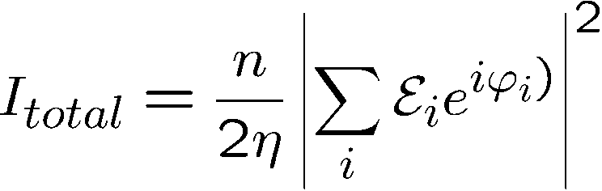



Random and Coherent source

Slide 21
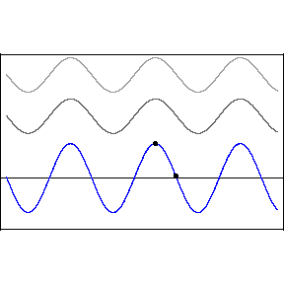
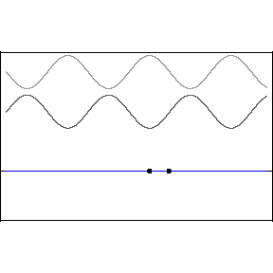
Waves of the different k vector magnitude, same frequencies
Two sine waves traveling in the same direction
Two sine waves traveling in opposite directions
“standing wave”

Slide 22









Waves of the same k vector, same frequency
Energy conservation
If the energy is lost by destructive interference, it has to reappear somewhere else
by constructive interference
A beam splitter is an element with a complex reflection coefficient
and a complex transmission coefficient
Energy conservation:

Slide 23
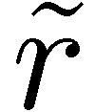
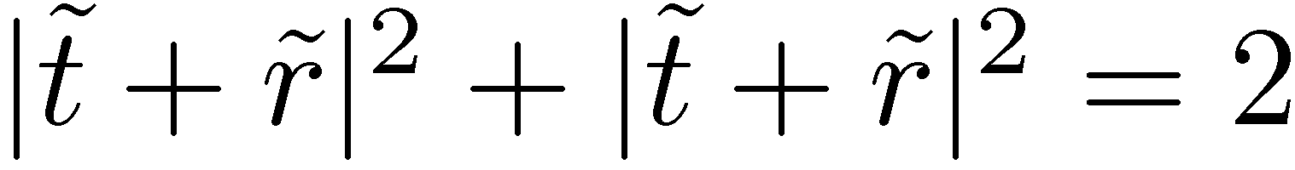
’
’
+
Example: check the asymmetric Fabry-Perot:

Slide 24
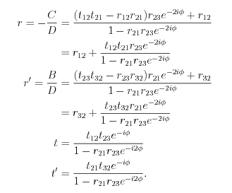
’
+

Slide 25








Waves of the same k vector, same frequency
Energy conservation
Mach Zehnder:
Michelson

Slide 26
SUPERPOSITION OF WAVES
Waves of (nearly) the same k vector, same frequency:
Fresnel biprism
Given the angle, what is the fringe spacing?
How to determine the angle of the biprism?

Slide 27
SUPERPOSITION OF WAVES
y
Waves of (nearly) the same k vector, same frequency:
Young’s double-slit experiment
P
S₁
S₂
Young’double-slit as a spectrometer: to each λ corresponds an angle θ,

Slide 28
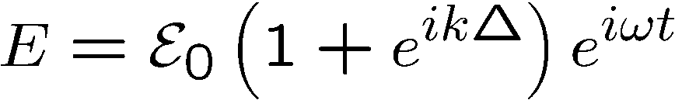
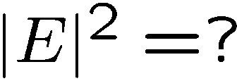
Young’s double slit
Shape of the interferences:
How far do the interference fringes extend?
Fringe visibility
Transverse coherence of a beam

Slide 29
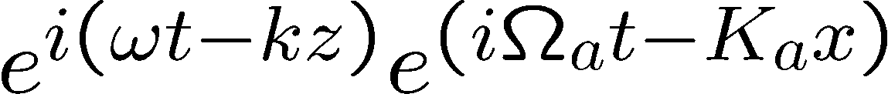
Waves mixing: not necessarily optical waves
Example: AOM

Slide 30
The Doppler effect
Who is Mr. Doppler?
Doppler was born in Lviv, Ukraine in 1821. At that time it was not part of the Russian empire, but the Austrian Empire), now At the age of 18 Franz was the first flautist at the opera in Budapest, and he went on to be the first flautist and stand-in conductor, and eventually chief conductor, of the Vienna Court Opera, as well as acquiring a position of Professor of Flute at the Vienna Conservatoire from 1864 until 1867. He died in Baden bei Wien, Austria in 1883.
Christian Doppler was born Salsburg, Austria, in 1803. He graduating at the age of 26 from the University of Vienna.
He published at 39 the “Doppler effect”. Died in 1853 in Venice.
"Über das farbige Licht der Doppelsterne und einiger anderer Gestirne des Himmels"
Rather dry… (he was a mathematican)

Slide 31

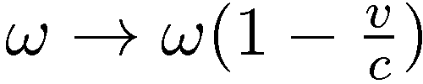
Wave propagation
Doppler shift
What if the receiver is moving:
Emitter
T
Time t
z₀
Receiver
z
z = c t

Slide 32
Wave propagation
Doppler shift
What if the receiver is moving:
"Über das farbige Licht der Doppelsterne und einiger anderer Gestirne des Himmels"
1842 – 14 pages!

Slide 33
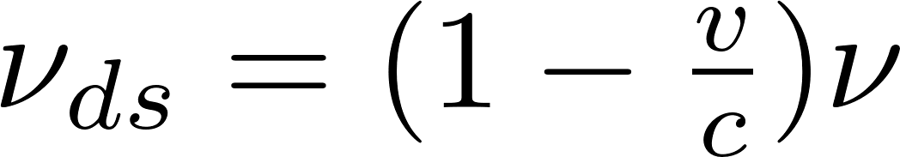
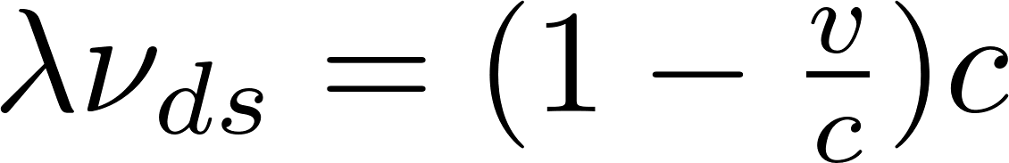
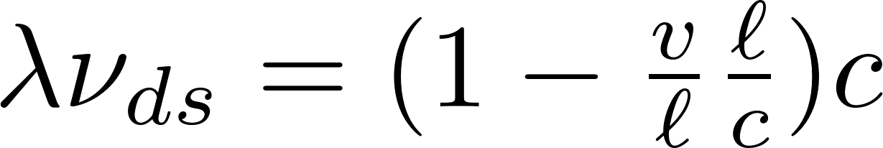

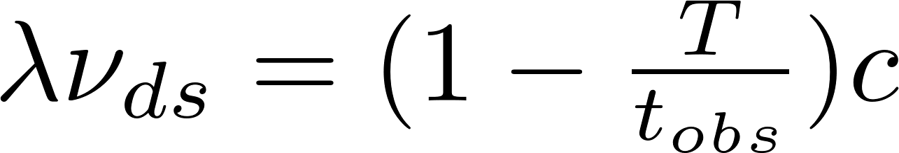
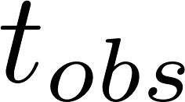
The Doppler derivation of Doppler
Notations!!!
= time needed to move by a wavelength
time for the observer to move by a wavelength

Slide 34
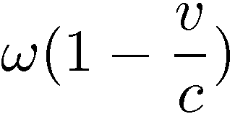
Doppler Shift
Wave propagating to the right
ω frequency of the wave
Frequency experienced by the duckling:
c velocity of the wave
v velocity of the duckling

Slide 35





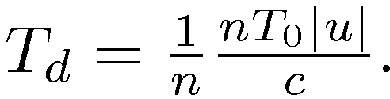

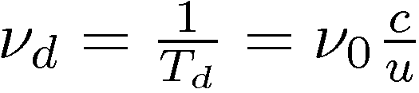
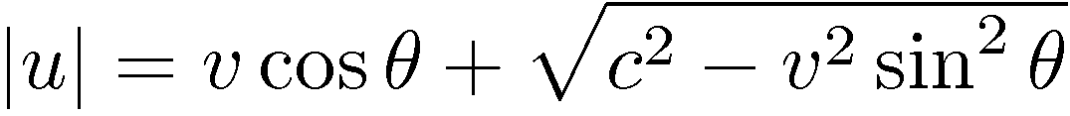
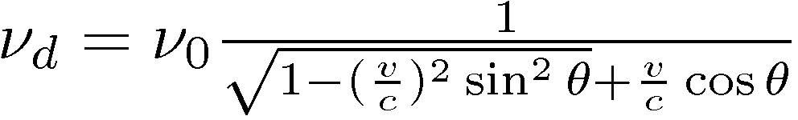


We are looking at n waves emitted by the source, over a time of n T_{0.}
Triangle of velocities:
Detector duck being hobbled at frequency
Distance between emitter and
Wave emitting duck moving at velocity emitting frequency
receiver
u
c
Time intervals between waves
There is a transverse Doppler shift:

Slide 36
MORE ON DOPPLER
WHY?
1) It is simple (“Blessed the feeble minded…”)
2) A good illustration of: “there is more than one way to look at things”
3) It can be confusing!!!
There is a transverse Doppler shift:
for the duck
There is a transverse Doppler shift (relativistic) for light
???????????????????????????????????

Slide 37
Lorentz transformation
Transverse Doppler without relativity
Lorentz transformation
Transverse Doppler with relativity
Follow-up later:
Application of Doppler to laser gyroscope
Sagnac experiment
The ether
Michelson-Morley experiment: the speed of light is the same in a moving or fixed frame of reference!
1892 – 1904: Lorentz transformation: space contraction and time dilatation

Slide 38



TIME DILATION
S
S’
v

Slide 39










t
P(t,x)
t’
r
r’

Slide 40
t
t’
r
r’
If x = ct x’ = ct’
The speed of light is conserved in the moving frame.

Slide 41







Lorentz transformation and transverse Doppler shift

Slide 42
Transverse Doppler without relativity
Lorentz transformation
Transverse Doppler with relativity
Follow-up later:
Application of Doppler to laser gyroscope
Sagnac experiment
The ether
Ether – particle wave duality - What characterizes laser light?

Slide 43
First dilemma in early attempts to interpret light waves: what is moving?
Sound waves require a medium; they need matter to exist.
Hence was born the notion of the “ether", a (fictitious?) medium to support the propagation of light waves.
Today the “ether" has simply given way to vacuum.
Quantum mechanics tells us that the amplitude of the positive-negative charge oscillation is restricted to discrete values. Consequently, the emitted oscillation takes also discrete values, to which is associated an energy: the photon energy h, where the frequency of the oscillation, and h is called the “Planck constant“.
It is as if the duckling had discrete gears to activate his webbed feet.
What is more puzzling is that the “neutral" gear is missing. The minimum energy state of the quantum harmonic oscillator is not zero, but (1/2)h. This is often referred to as vacuum fluctuation or the zero point energy.
The absence of vacuum (the ether concept) has been replaced by an absence of zero energy. Since, according to Einstein, there is an equivalence of matter and energy, the two concepts are not so far apart.

Slide 44






PARTICLE-WAVE DUALITY
Electron
Photon
Energy hν
Frequency ν
“Size”?
λ = c/ν
momentum?
wave: each particle responsible for the wave motion stays
at the same average position,
just inducing the motion of the next particle.
(case of light wave in a dielectric)
Photon: no mass, but an angular momentum and a linear momentum

Slide 45






Momentum:
The photon is a particle that propagates at the speed of light. We have to use special relativity to describe a particle propagating at relativistic velocities, which defines momentum, particle wavelength and velocity as:
W is the sum of the rest energy m₀c² and the kinetic energy, which is now defined as:
There are two limits:
classical mechanics
photon which is only possible if m₀ = 0

Slide 46

Putting “LASER” in context

Slide 47
WHAT CHARACTERIZE LASER LIGHT?
Most of the background material in this course dates before 1960.
What has changed since 1960 is the dynamic range of the properties associated with coherent light
Dynamic range for:
Wavelength
Time scales
Energies and power
Intensities
Radiation pressure

Slide 48

Dynamic range in wavelength, light period for laser light
Plane wave
Wave velocity:
T = period λ = wavelength
Light frequency (Hz):

Slide 49
Laser light – extreme range of properties.
Dynamic range for:
Wavelength
Time scales
Energies and power
Intensities
Radiation pressure
Coherence: a perfect sine or cosine that can be counted over 10¹⁵ cycles
Single photon at 1 micron, to PW pulses.

Slide 50


The perception of what is an “intense” laser pulse varies over a immense range.
For the medical user, a beam that burns the skin can be qualified as intense, and this requires no more than 10 or 100 W/cm2.
A chemist will consider high the intensity that will break a chemical bond, which can be in the range of MW/cm² to GW/cm².
Most power hungry are the physicists. At the lower end of the scale: multiphoton/tunneling
Multi Photon
Tunneling
Range: Terawatts to Petawatts.
-E
-E
-E
(d)
t
t
t
-
e
+
+
+
-
-
e
e

Slide 51


Range: Terawatts to Petawatts.
Mariana Trench:
1000 Bar

Slide 52


What means high intensity?
Today’s reach with the ELI in Roumania: 10²³ W/cm².

