Slide 1
ABOUT MIDTERM TEST
RULE NB 1: NO CELL PHONE
EVERYTHING ELSE ALLOWED (laptop, books, etc)
General review next Monday. Today, some examples of test questions
Index? Table of content?

Slide 2
Empty cavity, a quite ordinary Fabry-Perot with “normal” coatings.

Slide 3
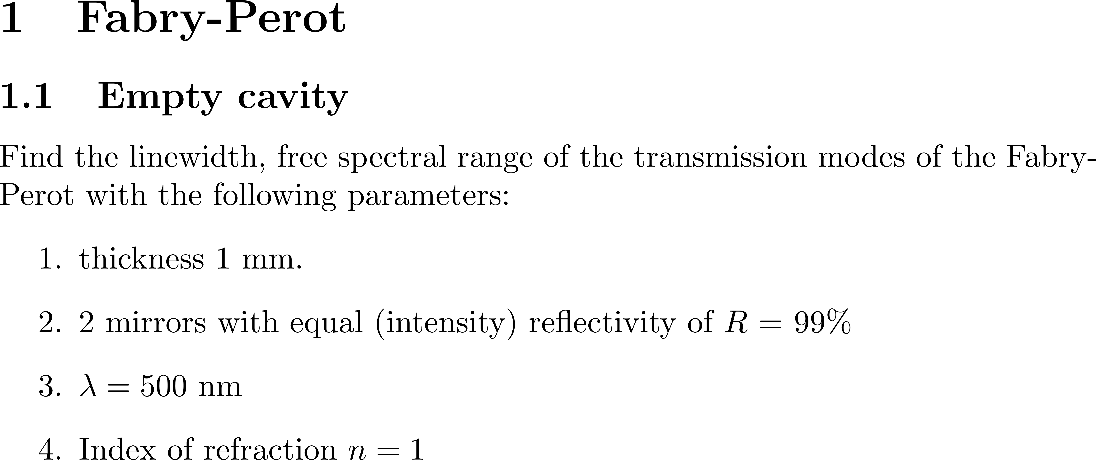

Slide 5
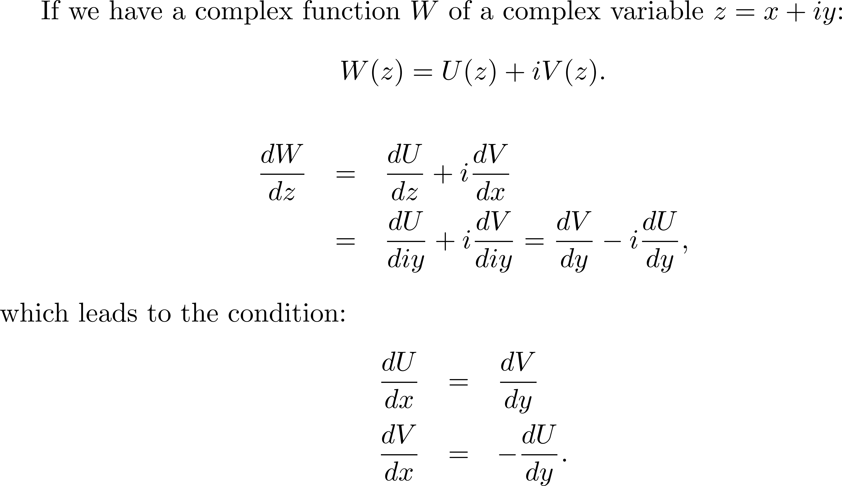
More about real/imaginary parts of a complex function
In the introductory lectures, the polarization was directly introduced as a complex function, of which the real part u represents polarization, the imaginary part v the absorption.
The Kramers-Kroenig relations are the integral form of the Cauchy Rieman condition. The Cauchy Rieman condition is that statement that you should obtain the same derivative independently of the path along which you take the derivative.

Slide 6
The derivation of the Kramers-Kroenig relations as the integral form of the Cauchy Rieman conditionis nicely illustrated on Wikepedia;

Slide 7
The example chosen is nearly always absorption and index of refraction, which are the exponent of the transfer function for propagation of light.
The KK relations apply also to the real part and imaginary parts of any transfer function, for instance that of the Fabry-Perot.

Slide 8
T
0

Slide 9
Different example of Kramers-Kroenig relation: Gaussian beams

Slide 10
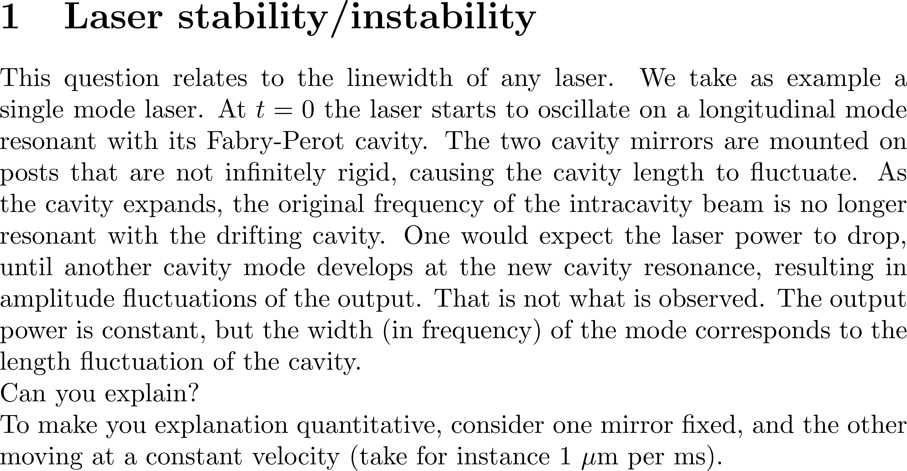

Slide 13
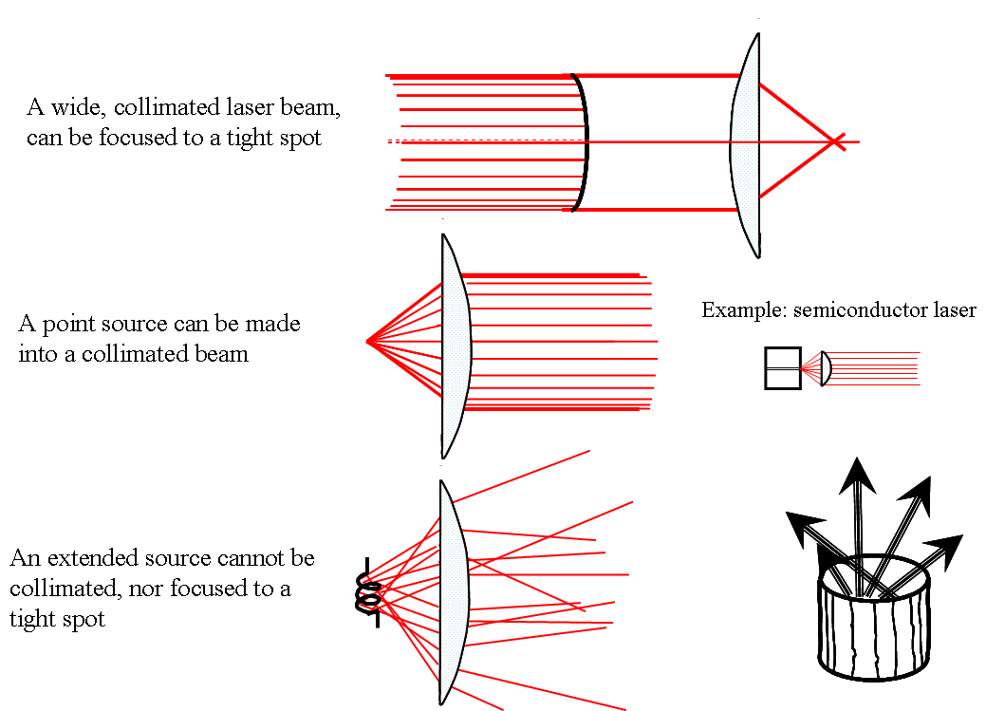
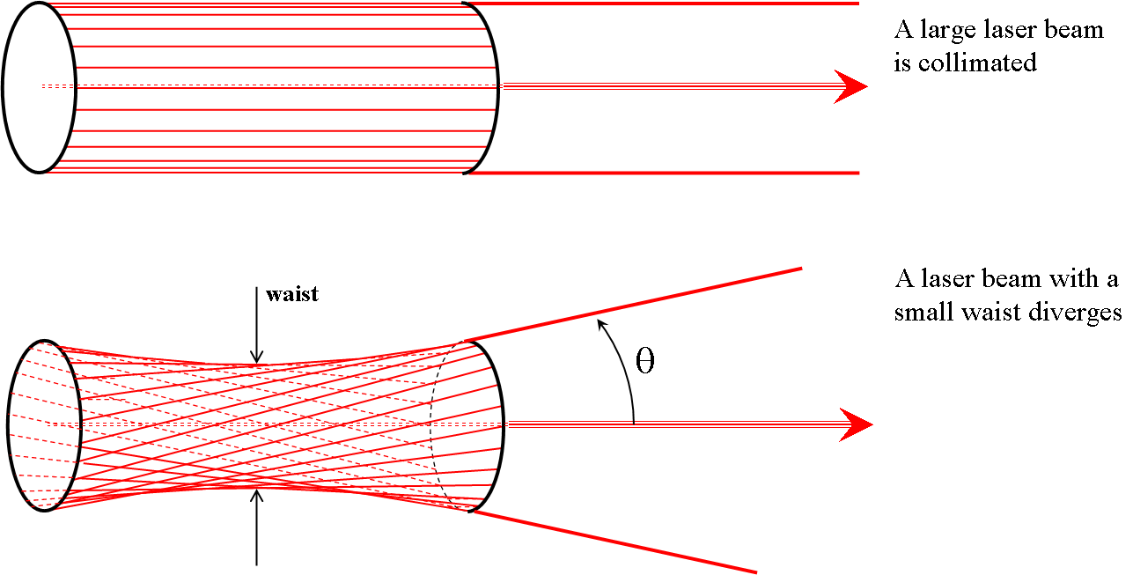

Slide 17
ABOUT THE CO2 LASER

Slide 18
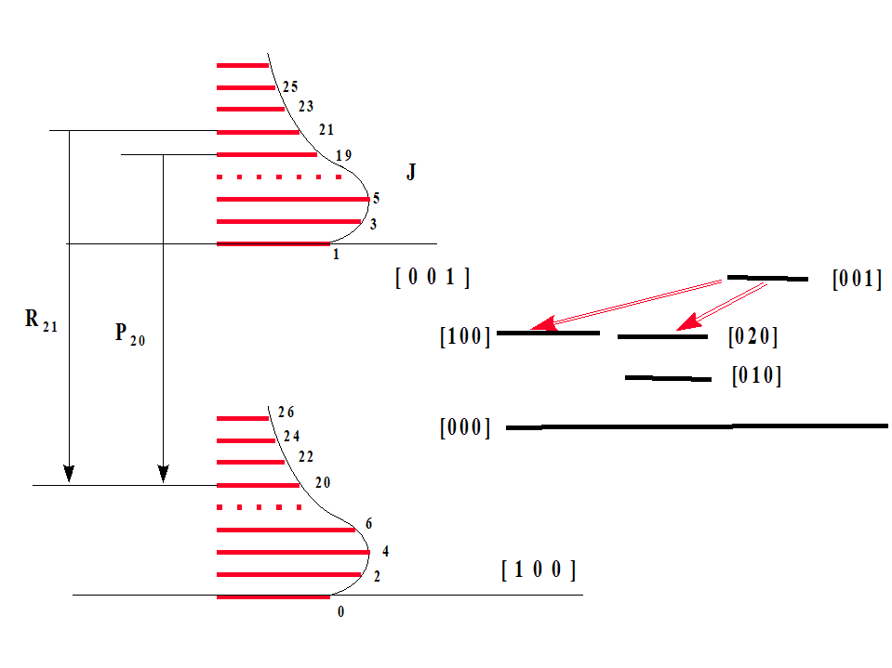

Slide 19
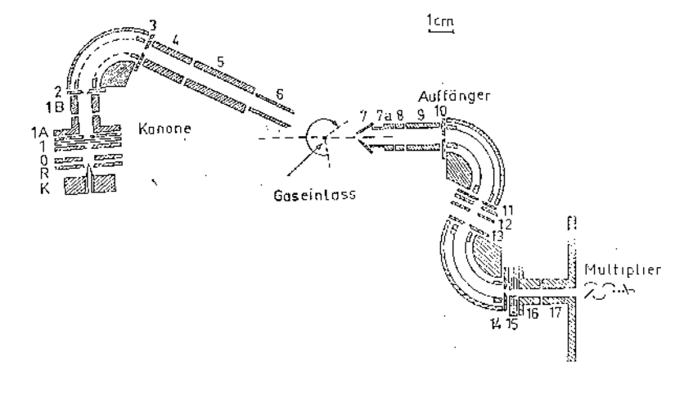

Slide 20
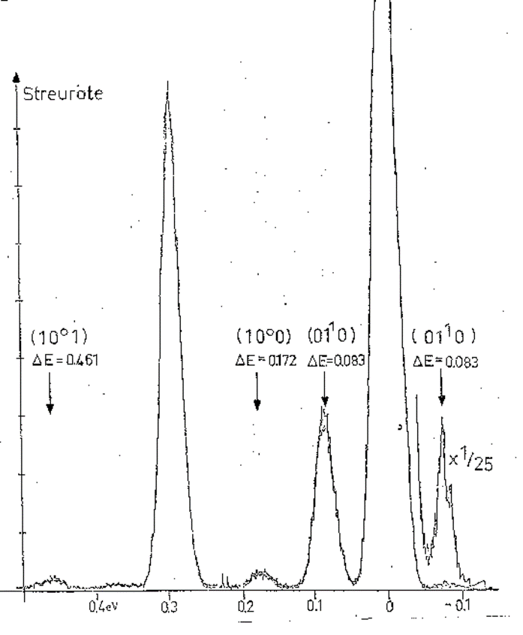
(0 0 1)

Slide 21
CLARIFICATION ABOUT MODE-LOCKING

Slide 23
Mode-locking – from textbook approach to reality

Slide 24
M=5

Slide 25
Simple matrix problems

Slide 26
Beam expander – reducer: use ABCD Matrices
d
0 1
0
-1/f 1
y
α
h₁
h₂
f₂
f₁
f₁

Slide 27
Beam expander – reducer: use ABCD Matrices
d
0 1
0
-1/f 1
y
α
θi
f₂
θ_{f}
f₁
f₁

Slide 28
Principal plane(s)
d
0 1
0
-1/f 1
?
F
y
α

Slide 29
Nodal points
d
0 1
0
-1/f 1
?
y
α

