Slide 1
NONINEAR SCHROEDINGER
EQUATION IN TIME
NOT NORMALIZED SOLUTIONS

Slide 2
The actions of nonlinearity and GVD exactly compensate each other.

Slide 3
The actions of nonlinearity and GVD exactly compensate each other.
From the soliton equation we got:

Slide 4
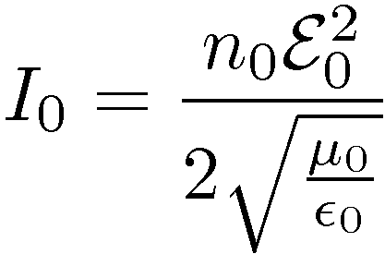
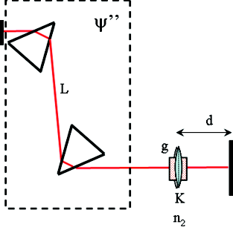
Another nearly equivalent approach is Gaussian time cavity
K is Kerr lensing in space and time!
Non-linear index:
In time:
Time lens:
L
d
K

Slide 5
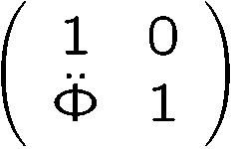
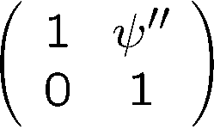
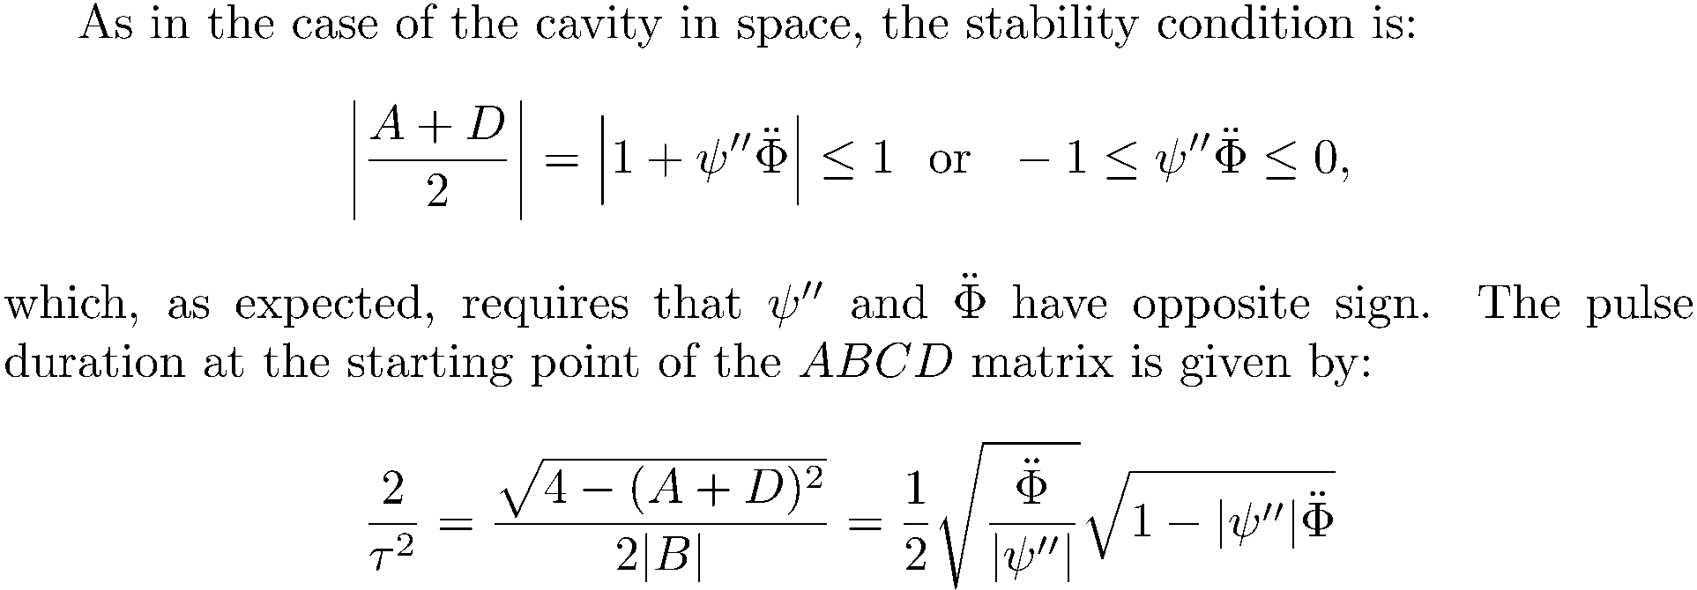
Time empty cavity
Lens matrix:
Matrix for dispersion:
Time lens:

Slide 6
From Gaussian beams/ABCD matrices we got:
Time lens:
From the soliton equation we got:
From GVD and dispersion compensating each other we got:

Slide 7
A purely dispersive mechanism, creates the soliton
FIBER
dispersion
Phase
Phase
dispersion
modulation
Phase
dispersion
dispersion
modulation
modulation
Phase
modulation
Dispersion
LASER
Are phase manipulations sufficient for mode-locking?
NO!
Intensity dependent losses are needed.

Slide 8
The coupled solution
Ensemble of stable solutions of ABCD in space
Coupling imposed by common energy
Ensemble of stable solutions of ABCD in time
Only one stable solution for given dispersion

Slide 9
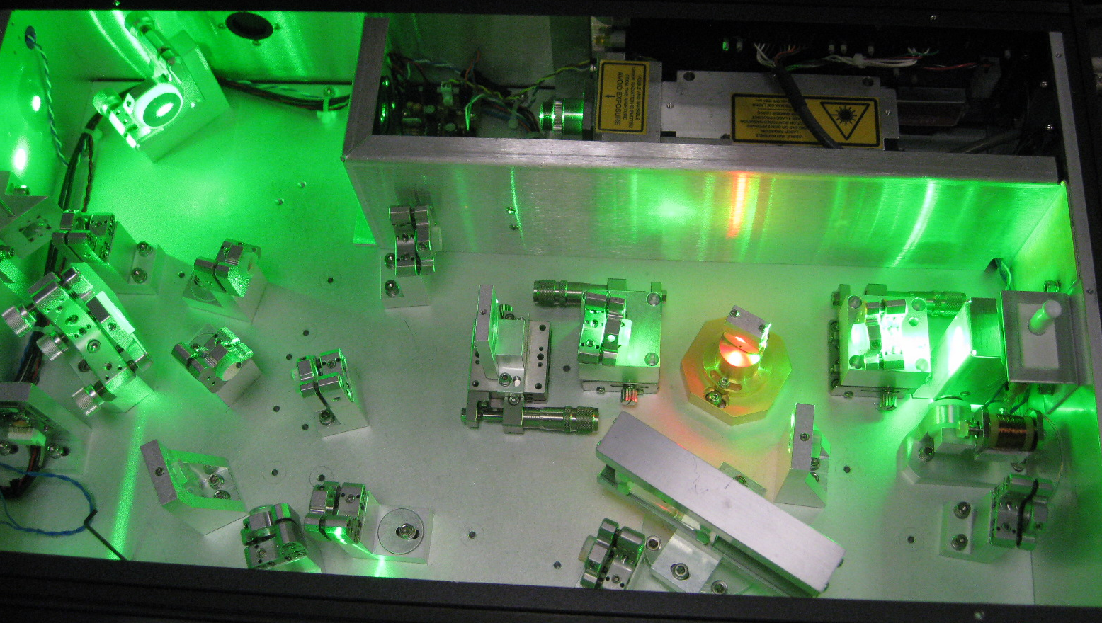

Slide 10
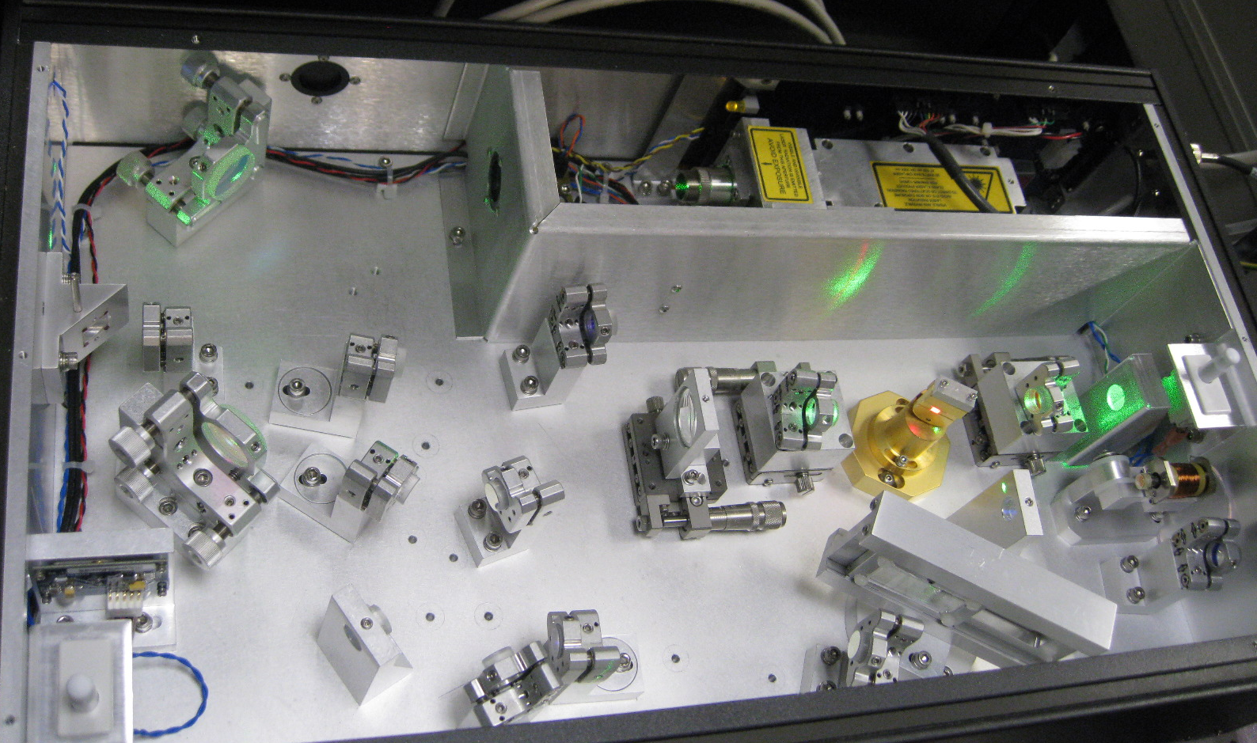

Slide 13
