Slide 1
LIGHT-MATTER INTERACTION
Time-Bandwidth product to Uncertainty relations
Uncertainty relations to Schroedinger equation
LASER-MATTER INTERACTION
Two level systems
Bloch Vector Model
Coherent propagationi
From transients to steady state

Slide 2
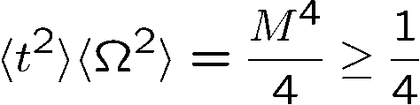

Uncertainty relation
In space:
Only holds for the pulse widths defined as
the mean square deviation
Demonstration: Wigner functions and Appendix A of book
(based purely on energy conservation)
Equality only holds for a Gaussian pulse (beam) shape free of any
phase modulation, which implies that the Wigner distribution for a
Gaussian shape occupies the smallest area in the time/frequency
plane.

Slide 3
Wigner Distribution
Gaussian
Chirped Gaussian

Slide 4
LASER-MATTER INTERACTION
SIMPLIFIED MATTER: 2 LEVEL SYSTEMS

Slide 5
An atom
2 level system
In ground state
N photons
N-1 photons
Atom in excited state
N-1 photons
N photons
An atom
2 level system
In ground state

Slide 6
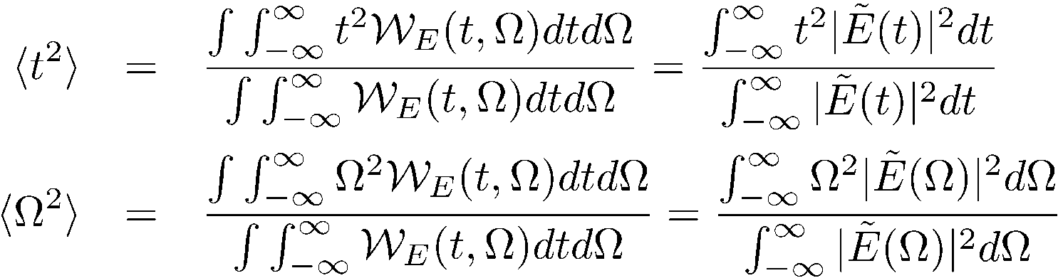
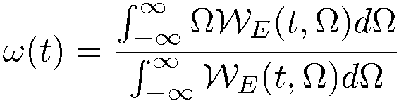
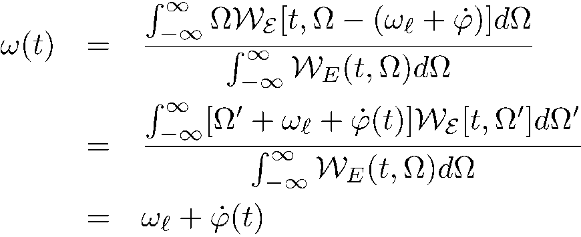

Wigner Distribution
Quantum Mechanics in 5 slides
Second moments
Instantaneous frequency: is it the derivative of the phase, or the center of gravity of the spectrum?
Uncertainty relation
where we used the fact that

Slide 7
Uncertainty relation
In space:
Only holds for the pulse widths defined as
the mean square deviation
Demonstration: Wigner functions and Appendix A of book
(based purely on energy conservation)
Equality only holds for a Gaussian pulse (beam) shape free of any
phase modulation, which implies that the Wigner distribution for a
Gaussian shape occupies the smallest area in the time/frequency
plane.

Slide 8











Quantum Mechanics: just add particle-wave duality:
Particle of energy W Wave of frequency
Particle of momentum p Wave of wave vector k
The Heisenberg uncertainty relation is contained directly in:
and
No need for quantum mechanics – just the wave particle duality!
Particle Wave
Energy W
Momentum p

Slide 9


Photon number – phase uncertainty
Small number of photons: small uncertainty.
P(n)
Small number of photons: large phase uncertainty.
Large number of photons: small phase uncertainty.
n
time

Slide 10
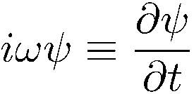
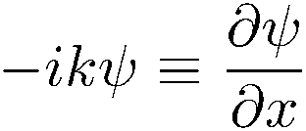
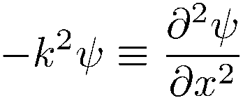
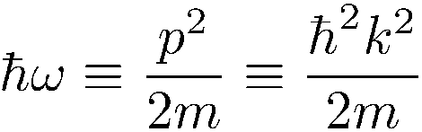
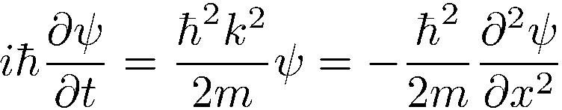
Particle wave duality, uncertainty principle, even leads to Schroedinger equation
The Wigner function in optics told us that:
and
Combine with particle-wave duality:
Particle Wave
Energy W
Momentum p
Particle-wave duality calls for a wave equation.
Differentiation with respect to t multiplication by ω
Differentiation with respect to x multiplication by k

Slide 11
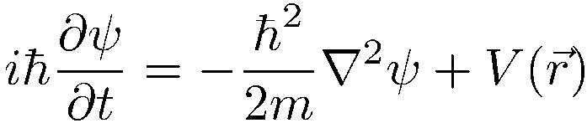
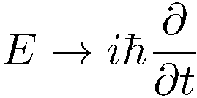

Two-level coherent.pdf
Bloch generalized.ppt

Slide 13
LASER-MATTER INTERACTION
SIMPLIFIED MATTER: 2 LEVEL SYSTEMS
@ARTICLE{Feynman56,
AUTHOR = "R.~P.~Feynman and F.~L.~Vernon and R.~W.~Hellwarth",
TITLE = "Geometrical representation of
the {Schroedinger} equation for solving maser problems",
JOURNAL = "J.~Appl.~Phys.",
VOLUME = "28",
PAGES = "49-52",
YEAR = {1957} }

Slide 14
An atom
2 level system
In ground state
N photons
N-1 photons
Atom in excited state
N-1 photons
N photons
An atom
2 level system
In ground state

Slide 15
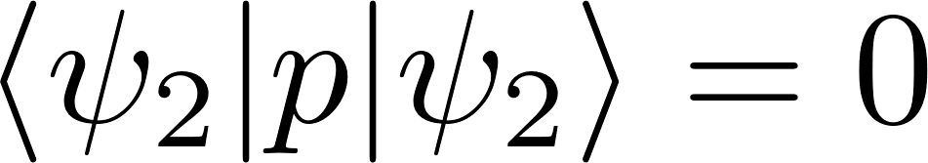
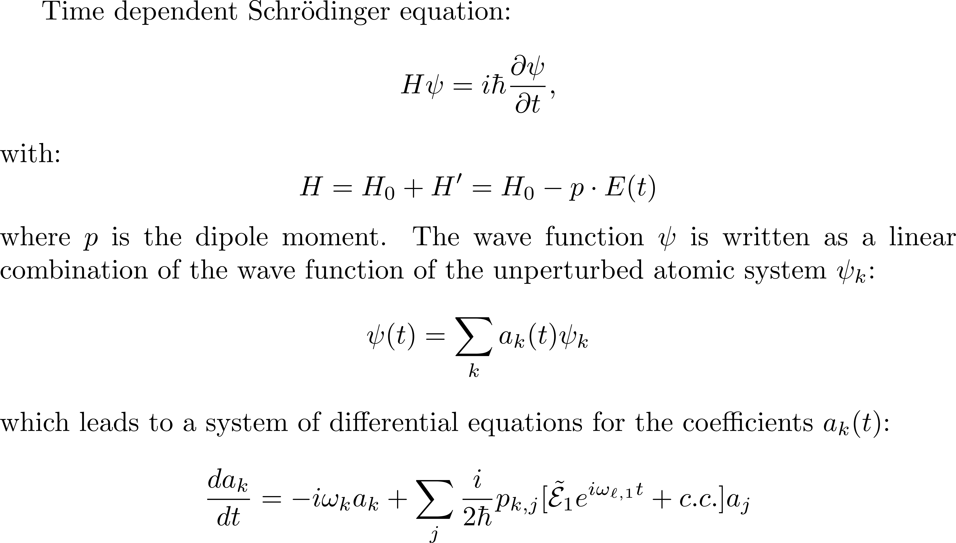
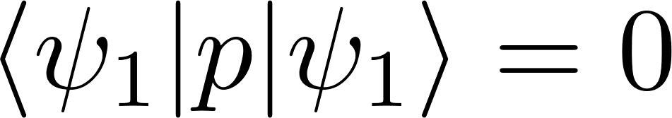
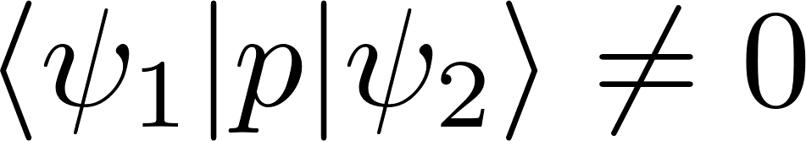
Pure states - do not radiate.

Slide 16
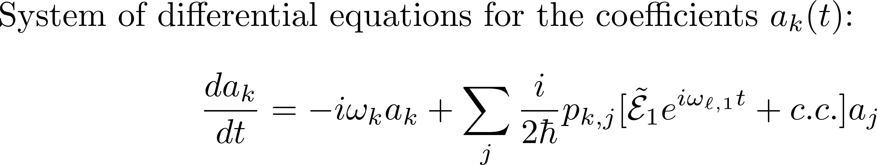
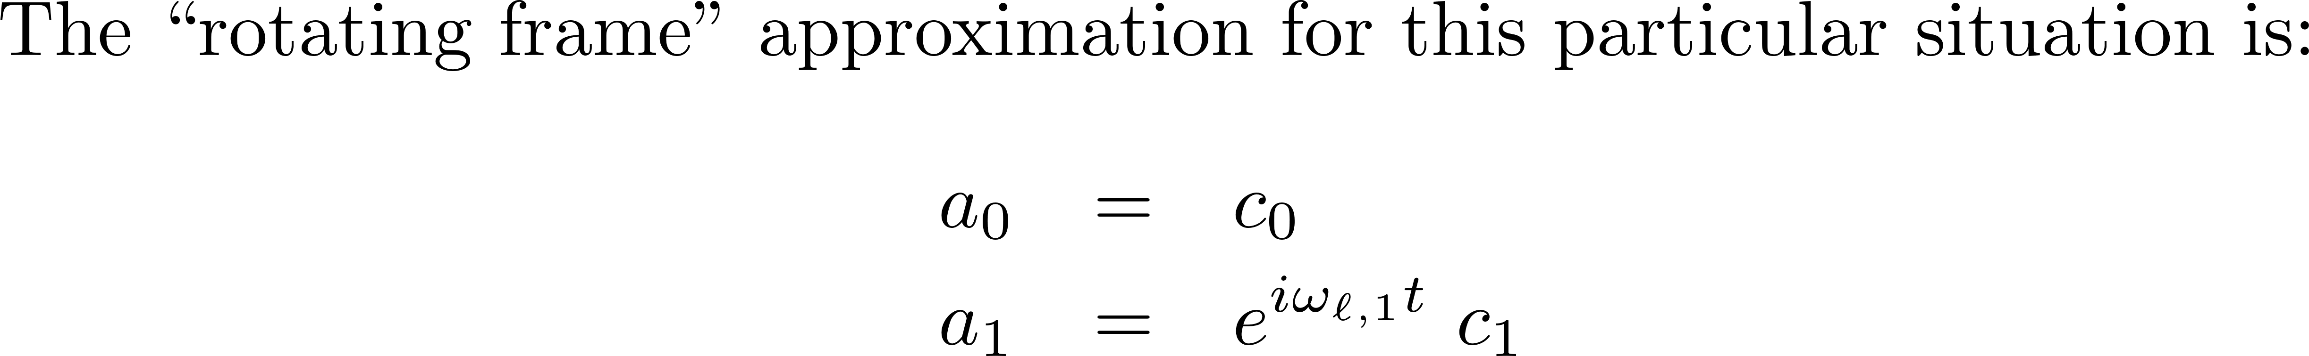
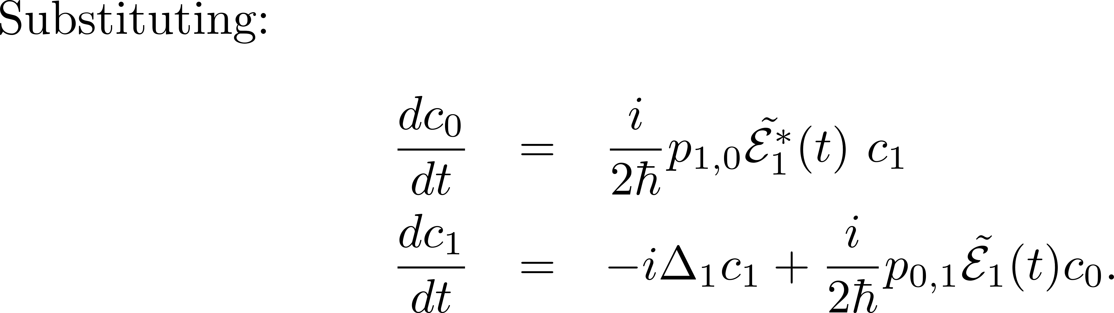

Slide 17
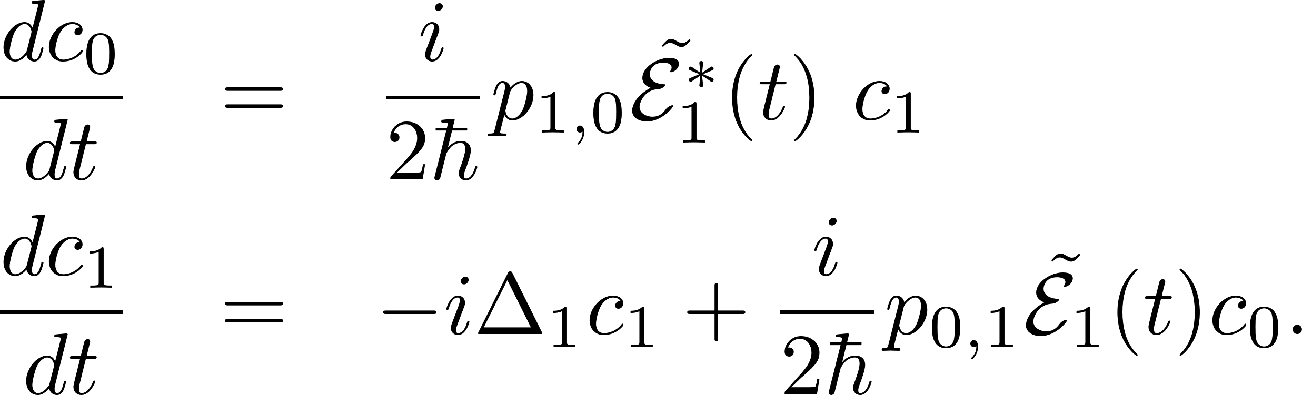
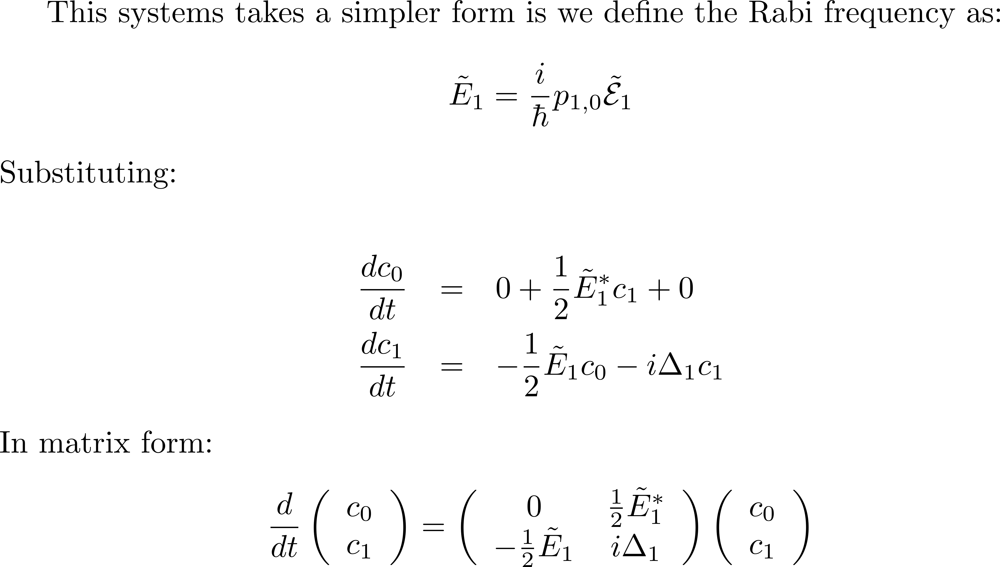

Slide 18
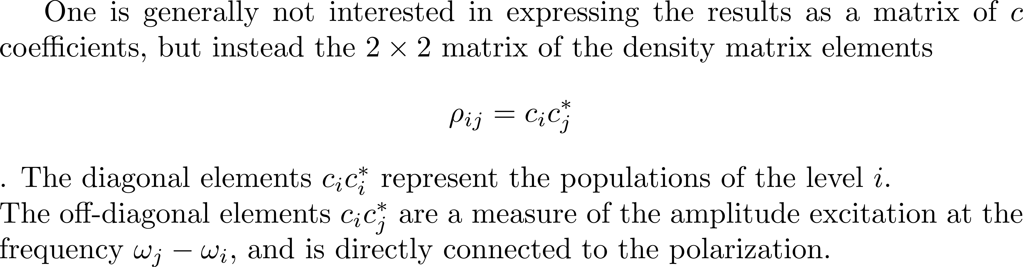
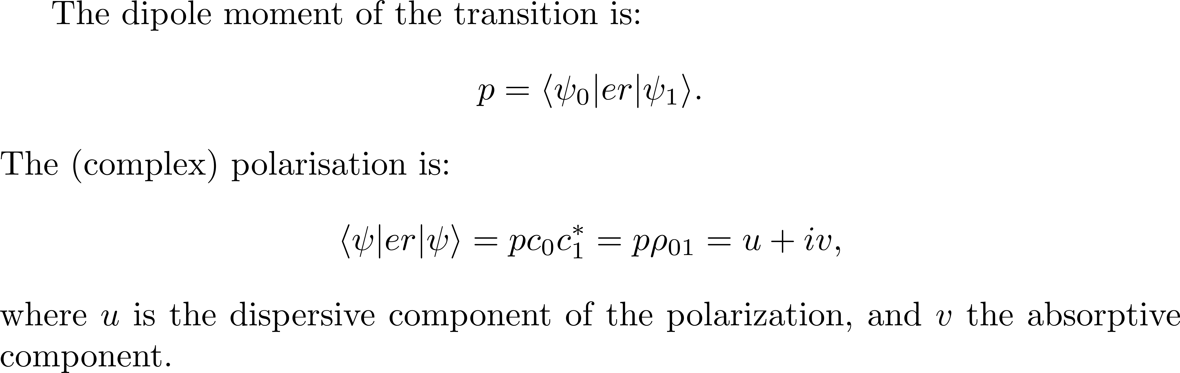

Slide 19
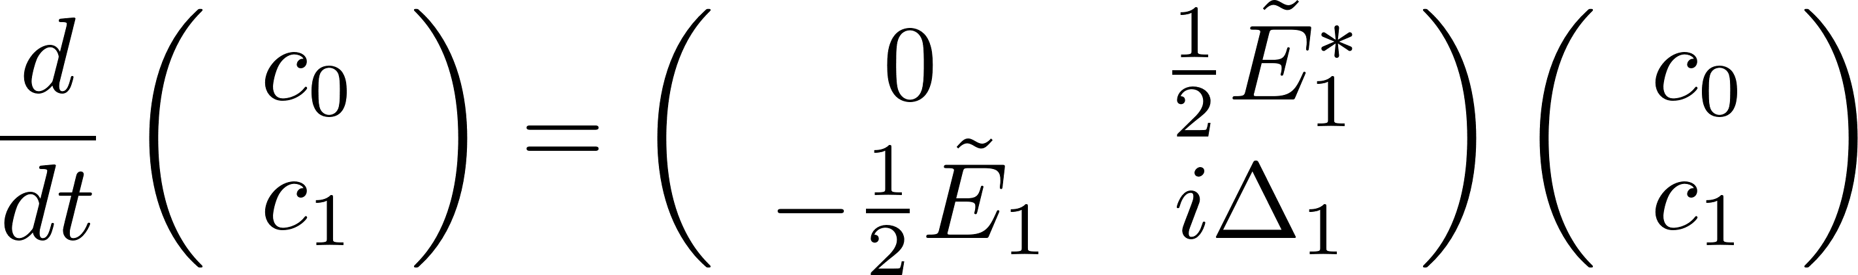
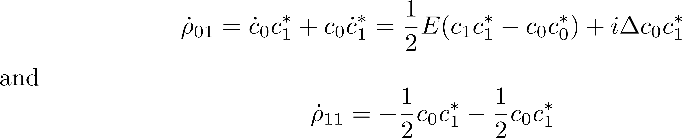
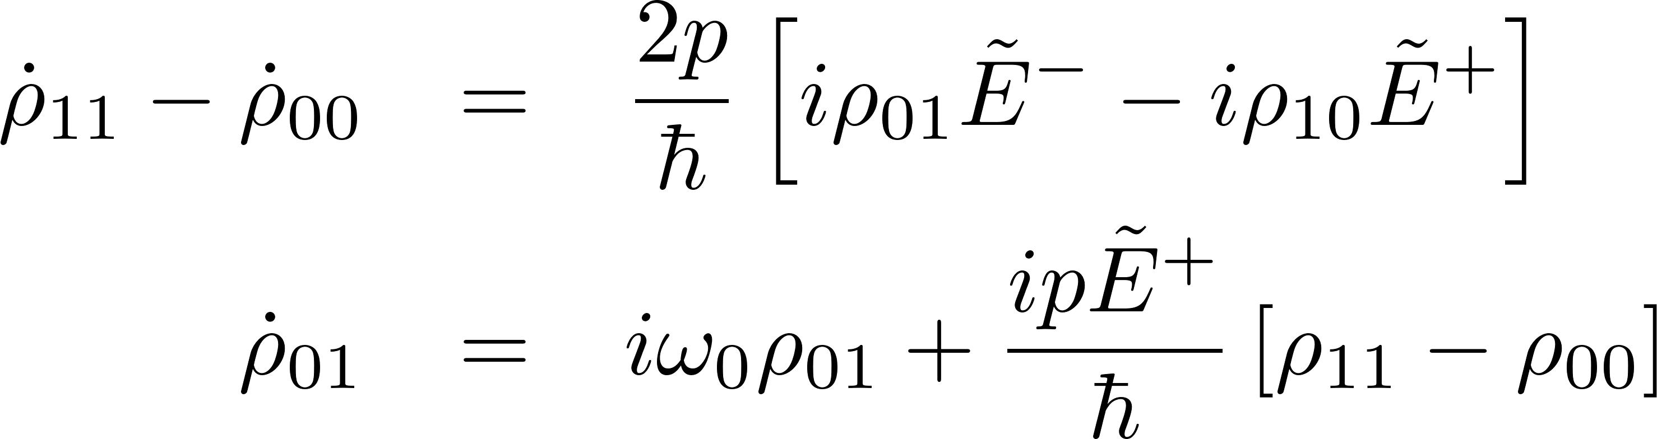
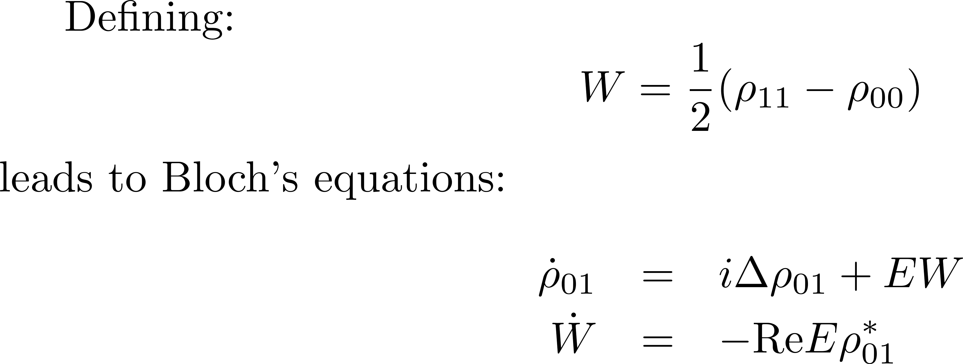

Slide 20
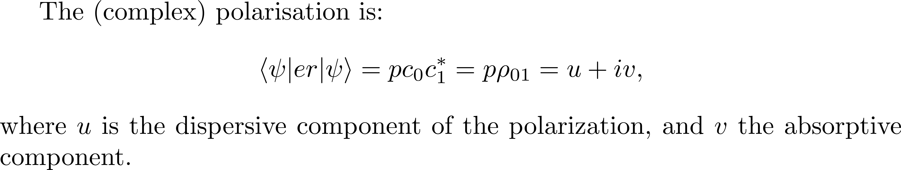
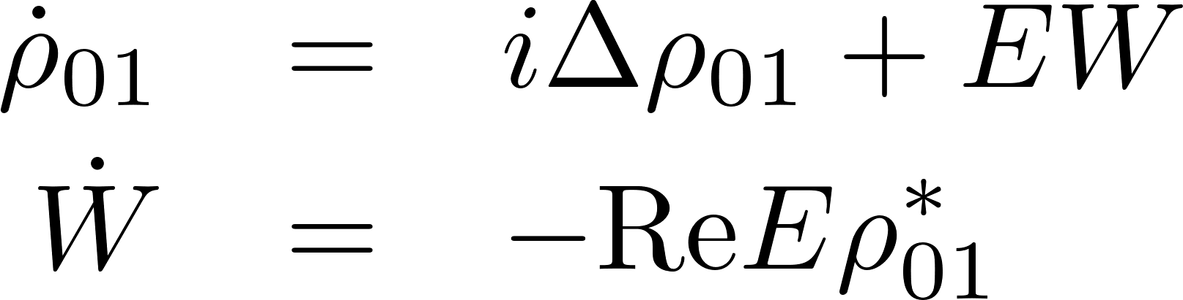
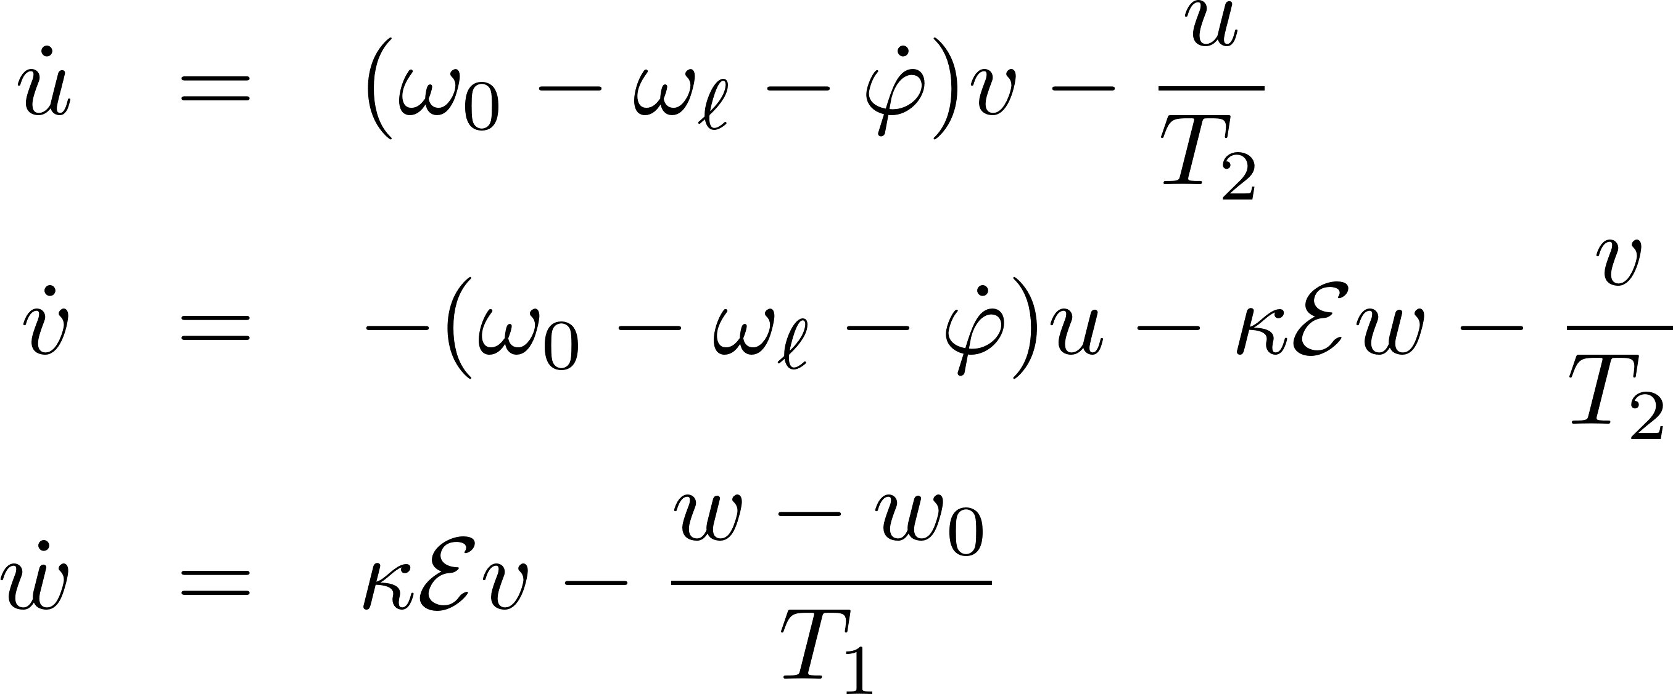
becomes

Slide 21
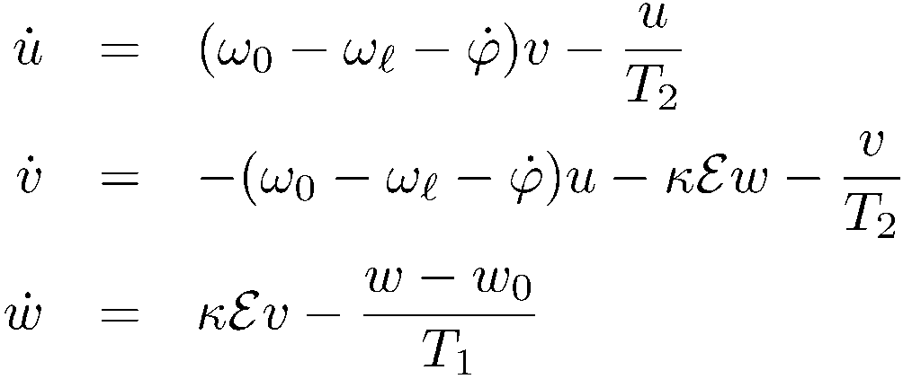
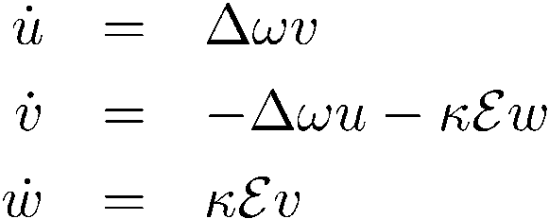
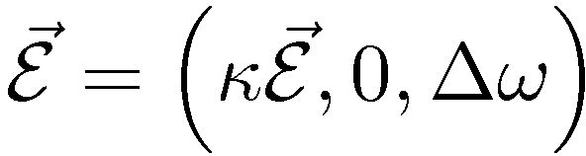
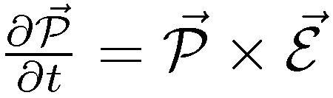
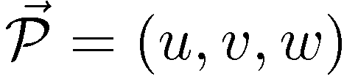
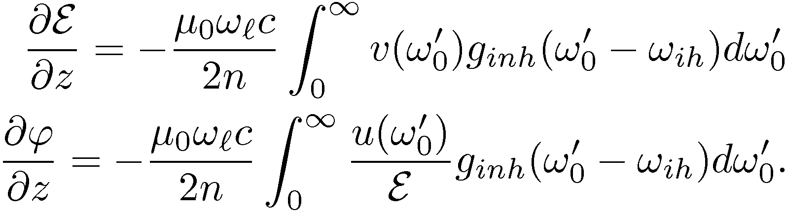
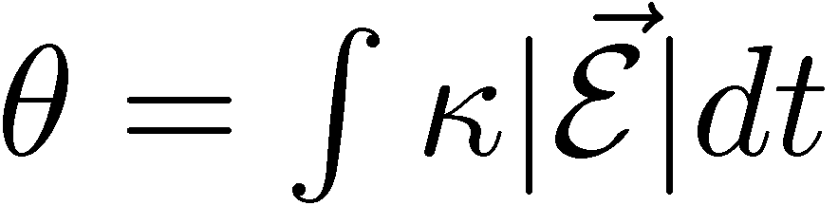

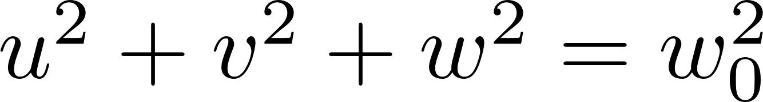

no relaxation
Propagation
w
u
v

Slide 22
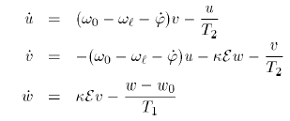
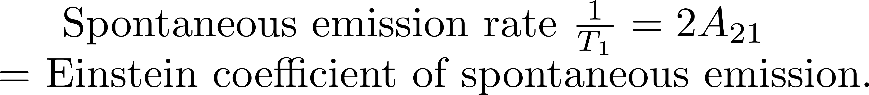
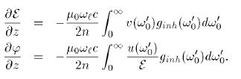
Homogeneous broadening
Inhomogeneous broadening

Slide 23

At resonance
0
z00
w
u
v

Slide 24
Application of π pulse
Li

Slide 25
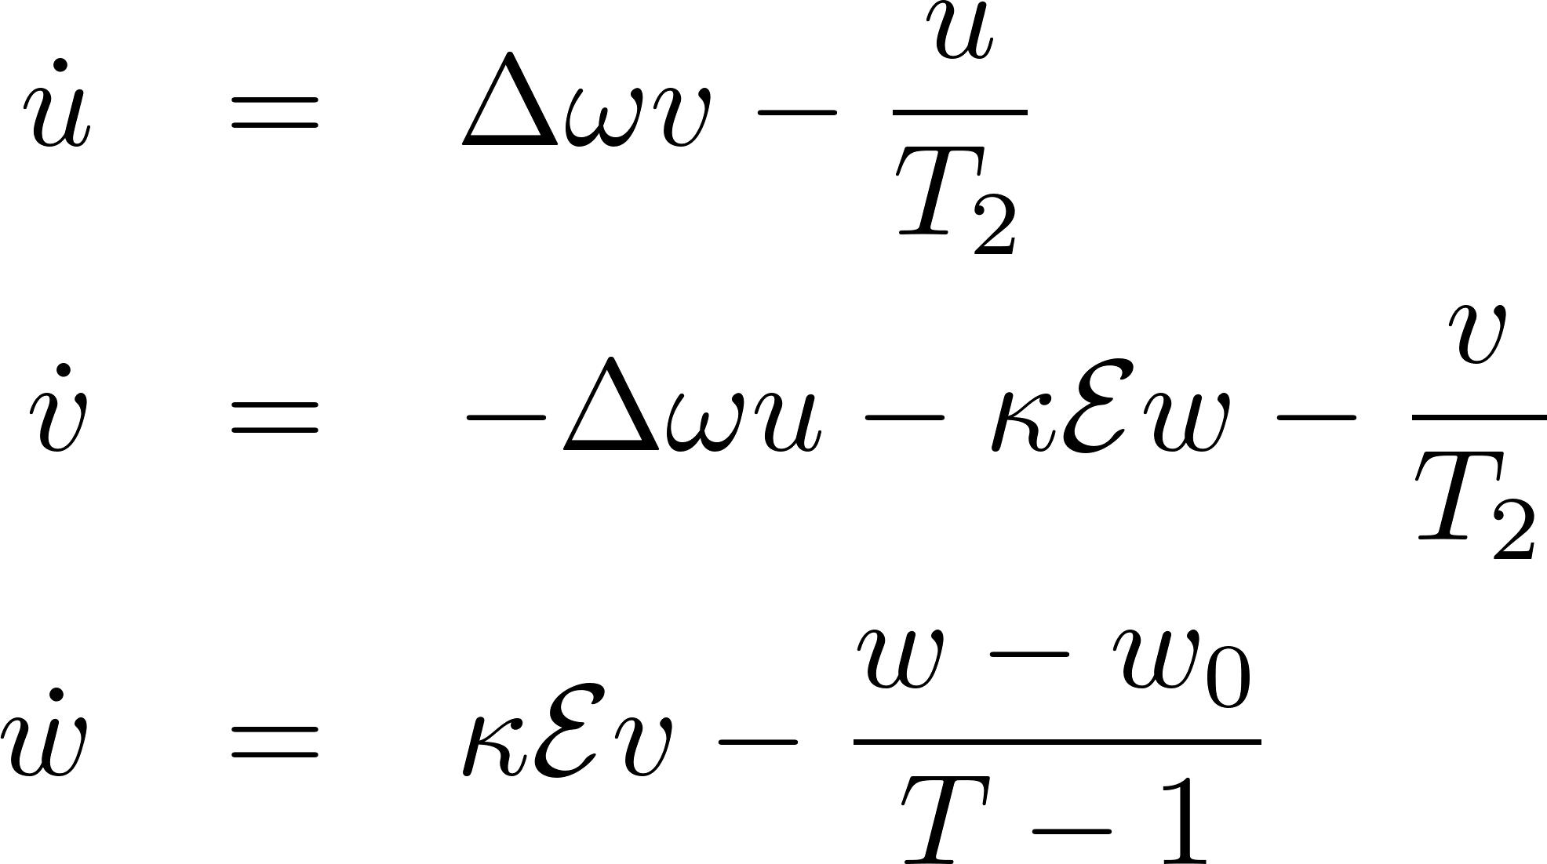
At resonance, phase relaxation
0
z00
w
u
v

Slide 26
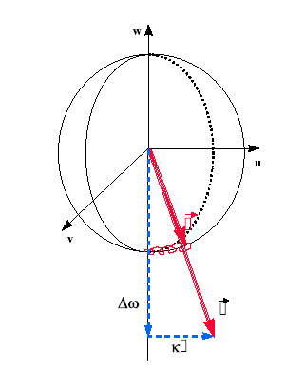
ADIABATIC FOLLOWING
(slow motion)

Slide 27
Coherent Propagation
Application of vector model
TexPoint fonts used in EMF.
Read the TexPoint manual before you delete this box.: AAAAA

Slide 28
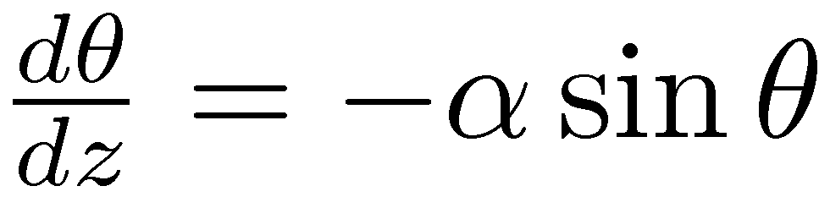
Application 1: Self-induced transparency

Slide 29
Self-induced transparency and “2π” pulses
Rabi frequency of the order of pulse spectral width
Sech solution – self preserving shape.
Bloch vector makes a full circle.
Observation of “Rabi oscillations in semiconductors”:
A. Schuelzgen et al., Phys Rev. Lett 82: 2346-2349 (1999)

Slide 30
Self-induced transparency and “2π” pulses
Rabi frequency of the order of pulse spectral width
Sech solution – self preserving shape.
Bloch vector makes a full circle.
Observation of “Rabi oscillations in semiconductors”:
A. Schuelzgen et al., Phys Rev. Lett 82: 2346-2349 (1999)

Slide 31

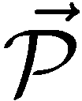
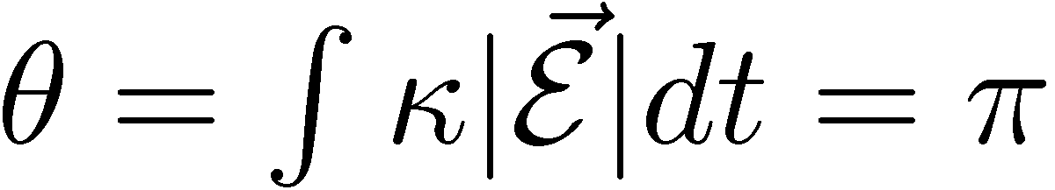
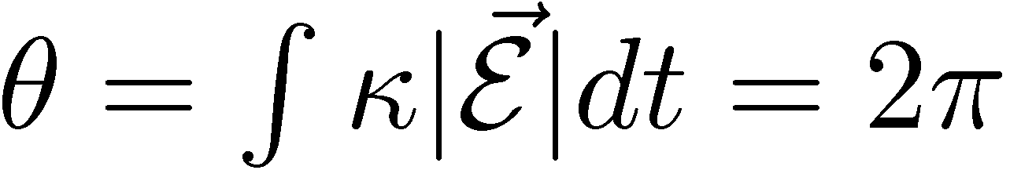
Energy conservation and 2 pi pulse propagation
W
U
V

Slide 32
AREA THEOREM

Slide 33
SELF-INDUCED TRANSPARENCY OFF RESONANCE

Slide 34
SELF-INDUCED TRANSPARENCY ON RESONANCE

Slide 35
SELF-INDUCED TRANSPARENCY OFF RESONANCE

Slide 36
Sech solution – self preserving shape.
Self-induced transparency is one the first examples of soliton propagation in
optics, based on coherent resonant propagation in an absorber.
It applies mostly to inhomogeneously broadened systems, for which the (undamped)
Bloch's interaction equations apply.
We derive here the form of the steady state propagating
pulse, the 2 pi sech, in the simpler narrow line limit.
The extension to the inhomogeneous broadening case adds a lot of mathematics
but little of physics.
We therefore consider the system of Bloch's Maxwell equations in the
slowly varying approximation, to be reduced to:
no relaxation

Slide 37
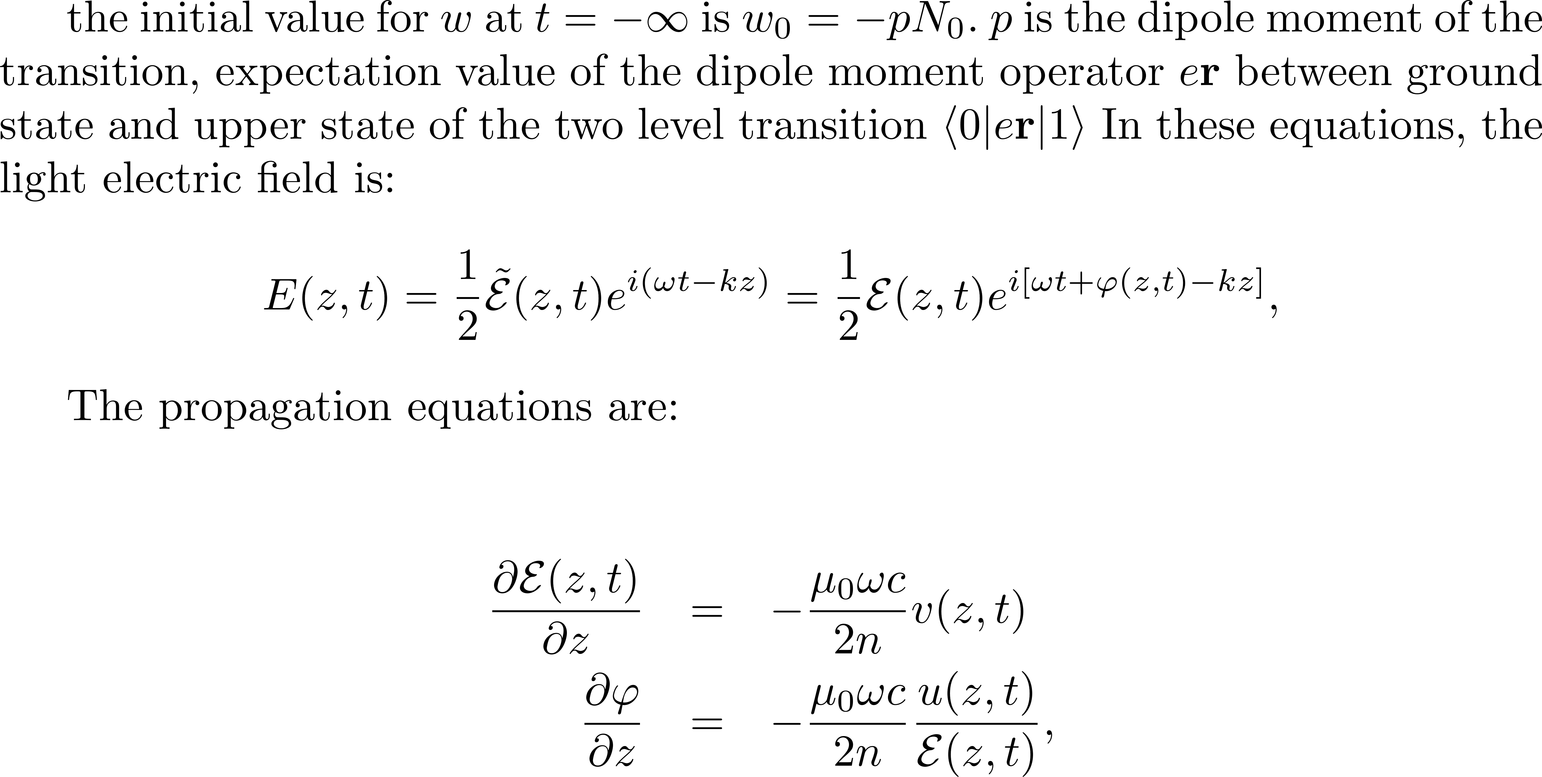
no relaxation

Slide 38
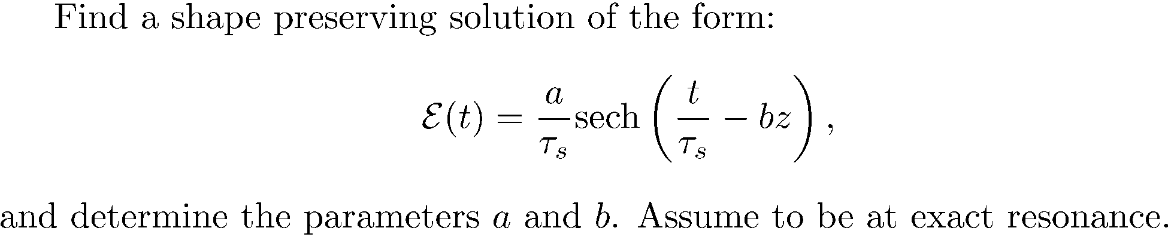

Slide 40
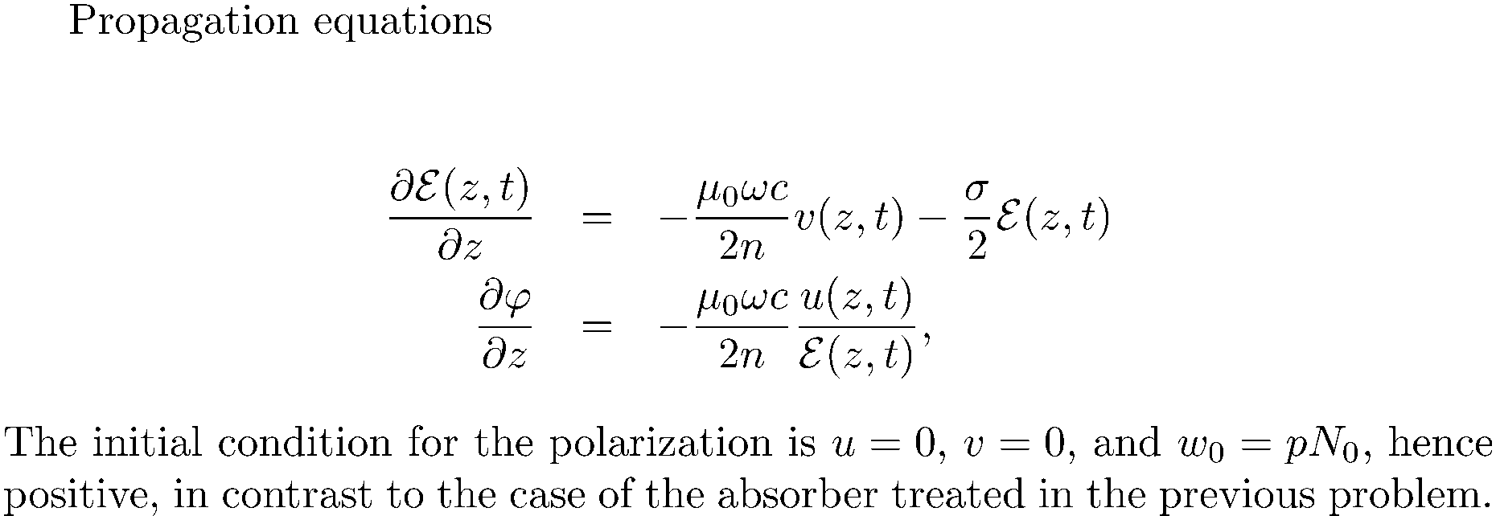
pi pulse propagation in an amplifier
W
U
V

Slide 41
ZERO-AREA PULSE PROPAGATION
W
U
V

Slide 47
DIFFERENCE BETWEEN COLLISION BROADENING, NATURAL LINE BROADENNG, AND INHOMOGENEOUS BROADENING
Homogeneous broadening
Inhomogeneous broadening
TexPoint fonts used in EMF.
Read the TexPoint manual before you delete this box.: AAAAAAA

Slide 48
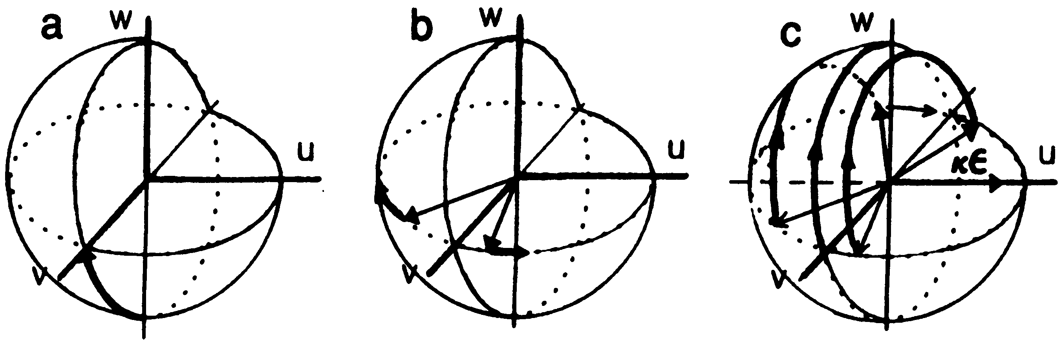
Photon Echoes
-- does not need π/2 and π pulses

Slide 49
THE TRANSIENT INTERACTION OF LIGHT WITH A TWO LEVEL SYSTEM EVOLVES TOWARDS STEADY STATE
STANDARD RATE EQUATIONS AND CLASSICAL LINEAR POLARIZATION ARE SUCCESSIVE STEPS OF THAT EVOLUTION

Slide 50





RATE EQUATIONS

Slide 51

RATE EQUATIONS
I_{s} is the saturation power..
You can never have population inversion
Saturation field such that its Rabi frequency is geometric average of T₁T₂.
It takes higher power to saturate off resonance.

Slide 52








LINEAR OPTICS
= steady state solution of Bloch’s equations

Slide 53



Small motions at the bottom of the sphere
The amplitude of the dipolar field that opposes the applied
field is proportional to the Fourier component of the applied field
at the dipole resonant frequency.
Energy absorbed proportional to the intensity at resonance frequency

Slide 54





Slide 55
RATE EQUATIONS

Slide 56
RATE EQUATIONS
I_{s} is the saturation power..
You can never have population inversion
Saturation field such that its Rabi frequency is geometric average of T₁T₂.
It takes higher power to saturate off resonance.

Slide 57
LINEAR OPTICS
= steady state solution of Bloch’s equations

