Slide 1
LIGHT-MATTER INTERACTION
Time-Bandwidth product to Uncertainty relations
Previous lectures in
“Review of Fourier transforms”
Uncertainty relations to Schroedinger equation
LASER-MATTER INTERACTION
Two level systems
Bloch Vector Model
Coherent propagation
From transients to steady state

Slide 2
References:
Ultrafast Phenomena: Section 3.3.4
Verdeyen Chapter 14
LASER-MATTER INTERACTION
SIMPLIFIED MATTER: 2 LEVEL SYSTEMS
@ARTICLE{Feynman56,
AUTHOR = "R.~P.~Feynman and F.~L.~Vernon and R.~W.~Hellwarth",
TITLE = "Geometrical representation of
the {Schroedinger} equation for solving maser problems",
JOURNAL = "J.~Appl.~Phys.",
VOLUME = "28",
PAGES = "49-52",
YEAR = {1957} }

Slide 3
An atom
2 level system
In ground state
N photons
N-1 photons
Atom in excited state
N-1 photons
N photons
An atom
2 level system
In ground state

Slide 4
PAUSE

Slide 5
LIGHT-MATTER INTERACTION
WHAT IS THE POLARIZATION?
The nature of light-matter interaction:
re-radiation of the electrons driven by the field.
CLASSICAL POLARIZATION
1) Bound electrons
2) Free electrons
SEMI-CLASSICAL
Matter treated Quantum Mechanically; field classically
BLOCH’EQUATIONS
RATE EQUATIONS
LINEAR POLARIZATION
Line shapes
Enstein coefficients

Slide 6
LIGHT-MATTER INTERACTION
WHAT IS THE POLARIZATION?
The nature of light-matter interaction:
re-radiation of the electrons driven by the field.
Light-matter interaction: the light field moves the electron. The field of the moving electrons adds to the applied light field.

Slide 7


P in phase with E but 90 degree out of phase with ??

Slide 8
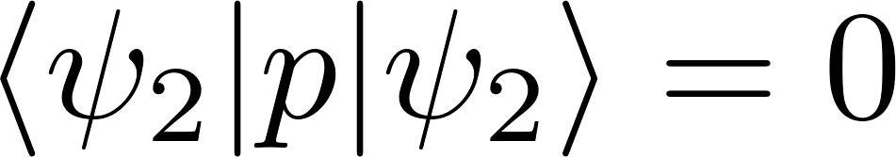
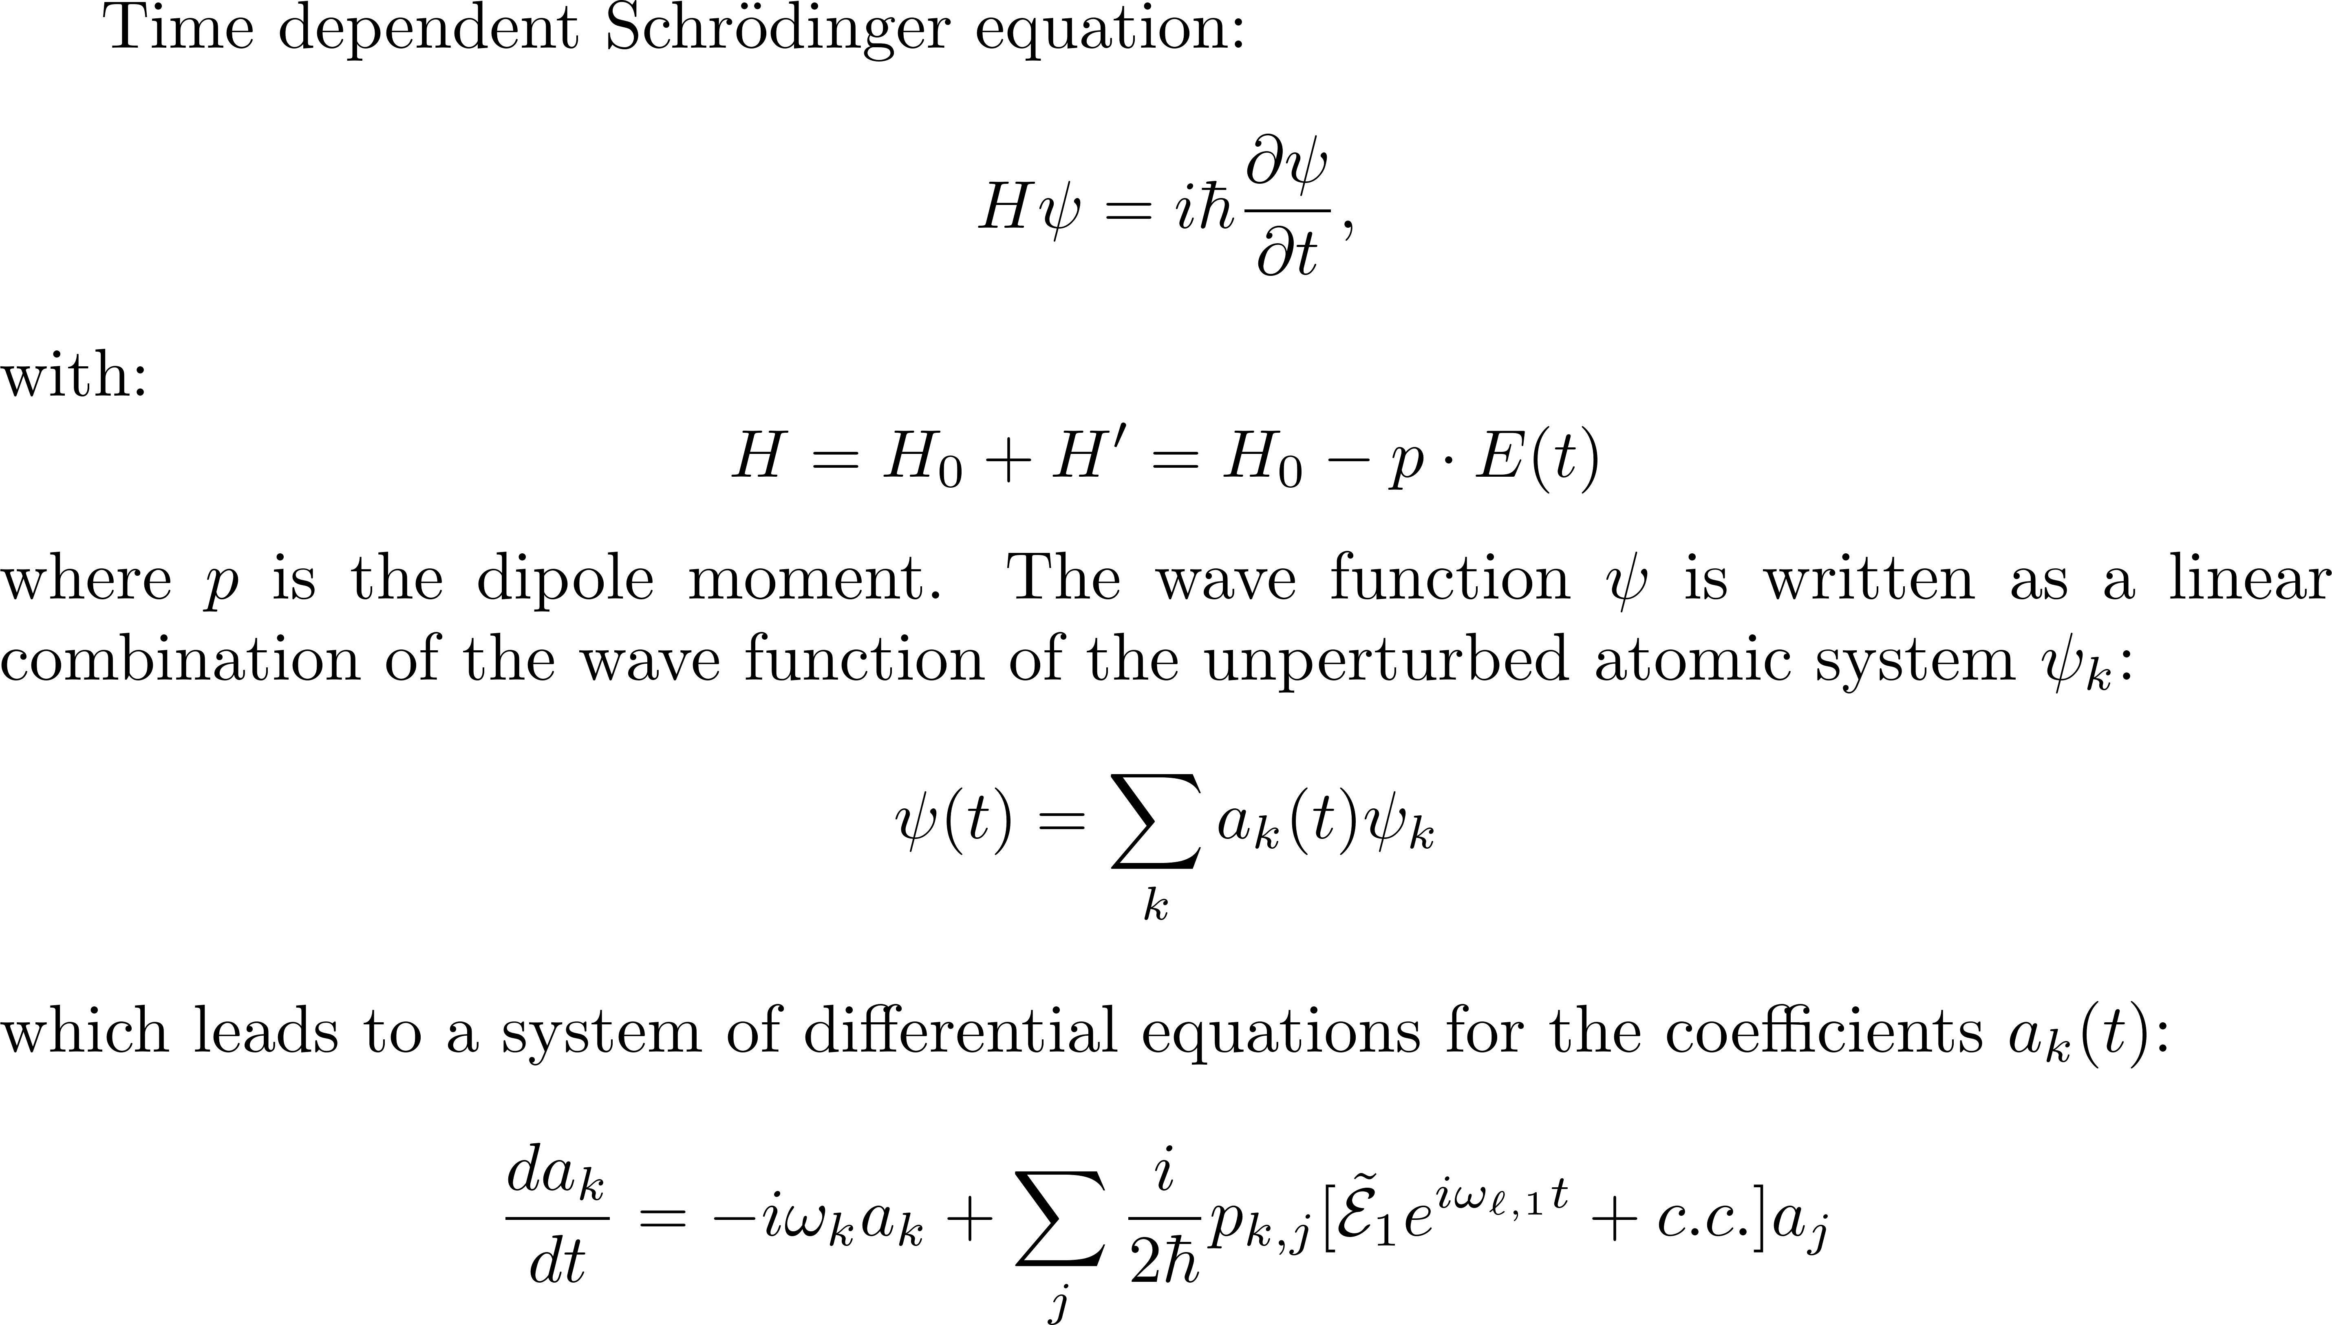
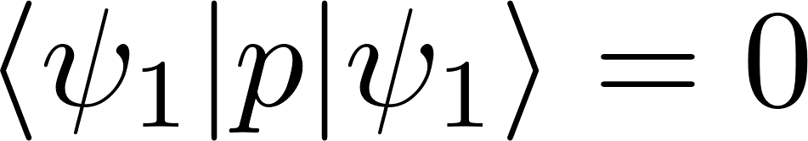
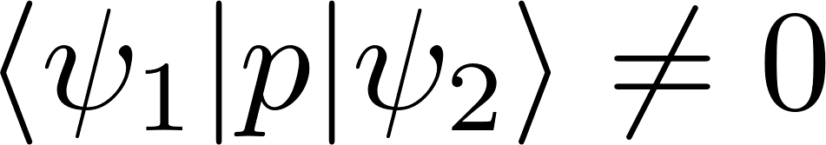
Pure states - do not radiate.

Slide 9
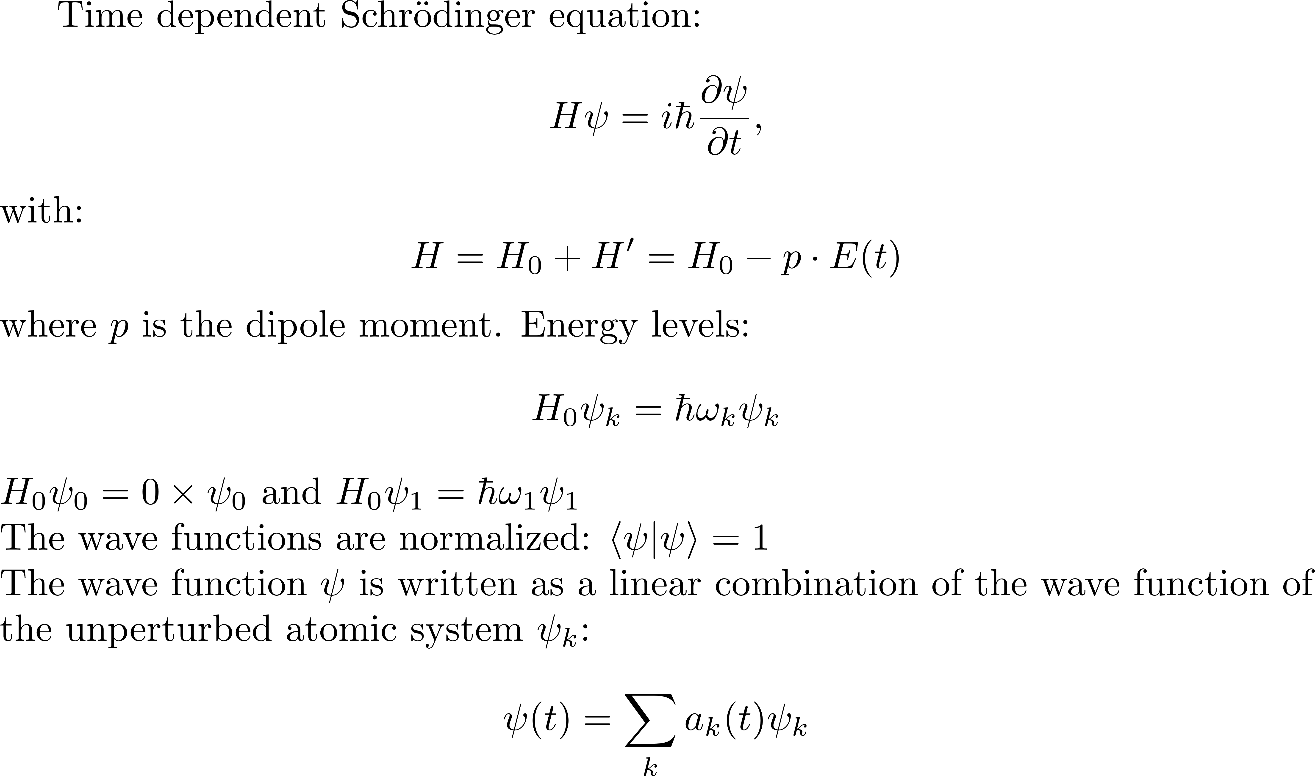
Pure states - do not radiate.

Slide 10
Pure states - do not radiate.

Slide 11
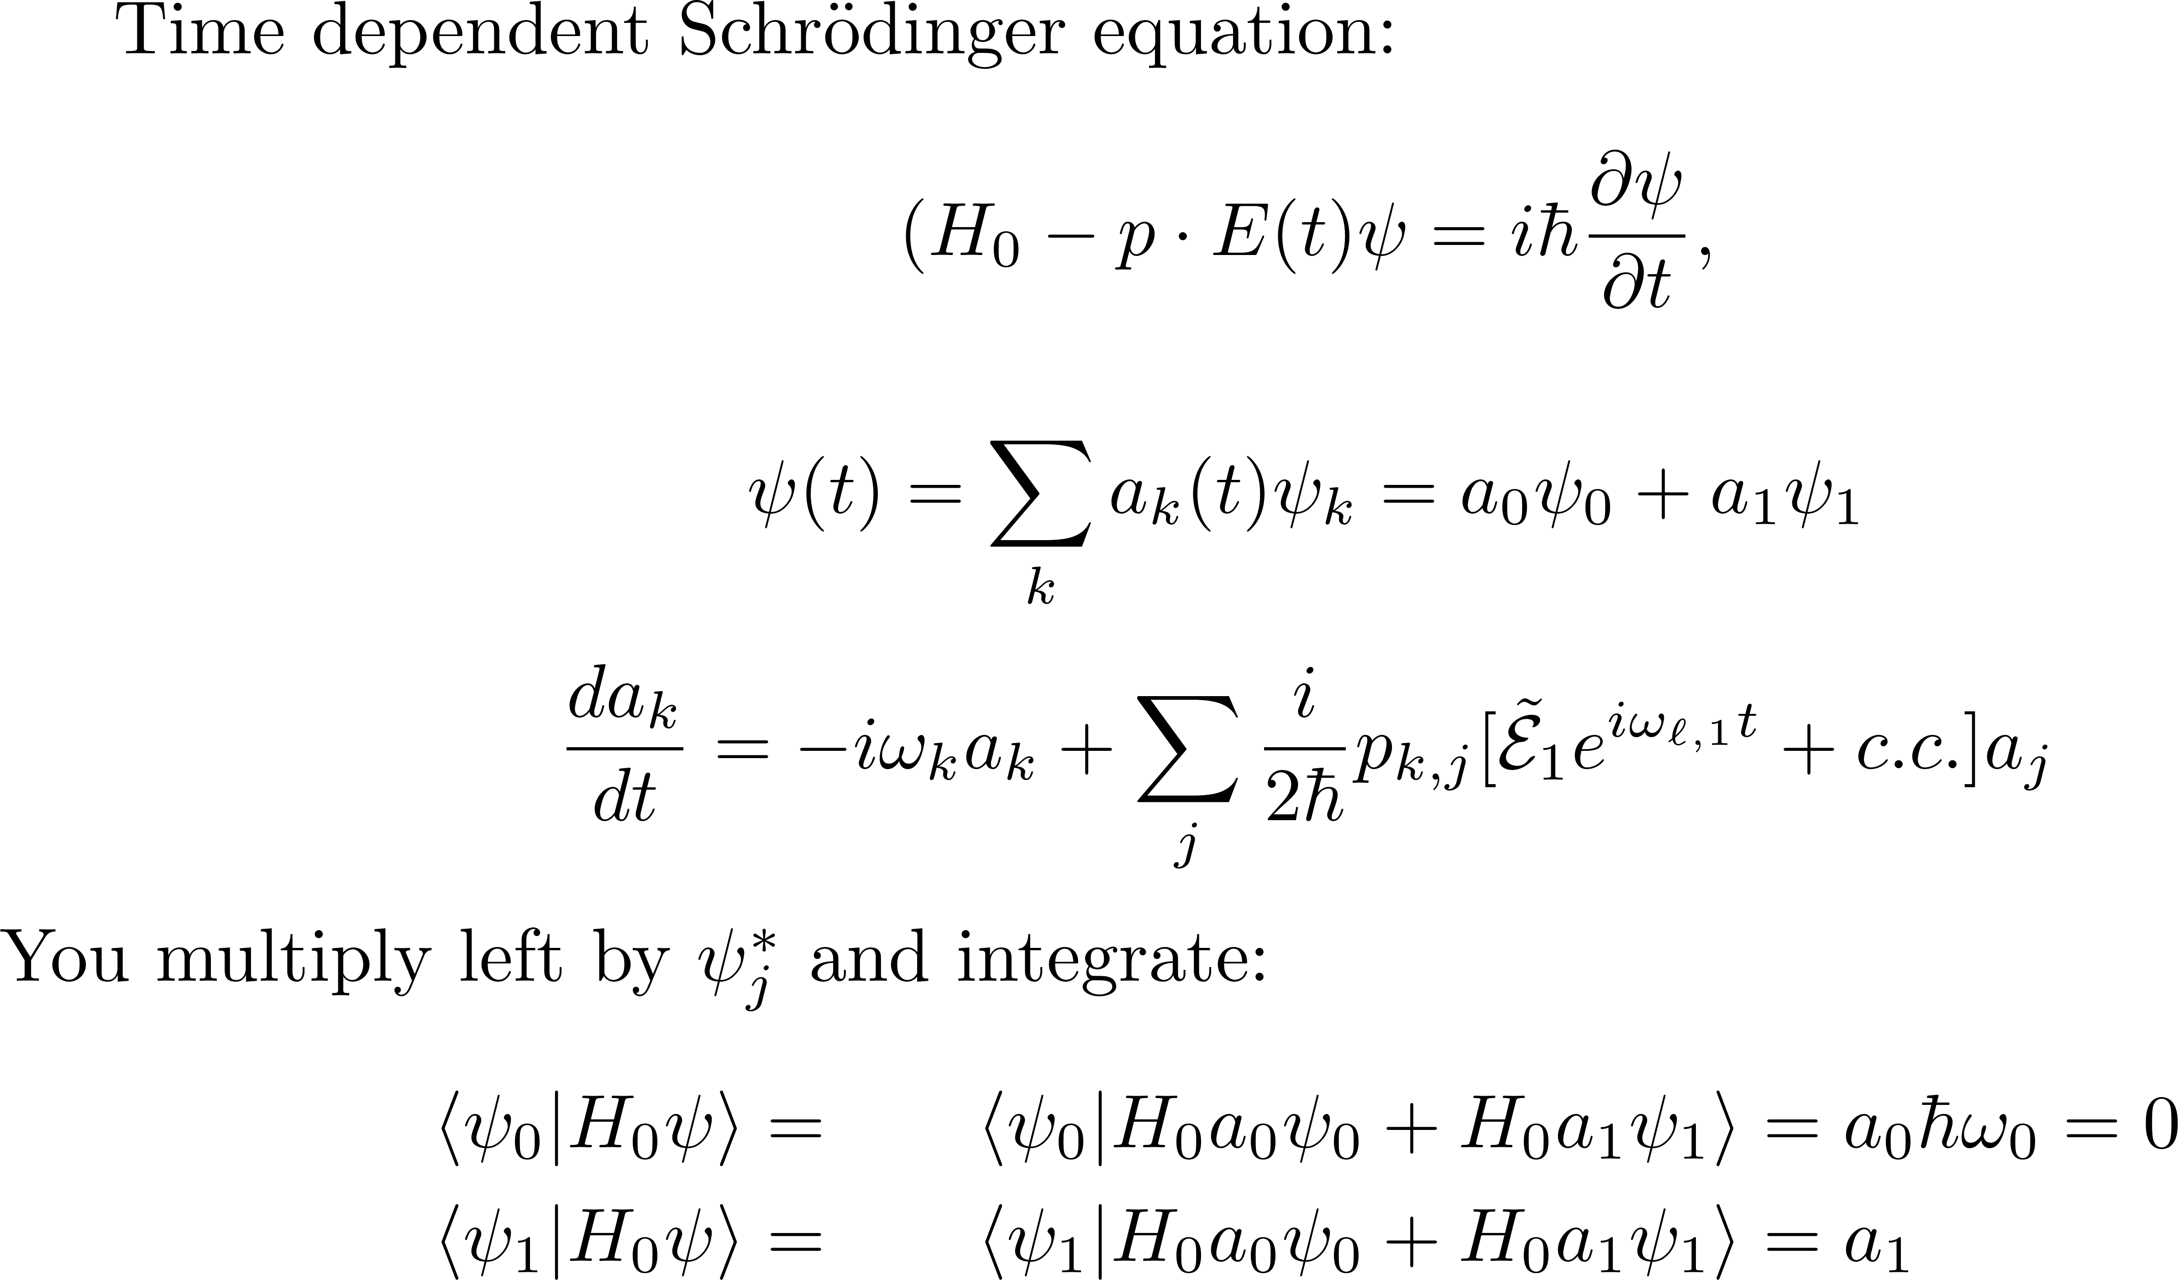
Pure states - do not radiate.

Slide 12
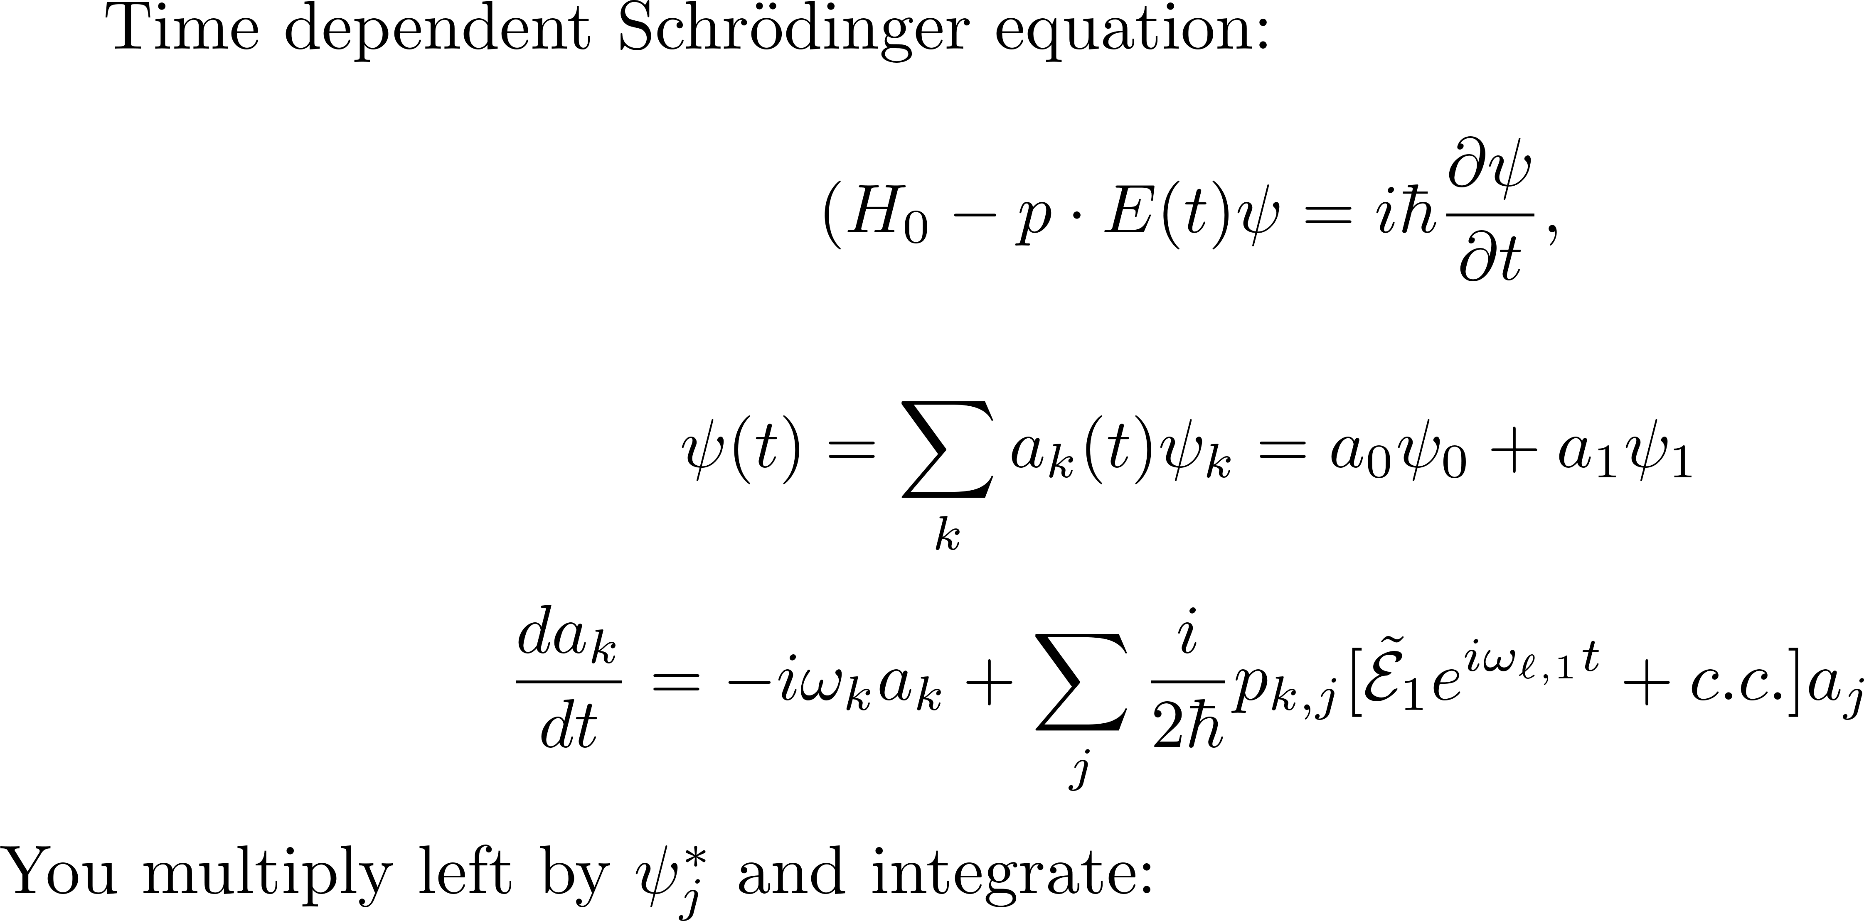
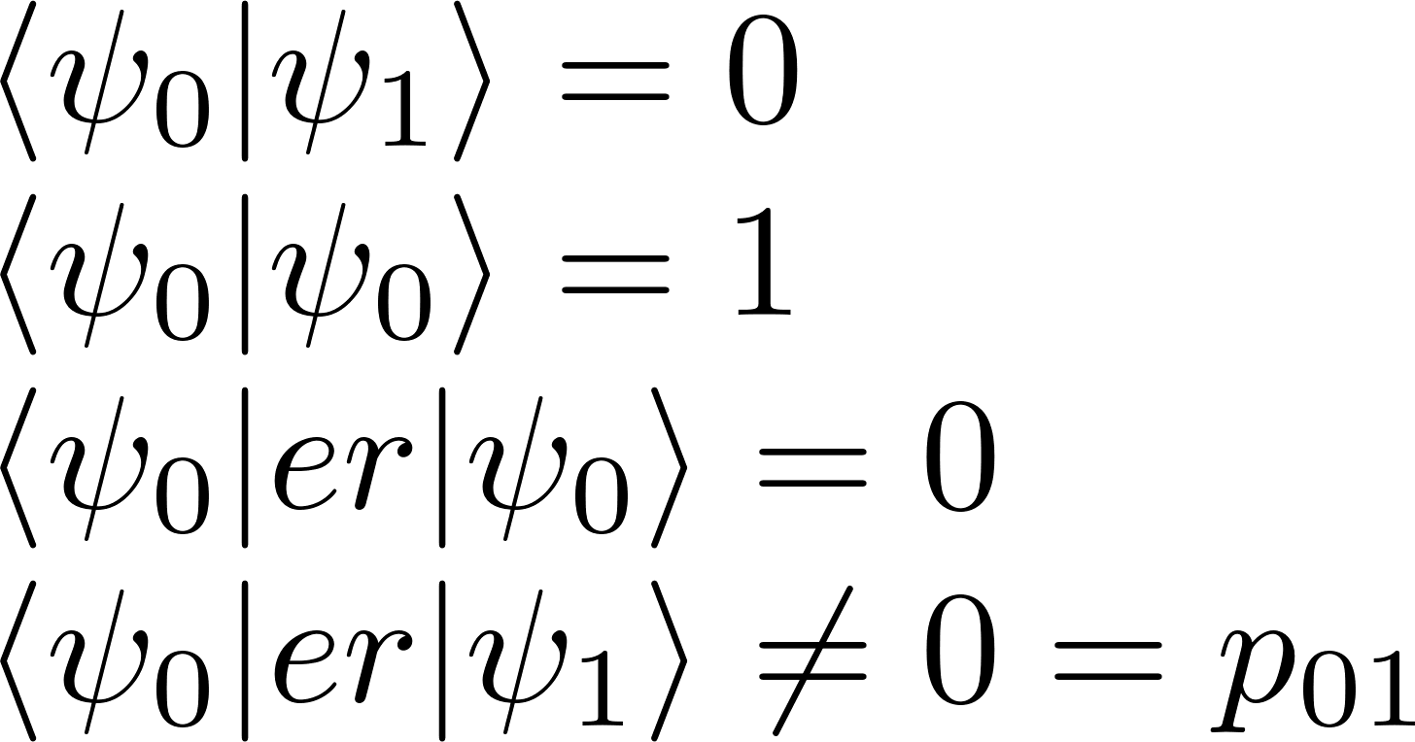
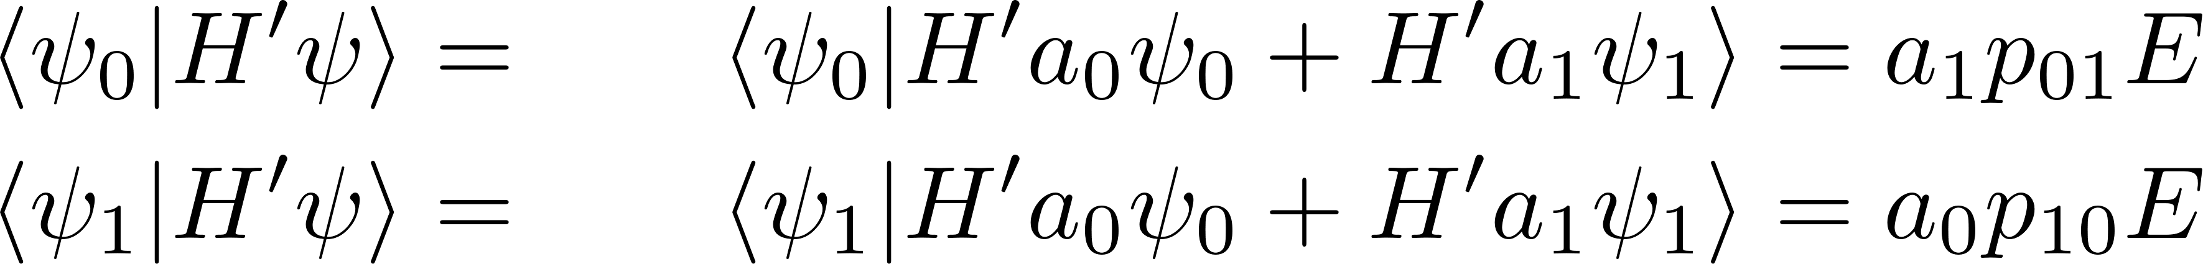
Pure states - do not radiate.

Slide 13
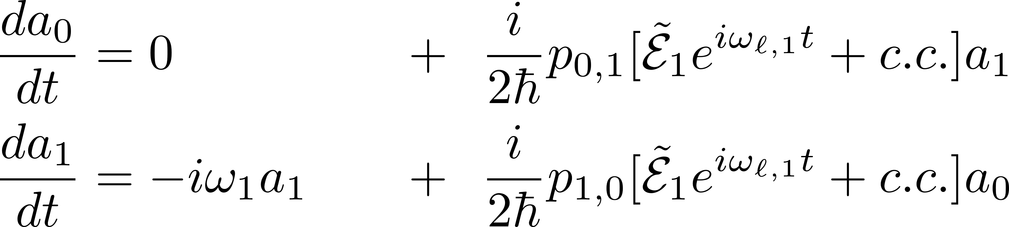
Pure states - do not radiate.

Slide 14
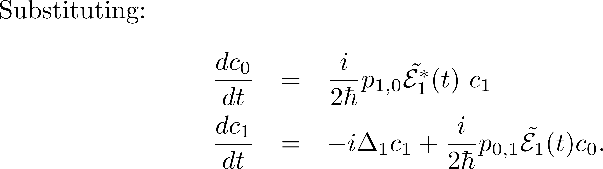

Slide 15
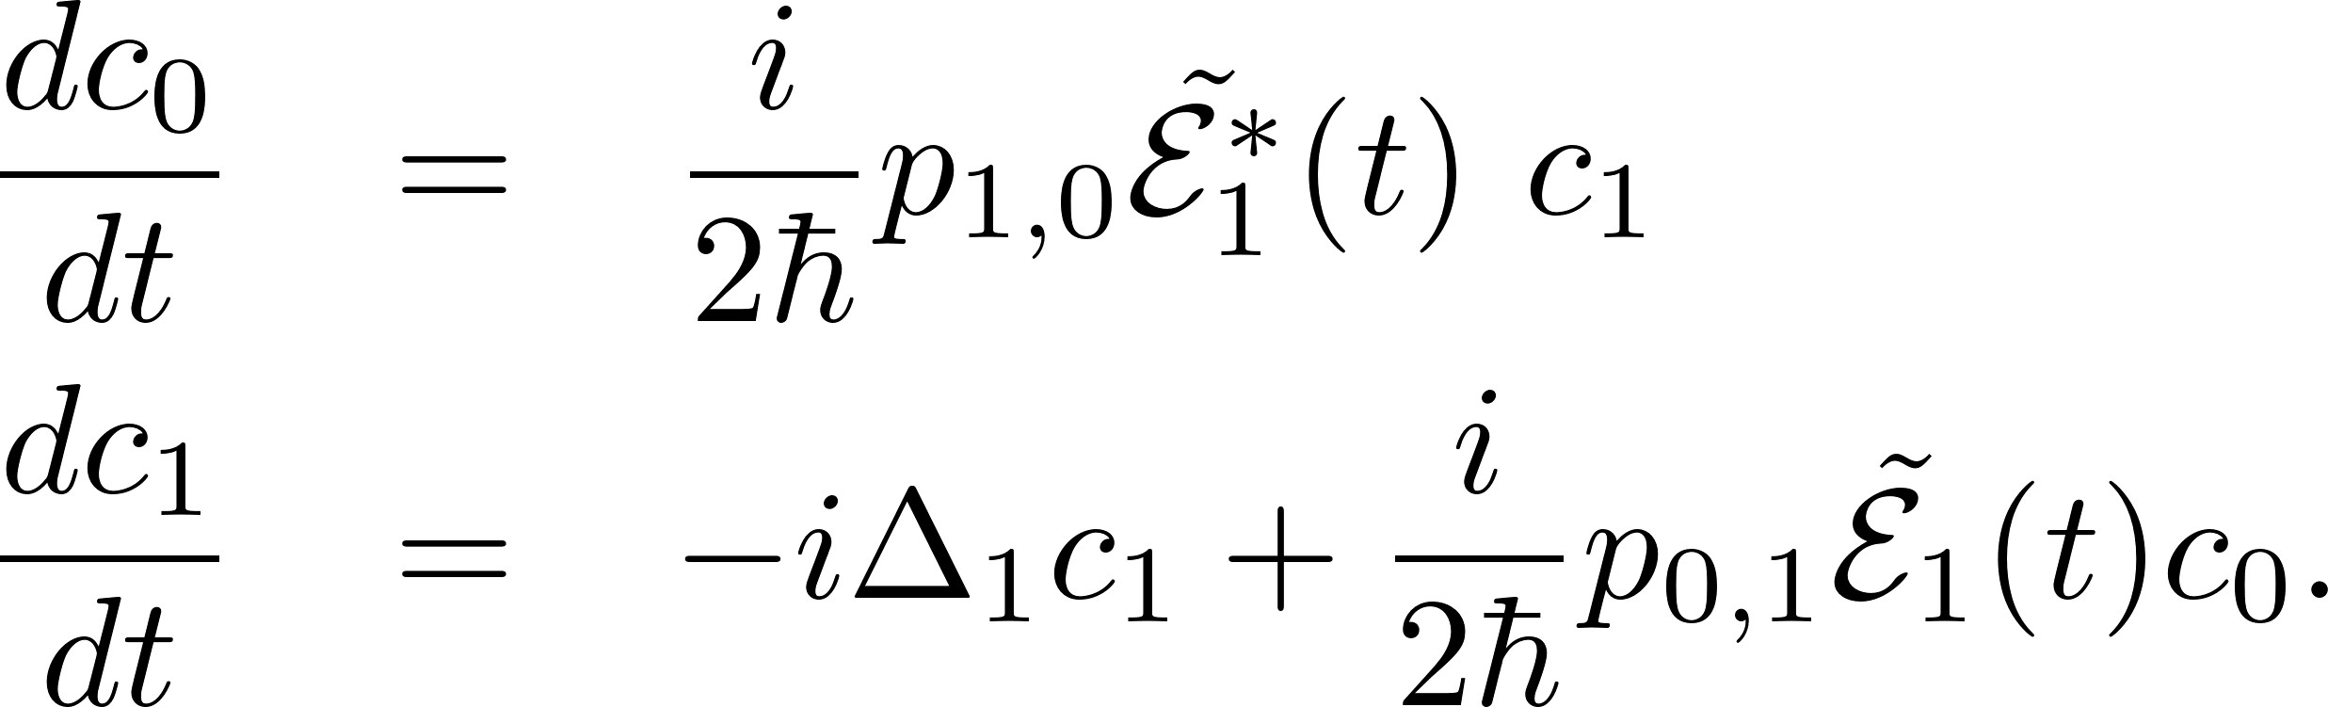
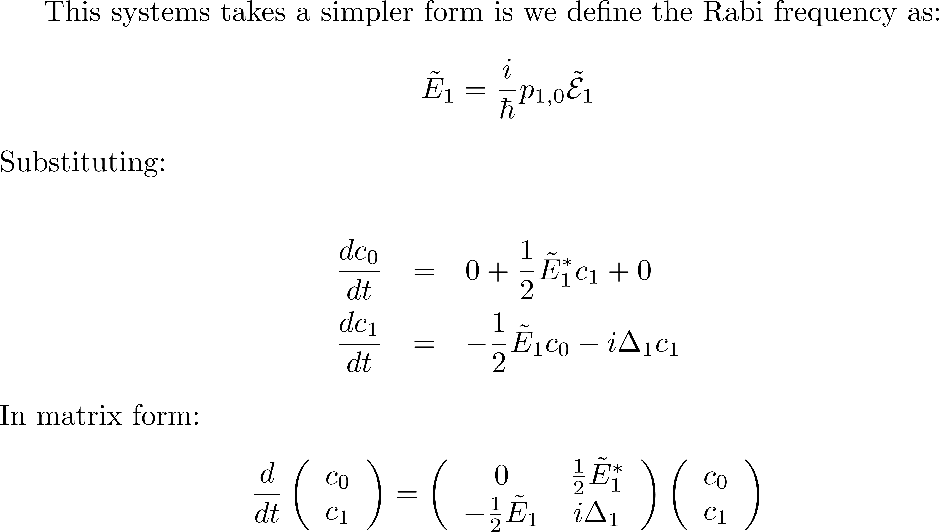

Slide 16
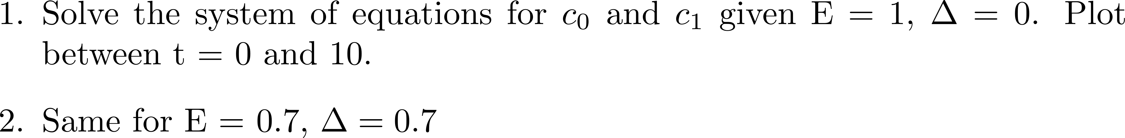
EXERCISES/PROBLEMS
3) Derive a system o 3 differential equations for a system of 3 levels

Slide 17
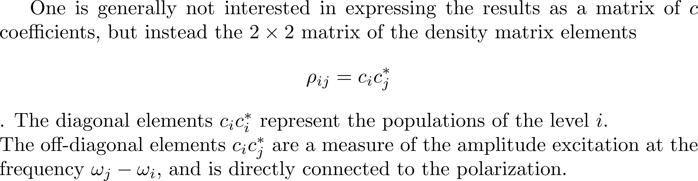
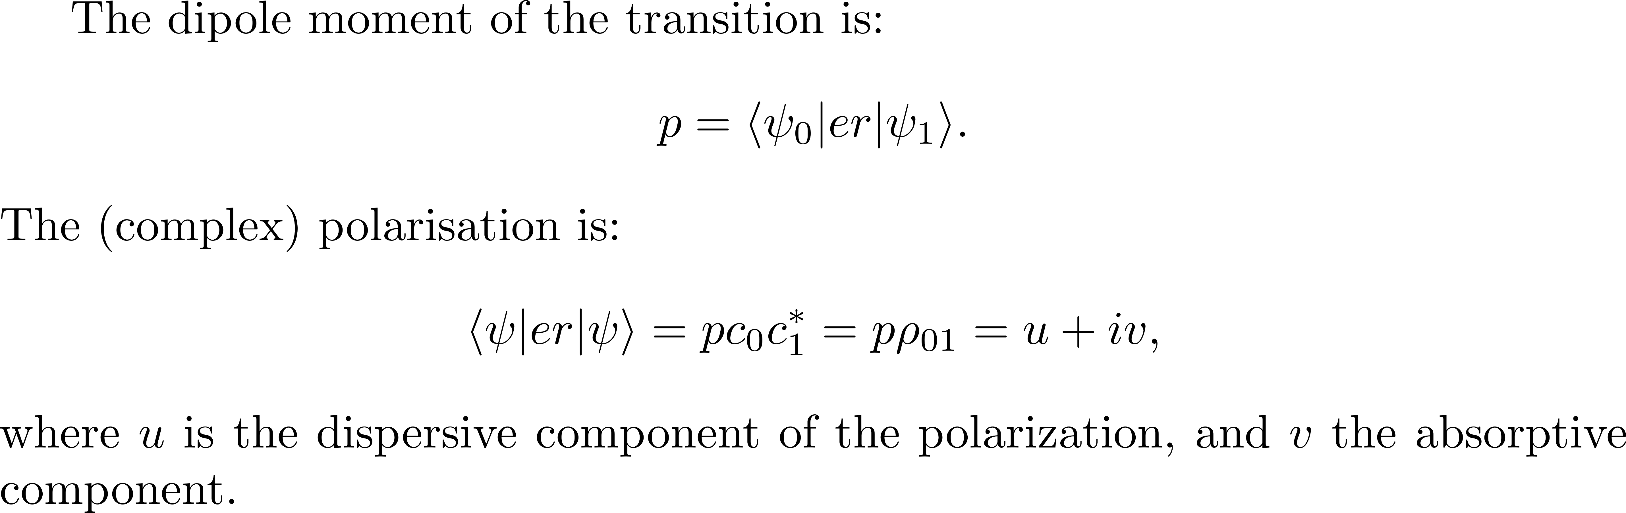

Slide 18
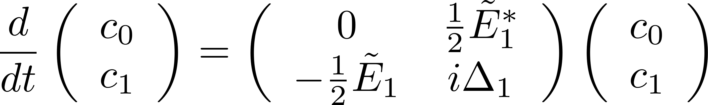
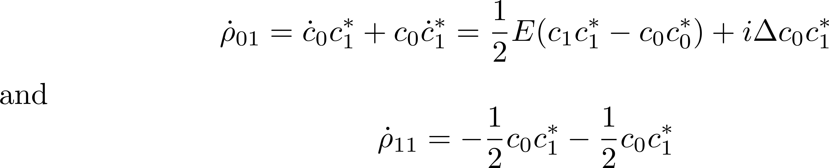
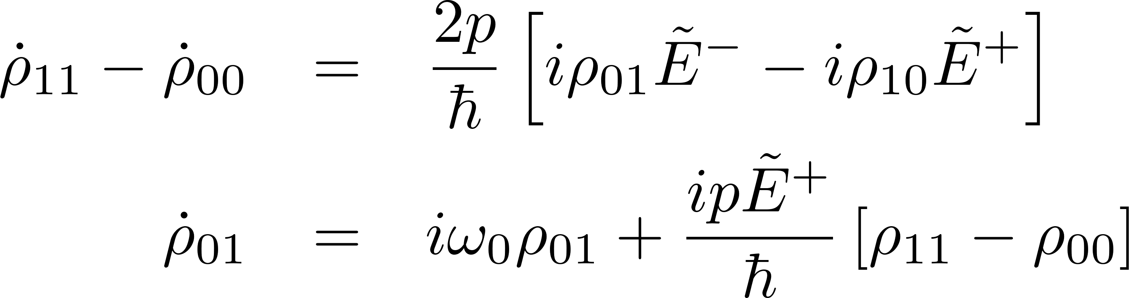
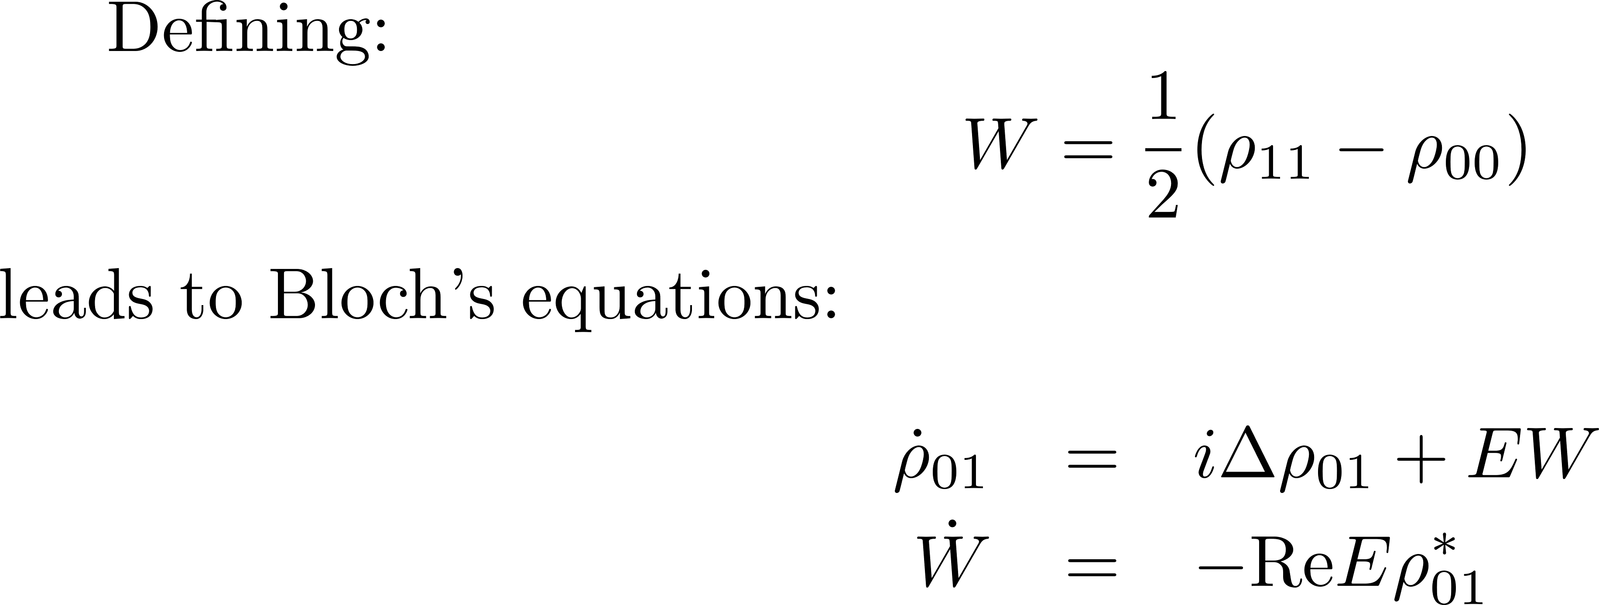

Slide 19
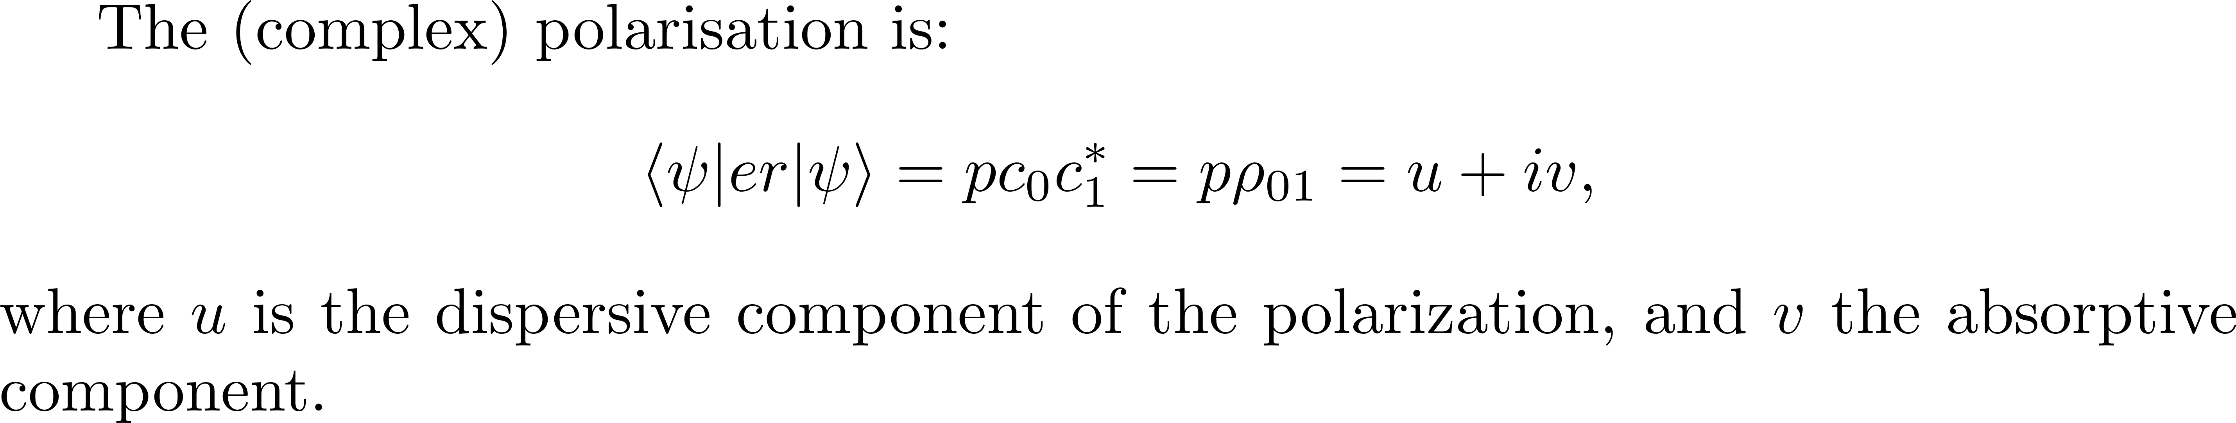
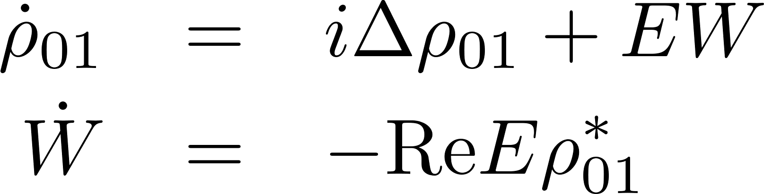
becomes

Slide 20
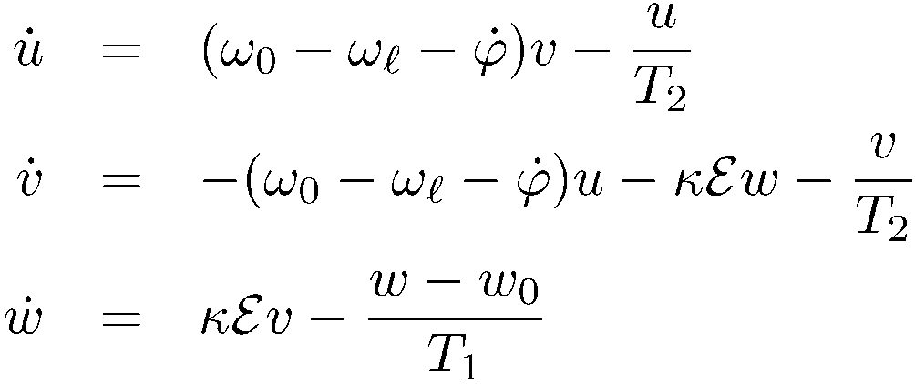
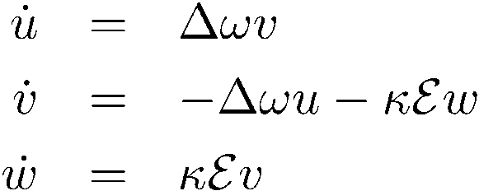
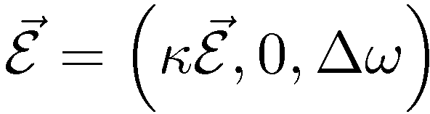
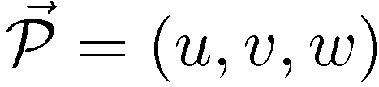


no relaxation
Propagation
w
u
v

Slide 21
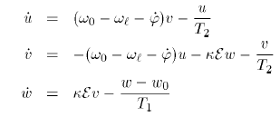
Homogeneous broadening
Inhomogeneous broadening

Slide 22

At resonance
0
z00
w
u
v

Slide 23
Application of π pulse
Li

Slide 24
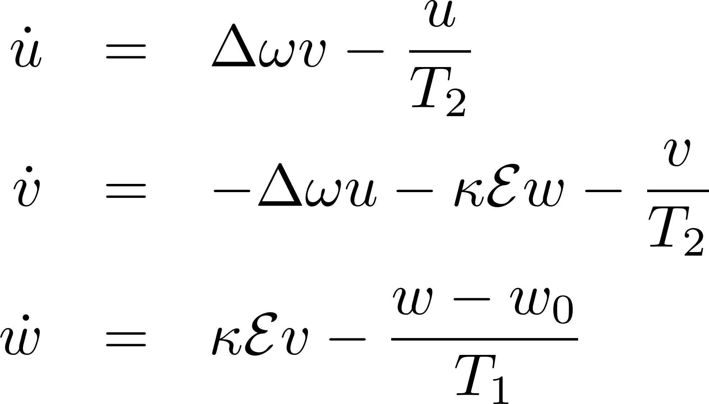
At resonance, phase relaxation
0
z00
w
u
v

Slide 25
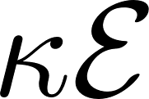



EXERCISES/PROBLEMS
0.1
0
1

Slide 26
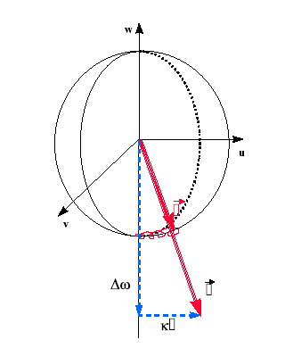
ADIABATIC FOLLOWING
(slow motion)

Slide 27
Coherent Propagation
Application of vector model
TexPoint fonts used in EMF.
Read the TexPoint manual before you delete this box.: AAAAA

Slide 28
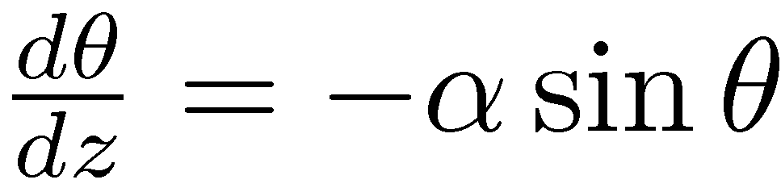
Application 1: Self-induced transparency

Slide 29
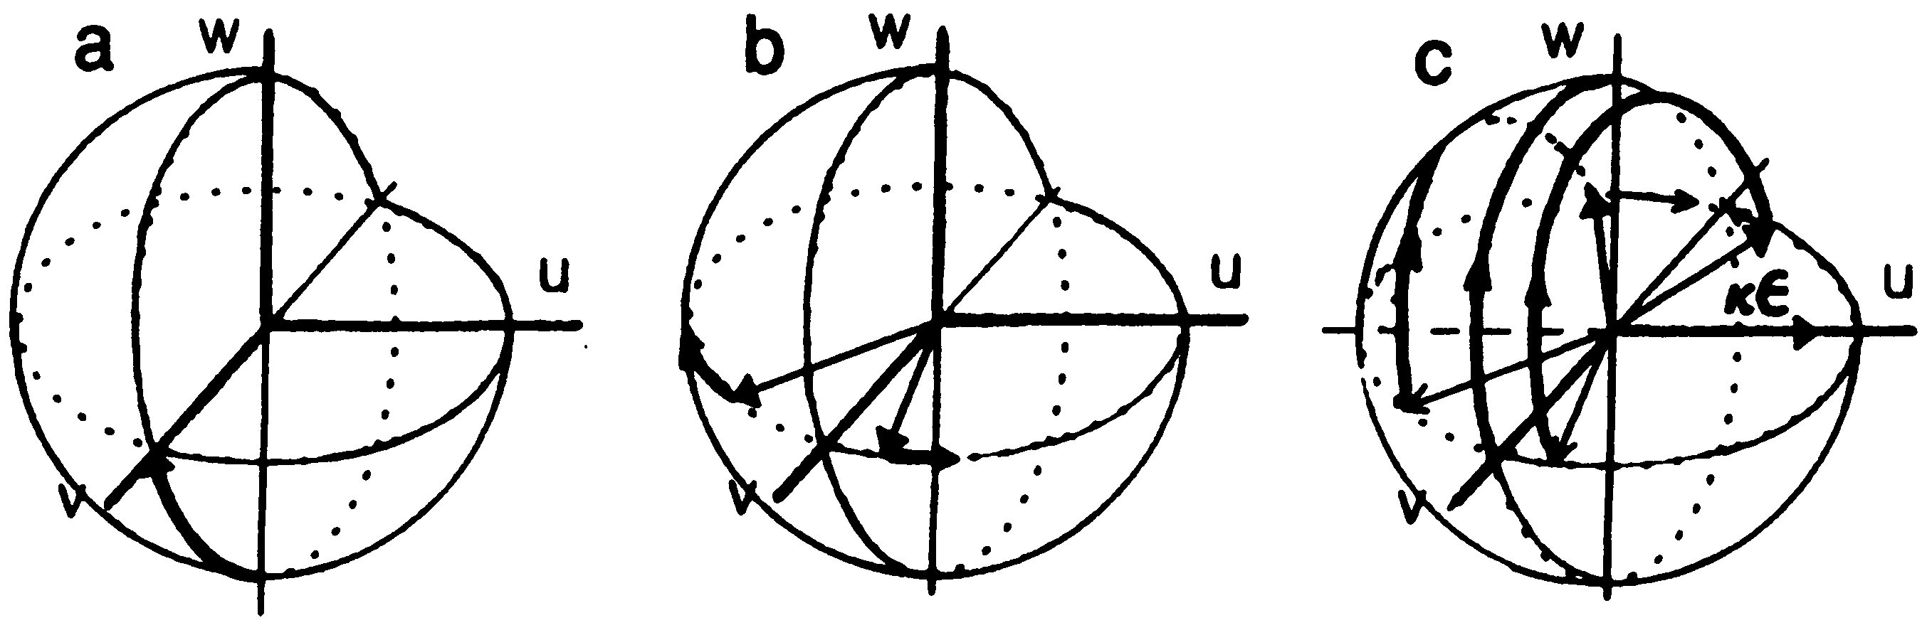
Photon Echoes
-- does not need π/2 and π pulses

Slide 30
Self-induced transparency and “2π” pulses
Rabi frequency of the order of pulse spectral width
Sech solution – self preserving shape.
Bloch vector makes a full circle.
Observation of “Rabi oscillations in semiconductors”:
A. Schuelzgen et al., Phys Rev. Lett 82: 2346-2349 (1999)

Slide 31


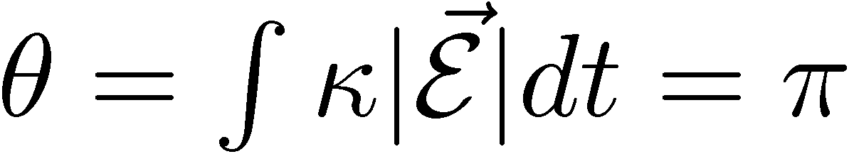
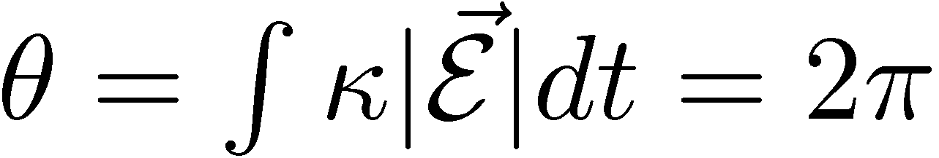
Energy conservation and 2 pi pulse propagation
W
U
V

Slide 32
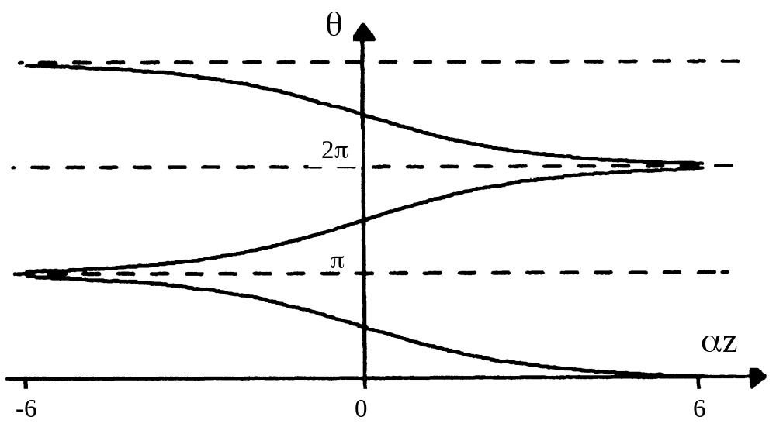
AREA THEOREM

Slide 33
SELF-INDUCED TRANSPARENCY OFF RESONANCE

Slide 34
SELF-INDUCED TRANSPARENCY ON RESONANCE

Slide 35
SELF-INDUCED TRANSPARENCY OFF RESONANCE

Slide 36
Sech solution – self preserving shape.
PROBLEM 3
Self-induced transparency is one the first examples of soliton propagation in
optics, based on coherent resonant propagation in an absorber.
It applies mostly to inhomogeneously broadened systems, for which the (undamped)
Bloch's interaction equations apply.
We derive here the form of the steady state propagating
pulse, the 2 pi sech, in the simpler narrow line limit.
The extension to the inhomogeneous broadening case adds a lot of mathematics
but little of physics.
We therefore consider the system of Bloch's Maxwell equations in the
slowly varying approximation, to be reduced to:
no relaxation

Slide 37
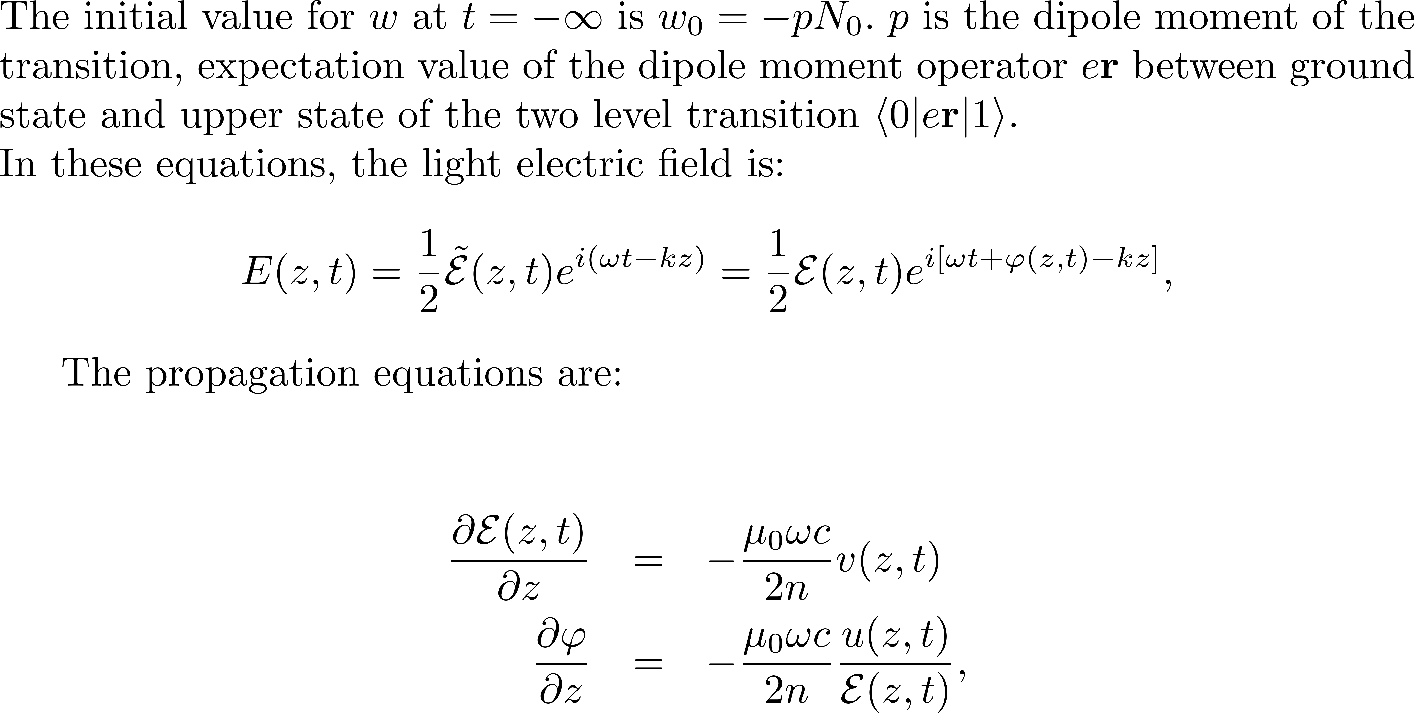
no relaxation
PROBLEM 3

Slide 38
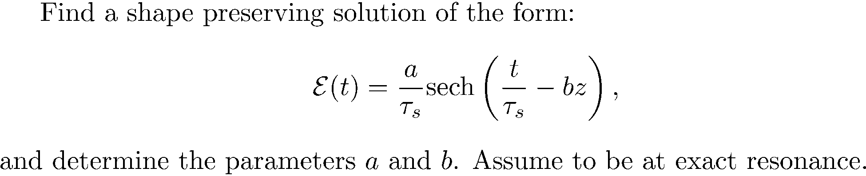
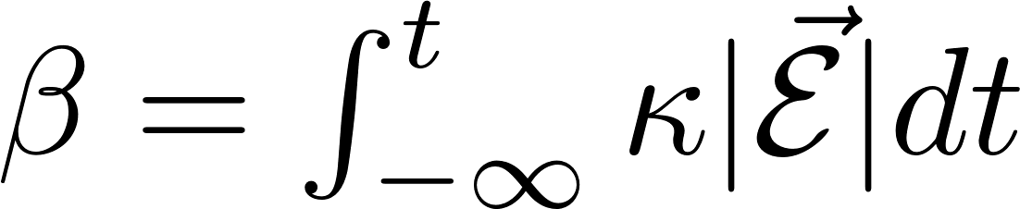
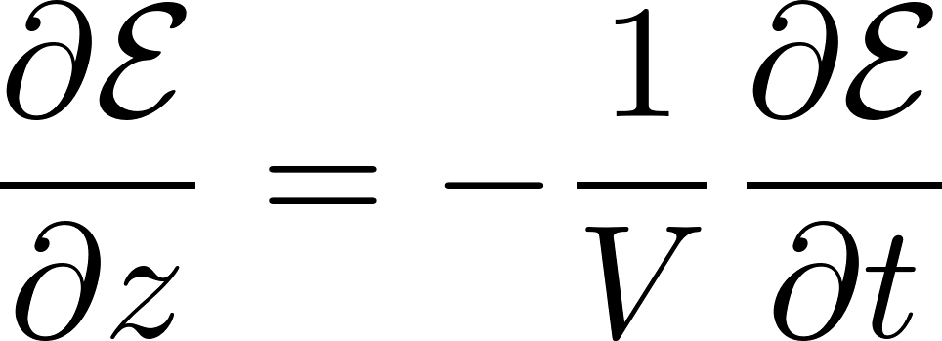
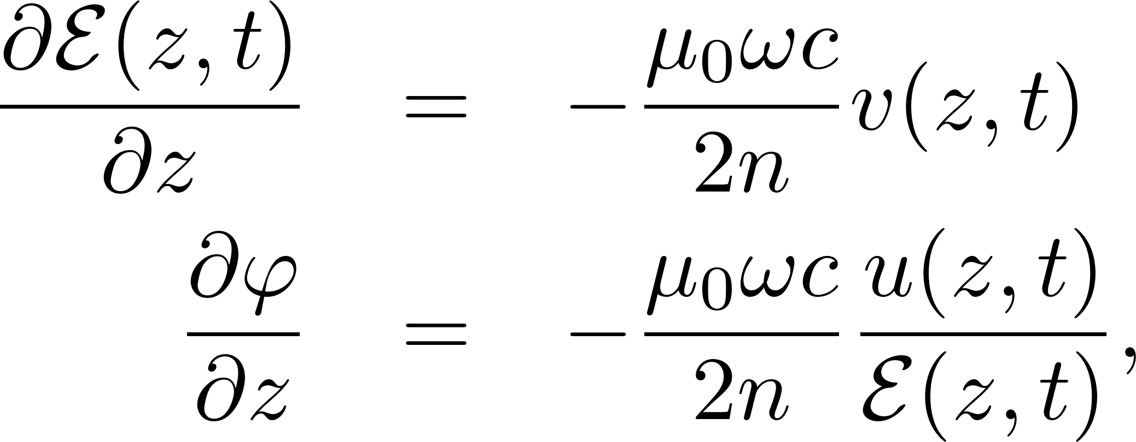
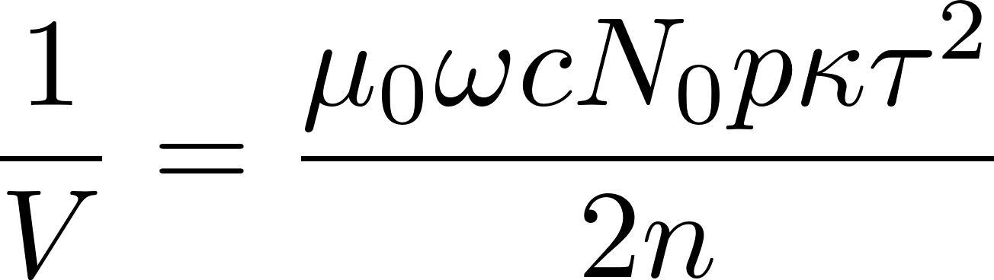
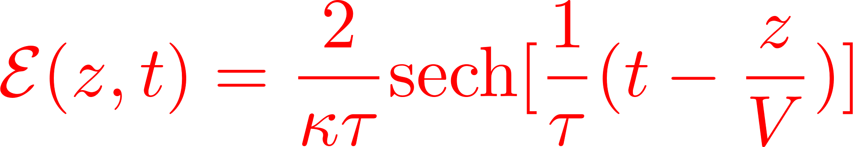
PROBLEM 3

Slide 39
pi pulse propagation in an amplifier

Slide 40
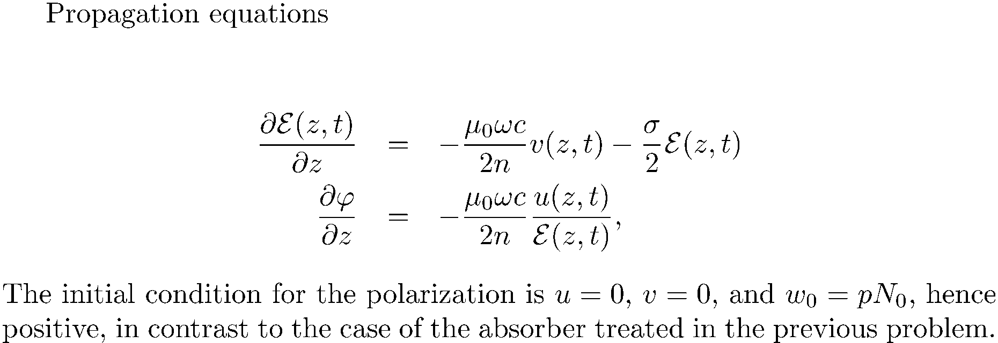
pi pulse propagation in an amplifier
W
U
V

Slide 41
ZERO-AREA PULSE PROPAGATION

Slide 42
ZERO-AREA PULSE PROPAGATION
W
U
V

Slide 44
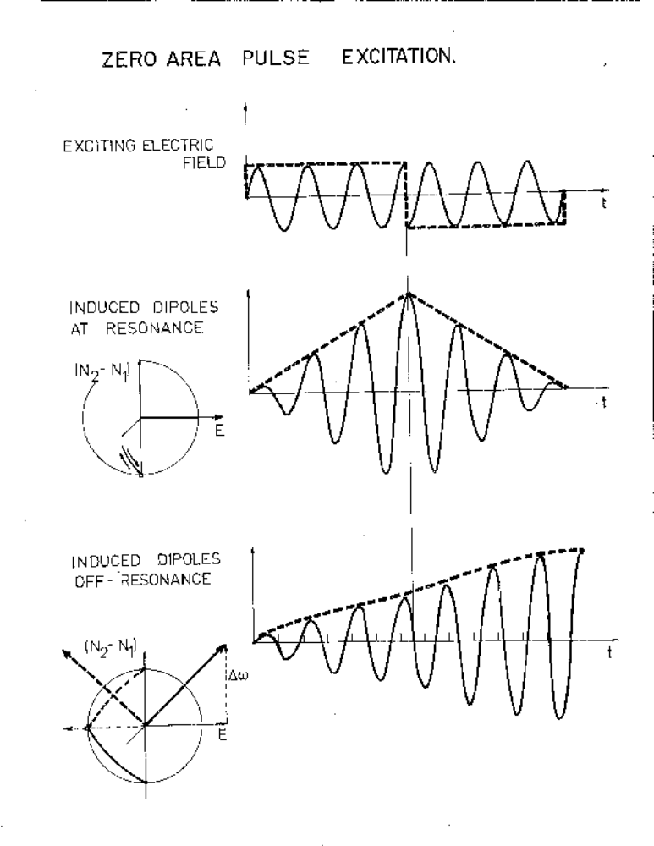

Slide 47
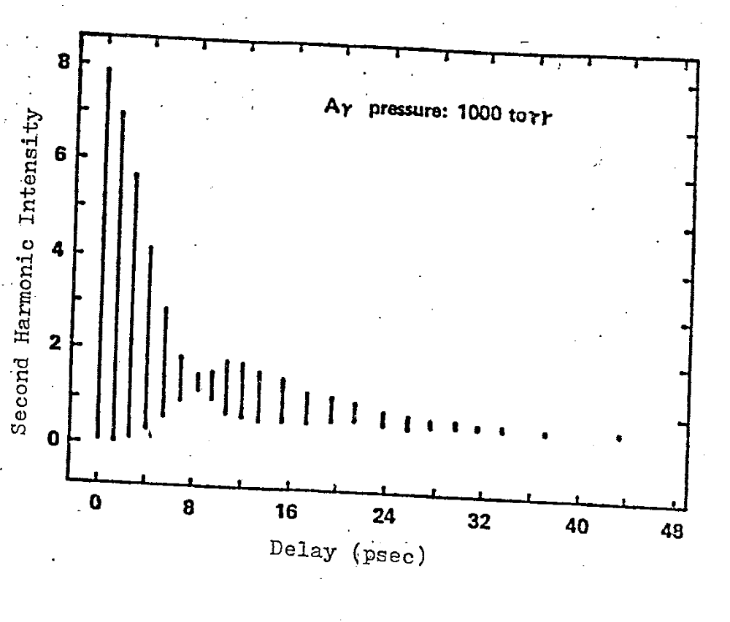

Slide 48
HOMOGENEOUS AND INHOMOGENEOUS BROADENING

Slide 49
DIFFERENCE BETWEEN COLLISION BROADENING, NATURAL LINE BROADENNG, AND INHOMOGENEOUS BROADENING
Homogeneous broadening
Inhomogeneous broadening
TexPoint fonts used in EMF.
Read the TexPoint manual before you delete this box.: AAAAAAA

Slide 50
Photon Echoes
-- does not need π/2 and π pulses

Slide 51
THE TRANSIENT INTERACTION OF LIGHT WITH A TWO LEVEL SYSTEM EVOLVES TOWARDS STEADY STATE
STANDARD RATE EQUATIONS AND CLASSICAL LINEAR POLARIZATION ARE SUCCESSIVE STEPS OF THAT EVOLUTION

Slide 52
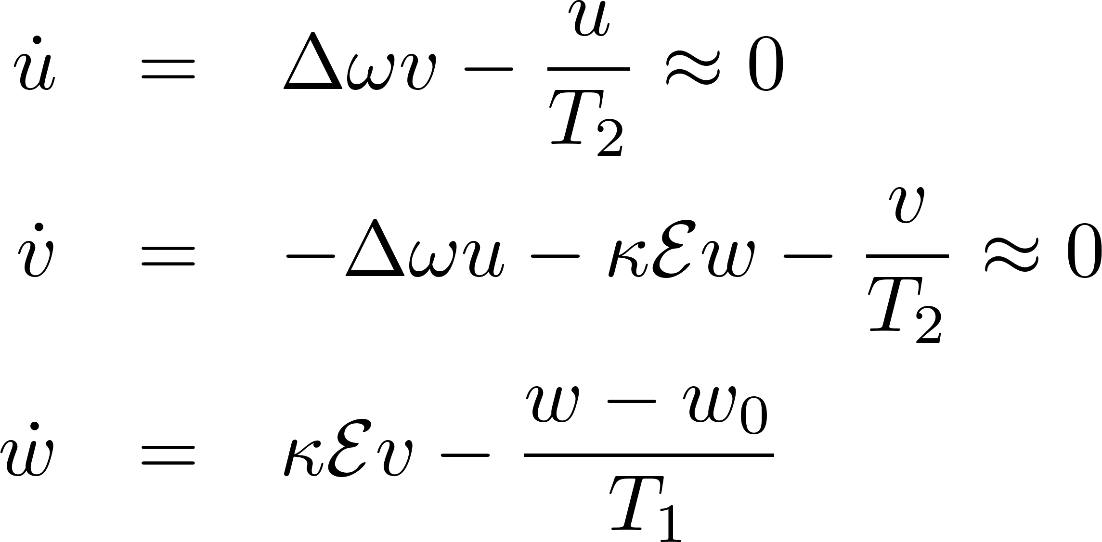
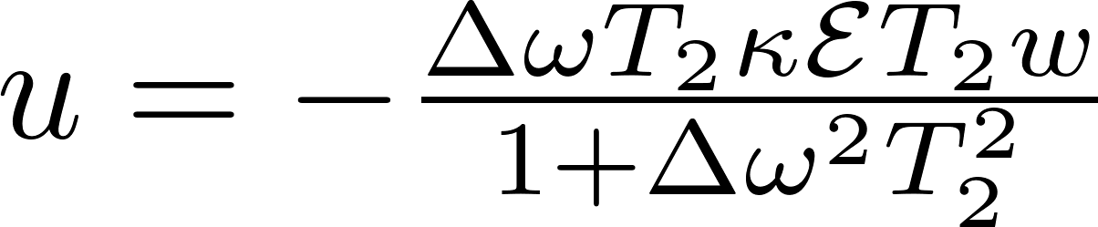
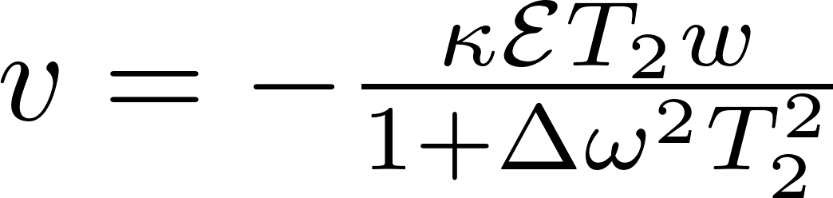
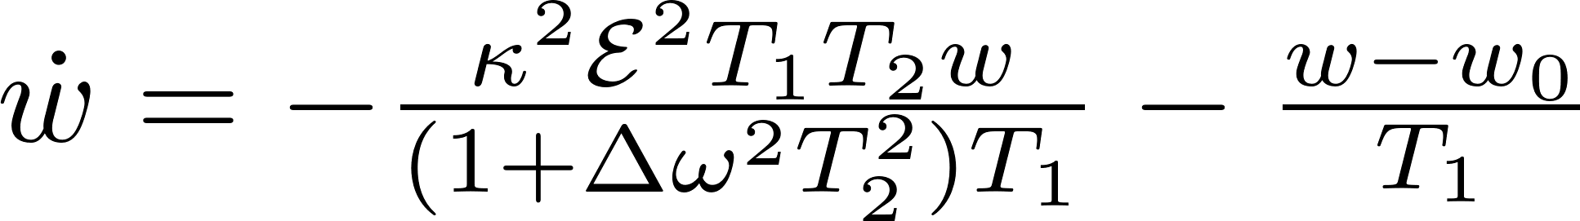
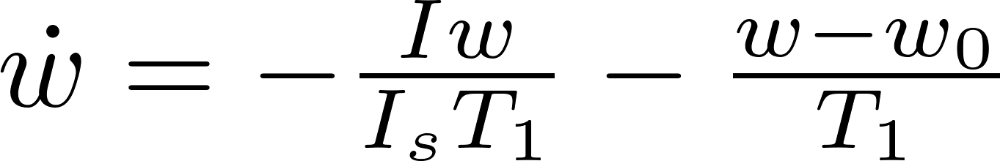
RATE EQUATIONS

Slide 53

RATE EQUATIONS
I_{s} is the saturation power..
You can never have population inversion
Saturation field such that its Rabi frequency is geometric average of T₁T₂.
It takes higher power to saturate off resonance.

Slide 54








LINEAR OPTICS
= steady state solution of Bloch’s equations

Slide 55



Small motions at the bottom of the sphere
The amplitude of the dipolar field that opposes the applied
field is proportional to the Fourier component of the applied field
at the dipole resonant frequency.
Energy absorbed proportional to the intensity at resonance frequency

Slide 56





Slide 57
RATE EQUATIONS

Slide 58
RATE EQUATIONS
I_{s} is the saturation power..
You can never have population inversion
Saturation field such that its Rabi frequency is geometric average of T₁T₂.
It takes higher power to saturate off resonance.

Slide 59
LINEAR OPTICS
= steady state solution of Bloch’s equations

