Slide 1
ALWAYS USE YOUR NI TO JUDGE AI!
I GIVE YOU TWO EXAMPLES WHERE AI IS AS
EXAMPLE II
Question:
What is the highest third harmonic conversion efficiency achieved?
Answer: Based on theoretical calculations and early experimental work,
phase-matched alkali metal vapors (such as Rubidium or Cesium) mixed with inert gases (e.g., Xenon) can achieve very high third-harmonic generation (THG) efficiencies, with theoretical predictions exceeding 50% for picosecond laser pulses.
These systems use resonant enhancement to produce large non-linear susceptibilities.
WRONG!
WRONG!
WRONG!
WRONG!
WRONG!
WRONG!
WRONG!
WRONG!
WRONG!

Slide 2
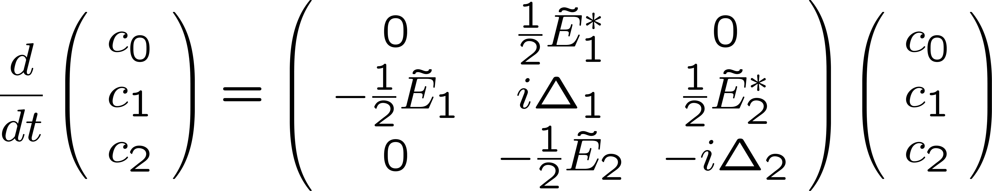
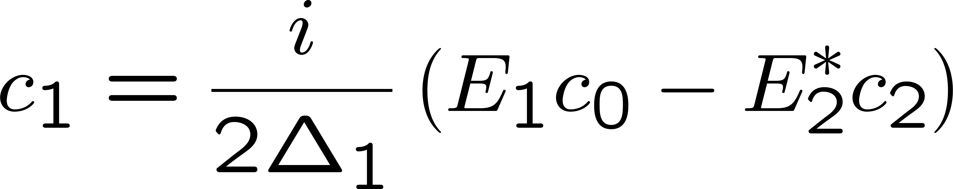
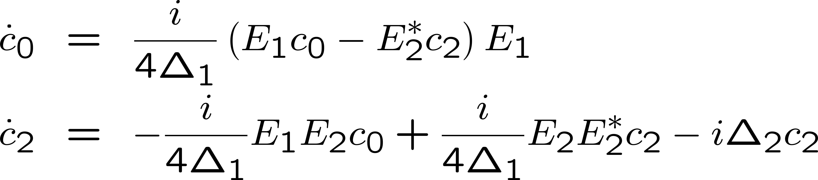
Adiabatic approximation
Detuning of the intermediate level 1 larger than the transition rates:
the second equation can be considered to be in steady state, and one
can solve for the coefficient c₁:

Slide 3
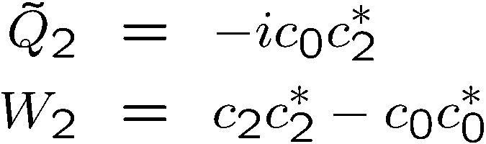

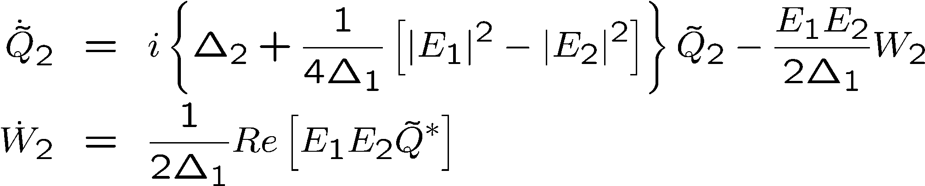

Adiabatic approximation
Defining:
Leads to:

Slide 4

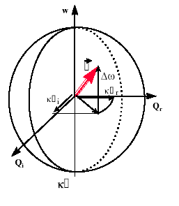

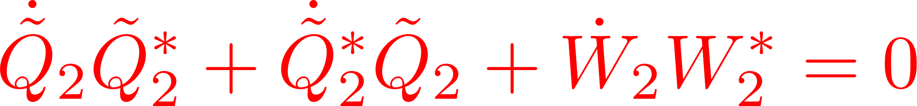



Adiabatic approximation
Bloch vector model

Slide 5
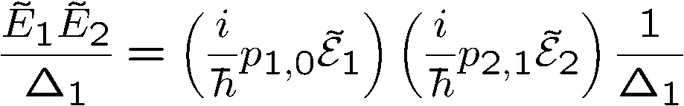
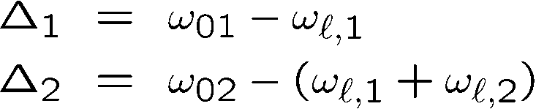
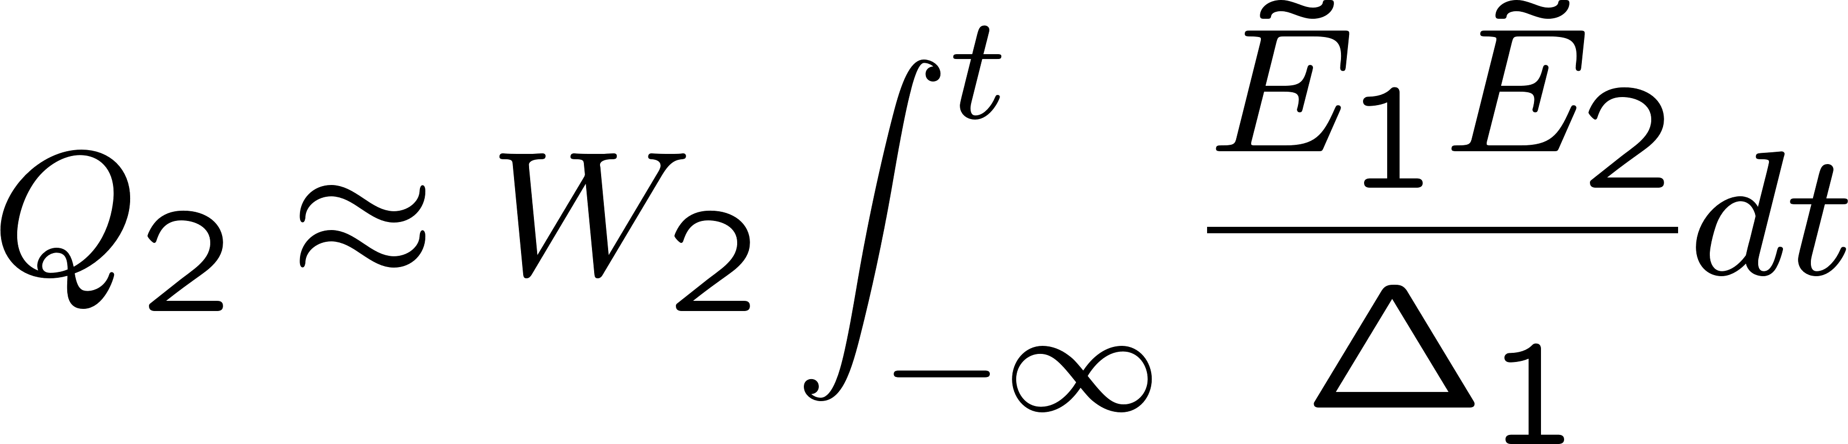
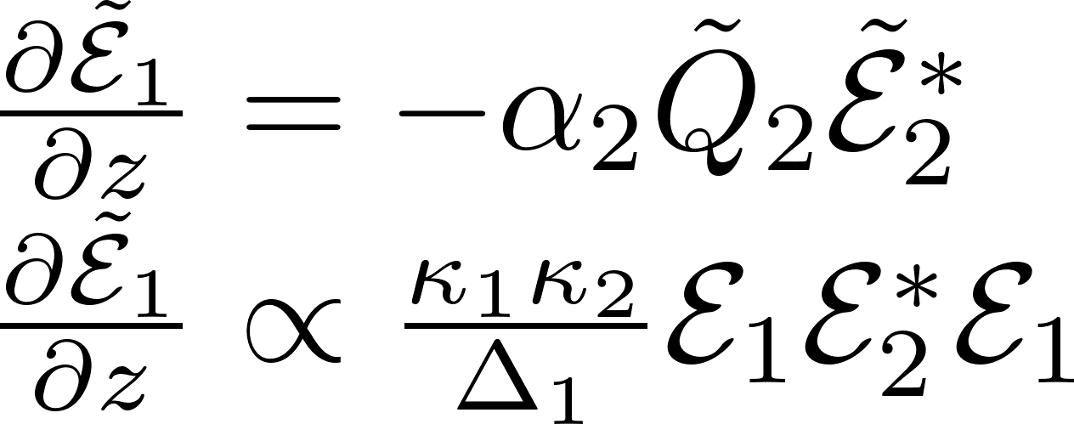
Transition rate: E₁E₂ or E²
Propagation:

Slide 6
Transition rate: E₁E₂ or E²
Propagation:

Slide 7
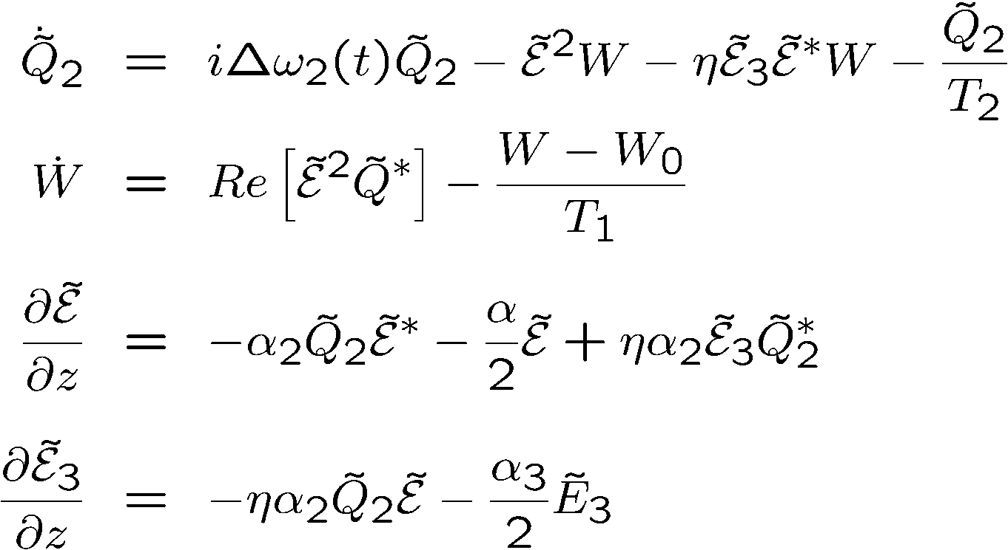
Bloch vector model
Contained in these expressions: Third order susceptibility, two-photon absorption,
third harmonic generation, stimulated Raman, phase conjugated FWM, etc...
The frequencies do no appear explicitly in these expressions.
But they can be “guessed” from the products of amplitudes.

Slide 8
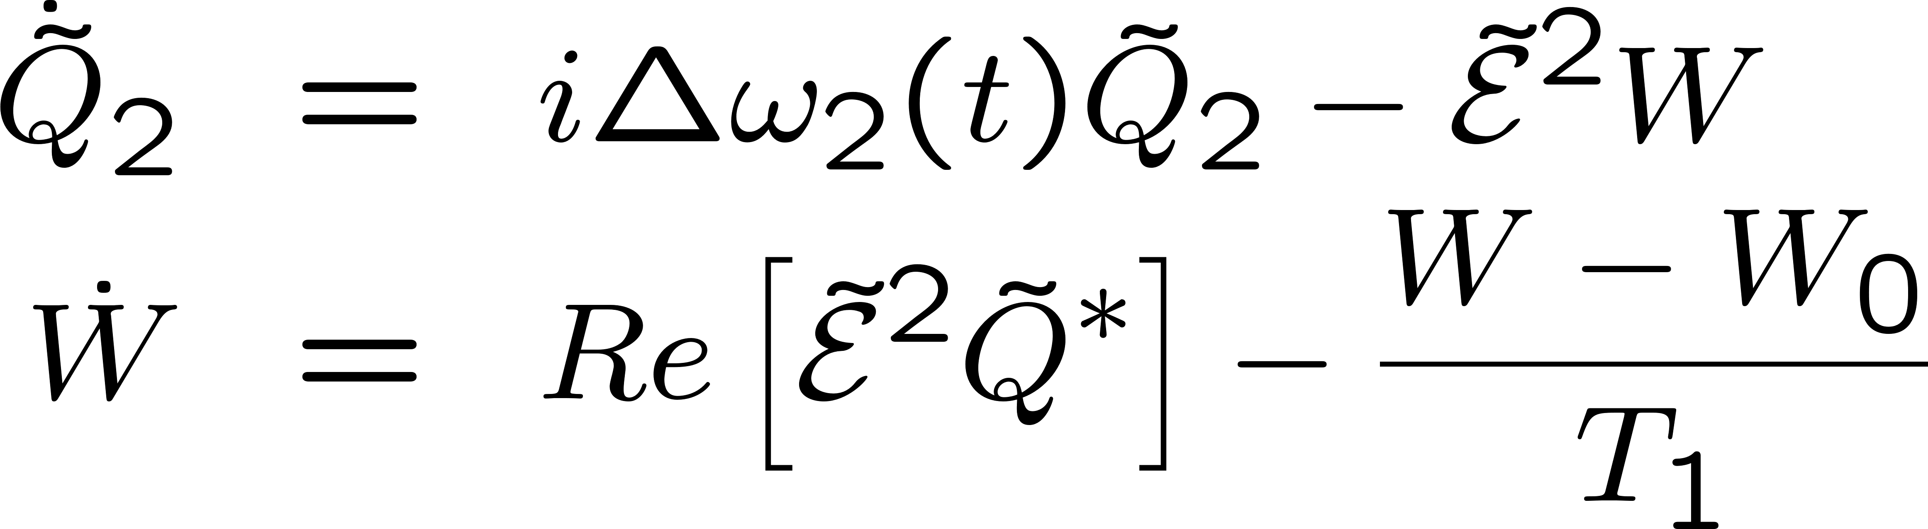
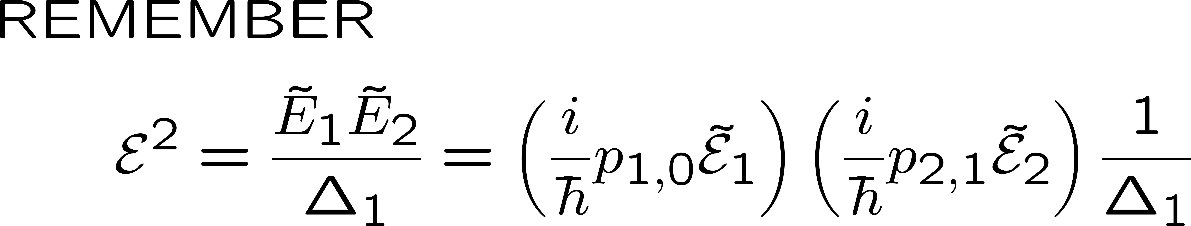
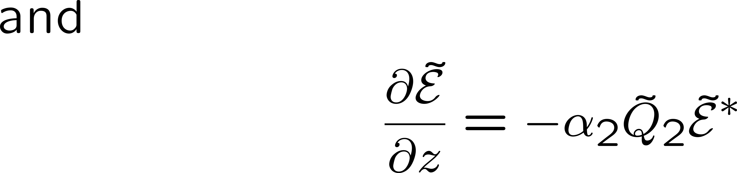



\

Slide 9
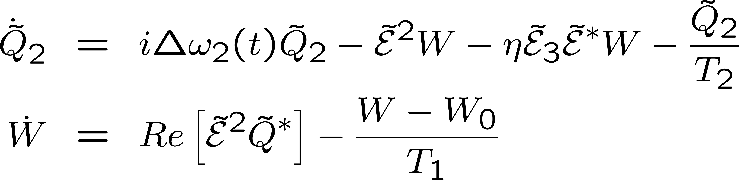
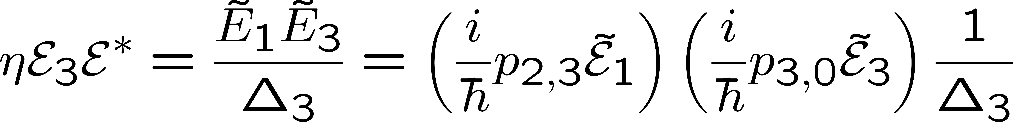
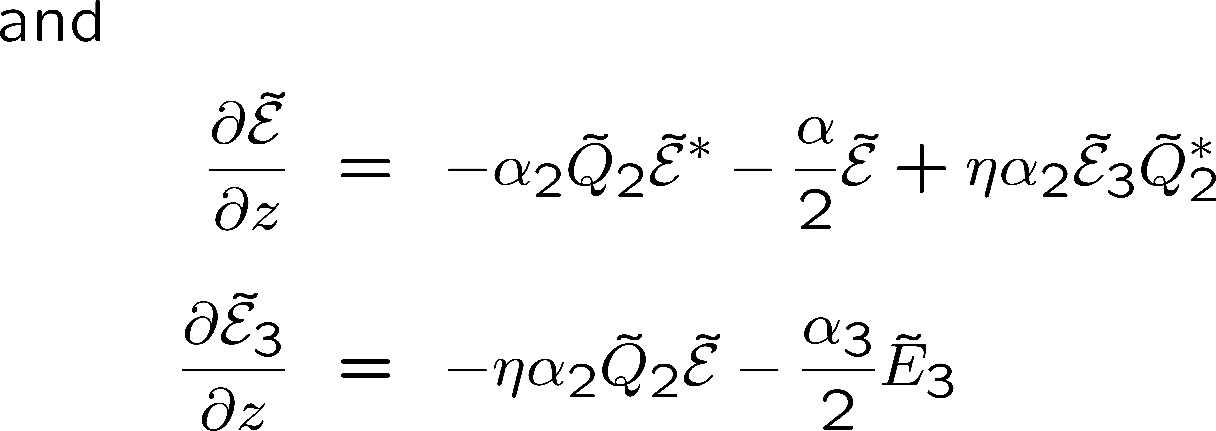

Slide 10
Bloch vector model
Contained in these expressions: Third order susceptibility, two-photon absorption,
third harmonic generation, stimulated Raman, phase conjugated FWM, etc...
The frequencies do no appear explicitly in these expressions.
But they can be “guessed” from the products of amplitudes.

Slide 11
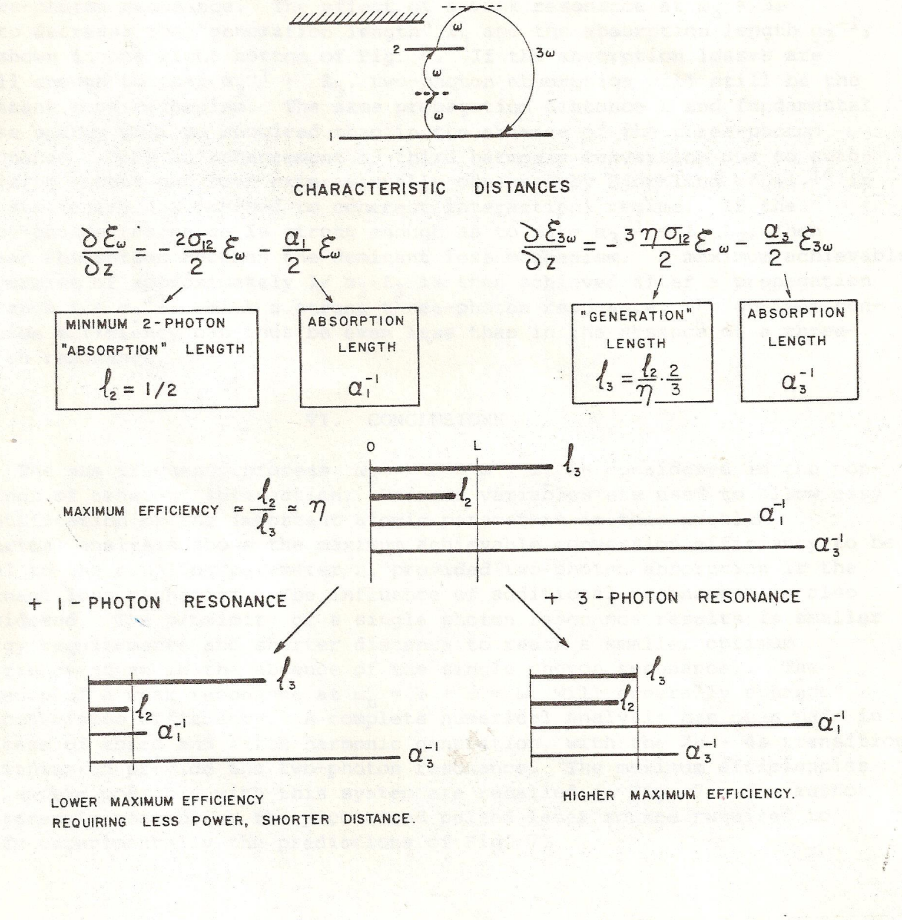

Slide 12
A resonance enhances harmonic generation
Less fundamental required to generate an harmonic.
The maximum power that you can achieve by harmonic generation is less.
That is a very general statement.
Other example: short pulse generation by Brillouin back scattering
Most efficient media cannot be used for highes power conversion

Slide 13
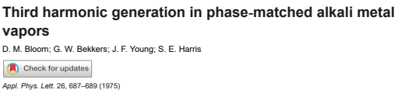
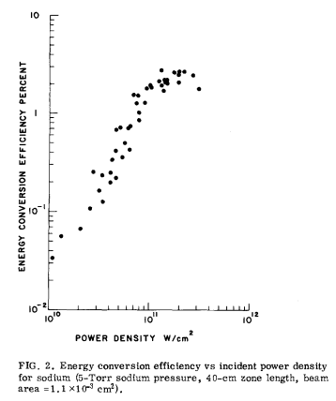

Slide 14
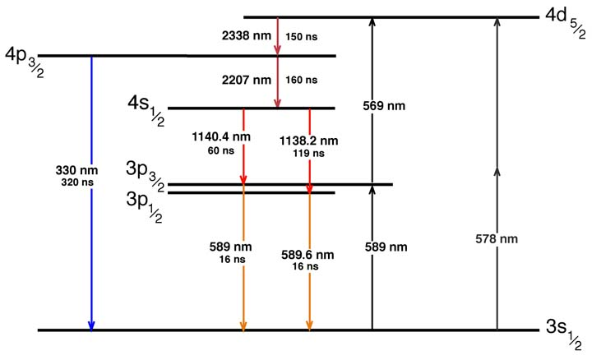
Sodium levels
355 nm

Slide 15
A resonance enhances harmonic generation
Less fundamental required to generate an harmonic.
The maximum power that you can achieve by harmonic generation is less.
YOU CAN GET AROUND THAT LIMITATION
USING COHERENT PROPAGATION
COHERENT INTERACTION:
THE ENERGY EXCHANGES CAN BE REVERSIBLE

Slide 16
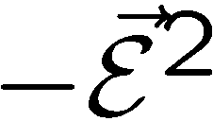
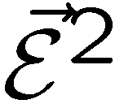

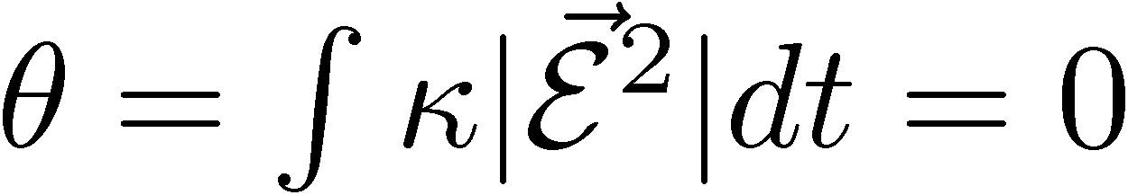
Energy conservation and zero-area pulse propagation
W
U
V

Slide 17

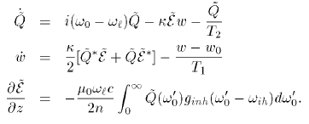
ε²
Pseudo-polarization vector
ε
ε
2
2
rotating around
2
2
2
2
2
2
2
2
2
Q₂ε∗

Slide 18
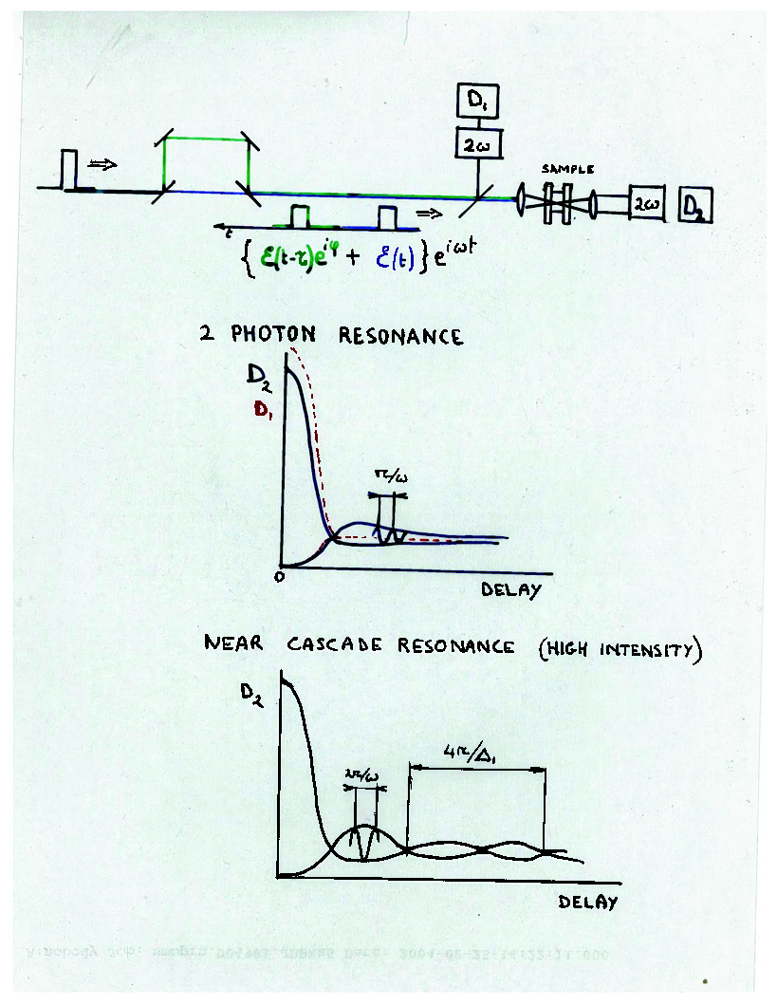

Slide 19
Back to two-photon resonant Third Harmonic generation
Example of lithium vapor
COHERENT INTERACTION:
THE ENERGY EXCHANGES CAN BE REVERSIBLE

Slide 20
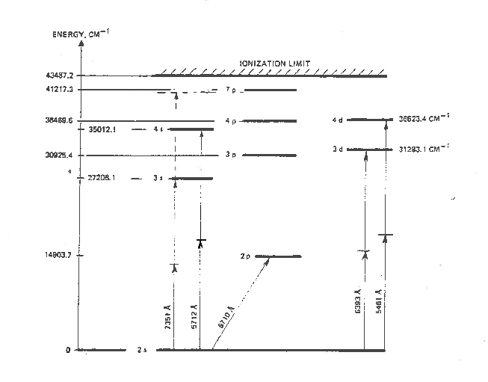

Slide 22
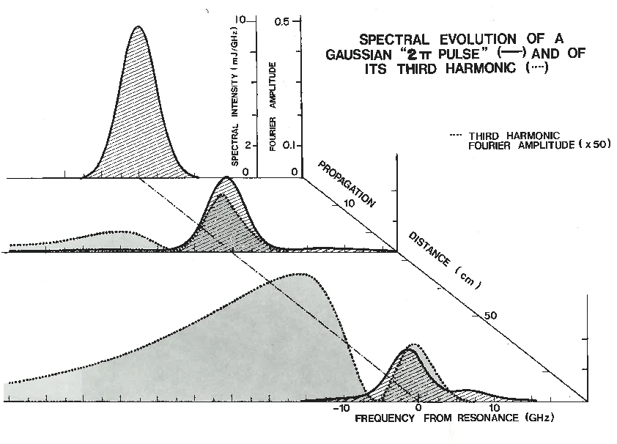

Slide 23
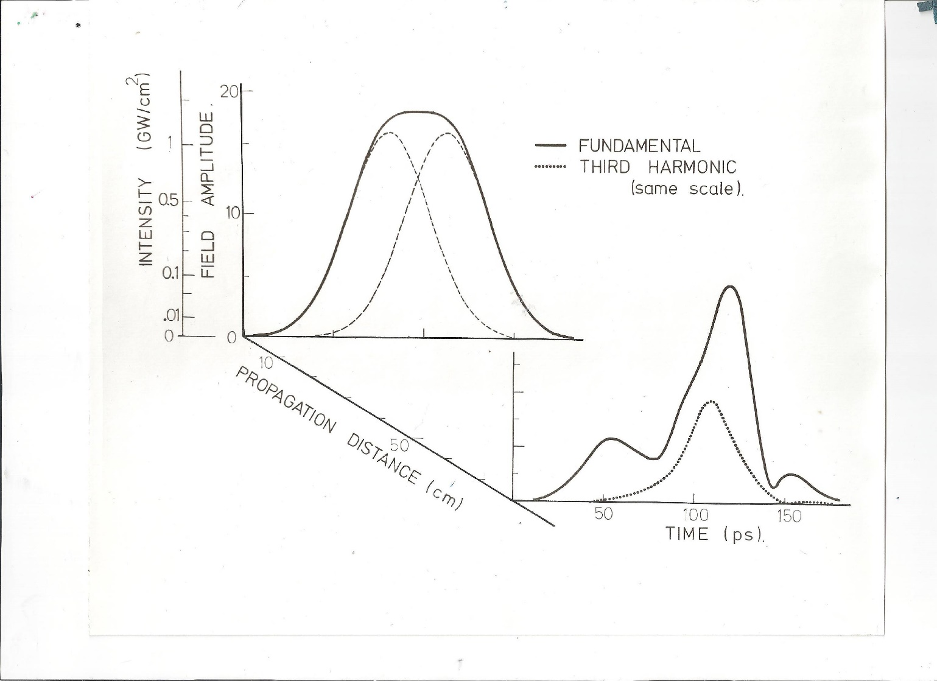
Simulations first
Third harmonic with 90 degree phase shifted pulses
90 degree phase shifted pulse propagation

Slide 24
Is it for real, or a gedanken experiment?
EXPERIMENTAL DEMONSTRATION
Take lithium vapor, in condition of 2 photon resonance
Quartz cell?

Slide 25
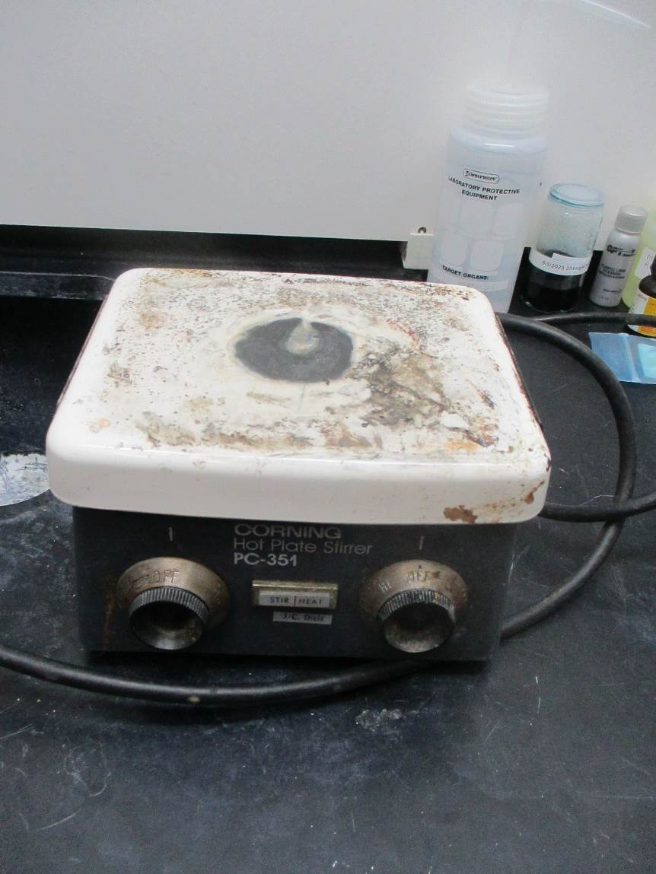
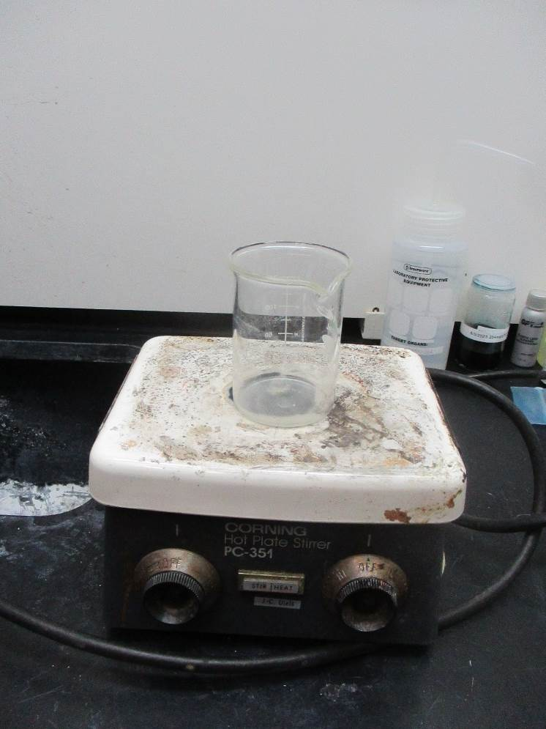

Slide 26
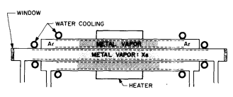
Is it for real, or a gedanken experiment?
lithium vapor, in condition of 2 photon resonance
Quartz cell?
Heat pipe
Vidal and Cooper
Journal of Applied Physics 40, 3370 (1969);

Slide 27
DISPERSION?

Slide 28
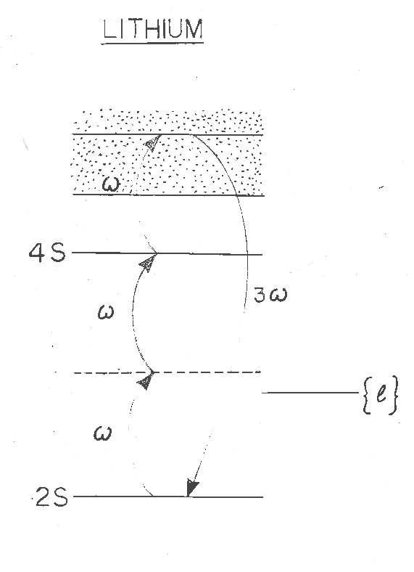
DISPERSION?
Phase matching
Mg
Li
ω
2ω
3ω
Ω

Slide 29
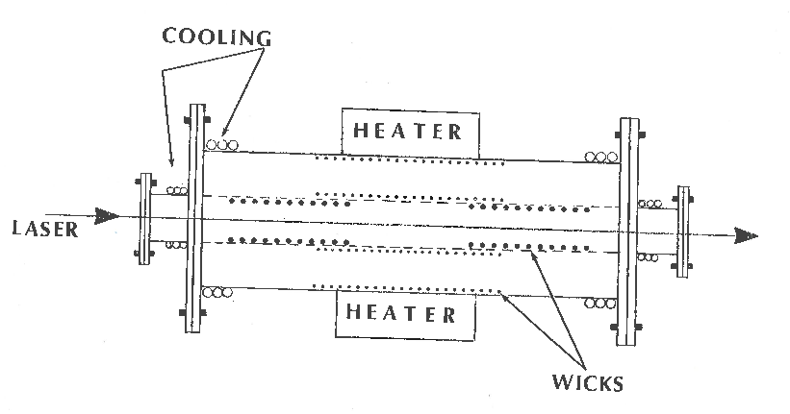
Heat pipe: How to mix magnesium and lithium?
Double heat pipe:
C. R. Vidal and M. M. Hessel Journal of Applied Physics 43, 2776 (1972)
Pa = 2 torr
Ta = 1500
Pb = 5 torr
Ta = 1500

Slide 30
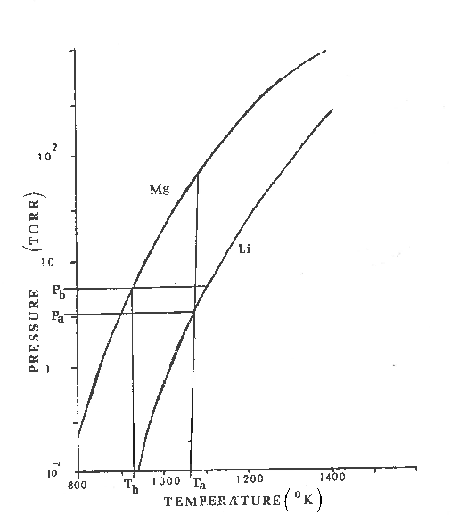
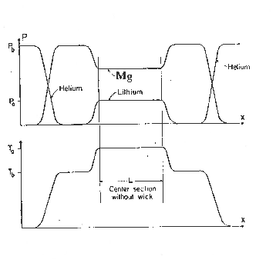
Mg partial pressure Pb - Pa
m

Slide 31
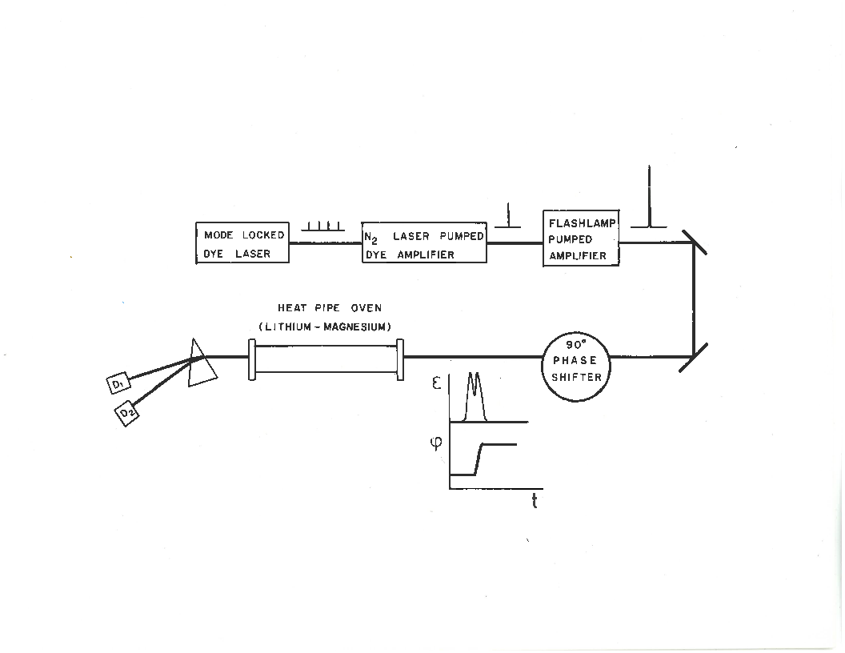

Slide 32
“PHASE SHIFTER”

Slide 33
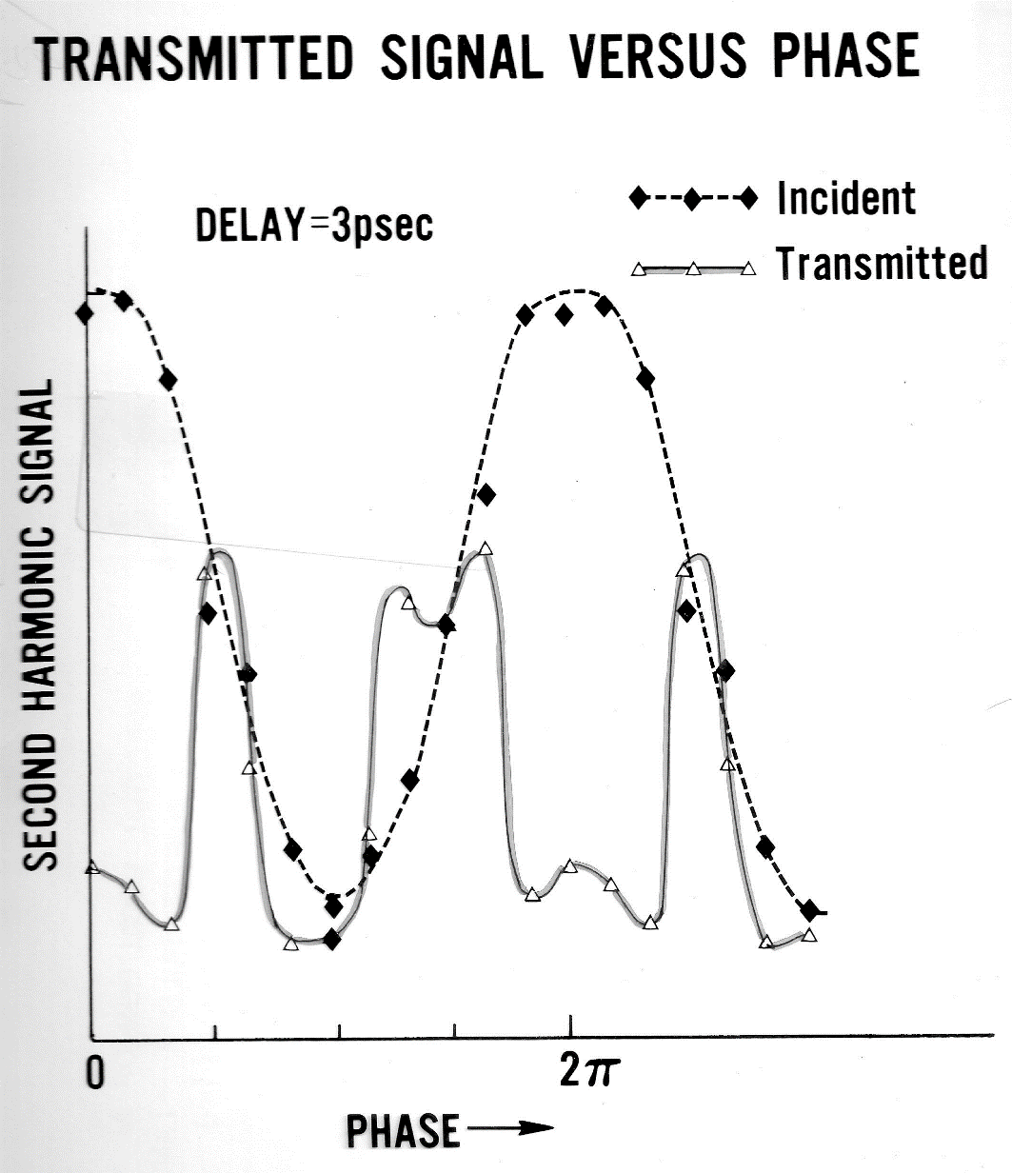

Slide 34
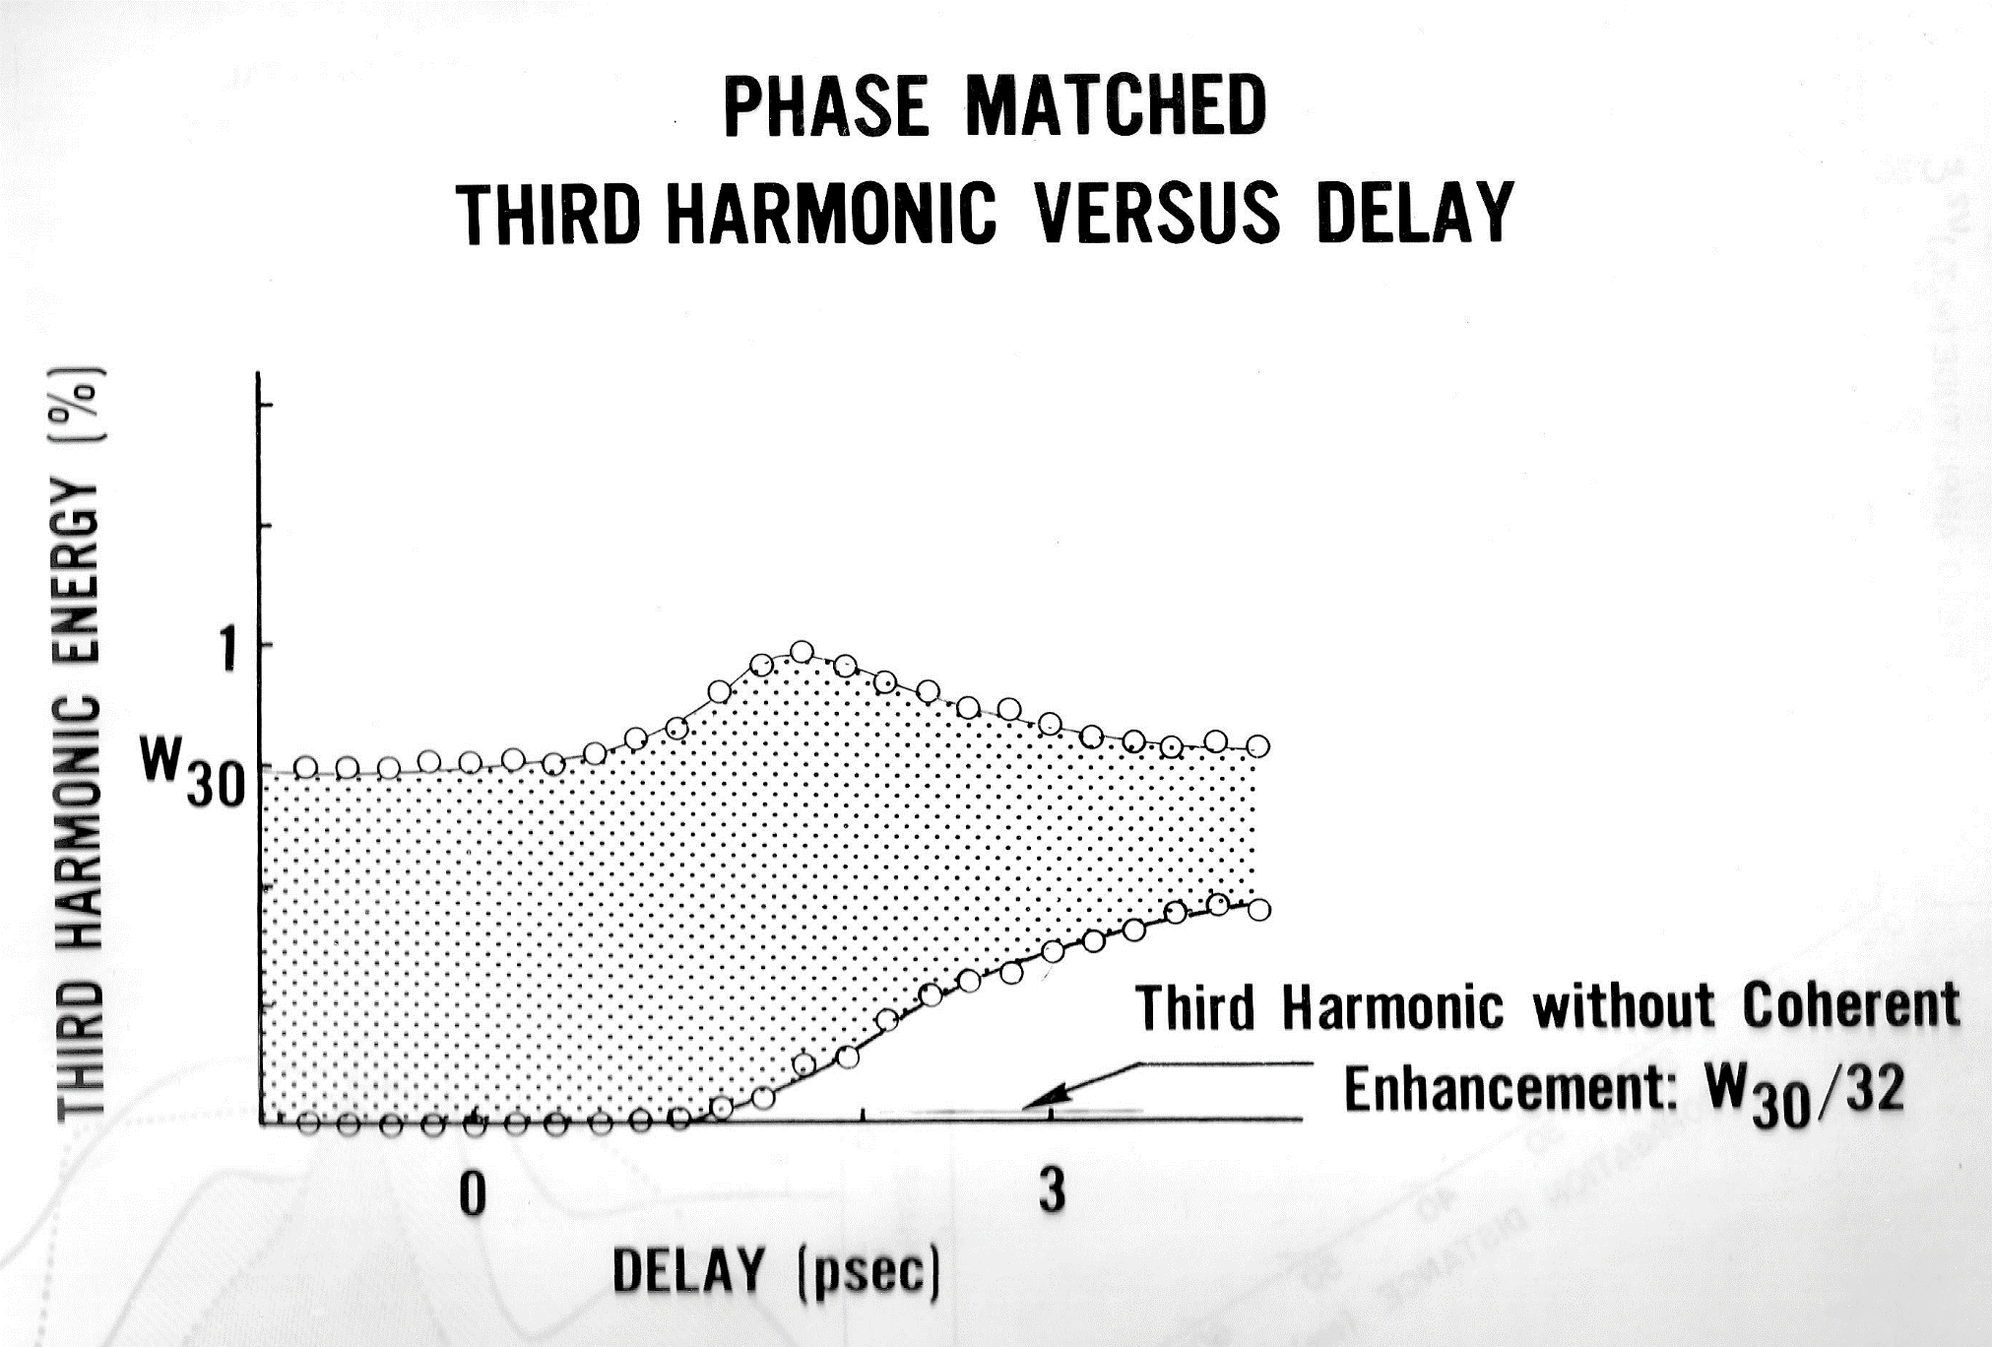

Slide 35
OTHER EXAMPLE OF APPLICATION OF COHERENT INTERACTION:

Slide 36
Bloch vector model
Contained in these expressions: Third order susceptibility, two-photon absorption,
third harmonic generation, stimulated Raman, phase conjugated FWM, etc...
The frequencies do no appear explicitly in these expressions.
But they can be “guessed” from the products of amplitudes.

Slide 37
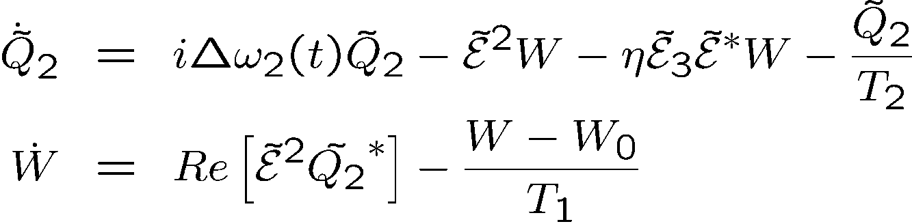
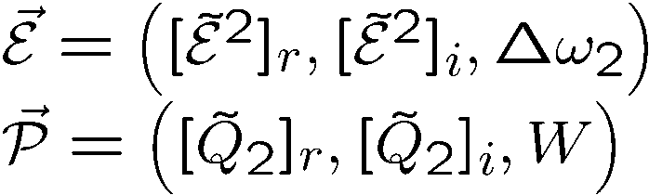
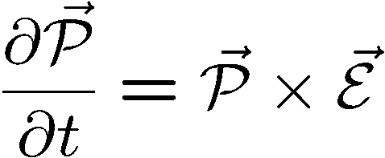
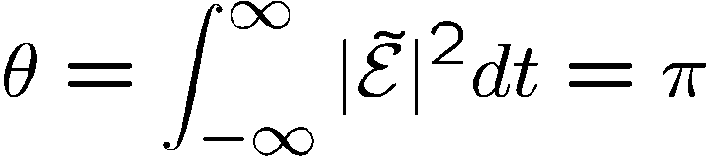



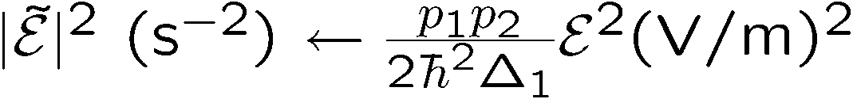




Two-photon absorption and optical pumping
W
Purpose: create a two photon population inversion
As before:
i
But we need to be ON resonance
r
Adiabatic approximation breaks down!

Slide 38
Two-photon absorption and optical pumping
Alternate to pi pulse pumping:
W
i
r

Slide 39
ON RESONANCE two photon absorption
OFF RESONANCE Kerr effect
(Kramers-Kroenig)

Slide 40
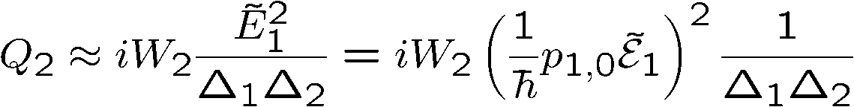
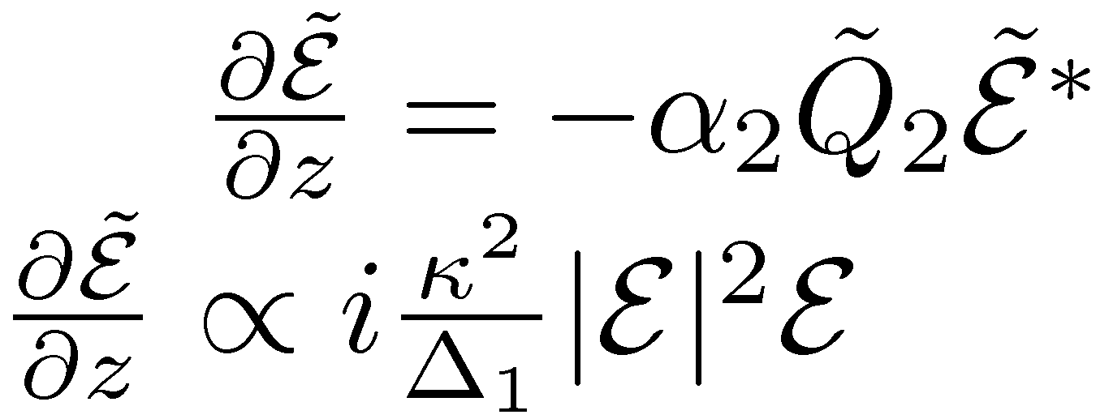
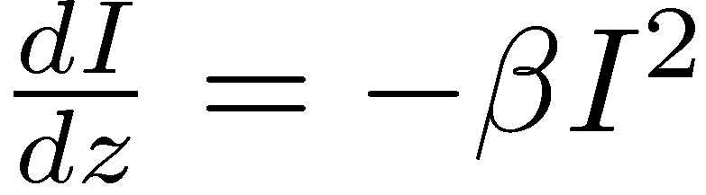
OFF RESONANCE? (Kramers-Kroenig)
Propagation:
Two photon absorption – two photon pumping

Slide 41

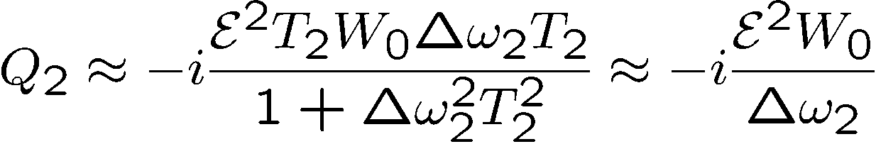
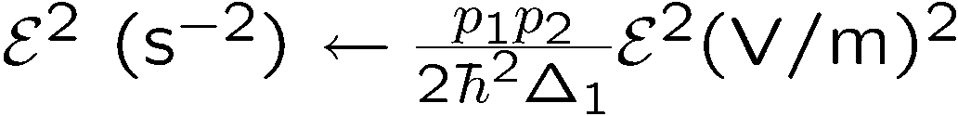





Two-photon Bloch’s equations, far off resonance
Small signal, steady state:
W
i
Third order susceptibility
Degenerate Four Wave Mixing
Phase conjugation
Nonlinear index of refraction
r
Effects enhanced by an intermediate resonance.

Slide 42

Two-photon Bloch’s equations
If a third harmonic is generated,
Raman excitation of the
transition (phase matching)
i
is the amplitude of an ``excitation’’ at
Its value cannot exceed the radius of the sphere
(full excitation of all atoms in phase)
r
is the amplitude of an ``excitation’’ at

Slide 43


Two-photon Bloch’s equations, to conventional 3rd harmonic
W
Small signal, steady state:
i
r

Slide 44

DEGENATE FOUR WAVE MIXING
Single photon resonance: what to expect

Slide 45


Two-photon absorption and DFWM
W
i
r

Slide 46






Two-photon absorption and DFWM
Exciting pulse:
G
FWHM = 76 fs = 1.72 τ
A
D
Delay
(units of FWHM of intensity autocorrelation)

Slide 47
OTHER EXAMPLE OF APPLICATION OF COHERENT INTERACTION:
THE BICHROMATIC GUIDESTAR

Slide 48

Example of application:
2 photon coherent excitation
of Sodium
Which we approximate by
2
1
0

Slide 49
Bichromatic Two-Photon Coherent Excitation
Closer to reality!
Excitation
Decay
demonstrated that it was possible to put 98% of the sodium atoms into the 4S state either with a single bichromatic pulse or with a sequence (90⁰ shifted pulse sequence) of two bichromatic pulses.

Slide 50
MOTIVATION
“Light travels undisturbed for
billions of years - only to get its
wavefront distorted in the last
few milliseconds”
What are the solutions to
atmospheric distortions?

Slide 51

1st solution:
Send an observer into space
…they selected Mr. Hubble

Slide 52
2nd solution:
Correct for the atmosphere
But how?
a)
Choose/create a point source within
2 arcsec of the object to be observed.
b)
Correct the telescope to minimize the
size of the image of the point source.

Slide 53
Example of application:
2 photon coherent excitation
of Sodium
Which we approximate by
2
1
0

Slide 54

1st approach: off-resonance zero area pulse excitation
now

Slide 55
1st approach: off-resonance zero area pulse excitation
now

Slide 56
1st approach: off-resonance zero area pulse excitation
now

Slide 57

GENTLE CRITICISM FROM PETER MILONNI:
The level structure is not this:
But this:
Excitation
Decay

Slide 58
1st approach: off-resonance zero area pulse excitation
The purist will tell you that you have to include the full hyperfine structure

Slide 59
1st approach: off-resonance zero area pulse excitation
The result of listening to the purist:
Δt = 650 ps
F₅₈₉ = .90 μJ/cm²
τ = 100 ps
F₁₁₄₀ = 2.2 μJ/cm²
Δ₁ = 14.6 GHz
Δ₂ = 2.39 GHz

Slide 60


Second approach: the two-photon “pi pulse”
τ=10 ps, 4.58 μJ/cm² (each)
Δ₁ = 1.91 GHz and Δ₂ = 2.39 GHz.

Slide 61

Including the complete hyperfine structure of the sodium atom, thereby increasing the size of the system of coupled partial differential equations from 3 to 112, gives a nearly identical result as the 3-level model.
Level populations
ρ₁₁ –level
ρ₂₂ –mid
ρ₃₃ –upper
A 90⁰ phase shifted sequence of two 100 ps pulses separated by 650 ps, fluence of 0.9 J/cm² with detunings of Δ =14.6 GHz near 589 nm, fluence of 2.2 J/cm² at 1140 nm with detunings of Δ =2.4 GHz.

Slide 62
Other Excitation Schemes
Excitation
Return
resonant two-photon
polychromatic
Foy et.al.
cw: > 10 kW, pulsed > 250 W
coherent non-res. two-photon
polychromatic
Biegert et.al.
pulsed > 400 mW

Slide 63
LABORATORY DEMONSTRATION
Based on Nd:YAG pumped OPO; 10 ps pulse duration.
(ideal pulse duration would be 800 ps)
PROCEDURE
Tune yellow at resonance;
adjust energy to reach max fluorescence; increase to 0 fluorescence.
Combine with increasing power and tuning 1140 to reach again max fluorescence
Compare photon yield IR and yellow – they should be equal
Single emission decay time – convolution of the two emission lifetimes
Fluorescence photon yield:
4s 3p:
3p 3s:
They are equal confirms cascade decay

Slide 64


Pulsed versus CW excitation
Pulse duration: 800 ps
Yellow pulse energy density 34 nJ/cm²
IR (1140 nm) pulse energy density 84 nJ/cm²
For a spot size of 120 cm diameter at the sodium layer, of density 5 10⁹ atoms/cm3,
the energy required per pulse is:
Yellow: 770 μJ
1140 nm: 1890 μJ
Photon return/pulse
Experiment and theory have established that a total inversion can be realized,
Number of photons emitted/pulse pair:
Number of photons collected by a 3 m telescope:
is the solid angle.
0.11 photons/cm² return per bichromatic pulse.
Note: Because a complete inversion is created, one can use a beam diameter (w = 20 cm?) than in the cw irradiation, hence reducing the energy required per pulse.

Slide 65
Pulsed versus CW excitation
0.11 photons/cm² return per bichromatic pulse.
Comparison made for 20W yellow (repetition rate of pulsed 25 kHz), which yields a photon return of 2,900 photons/(cm² s) for pulsed bichromatic excitation.
CW excitation using the same parameters: 660 photons/(cm² s) (details next slide)
For the same average power of 20 W, the bichromatic pulses give a larger
photon return by a factor 2,870/660 = 4.3.
Note: Both results may require a directional factor of 1.5 used in most theories.

Slide 66



CW excitation using the same parameters for sodium

