Slide 1
SUPERPOSITION OF WAVES
Plane waves
Spherical waves
Superposition

Slide 2
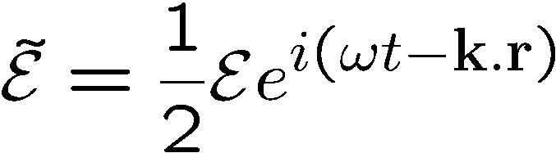
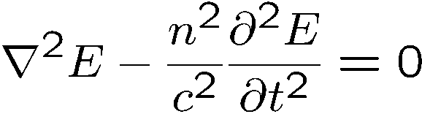
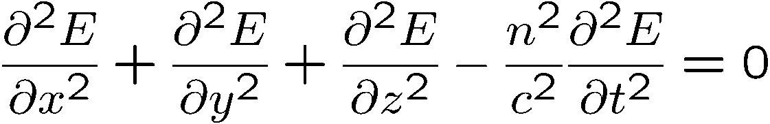
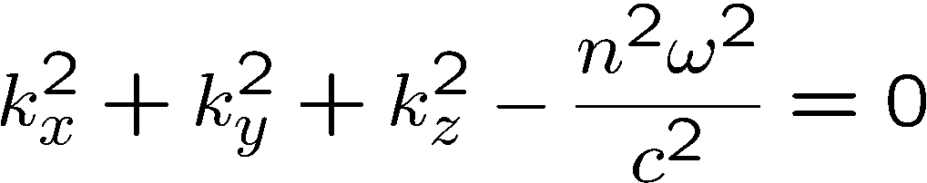
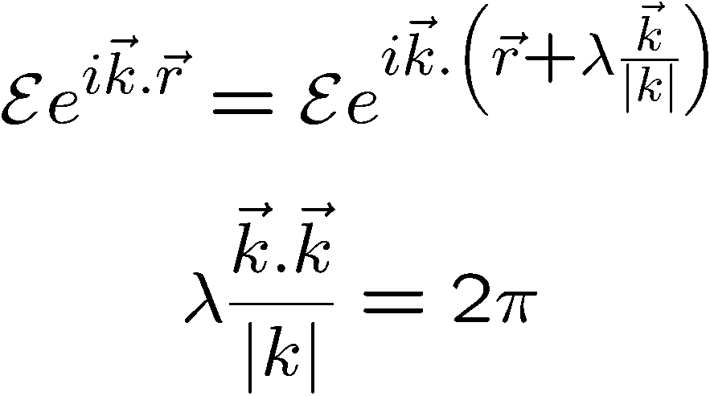
Plane waves
Solution of:
Substitute:
Surfaces of constant phase perpendicular to the vector k
Relation between k and λ
At t = cst, the field repeats itself
after λ

Slide 3
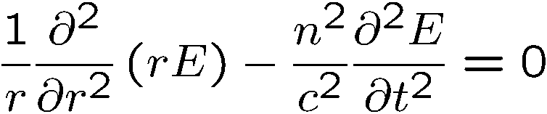
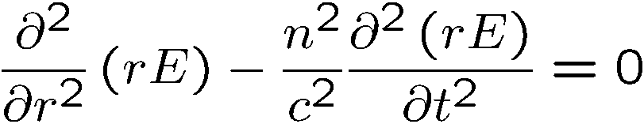
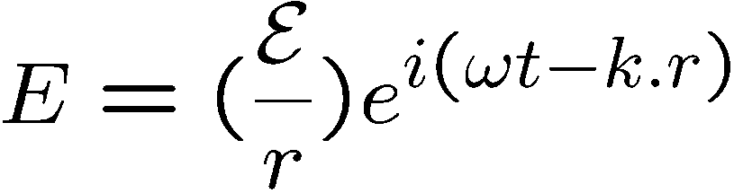
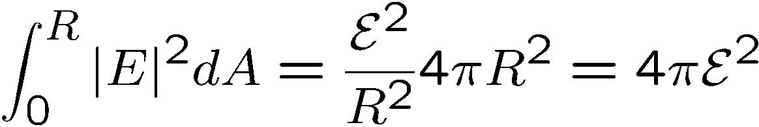
2. Spherical waves
Wave equation:
Write in spherical coordinates, assuming spherical symmetry:
c
c
Conservation of energy

Slide 4
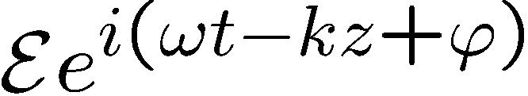
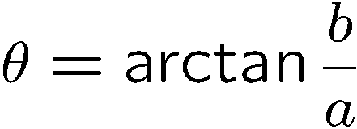
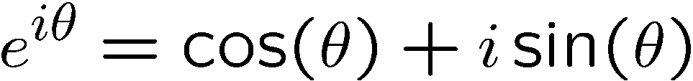
Making Waves: waves add like complex numbers
Complex number
Im
Z = a + i b
a = Re (z)
b = Im (z)
Z* = a - i b
b
z
θ
Re
a
Add and subtract exponentials and trigonometric functions
Plane waves, spherical waves

Slide 5

SUPERPOSITION OF WAVES
Waves of the same k vector,same frequency
Waves of the same k vector, different frequencies
Beat note
Creation of an arbitrary
Group velocity
Waves mixing (AOM)
Waves of different k vector, same frequency
Counter-propagating waves
Co-propagating, random phase
Intersecting waves

Slide 6
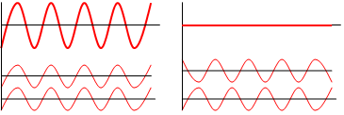
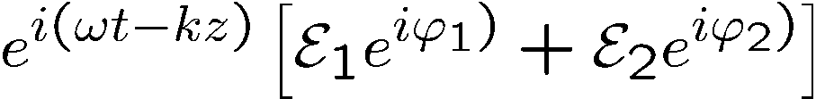
Waves of the same k vector,same frequency
Constructive and destructive
Constructive and destructive
y
Superposition
is just like adding two
vectors ,
x

Slide 7
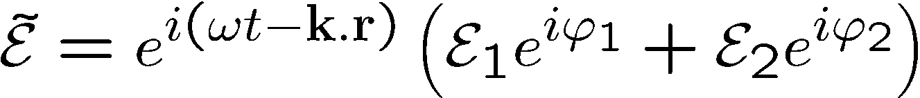





Interferences
Waves of the same k vector, same frequency
Constructive and destructive
constructive
destructive
Superposition
is just like adding two
vectors ,

Slide 8
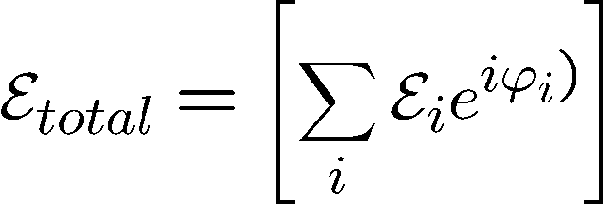
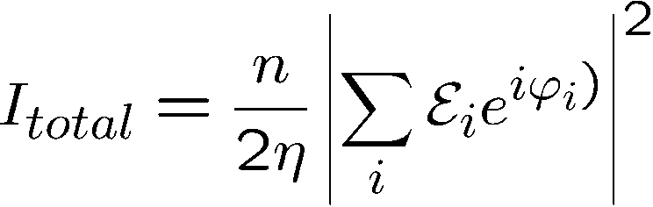



Coherent source
Incoherent source

Slide 9
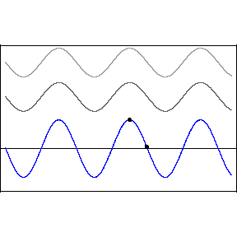
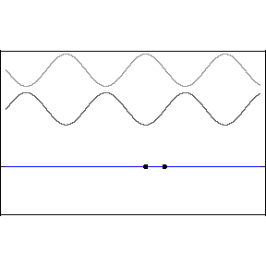
Waves of the different k vector magnitude, same frequencies
Two sine waves traveling in the same direction
Two sine waves traveling in opposite directions
“standing wave”

Slide 10









Waves of the same k vector, same frequency
Energy conservation
If the energy is lost by destructive interference, it has to reappear somewhere else
by constructive interference
A beam splitter is an element with a complex reflection coefficient
and a complex transmission coefficient
Energy conservation:

Slide 11
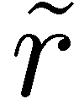
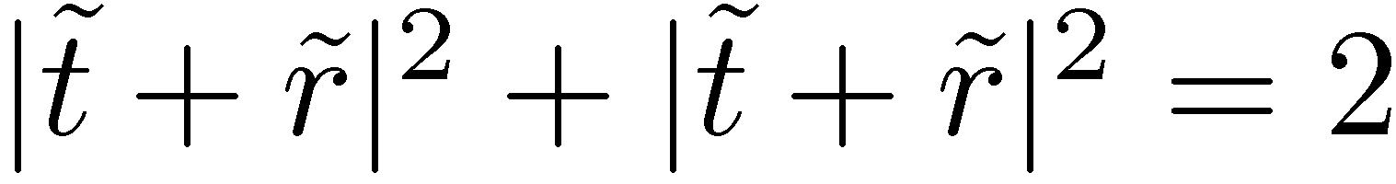
’
’
+
Example: check the asymmetric Fabry-Perot:

Slide 12








Waves of the same k vector, same frequency
Energy conservation
Mach Zehnder:
Michelson

Slide 13
SUPERPOSITION OF WAVES
Waves of (nearly) the same k vector, same frequency:
Fresnel biprism
Given the angle, what is the fringe spacing?
How to determine the angle of the biprism?

Slide 14
SUPERPOSITION OF WAVES
y
Waves of (nearly) the same k vector, same frequency:
Young’s double-slit experiment
P
S₁
S₂
Young’double-slit as a spectrometer: to each λ corresponds an angle θ,

Slide 15
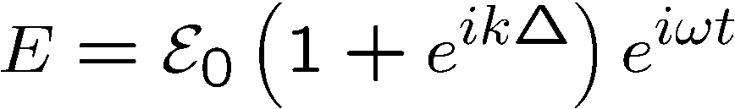
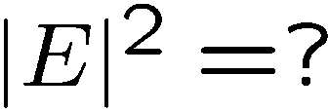
Young’s double slit
Shape of the interferences:
How far do the interference fringes extend?
Fringe visibility
Transverse coherence of a beam

Slide 16
DOPPLER EFFECT
Applies to all waves – not only light waves.

Slide 17
The Doppler effect
Who is Mr. Doppler?
Doppler was born in Lviv, Ukraine in 1821. At that time it was not part of the Russian empire, but the Austrian Empire), now At the age of 18 Franz was the first flautist at the opera in Budapest, and he went on to be the first flautist and stand-in conductor, and eventually chief conductor, of the Vienna Court Opera, as well as acquiring a position of Professor of Flute at the Vienna Conservatoire from 1864 until 1867. He died in Baden bei Wien, Austria in 1883.
Christian Doppler was born Salsburg, Austria, in 1803. He graduating at the age of 26 from the University of Vienna.
He published at 39 the “Doppler effect”. Died in 1853 in Venice.
"Über das farbige Licht der Doppelsterne und einiger anderer Gestirne des Himmels"
Rather dry… (he was a mathematican)

Slide 18

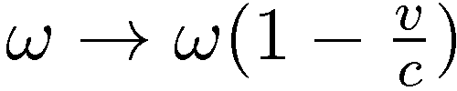

Wave propagation
Doppler shift
What if the receiver is moving:
Emitter
T
Time t
z₀
Receiver
z
z = c t

Slide 19
Wave propagation
Doppler shift
What if the receiver is moving:
"Über das farbige Licht der Doppelsterne und einiger anderer Gestirne des Himmels"
1842 – 14 pages!

Slide 20
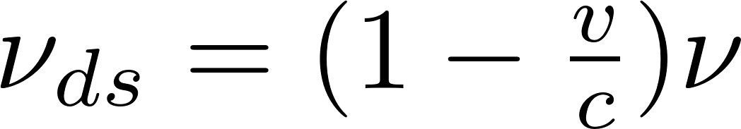
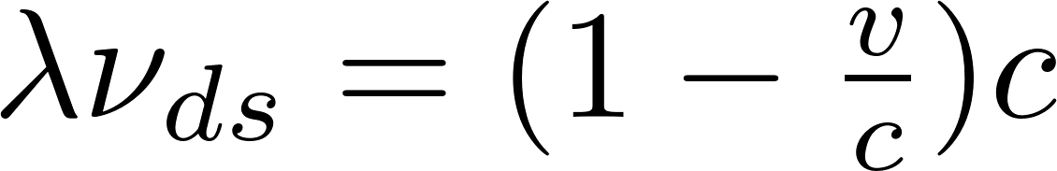
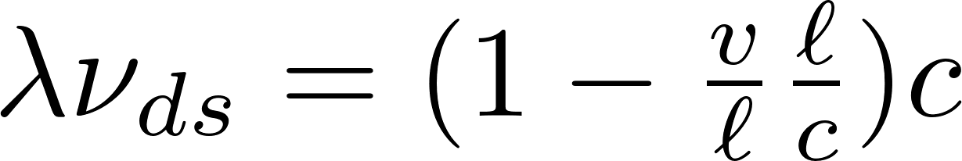
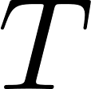
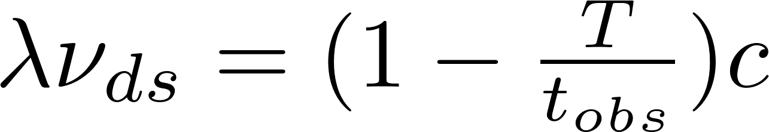
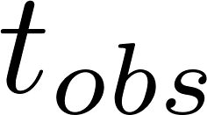
The Doppler derivation of Doppler
Notations!!!
= time needed to move by a wavelength
time for the observer to move by a wavelength

Slide 21
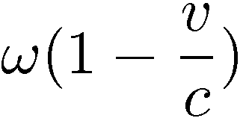
Doppler Shift
Wave propagating to the right
ω frequency of the wave
Frequency experienced by the duckling:
c velocity of the wave
v velocity of the duckling

Slide 22
Wave propagation
What if the receiver is moving:
ω frequency of the wave
c velocity of the wave
v velocity of the duckling

Slide 23
Wave propagation
What if the receiver is moving:
ω frequency of the wave
c velocity of the wave
v velocity of the duckling

Slide 24
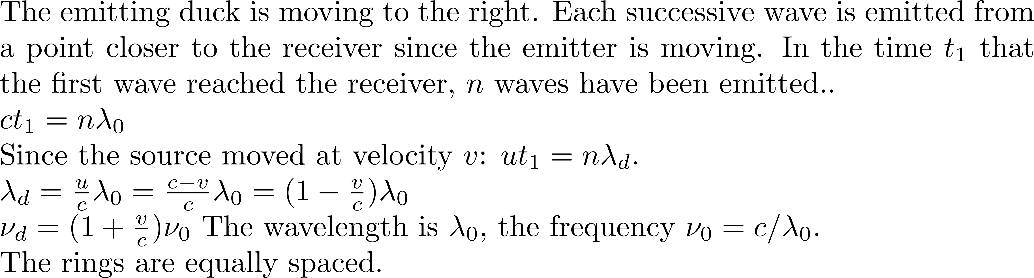
u
v
c

Slide 25




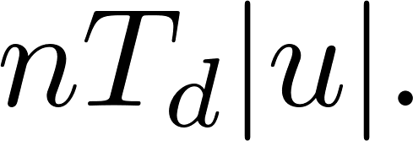
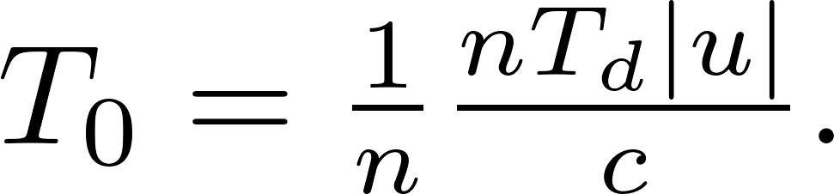

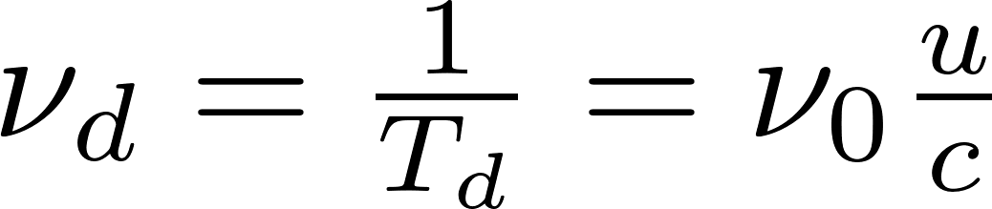
We are looking at n waves emitted by the source, over a time of n T_{0.}
Triangle of velocities:
Detector duck being hobbled at frequency
Distance between emitter and
Wave emitting duck moving at velocity emitting frequency
receiver
u
c
Time intervals between waves

Slide 26
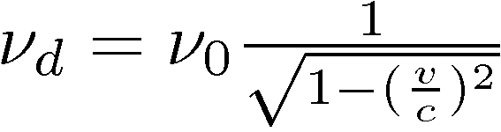
MORE ON DOPPLER
WHY?
1) It is simple (“Blessed the feeble minded…”)
2) A good illustration of: “there is more than one way to look at things”
3) It can be confusing!!!
There is a transverse Doppler shift:
for the duck
There is a transverse Doppler shift (relativistic) for light
???????????????????????????????????

Slide 27
Transverse Doppler without relativity
Lorentz transformation
Transverse Doppler with relativity
Follow-up later:
Application of Doppler to laser gyroscope
Sagnac experiment
The ether
Michelson-Morley experiment: the speed of light is the same in a moving or fixed frame of reference!
Lorentz transformation
1892 – 1904: Lorentz transformation: space contraction and time dilatation

Slide 28
BACK TO LIGHT
REVIEW FROM YOUR FAVORITE TEXTBOOK:
LORENZ TRANSFORMATION
TIME DILATION

Slide 29
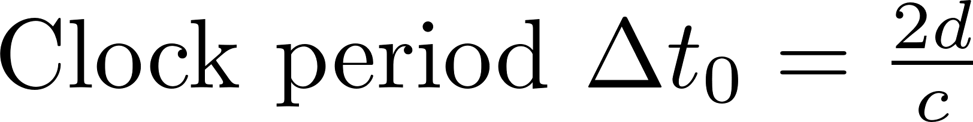
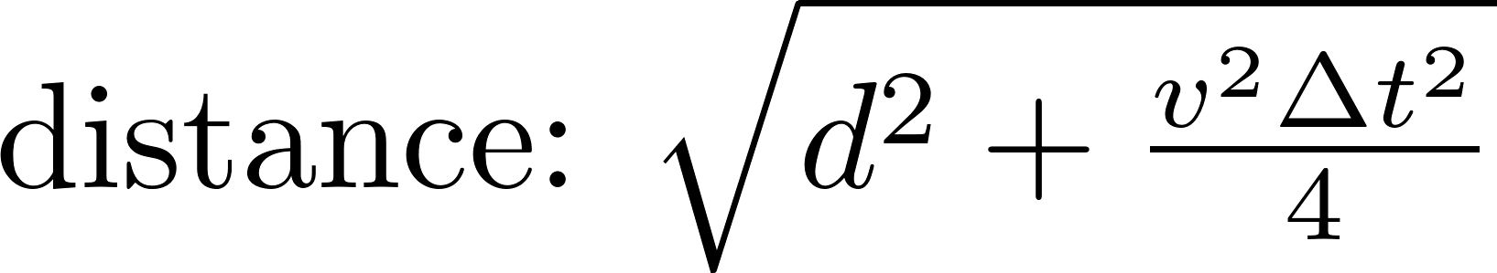
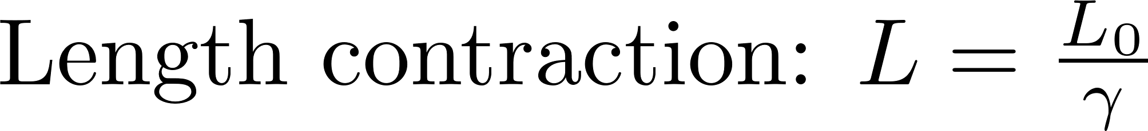
TIME DILATION
S
S’
v

Slide 30
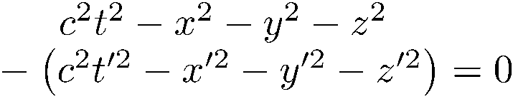
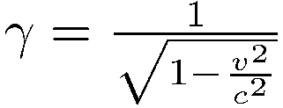
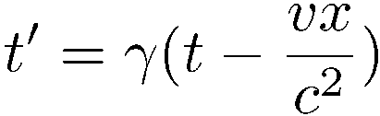



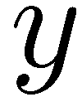



t
P(t,x)
t’
r
r’

Slide 31
t
t’
r
r’
If x = ct x’ = ct’
The speed of light is conserved in the moving frame.

Slide 32
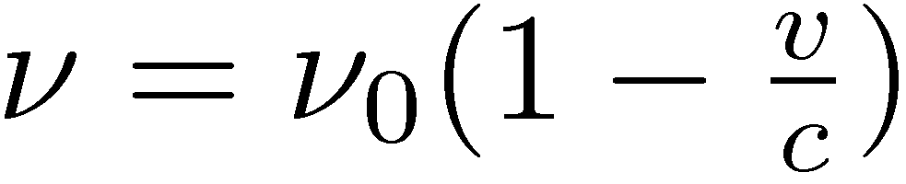
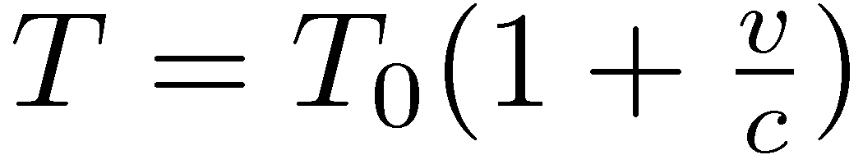
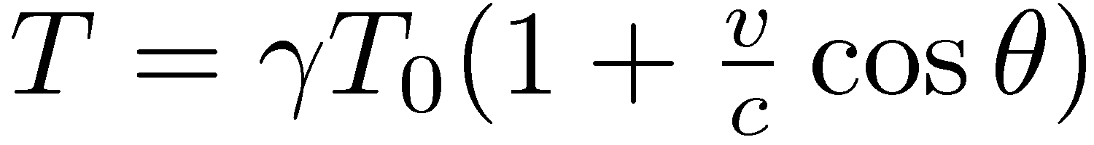
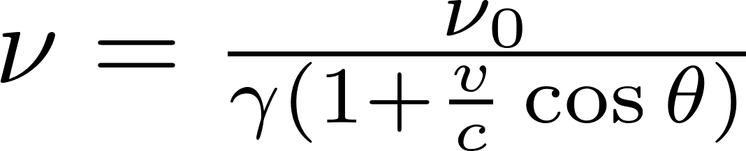

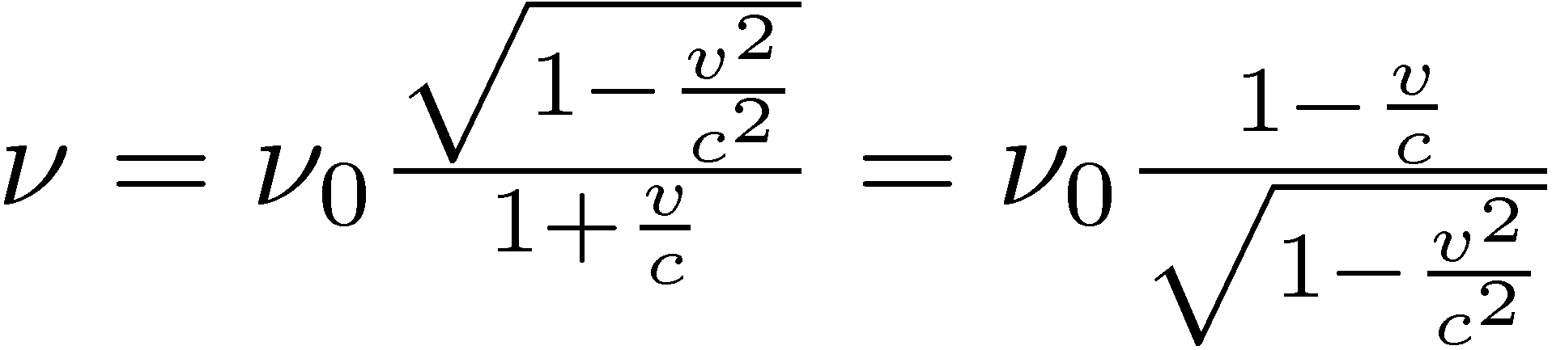
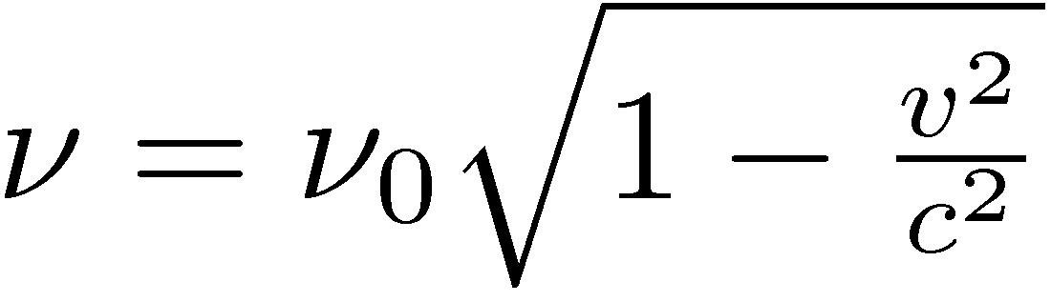
Lorentz transformation and transverse Doppler shift

Slide 33
Transverse Doppler without relativity
Lorentz transformation
Transverse Doppler with relativity
Follow-up later:
Application of Doppler to laser gyroscope
Sagnac experiment
The ether
Ether – particle wave duality - What characterizes laser light?

Slide 34
Ether – particle wave duality - What characterizes laser light?

Slide 35
First dilemma in early attempts to interpret light waves: what is moving?
Sound waves require a medium; they need matter to exist.
Hence was born the notion of the “ether", a (fictitious?) medium to support the propagation of light waves.
Today the “ether" has simply given way to vacuum.
Quantum mechanics tells us that the amplitude of the positive-negative charge oscillation is restricted to discrete values. Consequently, the emitted oscillation takes also discrete values, to which is associated an energy: the photon energy h, where the frequency of the oscillation, and h is called the “Planck constant“.
It is as if the duckling had discrete gears to activate his webbed feet.
What is more puzzling is that the “neutral" gear is missing. The minimum energy state of the quantum harmonic oscillator is not zero, but (1/2)h. This is often referred to as vacuum fluctuation or the zero point energy.
The absence of vacuum (the ether concept) has been replaced by an absence of zero energy. Since, according to Einstein, there is an equivalence of matter and energy, the two concepts are not so far apart.

