Slide 1

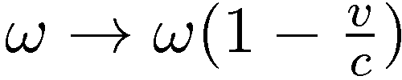
Wave propagation
What if the receiver is moving:
ω frequency of the wave
c velocity of the wave
v velocity of the duckling

Slide 2
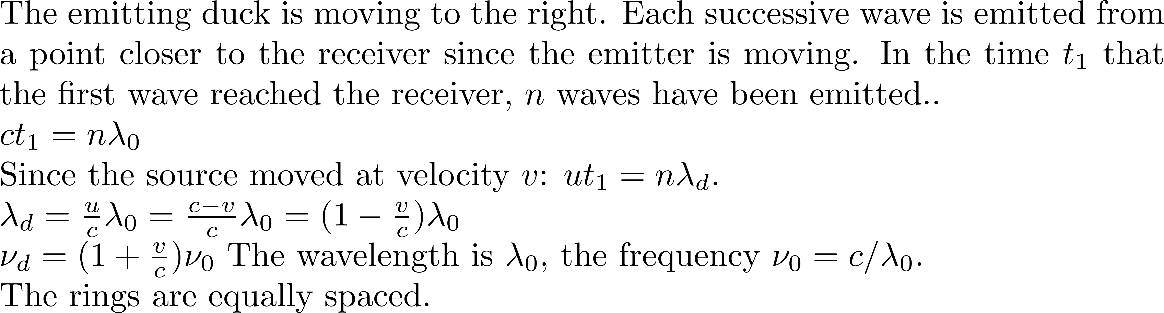
u
v
c

Slide 3





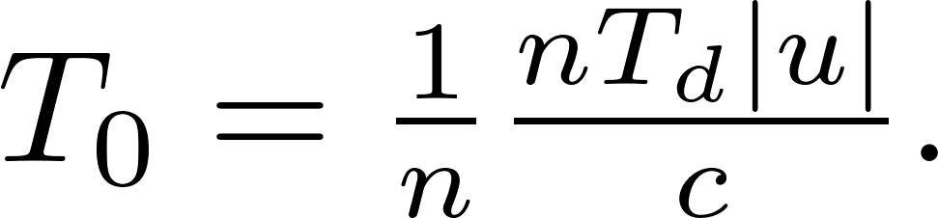

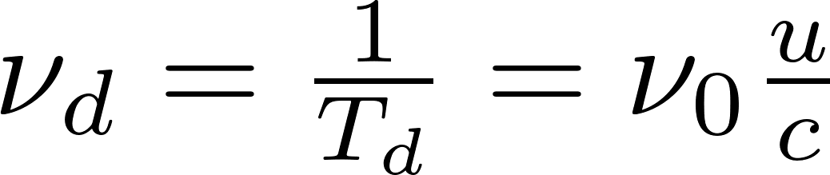
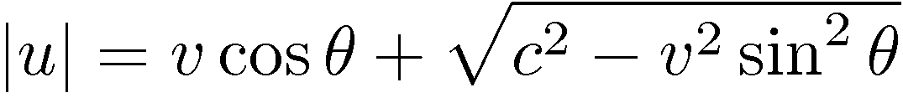
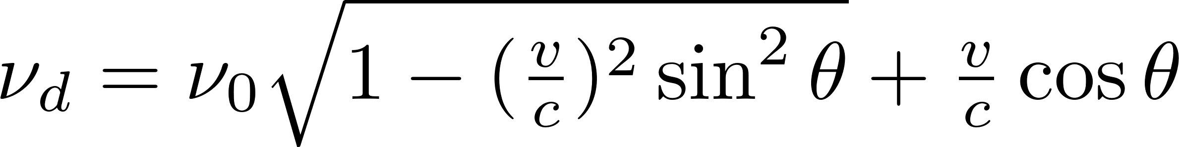
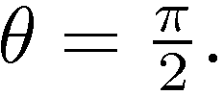
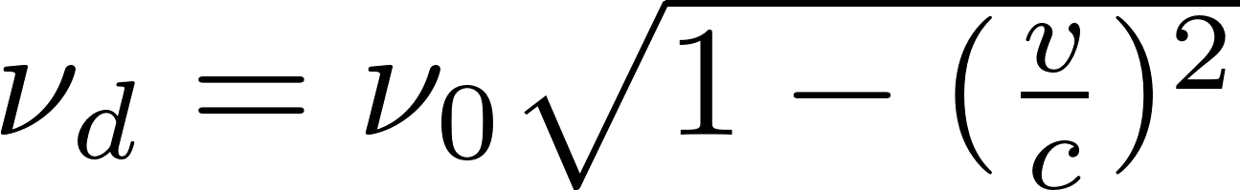
We are looking at n waves emitted by the source, over a time of n T_{0.}
Triangle of velocities:
Detector duck being hobbled at frequency
Distance between emitter and
Wave emitting duck moving at velocity emitting frequency
receiver
u
c
Time intervals between waves
There is a transverse Doppler shift:

Slide 4
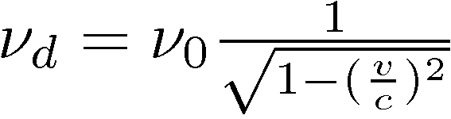
MORE ON DOPPLER
WHY?
1) It is simple (“Blessed the feeble minded…”)
2) A good illustration of: “there is more than one way to look at things”
3) It can be confusing!!!
There is a transverse Doppler shift:
for the duck
There is a transverse Doppler shift (relativistic) for light
???????????????????????????????????

Slide 5
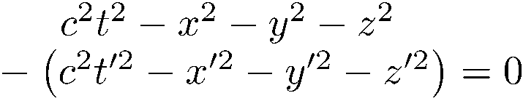
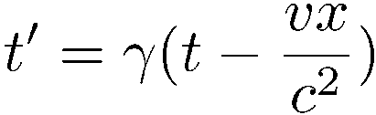
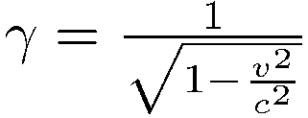

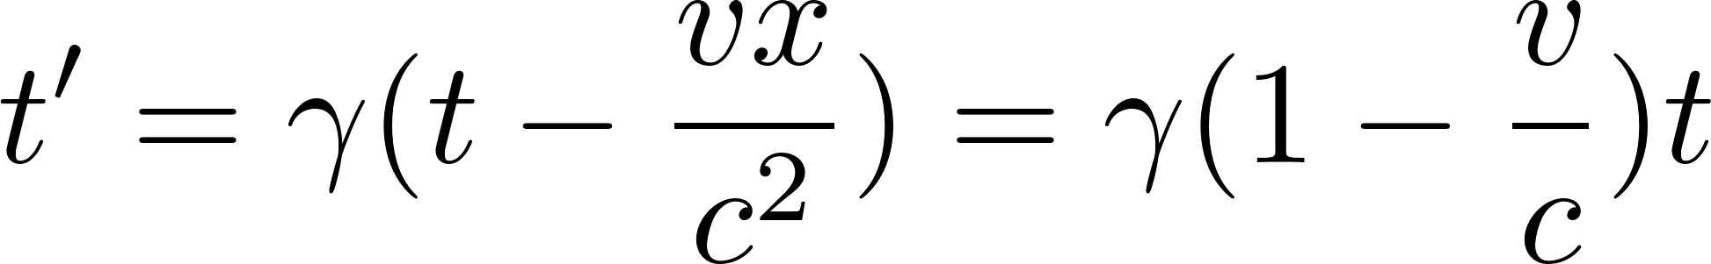
t
t’
r
r’
If x = ct x’ = ct’
The speed of light is conserved in the moving frame.

Slide 6
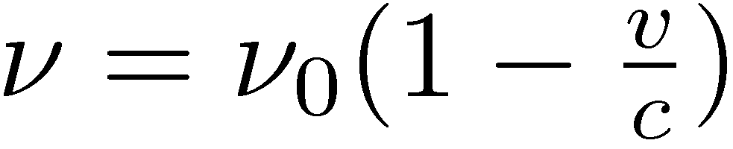
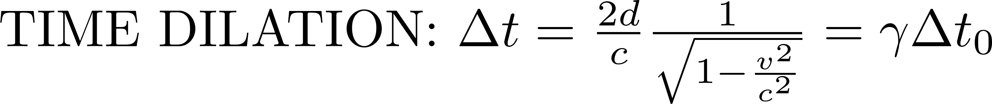
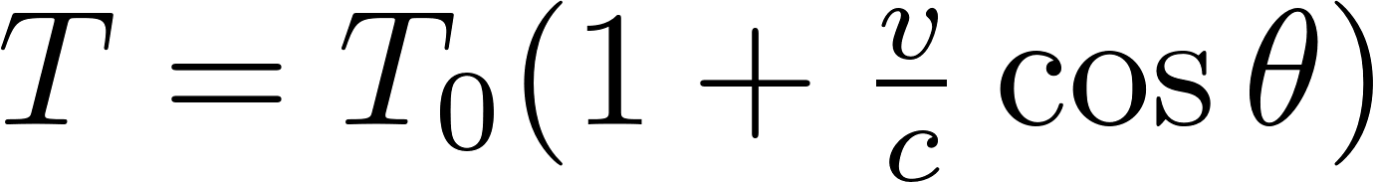
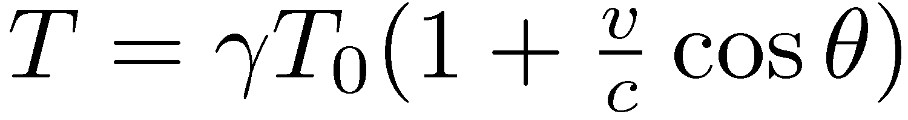
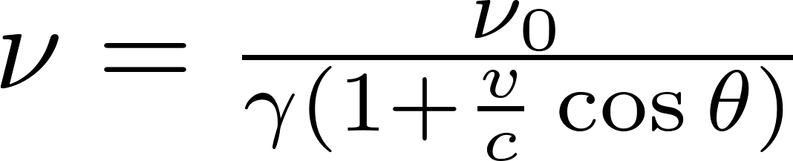

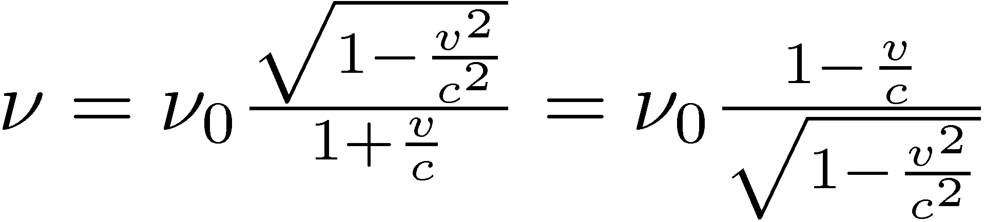
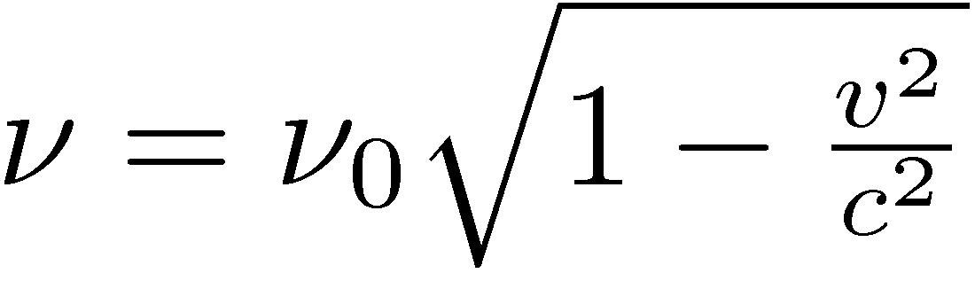
Lorentz transformation and transverse Doppler shift

Slide 7
Transverse Doppler without relativity
Lorentz transformation
Transverse Doppler with relativity
Follow-up later:
Application of Doppler to laser gyroscope
Sagnac experiment
The ether
Ether – particle wave duality - What characterizes laser light?

Slide 8
Ether – particle wave duality - What characterizes laser light?

Slide 9
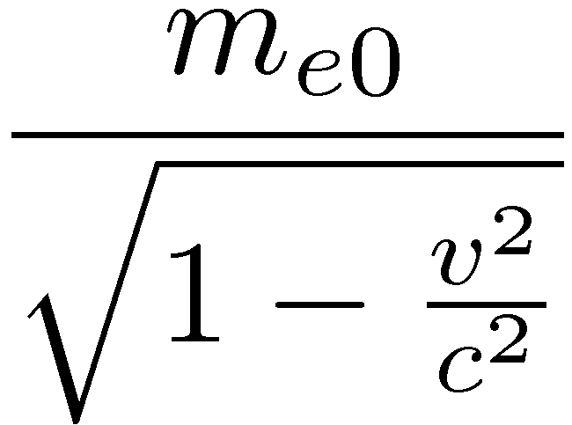
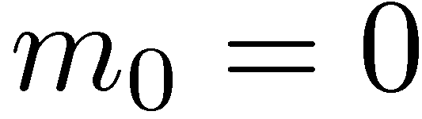
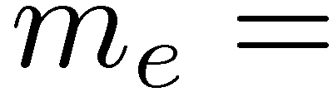

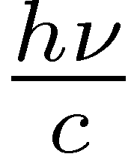

PARTICLE-WAVE DUALITY
Electron
Photon
Energy hν
Frequency ν
“Size”?
λ = c/ν
momentum?
wave: each particle responsible for the wave motion stays
at the same average position,
just inducing the motion of the next particle.
(case of light wave in a dielectric)
Photon: no mass, but an angular momentum and a linear momentum

Slide 10
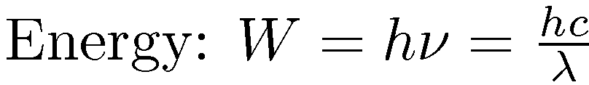
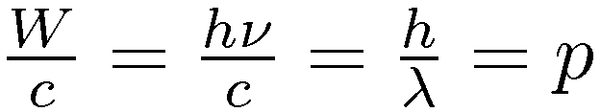
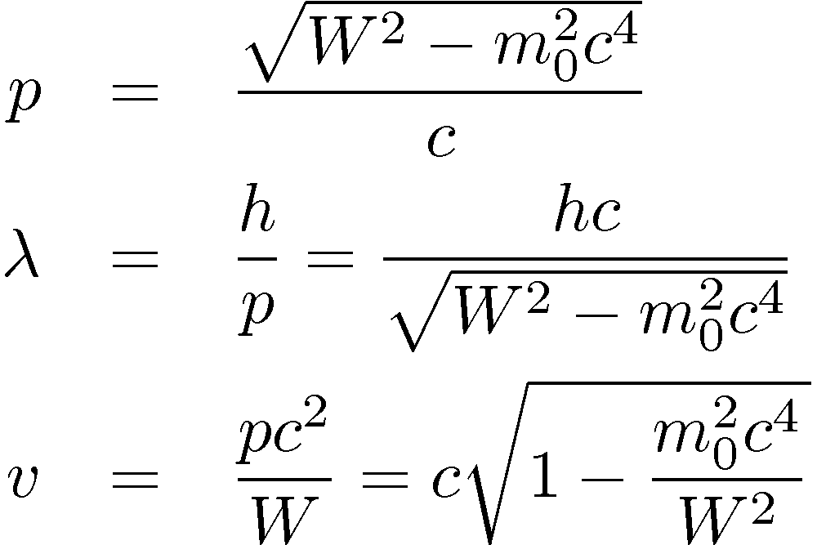
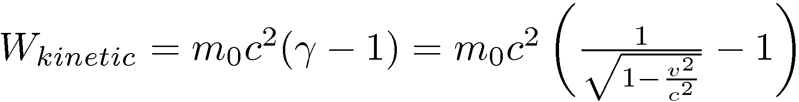


Momentum:
The photon is a particle that propagates at the speed of light. We have to use special relativity to describe a particle propagating at relativistic velocities, which defines momentum, particle wavelength and velocity as:
W is the sum of the rest energy m₀c² and the kinetic energy, which is now defined as:
There are two limits:
classical mechanics
photon which is only possible if m₀ = 0

Slide 11
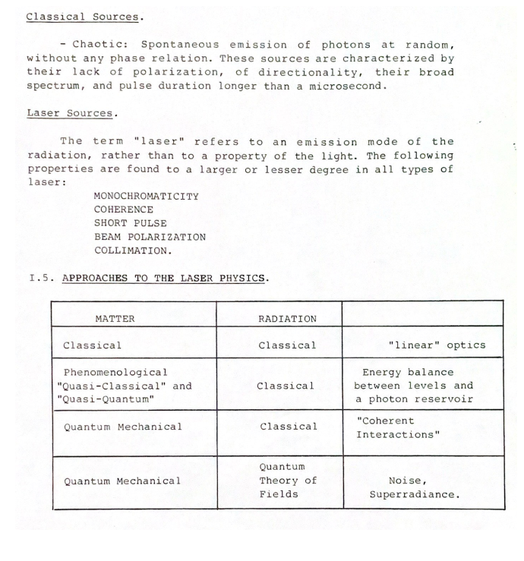
Putting “LASER” in context

Slide 12
Laser light – extreme range of properties.
Dynamic range for:
Wavelength
Time scales
Energies and power
Intensities
Radiation pressure
Coherence: a perfect sine or cosine that can be counted over 10¹⁵ cycles
Single photon at 1 micron, to PW pulses.

Slide 13
WHAT CHARACTERIZE LASER LIGHT?
Most of the background material in this course dates before 1960.
What has changed since 1960 is the dynamic range of the properties associated with coherent light
Dynamic range for:
Wavelength
Time scales
Energies and power
Intensities
Radiation pressure

Slide 14
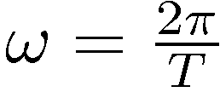
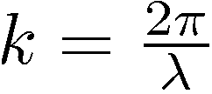
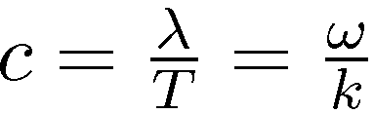
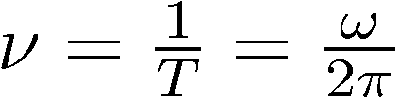
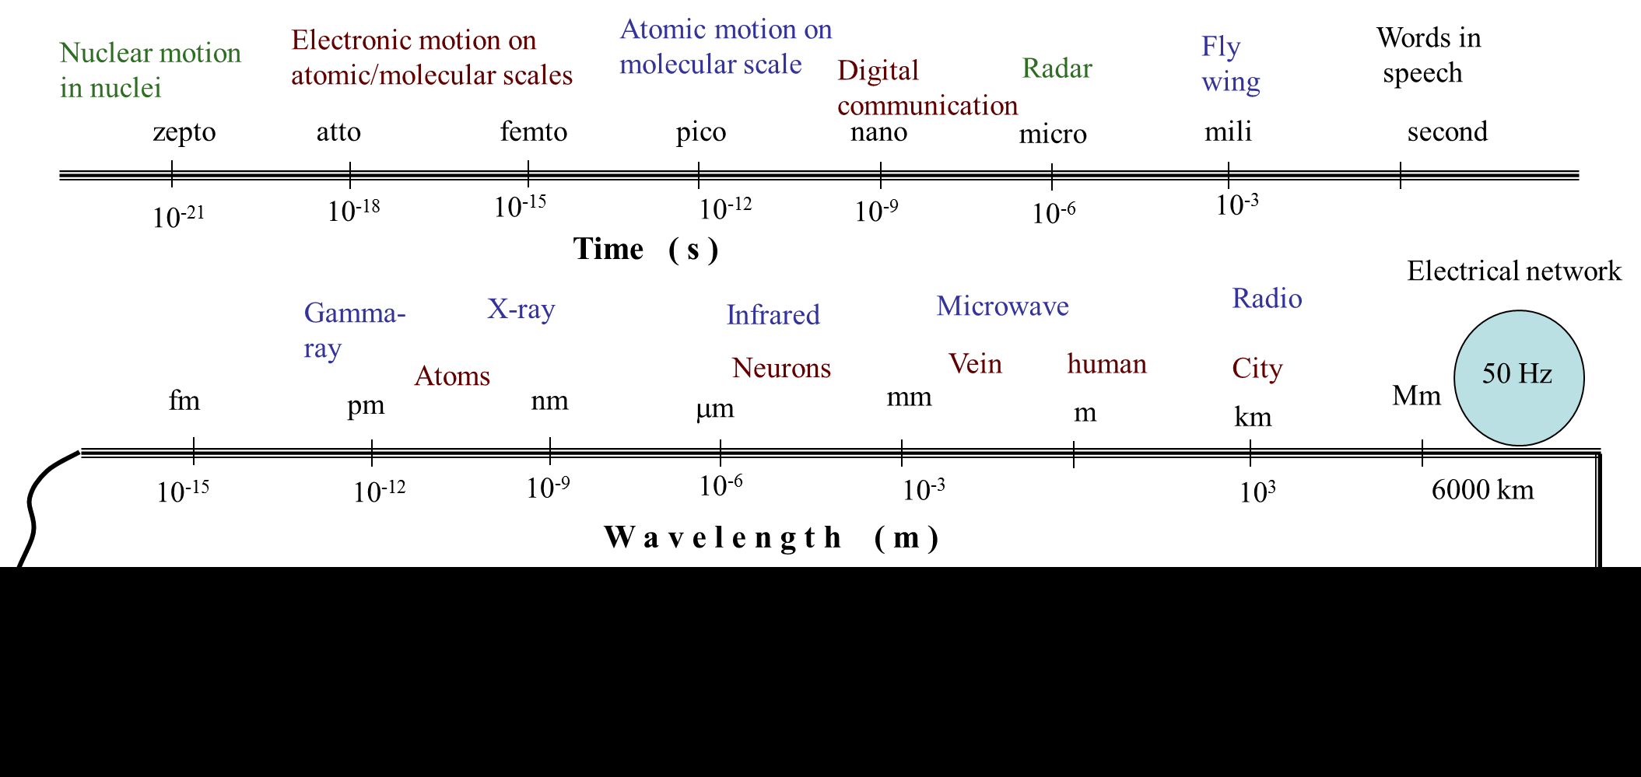
Dynamic range in wavelength, light period for laser light
Plane wave
Wave velocity:
T = period λ = wavelength
Light frequency (Hz):

Slide 15
Laser power (W) versus American power ($)
US deficit: 2 Tera$
US National debt 40 Tera$
US population 0.3 Giga
Biggest laser 20 PW
Kilo Mega Giga Tera Peta Exa Zetta Yotta
10³
10⁶
10⁹
10¹²
10¹⁵
10¹⁸
10²¹
10²⁴
For the relativist plasma physicist, high intensity means above 10¹⁸ W/cm², for one micron radiation. That intensity corresponds to an optical field strength the accelerates the electron to a speed at which the electron mass has increased by 50%.

Slide 16
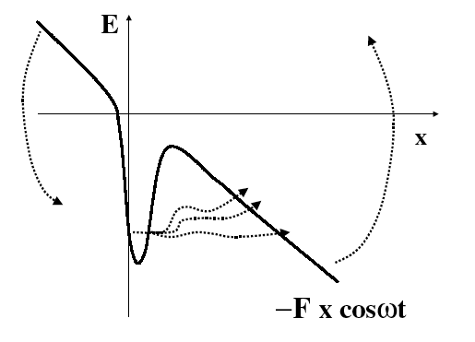
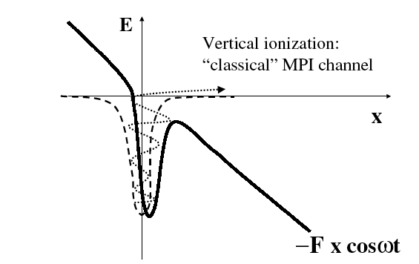
The perception of what is an “intense” laser pulse varies over a immense range.
For the medical user, a beam that burns the skin can be qualified as intense, and this requires no more than 10 or 100 W/cm2.
A chemist will consider high the intensity that will break a chemical bond, which can be in the range of MW/cm² to GW/cm².
Most power hungry are the physicists. At the lower end of the scale: multiphoton/tunneling
Multi Photon
Tunneling
Range: Terawatts to Petawatts.
-E
-E
-E
(d)
t
t
t
-
e
+
+
+
-
-
e
e

Slide 17
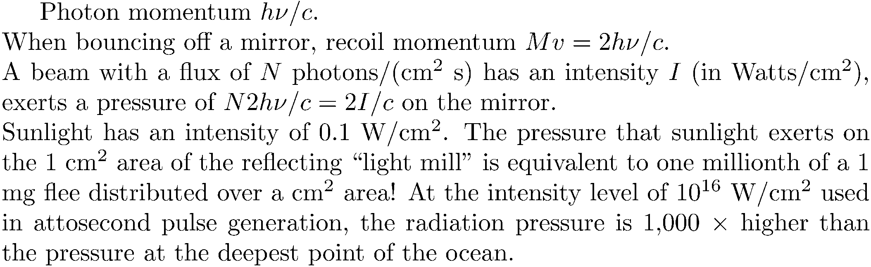
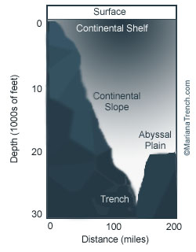
Range: Terawatts to Petawatts.
Light mill???
Mariana Trench:
1000 Bar

Slide 18
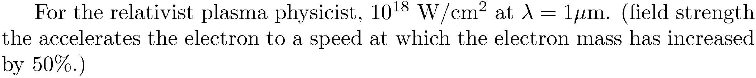
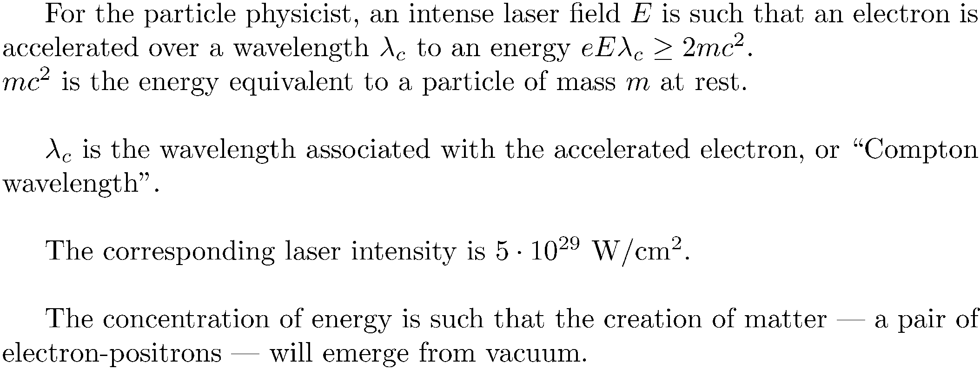
What means high intensity?
Today’s reach with the ELI in Roumania: 10²³ W/cm².

Slide 19
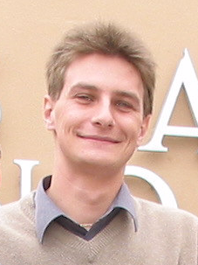
Kilo Mega Giga Tera Peta Exa Zetta Yotta
10³
10⁶
10⁹
10¹²
10¹⁵
10¹⁸
10²¹
10²⁴
For the relativist plasma physicist, high intensity means above 10¹⁸ W/cm², for one micron radiation. That intensity corresponds to an optical field strength the accelerates the electron to a speed at which the electron mass has increased by 50%.
ELI
Financed by the European union 850 Millions Euros project distributed over 3 countries:
Czech Repulic, Hungaria and Romania. The ELI-NP (Nuclear Physic) part in Romania requires a Laser able to deliver 2x100TW at 10Hz, 2x1PW at 1 Hz and 2x10PW at 1shot per minute. This makes this laser the most powerful laser in the world.
Budget: 310 MEuro
Olivier
Chalus
The US decided in 2019 to compete
with a grant of 10 M$ to U. of Michigan.

Slide 20
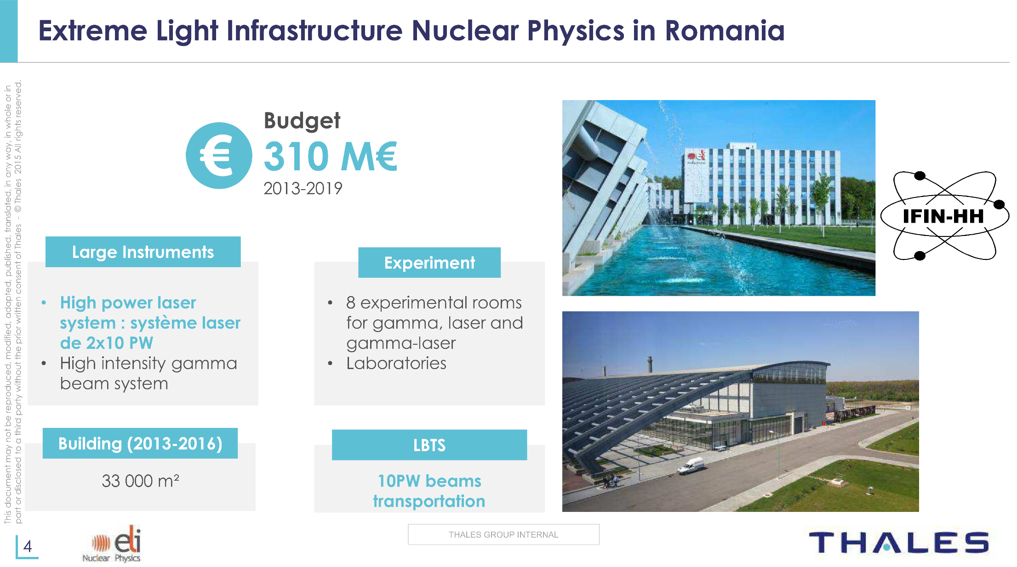
“Fraction” awarded to Thales: 130 Meu
Budget for the US “ELI” in Michigan: 10 Meu?

Slide 21
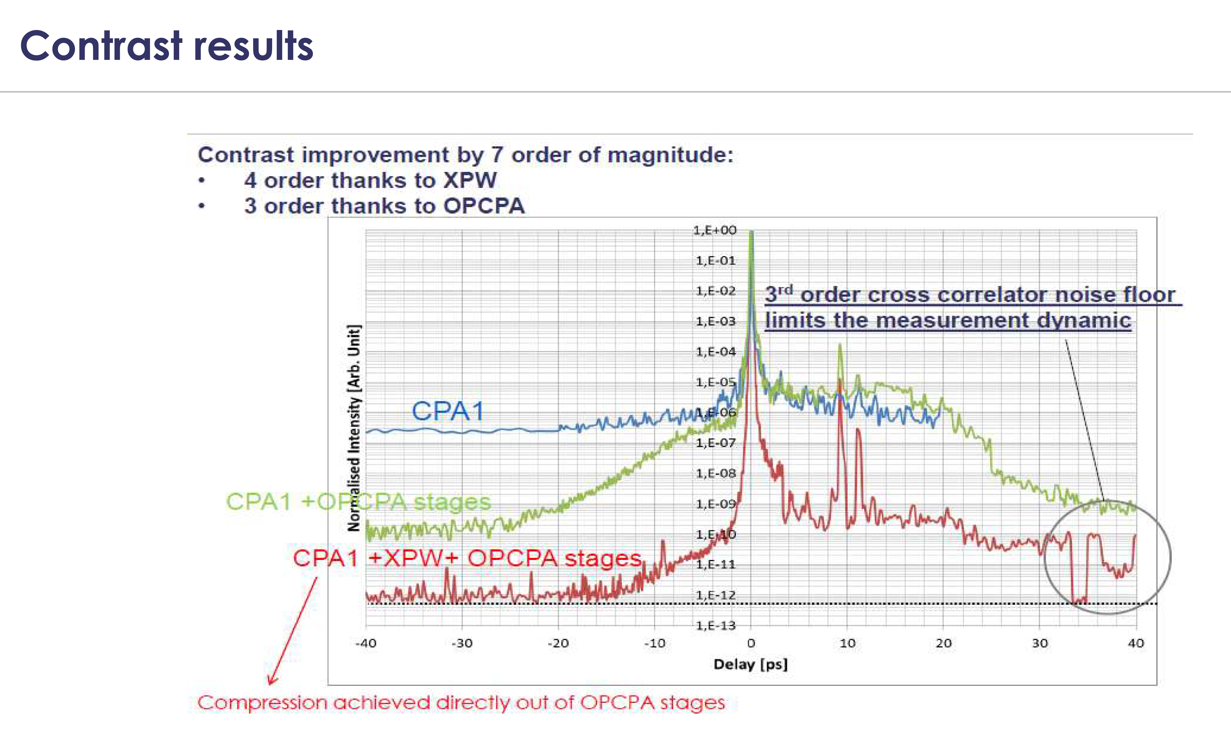

Slide 22
2 beams 10PW each, → 40 pW by coherent addition
300 J in 300 fs?
10 pW = 10¹⁶ W.
x30 FS = 3OO J
Focusing to w₀ = 5 μm → 8 10²² W/cm²
NEXT: POLARIZATION OF LASER LIGHT

Slide 23
POLARIZATION
Changed by a wave plate
Quarter wave to change from linear to circular
Half wave plate to turn linear 90 degrees
y
y
y
x
x
x
Quarter
wave
plate
E-field vector
Linear polarization
circular polarization

Slide 25
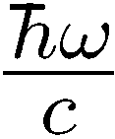

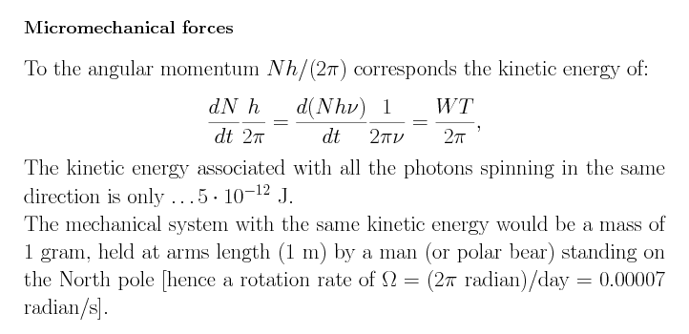
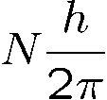




Photon momentum:
linear
angular (Spin):
“size” of photon?
SPIN ANGULAR MOMENTUM
Of light
Of light
Of light
Mechanical
Kinetic Energy
5 pJ
20 kW
Green beam
Circularly polarized laser
At ELI power of 40 PW?

Slide 26
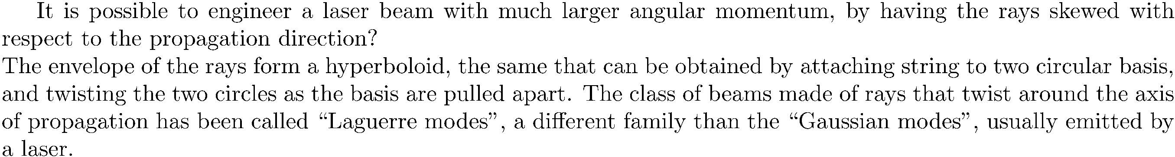
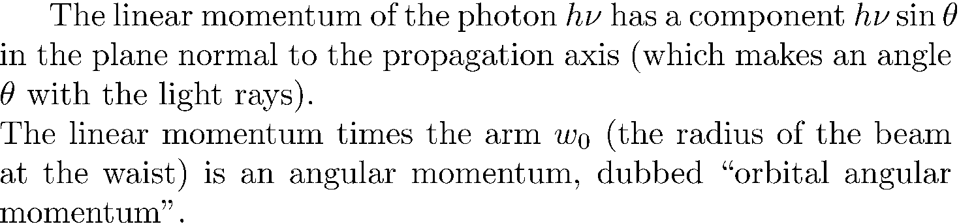


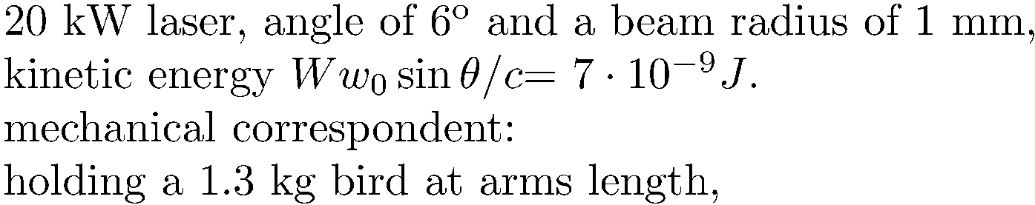
ORBITAL ANGULAR MOMENTUM
linear
angular (Spin):
“size” of photon?
Linear momentum
Kinetic energy

