Slide 1
HOW THE PHOTON ANGULAR MOMENTUM WAS MEASURED

Slide 2
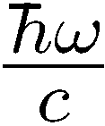

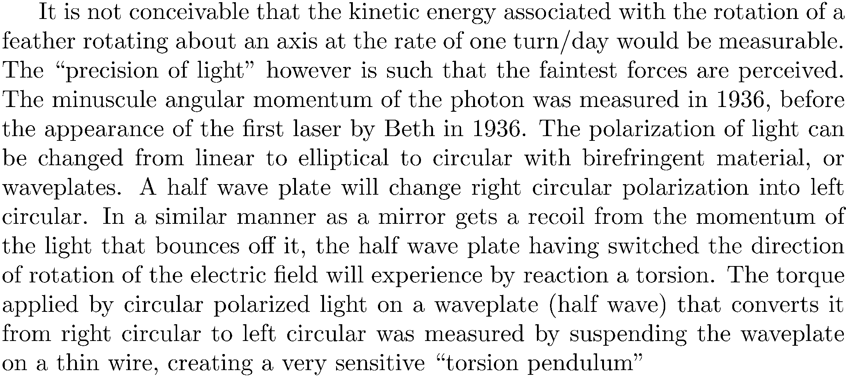
Photon momentum:
linear
angular (Spin):
“size” of photon?

Slide 3
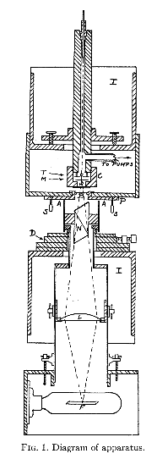
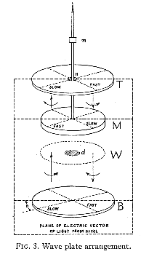
R.~A. Beth.
Mechanical detection and measurement of the angular momentum of light.
Physical Review, 50:115--125, 1936.
Quarter wave
+ reflector
left circular
left circular
Quartz halfwave plate suspended on fiber
Quartz window
Right circular
Right circular
Quarter wave
Linear polarization
Linear polarization

Slide 4
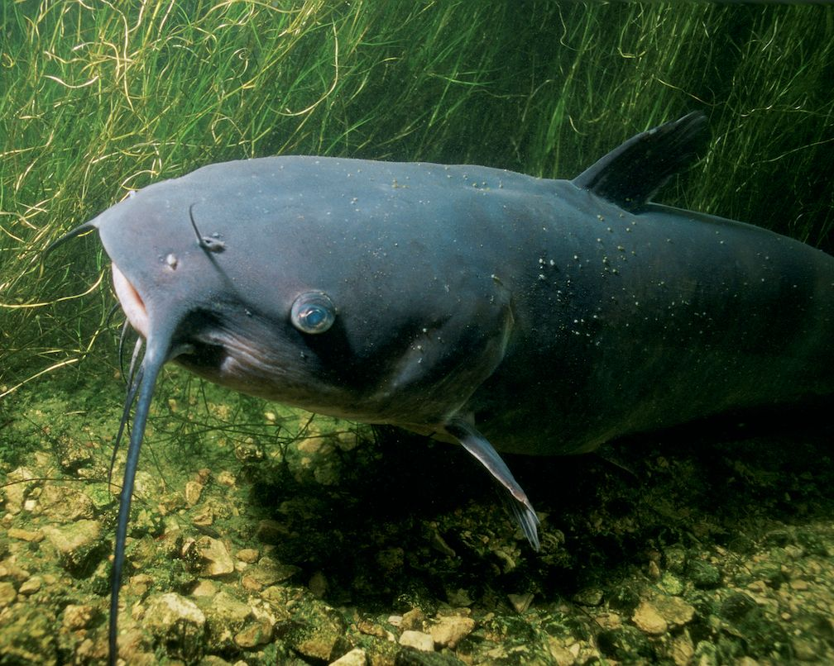
Back to Doppler shift, ether and Lorentz transformation
The laser gyro: there is more than one way to skin a cat
According to an American source, the “cat” referred to would be a Mississippi catfish

Slide 5


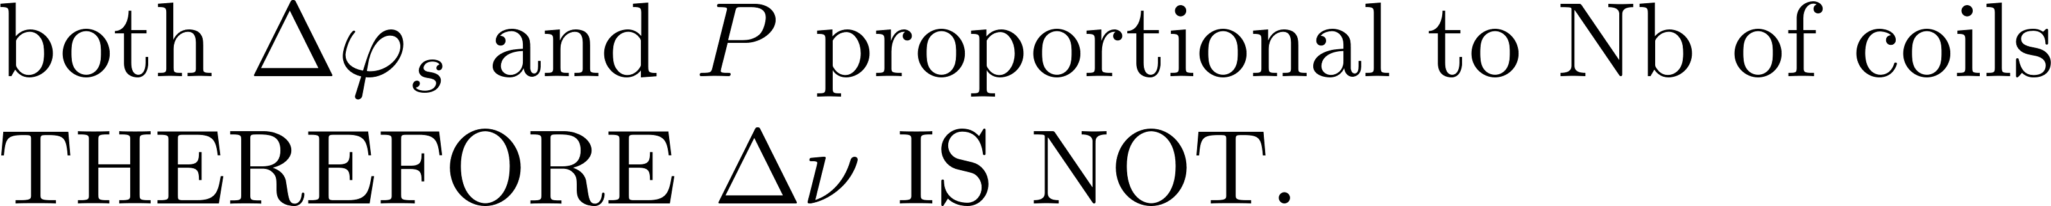
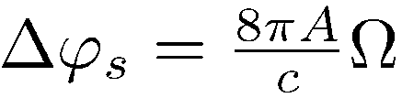
If there is a linear momentum of the photon, there is also an angular momentum
(1)
A mechanical gyroscope is based on the conservation of angular momentum
Best description of a laser gyro:
DOPPLER SHIFT SEEN BY THE OBSERVER
RΩ
Other description: There is a different phase shift (Sagnac phase shift) in the 2 senses of rotation
ν(1 - )
c
R
Fiber optic gyro (FOG):
phase accumulates with Nb of coils
Ω
Laser gyro:
RΩ
ν(1 - )
c
4A
Ω
Δν = 2RΩ
ν
=
R Ω
=
c
λ/2
Pλ

Slide 6
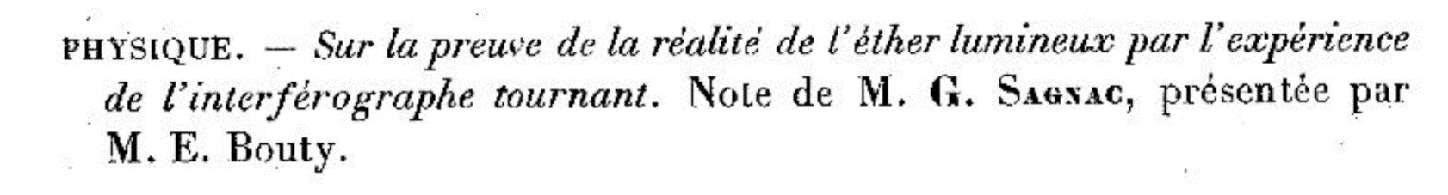
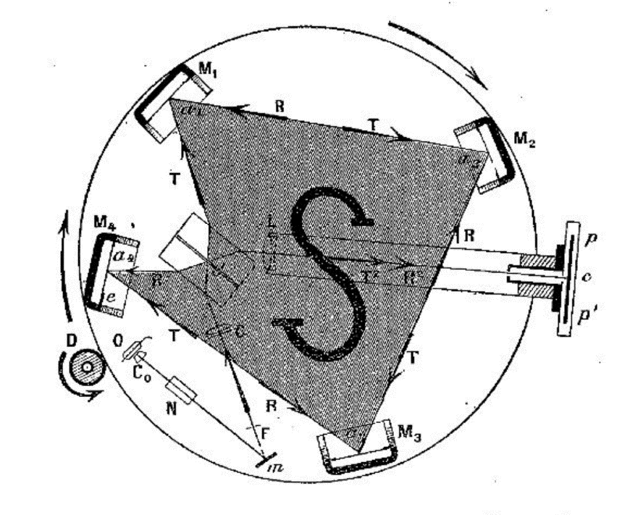
Sagnac experiment
Comptes rendus de l’academie des sciences pp1410-1413 (1913)
L is not a laser but a Hg arc lamp!
M₂
F
M₁
M₃
B
L
M₄

Slide 7
The Fiber Optic Gyroscope or FOG is nothing more than the Sagnac interferometer
R
LASER
D
FIBER

Slide 8
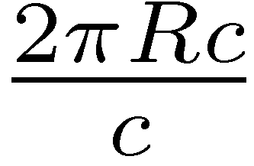
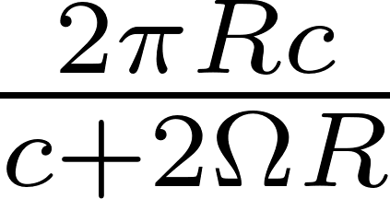


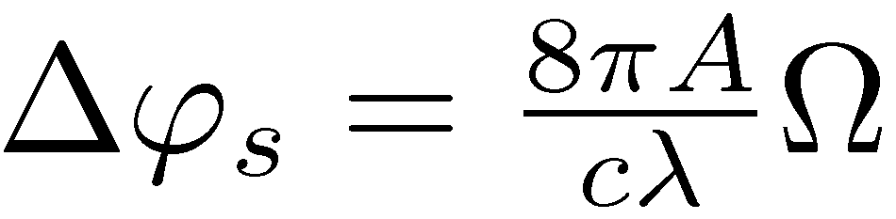

How does this prove the “ether”?

Slide 9
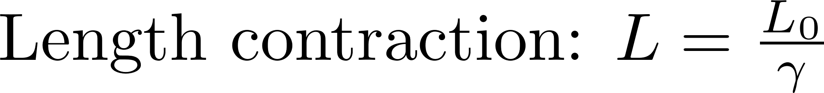
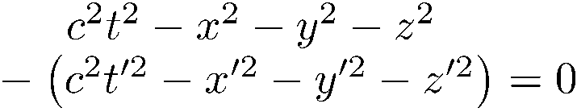
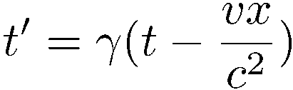

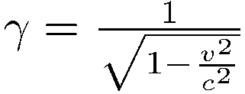
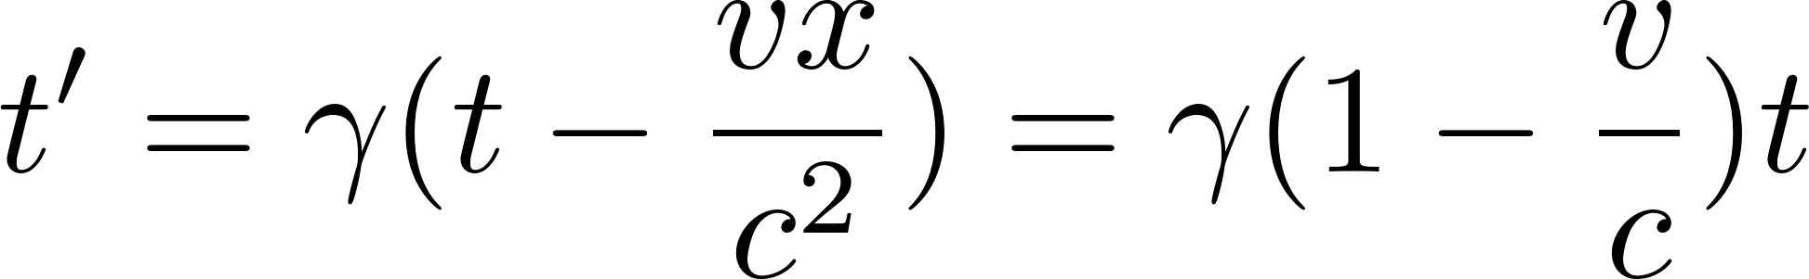
TODAY’S APROACH TO SAGNAC PHASE SHIFT
t
t’
r
r’
If x = ct x’ = ct’
The speed of light is conserved in the moving frame.

Slide 10
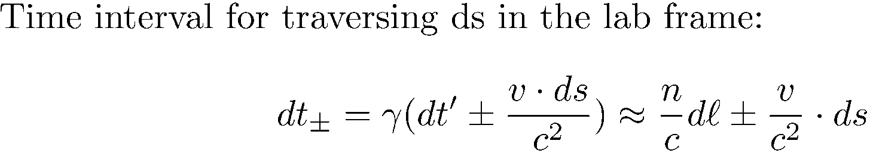


Sagnac phase shift in the special theory of relativity
(2)
Time difference for completing the circuit:
G. B. Malykin Physics ± Uspekhi 43 (12) 1229 ± 1252 (2000)

Slide 11
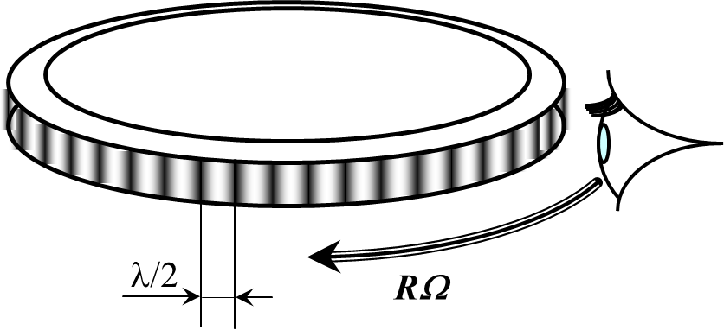
(3)
Previously: “MORE ON DOPPLER” because:
1) It is simple (“Blessed the feeble minded…”)
2) A good illustration of: “there is more than one way to look at things”
3) It can be confusing!!!
The laser gyro is even a better illustration of: “there is more than one way to look at things”
4A
Ω
=
R Ω
=
Δν
Pλ
λ/2

Slide 12
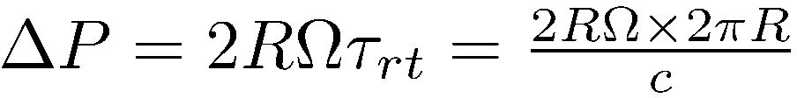
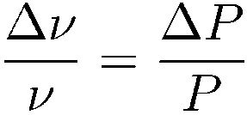
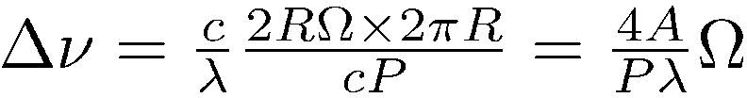



(4)
A 4th approach to laser gyro equation
RΩ
For the laser to be at resonance, you need an integer number of wavelenths.

