Slide 1
ALWAYS USE YOUR NI TO JUDGE AI!
I GIVE YOU TWO EXAMPLES WHERE AI IS AS

Slide 2
ALWAYS USE YOUR NI TO JUDGE AI!
I GIVE YOU TWO EXAMPLES WHERE AI IS AS
EXAMPLE I
Question: What is the displacement of two floating masses 100m apart due to a gravitational wave, versus the displacement of the ends of a solid rod the same length submitted to the same gravitational wave?
Answer from Chat-GTP: Different
Answer from GROK: The same

Slide 3
ALWAYS USE YOUR NI TO JUDGE AI!
I GIVE YOU TWO EXAMPLES WHERE AI IS AS
EXAMPLE II
Question:
What is the highest third harmonic conversion efficiency achieved?
Answer: Based on theoretical calculations and early experimental work,
phase-matched alkali metal vapors (such as Rubidium or Cesium) mixed with inert gases (e.g., Xenon) can achieve very high third-harmonic generation (THG) efficiencies, with theoretical predictions exceeding 50% for picosecond laser pulses.
These systems use resonant enhancement to produce large non-linear susceptibilities.
WRONG!
WRONG!
WRONG!
WRONG!
WRONG!
WRONG!
WRONG!
WRONG!
WRONG!

Slide 4
ALWAYS USE YOUR NI TO JUDGE AI!
I GIVE YOU TWO EXAMPLES WHERE AI IS AS
EXAMPLE II
Question:
What is the highest third harmonic conversion efficiency achieved?
The correct answer is much more elaborated – and elegant – and requires NI rather than AI

Slide 5
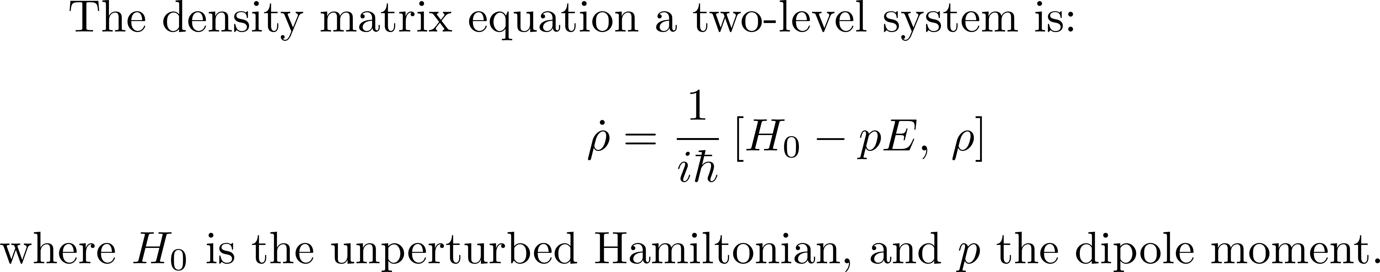
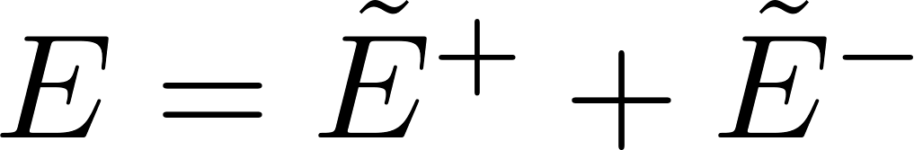
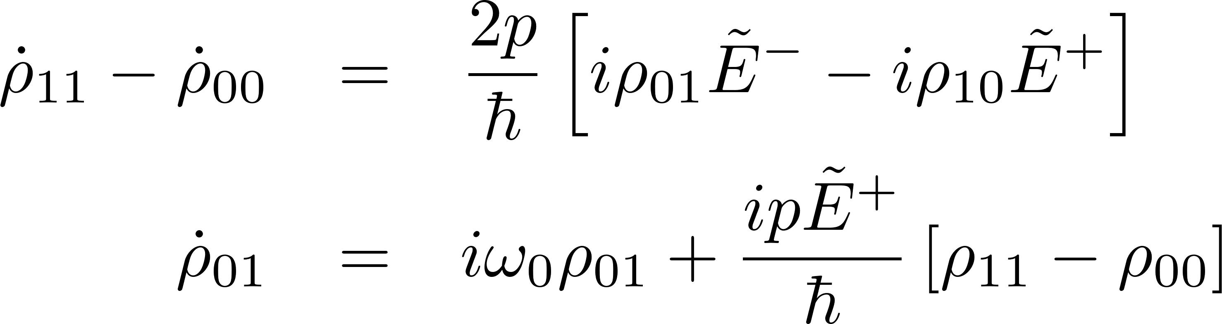
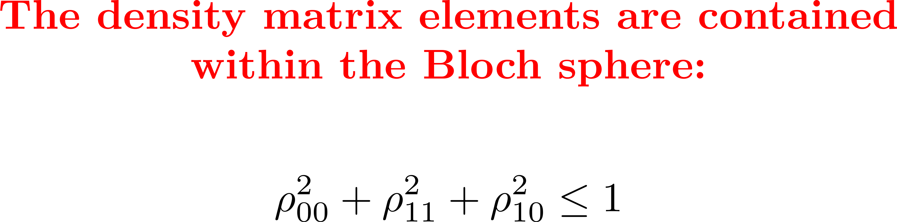
Other approach: Ultrafast Phenomena second edition page 225:
use directly the density matrix equation

Slide 6
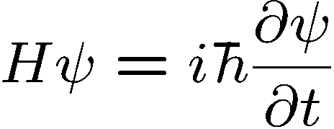

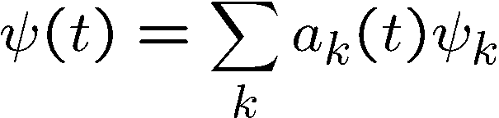
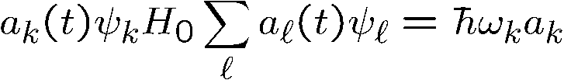
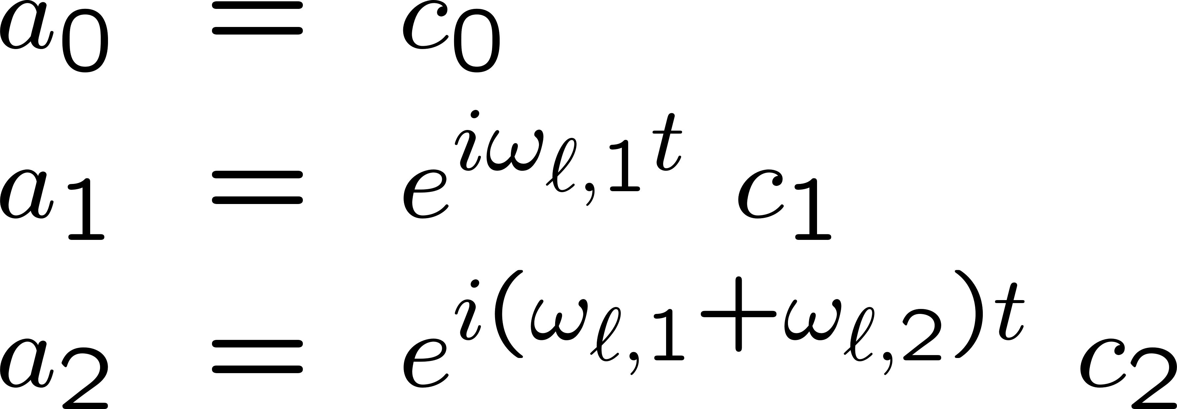
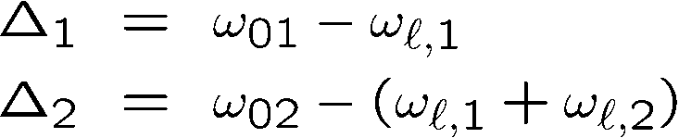
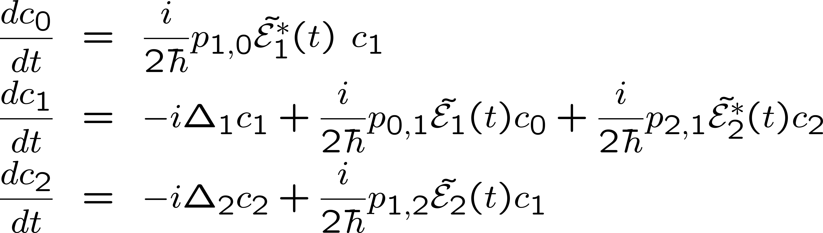
Interaction of light with a cascade of levels near resonance
Rotating frame approximation:

Slide 7
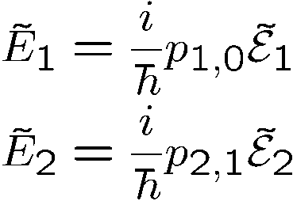
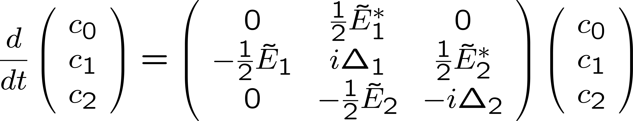
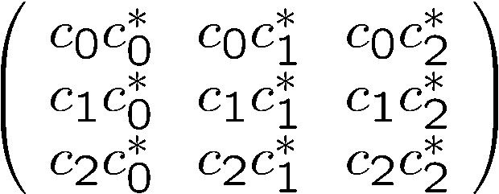

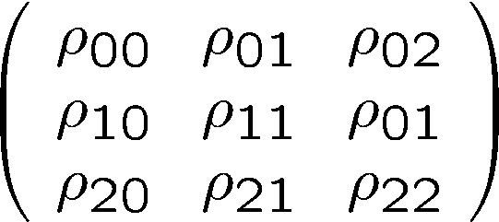
Interaction of light with a cascade of levels near resonance
This systems takes a simpler form is we define the Rabi frequencies as:
Solve, and construct
This is the density matrix
the matrix

Slide 8
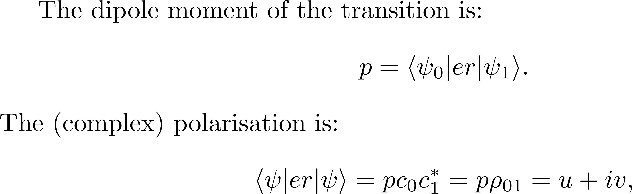

Slide 9
Easily extended at N levels → Optical pumping of molecules
Approximation: Intermediate level off resonance (adiabatic approximation)
Multilevel Bloch’s model
Optical pumping
Harmonic generation

Slide 10
Climbing an anharmonic ladder of levels
Solve, and construct
5 levels instead of 3
This is the density matrix
the matrix
Density matrix 5 x 5

Slide 11
Derivation of the vector model
Adiabatic approximation

Slide 12
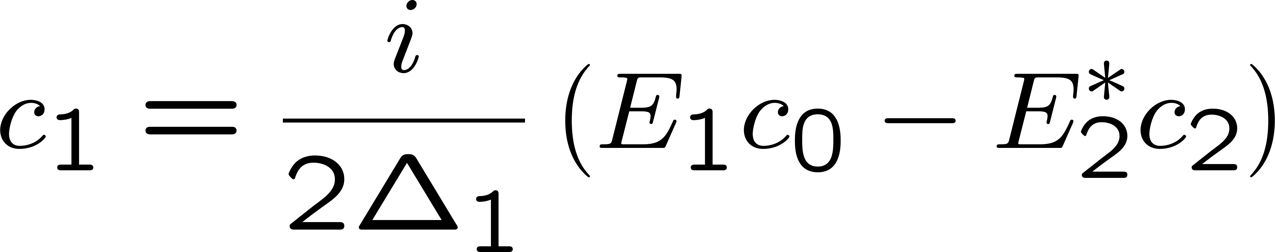
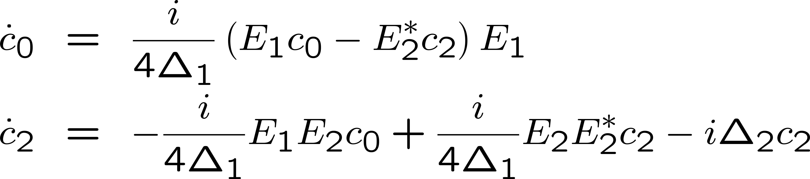
Adiabatic approximation
Detuning of the intermediate level 1 larger than the transition rates:
the second equation can be considered to be in steady state, and one
can solve for the coefficient c₁:

Slide 13
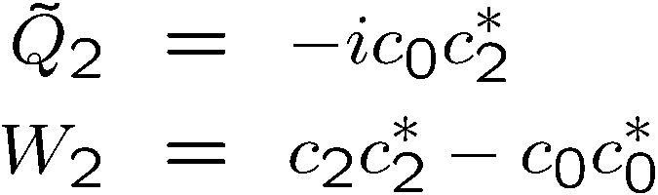

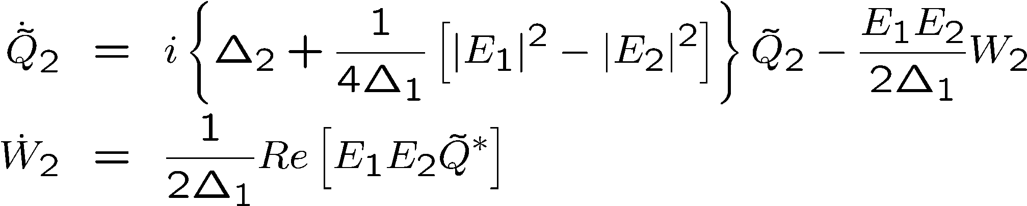

Adiabatic approximation
Defining:
Leads to:

Slide 14

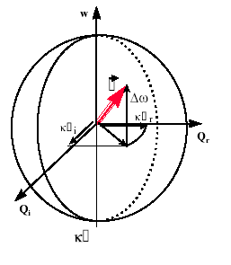

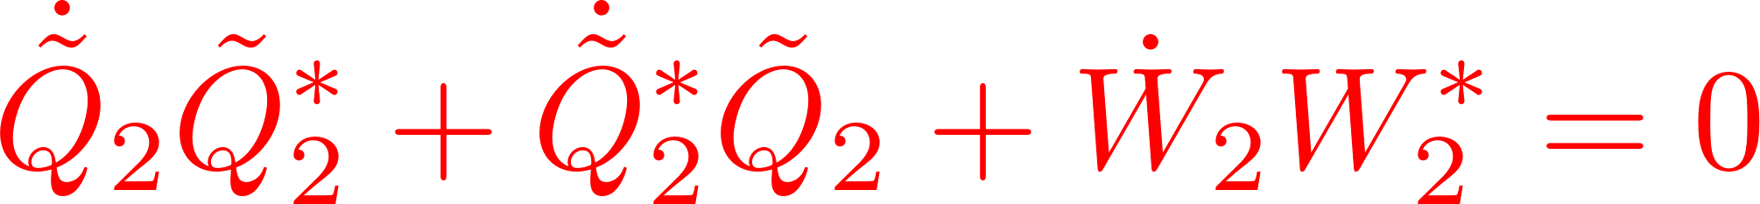



Adiabatic approximation
Bloch vector model

Slide 15
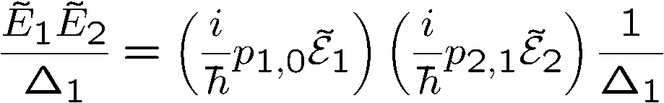
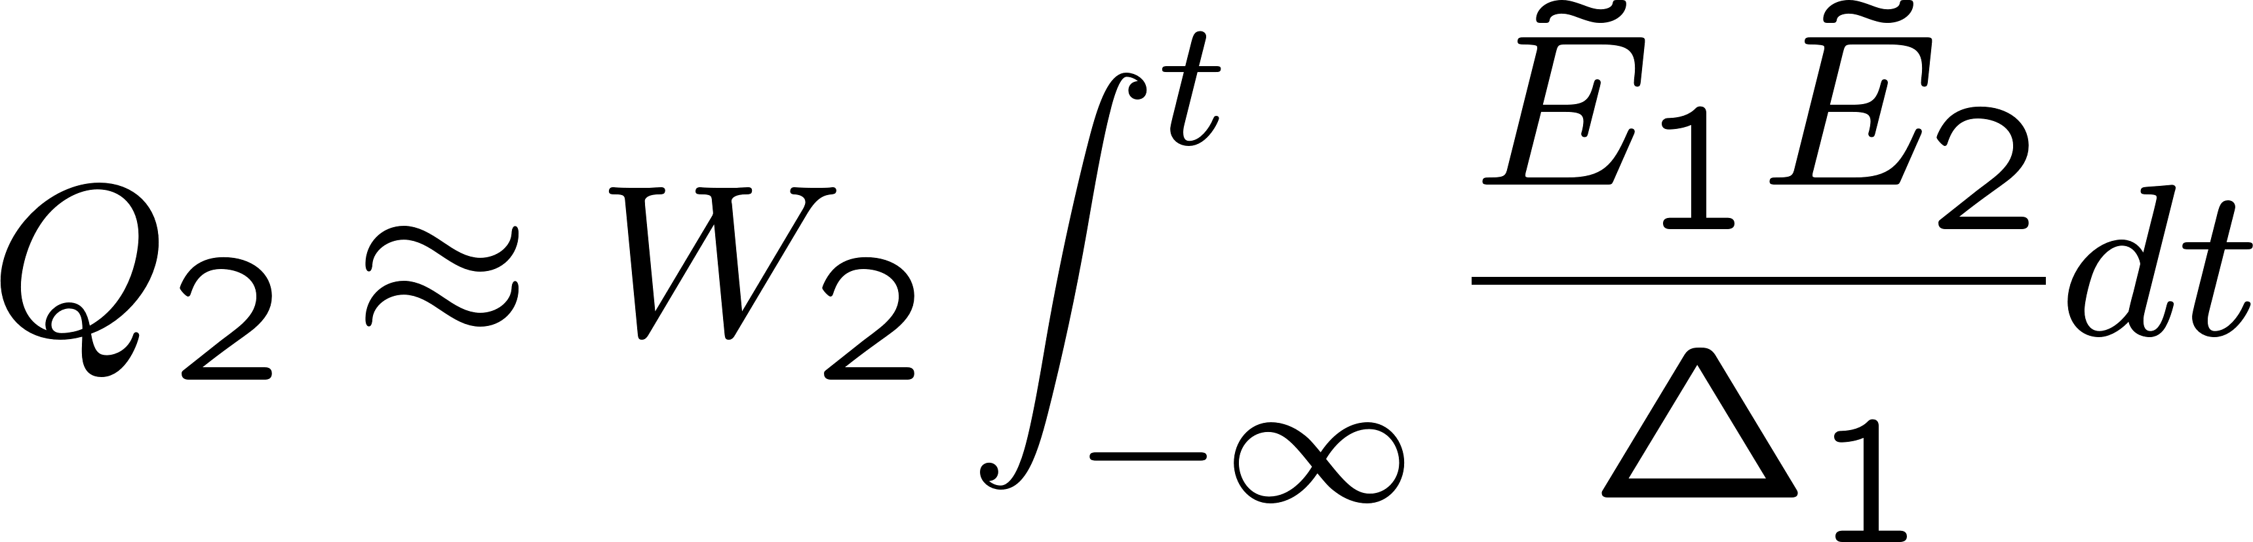
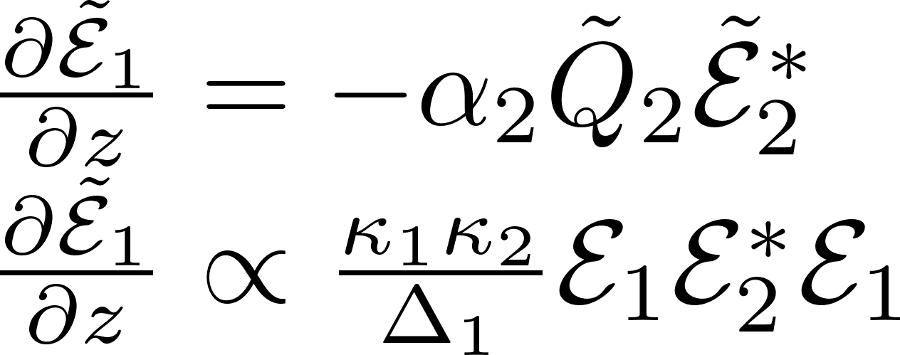
Transition rate: E₁E₂ or E²
Propagation:

Slide 16
Transition rate: E₁E₂ or E²
Propagation:

Slide 17
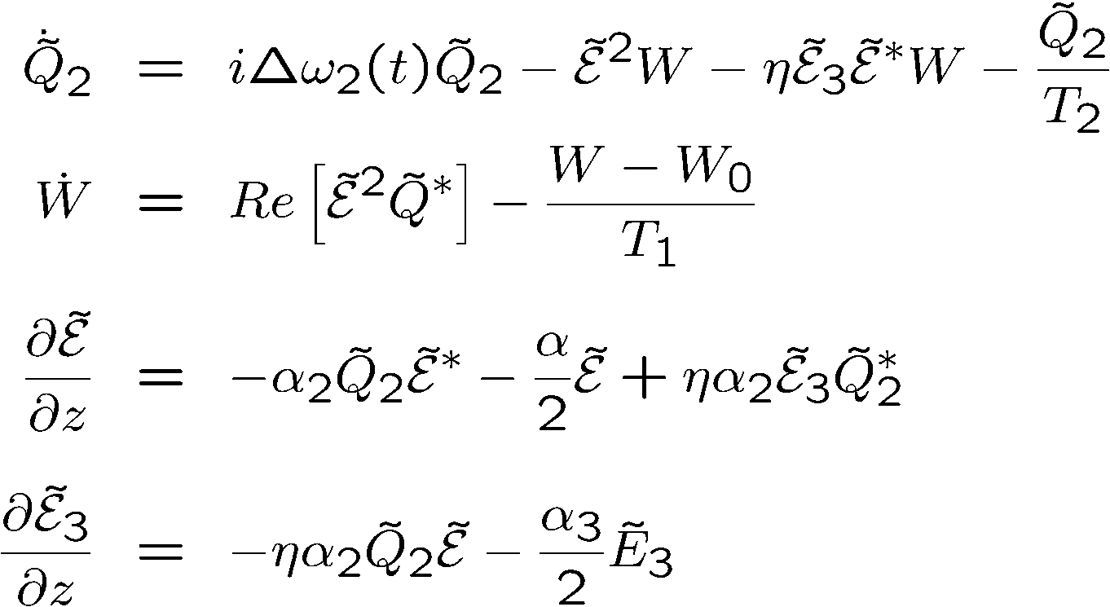
Bloch vector model
Contained in these expressions: Third order susceptibility, two-photon absorption,
third harmonic generation, stimulated Raman, phase conjugated FWM, etc...
The frequencies do no appear explicitly in these expressions.
But they can be “guessed” from the products of amplitudes.

Slide 18
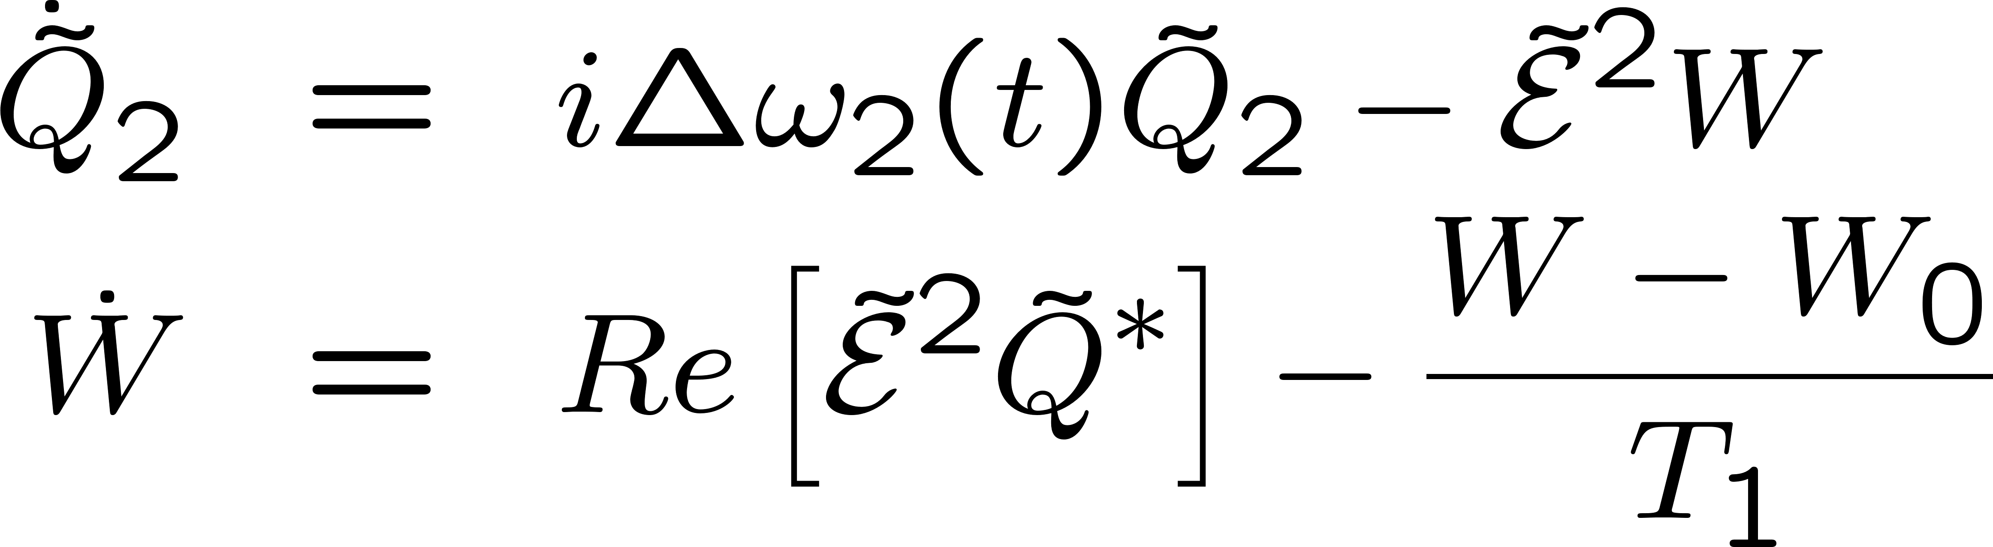
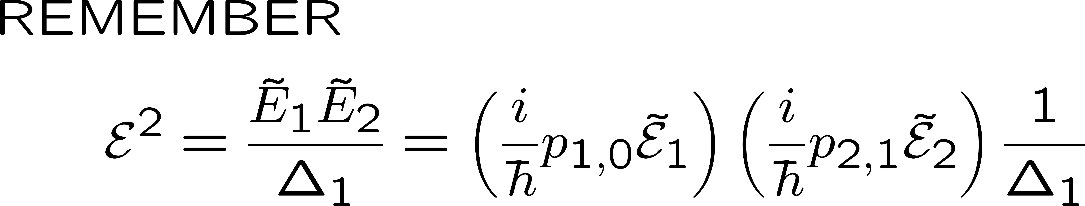
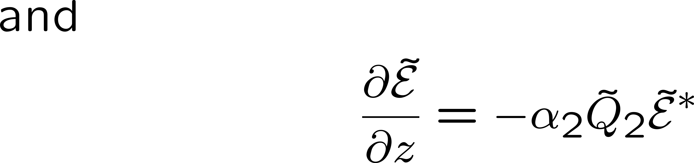
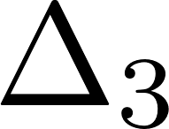


\

Slide 19
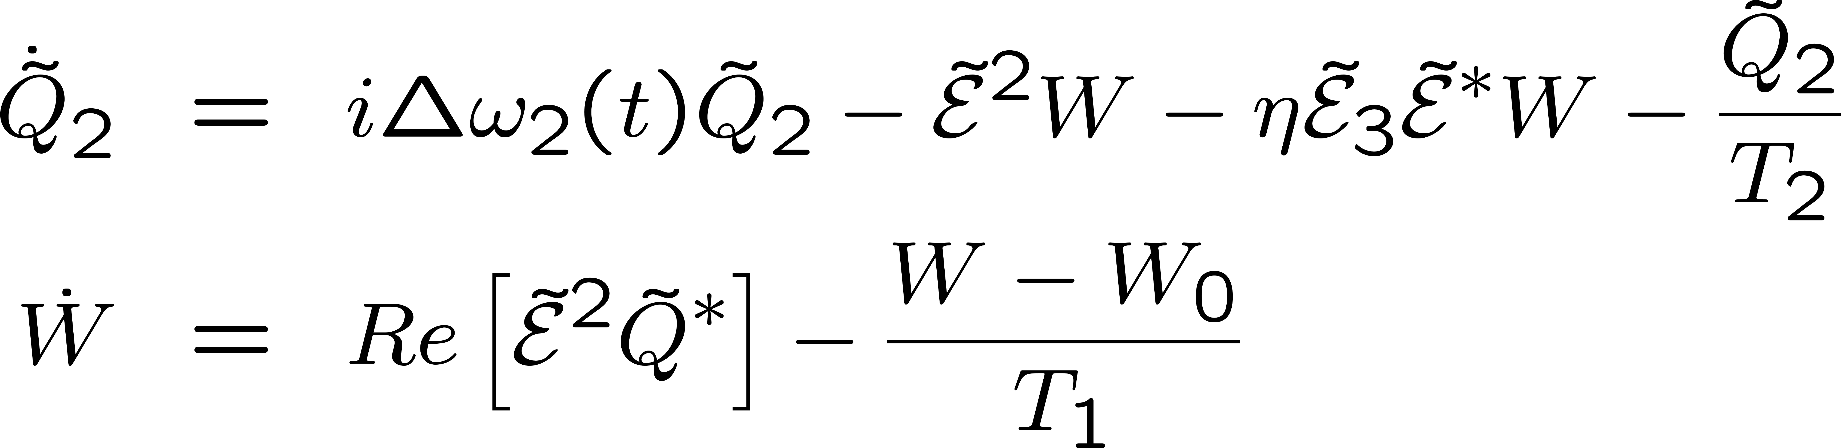
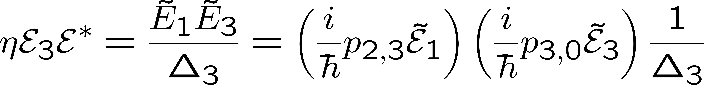
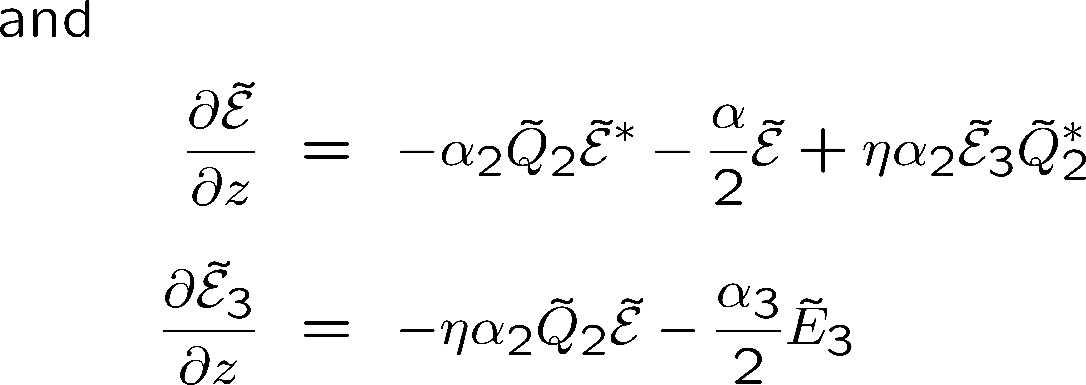

Slide 20
Bloch vector model
Contained in these expressions: Third order susceptibility, two-photon absorption,
third harmonic generation, stimulated Raman, phase conjugated FWM, etc...
The frequencies do no appear explicitly in these expressions.
But they can be “guessed” from the products of amplitudes.

Slide 21
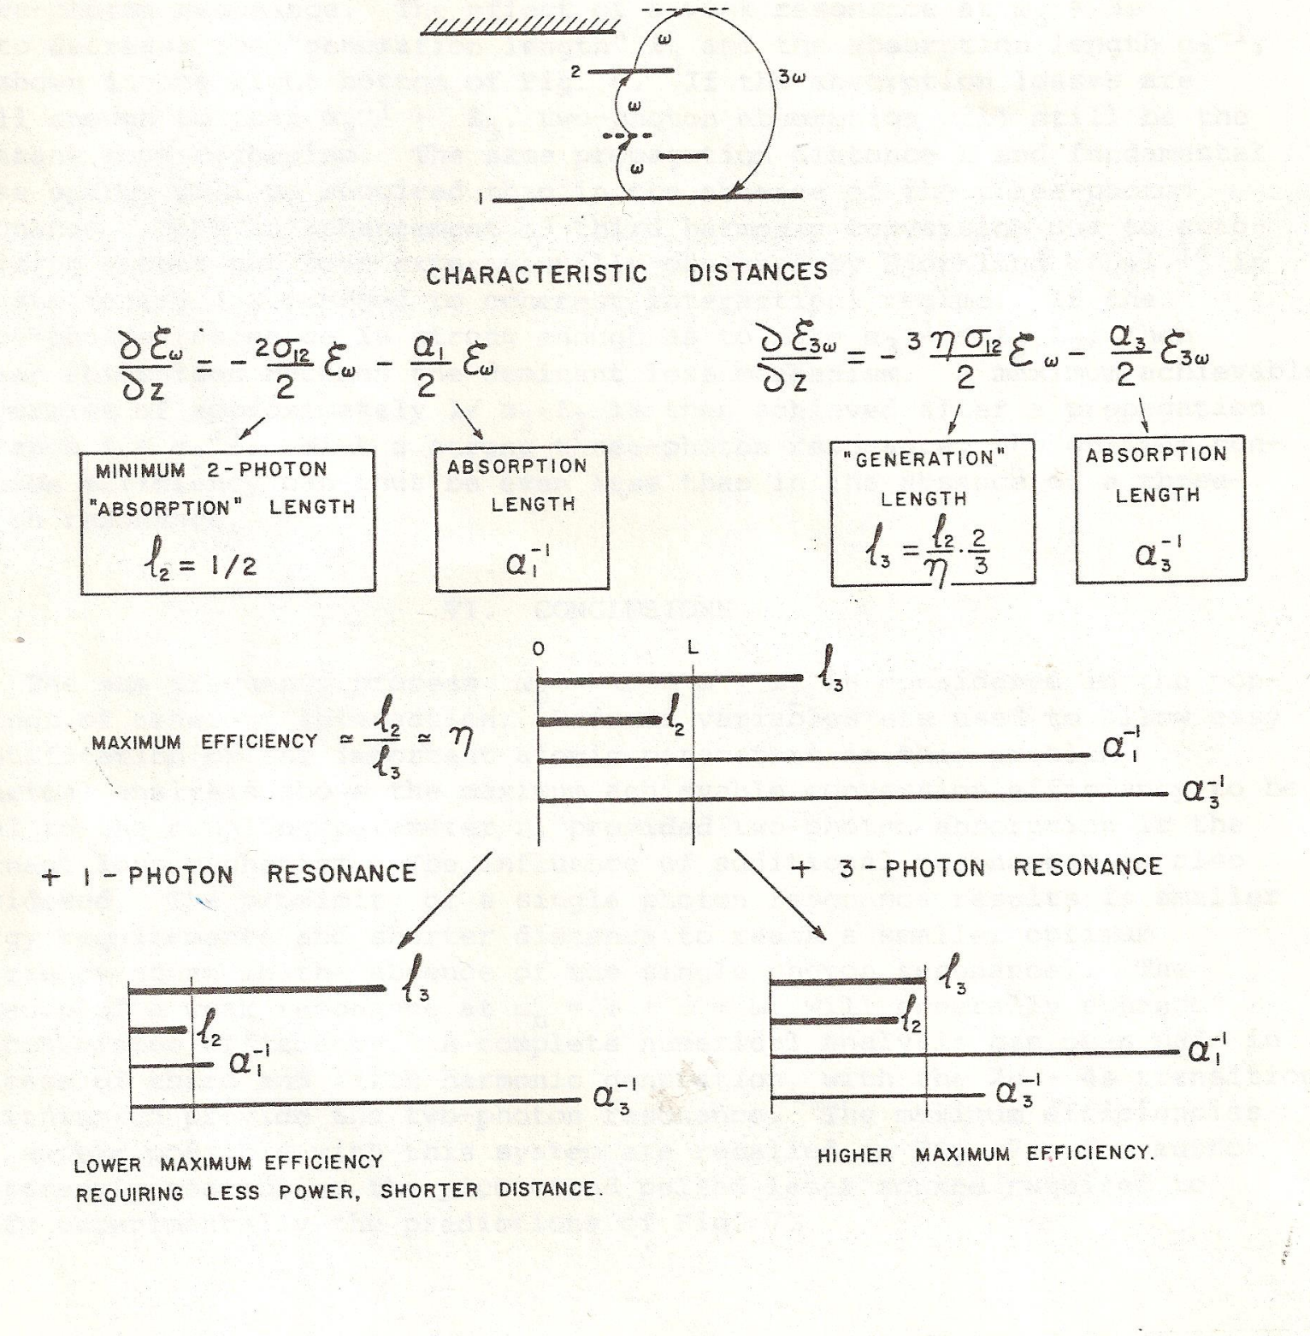

Slide 22
A resonance enhances harmonic generation
Less fundamental required to generate an harmonic.
The maximum power that you can achieve by harmonic generation is less.
That is a very general statement.
Other example: short pulse generation by Brillouin back scattering
Most efficient media cannot be used for highes power conversion

Slide 23
ALWAYS USE YOUR NI TO JUDGE AI!
I GIVE YOU TWO EXAMPLES WHERE AI IS AS
EXAMPLE II
Question:
What is the highest third harmonic conversion efficiency achieved?
Answer: Based on theoretical calculations and early experimental work,
phase-matched alkali metal vapors (such as Rubidium or Cesium) mixed with inert gases (e.g., Xenon) can achieve very high third-harmonic generation (THG) efficiencies, with theoretical predictions exceeding 50% for picosecond laser pulses.
These systems use resonant enhancement to produce large non-linear susceptibilities.
AND AI WAS WRONG
WRONG!
WRONG!
WRONG!
WRONG!
WRONG!
WRONG!
WRONG!
WRONG!
WRONG!

Slide 24
YOU CAN GET AROUND THAT LIMITATION
USING COHERENT PROPAGATION

Slide 25
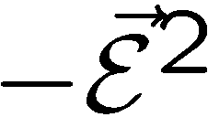
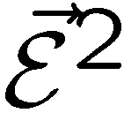

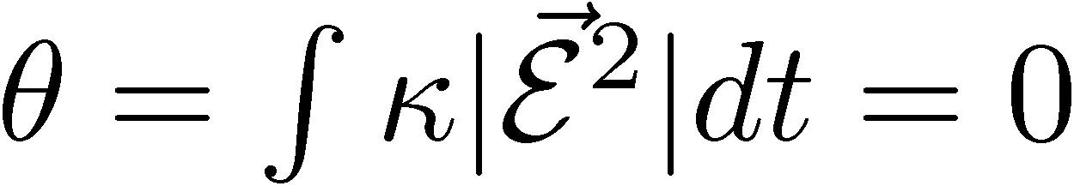
Energy conservation and zero-area pulse propagation
W
U
V

Slide 26

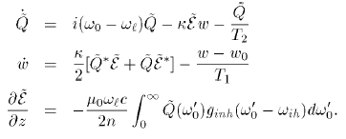
ε²
Pseudo-polarization vector
ε
ε
2
2
rotating around
2
2
2
2
2
2
2
2
2
Q₂ε∗

Slide 27
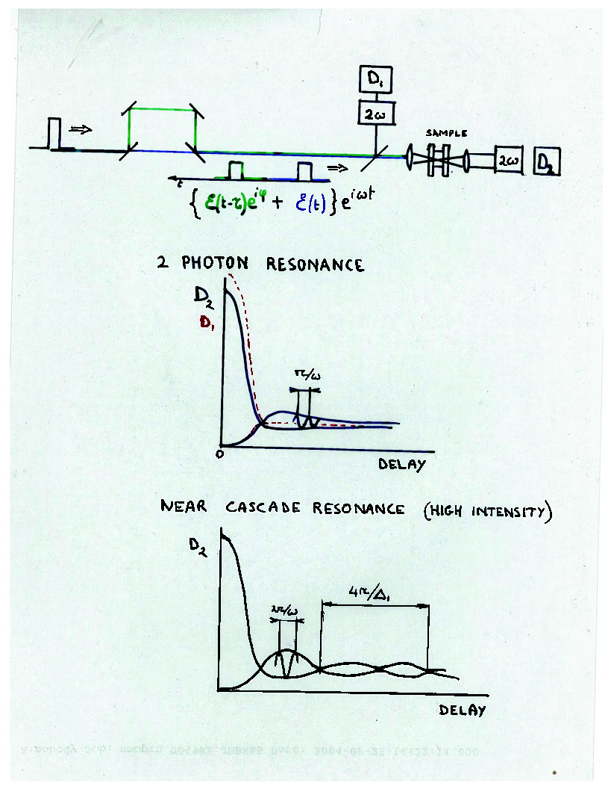

Slide 28
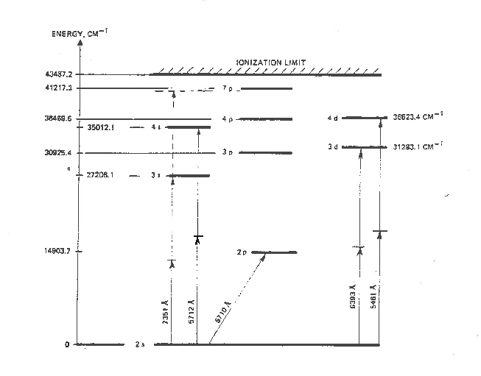

Slide 30
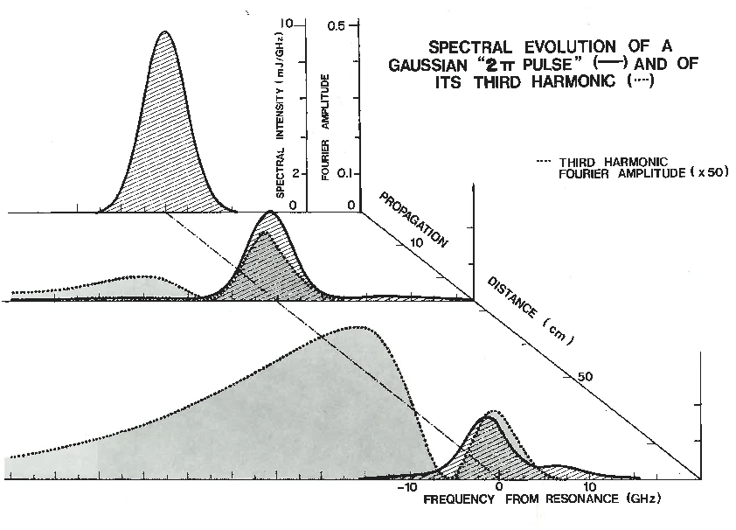

Slide 31
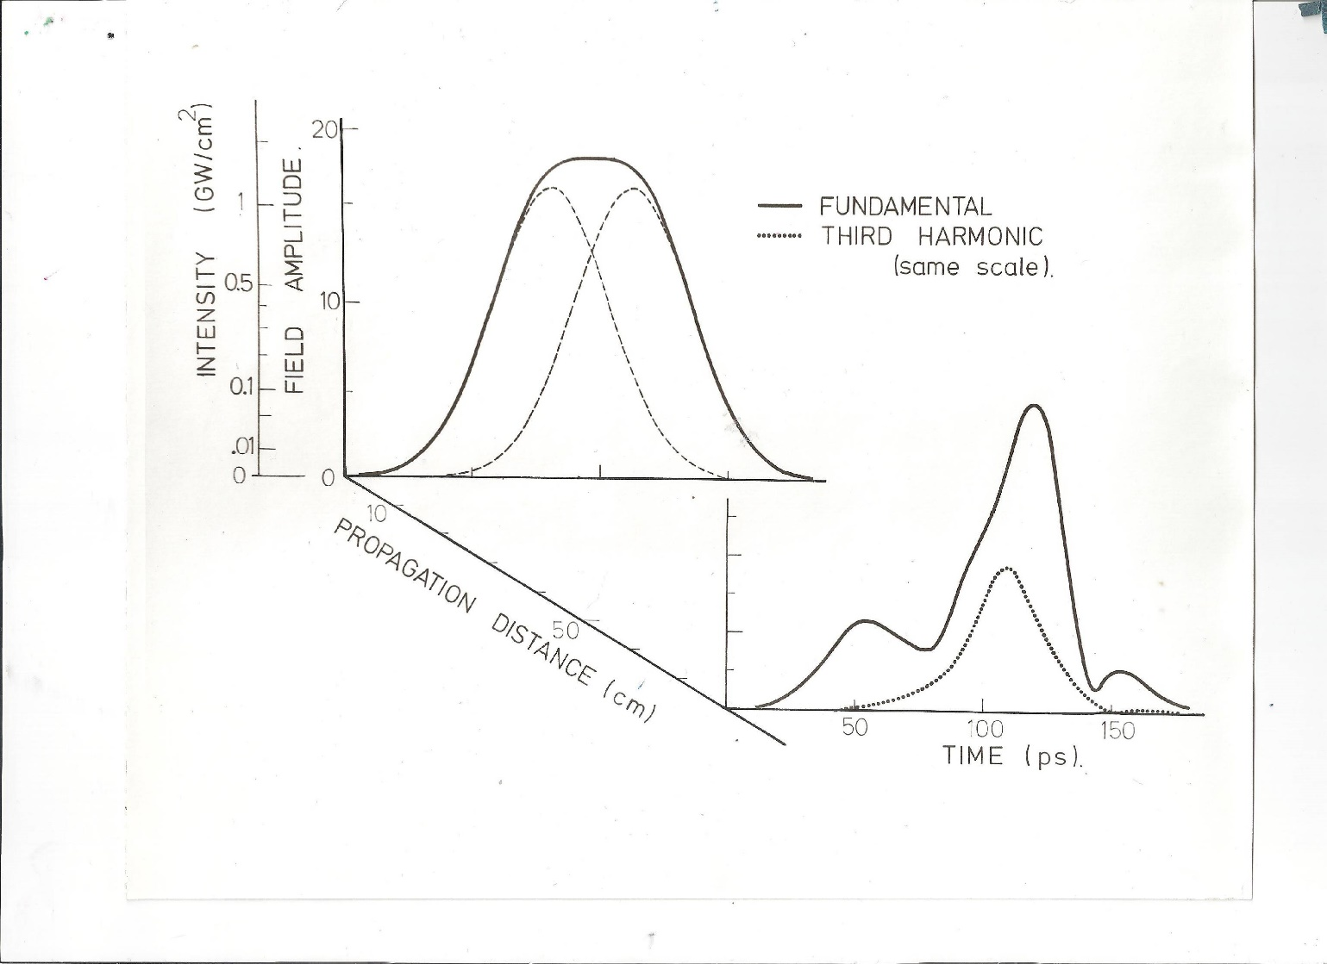
Simulations first
Third harmonic with 90 degree phase shifted pulses

Slide 32
Is it for real, or a gedanken experiment?
Take lithium vapor, in condition of 2 photon resonance
Quartz cell?

Slide 33
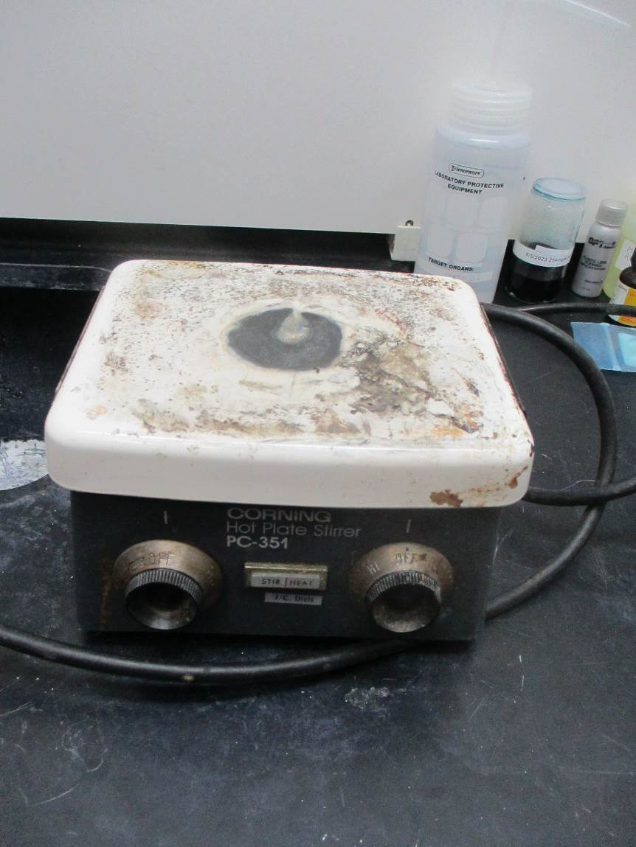
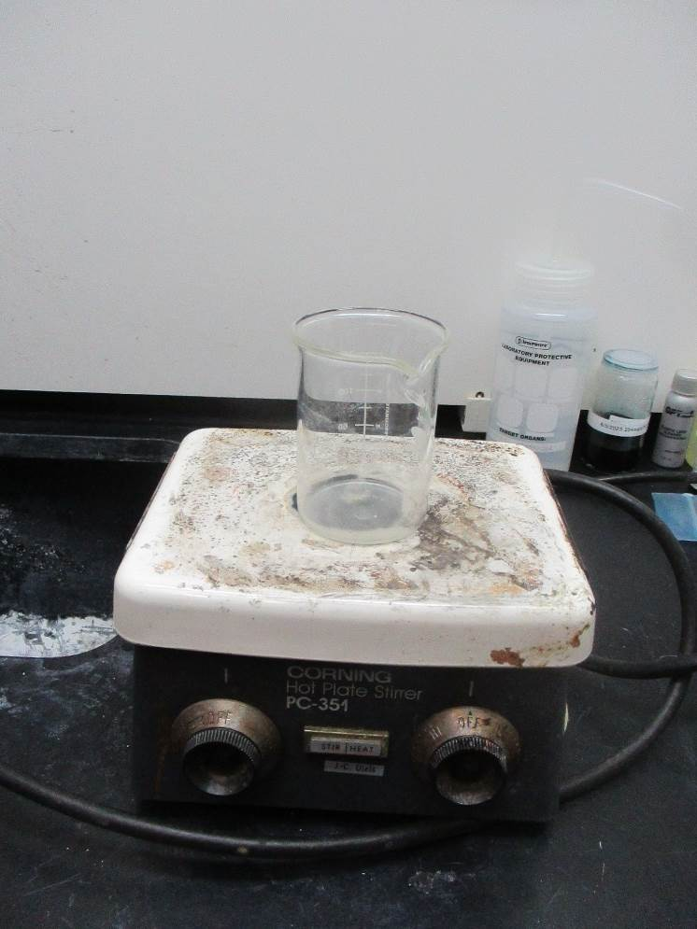

Slide 34
Is it for real, or a gedanken experiment?
lithium vapor, in condition of 2 photon resonance
Quartz cell?
Heat pipe
Vidal and Cooper
Journal of Applied Physics 40, 3370 (1969);

Slide 35
DISPERSION?

Slide 36
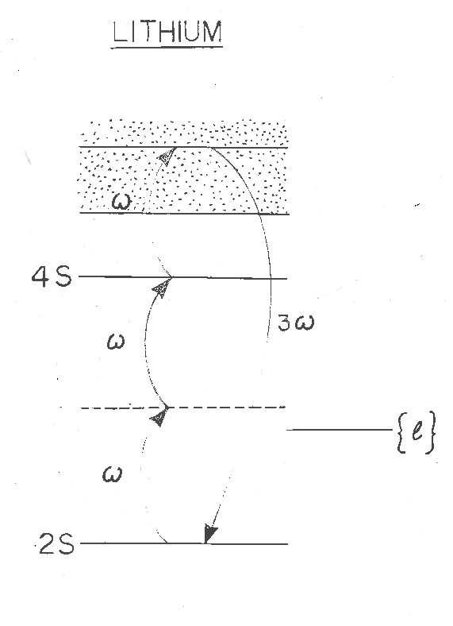
DISPERSION?
Phase matching
ω
2ω
3ω
Ω

Slide 37
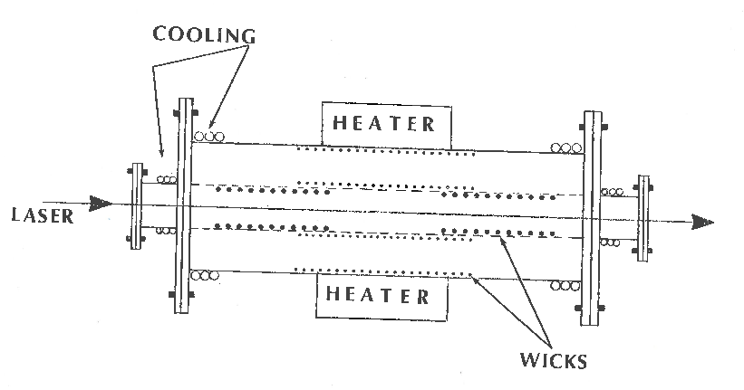
Heat pipe: How to mix magnesium and lithium?
Double heat pipe:
C. R. Vidal and M. M. Hessel Journal of Applied Physics 43, 2776 (1972)
Pa = 2 torr
Ta = 1500
Pb = 5 torr
Ta = 1500

Slide 38
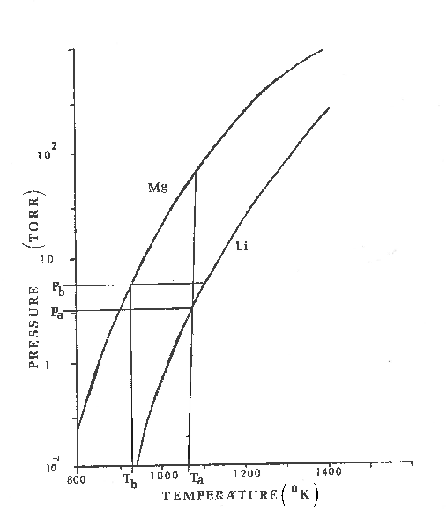
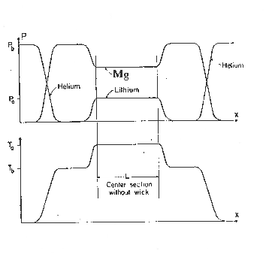
Mg partial pressure Pb - Pa
m

Slide 39
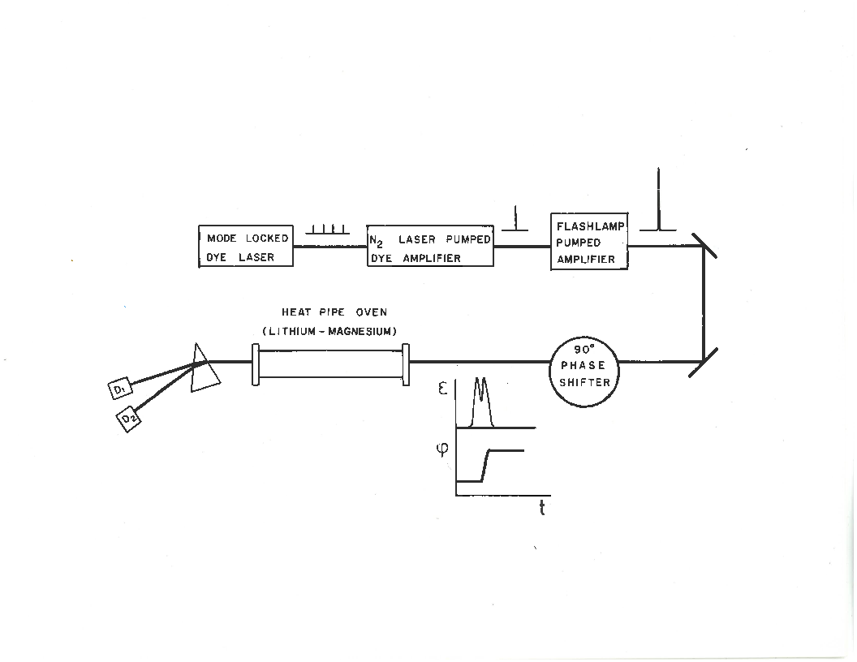

Slide 40
“PHASE SHIFTER”

Slide 41
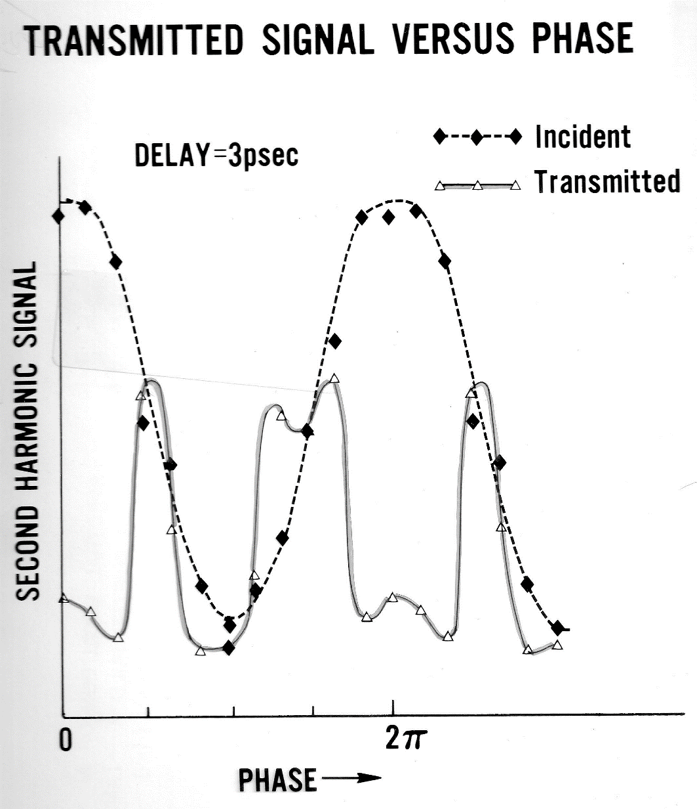

Slide 42
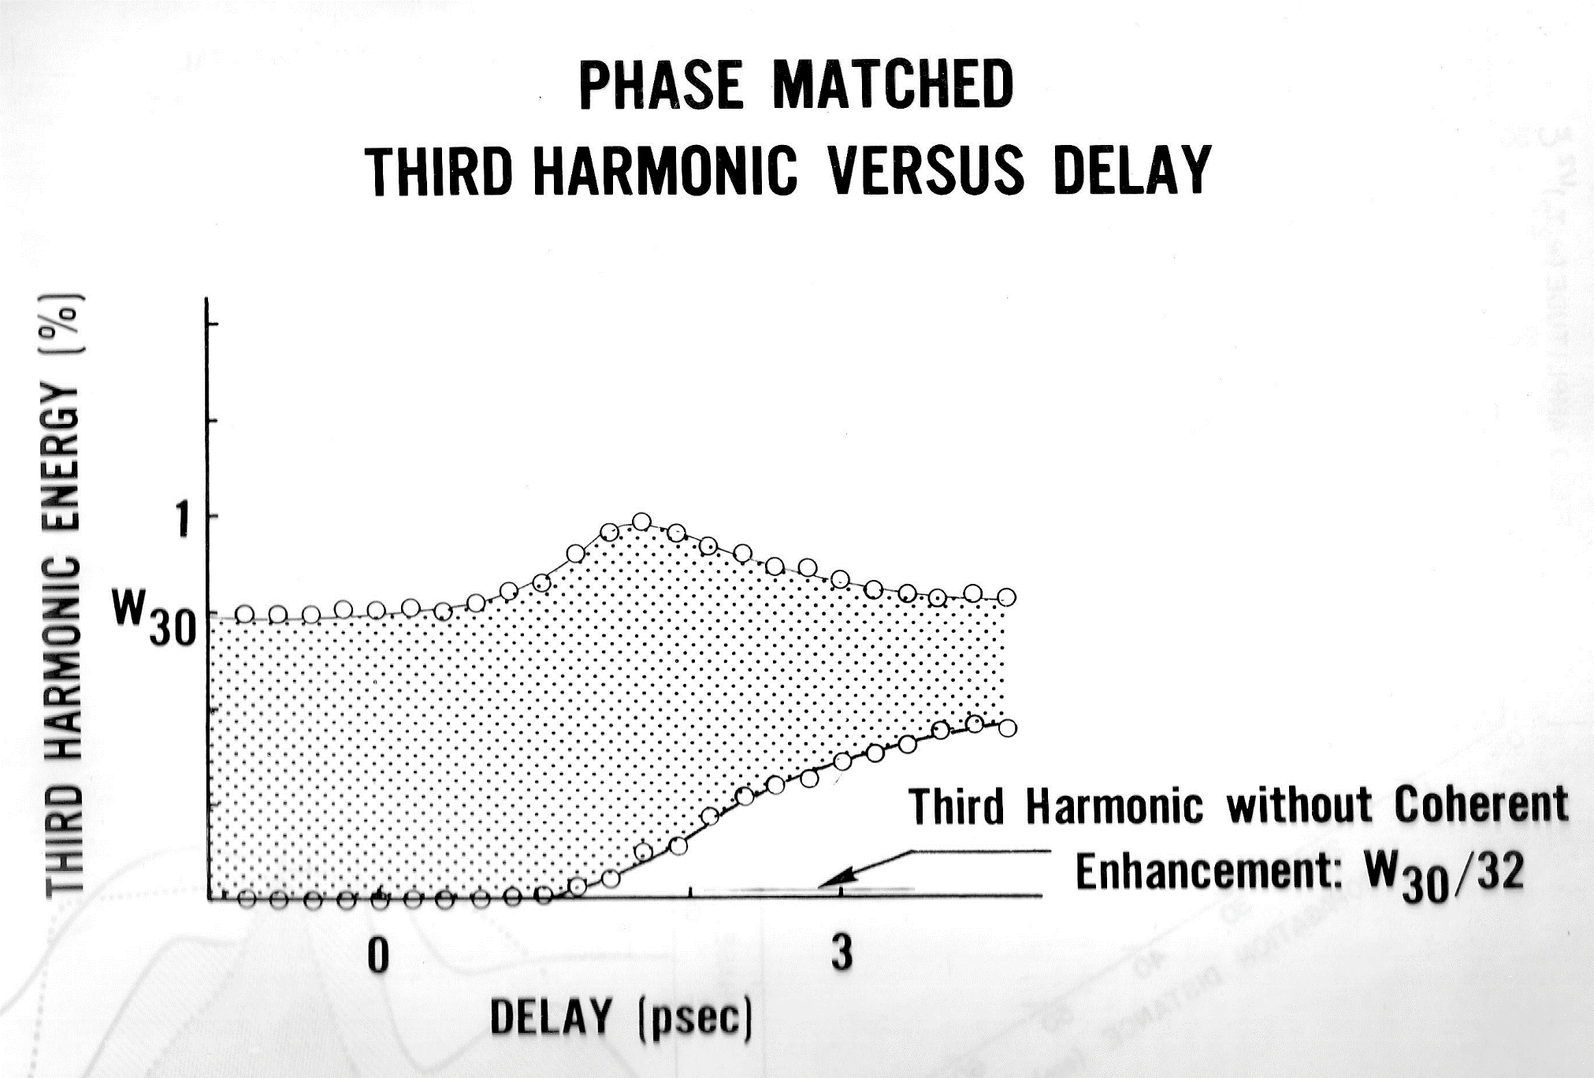

Slide 44
Bloch vector model
Contained in these expressions: Third order susceptibility, two-photon absorption,
third harmonic generation, stimulated Raman, phase conjugated FWM, etc...
The frequencies do no appear explicitly in these expressions.
But they can be “guessed” from the products of amplitudes.

Slide 45












Two-photon absorption and optical pumping
W
Purpose: create a two photon population inversion
As before:
i
But we need to be ON resonance
r
Adiabatic approximation breaks down!

Slide 46
Two-photon absorption and optical pumping
Alternate to pi pulse pumping:
W
i
r

Slide 47
ON RESONANCE two photon absorption
OFF RESONANCE Kerr effect
(Kramers-Kroenig)

Slide 48



OFF RESONANCE? (Kramers-Kroenig)
Propagation:
Two photon absorption – two photon pumping

Slide 49








Two-photon Bloch’s equations, far off resonance
Small signal, steady state:
W
i
Third order susceptibility
Degenerate Four Wave Mixing
Phase conjugation
Nonlinear index of refraction
r
Effects enhanced by an intermediate resonance.

Slide 50

Two-photon Bloch’s equations
If a third harmonic is generated,
Raman excitation of the
transition (phase matching)
i
is the amplitude of an ``excitation’’ at
Its value cannot exceed the radius of the sphere
(full excitation of all atoms in phase)
r
is the amplitude of an ``excitation’’ at

Slide 51


Two-photon Bloch’s equations, to conventional 3rd harmonic
W
Small signal, steady state:
i
r

Slide 52

DEGENATE FOUR WAVE MIXING
Single photon resonance: what to expect

Slide 53


Two-photon absorption and DFWM
W
i
r

Slide 54






Two-photon absorption and DFWM
Exciting pulse:
G
FWHM = 76 fs = 1.72 τ
A
D
Delay
(units of FWHM of intensity autocorrelation)

Slide 56

Example of application:
2 photon coherent excitation
of Sodium
Which we approximate by
2
1
0

Slide 57
Bichromatic Two-Photon Coherent Excitation
Closer to reality!
Excitation
Decay
demonstrated that it was possible to put 98% of the sodium atoms into the 4S state either with a single bichromatic pulse or with a sequence (90⁰ shifted pulse sequence) of two bichromatic pulses.

Slide 58
MOTIVATION
“Light travels undisturbed for
billions of years - only to get its
wavefront distorted in the last
few milliseconds”
What are the solutions to
atmospheric distortions?

Slide 59

1st solution:
Send an observer into space
…they selected Mr. Hubble

Slide 60
2nd solution:
Correct for the atmosphere
But how?
a)
Choose/create a point source within
2 arcsec of the object to be observed.
b)
Correct the telescope to minimize the
size of the image of the point source.

Slide 61
Example of application:
2 photon coherent excitation
of Sodium
Which we approximate by
2
1
0

Slide 62

1st approach: off-resonance zero area pulse excitation
now

Slide 63
1st approach: off-resonance zero area pulse excitation
now

Slide 64
1st approach: off-resonance zero area pulse excitation
now

Slide 65

GENTLE CRITICISM FROM PETER MILONNI:
The level structure is not this:
But this:
Excitation
Decay

Slide 66
1st approach: off-resonance zero area pulse excitation
The purist will tell you that you have to include the full hyperfine structure

Slide 67
1st approach: off-resonance zero area pulse excitation
The result of listening to the purist:
Δt = 650 ps
F₅₈₉ = .90 μJ/cm²
τ = 100 ps
F₁₁₄₀ = 2.2 μJ/cm²
Δ₁ = 14.6 GHz
Δ₂ = 2.39 GHz

Slide 68


Second approach: the two-photon “pi pulse”
τ=10 ps, 4.58 μJ/cm² (each)
Δ₁ = 1.91 GHz and Δ₂ = 2.39 GHz.

Slide 69

Including the complete hyperfine structure of the sodium atom, thereby increasing the size of the system of coupled partial differential equations from 3 to 112, gives a nearly identical result as the 3-level model.
Level populations
ρ₁₁ –level
ρ₂₂ –mid
ρ₃₃ –upper
A 90⁰ phase shifted sequence of two 100 ps pulses separated by 650 ps, fluence of 0.9 J/cm² with detunings of Δ =14.6 GHz near 589 nm, fluence of 2.2 J/cm² at 1140 nm with detunings of Δ =2.4 GHz.

Slide 70

Other Excitation Schemes
Excitation
Return
resonant two-photon
polychromatic
Foy et.al.
cw: > 10 kW, pulsed > 250 W
coherent non-res. two-photon
polychromatic
Biegert et.al.
pulsed > 400 mW

Slide 71
LABORATORY DEMONSTRATION
Based on Nd:YAG pumped OPO; 10 ps pulse duration.
(ideal pulse duration would be 800 ps)
PROCEDURE
Tune yellow at resonance;
adjust energy to reach max fluorescence; increase to 0 fluorescence.
Combine with increasing power and tuning 1140 to reach again max fluorescence
Compare photon yield IR and yellow – they should be equal
Single emission decay time – convolution of the two emission lifetimes
Fluorescence photon yield:
4s 3p:
3p 3s:
They are equal confirms cascade decay

Slide 72


Pulsed versus CW excitation
Pulse duration: 800 ps
Yellow pulse energy density 34 nJ/cm²
IR (1140 nm) pulse energy density 84 nJ/cm²
For a spot size of 120 cm diameter at the sodium layer, of density 5 10⁹ atoms/cm3,
the energy required per pulse is:
Yellow: 770 μJ
1140 nm: 1890 μJ
Photon return/pulse
Experiment and theory have established that a total inversion can be realized,
Number of photons emitted/pulse pair:
Number of photons collected by a 3 m telescope:
is the solid angle.
0.11 photons/cm² return per bichromatic pulse.
Note: Because a complete inversion is created, one can use a beam diameter (w = 20 cm?) than in the cw irradiation, hence reducing the energy required per pulse.

Slide 73
Pulsed versus CW excitation
0.11 photons/cm² return per bichromatic pulse.
Comparison made for 20W yellow (repetition rate of pulsed 25 kHz), which yields a photon return of 2,900 photons/(cm² s) for pulsed bichromatic excitation.
CW excitation using the same parameters: 660 photons/(cm² s) (details next slide)
For the same average power of 20 W, the bichromatic pulses give a larger
photon return by a factor 2,870/660 = 4.3.
Note: Both results may require a directional factor of 1.5 used in most theories.

Slide 74



CW excitation using the same parameters for sodium

