Slide 1

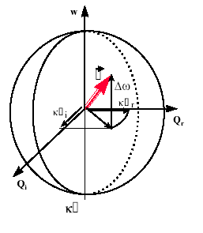
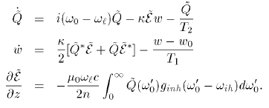
ε²
Pseudo-polarization vector
ε
ε
2
2
rotating around
2
2
2
2
2
2
2
2
2
Q₂ε∗

Slide 2
A resonance enhances harmonic generation
Less fundamental required to generate an harmonic.
The maximum power that you can achieve by harmonic generation is less.
YOU CAN GET AROUND THAT LIMITATION
USING COHERENT PROPAGATION
COHERENT INTERACTION:
THE ENERGY EXCHANGES CAN BE REVERSIBLE

Slide 3
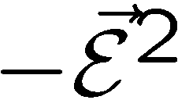
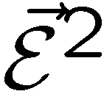

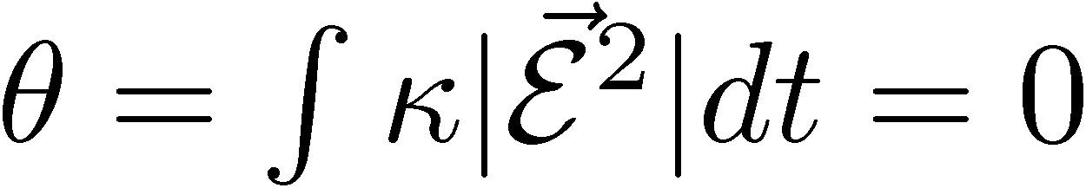
Energy conservation and zero-area pulse propagation
W
U
V

Slide 4

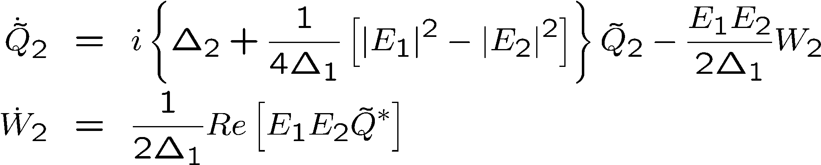



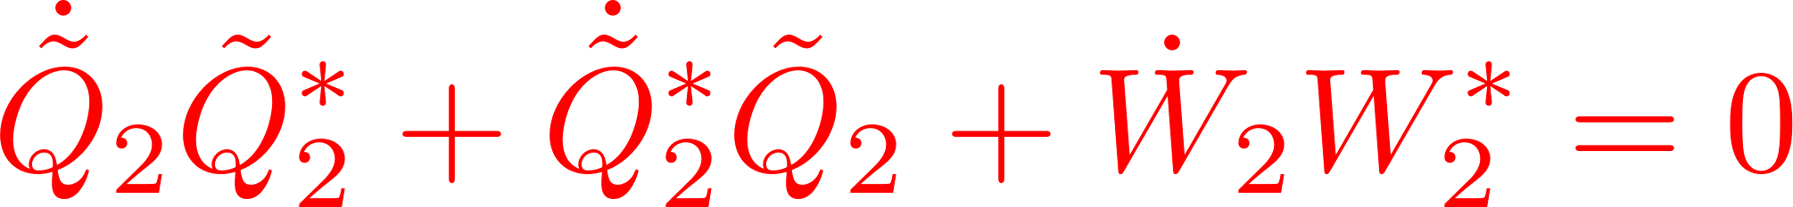



Adiabatic approximation
Bloch vector model

Slide 5
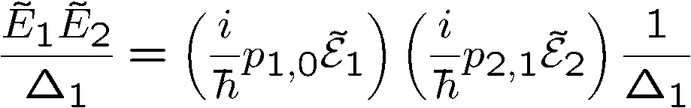
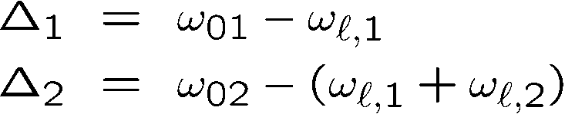
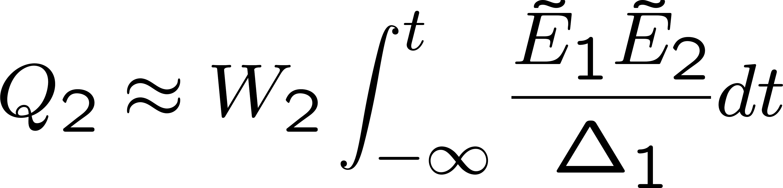
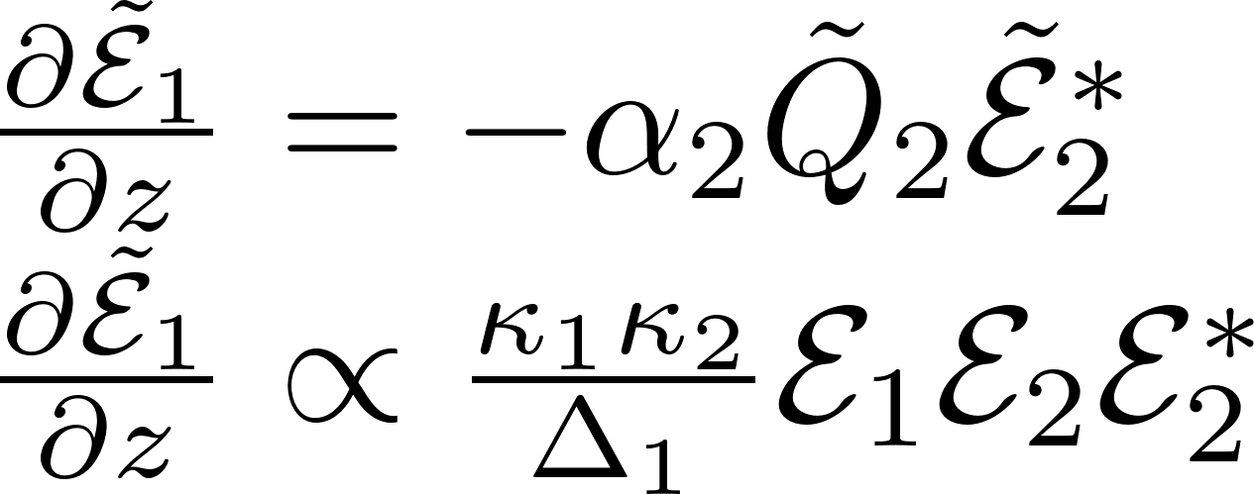
Transition rate: E₁E₂ or E²
Propagation:

Slide 6
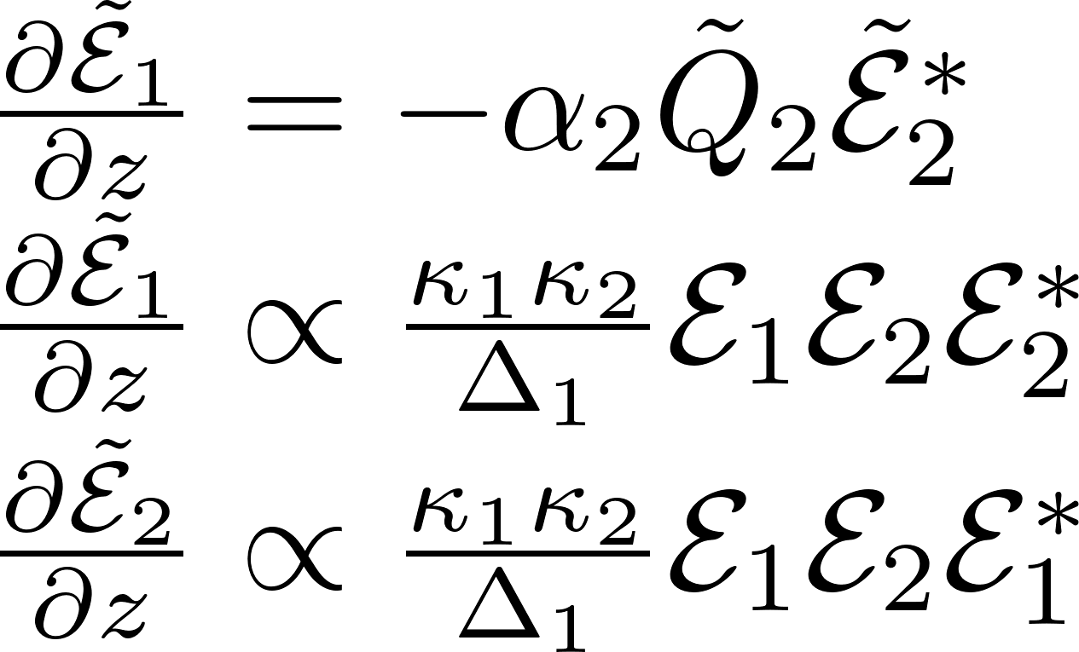

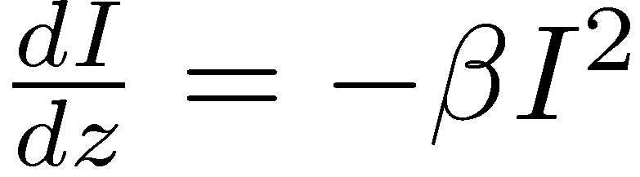
= 0 →
Propagation:
= 2 PHOTON PUMPING

Slide 7
Transition rate: E₁E₂ or E²
= 2 PHOTON PUMPING

Slide 8
ON RESONANCE two photon absorption
OFF RESONANCE Kerr effect
(Kramers-Kroenig)

Slide 9

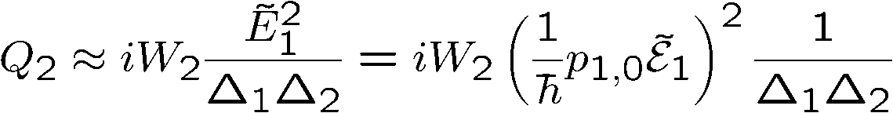
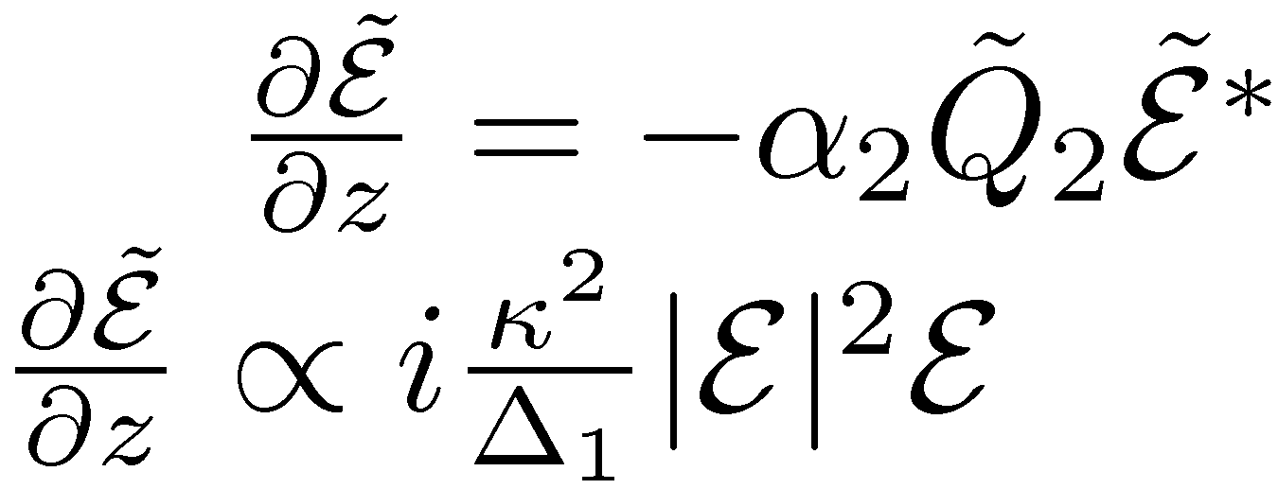
OFF RESONANCE? (Kramers-Kroenig)
Propagation:
Two photon absorption – two photon pumping

Slide 10
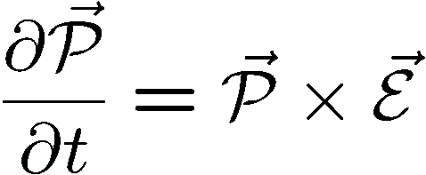
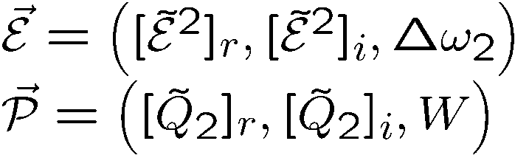

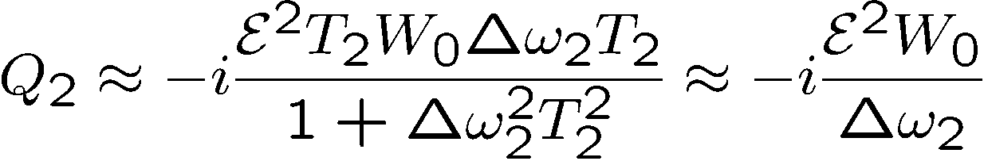
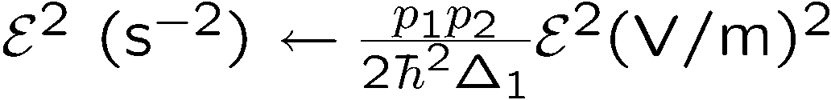

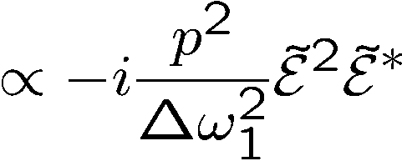
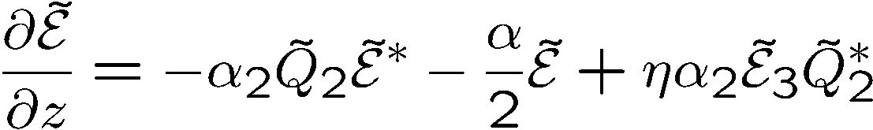




Two-photon Bloch’s equations, far off resonance
Small signal, steady state:
W
i
Third order susceptibility
Degenerate Four Wave Mixing
Phase conjugation
Nonlinear index of refraction
r
Effects enhanced by an intermediate resonance.

Slide 11
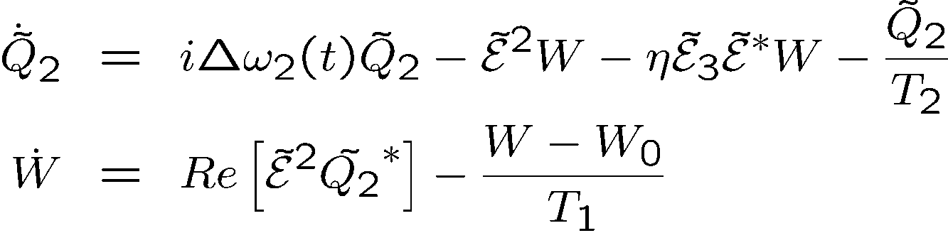

Two-photon Bloch’s equations
If a third harmonic is generated,
Raman excitation of the
transition (phase matching)
i
is the amplitude of an ``excitation’’ at
Its value cannot exceed the radius of the sphere
(full excitation of all atoms in phase)
r
is the amplitude of an ``excitation’’ at

Slide 12
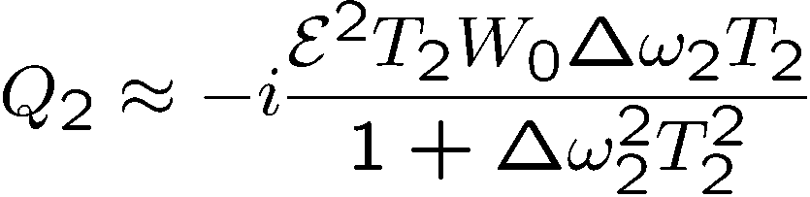

Two-photon Bloch’s equations, to conventional 3rd harmonic
W
Small signal, steady state:
i
r

Slide 13
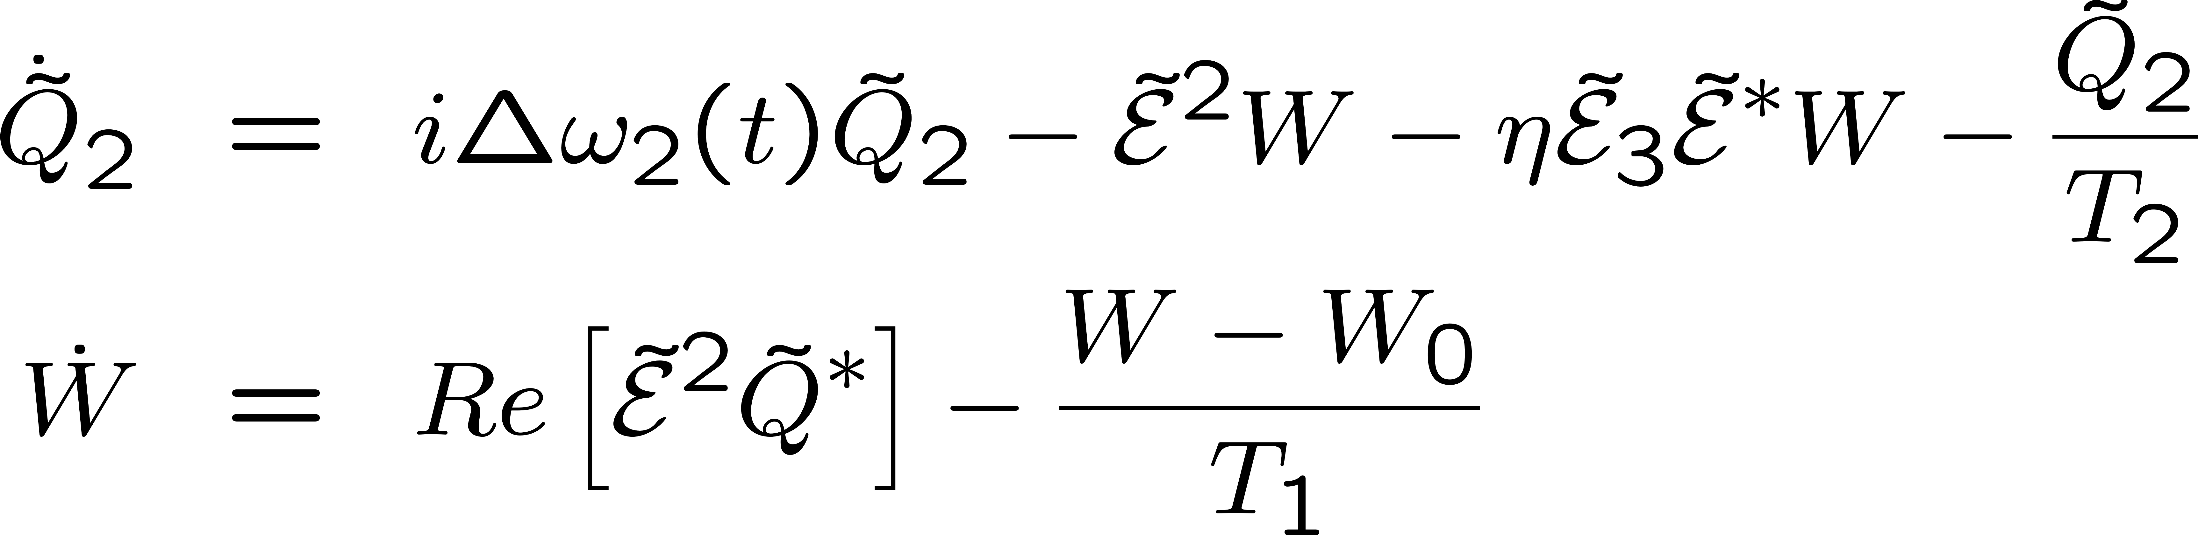
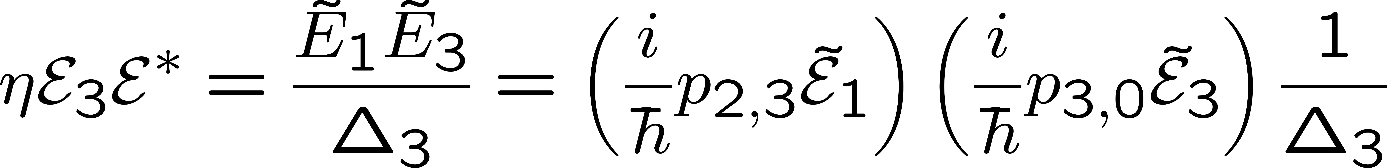
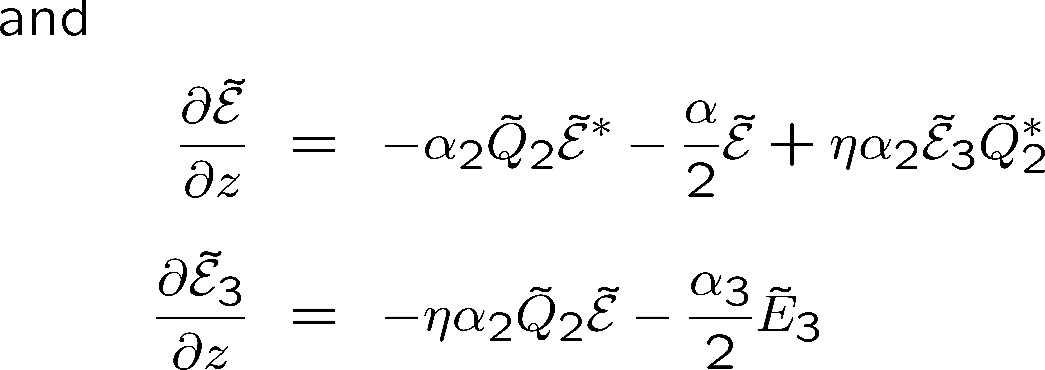
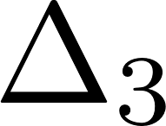


2 PHOTON PUMPING AND HARMONIC GENERATION

Slide 14
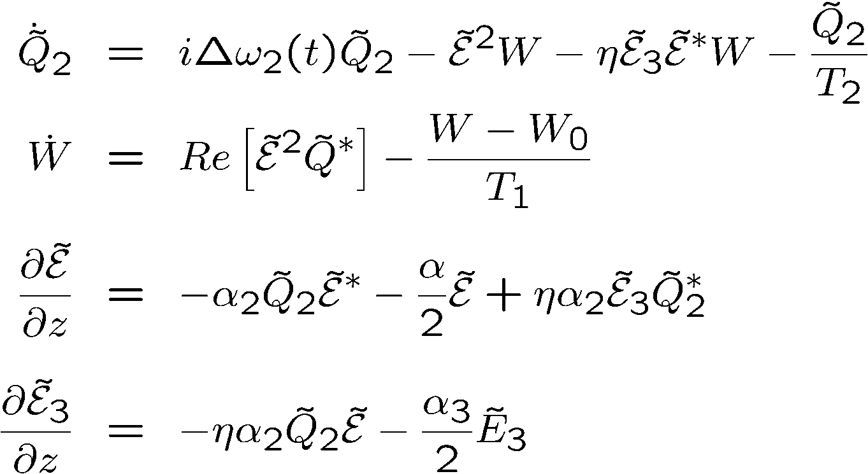
Bloch vector model
Contained in these expressions: Third order susceptibility, two-photon absorption,
third harmonic generation, stimulated Raman, phase conjugated FWM, etc...
The frequencies do no appear explicitly in these expressions.
But they can be “guessed” from the products of amplitudes.

Slide 15
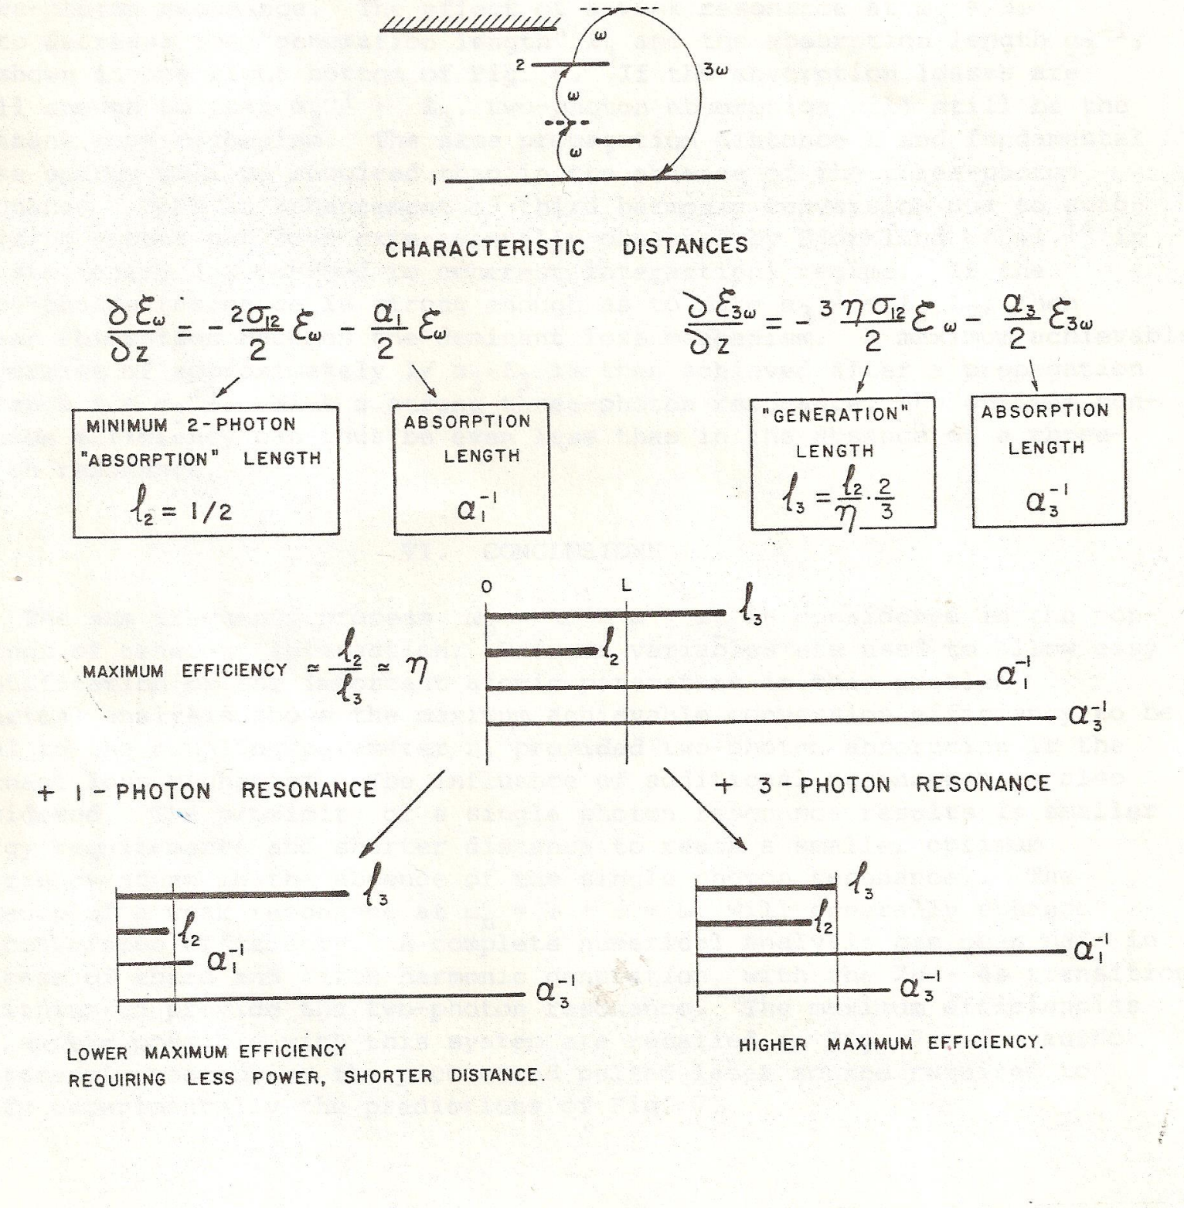

Slide 16
A resonance enhances harmonic generation
Less fundamental required to generate an harmonic.
The maximum power that you can achieve by harmonic generation is less.
That is a very general statement.
Other example: short pulse generation by Brillouin back scattering
Most efficient media cannot be used for highes power conversion

Slide 17
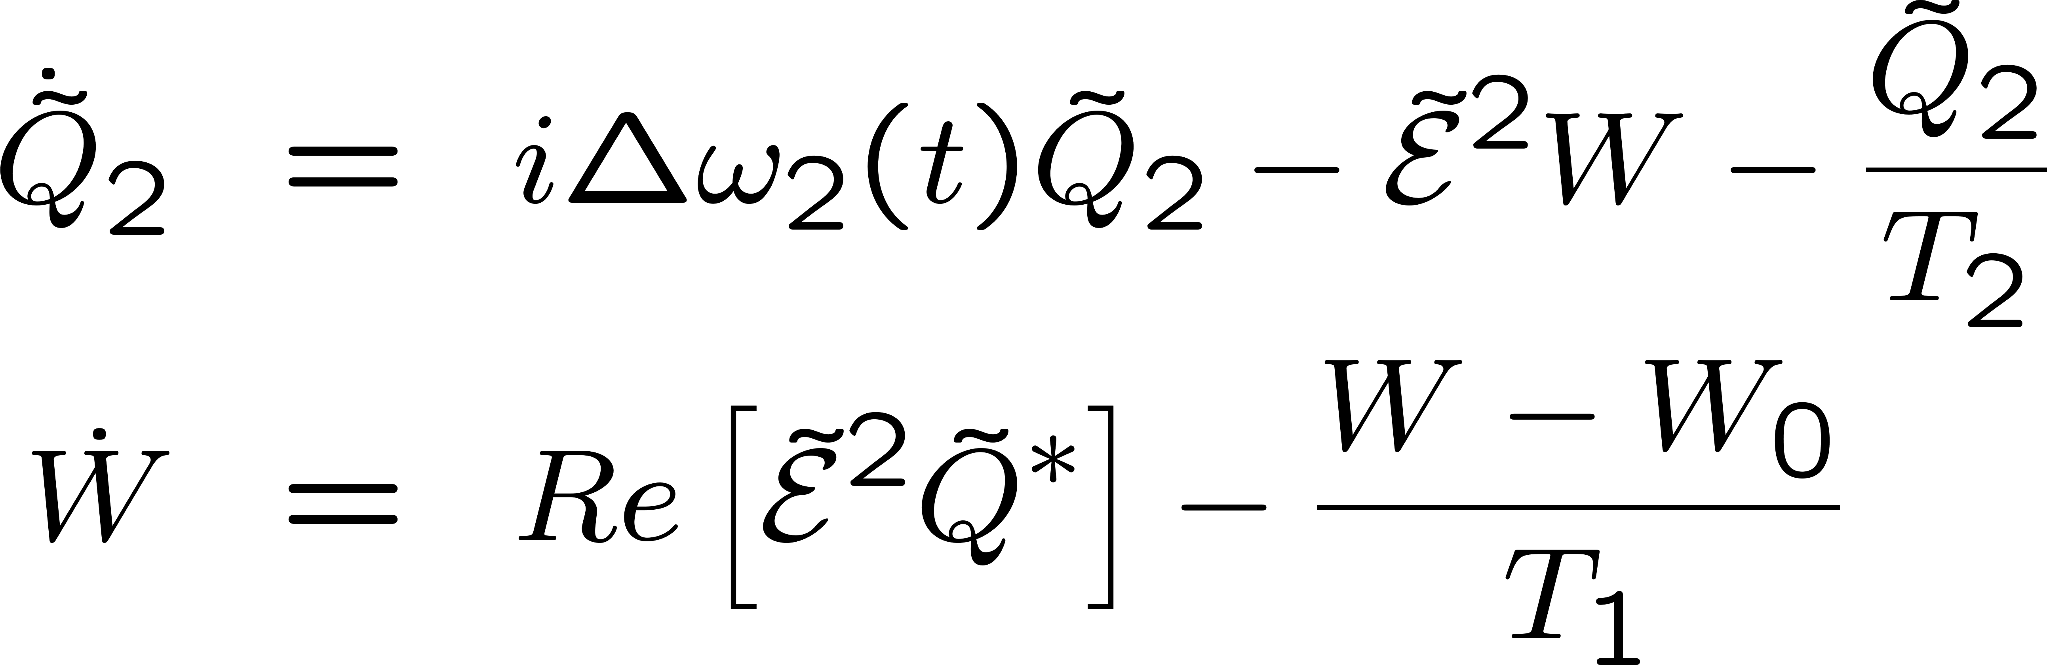

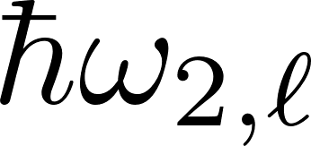
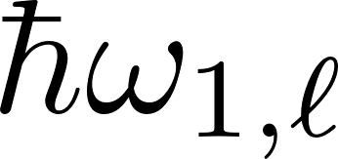
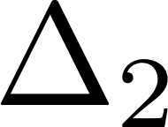
STIMULATED RAMAN SCATTERING

Slide 18
Back to two-photon resonant Third Harmonic generation
Example of lithium vapor
COHERENT INTERACTION:
THE ENERGY EXCHANGES CAN BE REVERSIBLE

Slide 19
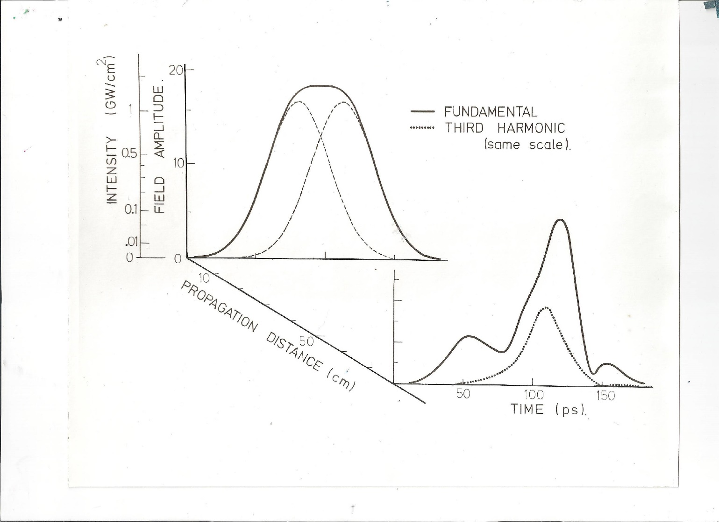
Simulations first
Third harmonic with 90 degree phase shifted pulses
90 degree phase shifted pulse propagation

Slide 20
OTHER EXAMPLE OF APPLICATION OF COHERENT INTERACTION:

Slide 21
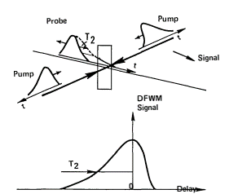
DEGENATE FOUR WAVE MIXING
What to expect

Slide 22
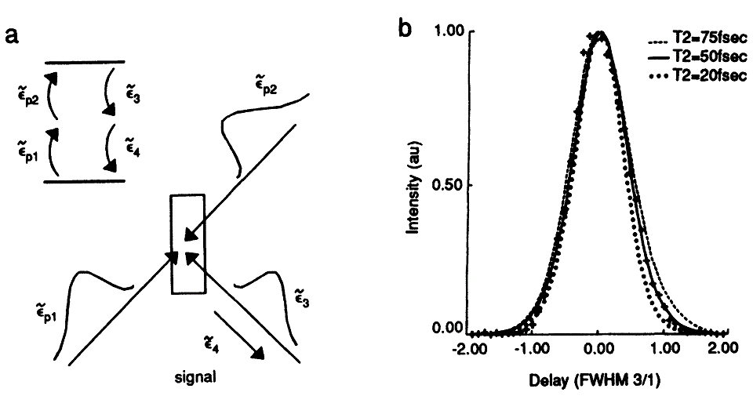
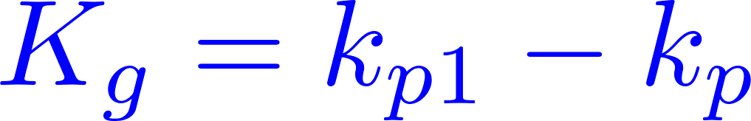



SINGLE PHOTON RESONANT
Grating interpretation
The probe beam and one pump form a grating.
The other pump scatters off that grating
to form the signal beam
w
u
v

Slide 23
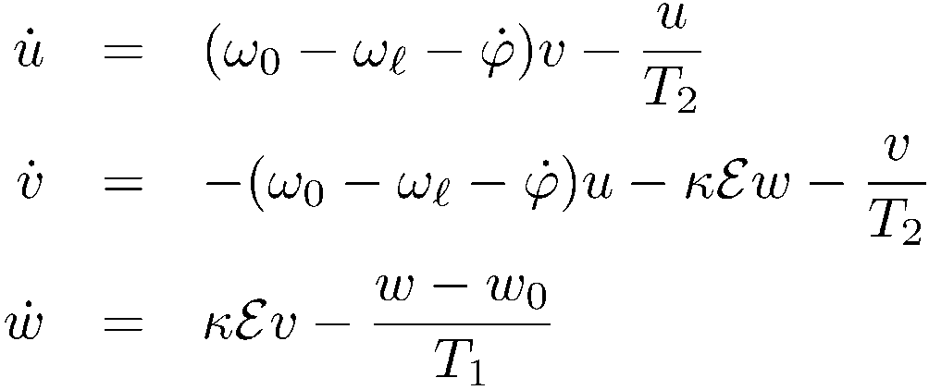
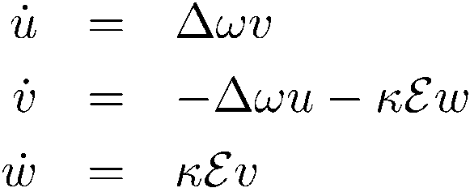
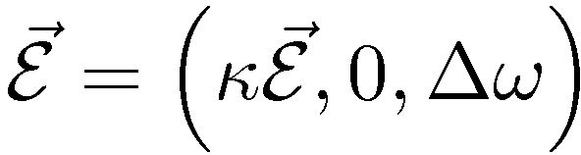
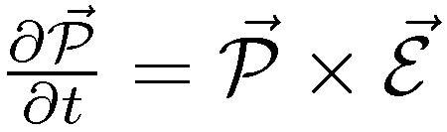
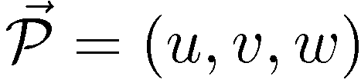
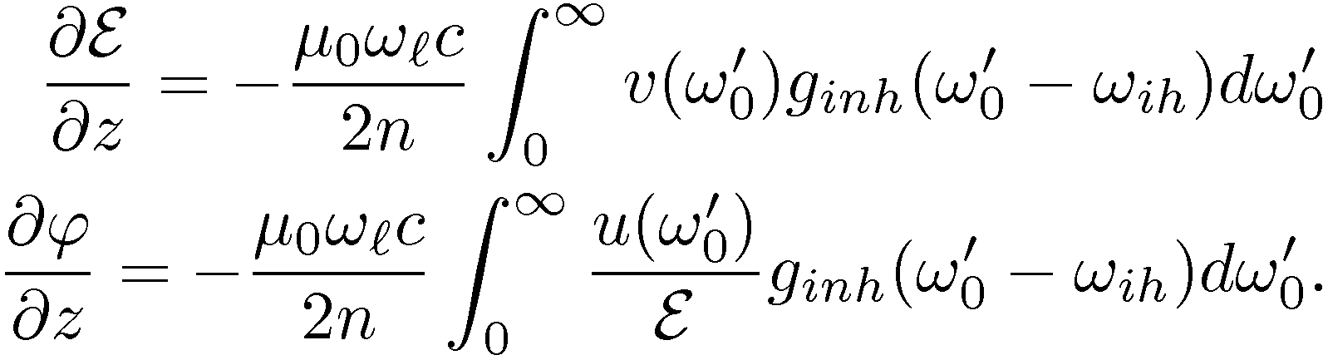

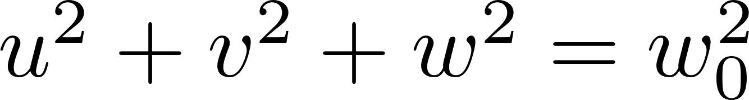
no relaxation
Propagation
w
u
v

Slide 24
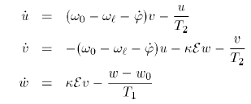
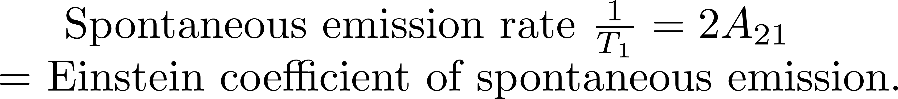
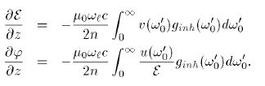
Homogeneous broadening
Inhomogeneous broadening

Slide 25
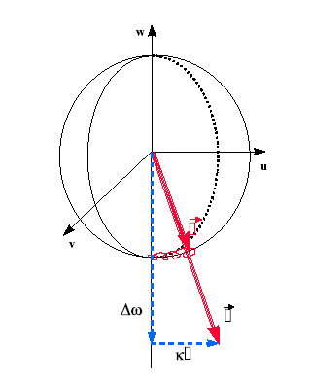

Slide 26
SINGLE PHOTON RESONANT

Slide 27

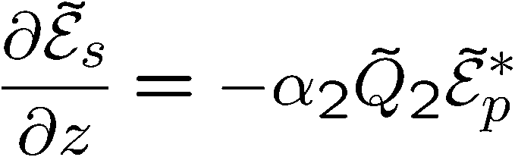

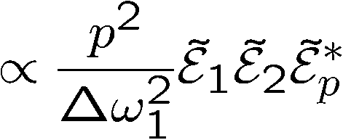

Two-photon absorption and DFWM
W
i
r

Slide 28






Two-photon absorption and DFWM
Exciting pulse:
G
FWHM = 76 fs = 1.72 τ
A
D
Delay
(units of FWHM of intensity autocorrelation)

Slide 29
OTHER EXAMPLE OF APPLICATION OF COHERENT INTERACTION:
THE BICHROMATIC GUIDESTAR

Slide 30
MOTIVATION
“Light travels undisturbed for
billions of years - only to get its
wavefront distorted in the last
few milliseconds”
What are the solutions to
atmospheric distortions?

Slide 31

1st solution:
Send an observer into space
…they selected Mr. Hubble

Slide 32
2nd solution:
Correct for the atmosphere
But how?
a)
Choose/create a point source within
2 arcsec of the object to be observed.
b)
Correct the telescope to minimize the
size of the image of the point source.

Slide 33
Corrrect telescope to minimize spot size
v
v

Slide 34
Thst does not correct the tilt
But you can correct if two wavelength return

Slide 35

Bichromatic Two-Photon Coherent Excitation
Closer to reality!
Excitation
Decay
We possible to put 98% of the sodium atoms into the 4S state either with a single bichromatic pulse or with a sequence (90⁰ shifted pulse sequence) of two bichromatic pulses.

Slide 36
Example of application:
2 photon coherent excitation
of Sodium
Which we approximate by
2
1
0

Slide 37




Two-photon absorption and optical pumping
W
Purpose: create a two photon population inversion
As before:
i
But we need to be ON resonance
r
Adiabatic approximation breaks down!

Slide 38
Two-photon absorption and optical pumping
Alternate to pi pulse pumping:
W
i
r

Slide 39

1st approach: off-resonance zero area pulse excitation
now

Slide 40
1st approach: off-resonance zero area pulse excitation
now

Slide 41
1st approach: off-resonance zero area pulse excitation
now

Slide 42

GENTLE CRITICISM FROM PETER MILONNI:
The level structure is not this:
But this:
Excitation
Decay

Slide 43
1st approach: off-resonance zero area pulse excitation
The purist will tell you that you have to include the full hyperfine structure

Slide 45
1st approach: off-resonance zero area pulse excitation
The result of listening to the purist:
Δt = 650 ps
F₅₈₉ = .90 μJ/cm²
τ = 100 ps
F₁₁₄₀ = 2.2 μJ/cm²
Δ₁ = 14.6 GHz
Δ₂ = 2.39 GHz

Slide 46


Second approach: the two-photon “pi pulse”
τ=10 ps, 4.58 μJ/cm² (each)
Δ₁ = 1.91 GHz and Δ₂ = 2.39 GHz.

Slide 47

Including the complete hyperfine structure of the sodium atom, thereby increasing the size of the system of coupled partial differential equations from 3 to 112, gives a nearly identical result as the 3-level model.
Level populations
ρ₁₁ –level
ρ₂₂ –mid
ρ₃₃ –upper
A 90⁰ phase shifted sequence of two 100 ps pulses separated by 650 ps, fluence of 0.9 J/cm² with detunings of Δ =14.6 GHz near 589 nm, fluence of 2.2 J/cm² at 1140 nm with detunings of Δ =2.4 GHz.

Slide 48

Other Excitation Schemes
Excitation
Return
resonant two-photon
polychromatic
Foy et.al.
cw: > 10 kW, pulsed > 250 W
coherent non-res. two-photon
polychromatic
Biegert et.al.
pulsed > 400 mW

Slide 49
LABORATORY DEMONSTRATION
Based on Nd:YAG pumped OPO; 10 ps pulse duration.
(ideal pulse duration would be 800 ps)
PROCEDURE
Tune yellow at resonance;
adjust energy to reach max fluorescence; increase to 0 fluorescence.
Combine with increasing power and tuning 1140 to reach again max fluorescence
Compare photon yield IR and yellow – they should be equal
Single emission decay time – convolution of the two emission lifetimes
Fluorescence photon yield:
4s 3p:
3p 3s:
They are equal confirms cascade decay

Slide 50


Pulsed versus CW excitation
Pulse duration: 800 ps
Yellow pulse energy density 34 nJ/cm²
IR (1140 nm) pulse energy density 84 nJ/cm²
For a spot size of 120 cm diameter at the sodium layer, of density 5 10⁹ atoms/cm3,
the energy required per pulse is:
Yellow: 770 μJ
1140 nm: 1890 μJ
Photon return/pulse
Experiment and theory have established that a total inversion can be realized,
Number of photons emitted/pulse pair:
Number of photons collected by a 3 m telescope:
is the solid angle.
0.11 photons/cm² return per bichromatic pulse.
Note: Because a complete inversion is created, one can use a beam diameter (w = 20 cm?) than in the cw irradiation, hence reducing the energy required per pulse.

Slide 51
Pulsed versus CW excitation
0.11 photons/cm² return per bichromatic pulse.
Comparison made for 20W yellow (repetition rate of pulsed 25 kHz), which yields a photon return of 2,900 photons/(cm² s) for pulsed bichromatic excitation.
CW excitation using the same parameters: 660 photons/(cm² s) (details next slide)
For the same average power of 20 W, the bichromatic pulses give a larger
photon return by a factor 2,870/660 = 4.3.
Note: Both results may require a directional factor of 1.5 used in most theories.

Slide 52



CW excitation using the same parameters for sodium

