Slide 1
OTHER EXAMPLE OF APPLICATION OF COHERENT INTERACTION:
THE BICHROMATIC GUIDESTAR

Slide 2
MOTIVATION
“Light travels undisturbed for
billions of years - only to get its
wavefront distorted in the last
few milliseconds”
What are the solutions to
atmospheric distortions?

Slide 3

1st solution:
Send an observer into space
…they selected Mr. Hubble

Slide 4
2nd solution:
Correct for the atmosphere
But how?
a)
Choose/create a point source within
2 arcsec of the object to be observed.
b)
Correct the telescope to minimize the
size of the image of the point source.

Slide 5
Corrrect telescope to minimize spot size
v
v

Slide 6
Thst does not correct the tilt
But you can correct if two wavelength return

Slide 7
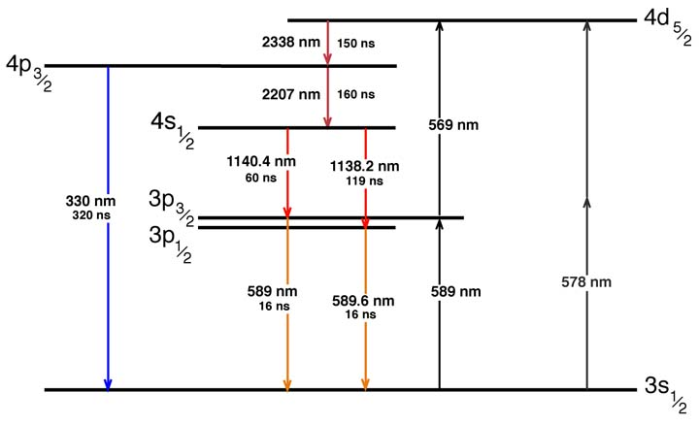
Sodium levels
355 nm

Slide 8
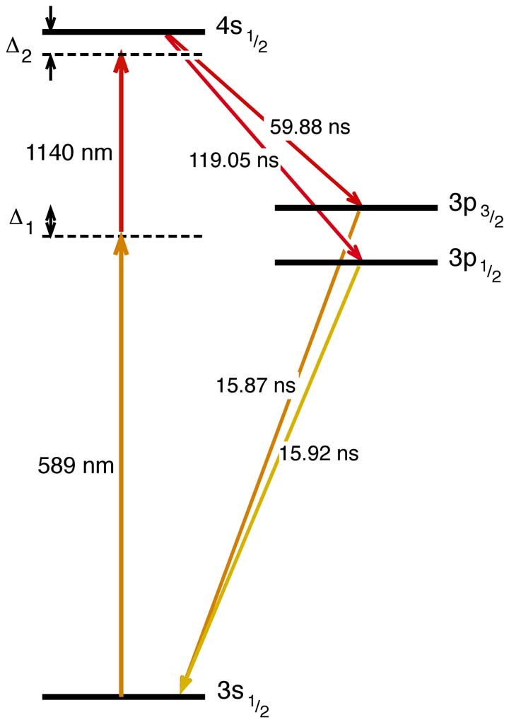
Bichromatic Two-Photon Coherent Excitation
Excitation
Decay
Which we approximate by
2
1
0

Slide 9
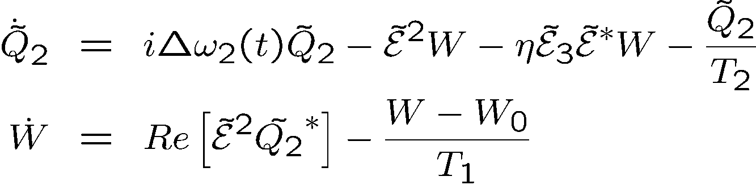
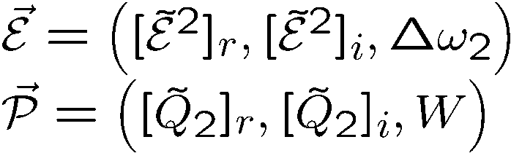
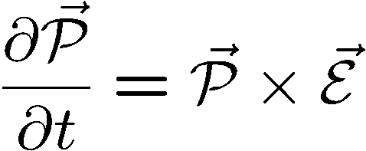
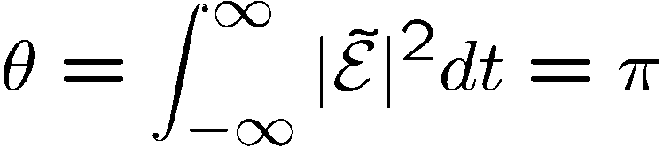



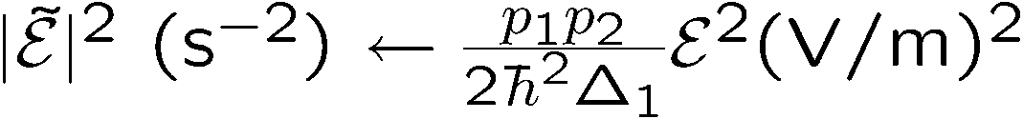




Two-photon absorption and optical pumping
W
Purpose: create a two photon population inversion
As before:
i
But we need to be ON resonance
r
Adiabatic approximation breaks down!

Slide 10
Two-photon absorption and optical pumping
Alternate to pi pulse pumping:
W
i
r

Slide 11
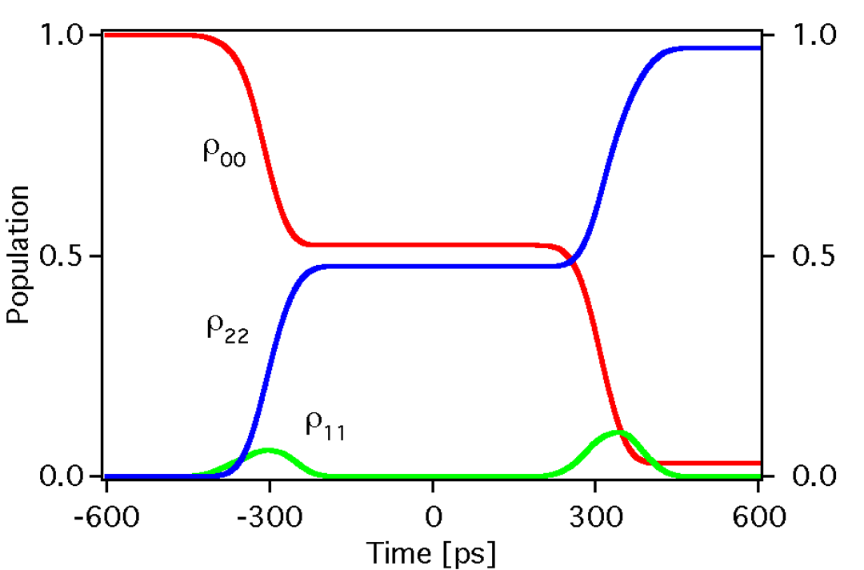
1st approach: off-resonance zero area pulse excitation
now

Slide 12
1st approach: off-resonance zero area pulse excitation
now

Slide 13
1st approach: off-resonance zero area pulse excitation
now

Slide 14
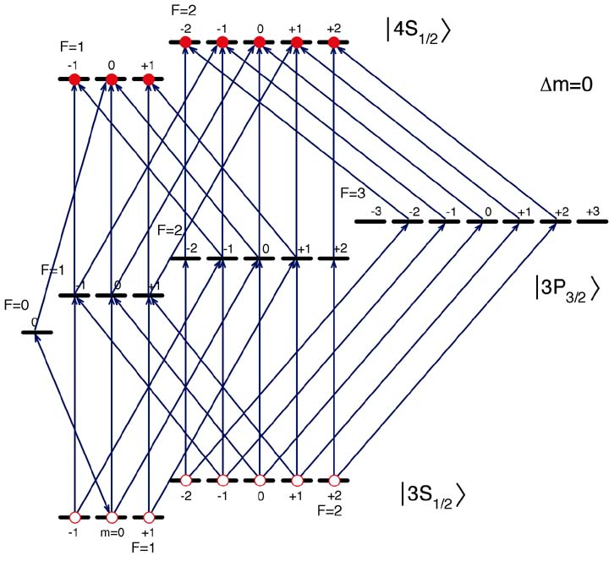
GENTLE CRITICISM FROM PETER MILONNI:
The level structure is not this:
But this:
Excitation
Decay
32 coupled equations with 112 terms
+ Doppler broadening

Slide 15
1st approach: off-resonance zero area pulse excitation
The purist will tell you that you have to include the full hyperfine structure

Slide 17
1st approach: off-resonance zero area pulse excitation
The result of listening to the purist:
32 coupled equations with 112 terms
+ Doppler broadening
Δt = 650 ps
F₅₈₉ = .90 μJ/cm²
τ = 100 ps
F₁₁₄₀ = 2.2 μJ/cm²
3 level approximation: the effective dipole moments
are not the mean square average
of the 56 matrix elements
Δ₁ = 14.6 GHz
Δ₂ = 2.39 GHz

Slide 18
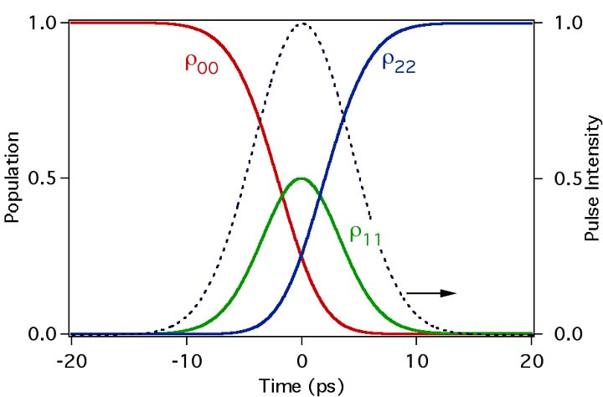
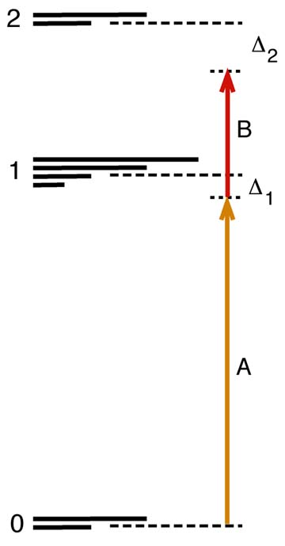
Second approach: the two-photon “pi pulse”
τ=10 ps, 4.58 μJ/cm² (each)
Δ₁ = 1.91 GHz and Δ₂ = 2.39 GHz.

Slide 19
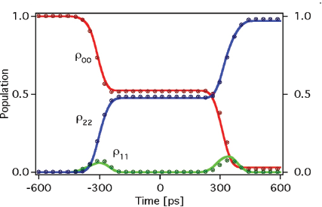
Including the complete hyperfine structure of the sodium atom, thereby increasing the size of the system of coupled partial differential equations from 3 to 112, gives a nearly identical result as the 3-level model.
Level populations
ρ₁₁ –level
ρ₂₂ –mid
ρ₃₃ –upper
A 90⁰ phase shifted sequence of two 100 ps pulses separated by 650 ps, fluence of 0.9 J/cm² with detunings of Δ =14.6 GHz near 589 nm, fluence of 2.2 J/cm² at 1140 nm with detunings of Δ =2.4 GHz.

Slide 20
Other Excitation Schemes
Excitation
Return
resonant two-photon
polychromatic
Foy et.al.
cw: > 10 kW, pulsed > 250 W
coherent non-res. two-photon
polychromatic
Biegert et.al.
pulsed > 400 mW

Slide 21
LABORATORY DEMONSTRATION
Based on Nd:YAG pumped OPO; 10 ps pulse duration.
(ideal pulse duration would be 800 ps)
PROCEDURE
Tune yellow at resonance;
adjust energy to reach max fluorescence; increase to 0 fluorescence.
Combine with increasing power and tuning 1140 to reach again max fluorescence
Compare photon yield IR and yellow – they should be equal
Single emission decay time – convolution of the two emission lifetimes
Fluorescence photon yield:
4s 3p:
3p 3s:
They are equal confirms cascade decay

Slide 22


Pulsed versus CW excitation
Pulse duration: 800 ps
Yellow pulse energy density 34 nJ/cm²
IR (1140 nm) pulse energy density 84 nJ/cm²
For a spot size of 120 cm diameter at the sodium layer, of density 5 10⁹ atoms/cm3,
the energy required per pulse is:
Yellow: 770 μJ
1140 nm: 1890 μJ
Photon return/pulse
Experiment and theory have established that a total inversion can be realized,
Number of photons emitted/pulse pair:
Number of photons collected by a 3 m telescope:
is the solid angle.
0.11 photons/cm² return per bichromatic pulse.
Note: Because a complete inversion is created, one can use a beam diameter (w = 20 cm?) than in the cw irradiation, hence reducing the energy required per pulse.

Slide 23
Pulsed versus CW excitation
0.11 photons/cm² return per bichromatic pulse.
Comparison made for 20W yellow (repetition rate of pulsed 25 kHz), which yields a photon return of 2,900 photons/(cm² s) for pulsed bichromatic excitation.
CW excitation using the same parameters: 660 photons/(cm² s) (details next slide)
For the same average power of 20 W, the bichromatic pulses give a larger
photon return by a factor 2,870/660 = 4.3.
Note: Both results may require a directional factor of 1.5 used in most theories.

Slide 24
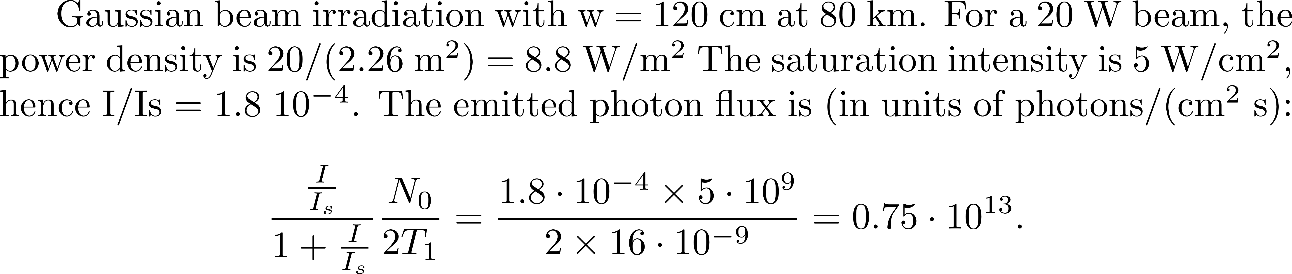
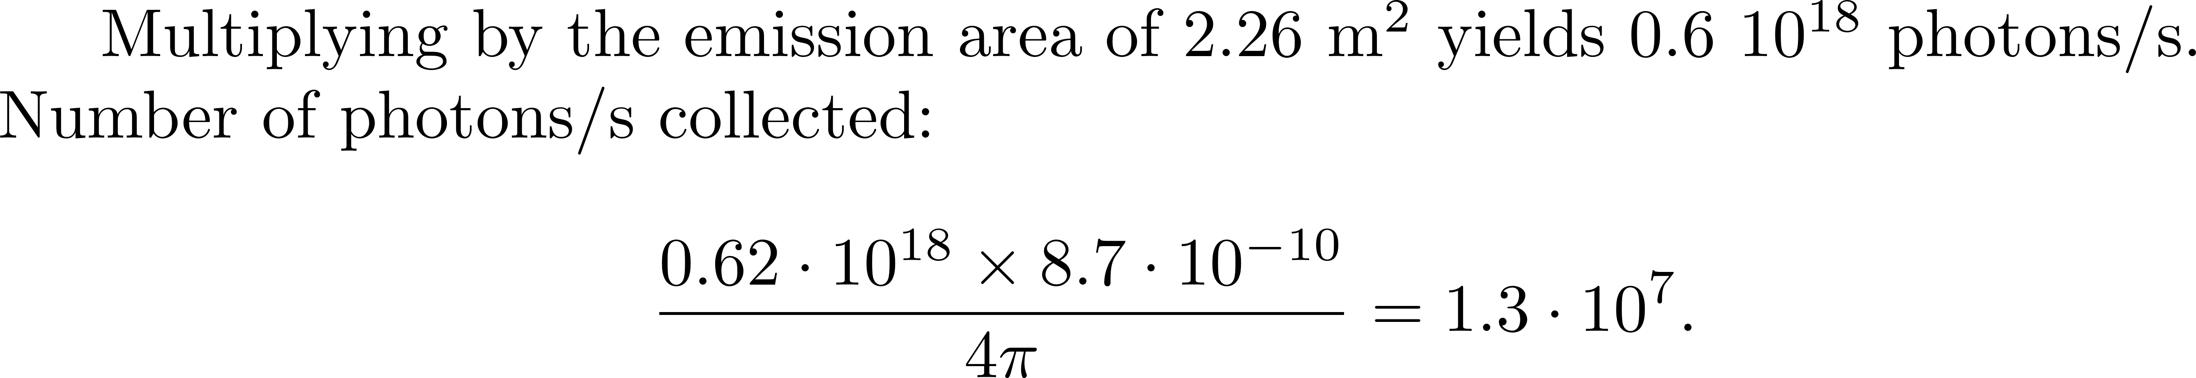
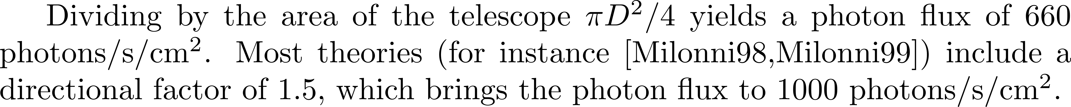
CW excitation using the same parameters for sodium

Slide 25
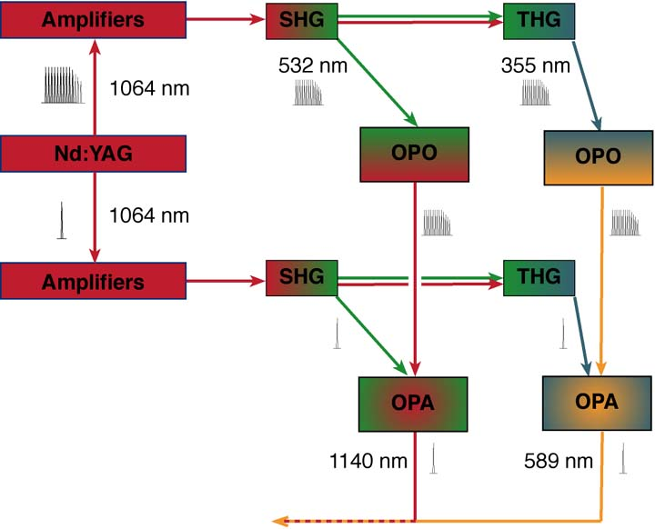
Bichromatic Tunable Source

Slide 26
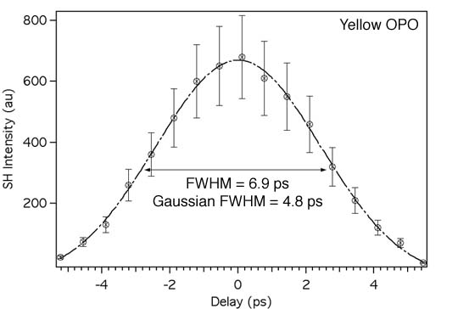
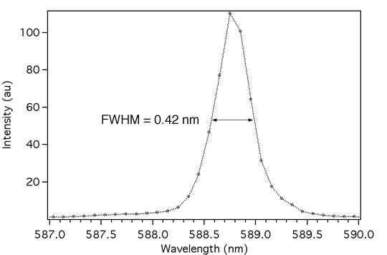
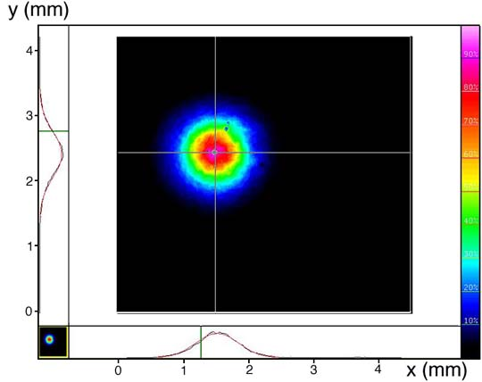
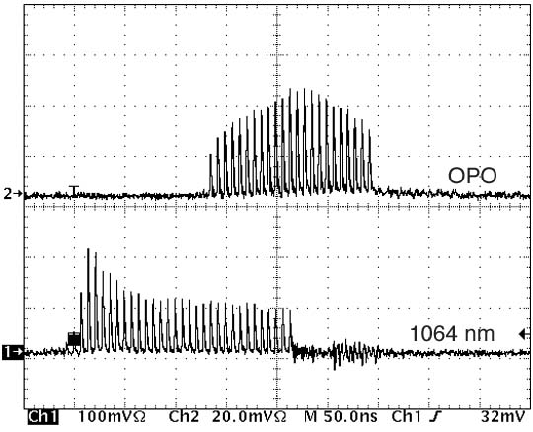
Yellow OPO

Slide 27
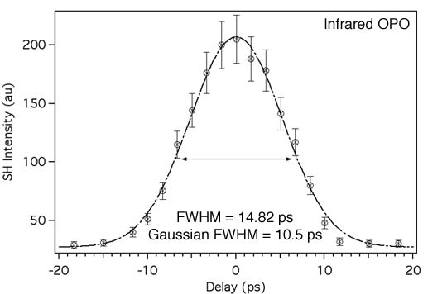
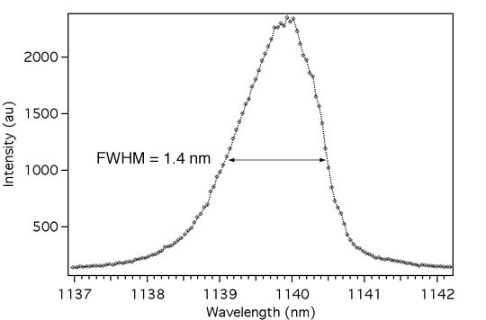
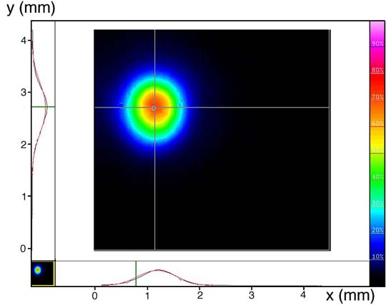
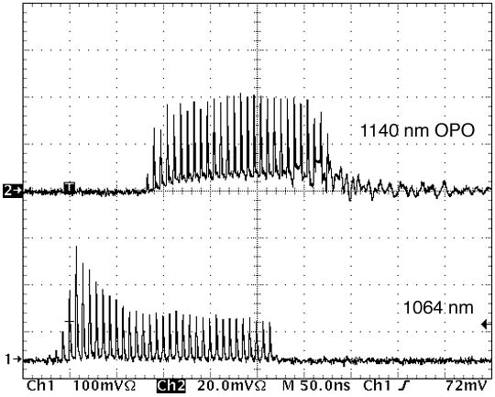
Infrared OPO

Slide 28
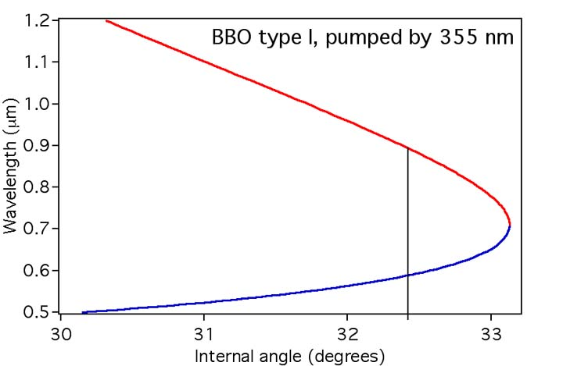
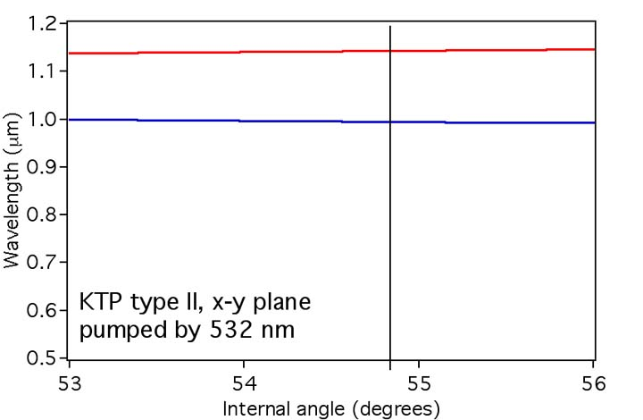
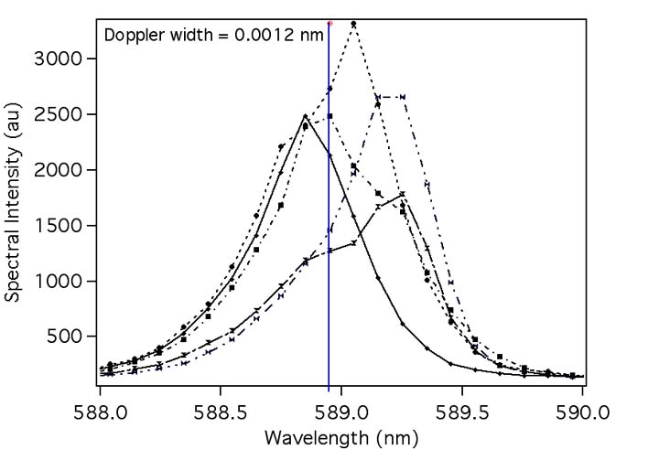
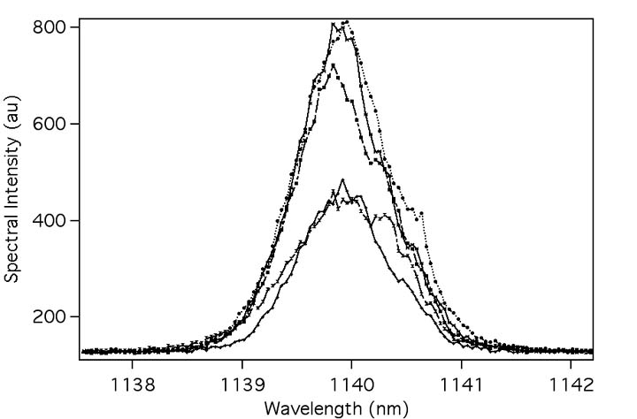
Wavelength Jitter

Slide 29
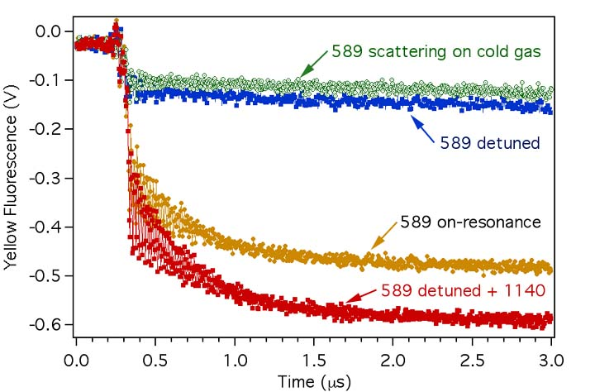
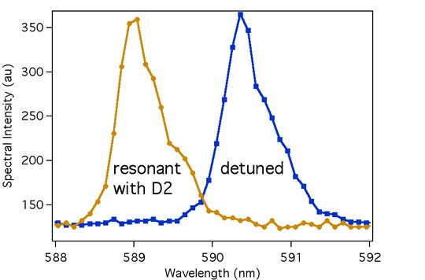
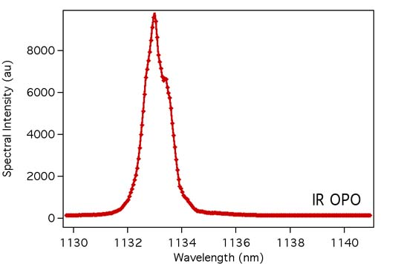
Excitation via the 3p_{3/2} state

Slide 30
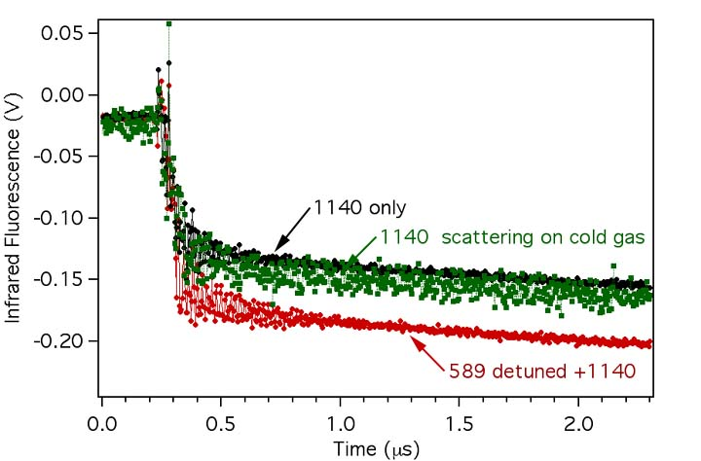
Excitation via the 3p_{3/2} state
Photon yield:
4s 3p:
3p 3s:
They are equal confirms cascade decay

Slide 31
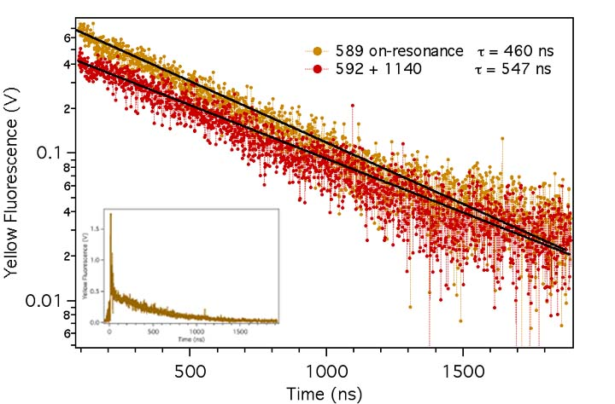
Time-Resolved Fluorescence
Measured with fast PMT (ungated, 650 ps time resolution)
Scattering signal too strong longer time response
Measure instrument response time
deconvolve signals

Slide 32
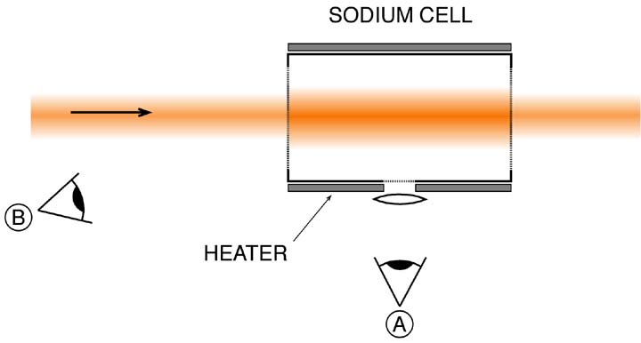
Detection Geometry
Both positions give the same expected signal
Scattering is much larger at (B)

