Slide 1
LIGHT-MATTER INTERACTION
The Wigner distribution
Moments
Define the instantaneous frequency in time and frequency Wigner applied to pulse measurements
Time bandwidth product
Time-Bandwidth product to Uncertainty relations
Uncertainty relations to Schroedinger equation
Particle wave duality
Uncertainty relations
The double slit experiment
LASER-MATTER INTERACTION
Bloch Vector Model
Coherent propagation
Photon Echoes
Free induction decay
Coherent transients
From transients to steady state

Slide 2
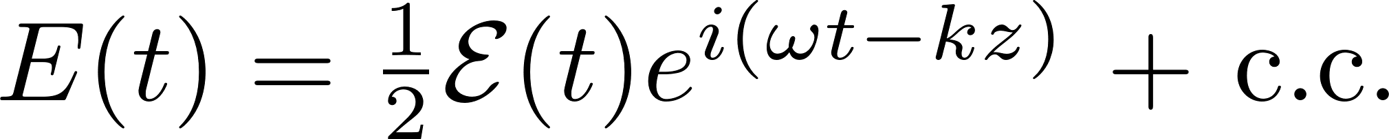
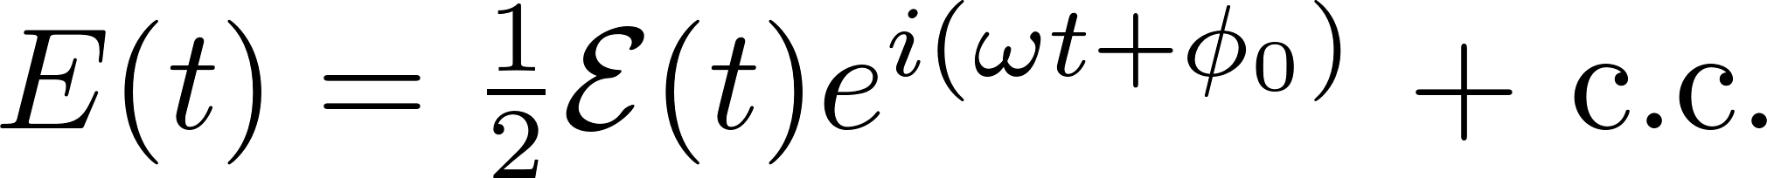
Different representations of a signal
Carrier to envelope phase and carrier to envelope offset
Carrier to envelope phase: a definition independent of a carrier and envelope
Carrier to envelope offset: it is a frequency, and exists only in combs
No carrier, but envelopes in time and frequency: the Wigner representation

Slide 3


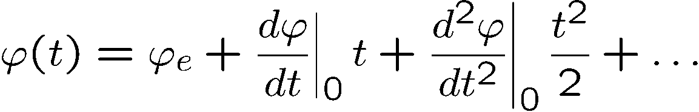
Description of an optical pulse
How to get to complex notations the easy way
Real electric field:
Fourier transform:
Positive and negative frequencies: redundant information
Eliminate
Relation with the real physical measurable field:
Instantaneous frequency
Notes:
we summarize the essential notations and definitions.
Inside the laser typically, only one pulse circulate. A complex representation
of the field amplitude is particularly convenient in dealing with
propagation problems of electromagnetic pulses.

Slide 4




Wigner Distribution
Ref: L. Praxmeier and K. Wodkiewicz. Time and frequency description of optical pulses.
arXiv:physics, 0502079v2:1–12, 2005.
Pulse measurements?
You can measure I(t) – that does not give you E(t).
You can measure I(Ω) – that does not give you E(t).
Can we replace the notion amplitude-phase by intensity in time vs intensity in frequency?
Space-time analogy:
Beam measurements?
You can measure I(x,y) – that does not give you E(x,y).
You can measure I(k_{x}, k_{y}) – that does not give you E(k_{x},k_{y}).
-> Wigner function plot I(x, y) vs I(kx, ky)

Slide 5
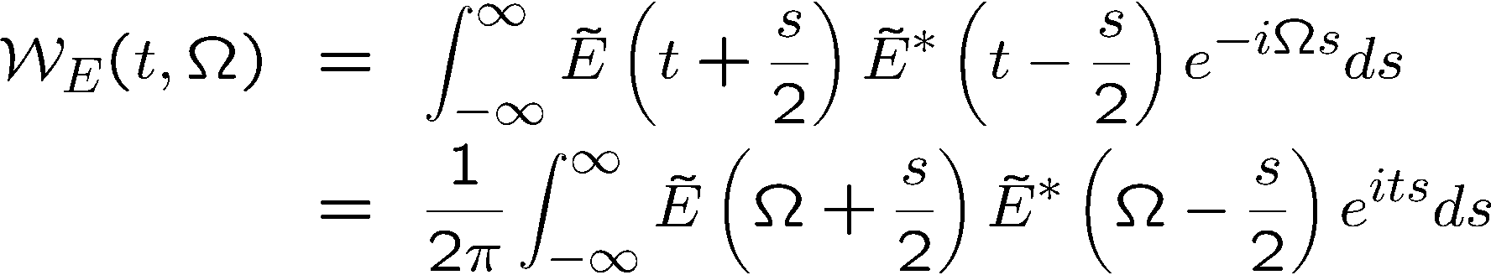
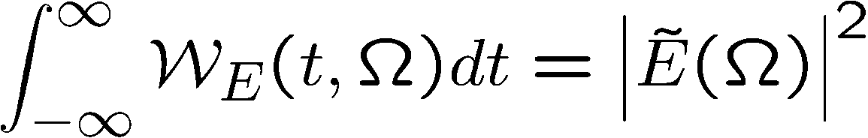
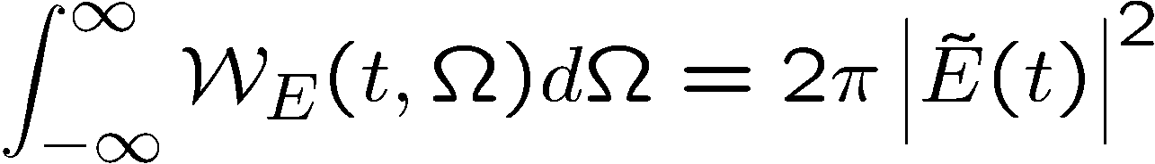
TIME-FREQUENCY
Pulse duration, Spectral width
Two-D representation of the field: Wigner function

Slide 6
Wigner Distribution
Gaussian
Chirped Gaussian

Slide 7
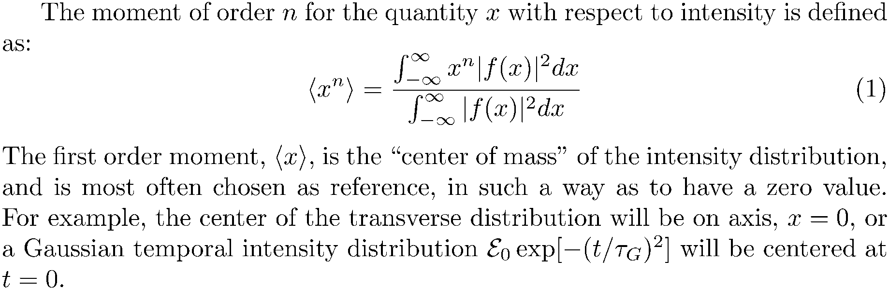
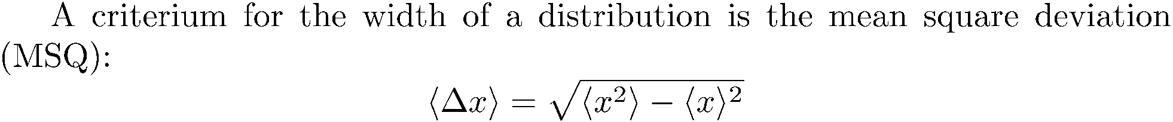
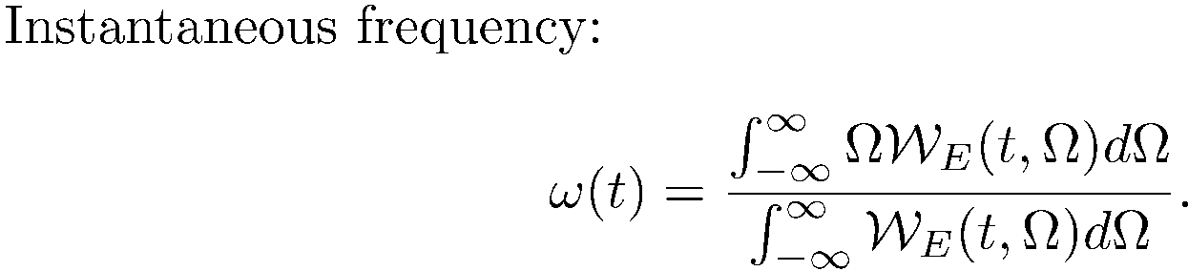

Slide 8
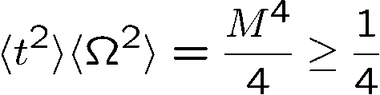
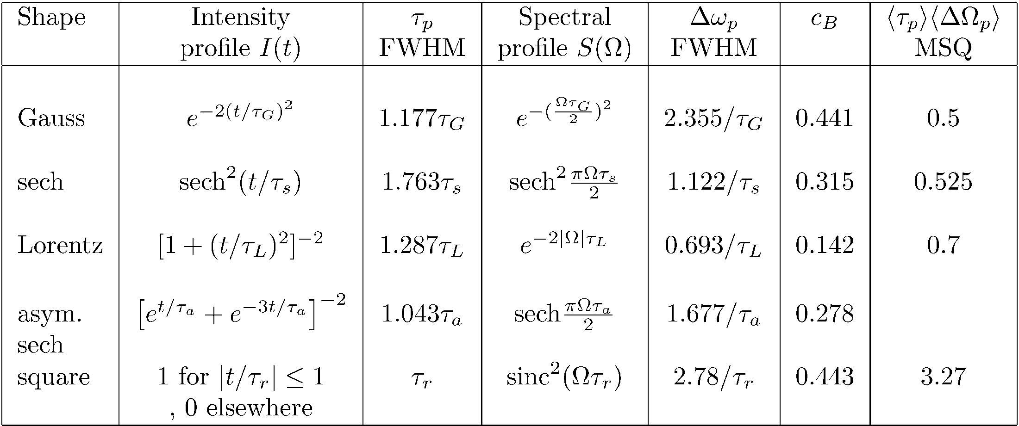
Uncertainty relation
Only holds for the pulse widths defined as
the mean square deviation

Slide 9
LIGHT-MATTER INTERACTION
The Wigner distribution
Moments
Define the instantaneous frequency in time and frequency Wigner applied to pulse measurements
Time bandwidth product
Time-Bandwidth product to Uncertainty relations
Uncertainty relations to Schroedinger equation
Particle wave duality
Uncertainty relations
The double slit experiment
LASER-MATTER INTERACTION
Bloch Vector Model
Coherent propagation
Photon Echoes
Free induction decay
Coherent transients
From transients to steady state

Slide 10
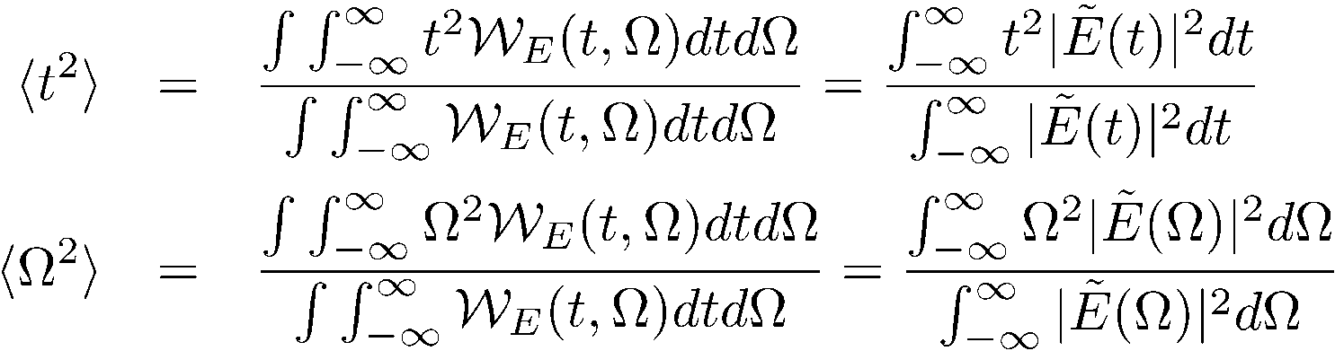
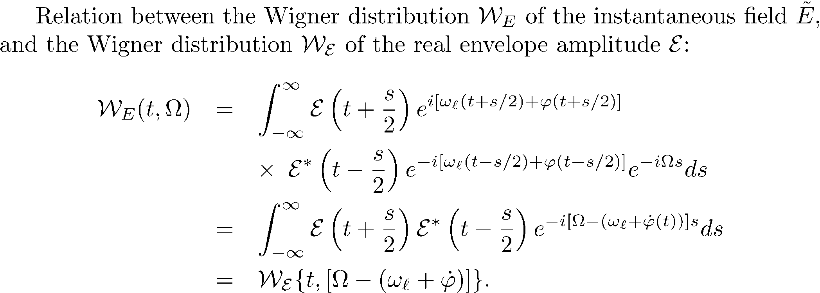
Wigner Distribution
Second moments

Slide 11
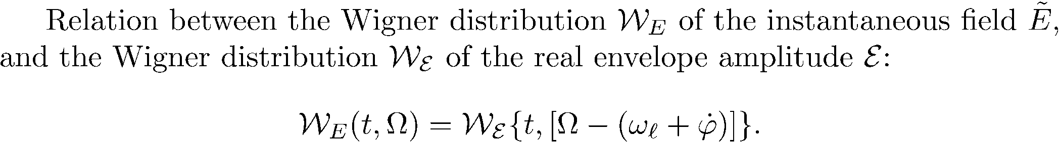

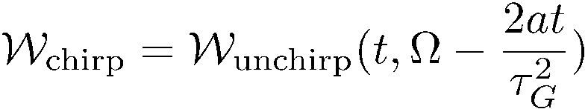
Unchirped Gaussian

Slide 12
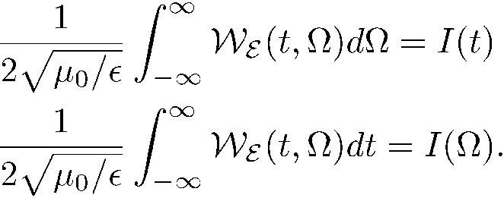
The intensity and spectral intensities are directly proportional to frequency
and time integrations of the Wigner function.
Unchirped Gaussian

Slide 13
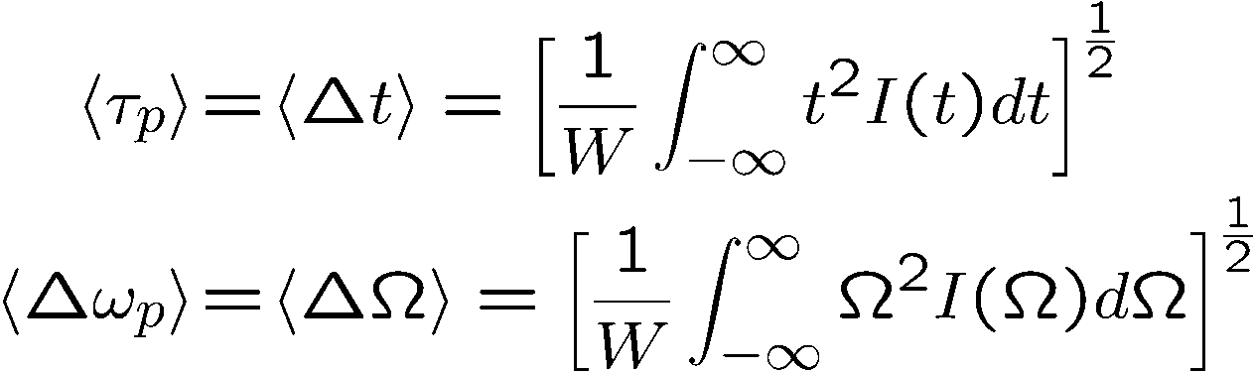
Wigner Distribution
Second moments
Gaussian
Chirped Gaussian

Slide 14
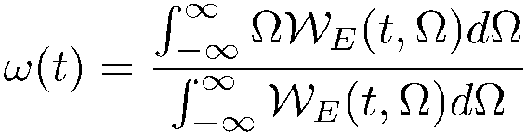
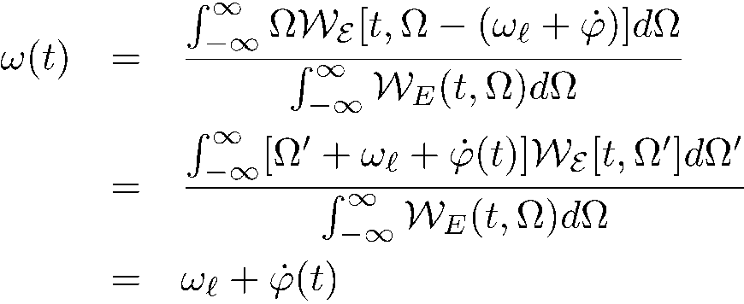

Wigner Distribution
Second moments
Instantaneous frequency: is it the derivative of the phase, or the center of gravity of the spectrum?
where we used the fact that

Slide 15
LIGHT-MATTER INTERACTION
The Wigner distribution
Moments
Define the instantaneous frequency in time and frequency Wigner applied to pulse measurements
Time bandwidth product
Time-Bandwidth product to Uncertainty relations
Uncertainty relations to Schroedinger equation
Particle wave duality
Uncertainty relations
The double slit experiment
LASER-MATTER INTERACTION
Bloch Vector Model
Coherent propagation
Photon Echoes
Free induction decay
Coherent transients
From transients to steady state

Slide 16
TIME-FREQUENCY
Pulse duration, Spectral width
Can a measurement provide a two-D representation of the field (Wigner function)
The FROG
Frequency Resolved Optical Gating

Slide 17
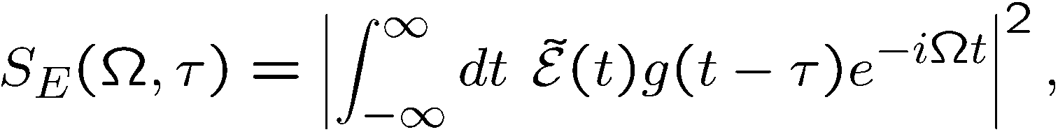
The FROG
Frequency Resolved Optical Gating
It is a time gated spectrum, measuring a two D function:
References:
Advantage: the raw data give a nice representation
Disadvantage: considerable iterations
FROG Trebino,
Kluwer, 2002
Adam S. Wyat
PhD Thesis
University of Oxford
(2007)

Slide 18
Spectrograms for Linearly Chirped Pulses
Negatively chirped Unchirped Positively chirped
Frequency
Time
Frequency
Delay
Like a musical score, the spectrogram visually displays the frequency vs. time (and the intensity, too).
Notes:
18

Slide 19
As in all measurements, there is competition between accuracy in amplitude or phase
Algorithms exist to retrieve E(t) from its spectrogram.
The spectrogram essentially uniquely determines the waveform intensity, I(t), and phase, φ(t).
There are a few ambiguities, but they’re “trivial.”
The gate need not be—and should not be—much shorter than E(t).
Suppose we use a delta-function gate pulse:
= The Intensity.
No phase information!
Notes:
19

Slide 20
LIGHT-MATTER INTERACTION
The Wigner distribution
Moments
Define the instantaneous frequency in time and frequency Wigner applied to pulse measurements
Time bandwidth product
Time-Bandwidth product to Uncertainty relations
Uncertainty relations to Schroedinger equation
Particle wave duality
Uncertainty relations
The double slit experiment
LASER-MATTER INTERACTION
Bloch Vector Model
Coherent propagation
Photon Echoes
Free induction decay
Coherent transients
From transients to steady state

Slide 21
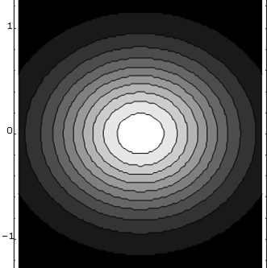
Minimum uncertainty
wave packet
Frequency
Time
“Pure state”
2
1
Frequency
0
-1
-2
-2
-1
0
1
2
Time

Slide 22
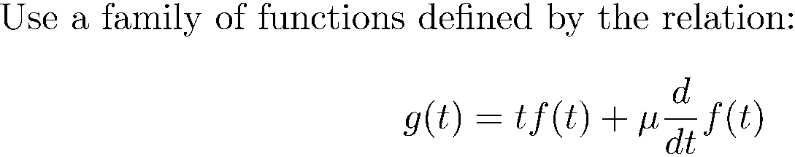

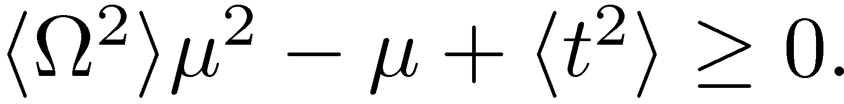
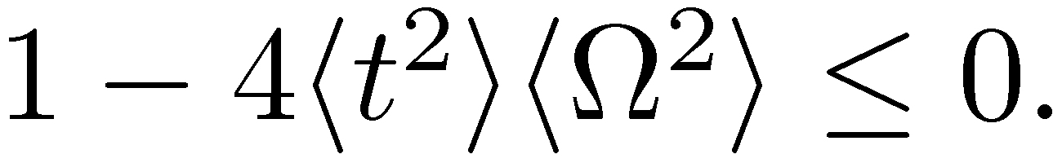
DERIVATION OF THE TIME-BANDWIDTH RELATIONS
Energy:
0
No roots implies

Slide 23
Wigner Distribution
Quantum Mechanics in 5 slides
Second moments
Instantaneous frequency: is it the derivative of the phase, or the center of gravity of the spectrum?
Uncertainty relation
where we used the fact that

Slide 24
LIGHT-MATTER INTERACTION
The Wigner distribution
Moments
Define the instantaneous frequency in time and frequency Wigner applied to pulse measurements
Time bandwidth product
Time-Bandwidth product to Uncertainty relations
Uncertainty relations to Schroedinger equation
Particle wave duality
Uncertainty relations
The double slit experiment
LASER-MATTER INTERACTION
Bloch Vector Model
Coherent propagation
Photon Echoes
The double slit experiment
Uncertainty relations
Coherent transients
From transients to steady state

Slide 25

Uncertainty relation
In space:
Only holds for the pulse widths defined as
the mean square deviation
Equality only holds for a Gaussian pulse (beam) shape free of any
phase modulation, which implies that the Wigner distribution for a
Gaussian shape occupies the smallest area in the time/frequency
plane.

Slide 26











Quantum Mechanics: just add particle-wave duality:
Particle of energy W Wave of frequency
Particle of momentum p Wave of wave vector k
The Heisenberg uncertainty relation is contained directly in:
and
No need for quantum mechanics – just the wave particle duality!
Particle Wave
Energy W
Momentum p

Slide 27


Photon number – phase uncertainty
Small number of photons: small uncertainty.
P(n)
Small number of photons: large phase uncertainty.
Large number of photons: small phase uncertainty.
n
time

Slide 28
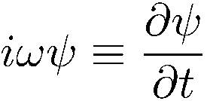
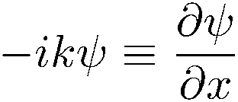
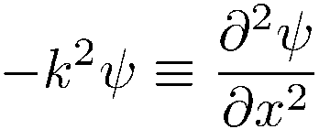
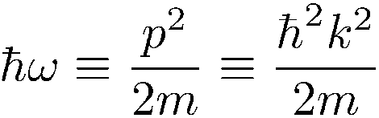
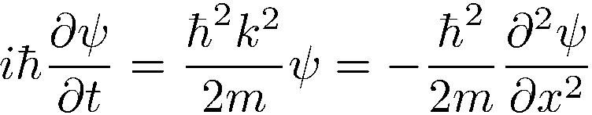
Particle wave duality, uncertainty principle, even leads to Schroedinger equation
The Wigner function in optics told us that:
and
Combine with particle-wave duality:
Particle Wave
Energy W
Momentum p
Particle-wave duality calls for a wave equation.
Differentiation with respect to t multiplication by ω
Differentiation with respect to x multiplication by k

Slide 29
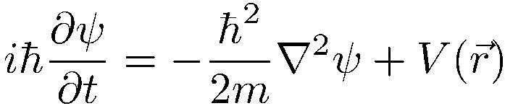
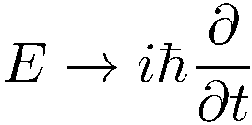


Slide 30
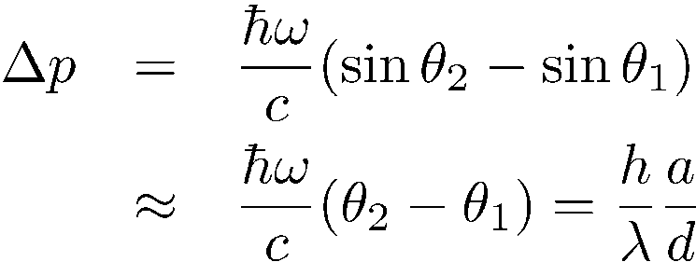

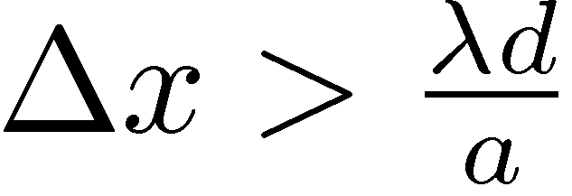
Double slit: a Gedanken experiment
You measure the momentum on the slitted screen each time a photon is detected on P
Δ(photon momentum)
P
θ₂
=
but
a
θ₁
=
The uncertainty is larger than the fringe spacing!
d

Slide 31
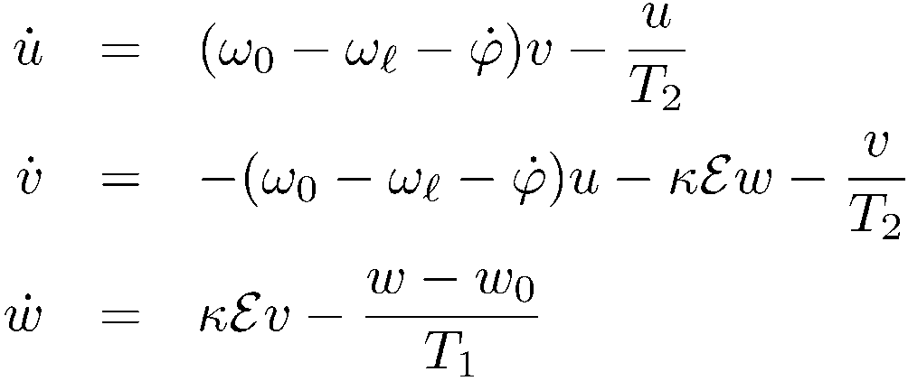
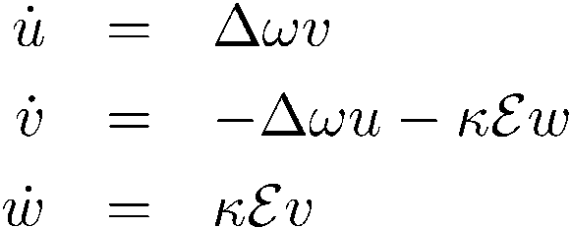
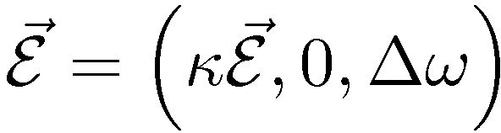
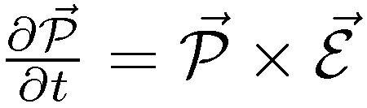
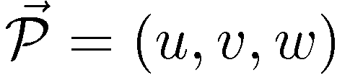
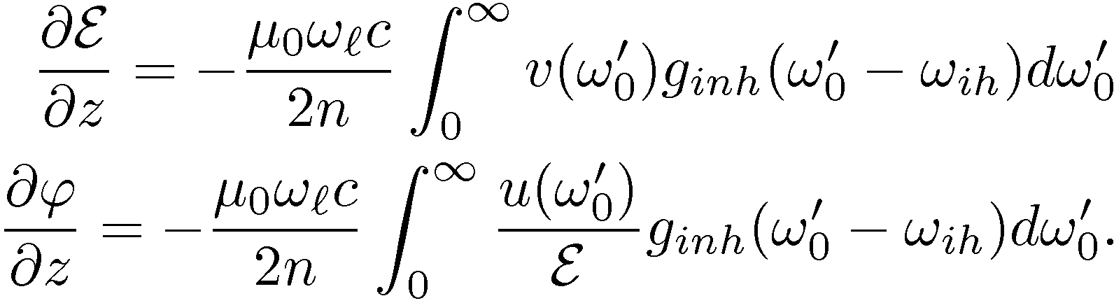
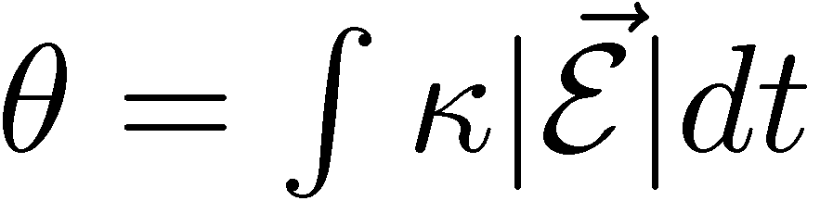

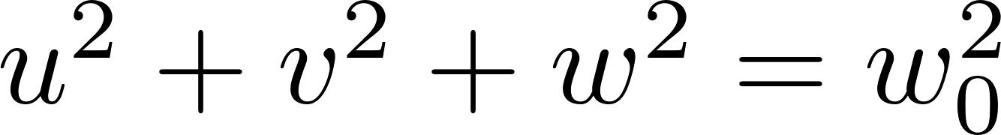

no relaxation
Propagation
w
u
v

Slide 32
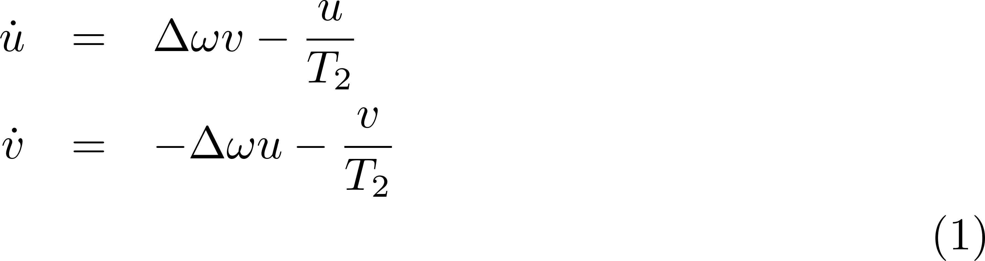
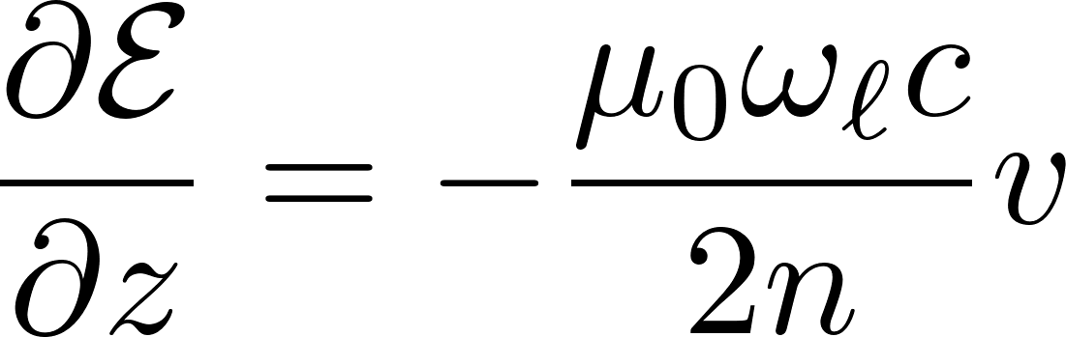
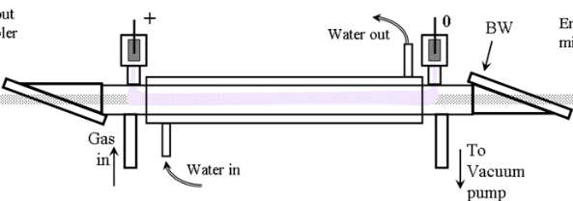
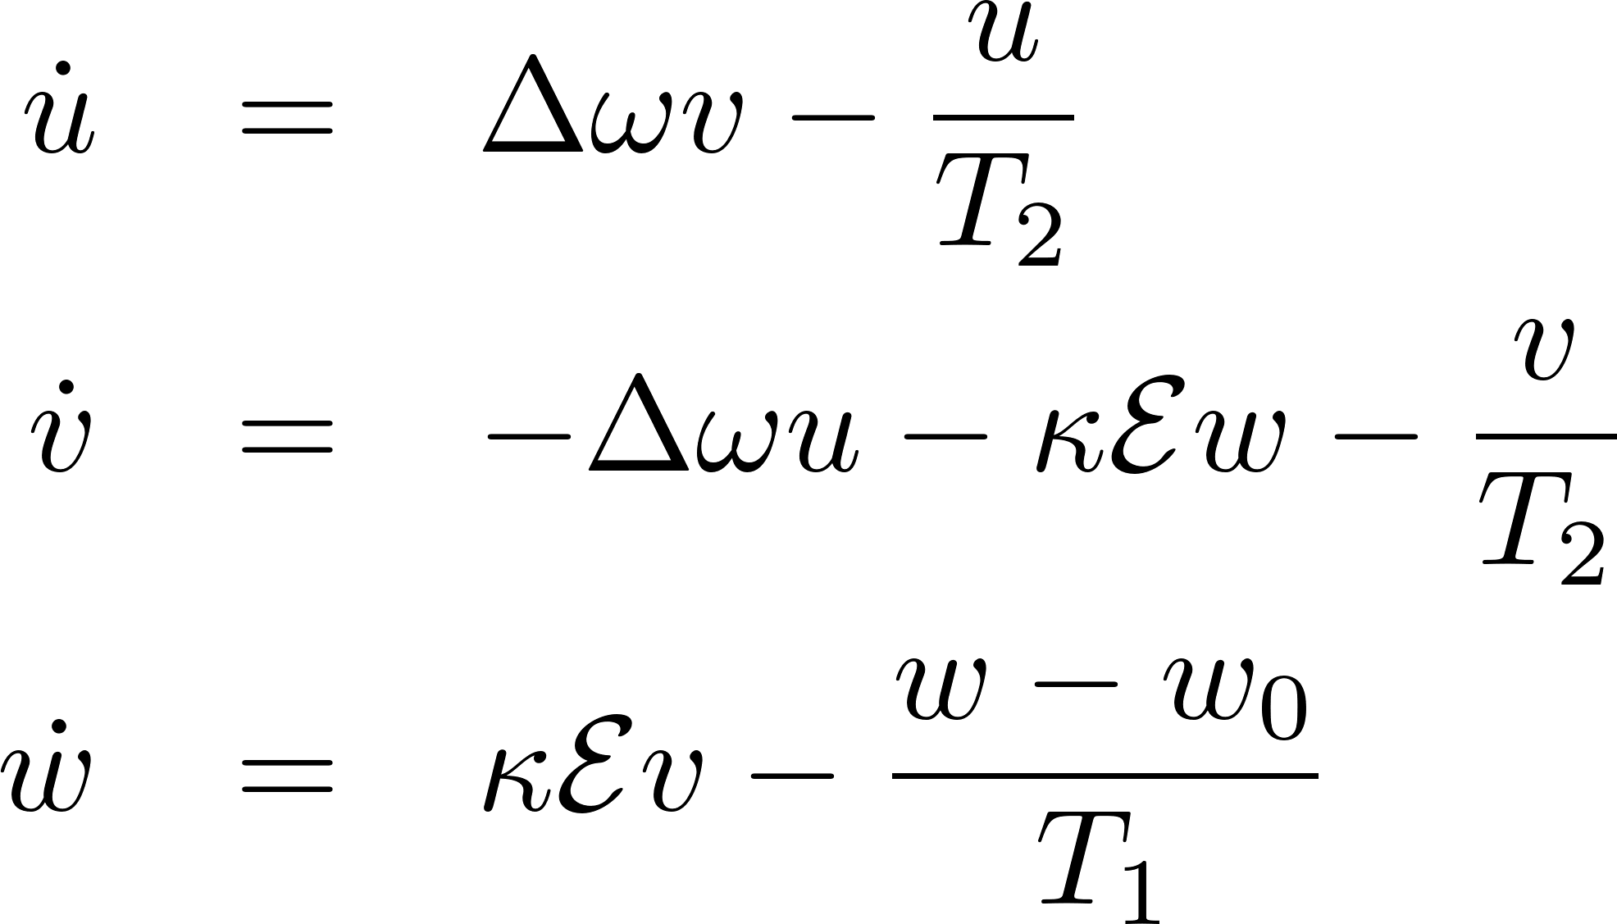
FREE INDUCTION DECAY
w
E
w
E
E
u
t
u
v
v
HP CO2
HOT CO2

Slide 33
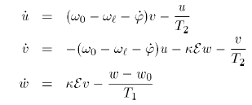
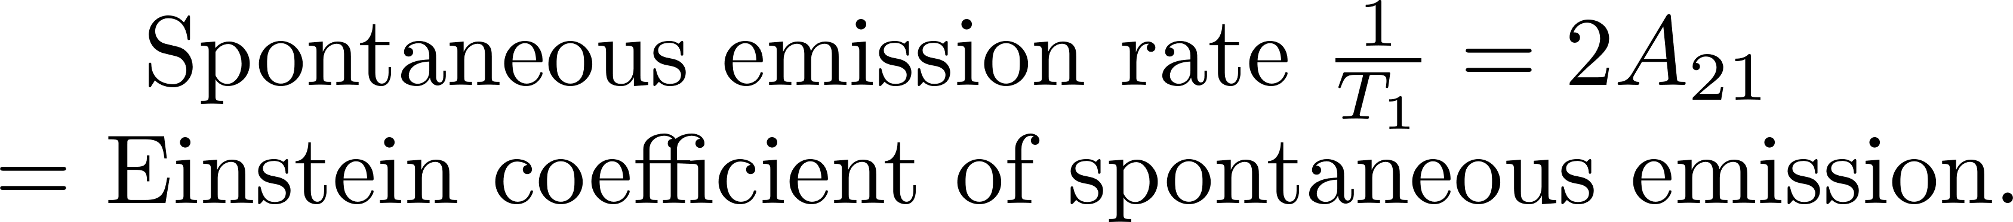
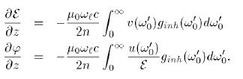
DIFFERENCE BETWEEN COLLISION BROADENING, NATURAL LINE BROADENNG, AND INHOMOGENEOUS BROADENING
Homogeneous broadening
Inhomogeneous broadening
TexPoint fonts used in EMF.
Read the TexPoint manual before you delete this box.: AAAAAAA

Slide 34
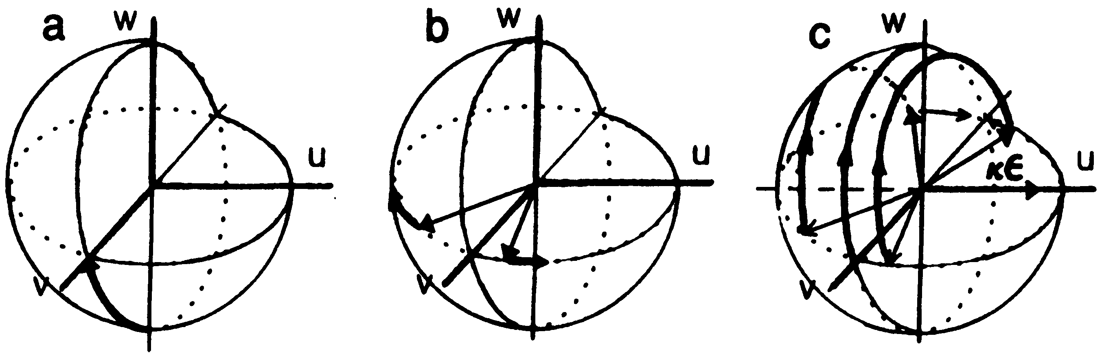
Photon Echoes
-- does not need π/2 and π pulses

Slide 35
THE TRANSIENT INTERACTION OF LIGHT WITH A TWO LEVEL SYSTEM EVOLVES TOWARDS STEADY STATE
STANDARD RATE EQUATIONS AND CLASSICAL LINEAR POLARIZATION ARE SUCCESSIVE STEPS OF THAT EVOLUTION

Slide 36
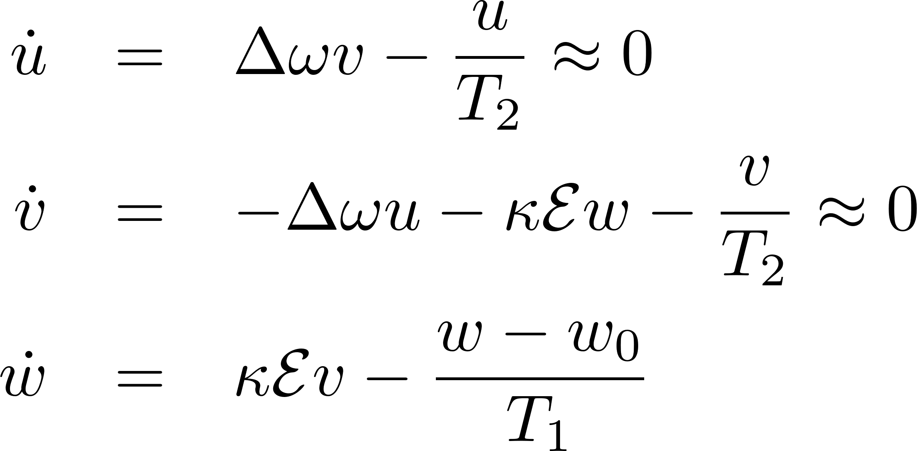




RATE EQUATIONS

Slide 37

RATE EQUATIONS
I_{s} is the saturation power..
You can never have population inversion
Saturation field such that its Rabi frequency is geometric average of T₁T₂.
It takes higher power to saturate off resonance.

Slide 38








LINEAR OPTICS
= steady state solution of Bloch’s equations

