Slide 1
HOMEWORK I SOLUTION

Slide 2
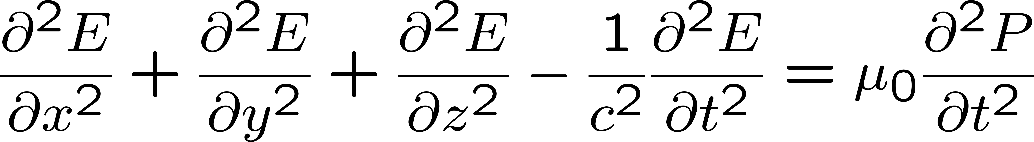

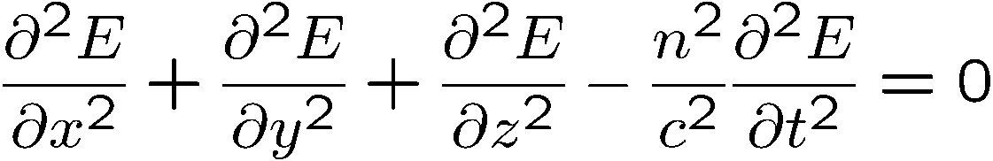
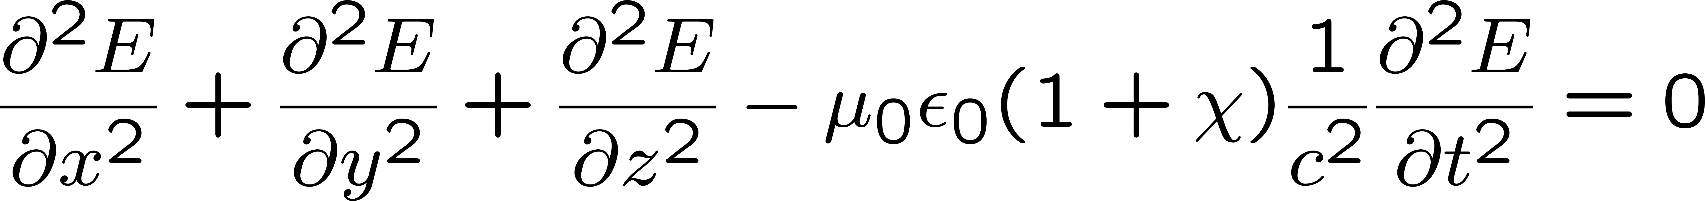
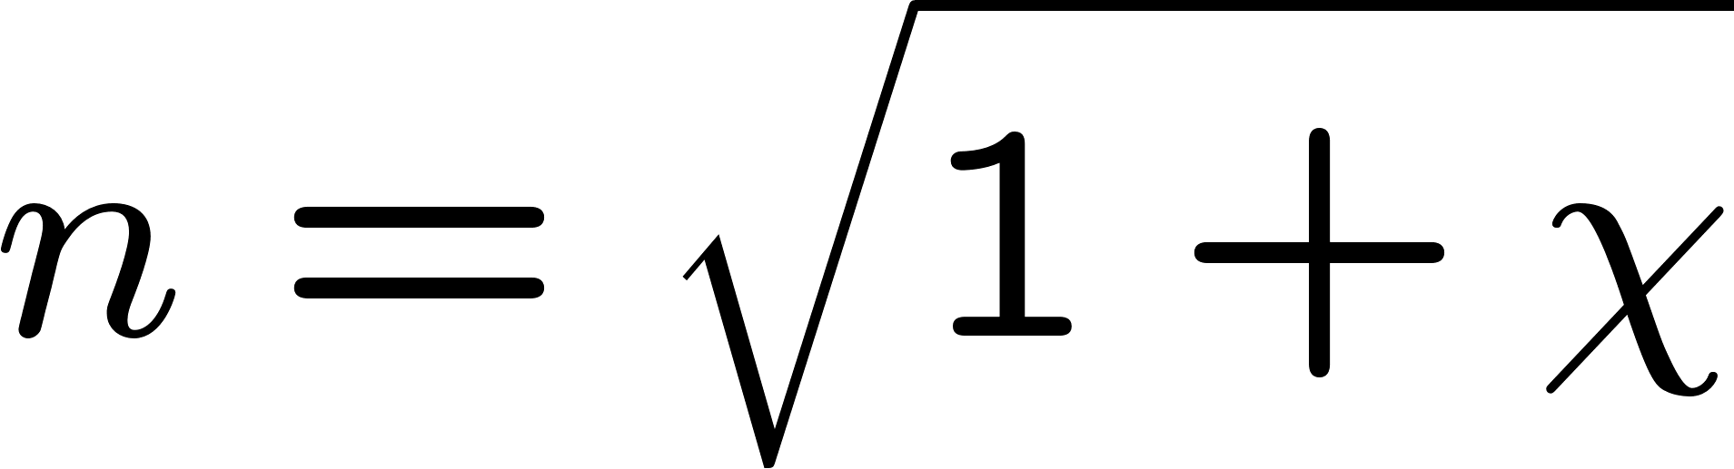
Plane waves in dielectric
How do you get from here
To here

Slide 3
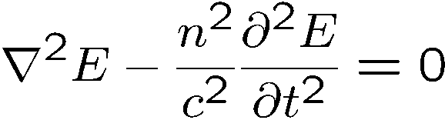
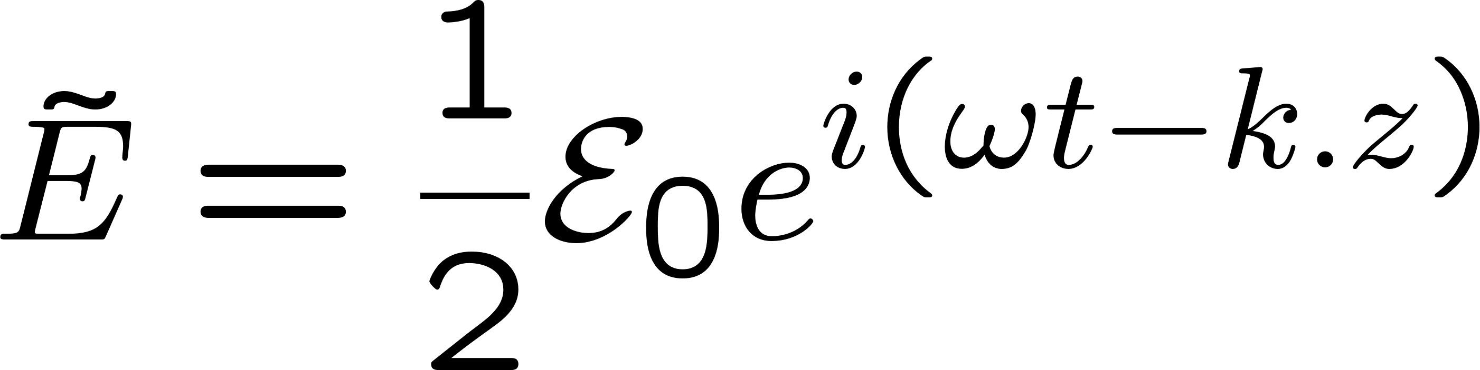
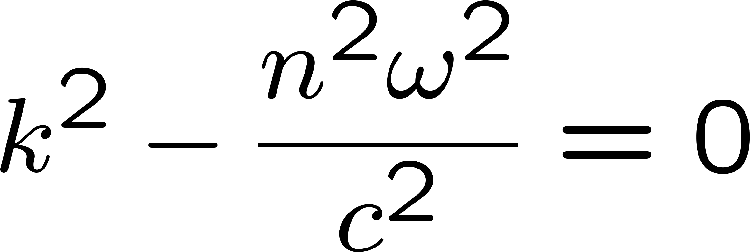
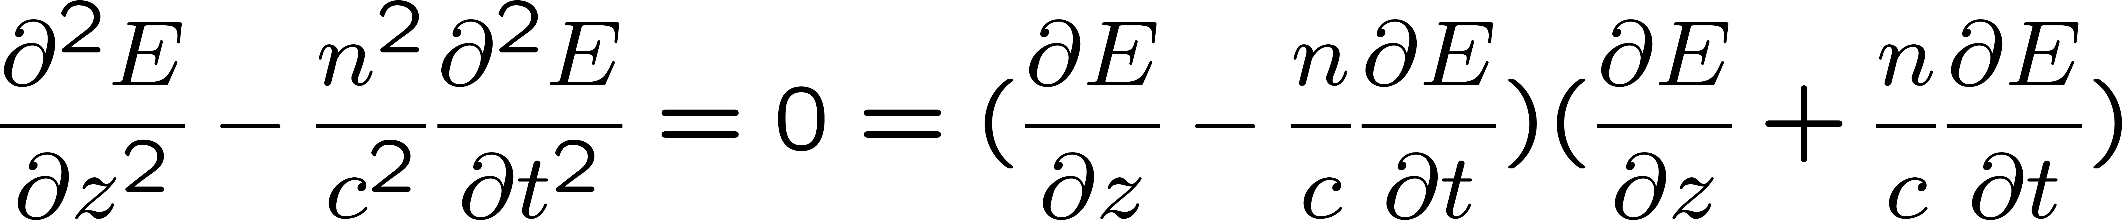
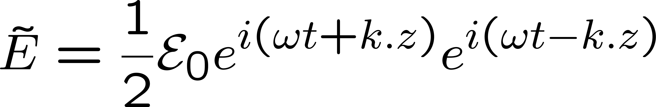
Plane waves along z in vacuum
Substitute
Solution:
From second order to first order
Substitute
Take only the forward propagating wave. Can you get to the same k vector as for the second order equation?

Slide 4
From Second order to first order (the tedious way)
(Polarization envelope)

Slide 5
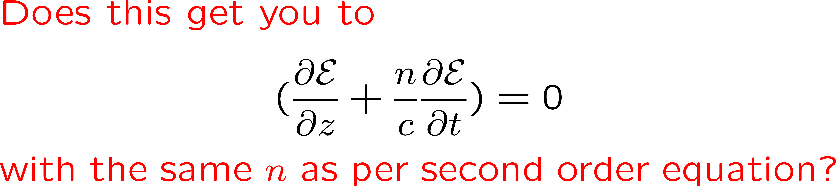
Study of propagation from second to first order
apply this first, to give (– 2 i k E)

Slide 6
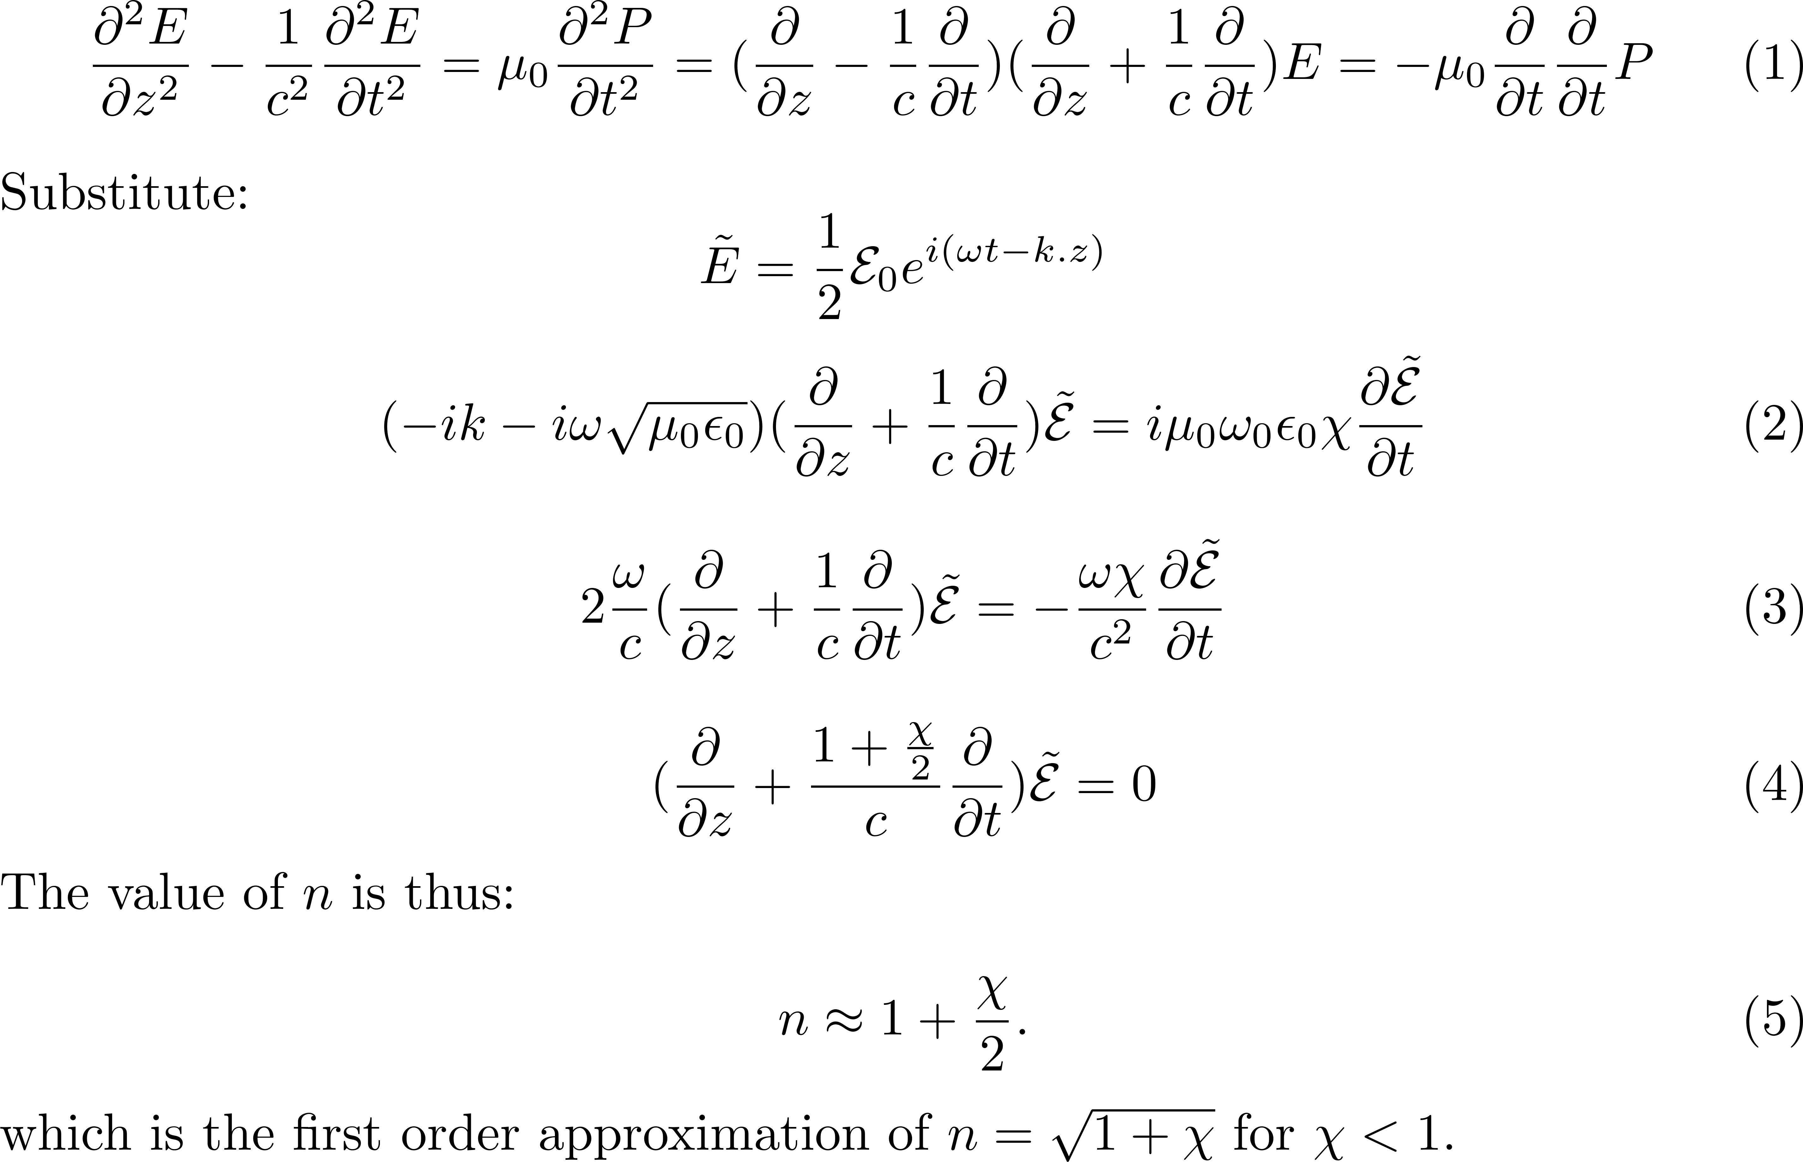

Slide 7
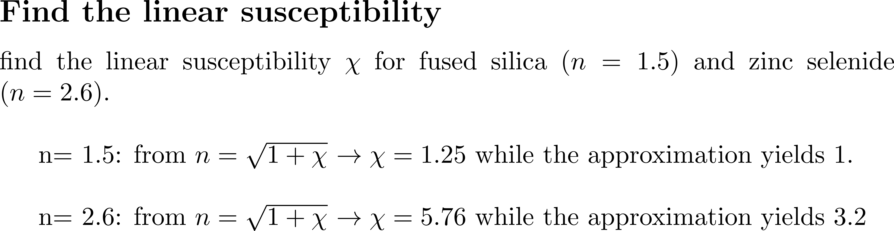
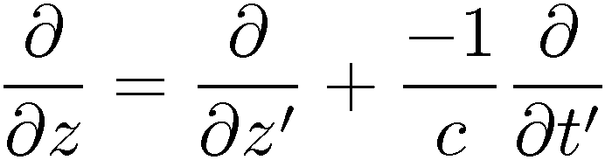

Slide 8
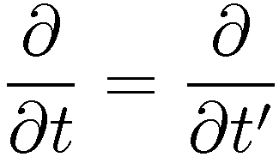
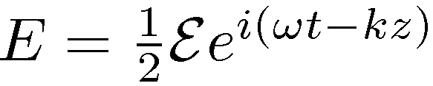
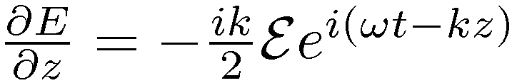


Retarded frame: t’ = t – z/c
z’ = z
imag
Best test of numerical methods
real

