Slide 1
HOMEWORK III

Slide 2
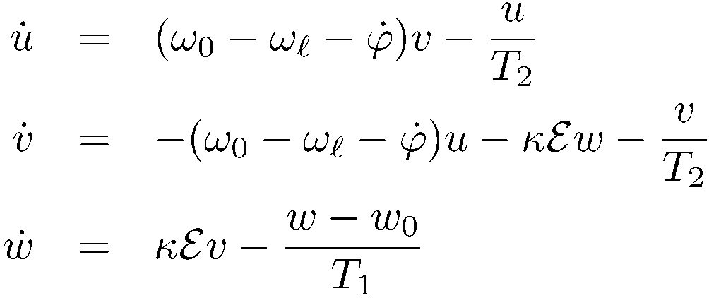
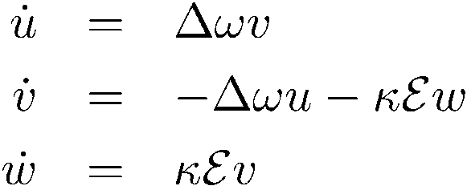








no relaxation
Propagation
w
u
v

Slide 3

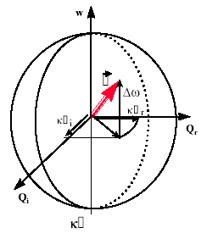
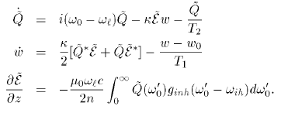
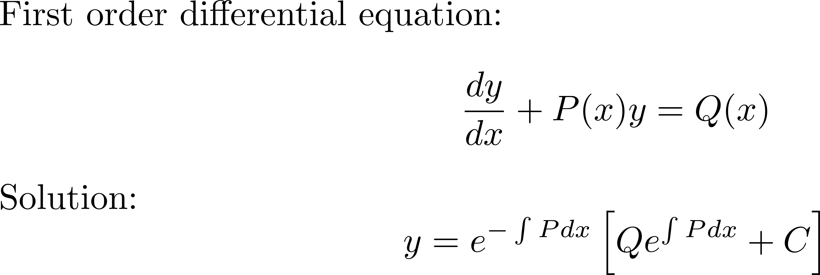
Pseudo-polarization vector
rotating around

Slide 4







z00
w
The amplitude of the dipolar field that opposes the applied
field is proportional to the Fourier component of the applied field
at the dipole resonant frequency.
u
v
Energy absorbed proportional to the intensity at resonance frequency

Slide 5
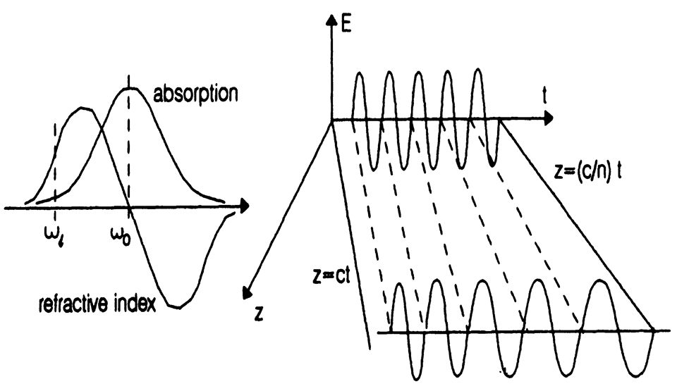
PROBLEM: PROVE THIS:

Slide 6


Slide 7



