Slide 1
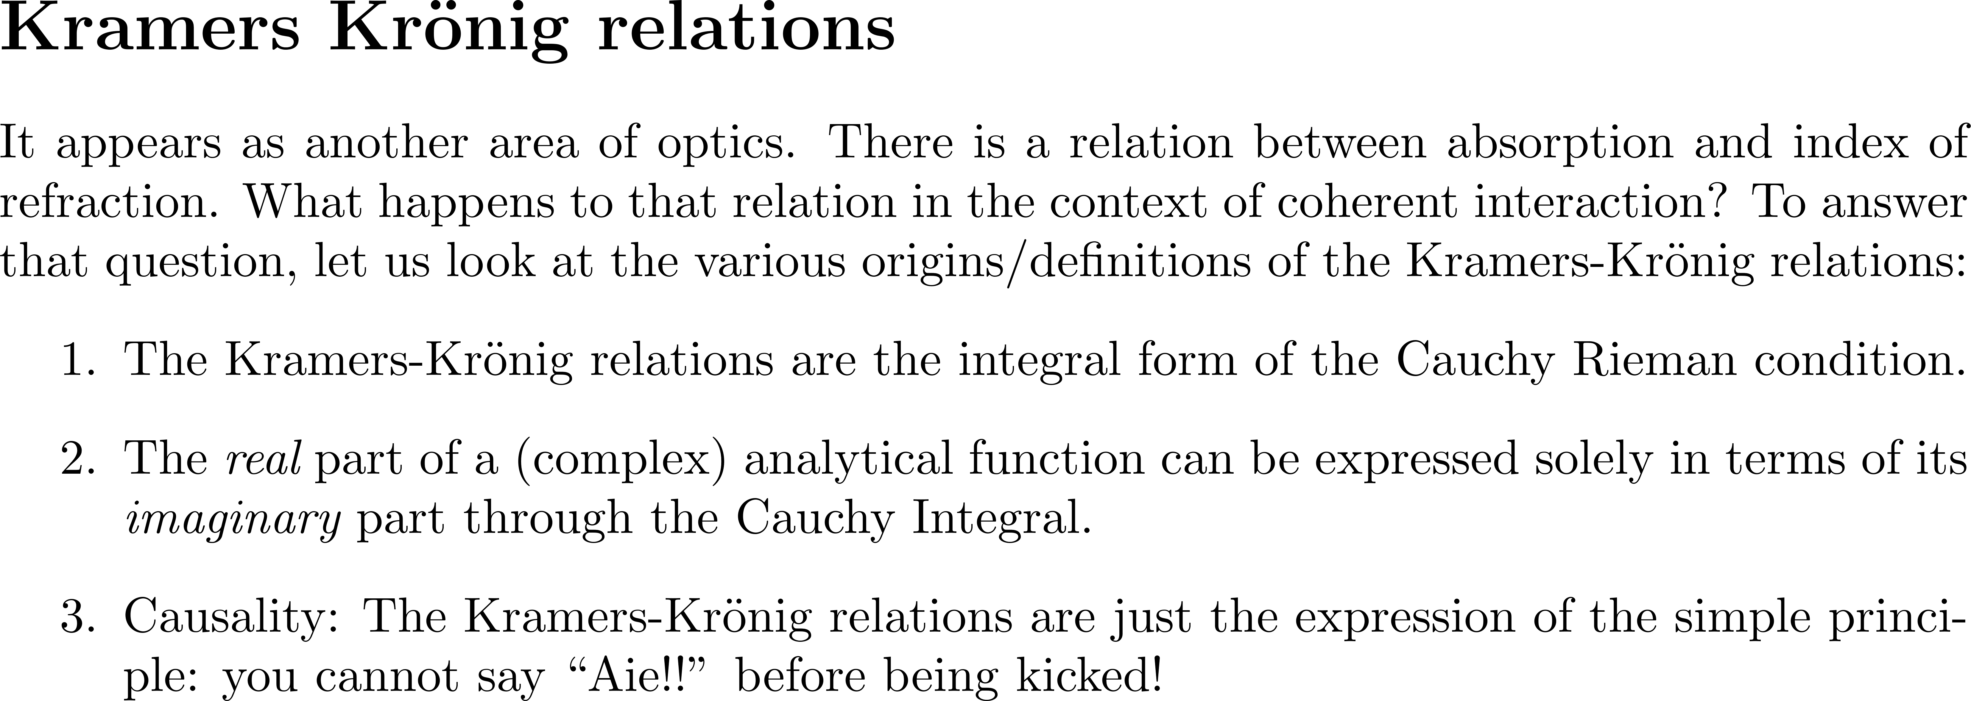
Hutchings et al Opt and Quantum Electronics, tutorial, 1992

Slide 2
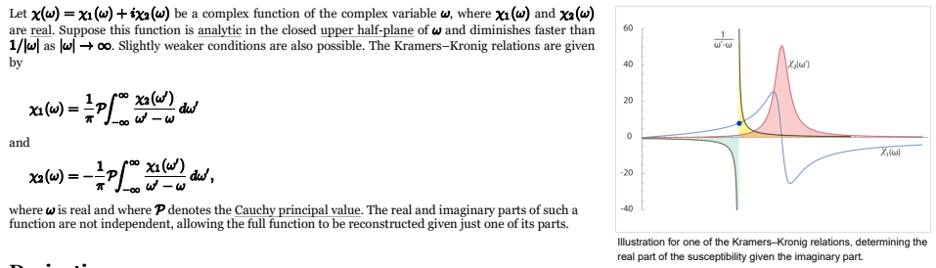

Slide 3
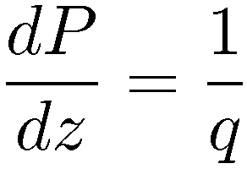
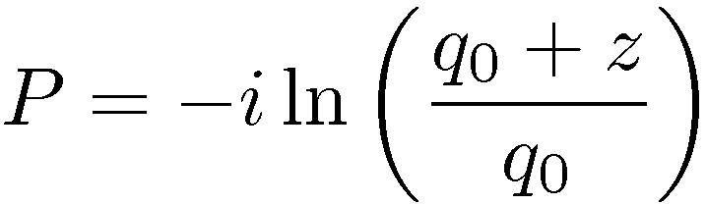

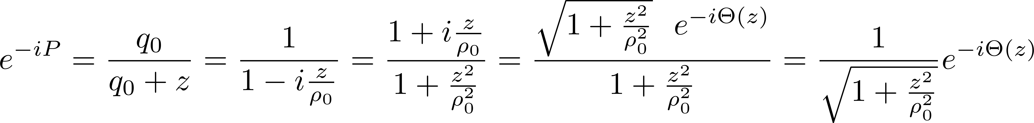

Guoy phase shift

Slide 4
ABSORPTION, DISPERSION, GROUP DELAY AND … NUMERICS

Slide 5
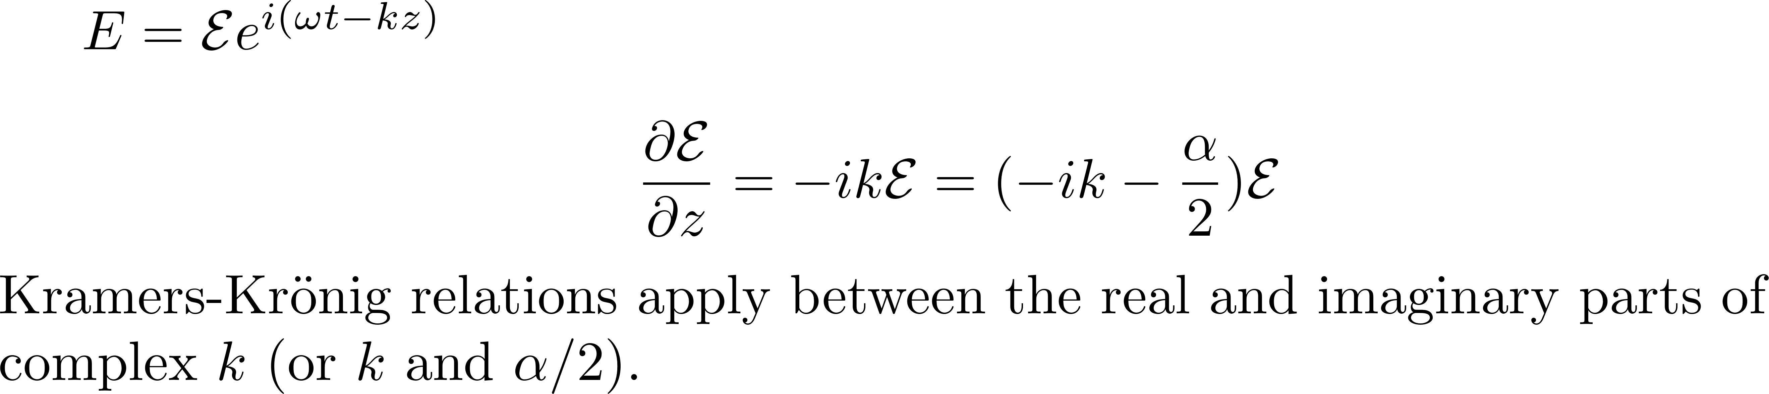
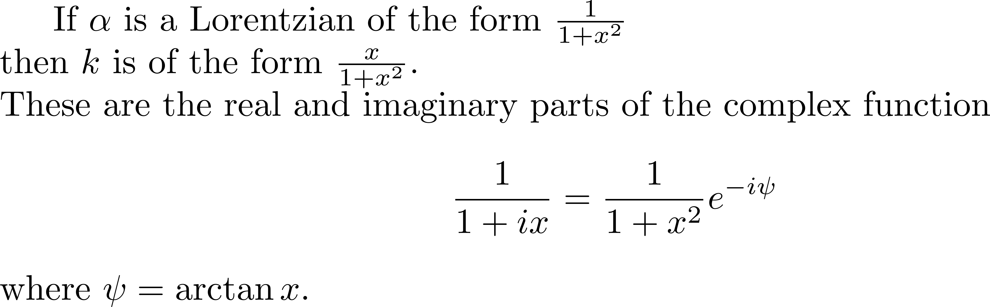





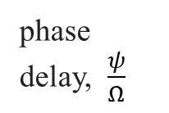

T
0

Slide 6
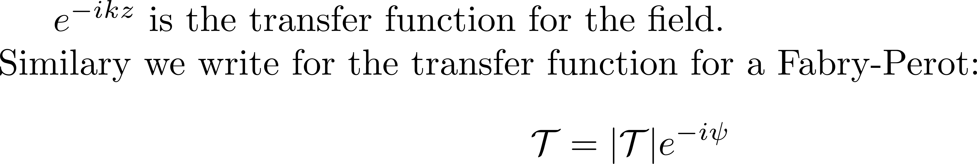
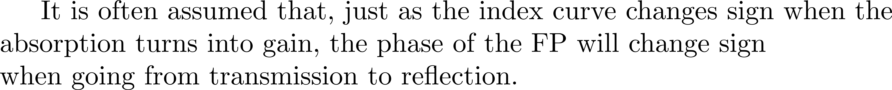
WRONG!

Slide 7
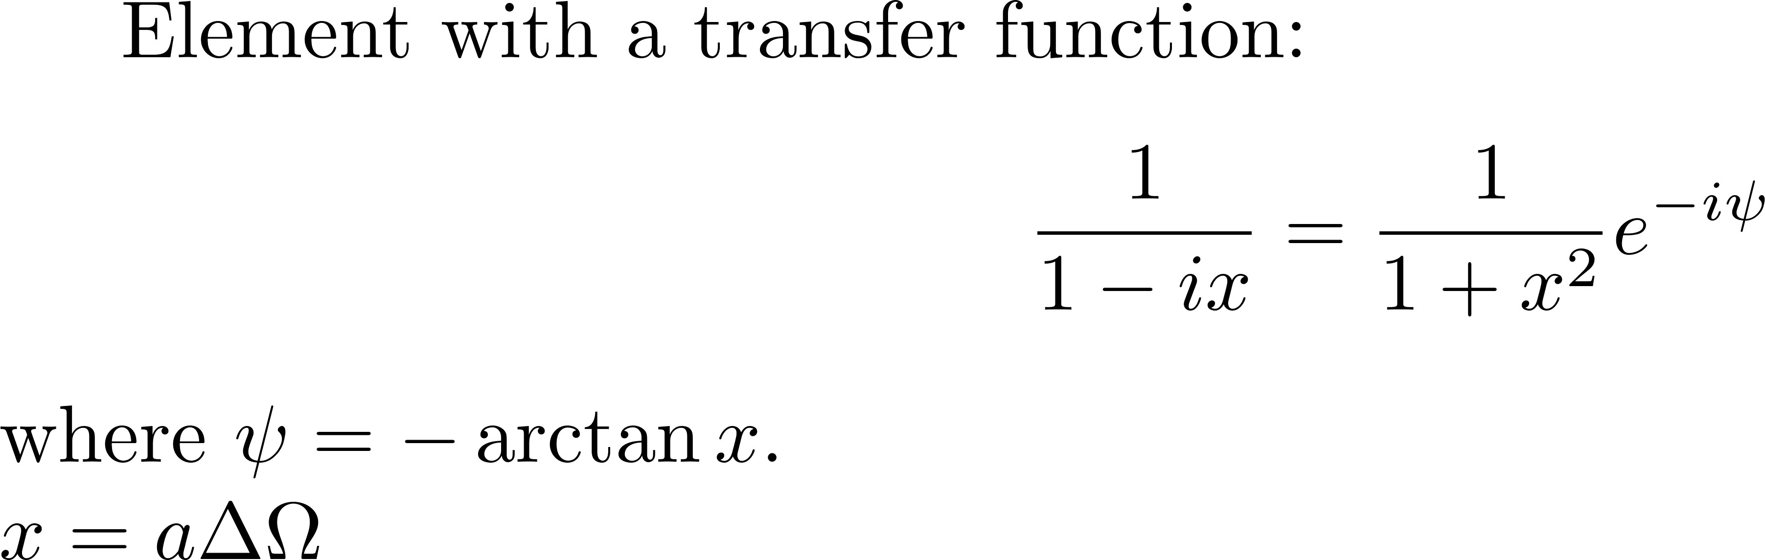
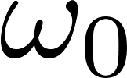
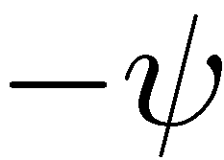

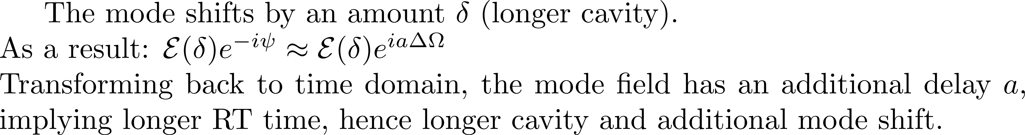
WHAT IS THE BIG DEAL ABOUT THE PHASE AND DELAY?
Resonant passive element
GAIN
a
Ω

Slide 8
WHAT IS THE BIG DEAL ABOUT THE PHASE AND DELAY?
Resonant passive element
GAIN
a
a
Ω

Slide 9
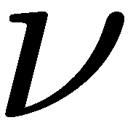
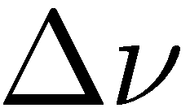
WHAT IS THE BIG DEAL ABOUT THE PHASE AND DELAY?
Resonant passive element
GAIN
D_{b}
Δν
ΔL/L_{cav}
λ
λ

Slide 10
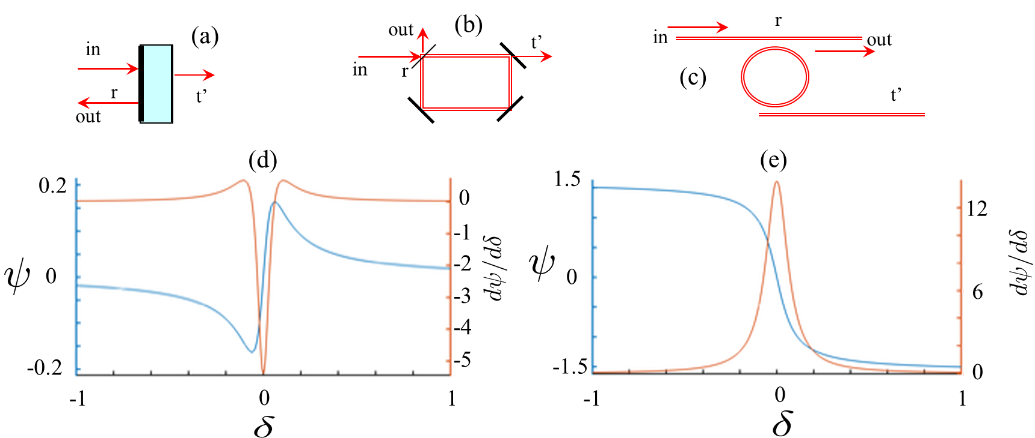
Gires Tournois reflection/dispersion Fabry-Perot transmission/dispersion
WRONG!
Notes:
10
3/1/2026

Slide 11
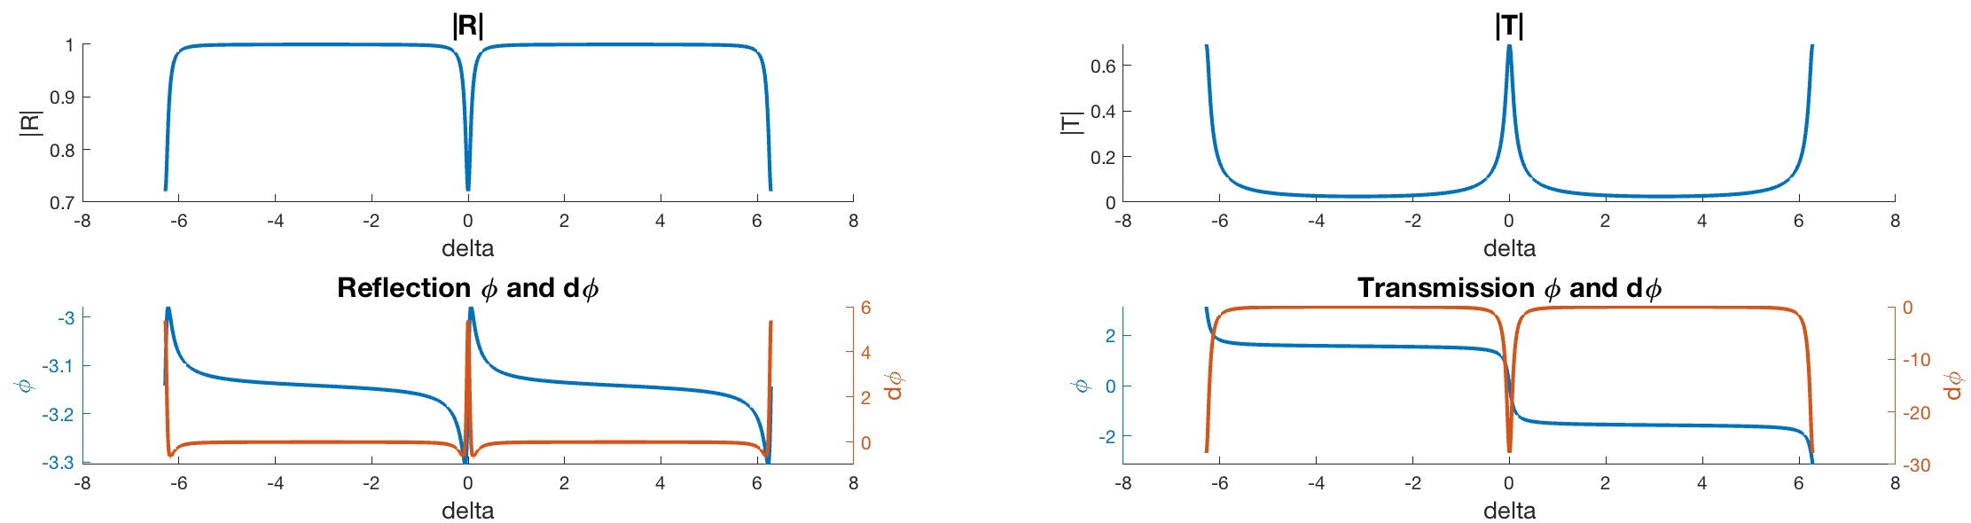




3 E q u i v a l e n t s t r u c t u r e s:
out
r
r’
in
out
in
r
r
r’
r’
Fabry-Perot transmission/dispersion
r = 0.99
r’ = 0.94
6
20
20
2
2
4
0
0
0
0
0
-2
-2
-20
-20
-8
-8
-4
-4
0
0
4
4
8
8

Slide 12

Gires Tournois reflection/dispersion
out
r
r’
in
out
in
r
r
r’
r’
1
r = 0.99
r’ = 0.94
|R|
0.9
6
-3.1
4
WRONG!
-3.2
0
-8
-4
0
4
8

Slide 13
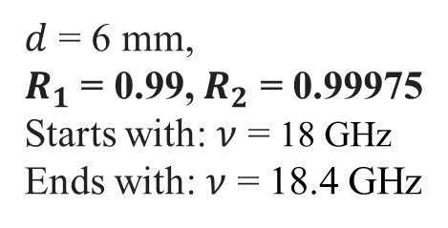
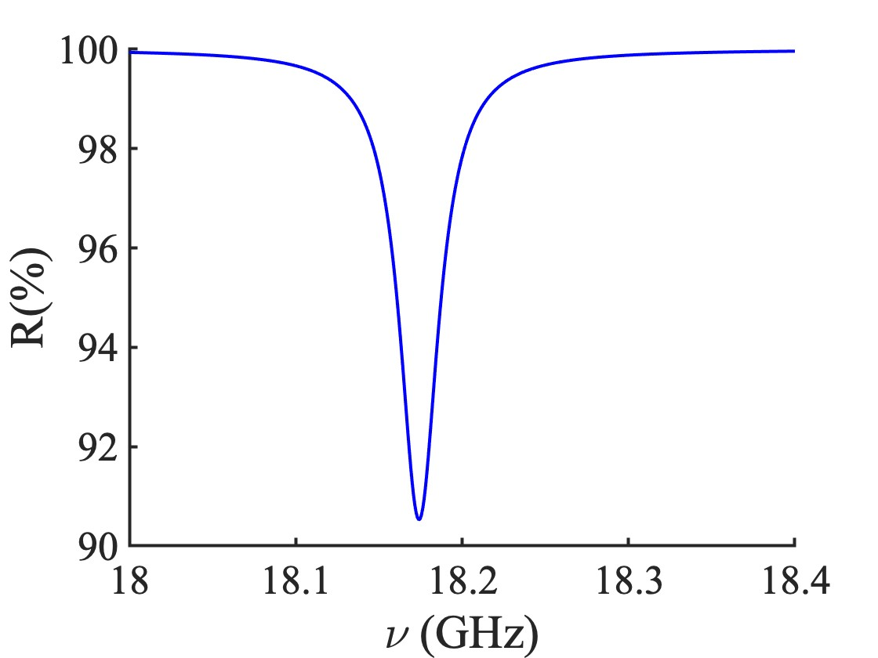
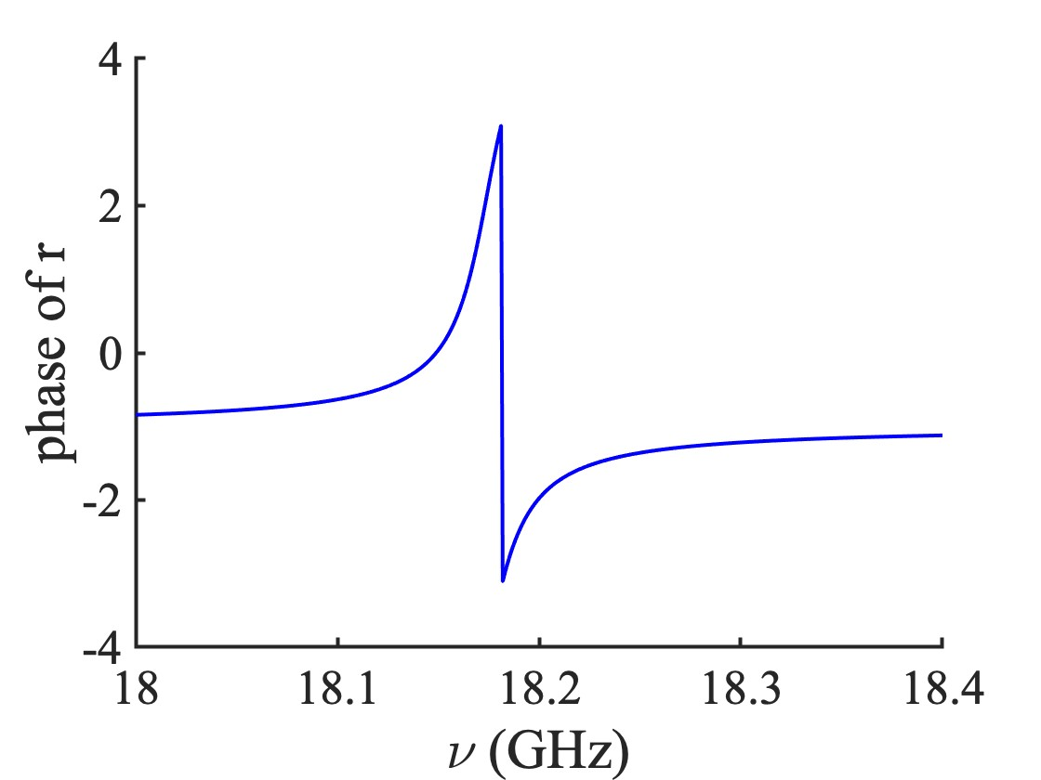
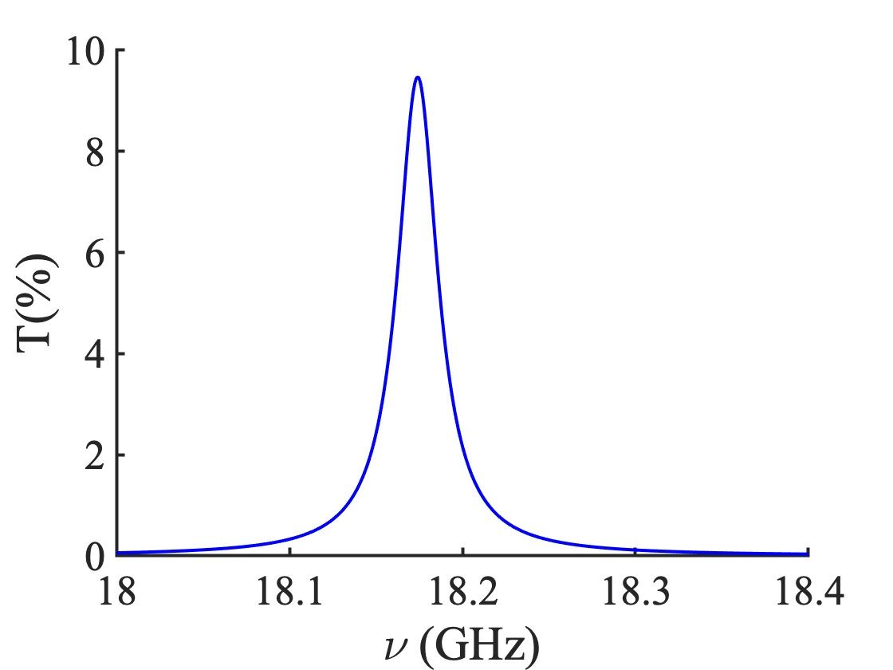
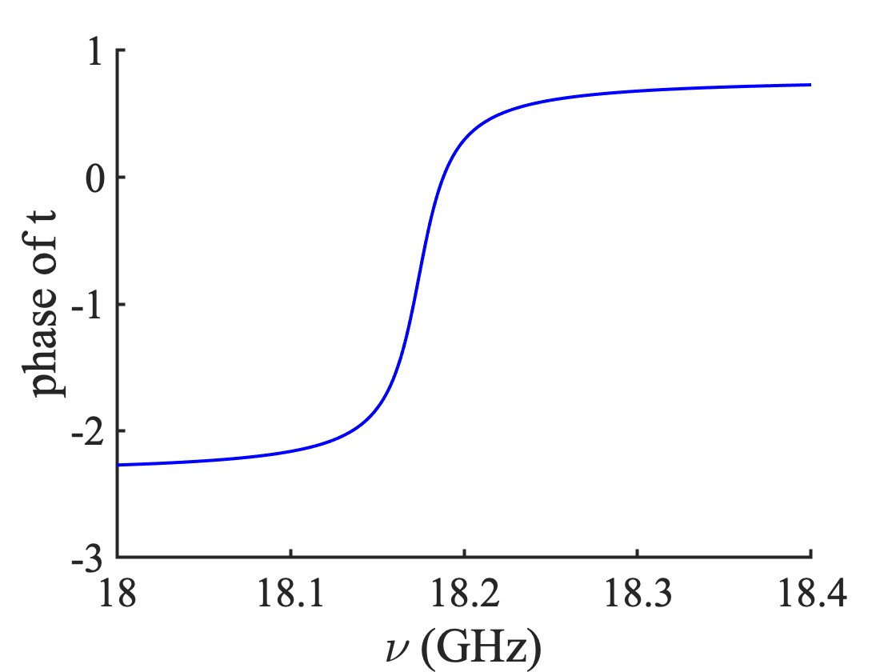
Gires-Tournois
in reflection
WRONG!
Fabry-Perot
in transmission

Slide 14
In mathlab: atan2 is trying to put a correct determination. Below my algorithm (in Fortran of course…)
E2=0.
DET=0.
SCAP=0.
E(1)=ER(1)
PH(1)=0.
do 2 I=2,MEXT
E1=E2
E2=ER(I) %Real part
EI2=EI(I) ) %Imaginary part
if (abs(sign(1.,E1)*sign(1.,E2)-1.).LT..1) go to 3
DET=DET+PI*sign(1.,E1)*sign(1.,EI2)
3 if (abs(E2).LE..1E-9) PH(I)=PH(I-1)
if (abs(E2).GT..1E-10) PH(I)=atan(EI2/E2)+DET
if (abs(E2)..LE..1E-12) E(I)=0.
if (abs(E2).GT..1E-12) E(I)=sqrt(E2**2+EI2**2)
2 if (SCAP.LT.E(I)) SCAP=E(I)
PH(1)=PH(2)
SCAP=80./SCAP
Neither mathlab atan2 nor my algorithm are foolproof as demonstrated in the next slide.

Slide 15
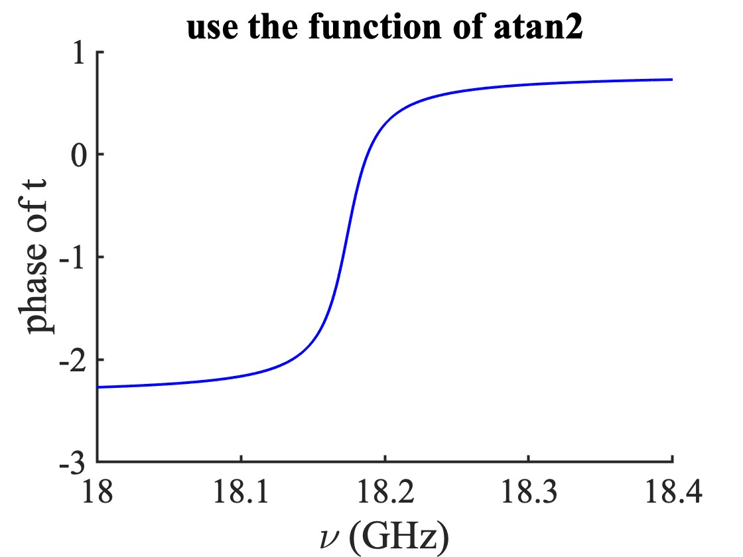
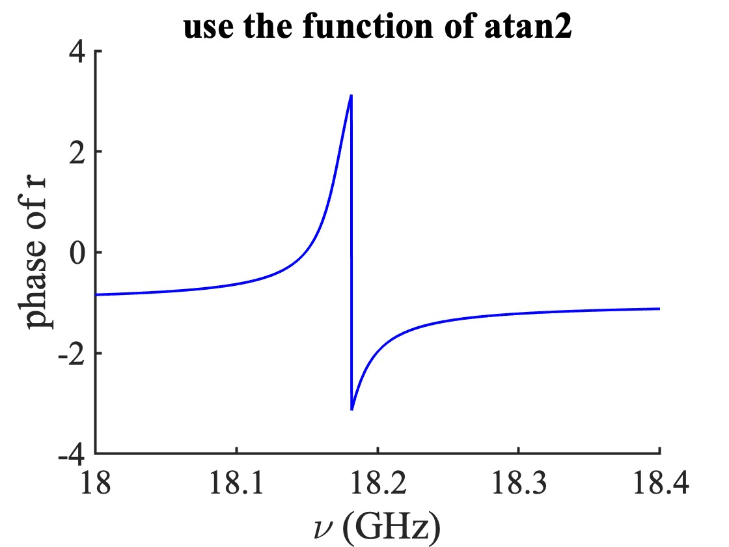
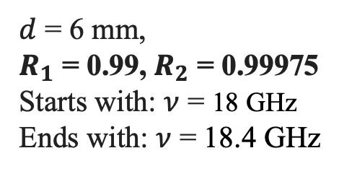
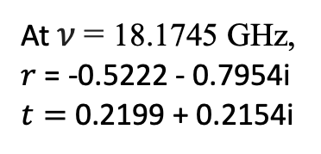
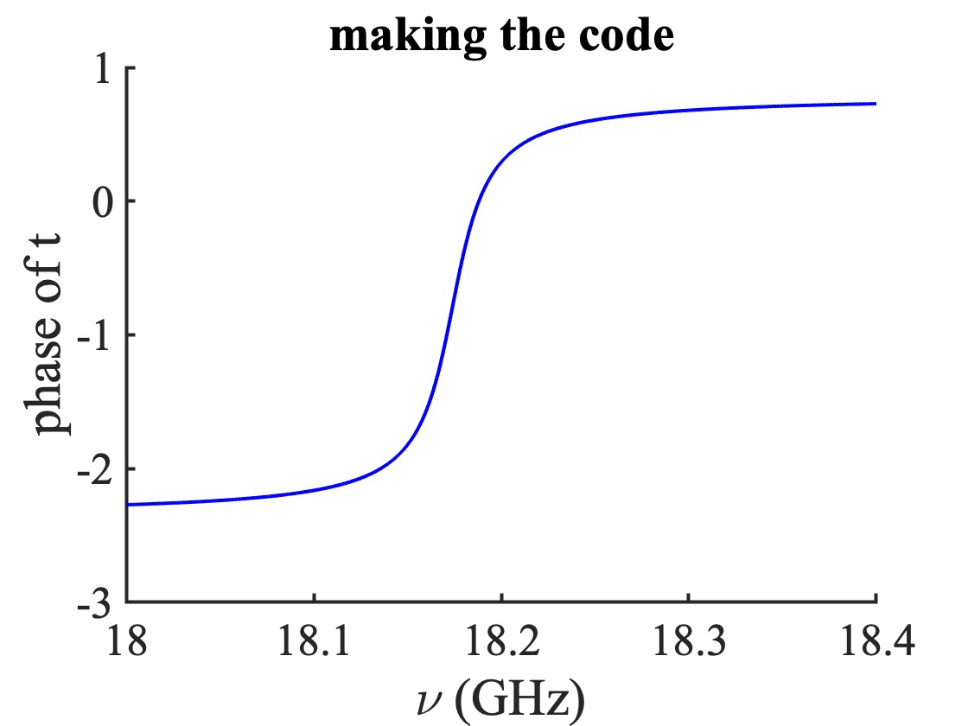
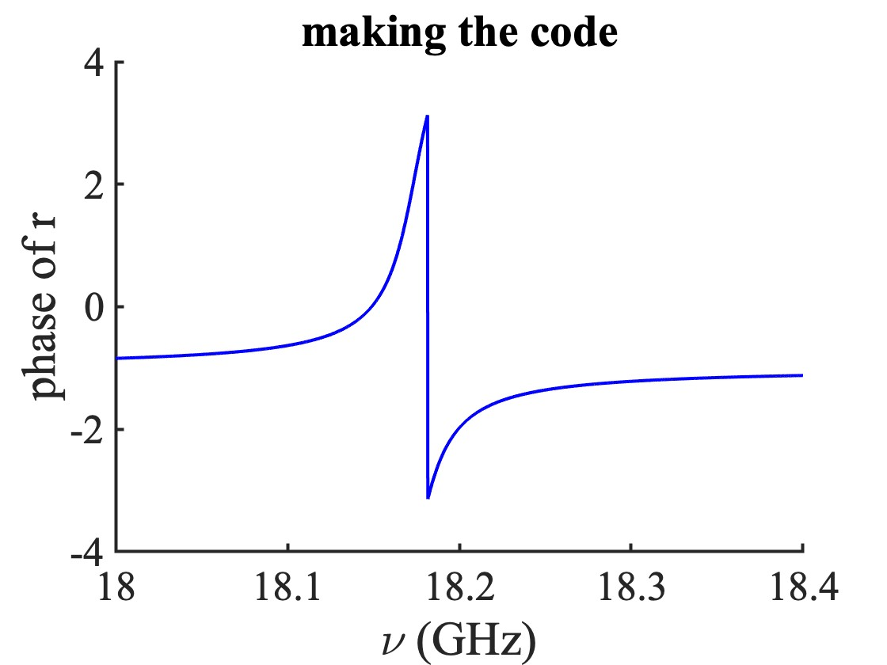
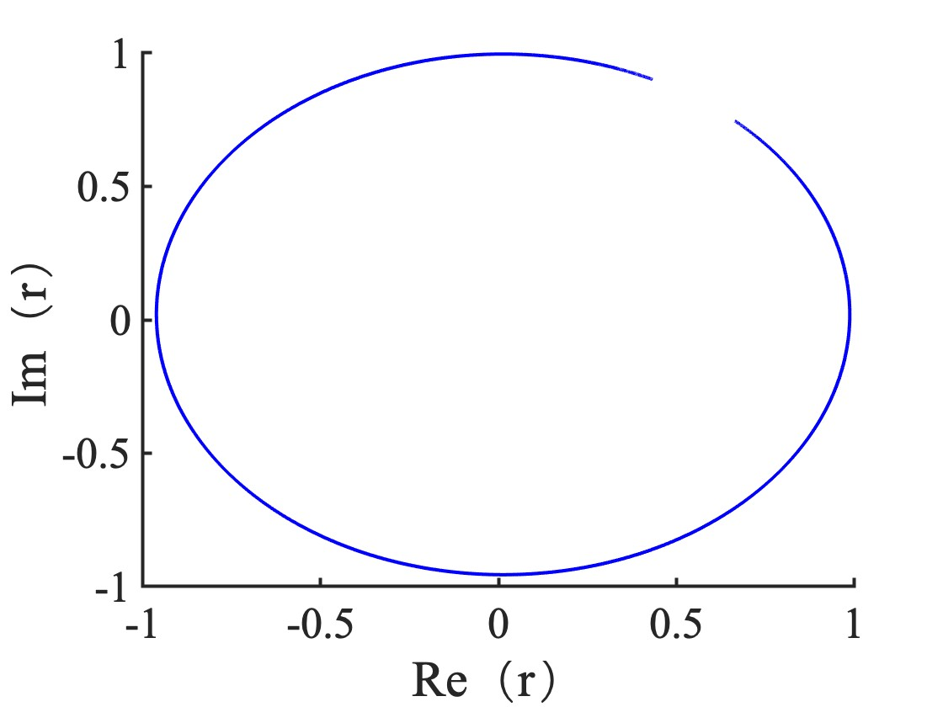
Numerical solution of the phase – by making code
Notes:
15
3/1/2026

Slide 16
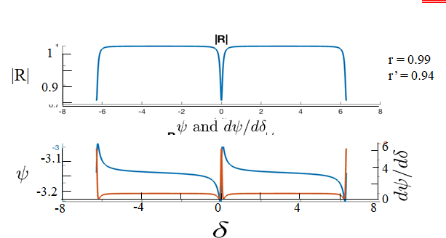
Very Very Very Very Very common errors:
1) too many points: N = 3000!!!
2) Line instead of dots
3) If they had run the program with 20 points, only symbols in the plots, they would have seen the discontinuity.
Mathlab atan2 is as bad as my own subroutine. Do not believe in commercial softwares. Same experience with FFT’s.
Always make a plot of imaginary part versus real, with a minimum number of points

Slide 17

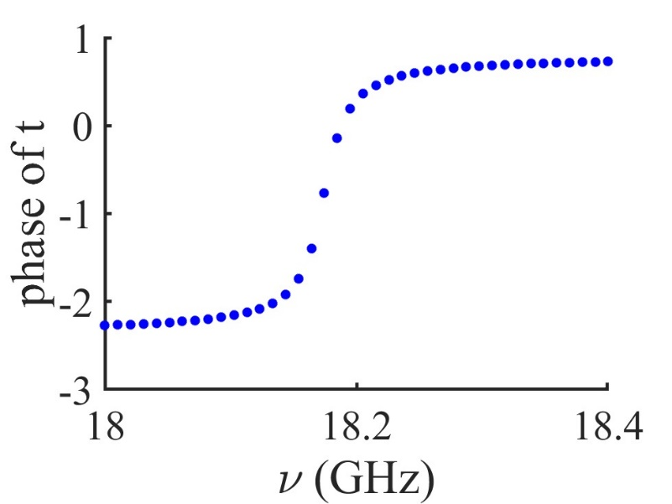
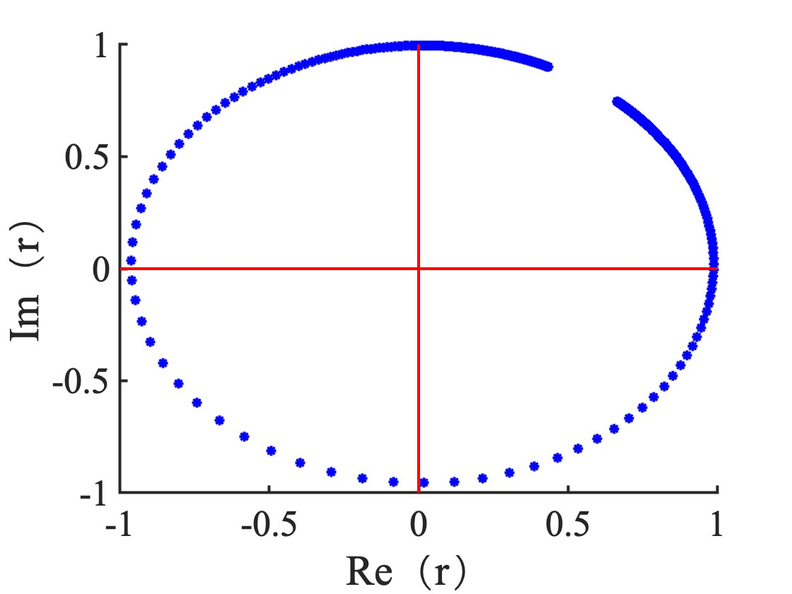
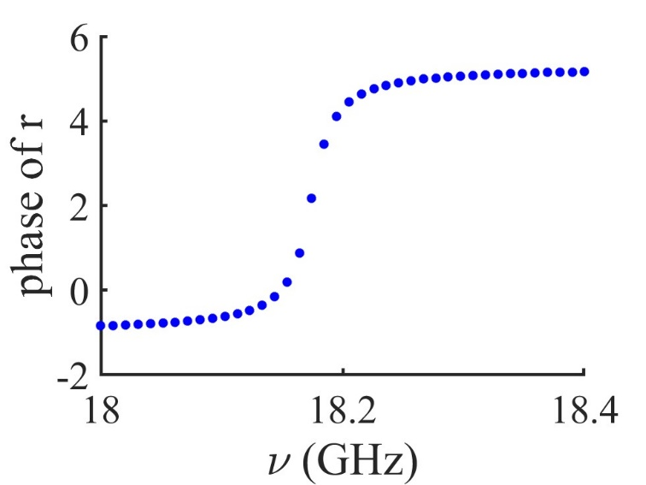
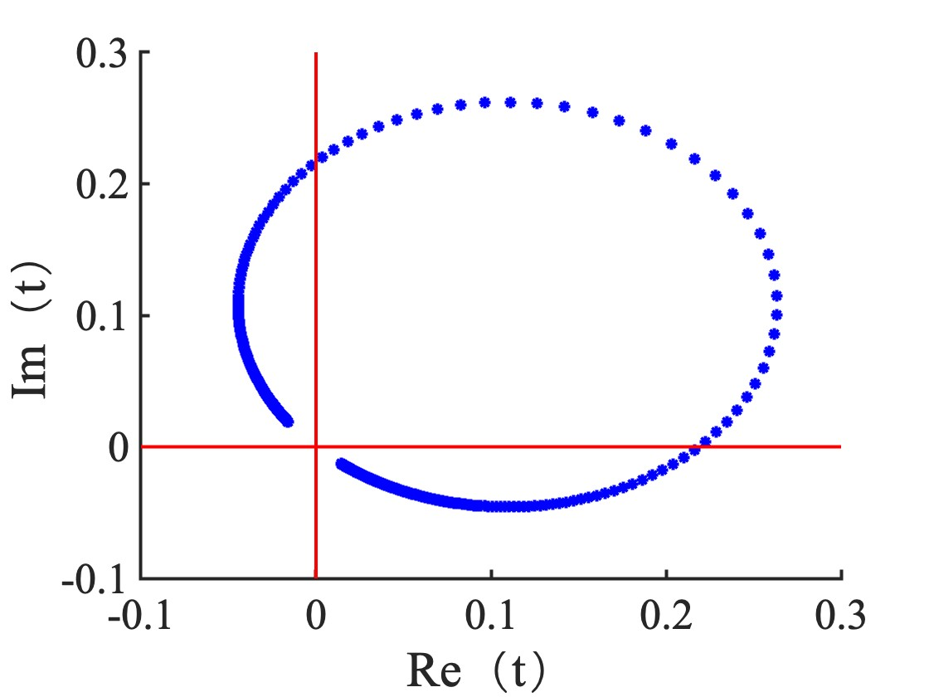
CORRECT PLOTS
Notes:
17
3/1/2026

Slide 18
Numerical solution of the phase – by making code
Notes:
18
3/1/2026

Slide 19
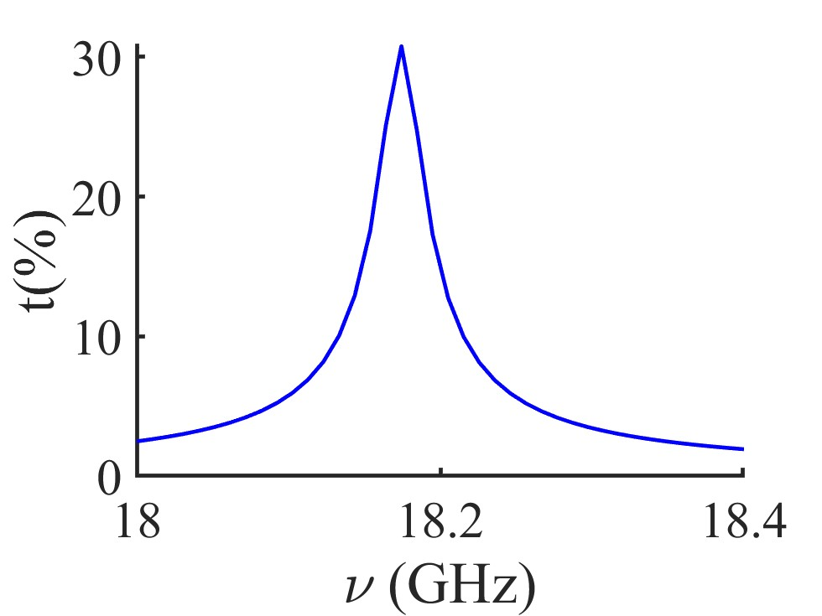
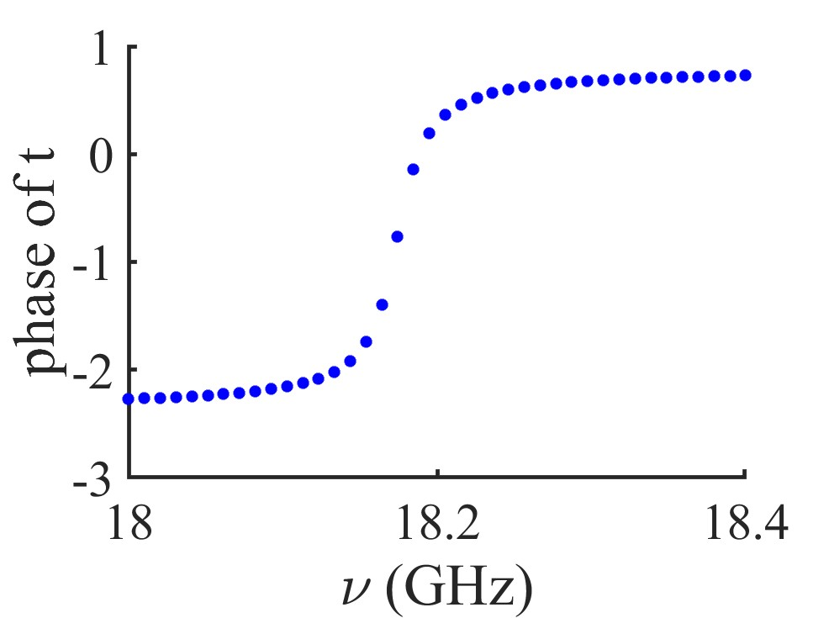
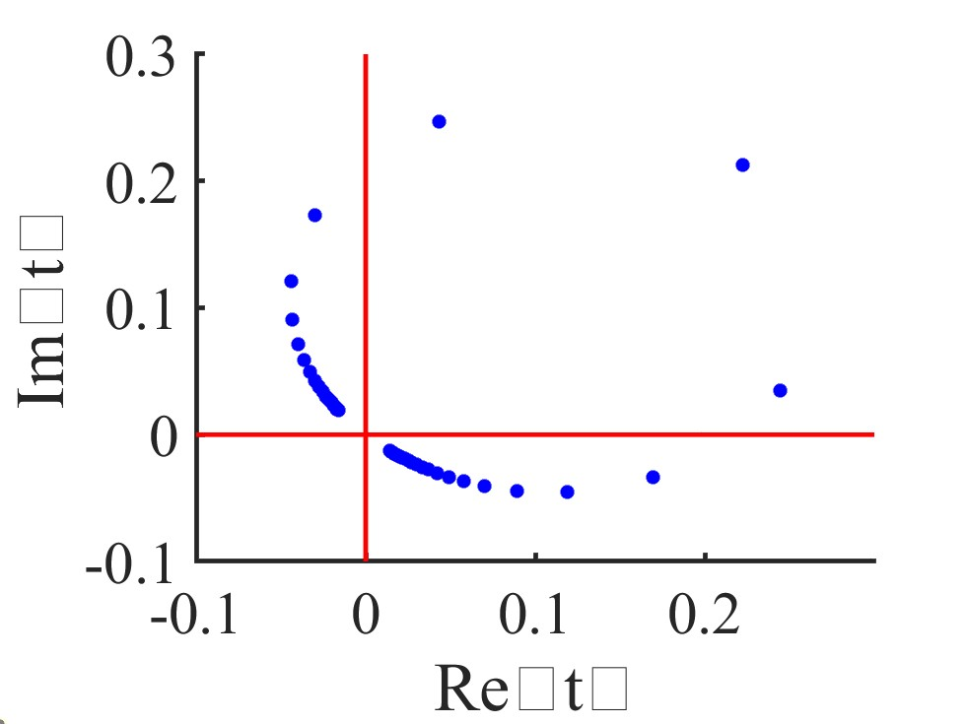

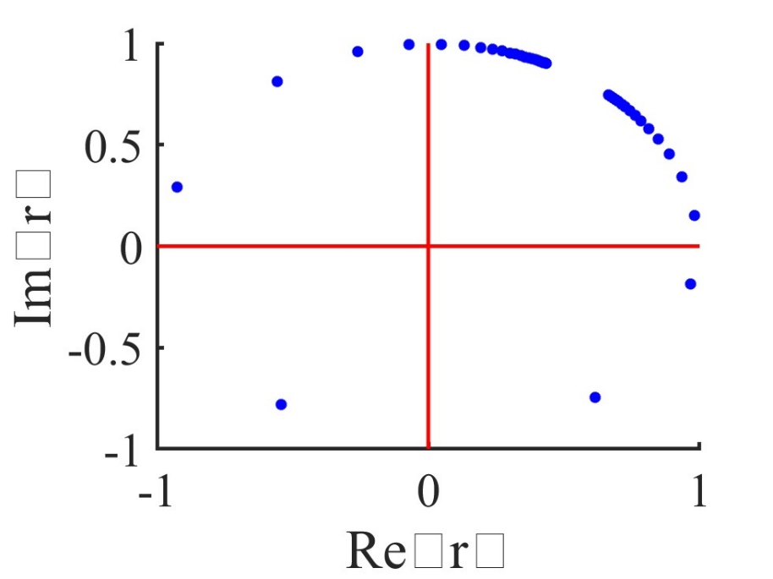
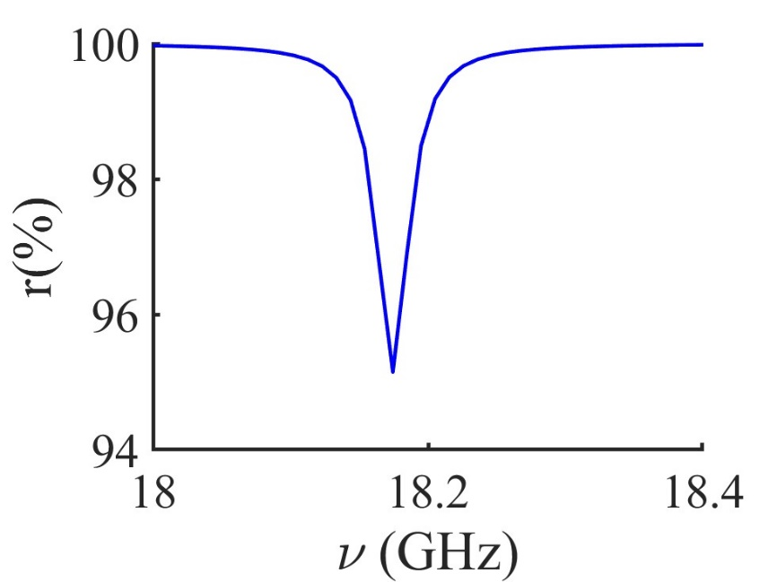
Kramers-Kroenig does not apply to amplitude and phase

Slide 20
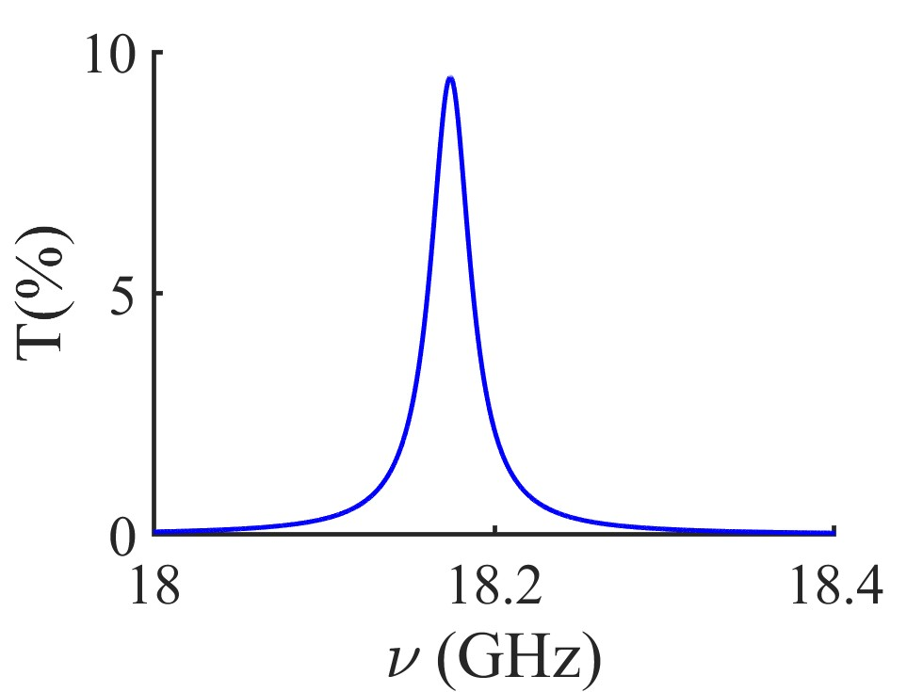
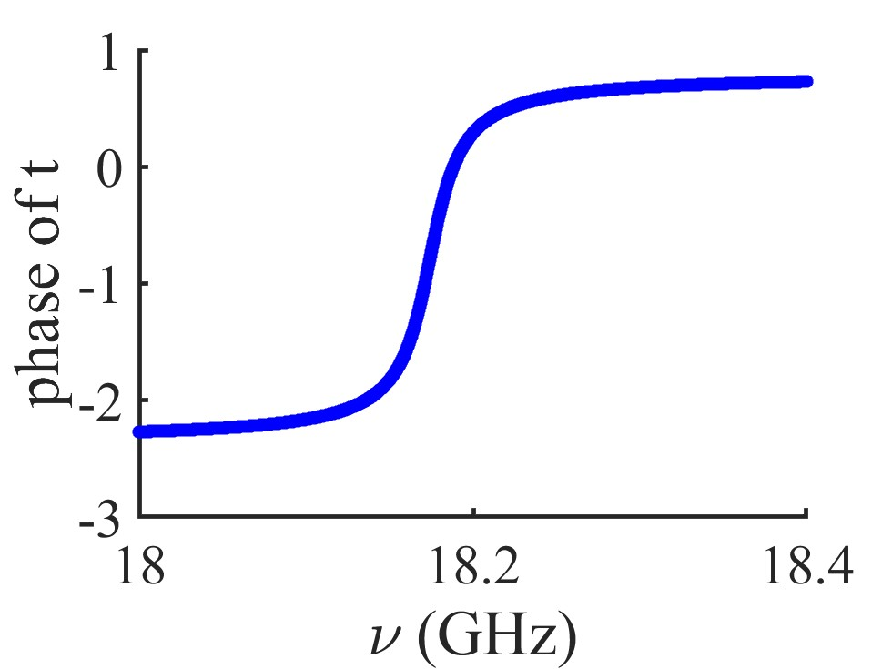
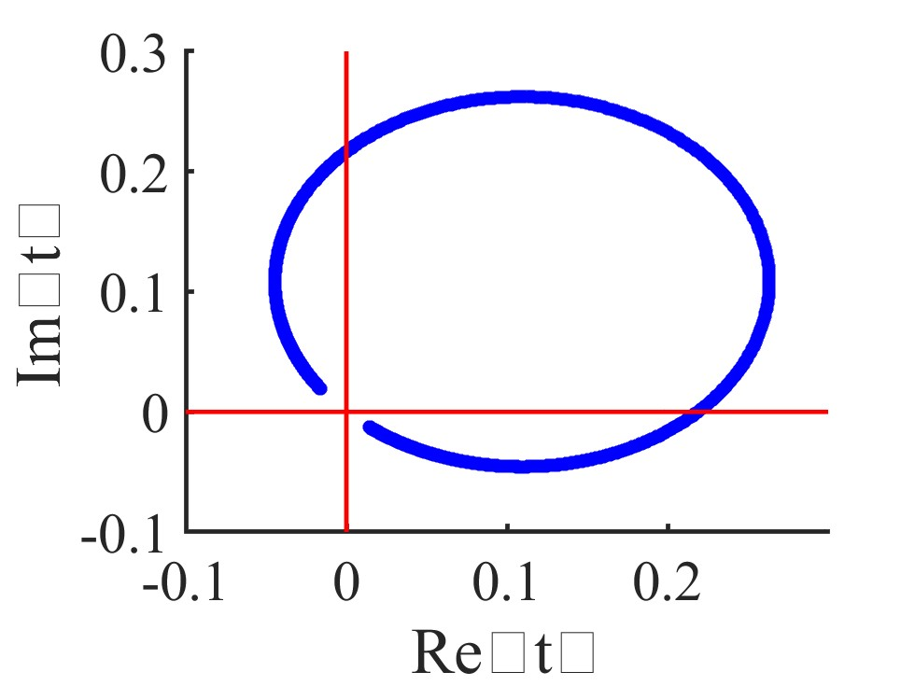
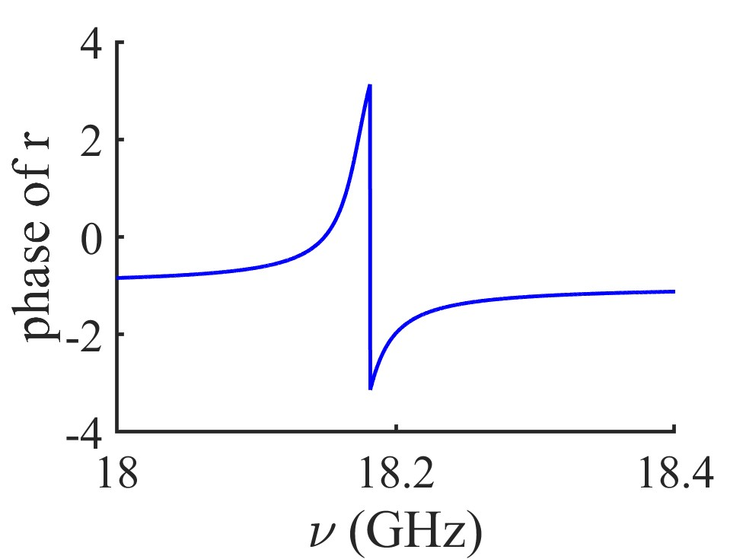
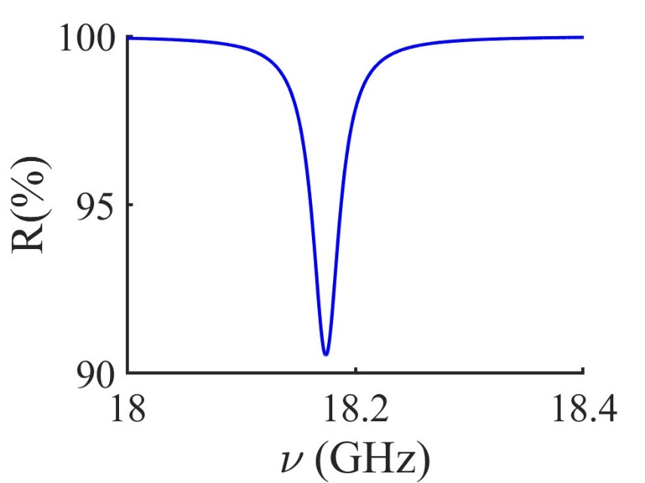
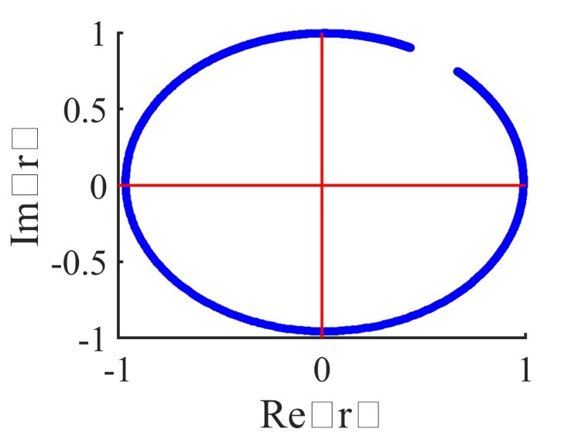
Was the phase determination routine REALLY corrected?
Change N back to 3000

