Slide 1
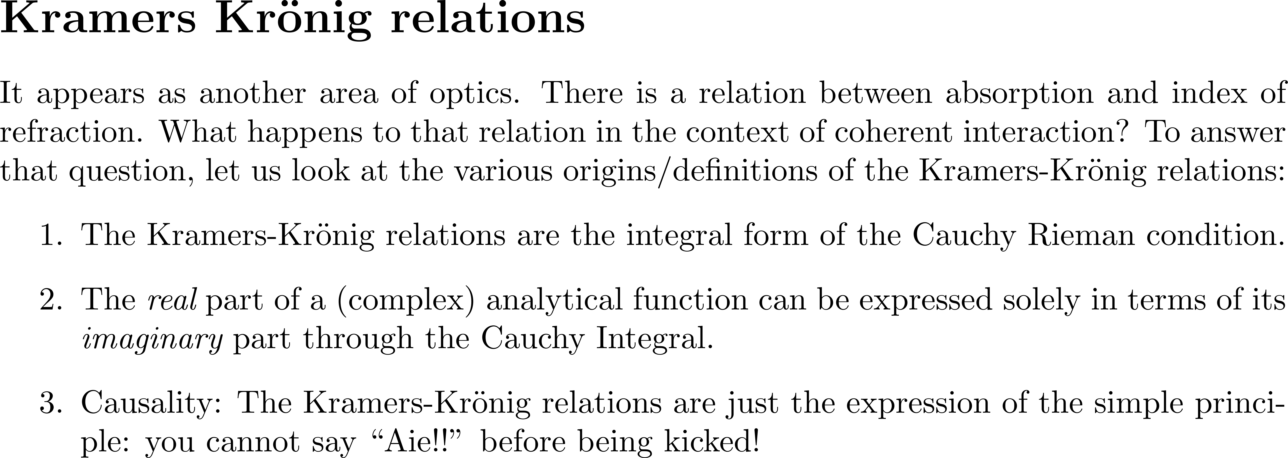
Hutchings et al Opt and Quantum Electronics, tutorial, 1992

Slide 2
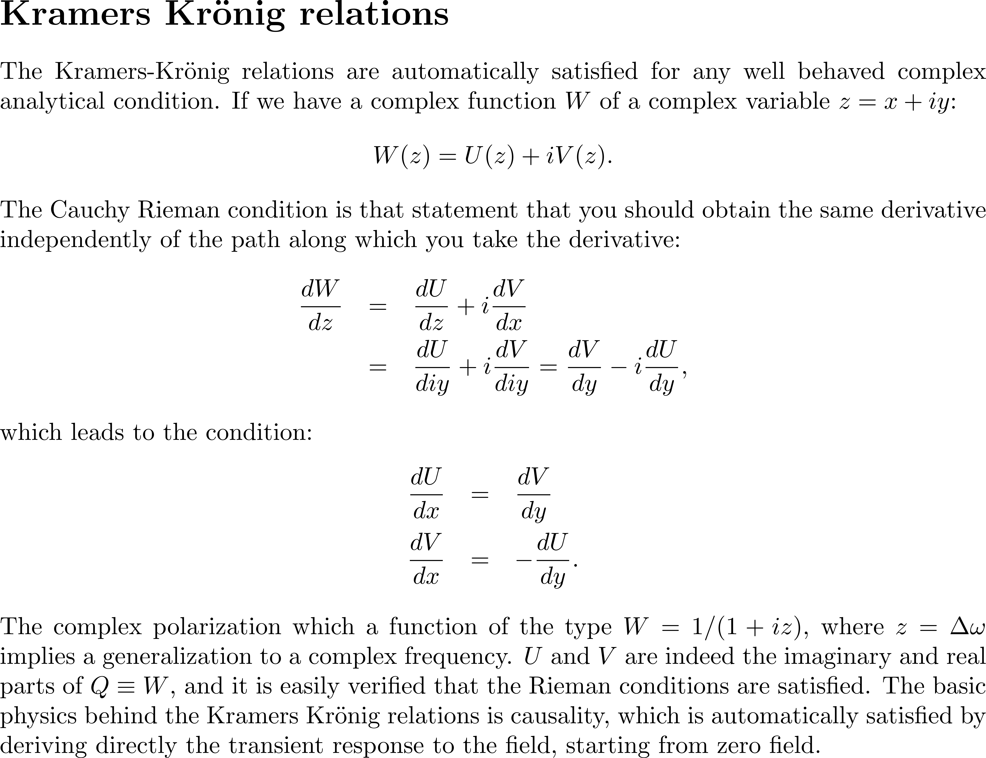

Slide 3
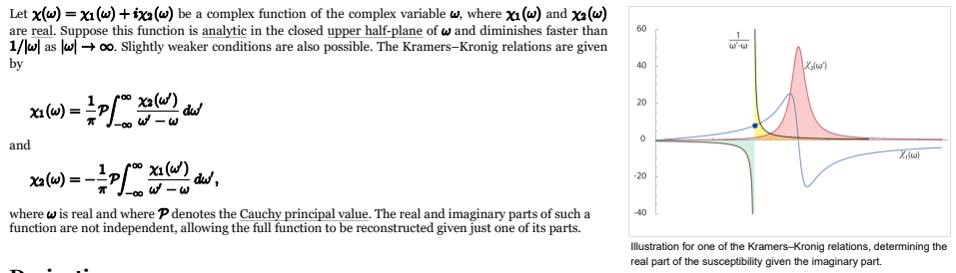

Slide 4
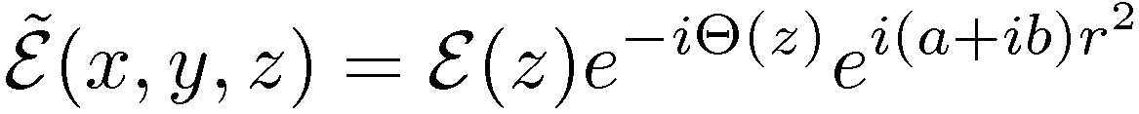
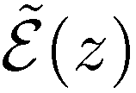

Kramers-Kroenig is not only about polarization
Relation between the real and imaginary part of the field of a Gaussian beam:
Or relation between the Guoy phase shift and the field amplitude on axis
Guoy phase shift

Slide 5
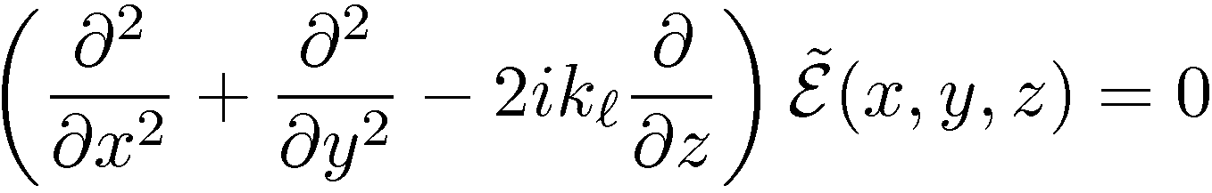
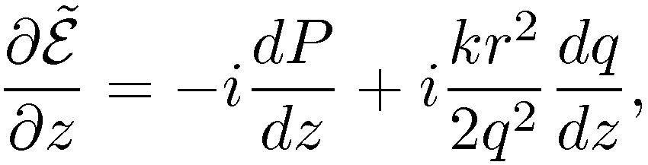
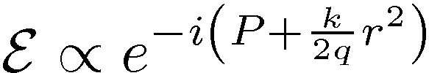
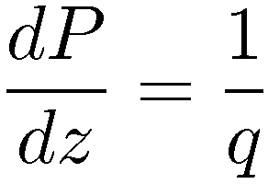
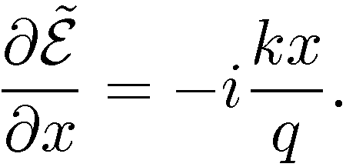
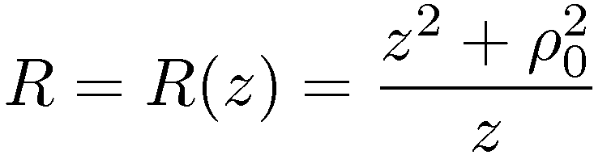
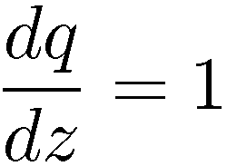
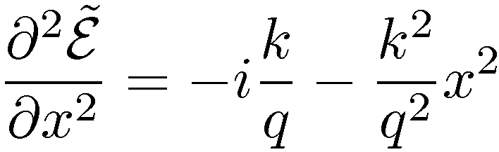
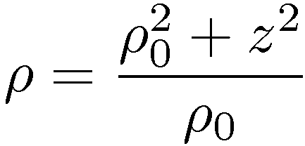

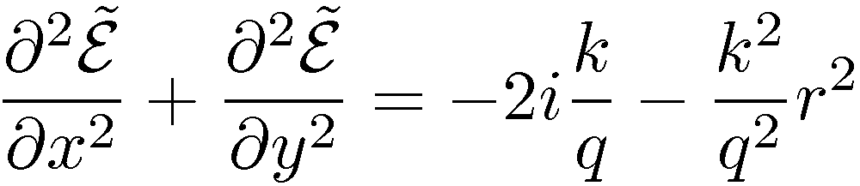
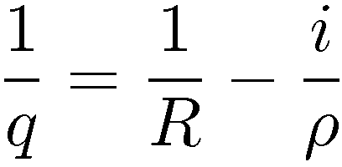
Trial solution in the space domain, inserting the Gaussian in:
Or

Slide 6
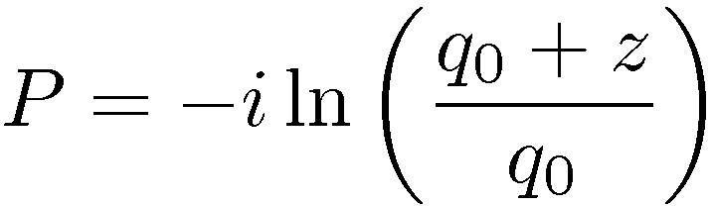
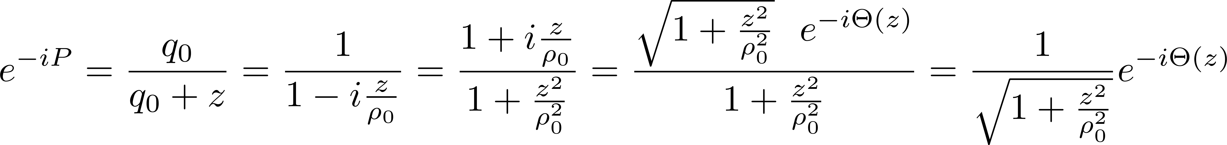
Guoy phase shift

Slide 7
ABSORPTION, DISPERSION, GROUP DELAY AND … NUMERICS

Slide 8
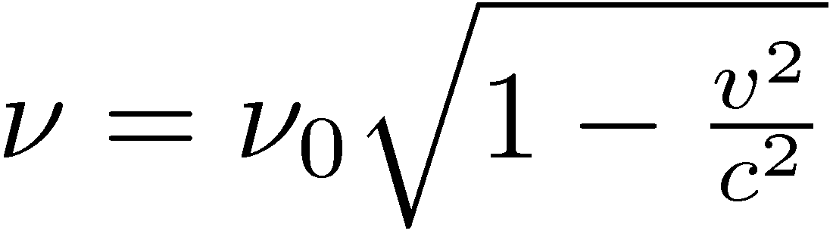
Transverse Doppler shift

Slide 9
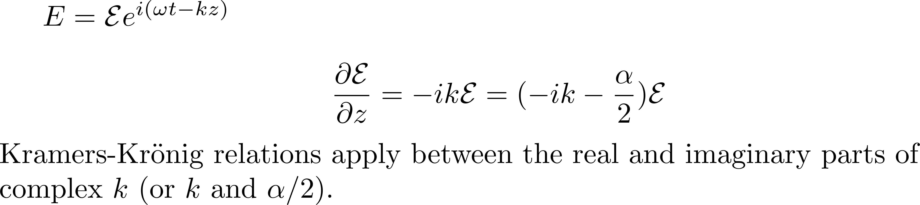
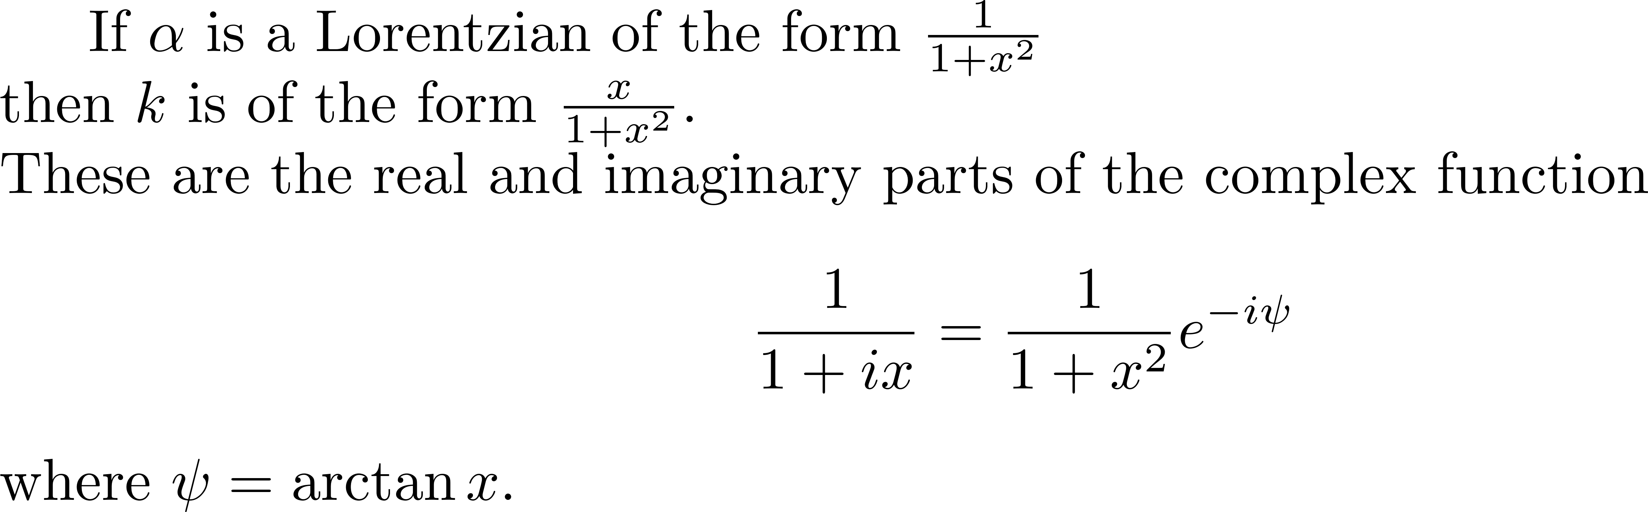





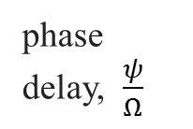

T
0

Slide 10
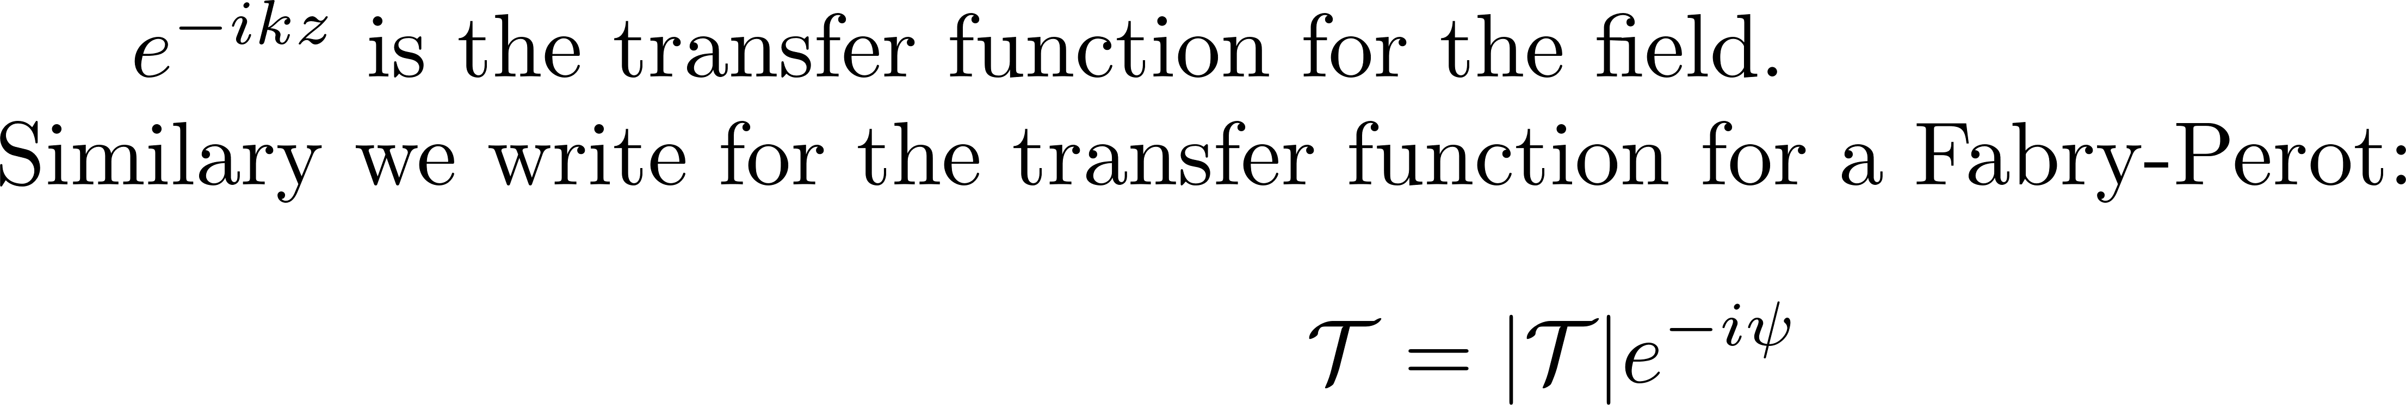
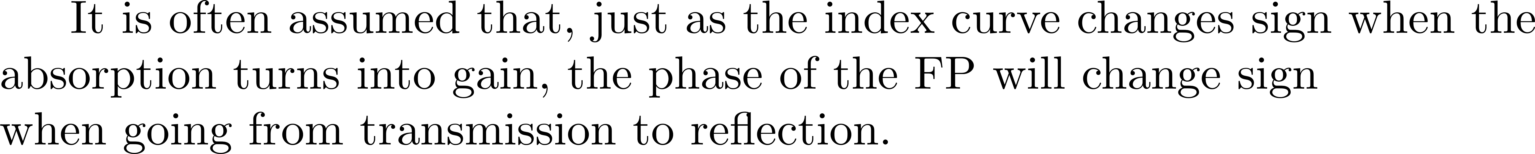
WRONG!

Slide 11
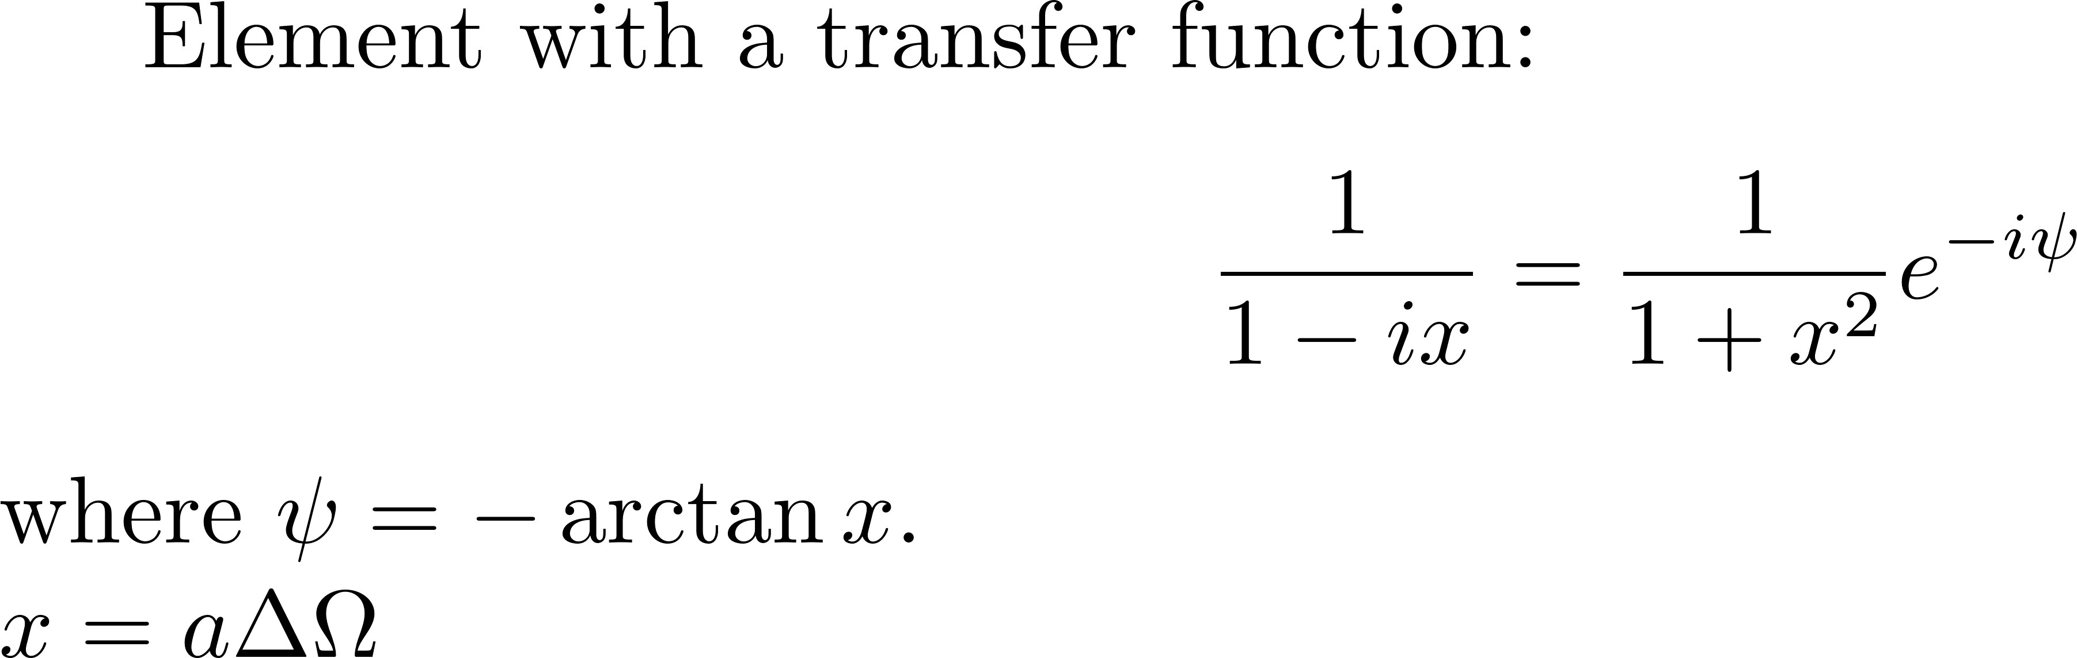
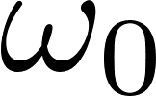
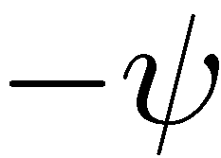

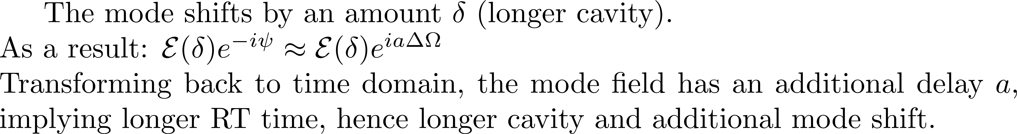
WHAT IS THE BIG DEAL ABOUT THE PHASE AND DELAY?
Resonant passive element
GAIN
a
Ω

Slide 12
WHAT IS THE BIG DEAL ABOUT THE PHASE AND DELAY?
Resonant passive element
GAIN
a
a
Ω

Slide 13
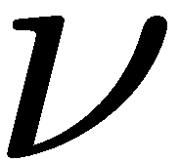
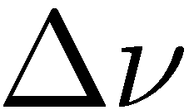
WHAT IS THE BIG DEAL ABOUT THE PHASE AND DELAY?
Resonant passive element
GAIN
D_{b}
Δν
ΔL/L_{cav}
λ
λ

Slide 14
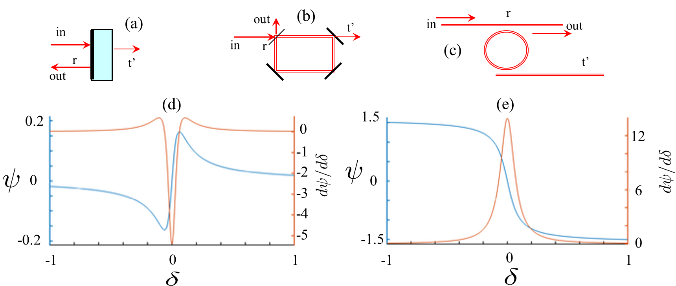
Gires Tournois reflection/dispersion Fabry-Perot transmission/dispersion
WRONG!
Notes:
14
2/2/2024

Slide 15
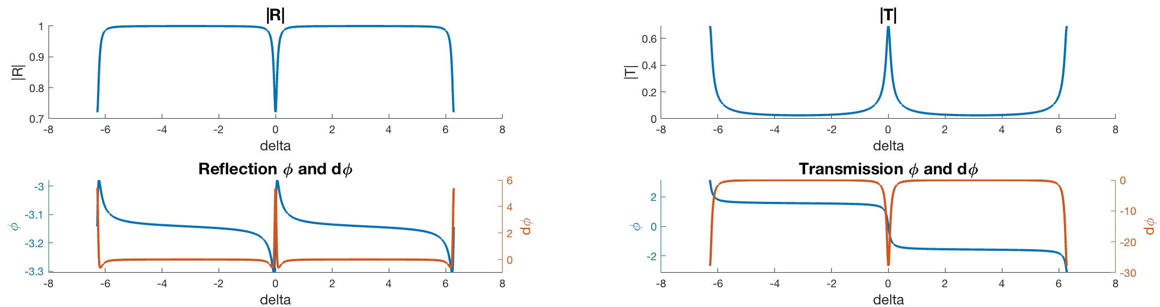




3 E q u i v a l e n t s t r u c t u r e s:
out
r
r’
in
out
in
r
r
r’
r’
Fabry-Perot transmission/dispersion
r = 0.99
r’ = 0.94
6
20
20
2
2
4
0
0
0
0
0
-2
-2
-20
-20
-8
-8
-4
-4
0
0
4
4
8
8

Slide 16

Gires Tournois reflection/dispersion
out
r
r’
in
out
in
r
r
r’
r’
1
r = 0.99
r’ = 0.94
|R|
0.9
6
-3.1
4
WRONG!
-3.2
0
-8
-4
0
4
8

Slide 17
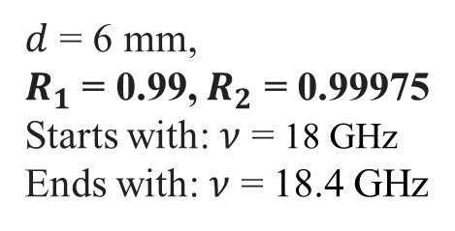
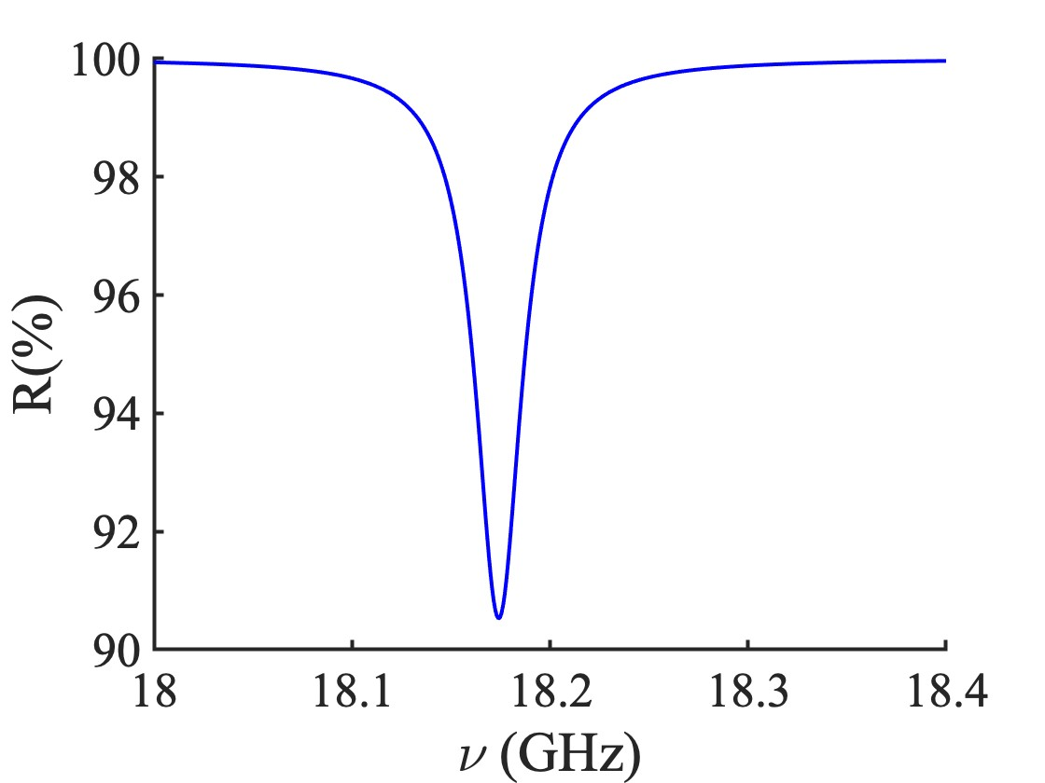
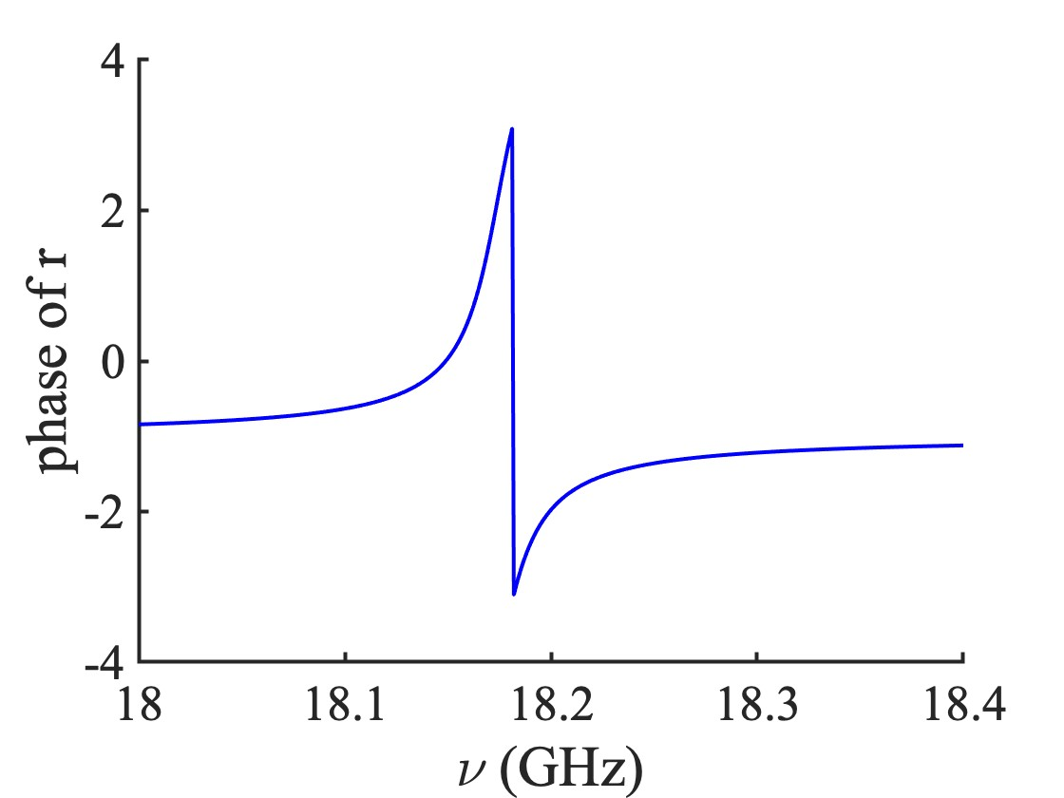
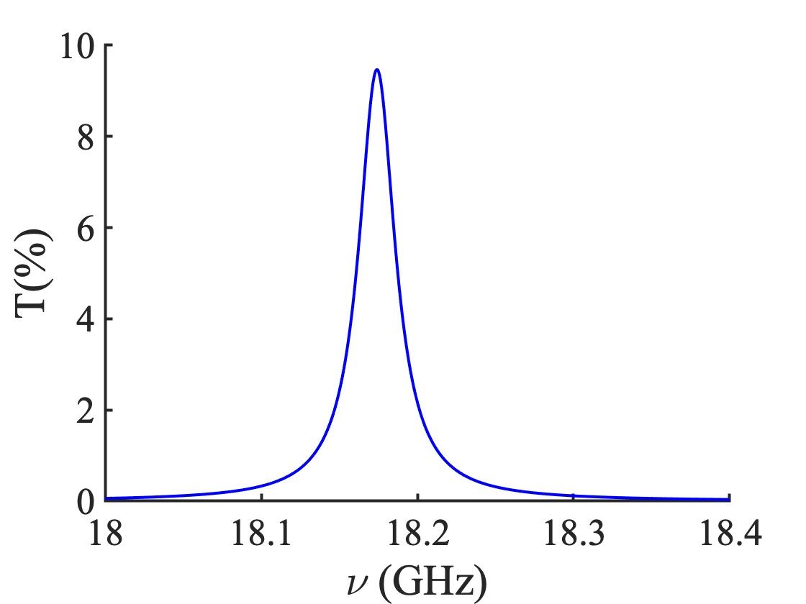
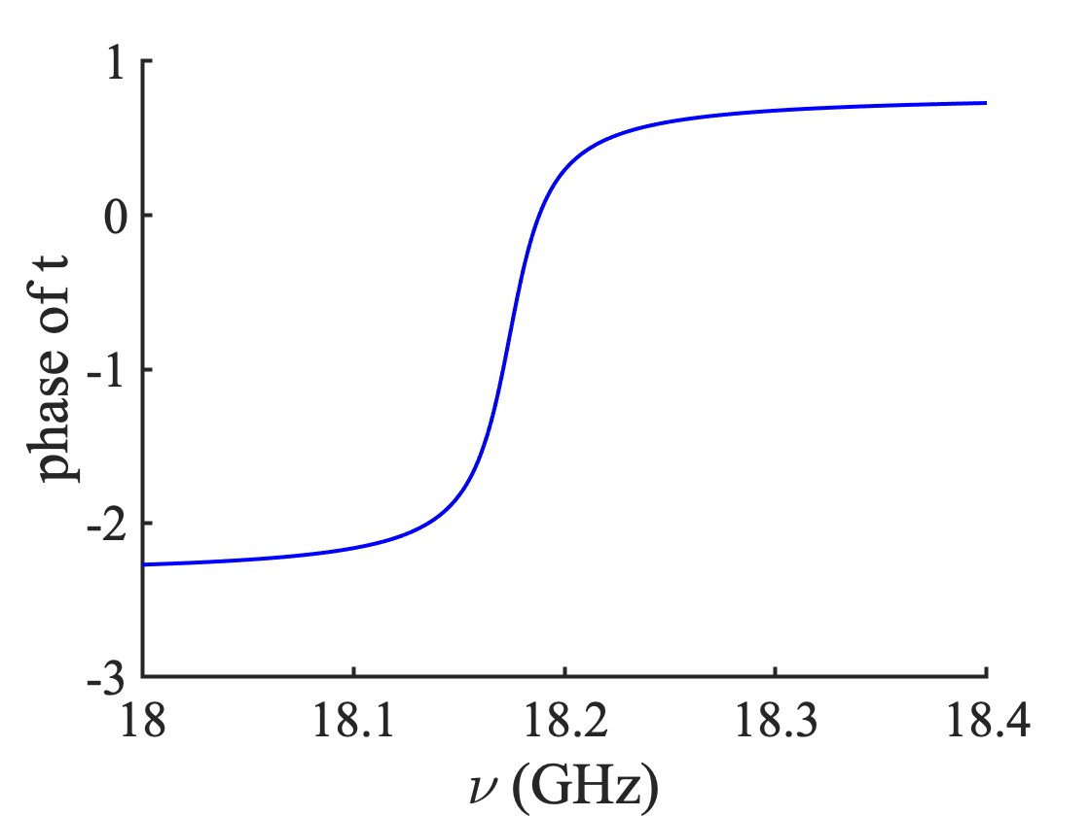
Gires-Tournois
in reflection
WRONG!
Fabry-Perot
in transmission

Slide 18
In mathlab: atan2 is trying to put a correct determination. Below my algorithm (in Fortran of course…)
E2=0.
DET=0.
SCAP=0.
E(1)=ER(1)
PH(1)=0.
do 2 I=2,MEXT
E1=E2
E2=ER(I) %Real part
EI2=EI(I) ) %Imaginary part
if (abs(sign(1.,E1)*sign(1.,E2)-1.).LT..1) go to 3
DET=DET+PI*sign(1.,E1)*sign(1.,EI2)
3 if (abs(E2).LE..1E-9) PH(I)=PH(I-1)
if (abs(E2).GT..1E-10) PH(I)=atan(EI2/E2)+DET
if (abs(E2)..LE..1E-12) E(I)=0.
if (abs(E2).GT..1E-12) E(I)=sqrt(E2**2+EI2**2)
2 if (SCAP.LT.E(I)) SCAP=E(I)
PH(1)=PH(2)
SCAP=80./SCAP
Neither mathlab atan2 nor my algorithm are foolproof as demonstrated in the next slide.

Slide 19
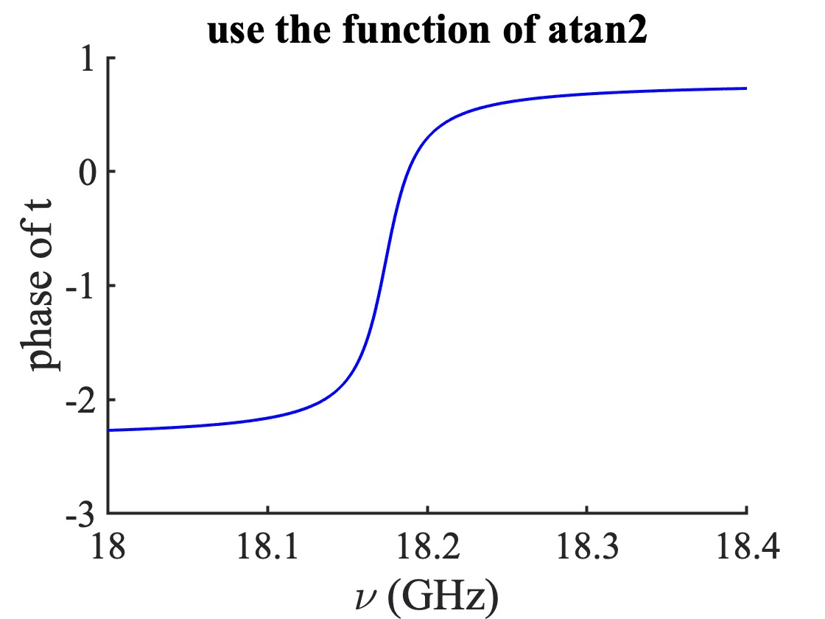
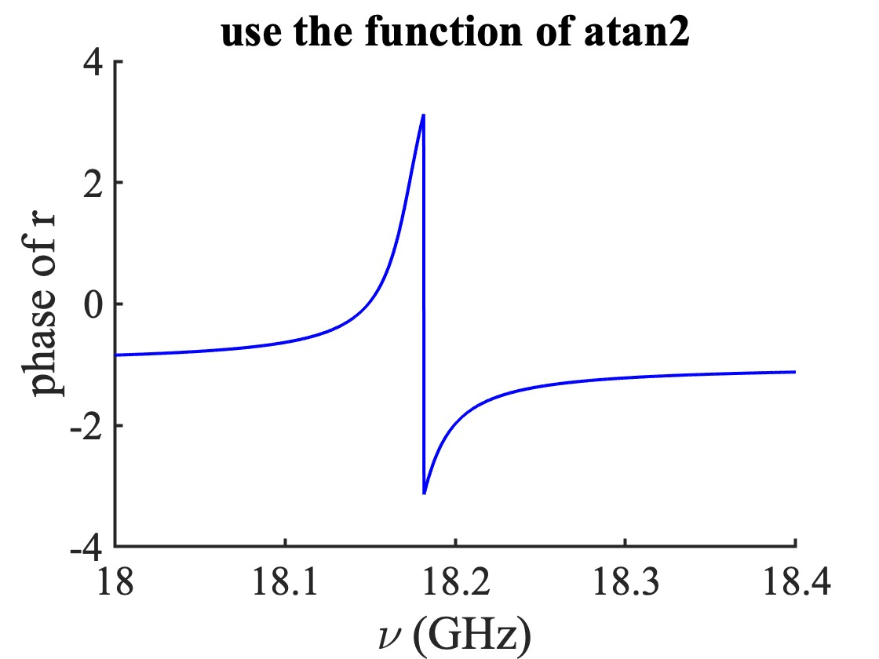
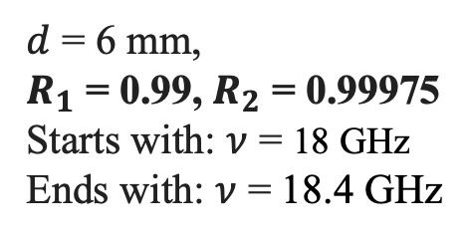
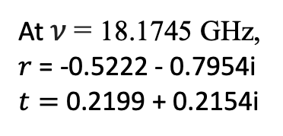
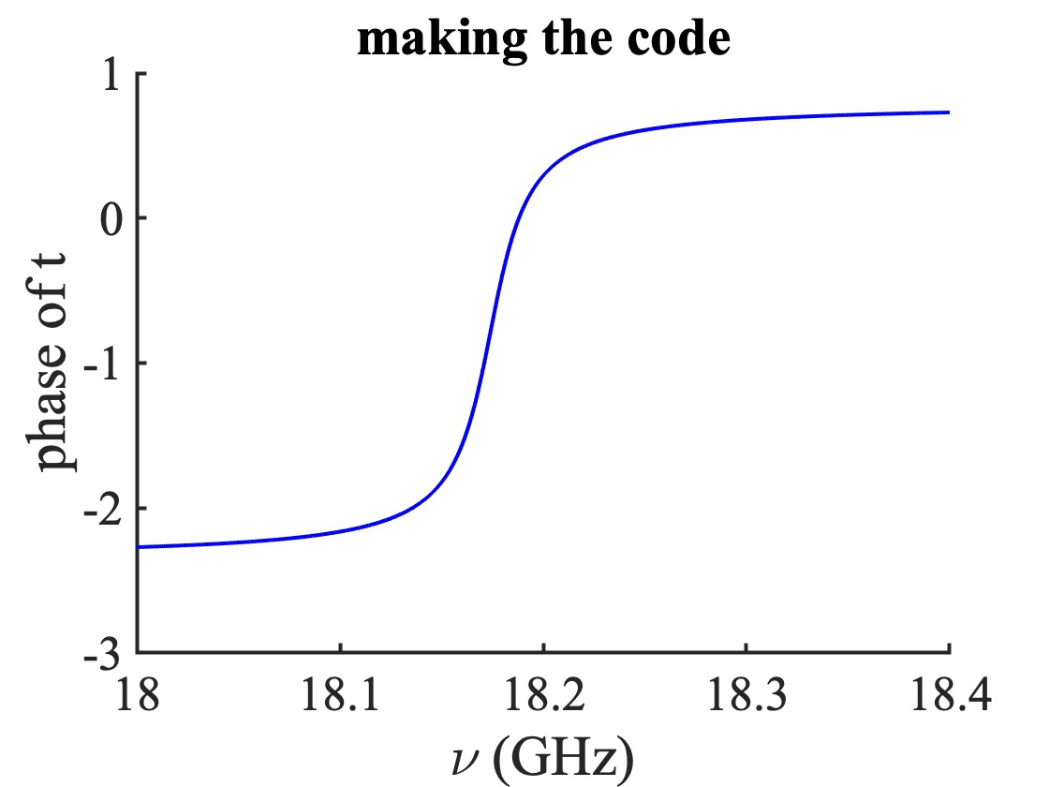
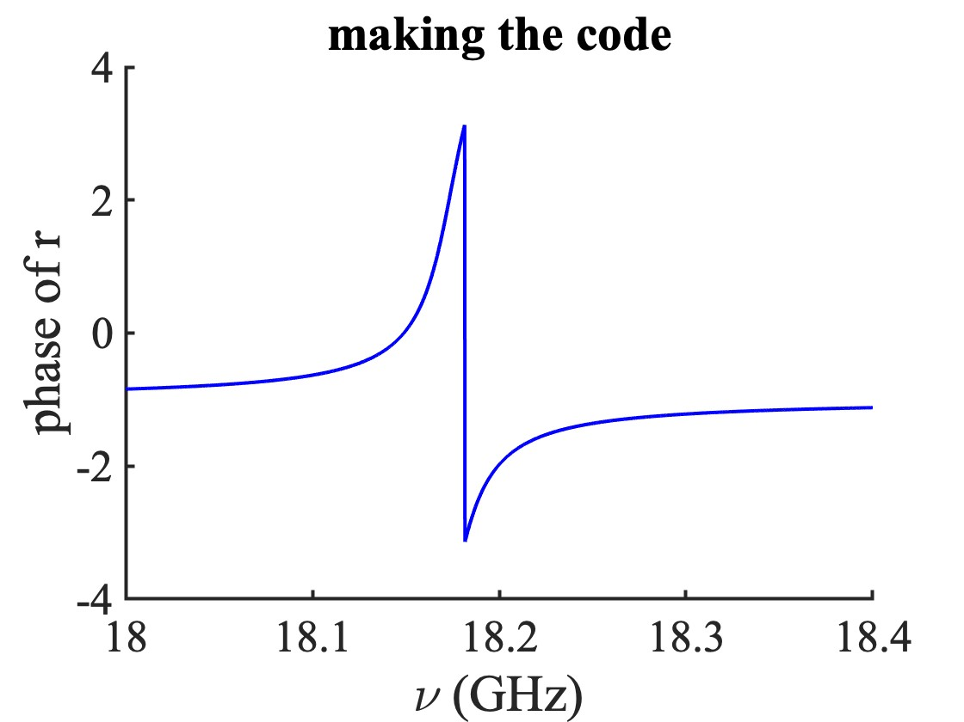
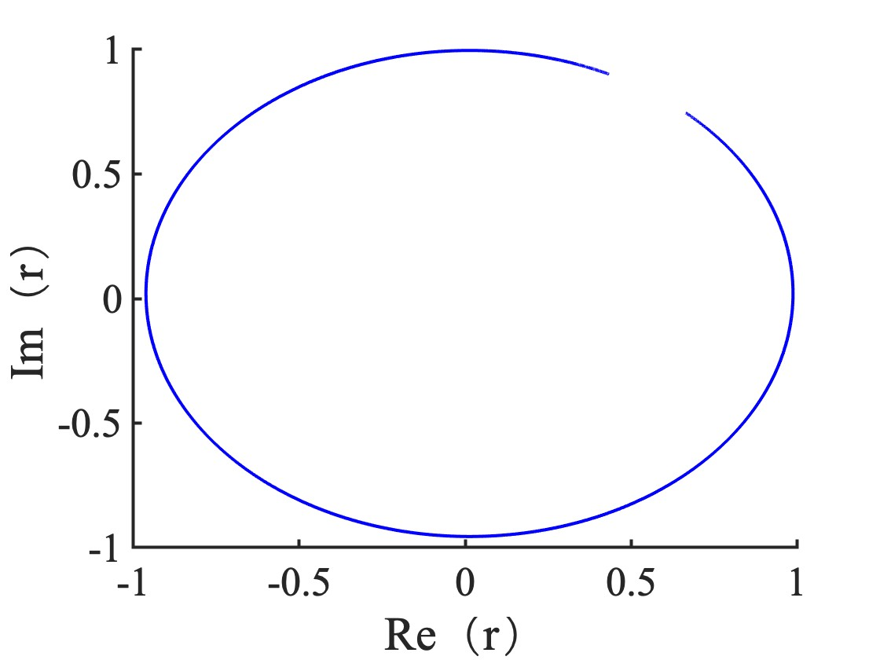
Numerical solution of the phase – by making code
Notes:
19
2/2/2024

Slide 20
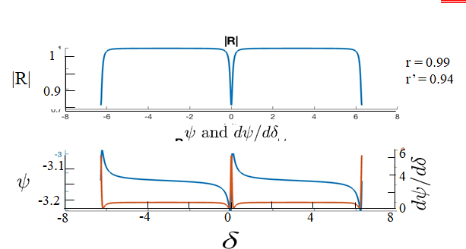
Very Very Very Very Very common errors:
1) too many points: N = 3000!!!
2) Line instead of dots
3) If they had run the program with 20 points, only symbols in the plots, they would have seen the discontinuity.
Mathlab atan2 is as bad as my own subroutine. Do not believe in commercial softwares. Same experience with FFT’s.
Always make a plot of imaginary part versus real, with a minimum number of points

Slide 21

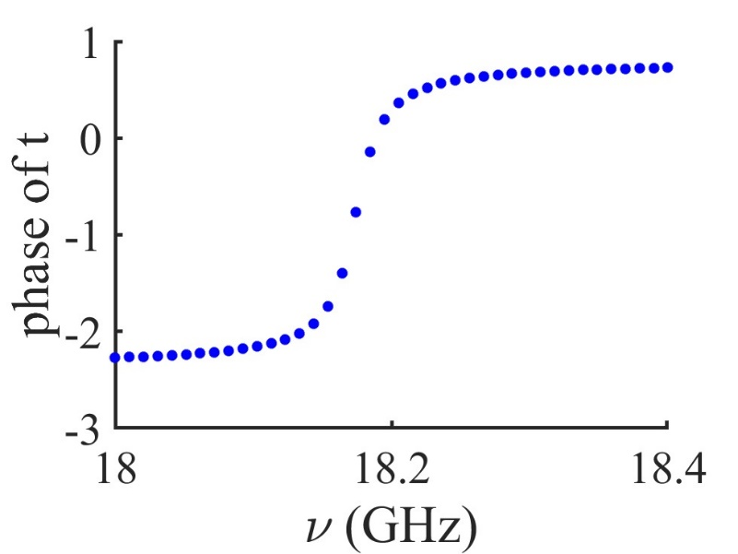
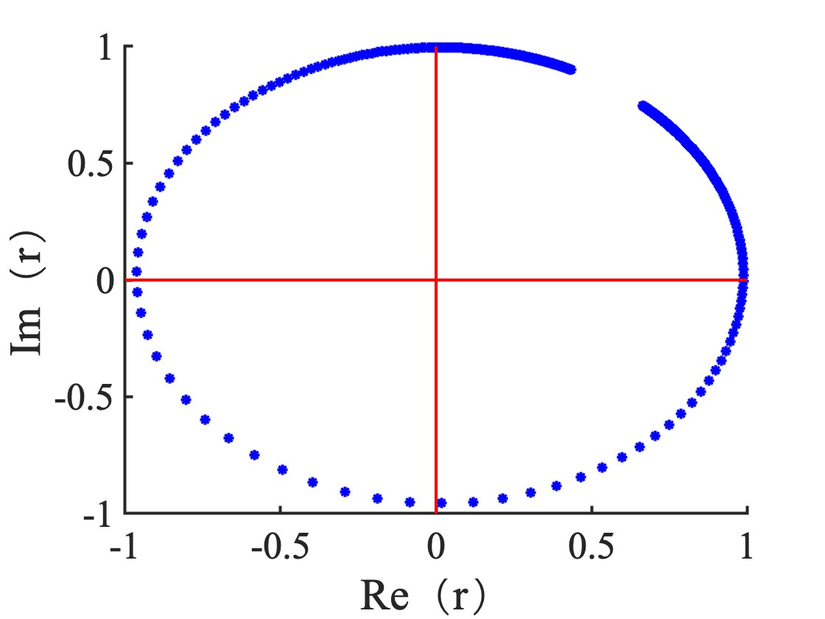
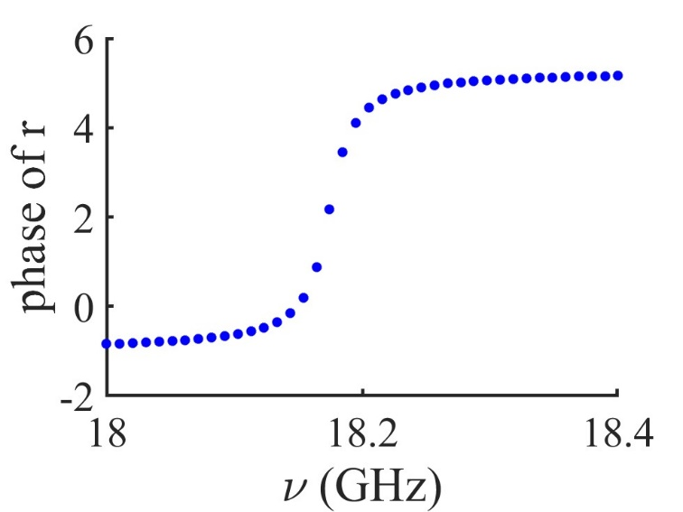
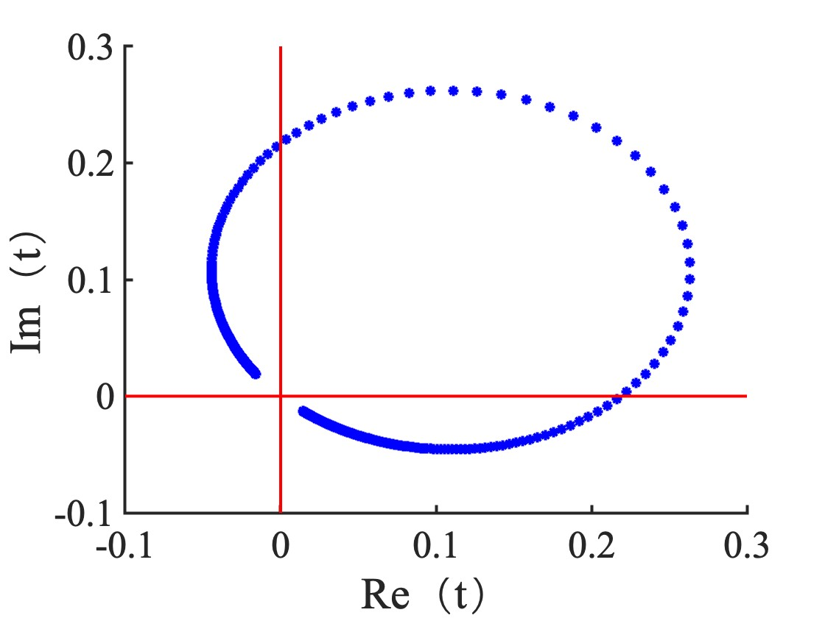
CORRECT PLOTS
Notes:
21
2/2/2024

Slide 22
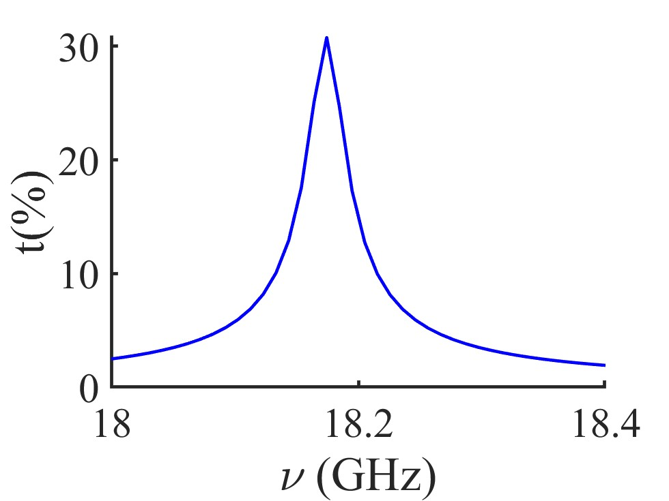





Kramers-Kroenig does not apply to amplitude and phase

Slide 23






Was the phase determination routine REALLY corrected?
Change N back to 3000

