Slide 1
LASER PHYSICS
Optics 464
PAIS or CHTM?
Web site:Dielslab.unm.edu/courses
TexPoint fonts used in EMF.
Read the TexPoint manual before you delete this box.: AAAAAAAA

Slide 2
E-MAIL FROM THE PHYSICS CHAIR

Slide 3
E-MAIL TO ME

Slide 4
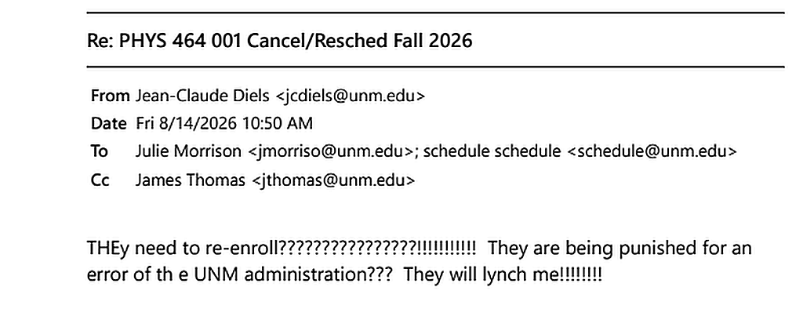
MY ANSWER
In view of the great vision of UNM administrators, their mascot should not be the lobo
but the MOLE
…with blinders

Slide 5
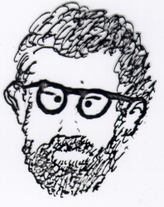
LASER PHYSICS
Optics 464
PAIS or CHTM?
Jean-Claude Diels
Physics & Astronomy room PAIS 2236, phone 277 4026
CHTM, room 114A, phone 272 7830 Do not send text messages– these are landlines! DO LEAVE VOICE messages.
email: jcdiels@unm.edu
WHERE DO I FIND MATERIAL TO UNDERSTAND THE CLASS?
Not in books, not in google, not in Wikepedia, not in chat-gtp…
But in here!

Slide 6
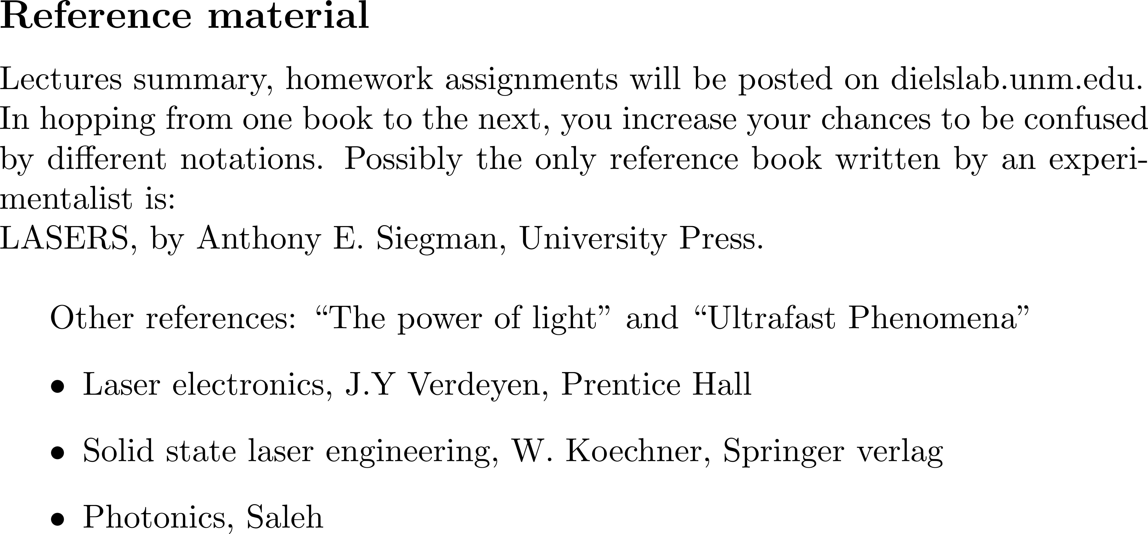
LASER PHYSICS
Optics 464
Jean-Claude Diels
Physics & Astronomy room PAIS 2236, phone 277 4026
CHTM, room 114A, phone 272 7830 Do not send text messages– these are landlines! DO LEAVE VOICE messages.
email: jcdiels@unm.edu

Slide 7
LASER PHYSICS
Optics 464
PAIS 1160?
Jean-Claude Diels
Physics & Astronomy room PAIS 2236, phone 277 4026
CHTM, room 114A, phone 272 7830 Do not send text messages– these are landlines! DO LEAVE VOICE messages.
email: jcdiels@unm.edu
Homework problems will be assigned on a regular base, due generally on Wednesdays. They will count for 40% of the final grade.
Some problems will be treated in class.
Exams Two midterm and one final (format to be decided); 60% of grade total.
..
Grading based on HOW you approach the problem, rather than the result.
Teaching assistant: Yinmiao Wang
yinmiao@unm.edu

Slide 8
INTERRUPT ME!
ASK QUESTIONS
OR
CORRECT ME IF I AM WRONG
Or if you think I am wrong…)

Slide 9
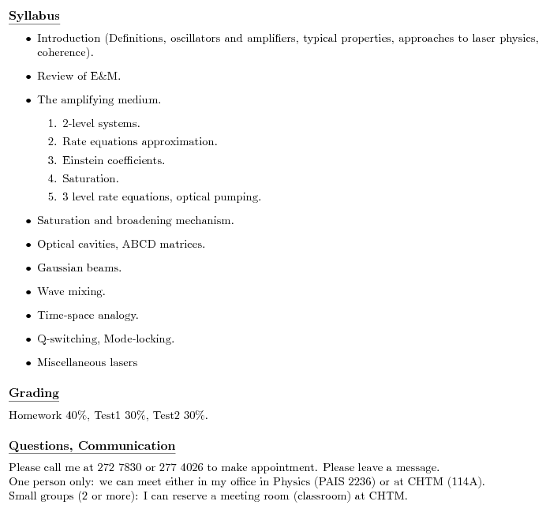

Slide 10

Accessibility
Accommodations: UNM is committed to providing equitable access to learning opportunities for students with documented disabilities. As your instructor, it is my objective to facilitate an inclusive classroom setting, in which students have full access and opportunity to participate. To engage in a confidential conversation about the process for requesting reasonable accommodations for this class and/or program, please contact Accessibility Resource Center at arcsrvs@unm.edu or 505-277-3506
Title IX
In an effort to meet obligations under Title IX, UNM faculty, Teaching Assistants, and Graduate Assis- tants are considered “responsible employees” by the Department of Education. This designation requires that any report of gender discrimination which includes sexual harassment, sexual misconduct and sexual violence made to a faculty member, TA, or GA must be reported to the Title IX Coordinator at the Office of Equal Opportunity (oeo.unm.edu). For more information on the campus policy regarding sexual misconduct, see: https://policy.unm.edu/university-policies/2000/2740.html
Replaced by:
UAP 2720 and 2740. Our classroom and university should foster mutual respect, kindness, and support. If you have concerns about discrimination, harassment, or violence, please seek support and report inci- dents. Find confidential services at LoboRESPECT Advocacy Center, the Womens Resource Center, and the LGBTQ Resource Center. UNM prohibits discrimination on the basis of sex (including gender, sex stereotyping, gender expression, and gender identity). All instructors are “responsible employees” who must communicate reports of sexual harassment, sexual misconduct and sexual violence to Compliance, Ethics and Equal Opportunity. For more information, please see UAP 2720 and UAP 2740
H Y P O C R I S Y
ADA = Annihilation by Darwin selestion of the hAndicapped

Slide 11
Credit hours
This is a three-credit-hour course. Class meets for three 50-minute sessions/two 75-minute sessions of direct instruction for fifteen weeks during the Fall 2025 semester. Please plan for a minimum of six hours of out-of-class work (or homework, study, assignment completion, and class preparation) each week.
Academic Integrity
Each student is expected to maintain the highest standards of honesty and integrity in academic and professional matters. The University reserves the right to take disciplinary action, up to and including dismissal, against any student who is found guilty of academic dishonesty or otherwise fails to meet the standards. Any student judged to have engaged in academic dishonesty in course work may receive a reduced or failing grade for the work in question and/or for the course. Academic dishonesty includes, but is not limited to, dishonesty in quizzes, tests, or assignments; claiming credit for work not done or done by others; hindering the academic work of other students; misrepresenting academic or professional qualifica- tions within or without the University; and nondisclosure or misrepresentation in filling out applications or other University records.

Slide 12
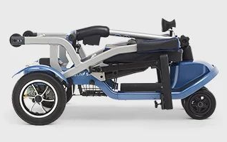
PROLOGUE
Why the scooter
and the cane???
?
It is not COVID, but the UNM Provost for Research Tom Turner. In March 2020, I was ordered to move my lab out of the old physics building. The old building was to be bulldozed within a week. At the same time, the administration close the buildings to students. Associate Provost for Research refused to make an exception by allowing one student to help me with the move.
That forced me to move a whole optics lab by myself resulting in spinal injury. This is consistent with UNM motto: RULE first! Feed faculty to COVID!
In view of the great vision of UNM administrators, their mascot should not be the lobo
but the MOLE
…with blinders

Slide 13
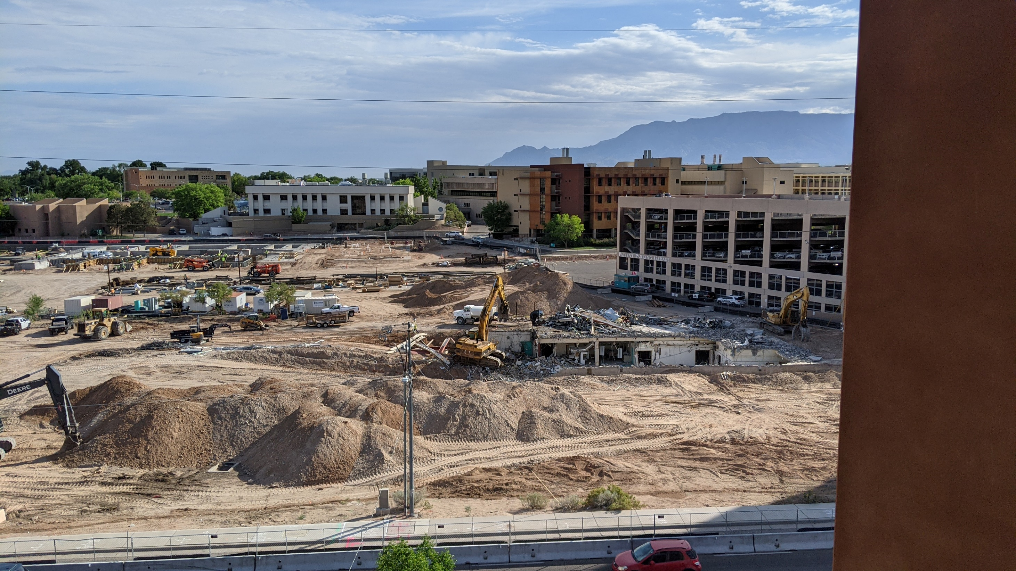

Slide 14
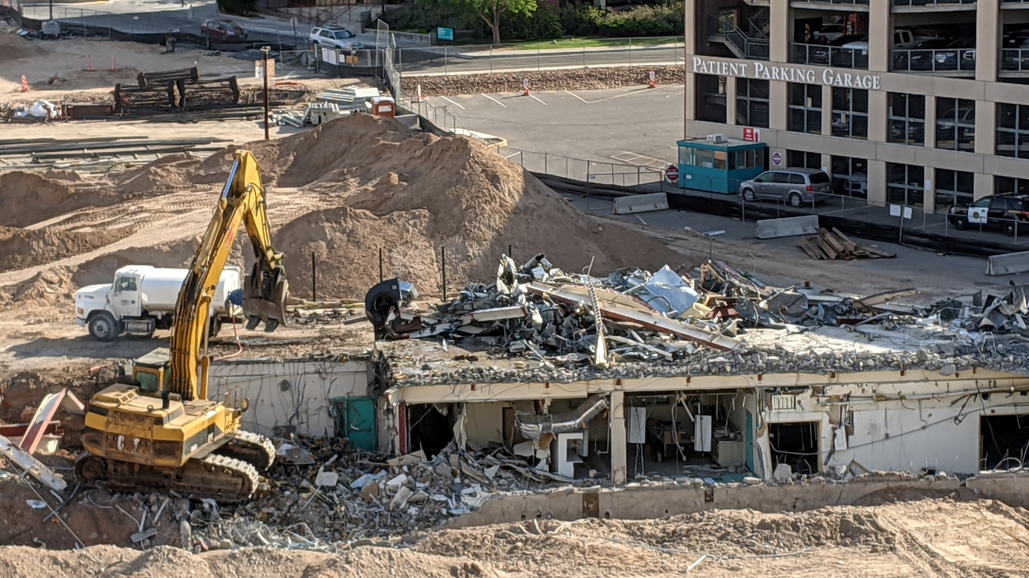

Slide 15
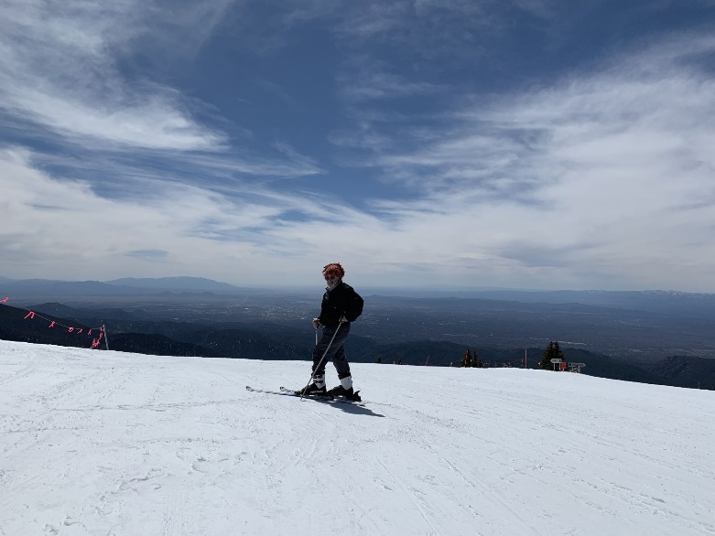
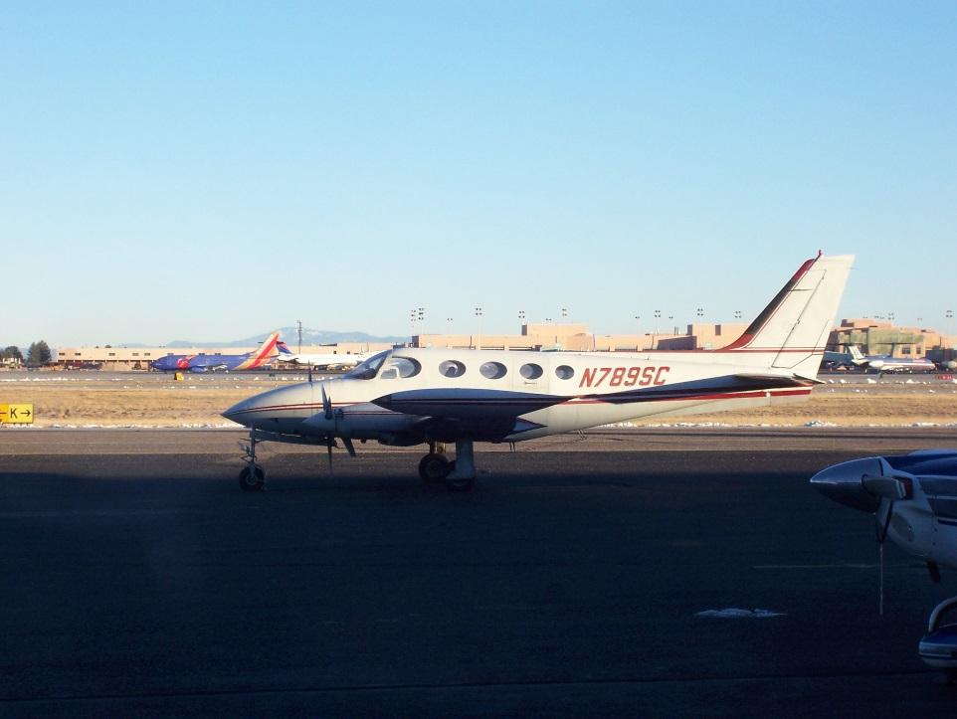
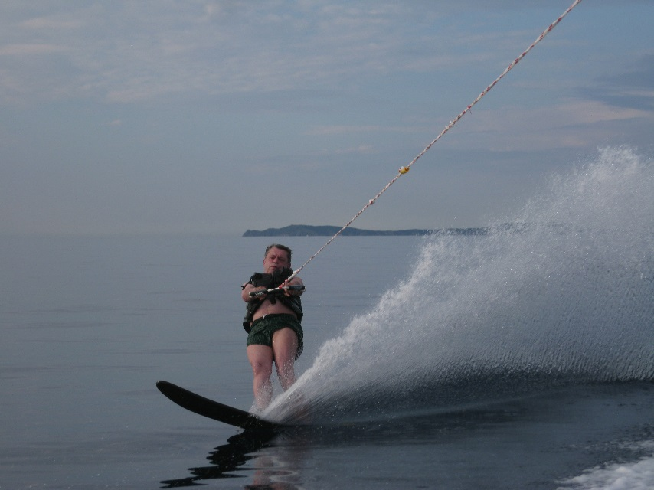
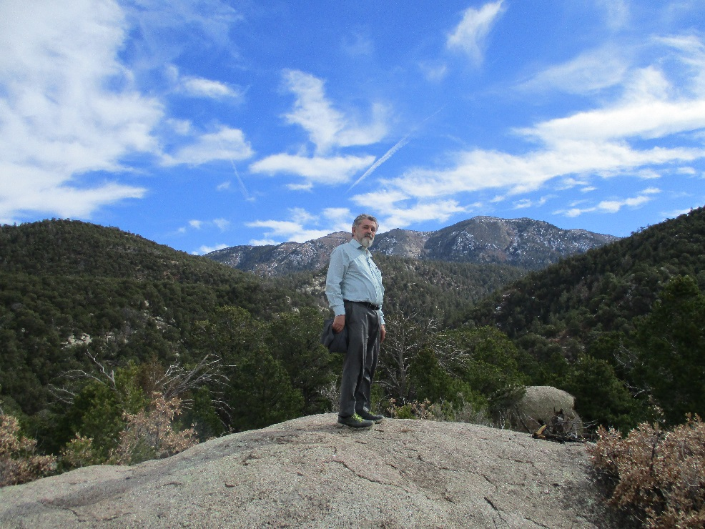
PROLOGUE
I MISS…
skying
Hiking
Piloting
Waterskying
…but I can still enjoy teaching
and doing research.

Slide 16
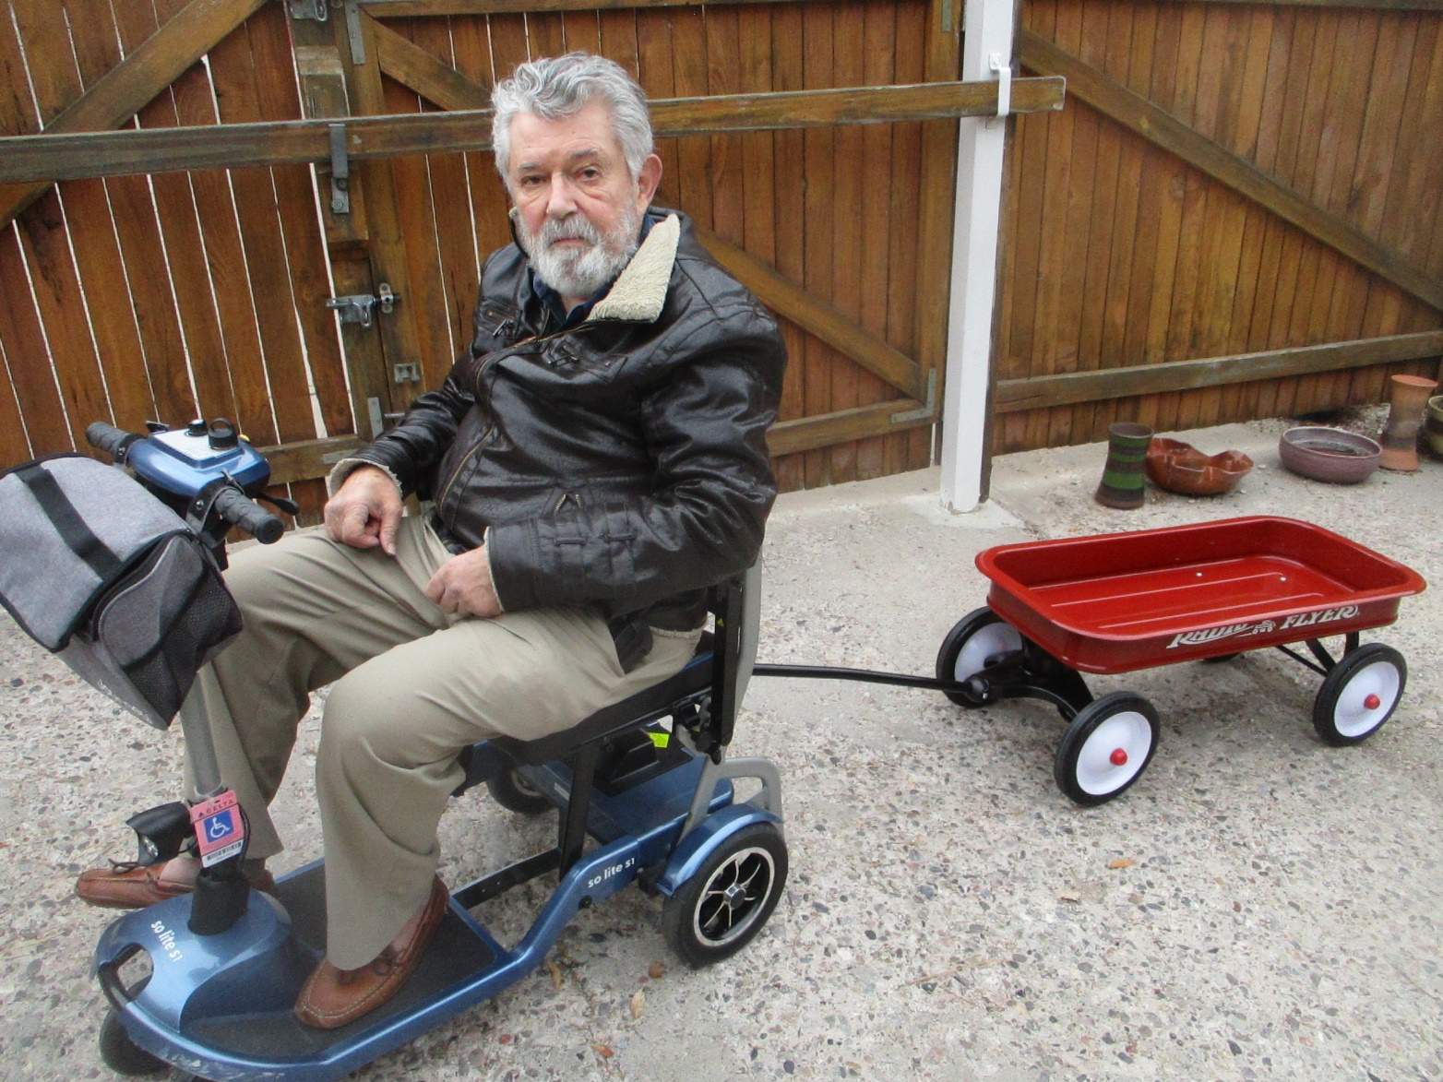
Every problem has a solution
I cannot run through the hallways anymore,
But I can still be the terror of the hallways

Slide 17
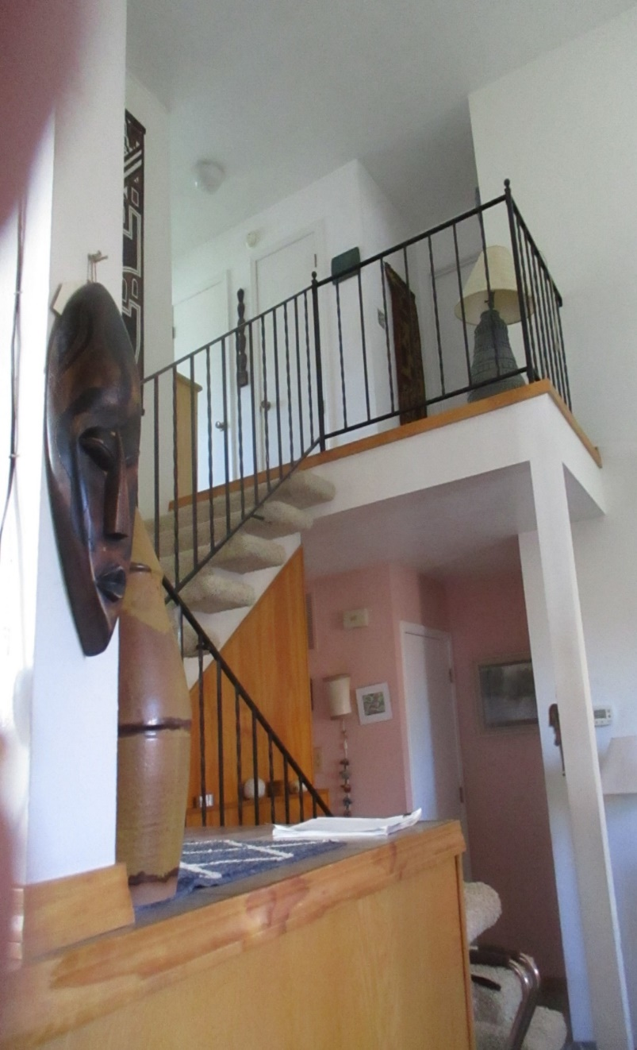
Every problem has a solution
Climbing the “Kilimanjaro” to my home office.

Slide 18
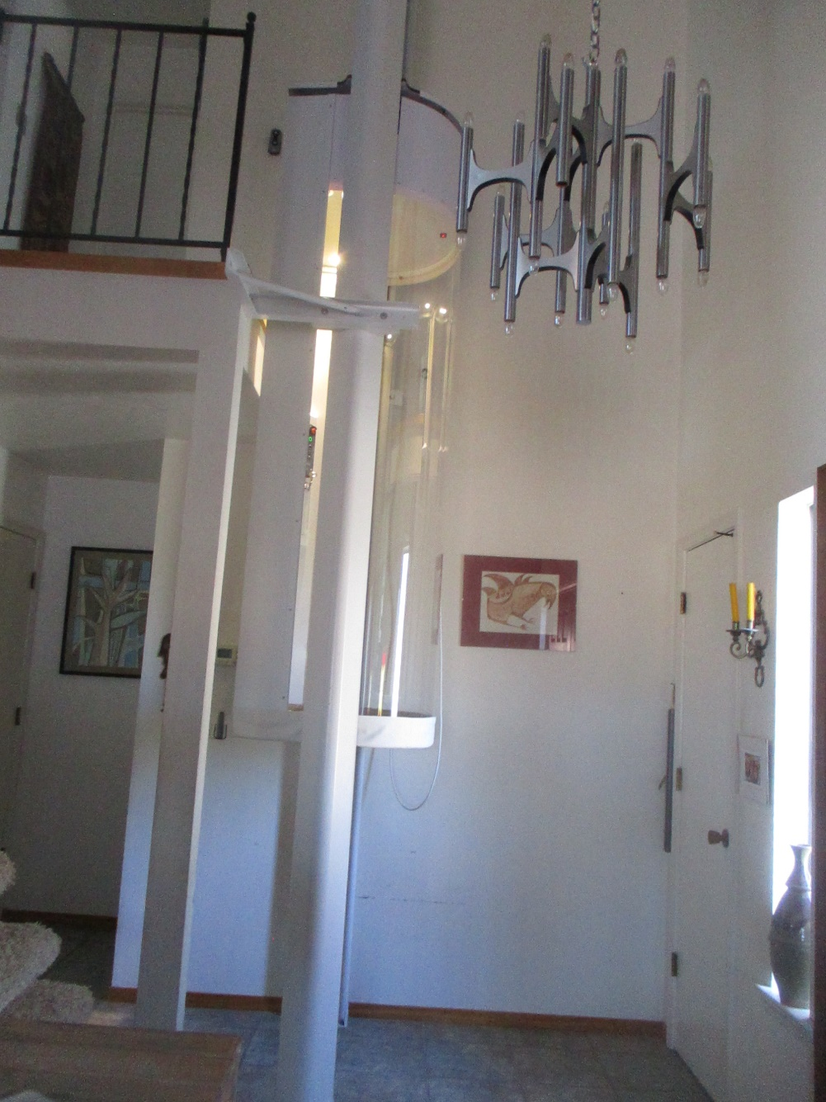
Climbing the “Kilimanjaro” to my home office.
Latest approach: The elevator to heaven
fortunately it stops at the second floor
…for now
After being stuck twice, I installed a phone in it, so that I can tell God I am on my way.

Slide 19
Introduction to light
Introduction to waves
What is a wave? There is always a pattern and motion associated to the wave; the ripples of a
stone thrown in a pond. If you take a picture from the ripples on the pond you realize that there are regular patterns that repeat in water, and you can possibly count the number of peaks on the water surface, that are separated by “wavelength". You can also only consider a fixed point on the surface, and monitor its motion as it goes up and down, or oscillates. It takes a “period" for each point on the pond to repeat its position. The pattern on the wave (for example the peaks) have a certain “speed“ or “wave velocity"
When a wave goes through a medium it does not mean that the medium is necessarily moving with it.. The wave propagate for huge distances, while each particle responsible for the
wave motion stays at the same average position, just inducing the motion of the next particle. In most cases, the wave starts from a local oscillation , and propagates radially from there, like rings produced by a duck paddling on a pond. In the case of light, it is the electric field produced
by a charge oscillating up and down that starts off the wave.

Slide 20
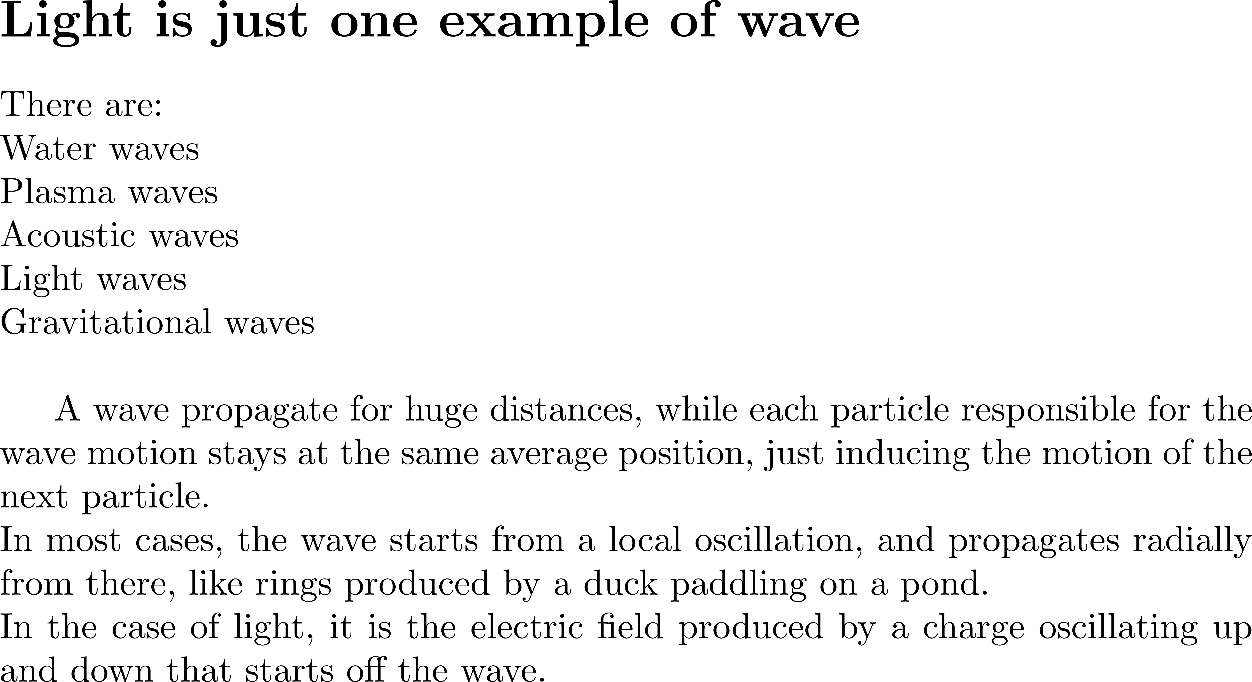

Slide 21
General wave propagation equation (first order)
No physics needed – it is pure logic

Slide 22
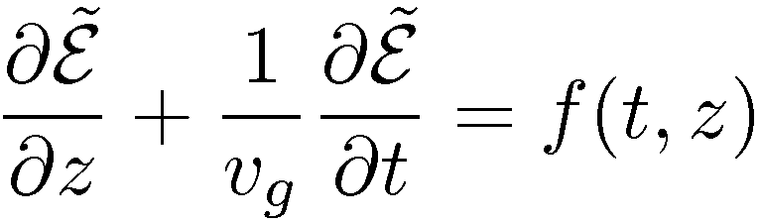
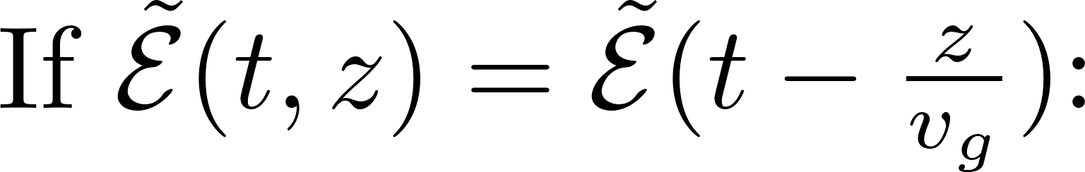
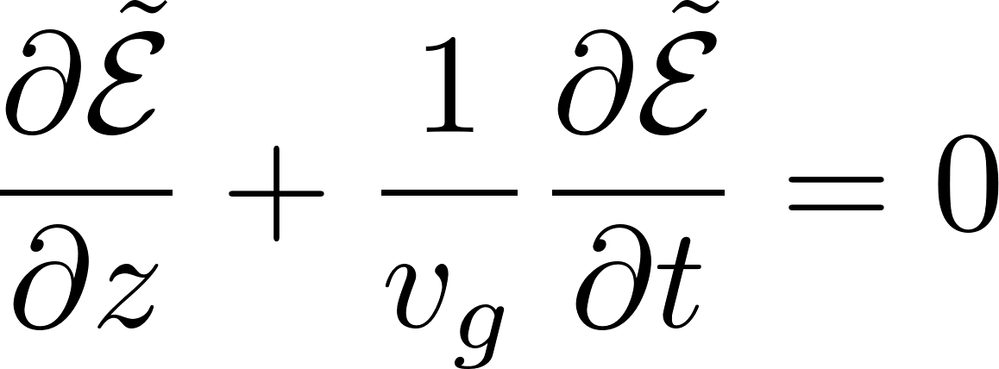

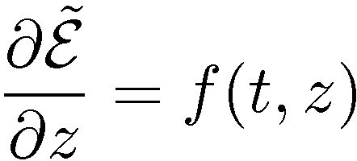

Wave propagation equation (first order)
Whatever the nature of wave is, it is something that propagates at a constant velocity
retarded frame
t=0
t
In the retarded frame:
t=0
t’=0
z
t’

Slide 23
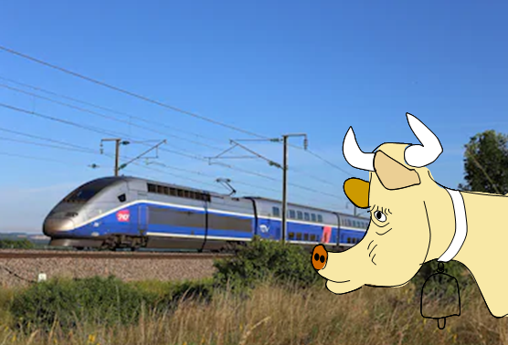
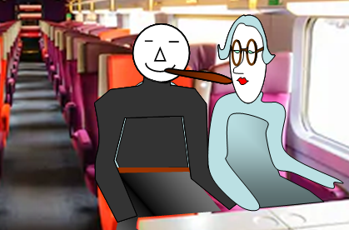
What the retarded frame of reference means
In the laboratory frame:
t=0
t
t=0
t’=0
In the retarded frame:
z
t’
The observer in the laboratory frame
is the cow that watches the TGV go by.
There is no way she can tell what is
happening inside [(i.e. f(t,z)].
For that, she must be in the retarded frame
which means inside the TGV,
or galloping next to it.

Slide 24
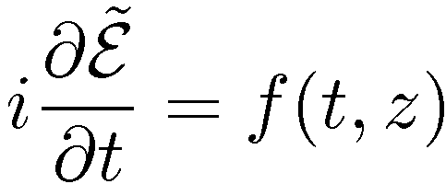
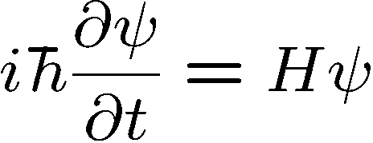
Retarded frame
HERESIE says the quantum physicist!
It should be:
Why?
Because the Schroedinger equation is
If it is not “quantum”, forget it.

Slide 25
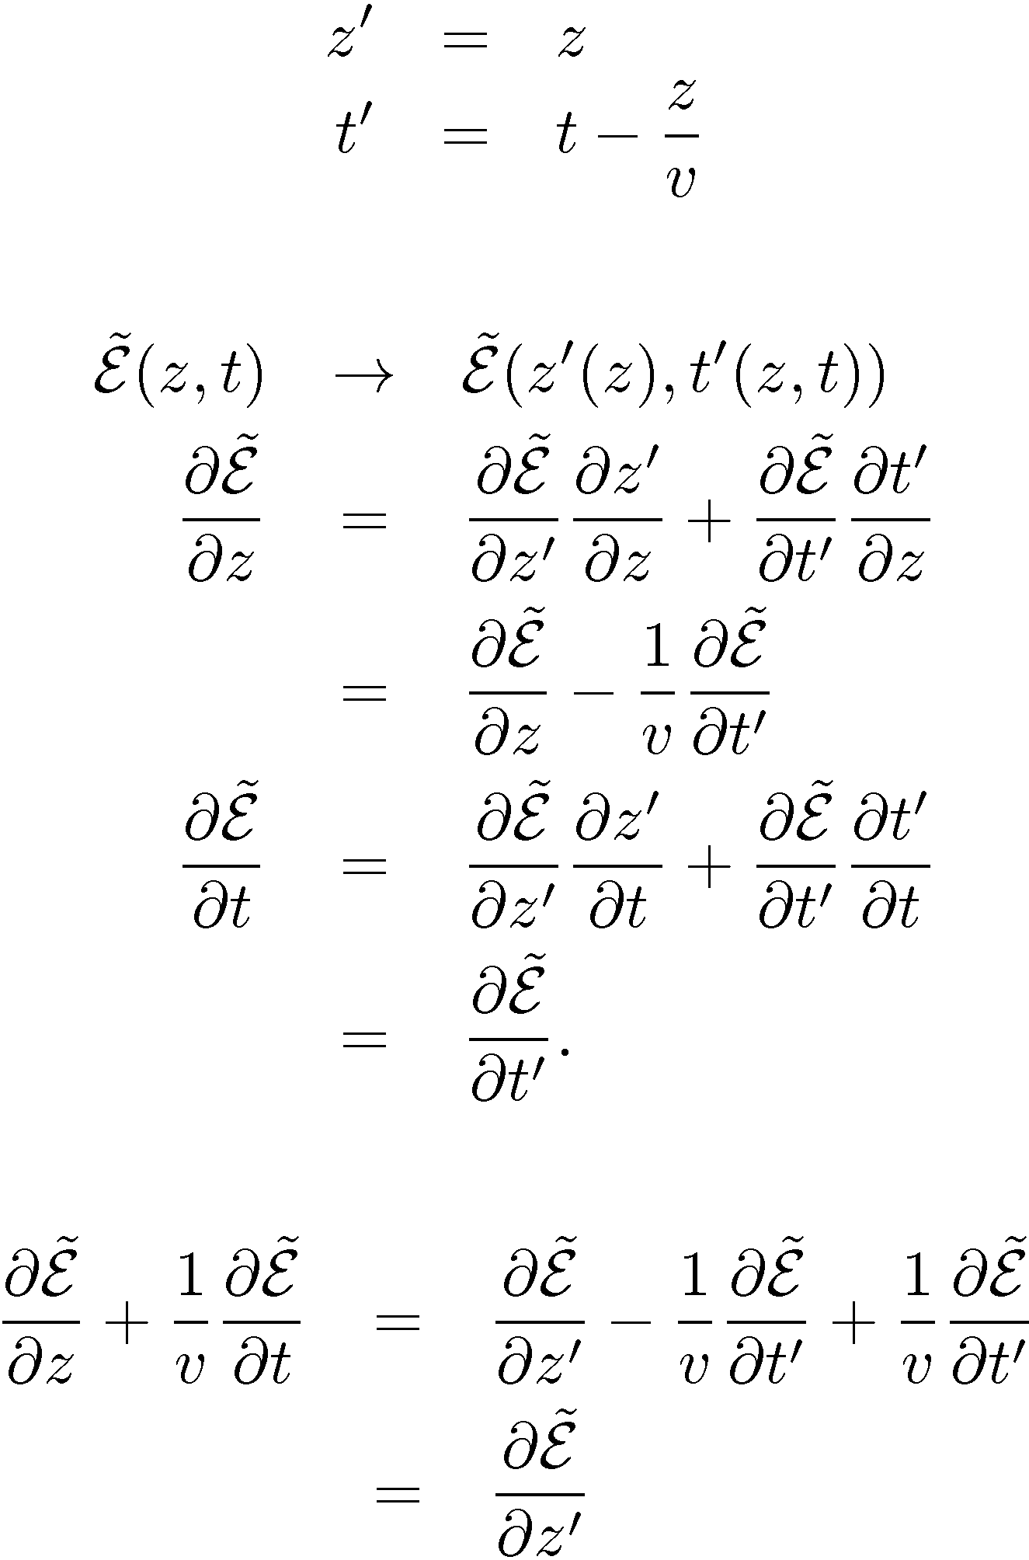
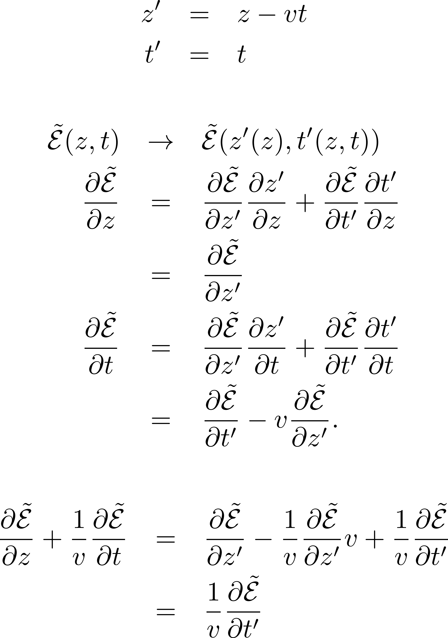
Retarded frame
“Running space coordinate”

Slide 26
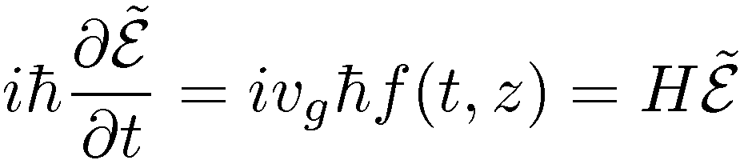
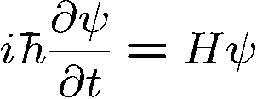
Retarded frame
“Running space coordinate”
Alleluia!
and the quantum physicist is happy
The cow-watching-the-TGV-is-not.
?
?
What is the physical meaning of the
?
“Running space coordinate”???
The rails are moving opposite to the train velocity so that the TGV is at standstill?

Slide 27
Sine waves and “Rogue waves”
Wave
amplitude
0
time

Slide 28
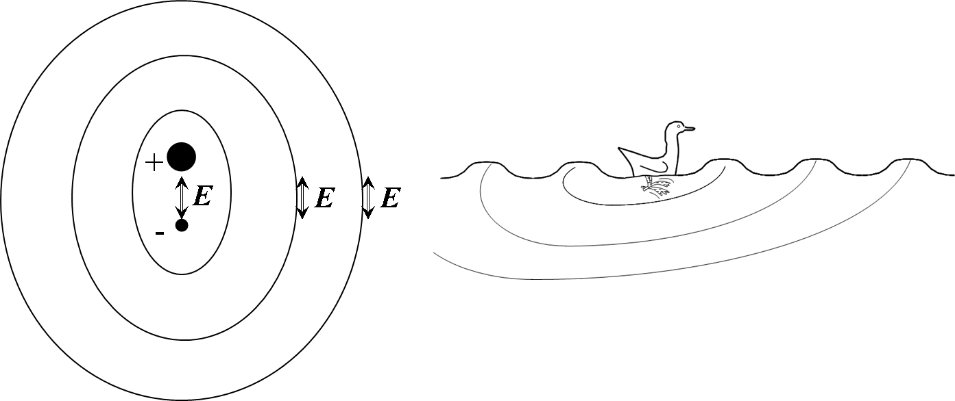
In the retarded frame, the propagation shape is not the bobbling duckling, but rather a surfer.
Or a “rogue wave”.
Biggest mystery of the seas. Large ships disappeared over centuries, without leaving any tracks. It lead to the creation of myths of Sea Monsters, then that of “Giant waves”. These stories were dismissed as seaman’s tales, until two well documented events in 1995:
1. Automated recording at the Norwegian Oil platform Draupner-E, which indicated in the New Year night a single wave of 26 meter height.
2. Luxury liner Queen Elizabeth 2 on its way to New York hit by a giant wave.
All oceanographic models so far predicted a statistical distribution of waves not exceeding 7 meter, while the freak waves recorded reached more than 30 m.
The wave equations used were similar to the linear wave propagation in optics, including a frequency dependent wave velocity. The higher the wave, the less its velocity would be affected by friction with the deeper water.
Kasparian, J., Béjot, P., Wolf, J.P., and Dudley, J.M. (2008) Optical rogue wave statistics in laser filamentation. Optics Express, 17, 12 070–12 075.
Solli, D.R., Ropers, C., Koonath, P., and Jalali, B. (2007) Optical rogue waves. Nature, 450, 1054.

Slide 29
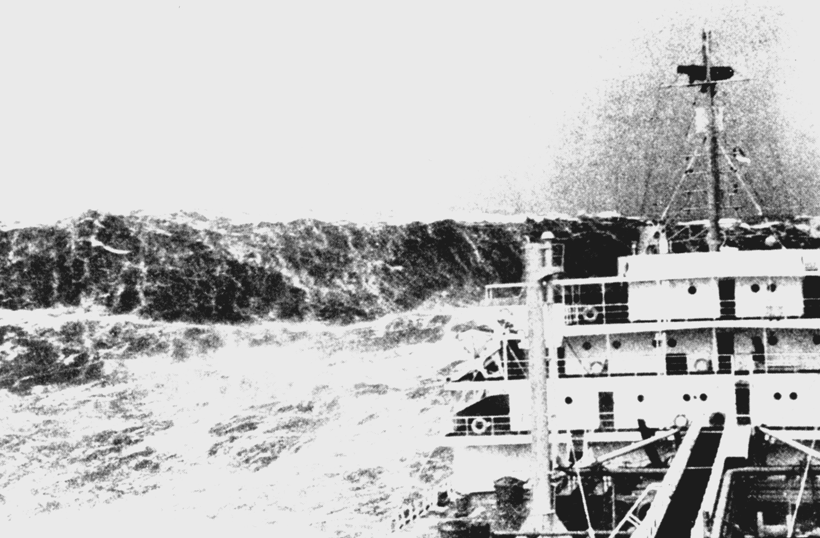
“Rogue wave” on the Bay of Biscay (1993)

Slide 30
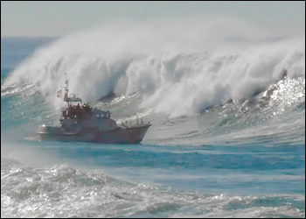
Solli, D.R., Ropers, C., Koonath, P., and Jalali, B. (2007) Optical rogue waves. Nature, 450, 1054.

Slide 31
Water waves, acoustic waves, gravitational waves and light waves

Slide 32

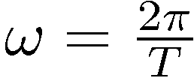
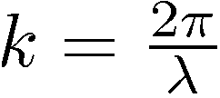
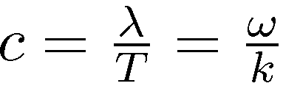
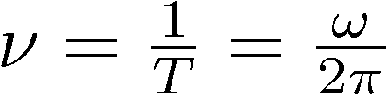
Wave propagation
E
c
c
Wave velocity:
T = period λ = wavelength
Light frequency (Hz):

Slide 33

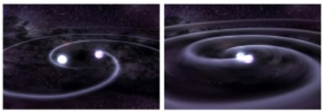
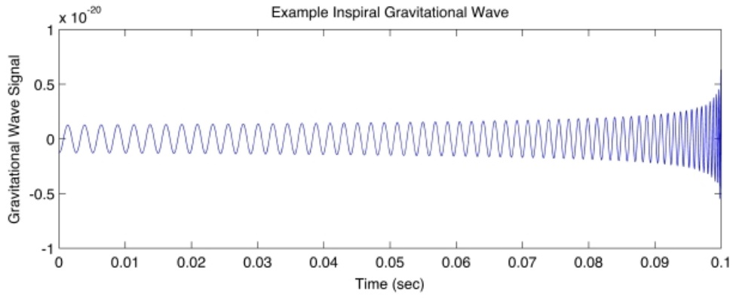
Water waves
Plasma waves
Acoustic waves
Light waves
Gravitational waves
Optical Waves Gravitational Waves
Created by oscillating (+)-(-) charges
Created by oscillating masses (quadrupole radiation)
inspirals
Light waves 10¹⁵ Hz
Gravitational Waves 10⁻⁹ to 1000 Hz
Light waves are absorbed, refracted, bent by gravity
GW interact weakly with matter carrying information about their origins across the universe without modification

Slide 34
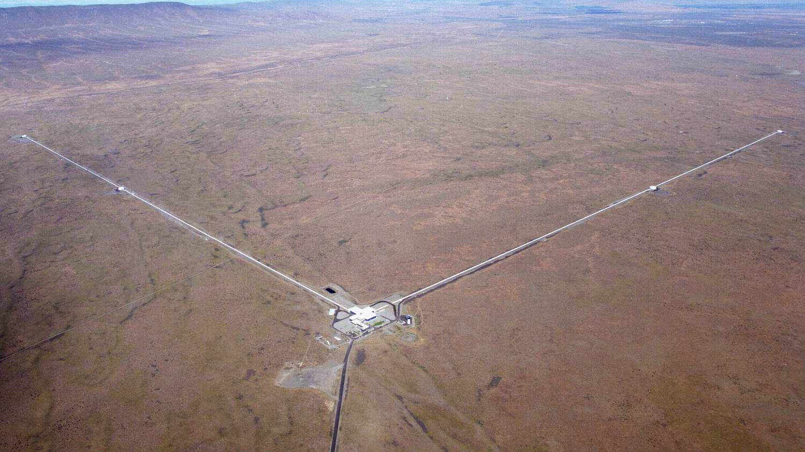
Laser Interferometer Gravitational-Wave Observatory

Slide 35
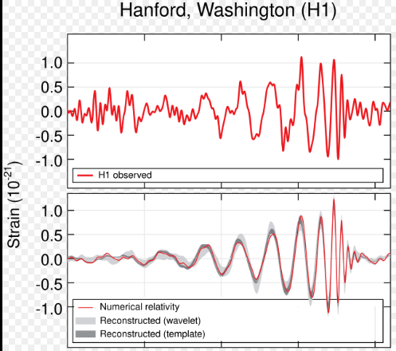
Laser Interferometer Gravitational-Wave Observatory
September 14, 2015, at 5:51 a.m. EDT
GW First “light” 2015: Nobel Prize 2017, Rainer Weiss, Barry Barish, & Kip Thorne

Slide 36

Laser Interferometer Space Antenna (LISA)
Arms: 2.5 Gm
Limited to detecting frequencies below ~1 mHz
1.5 million miles

Slide 37
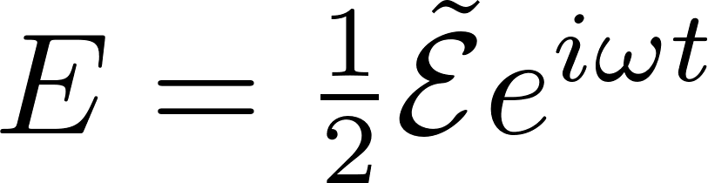
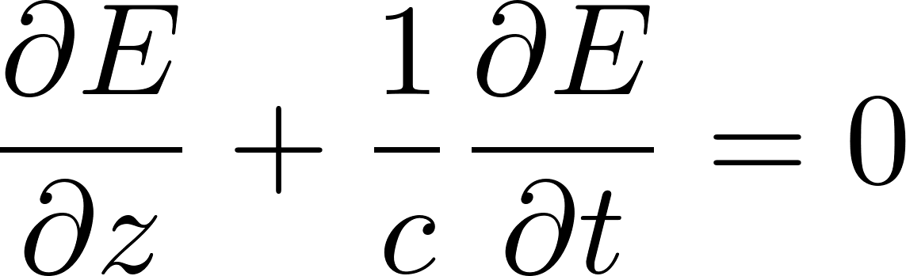
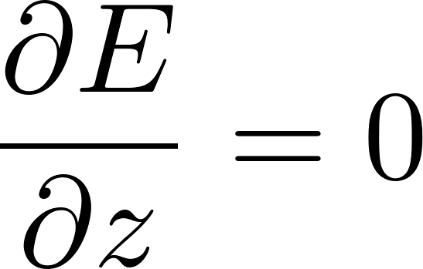
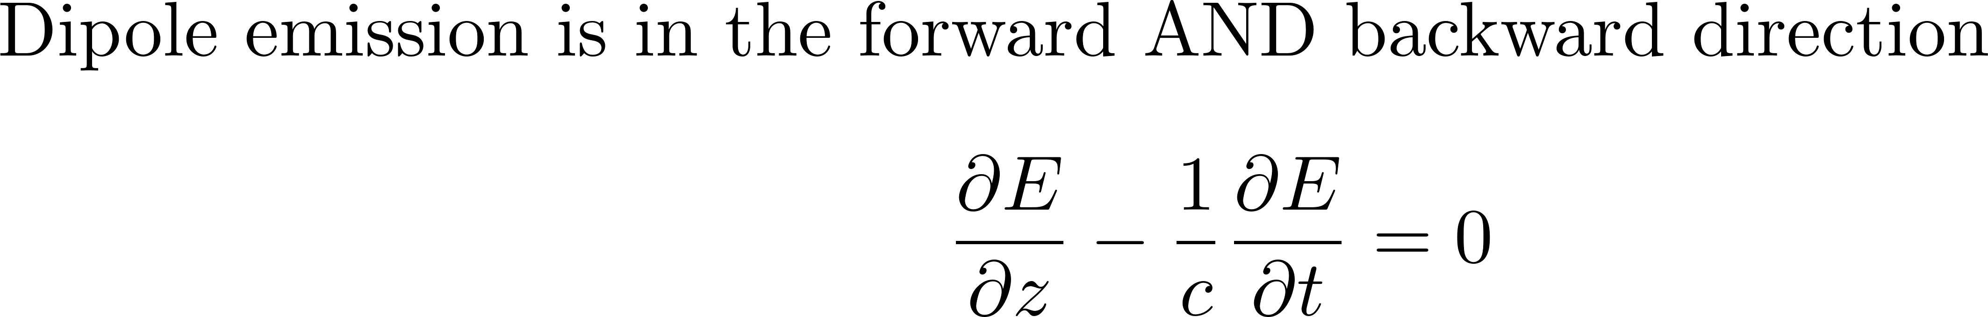
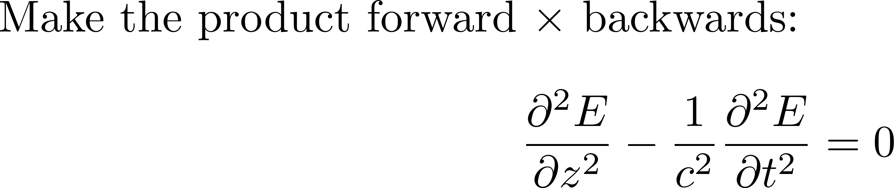
Light waves
The electric field produces a magnetic field that produces an electric field, and that is essentially
how light waves propagate. The velocity of a wave is a property of the medium in which the wave
propagates. Sound waves propagate at 343 m/s in dry air at room temperature, and faster
in denser media. It is the opposite for the light waves which usually travel faster in air or vacuum.
In the retarded frame:
MAXWELL’S SECOND ORDER PROPAGATION EQUATION

Slide 38
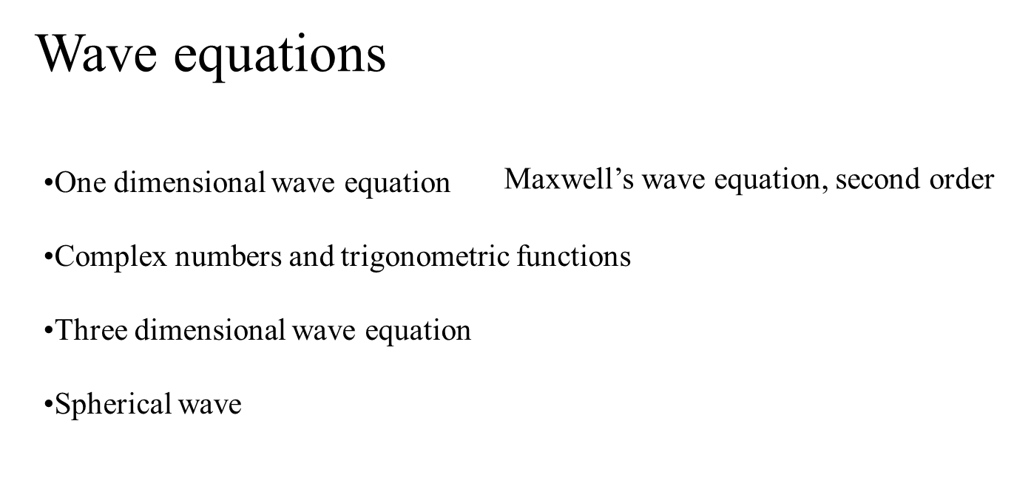
Making Waves

Slide 39
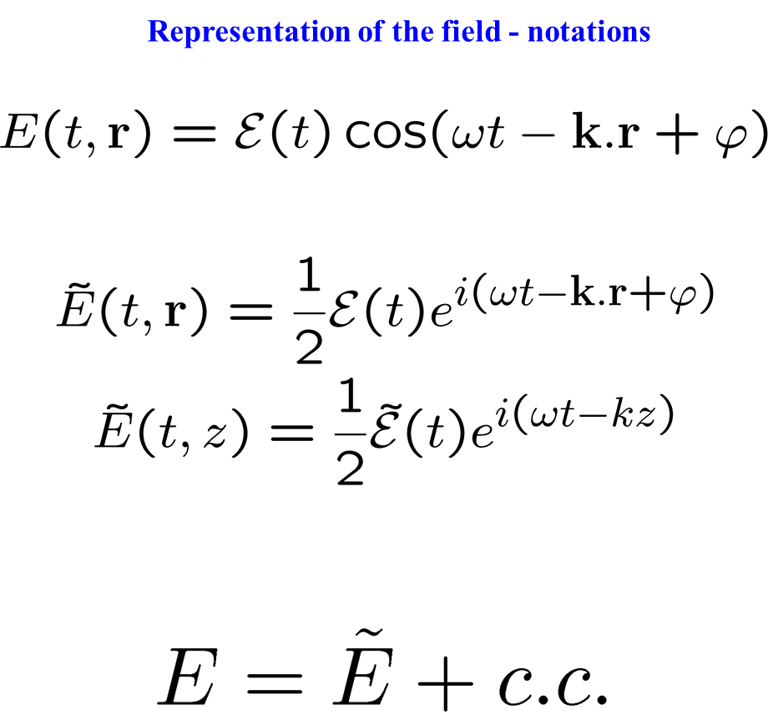

Slide 40
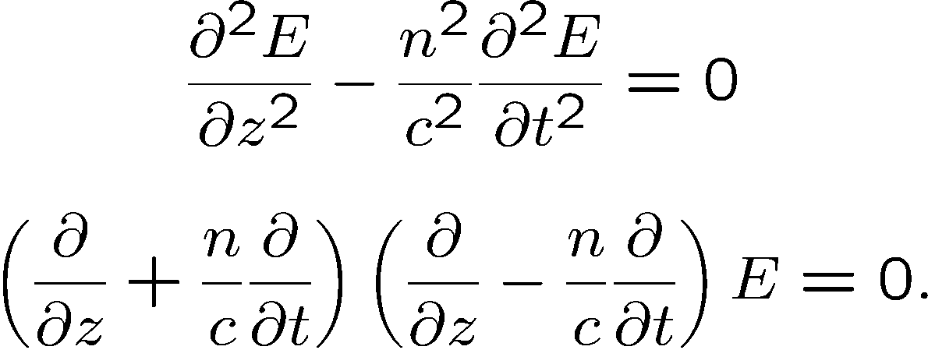
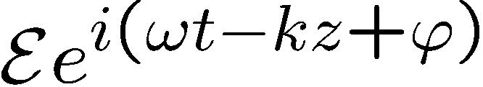
Maxwell’s second order wave equation
forward
backward
SOLUTIONS?
Principle of superposition: all solutions can be written as a linear combination of
(complex numbers)
Substitute in wave equation to find the wave velocity

Slide 41
Propagation of the complex field
Maxwell’s equations, linear propagation

Slide 42
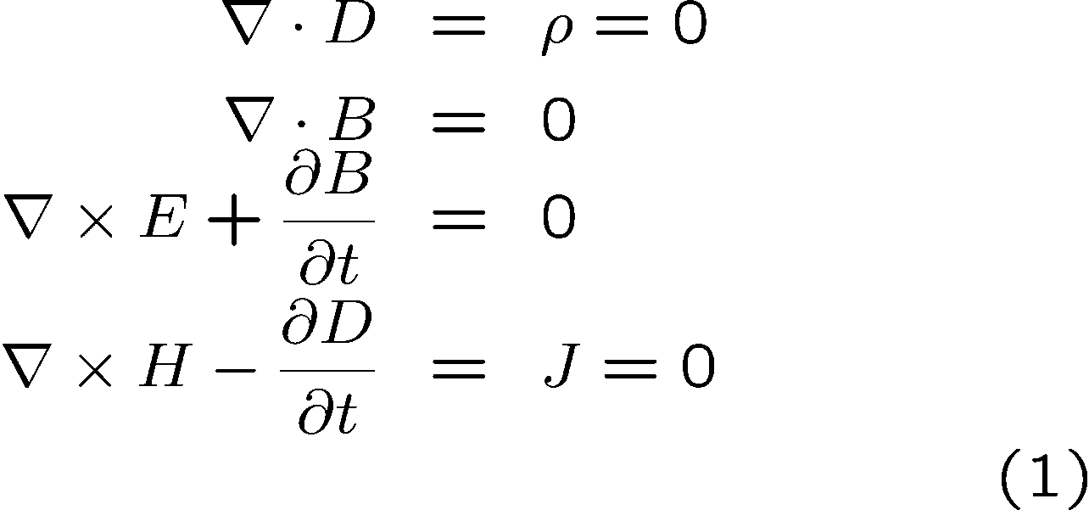
Maxwell’s equations
Dielectrics, no charge, no current:

Slide 43

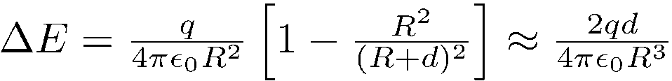
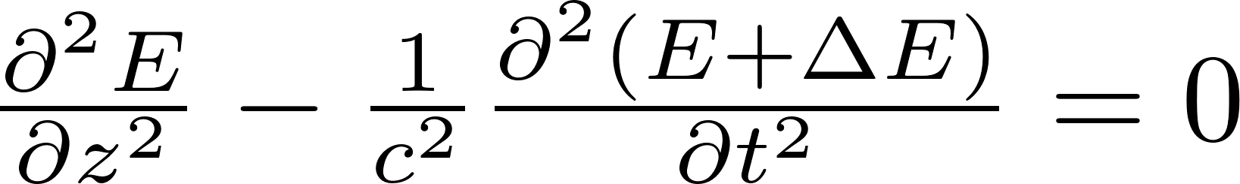



POLARIZATION: IT IS JUST THE FIELD OF INDUCED DIPOLES OPPOSING THE APPLIED FIELD
The classical oscillator
The classical approach is to calculate the motion of the bound electron, modeled as a dipole. The electron is at a (small) distance d from the positive ion. It oscillates with the applied electric field.
This is the classical oscillator model.
Under the influence of an optical oscillating field at ω the motion of the electron follows the frequency of the applied field, in phase, and is thus
At a point of observation at a distance R from the dipole, the field due to the dipole is
Putting that in Maxwell's propagation equation
N
N
R
-
d
+

Slide 44


Slide 45
POLARIZATION
Medium equation:

Slide 46

Maxwell’s equations, linear propagation
Dielectrics, no charge, no current:
Medium equation:

Slide 47



In a linear medium:
More generally:

Slide 48



Maxwell’s equations, nonlinear propagation
Maxwell’s equation:
Since
the E field is no longer transverse
Gadi Fibich and Boaz Ilan
PHYSICAL REVIEW E 67, 036622 (2003)
Is it important?
Only if

Slide 49





Plane waves in vacuum
Substitute
Solution:
Surfaces of constant phase perpendicular to the vector k
Relation between k and λ
At t = cst, the field repeats itself
after λ

Slide 50





Plane waves along z in vacuum
Substitute
Solution:
From second order to first order
Substitute

Slide 51

Study of propagation from second to first order
apply this first, to give (– 2 i k E)

Slide 52
From second order to first order
Substitute
?

Slide 53
From Second order to first order (the tedious way)

