Slide 1

Laser Interferometer Space Antenna (LISA)
Arms: 2.5 Gm
Limited to detecting frequencies below ~1 mHz
1.5 million miles

Slide 2
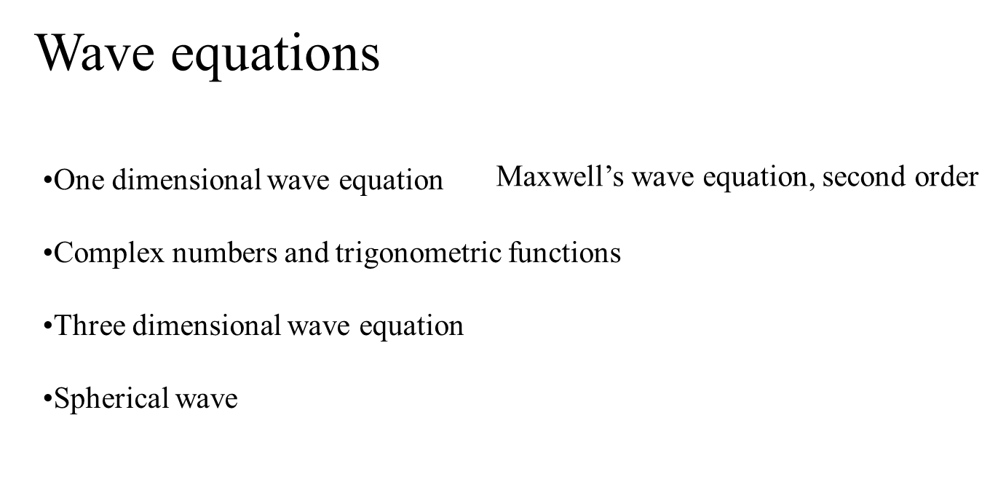
Making Waves

Slide 3
REVIEW OF ELECTROMAGNETISM
The second order equation – meaning?
From second order to first order

Slide 4
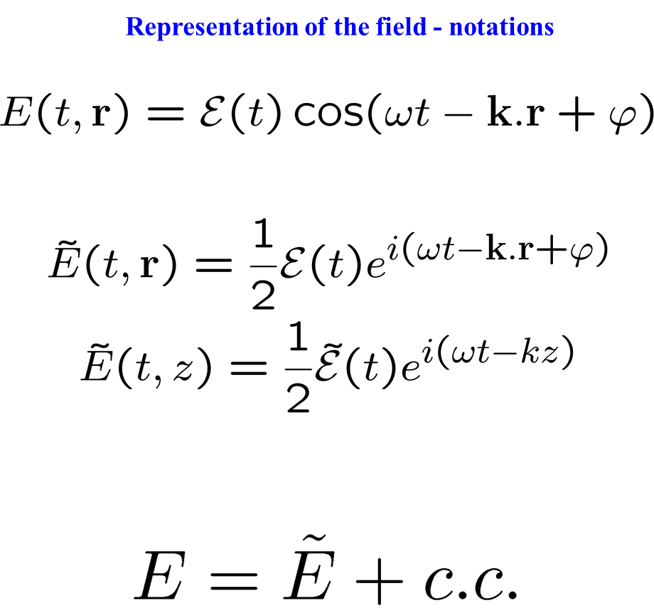

Slide 5
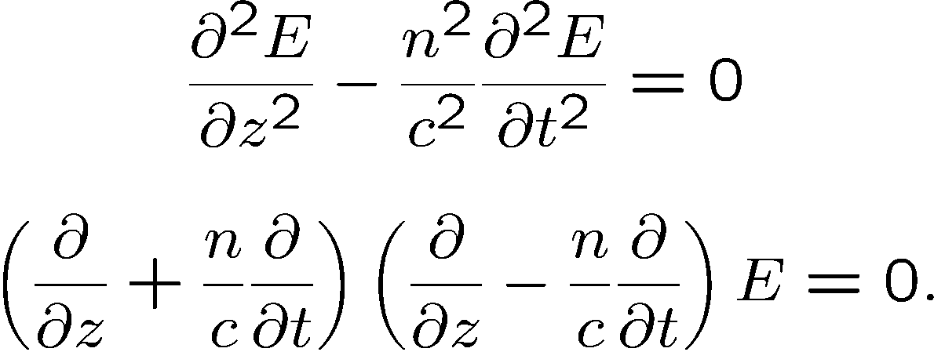
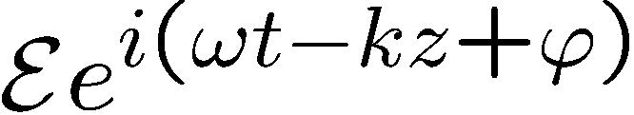
Maxwell’s second order wave equation
forward
backward
SOLUTIONS?
Principle of superposition: all solutions can be written as a linear combination of
(complex numbers)
Substitute in wave equation to find the wave velocity

Slide 6
Propagation of the complex field
Maxwell’s equations, linear propagation

Slide 7
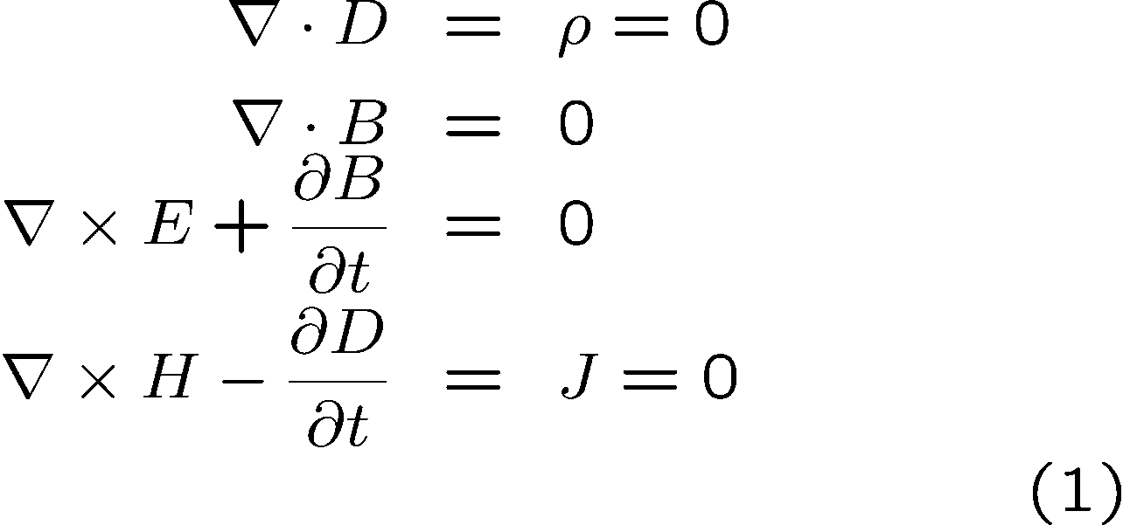
Maxwell’s equations
Dielectrics, no charge, no current:

Slide 8
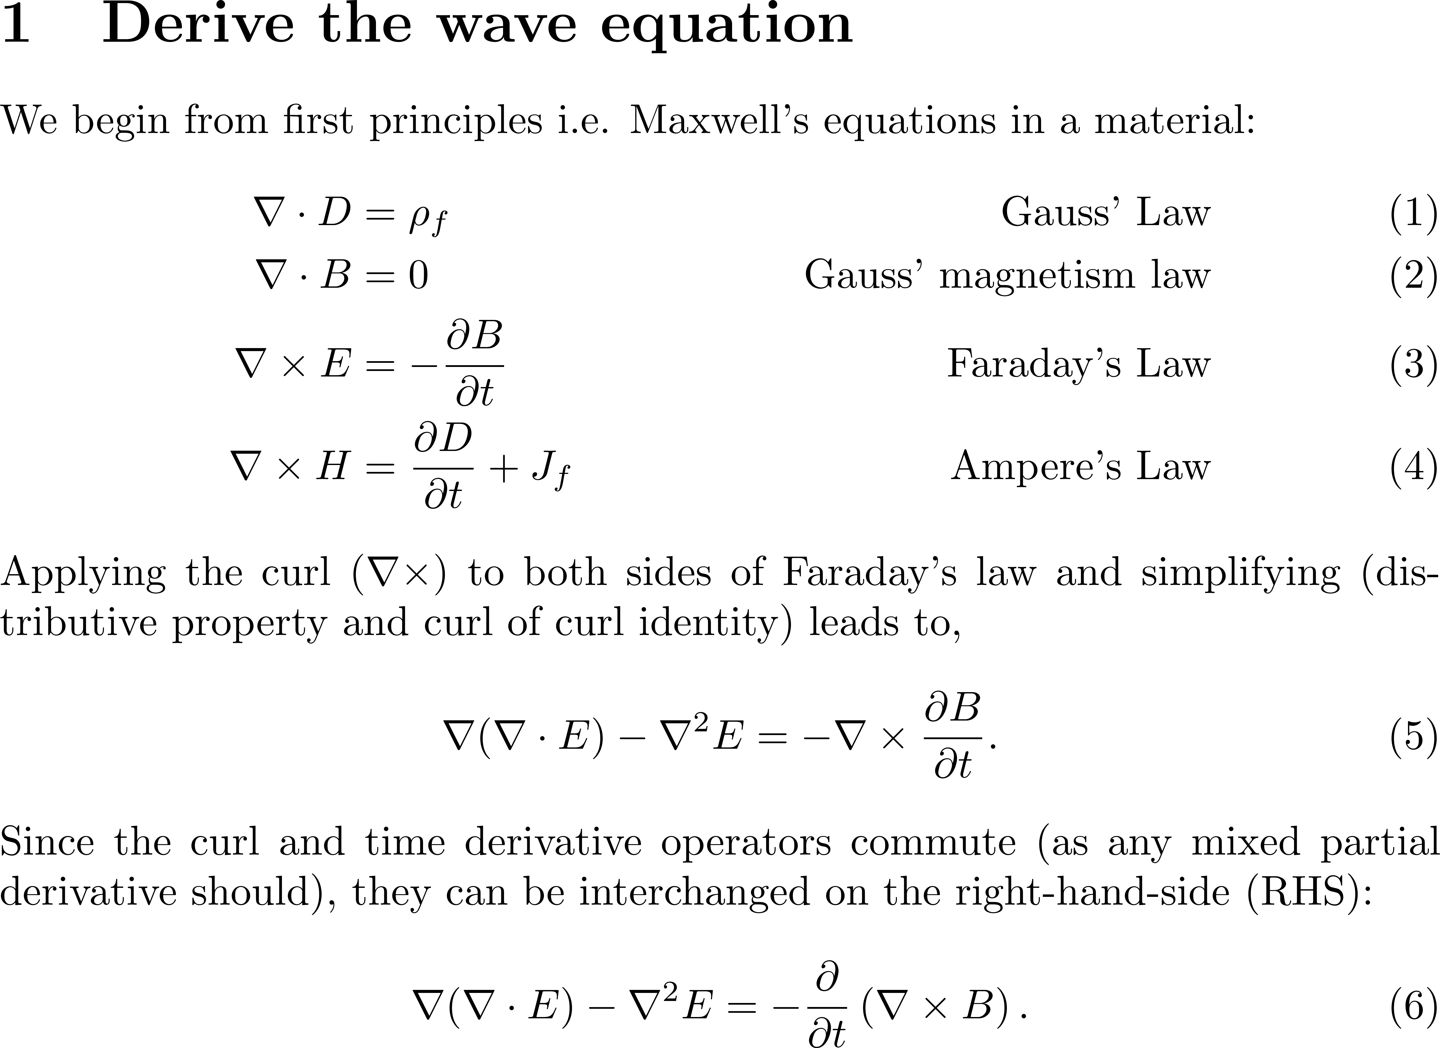
Maxwell’s equations to wave equation
See file Maxwell step= by step

Slide 9
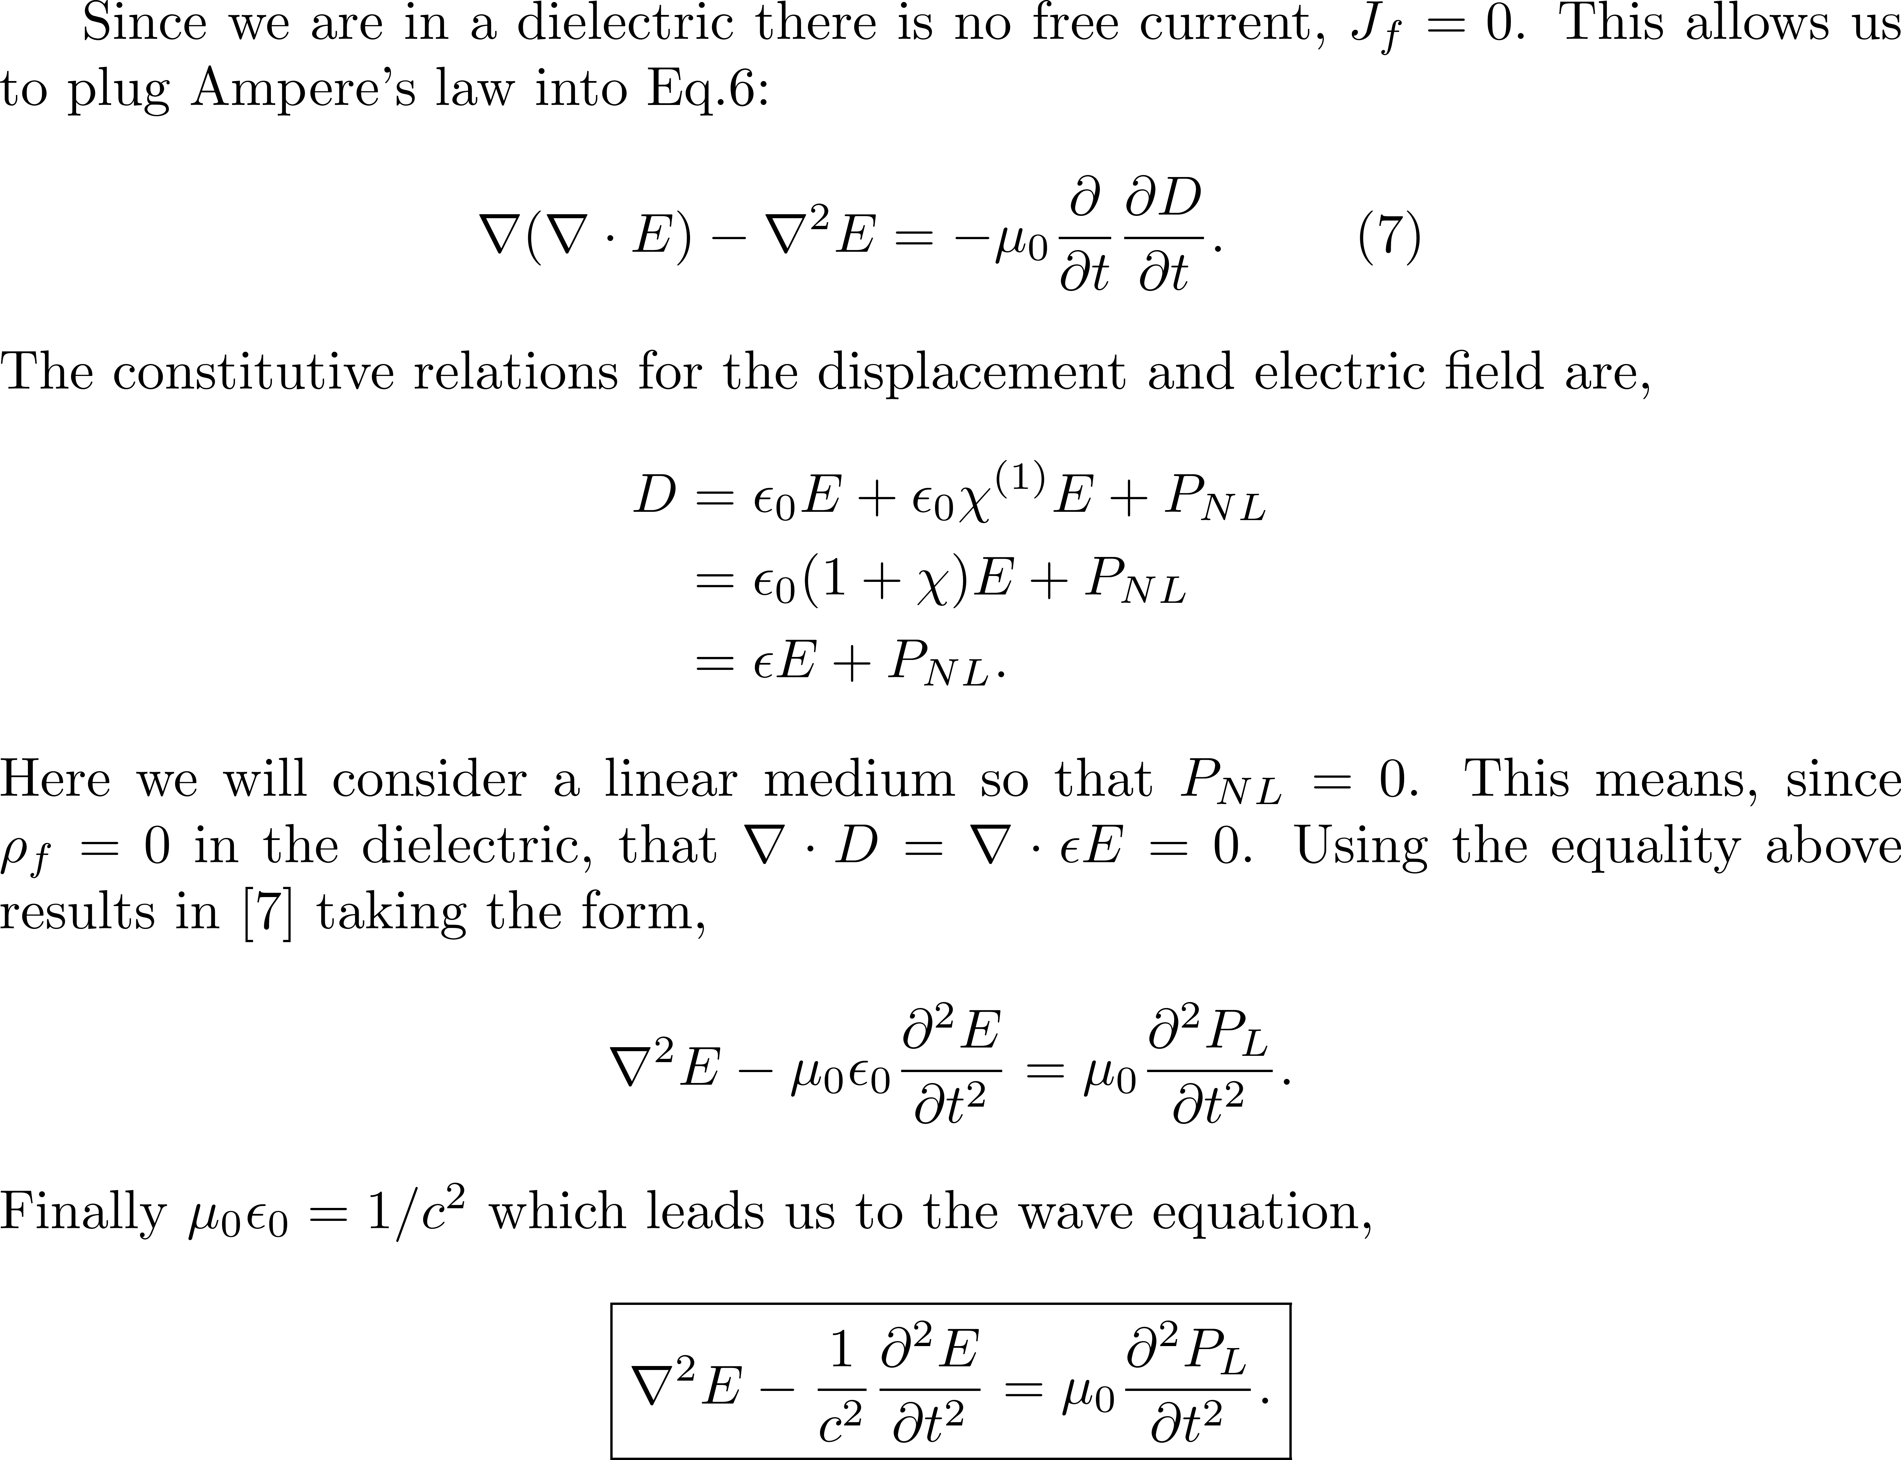

Slide 10

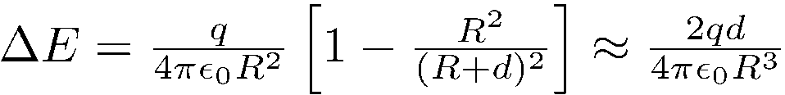
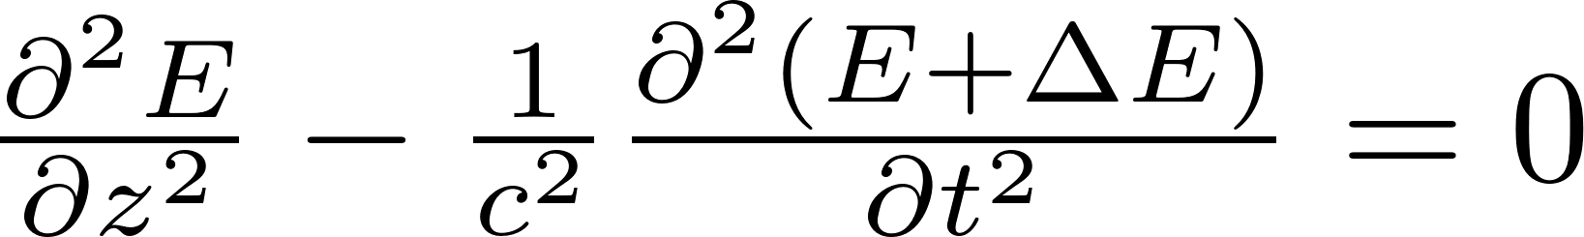
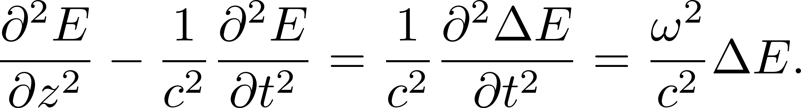

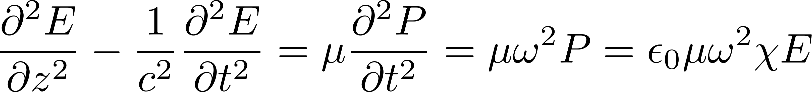
POLARIZATION: IT IS JUST THE FIELD OF INDUCED DIPOLES OPPOSING THE APPLIED FIELD
The classical oscillator
The classical approach is to calculate the motion of the bound electron, modeled as a dipole. The electron is at a (small) distance d from the positive ion. It oscillates with the applied electric field.
This is the classical oscillator model.
Under the influence of an optical oscillating field at ω the motion of the electron follows the frequency of the applied field, in phase, and is thus
At a point of observation at a distance R from the dipole, the field due to the dipole is
Putting that in Maxwell's propagation equation
N
N
R
-
d
+

Slide 11
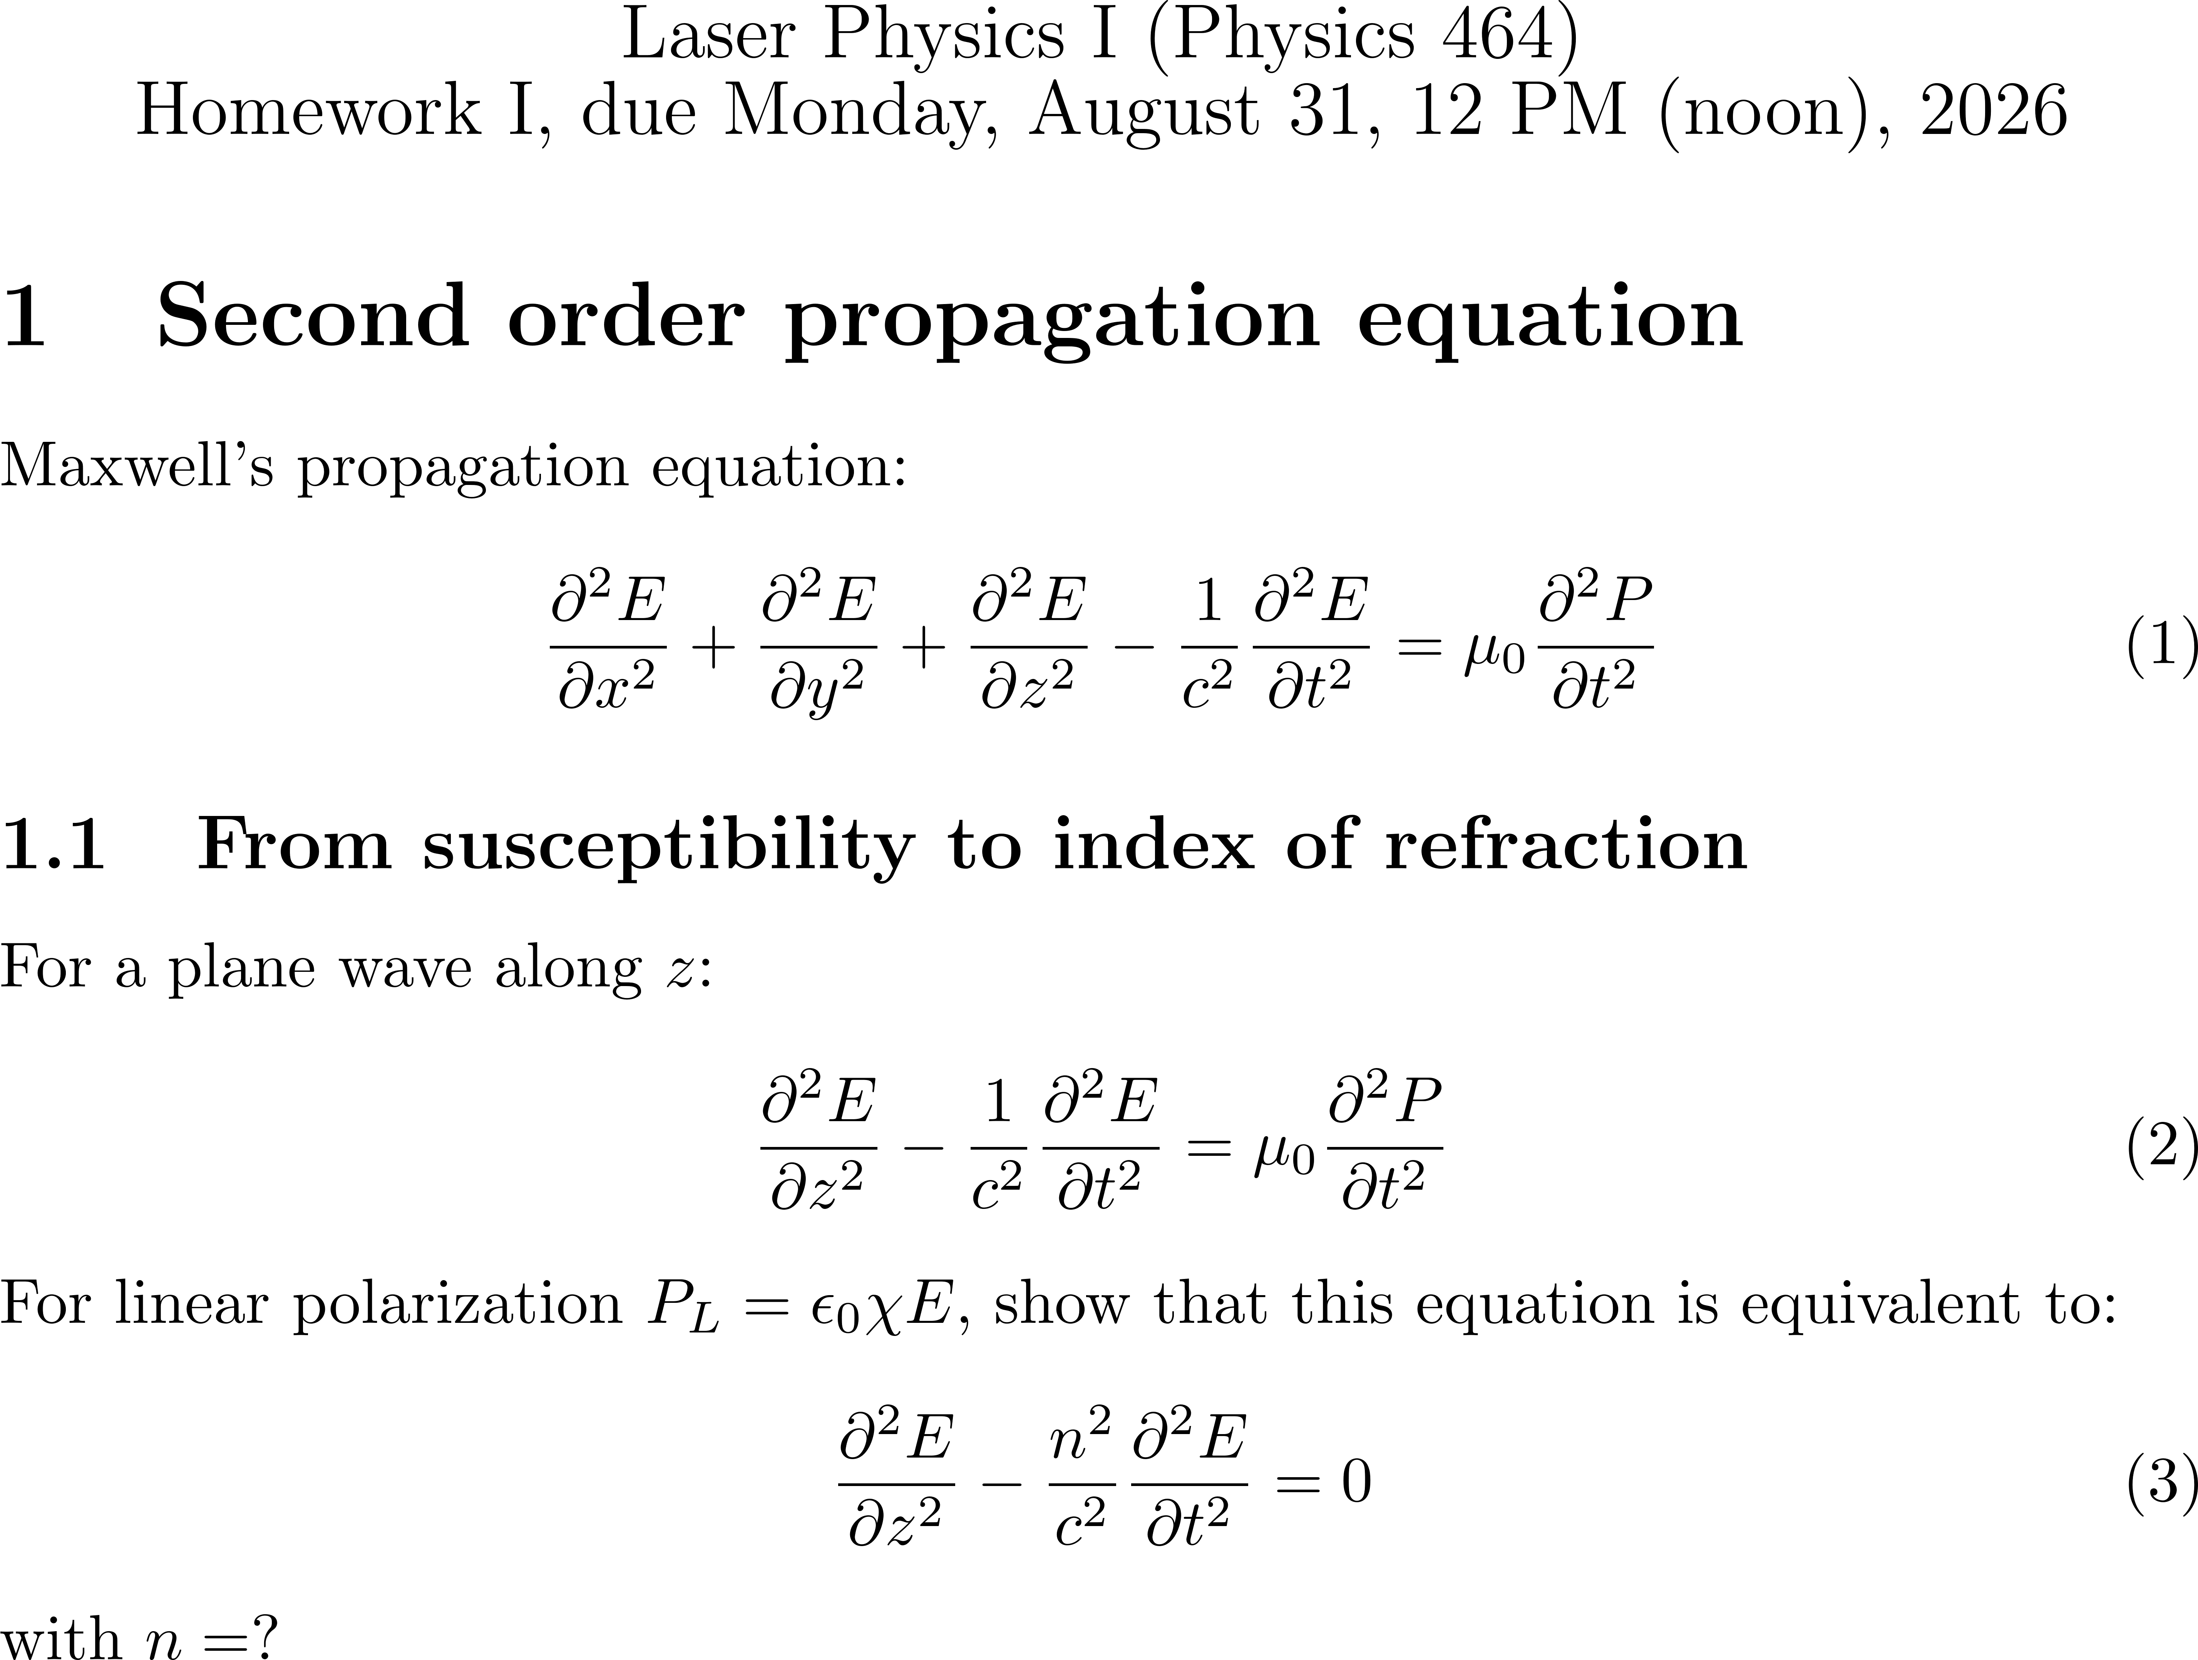

Slide 12
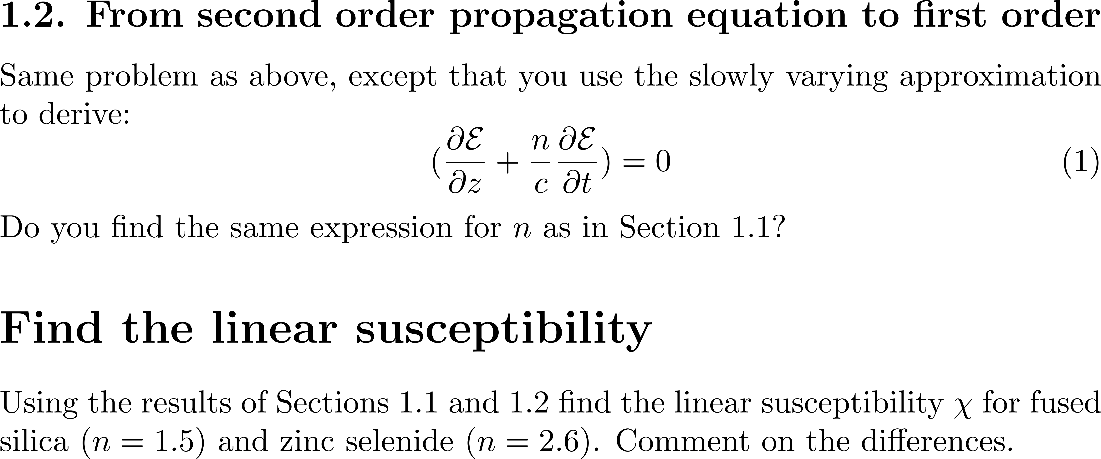

Slide 13

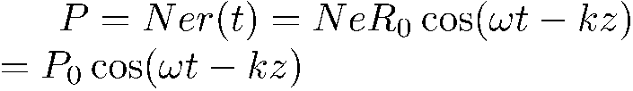



LINEAR POLARIZATION
Define what is linear Optics
Linear interaction between light and matter: the electron responds instantaneously to the field.
Description of light field: periodic electric field
Description of matter: electron + restoring force
Description of matter: electron + restoring force
Interaction: Maxwell’s equations
Second order propagation equation
Task1: explain cos →exp
Task 3: explain “Instantaneous”
Second order propagation
make 1st order approximation
pol at 90 deg???
Task 2: explain the phase shift
TexPoint fonts used in EMF.
Read the TexPoint manual before you delete this box.: AAAA

Slide 14




Book Chapter 1, introduction
Task 1: explain cos →exp
How to get to complex notations the easy way
In time:
TIME t
In frequency:
FREQUENCY Ω
Notes:
14

Slide 15
Sine waves and “Rogue waves”
Wave
amplitude
0
time

Slide 16
FOURIER TRANSFORM REVIEW
Main properties: see pdf file Fourier_Properties.pdf

Slide 17
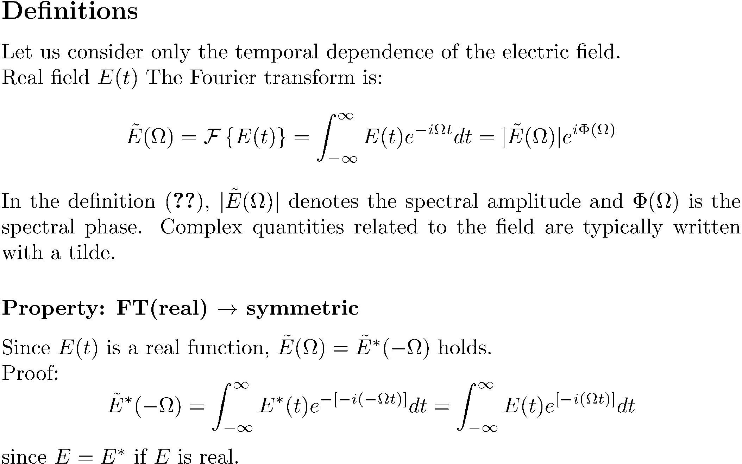

Slide 18
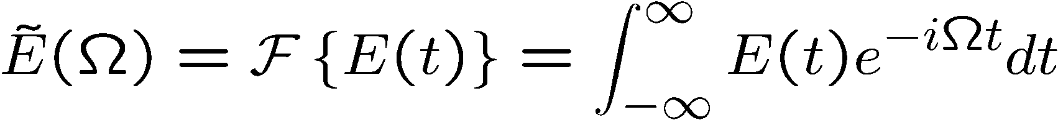
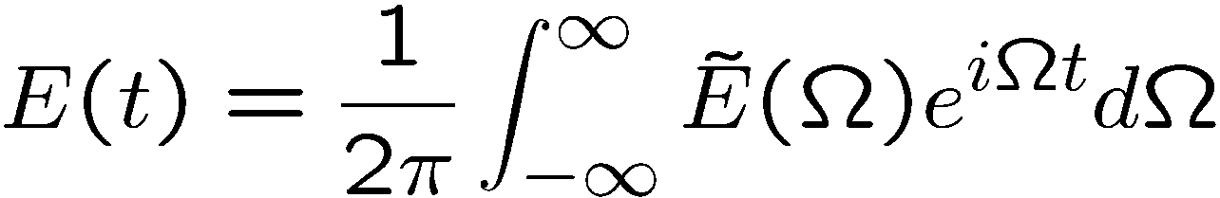
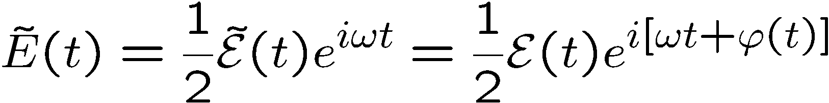
Mathematical approach: Fourier transforms (meaning of the complex representation)
0

Slide 19
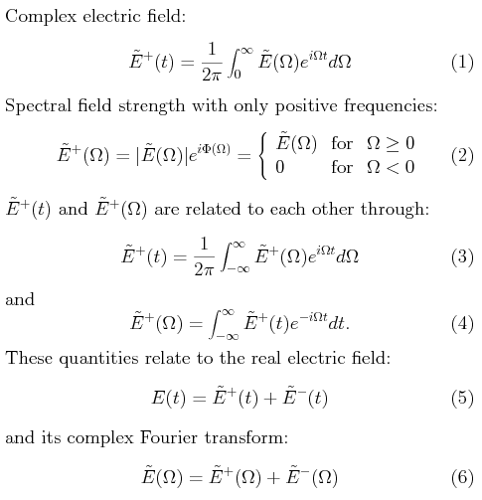


Book Chapter 1, introduction
Task 1: explain cos →exp
How to get to complex notations the easy way
In time:
TIME t
In frequency:
FREQUENCY Ω
TIME t
Notes:
19

Slide 20
Task 2: explain “Instantaneous”
“Instantaneous” – a requirement to be linear in time.

Slide 21
LINEAR POLARIZATION
Define what is linear Optics
Linear interaction between light and matter: the electron responds instantaneously to the field.
Description of light field: periodic electric field
Description of matter: electron + restoring force
Description of matter: electron + restoring force
Interaction: Maxwell’s equations
Second order propagation equation
Task1: explain cos →exp
Task 3: explain “Instantaneous”
Second order propagation
make 1st order approximation
pol at 90 deg???
Task 2: explain the phase shift
TexPoint fonts used in EMF.
Read the TexPoint manual before you delete this box.: AAAA

Slide 22
Can it be non-instantaneous and linear?
Because nothing is instantaneous, propagation is not linear in time
Nothing is instantaneous, but because of the principle of superpositon, propagation is linear in frequency.

Slide 23



Nonlinear optics and non-instantaneous response
E
E
E
E
t
t

Slide 24
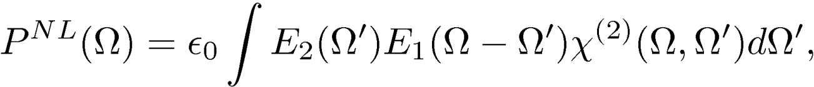
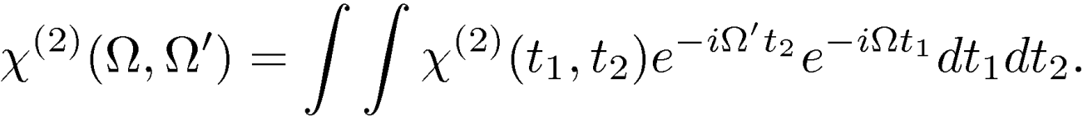
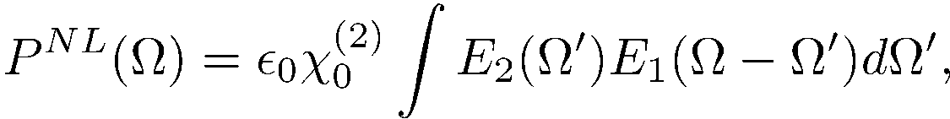

Details chapter 4 pg 187
Instantaneous response:

Slide 25
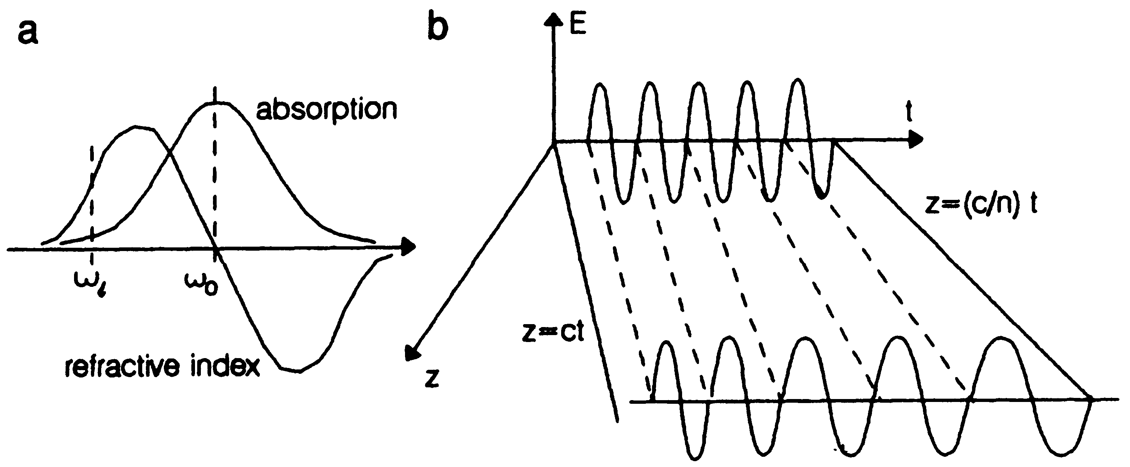
In time, even the light frequency is not conserved

Slide 26
There is a transient for the polarization to appear.
There is a transient for the polarization to disappear.

Slide 27
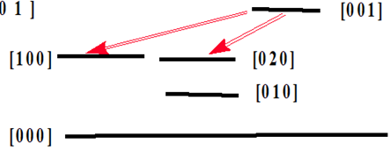
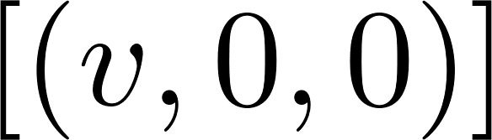
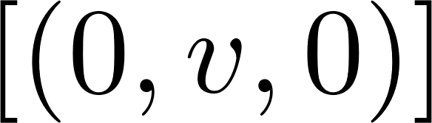
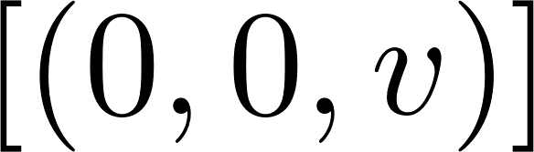
Fermi resonance
1351.2 cm⁻¹
1344.8 cm⁻¹

Slide 28
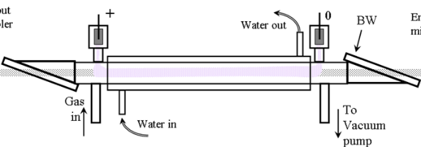
EXAMPLE: FREE INDUCTION DECAY
HP CO2
HOT CO2
E
E
E
t

Slide 29
ABOUT LINEAR INSTANTANEOUS POLARIZATION
Define what is linear Optics
Linear interaction between light and matter: the electron responds instantaneously to the field.
Description of light field: periodic electric field
Description of matter: electron + restoring force
Description of matter: electron + restoring force
Interaction: Maxwell’s equations
Second order propagation equation
Task 1: explain cos →exp
Task 2: explain “Instantaneous”
Second order propagation
make 1st order approximation
pol at 90 deg???
Task 3: explain the phase shift

Slide 30
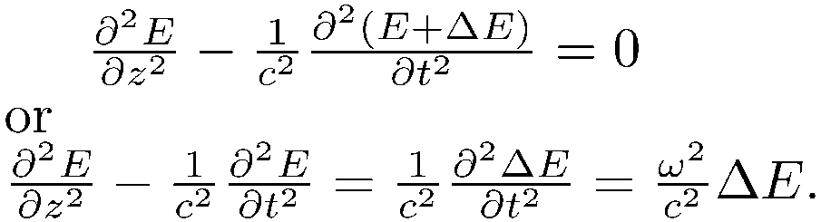
Task 3: explain the phase shift
Task 2: explain the phase shift
The classical oscillator and Maxwells equations
The classical approach is to calculate the motion of the bound electron, modeled as a dipole. The electron is at a (small) distance d from the positive ion. It oscillates with the applied electric field.
This is the classical oscillator model.
Under the influence of an optical oscillating field at ω the motion of the electron follows the frequency of the applied field, in phase, and is thus
At a point of observation at a distance R from the dipole, the field due to the dipole is
Putting that in Maxwell's propagation equation
R
-
d
+

Slide 31


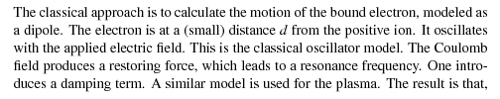
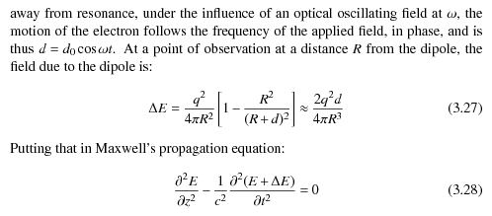
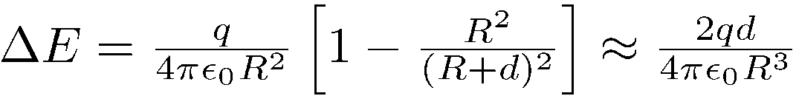
Task 2: explain the phase shift
P in phase with E but 90 degree out of phase with ??
R
-
d
+

Slide 32
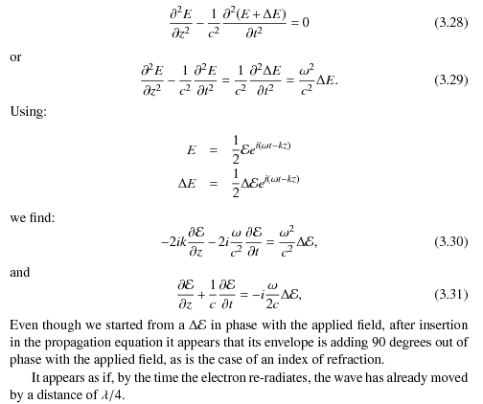

Slide 33
SUPERPOSITION OF WAVES

Slide 34
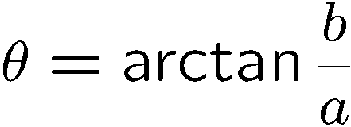
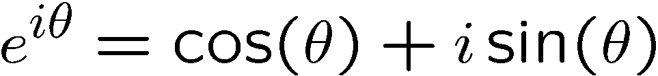
Making Waves: waves add like complex numbers
Complex number
Im
Z = a + i b
a = Re (z)
b = Im (z)
Z* = a - i b
b
z
θ
Re
a
Add and subtract exponentials and trigonometric functions
Plane waves, spherical waves

Slide 35
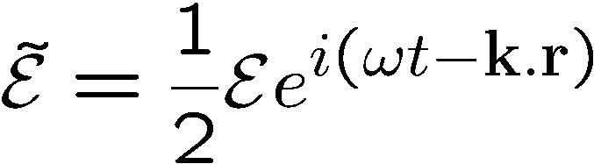
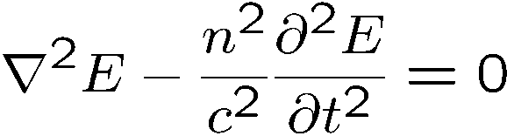
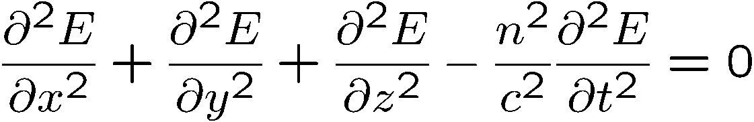
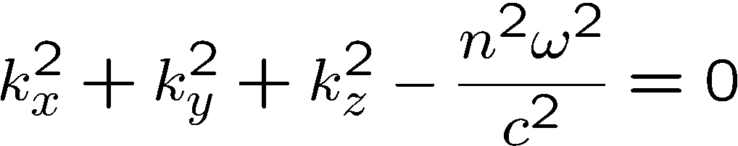
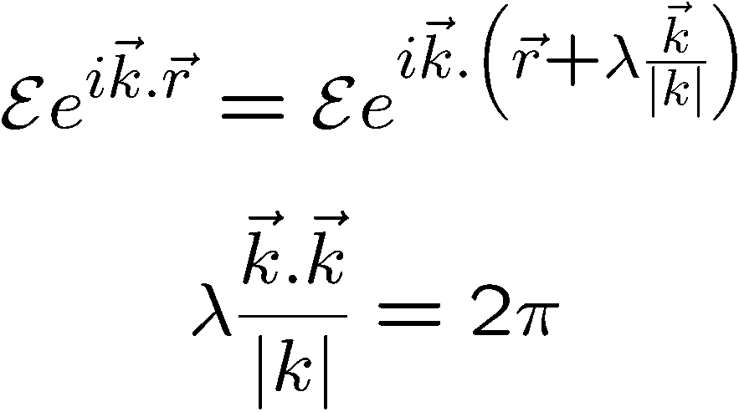
Plane waves
Solution of:
Substitute:
Surfaces of constant phase perpendicular to the vector k
Relation between k and λ
At t = cst, the field repeats itself
after λ

Slide 36
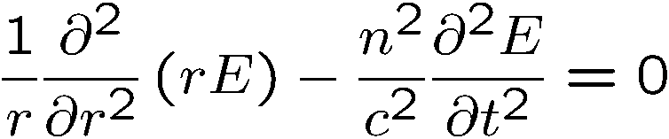
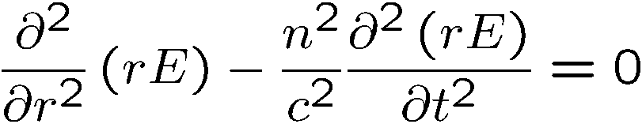
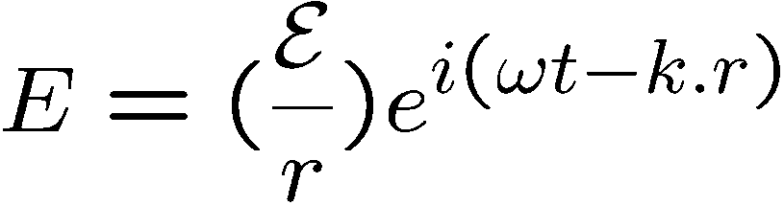
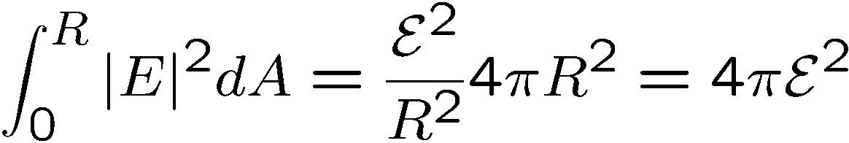
2. Spherical waves
Wave equation:
Write in spherical coordinates, assuming spherical symmetry:
c
c
Conservation of energy

Slide 37

SUPERPOSITION OF WAVES
Waves of the same k vector,same frequency
Waves of the same k vector, different frequencies
Beat note
Creation of an arbitrary
Group velocity
Waves mixing (AOM)
Waves of different k vector, same frequency
Counter-propagating waves
Co-propagating, random phase
Intersecting waves

Slide 38
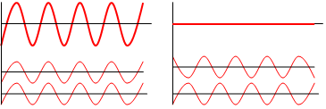
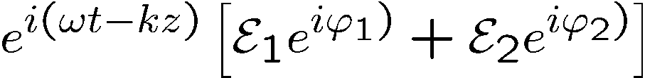
Waves of the same k vector,same frequency
Constructive and destructive
Constructive and destructive
y
Superposition
is just like adding two
vectors ,
x

Slide 39
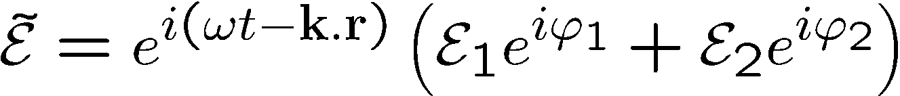





Interferences
Waves of the same k vector, same frequency
Constructive and destructive
constructive
destructive
Superposition
is just like adding two
vectors ,

Slide 40
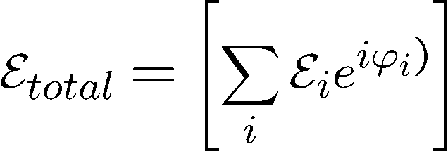
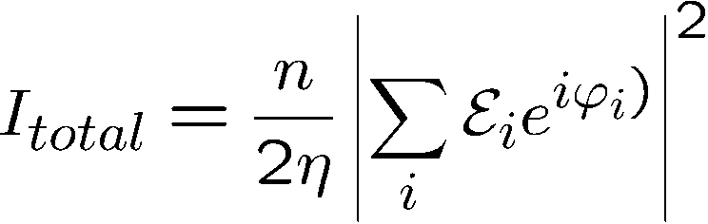



Coherent source
Incoherent source

Slide 41
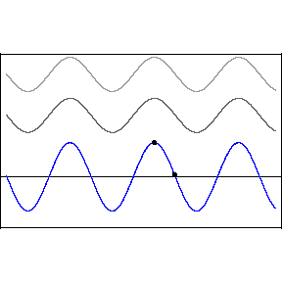

Waves of the different k vector magnitude, same frequencies
Two sine waves traveling in the same direction
Two sine waves traveling in opposite directions
“standing wave”

Slide 42









Waves of the same k vector, same frequency
Energy conservation
If the energy is lost by destructive interference, it has to reappear somewhere else
by constructive interference
A beam splitter is an element with a complex reflection coefficient
and a complex transmission coefficient
Energy conservation:

Slide 43


’
’
+
Example: check the asymmetric Fabry-Perot:

Slide 44








Waves of the same k vector, same frequency
Energy conservation
Mach Zehnder:
Michelson

Slide 45
SUPERPOSITION OF WAVES
Waves of (nearly) the same k vector, same frequency:
Fresnel biprism
Given the angle, what is the fringe spacing?
How to determine the angle of the biprism?

Slide 46
SUPERPOSITION OF WAVES
y
Waves of (nearly) the same k vector, same frequency:
Young’s double-slit experiment
P
S₁
S₂
Young’double-slit as a spectrometer: to each λ corresponds an angle θ,

Slide 47


Young’s double slit
Shape of the interferences:
How far do the interference fringes extend?
Fringe visibility
Transverse coherence of a beam

Slide 48



Waves mixing: not necessarily optical waves
Example: AOM
Frequency shifter
Scanner
Amplitude modulator

