Slide 1
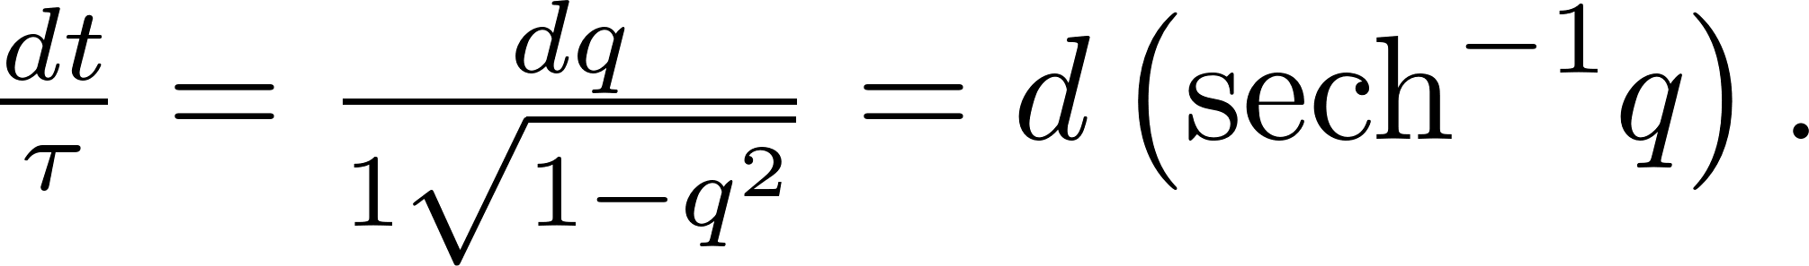
Hint for HW3:
Reading:
Spectroscopy with shaped femtosecond pulses Weiner. In SPIE Proceedings 1209, pages 185–195, Los Angeles, CA, 1990.

Slide 2
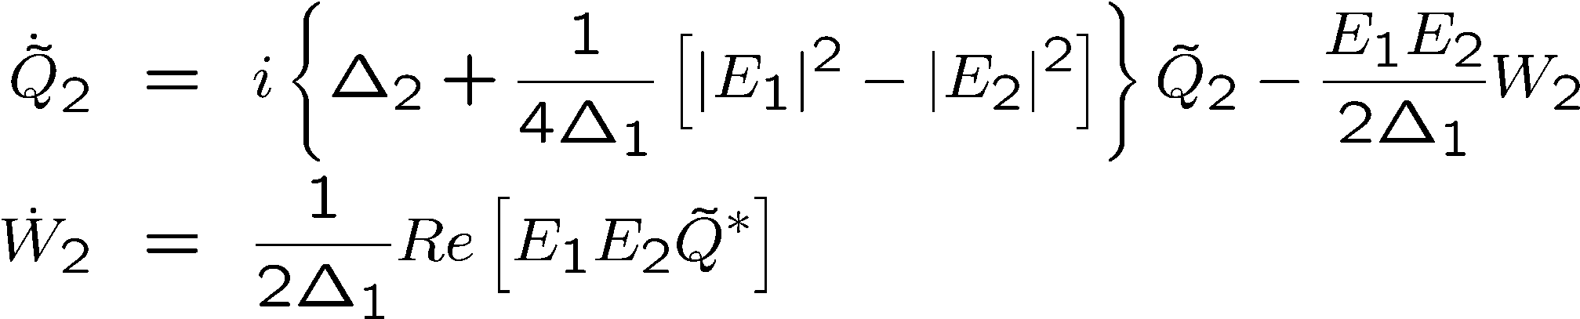
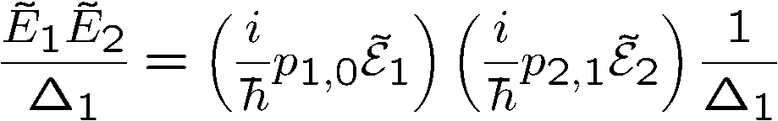
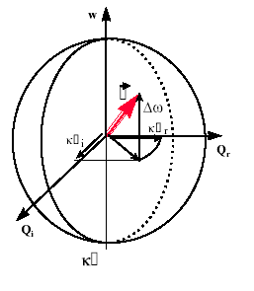
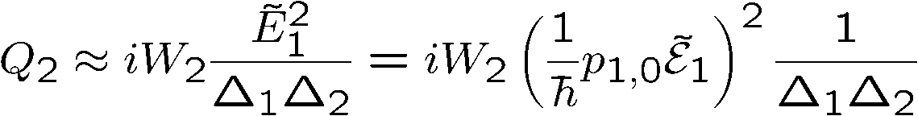



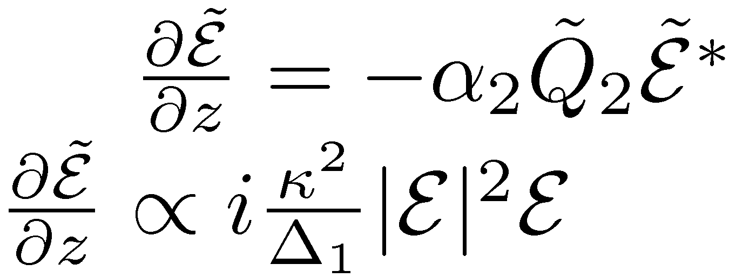

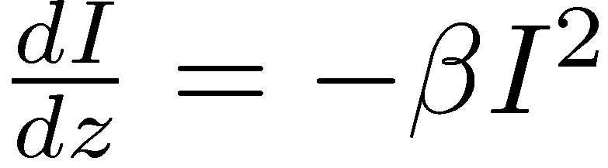
OFF RESONANCE? (Kramers-Kroenig)
Propagation:
Two photon absorption – two photon pumping

Slide 3
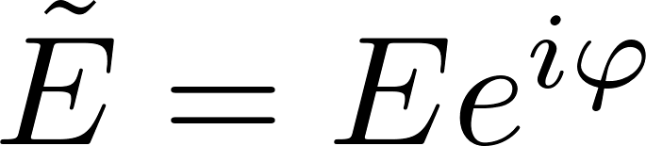
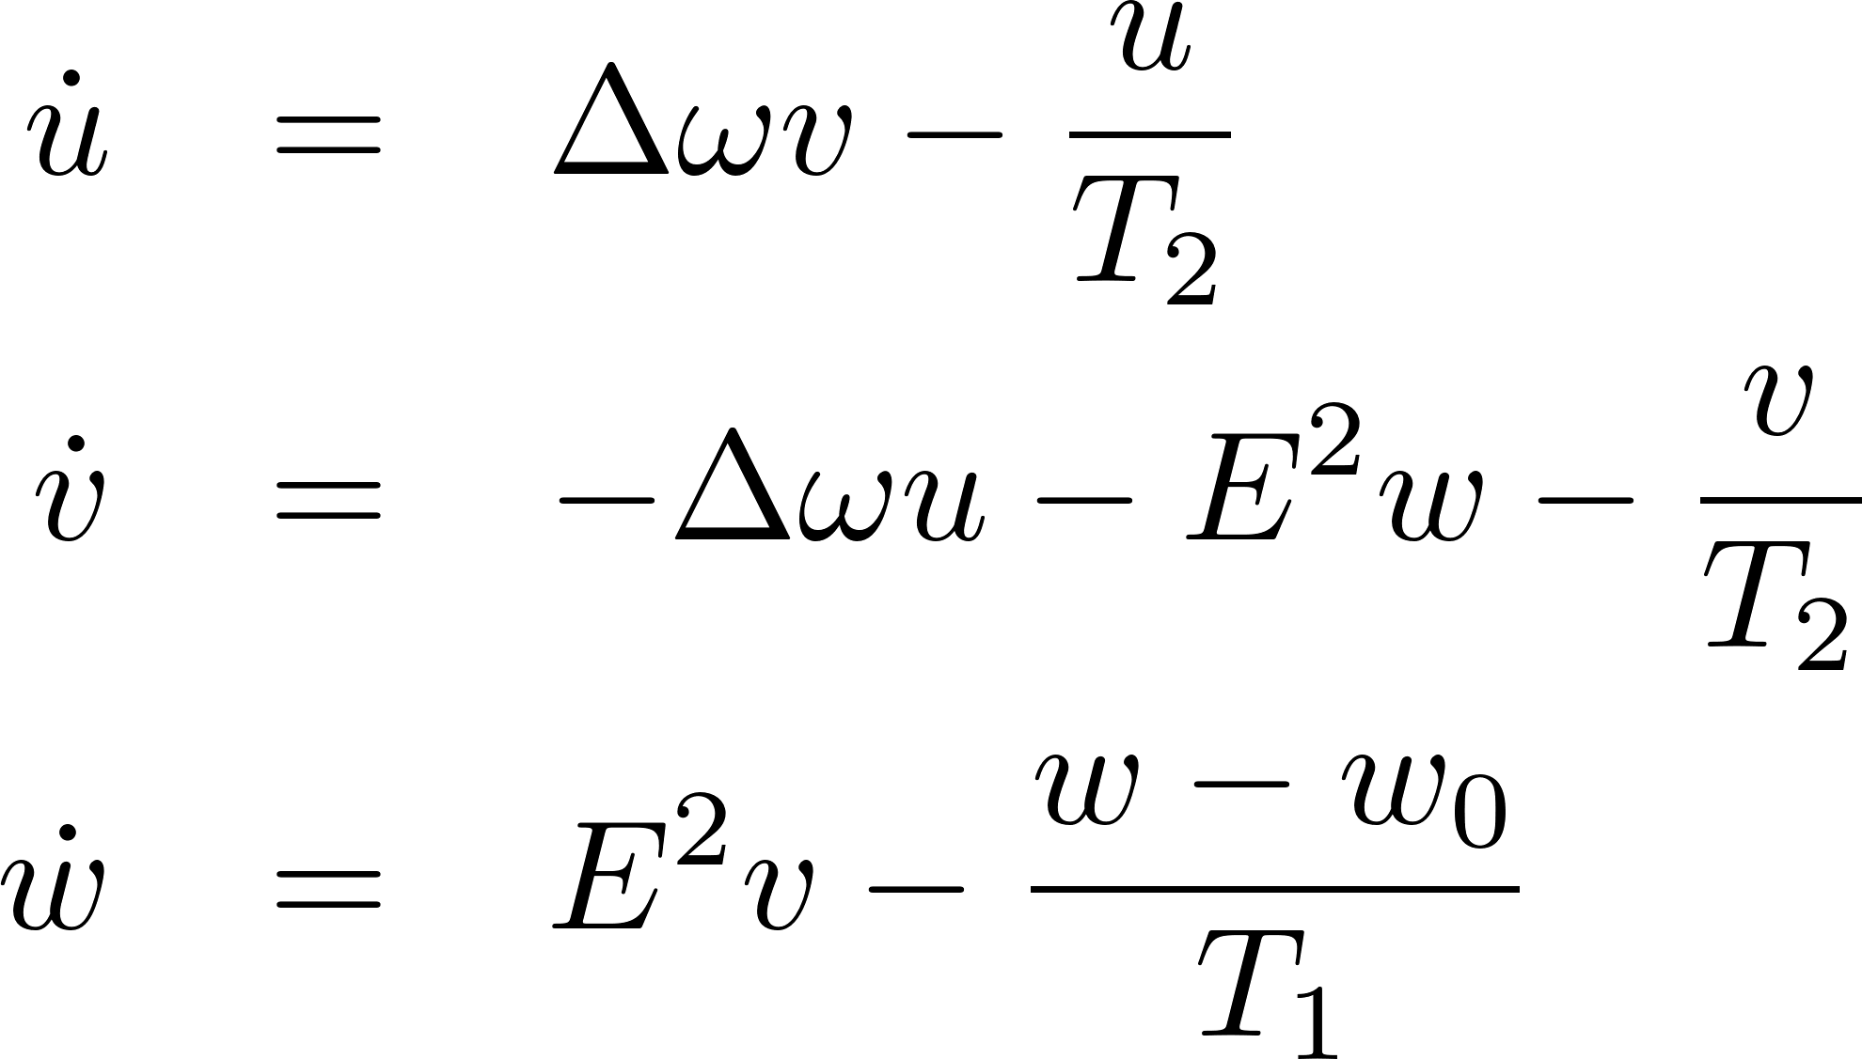
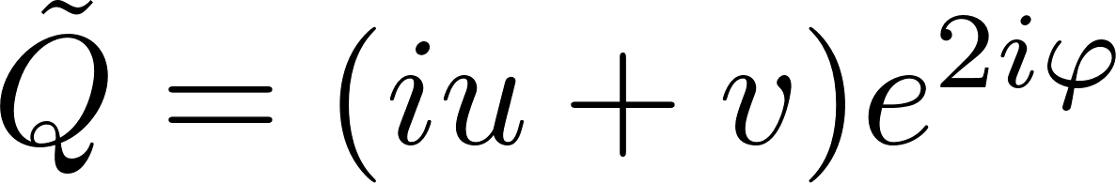
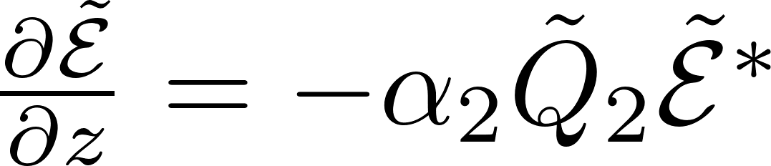
Propagation:

Slide 4
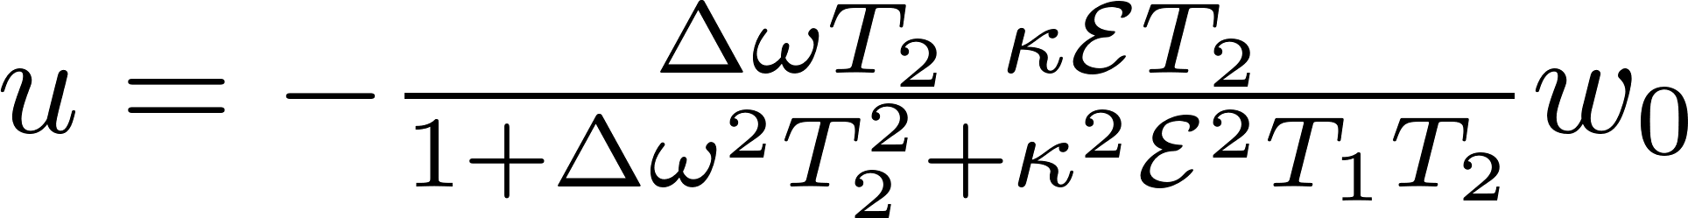
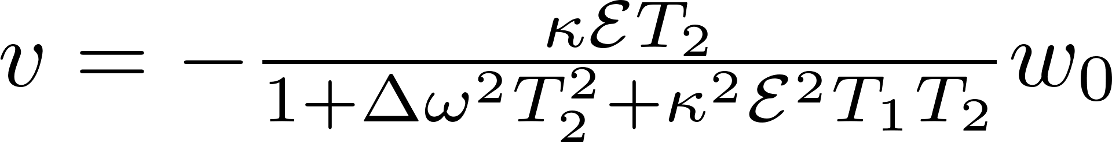
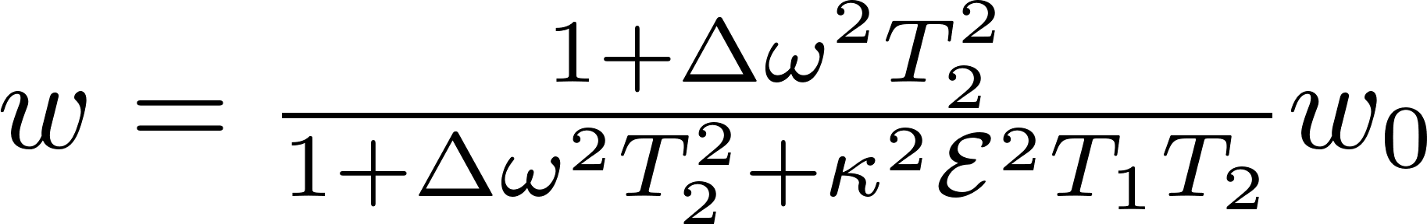
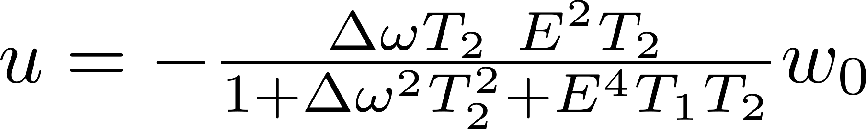
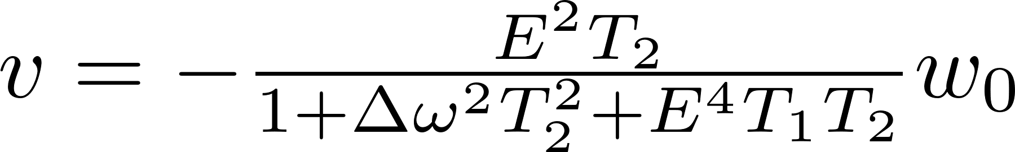
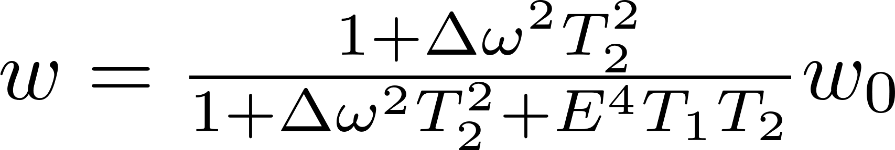
steady state solution
Single photon
Two photon

Slide 5
RAMAN AND BRILLOUIN

Slide 6
Rotational levels Raman spectroscopy

Slide 7

IMPULSIVE STIMULATED
ROTATIONAL
RAMAN SCATTERING
THEORY
“Rotational excitation and molecular alignment in intense laser fields”, Tamar Seideman,
J. Chem. Phys. 103: 7887-7895 (1995)
J
Dipole excitation – how is the distribution of rotation lines after excitation?
A broad wave packet in angular momentum aligned along the polarization direction
The alignment recurs at regular times.
J
Rotational levels:
Direct transitions:
Transitions frequencies: 2(J+1) (P branch)
-2J (R Branch)

Slide 8

Raman and Brillouin scattering
I Coherent Raman scattering with discrete levels – Chapter 3 (discussed earlier)
II Coherent Raman scattering in diatomics:
end of Chapter 3
Δω
ω_{p}
ω_{a}
ω_{p}
ω_{s}
2
δω
0
J
δω
0,2

Slide 9

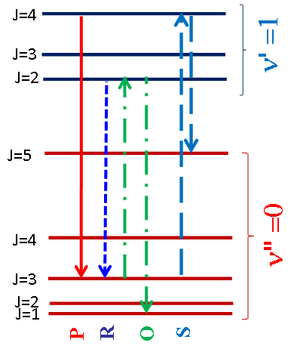
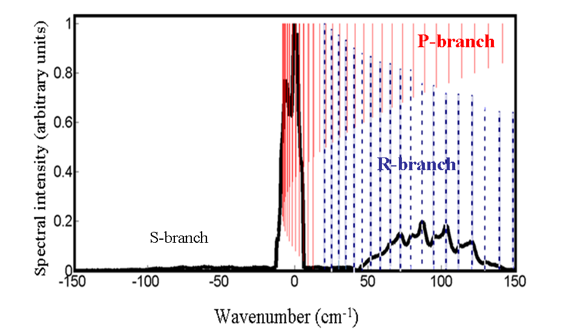
Measurements on the 428 nm nitrogen ion emission line.
Spectroscopy of forward emission of molecular nitrogen ion
shows population at high J states
No electronic angular momentum in ground state
→ No Q branch emission
Spectrum taken with 15 mJ, 60 fs pulses at 800 nm (10 Hz)
R-branch shows Boltzman distribution peaking at J=13 (900ºK)
0
50
100
150
Wavenumber (cm⁻¹)

Slide 10

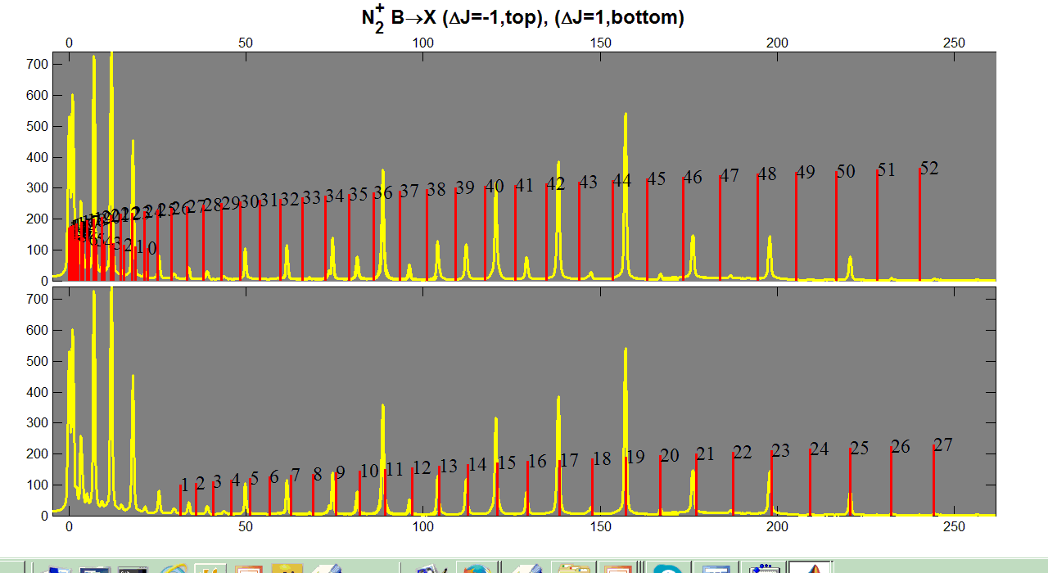
Measurements on the 391 nm nitrogen ion emission line.
Spectrum taken with 1.3 mJ, 50 fs pulses at 795 nm (1kHz)
P-branch
R-branch
Wavenumber (cm⁻¹)

Slide 11
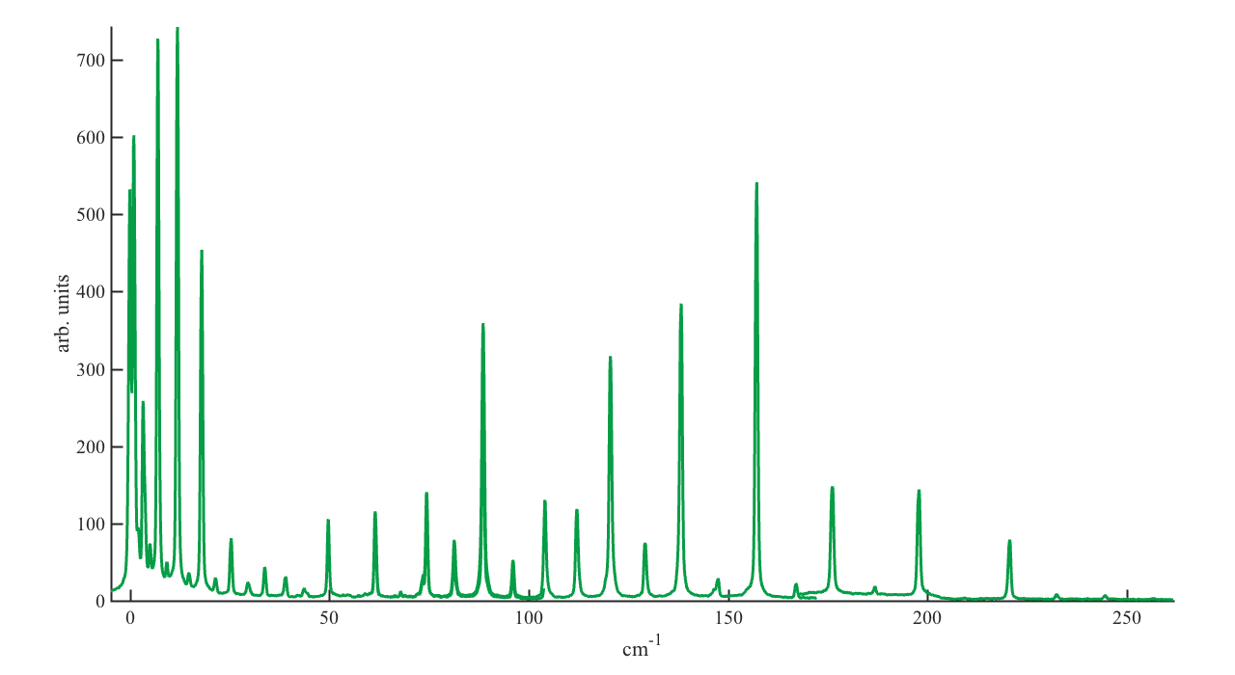
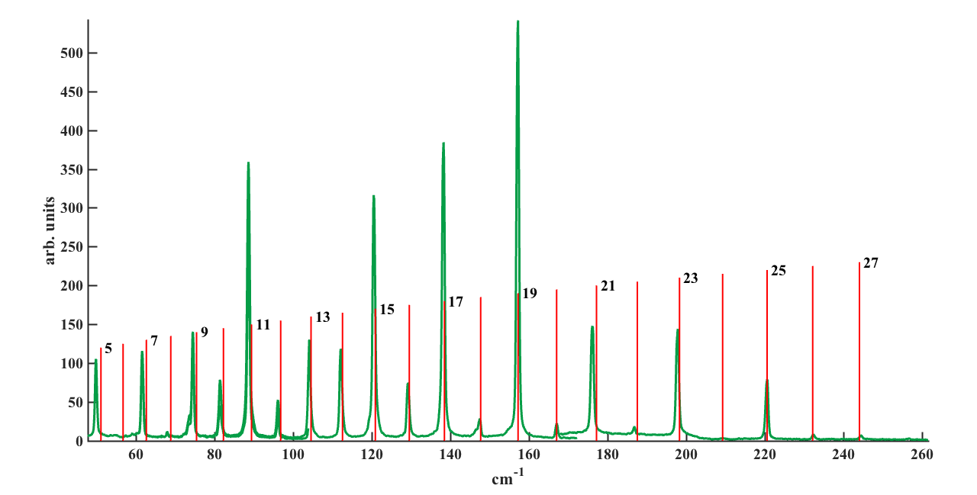
Identifying the R-branch o the 391 nm N₂⁺ emission line.
N₂⁺ (B²Σ_{u}⁺ (ν=0) → X²Σ_{g}⁺ (ν=0))
R-branch (ΔJ=+1)
R-branch

Slide 12
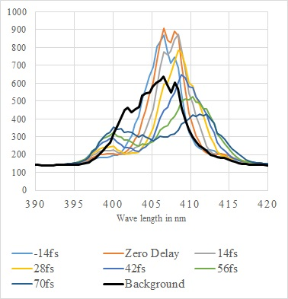
N₂
(b)
λ/4
spectrometer
(a)
SHG

Slide 13
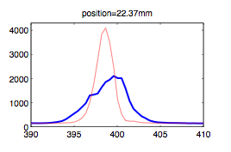
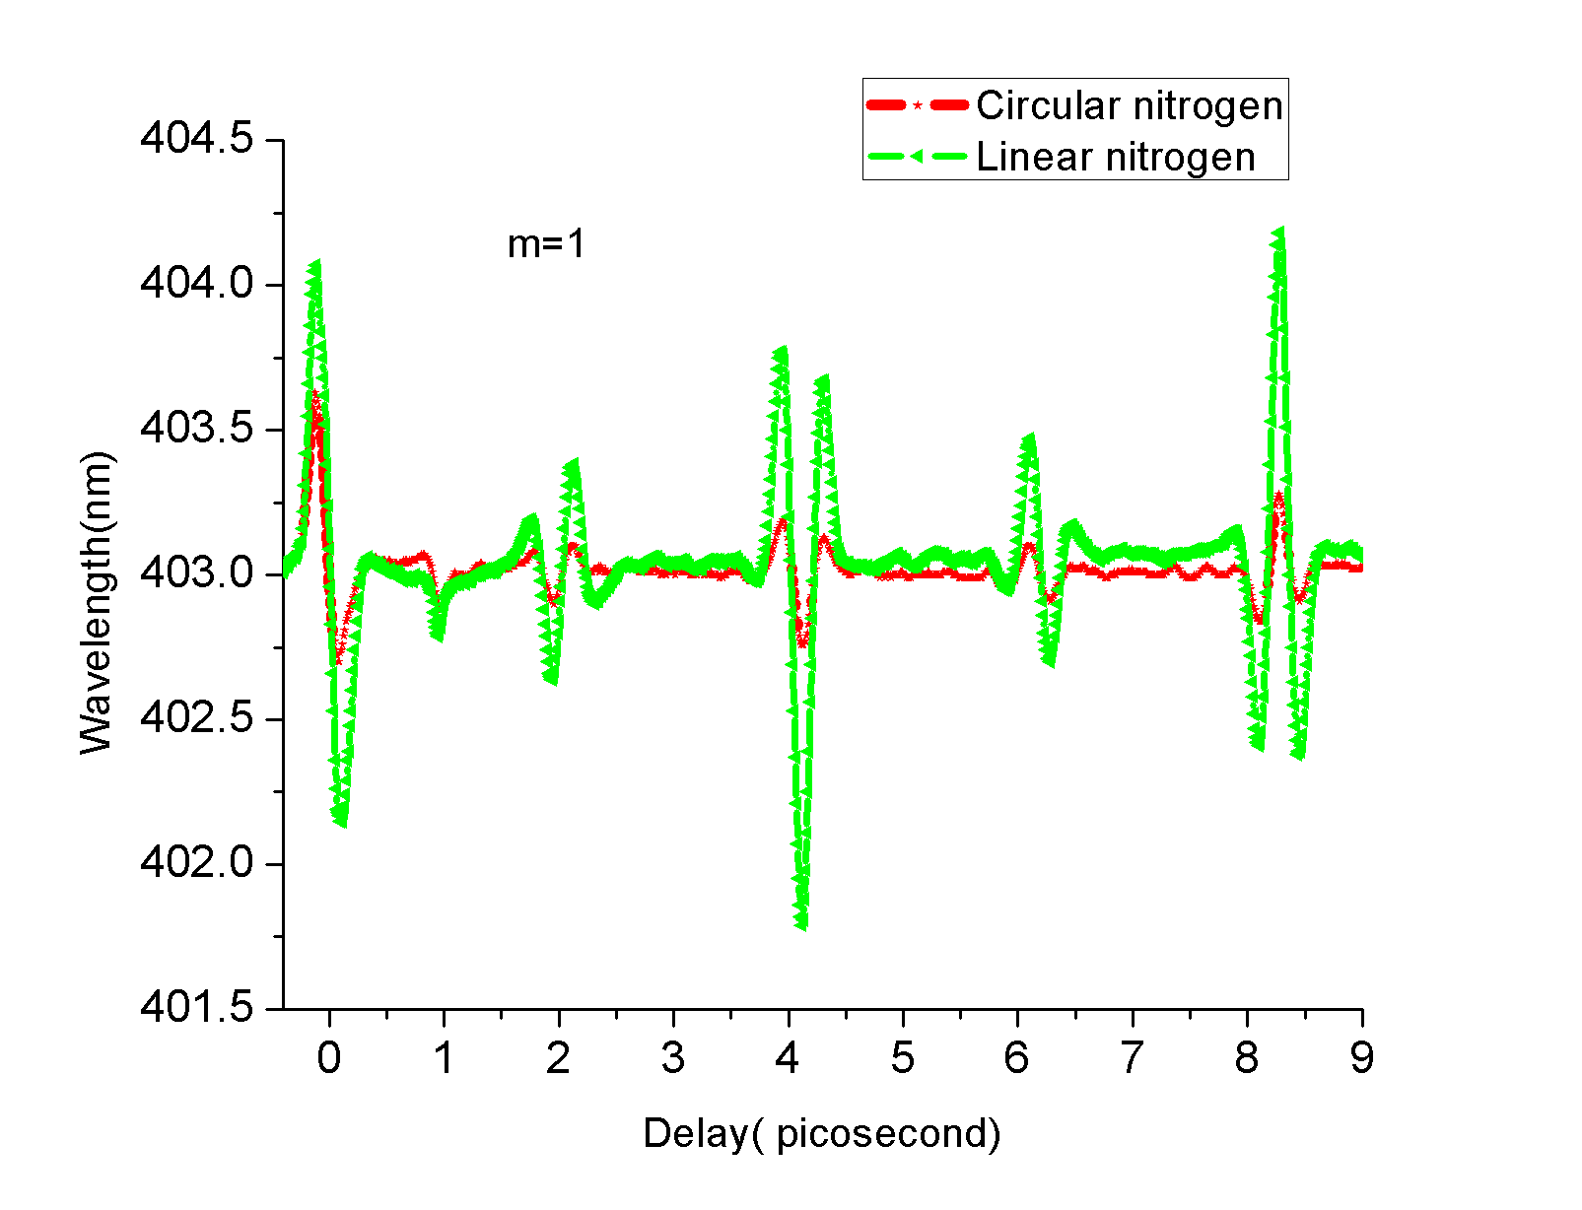
Spectrometer
Low resolution
A typical spectrum of N2+
400nm
f=40cm
Gas
Spectrometer
High resolution
800nm
The seed is modulated by time dependent index of refraction
Seed center wavelength
Seed spectrum

Slide 14
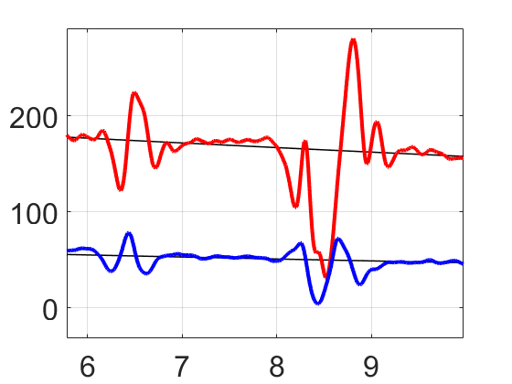
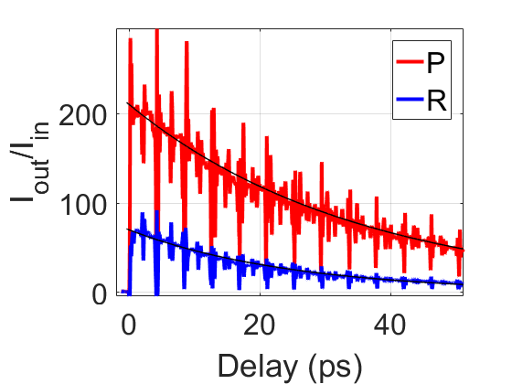
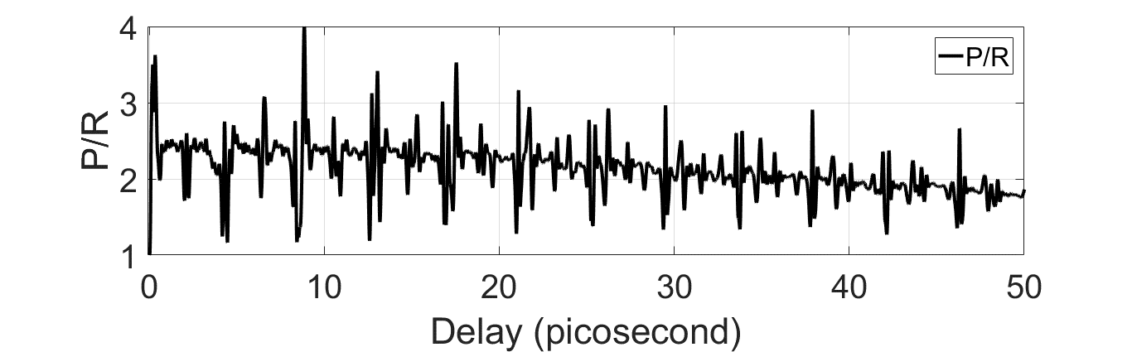
Gain dynamics in P and R are not in phase
Exp decay with
30 ps decay constant
@760 torr

Slide 15
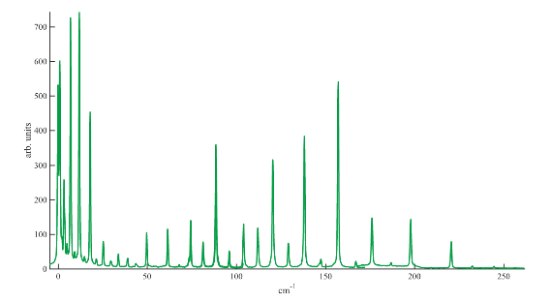
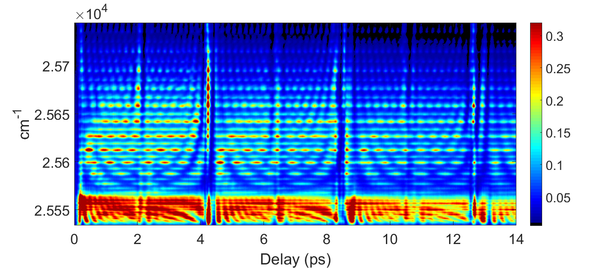
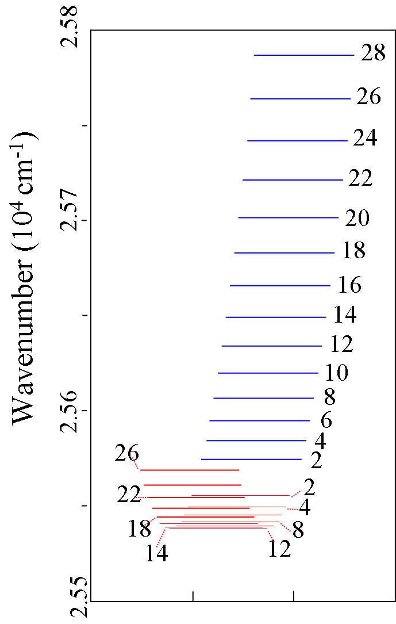
Gain dynamics @ early delays

Slide 16
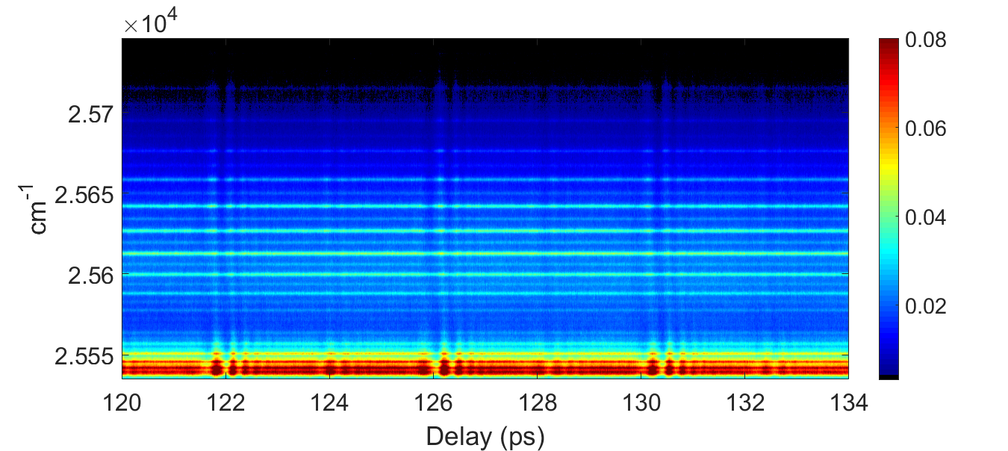
Gain dynamics @ later delays

Slide 17
Transient gain due to Stimulated Raman
J’
Resonant Raman process transfers the population in the rotational manifold
R
P
J”=J’-1
J”=J’+1
Seed gain at particular line (a.u)
Highest J measured
with 0.5 mJ 800
@100 torr
Delay (ps)

Slide 18

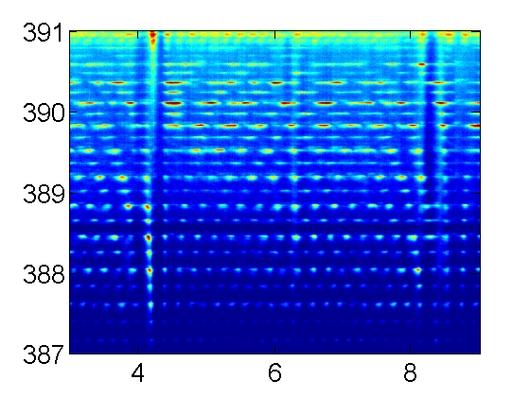
Transient gain/ absorption due to Stimulated Raman
Absorption and gain is measured on individual emission lines
Frequency of modulation increases with rotational J
Gain is not present at all delays
Both absorption/ emission are measured
→ Transient gain
Seed gain at particular line (a.u)
arXiv:1802.00063v1
Delay (ps)

Slide 19
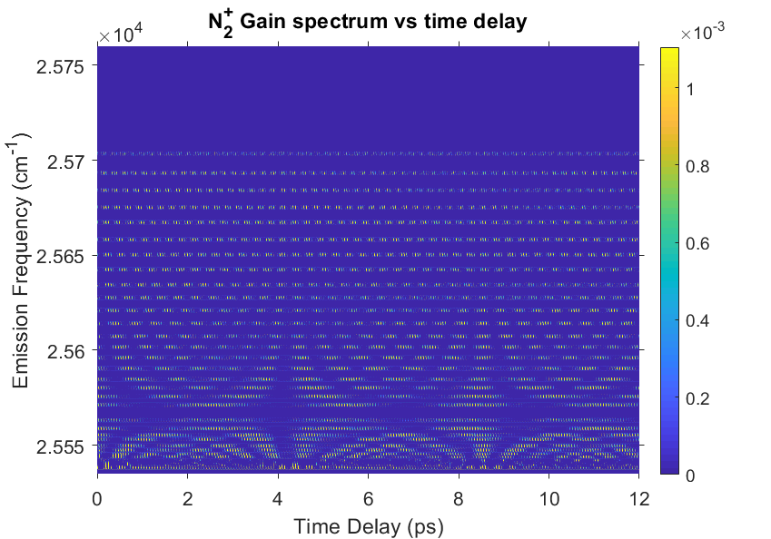
calculation of gain dynamics
David Villeneuve @ NRC Ottawa

Slide 20
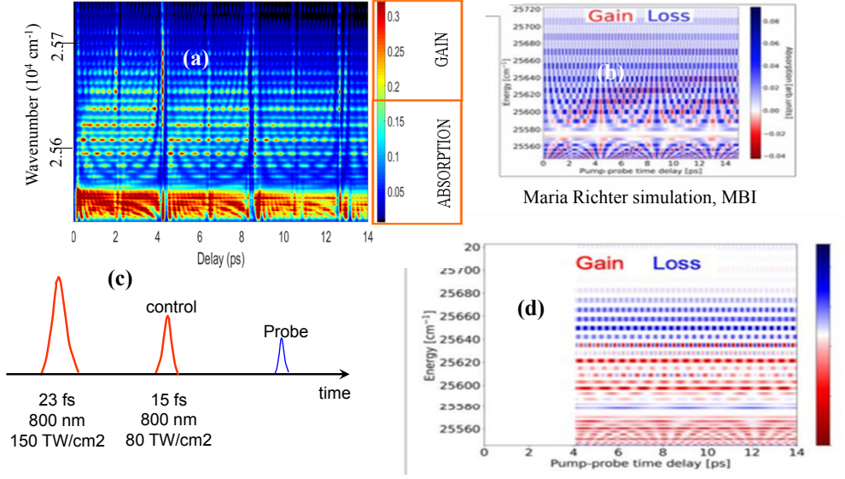
Simulation from Maria Richter (MBI)
(c) Simulation from Maria Richter (MBI): control pulse added.
Simulation from Maria Richter (MBI): continuous gain.

Slide 21
III “Simple” Raman scattering in liquids
ω_{p}
ω_{a}
ω_{p}
ω_{s}
2
δω
molecular
vibrations
0
Brillouin scattering
A high-energy laser pulse is focused into a SBS active medium. At the focus the field initiates a backward scattered “Stokes" field which produces a standing wave with the incoming field. Due to electrostriction, the standing wave generates a density grating (i.e. a moving grating). The moving grating back scatters more energy into the Stokes field, leading to depletion of the incident pulse and a compressed Stokes pulse.
ω_{p}
ω_{s}
2
δω
Phonons
0

Slide 22
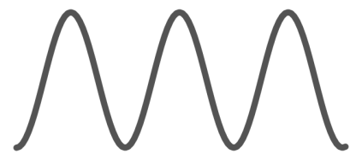
SBS = Stimulated Brillouin Scattering
A high-energy laser pulse is focused into a SBS active medium. At the focus the field initiates a backward scattered “Stokes" field which produces a standing wave with the incoming field. Due to electrostriction, the standing wave generates a density grating (i.e. a moving grating). The moving grating back scatters more energy into the Stokes field, leading to depletion of the incident pulse and a compressed Stokes pulse.
Two beam interference
Pump:
Stokes:
Acoustic
wave
z=0
z=L
Positive
feedback
Electrostriction
z
[1] R. Boyd, Nonliner Optics 3rd edition, Academic Press 2008
[2] D.T. Hon, Opt. Lett. 5,516-518 (1980)
Notes:
Medium selection: FC-72 fluorocarbon low absorption, water (absorption and thermal)
Fundamental physics: Electrostriction: polarized molecules are attracted to the region where the electric field is higher. Modulation of electric field in space induce modulation of material density.
Brillouin scattering: When light propagates in a medium with density fluctuation, it gets scattered. This can become stimulated if the scattered light is strong enough to interfere with pump.
A typical setup for compression is to use a lens to focus into the SBS medium. At the focus where intensity is high enough, the pulse starts to scatter back. It then interfere with the remaining of the itself and enhance the density grating, thus more energy get reflected into the stokes and eventually saturates the pump. Just like a fast moving mirror reflect the pulse back. Because the energy is always reflected at the interface of the pump and stokes, it become accumulated at the leading edge of the stokes. When the interaction length is long enough this leads to a compressed stokes.
Interaction length is ~ spatial pulse length of the input pulse 10 ns ~ 2.5 m long
For such a long interaction length, medium with low absorption and less sensitive to thermal are desired.
22

Slide 23

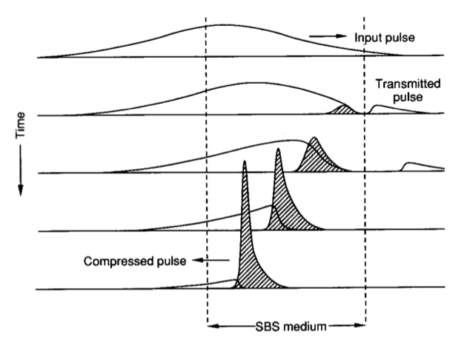
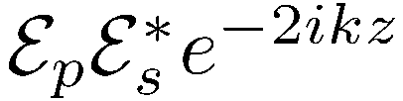
Phase conjugation
Pulse compression
SBS medium
Pump:
Stokes:
Acoustic
wave
z=0
z=L
FC-72, water
Input pulse
Pump and Stokes make a standing wave of amplitude proportional to:
Transmitted pulse
Time
Compressed pulse
The pump diffraction adds to the Stokes:
Distance
23

Slide 24

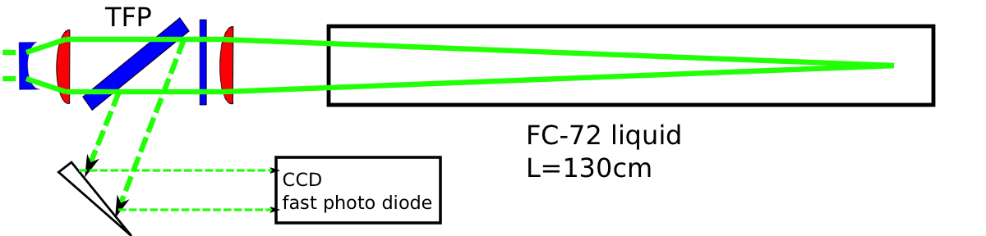
Single cell experiments

Slide 25
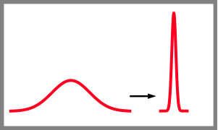
Single-cell setup does not work for high energy compression
SRS signal
25
Notes:
Energy limitation due to competing nonlinear effect in the focusing geometry.
Neither of these setup met our requirement:
Goal: compress >1J, challenges
25

Slide 26
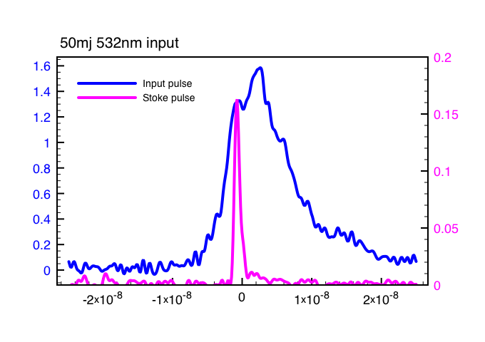
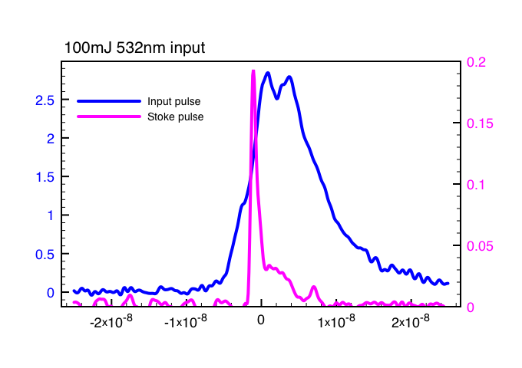
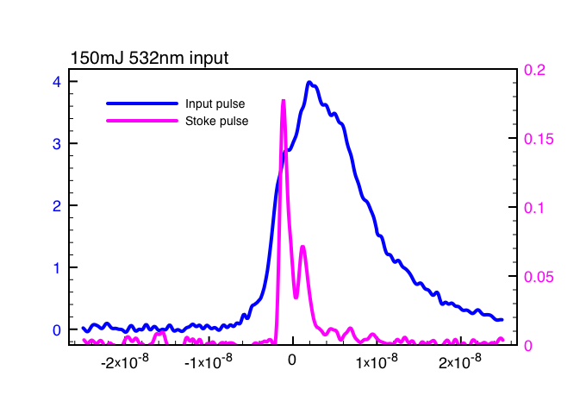
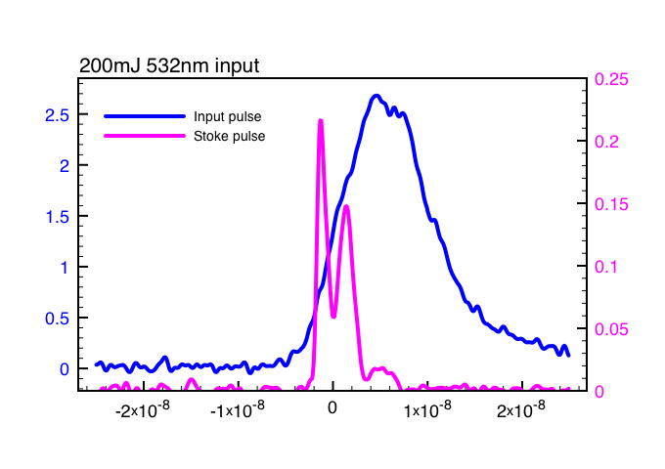
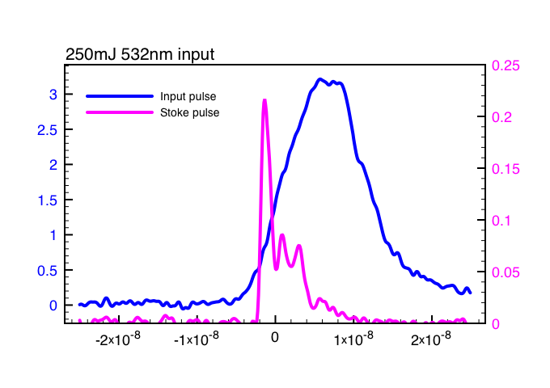
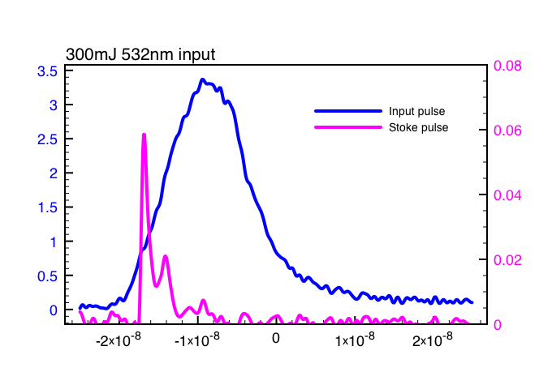
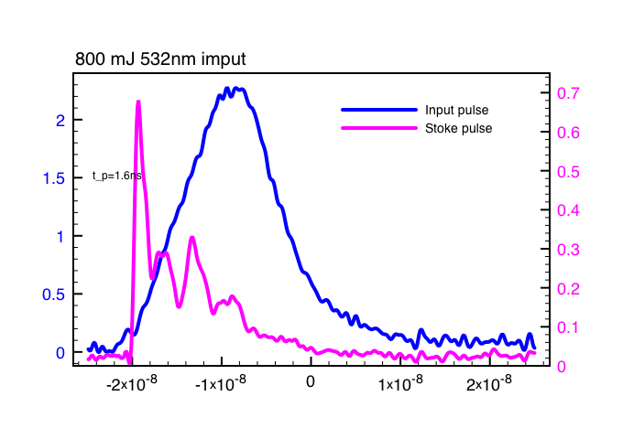
Experiments with 532nm summary--compression
Stoke pulse reflected back earlier as input energy increase
Multiple pulses show up as input energy increase

Slide 27
Short Summary 1
Single cell setup works at low energy
Both compression (multiple tail pulses) and phase conjugation (competition with noise mode) degrade as input energy increase
Liquid purity is very important
Work with 1064nm at low energy and then amplify after compression?

Slide 28
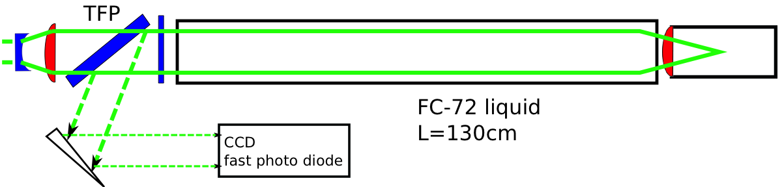
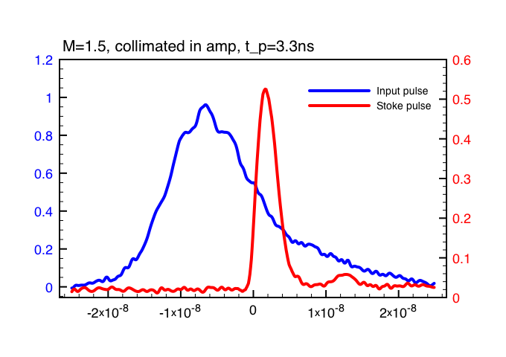
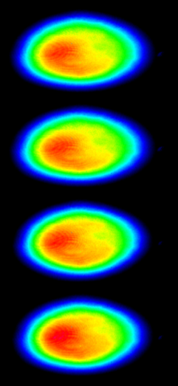
2-cell experiments with 1064nm
(unstable beam profile with single cell setup, similar as 532nm)
f=20 cm in liquid
Stable same profile as input
Pulse width 13ns→3-4ns

Slide 29

Generation-amplification setup for high energy compression
HW: Half wave plate QW: Quarter wave plate TFP: Thin film polarizer
f: Focal lens Ls: Generator length La: Amplifier length
Dane et al, IEEE J. Quant. Electron. 30, 1907 (1994)
With controllable energy in the focusing cell
Potentially scalable to high energy >1 J
29
Notes:
Current setup inspired by this article.
The idea is to generate a small seeding pulse first in a focusing setup, without breakdown, then amplify the seed in a non-focusing setup. In this way it can take much higher energy.
use a H-W + PBS the control the energy entering the generator. Majority of the 7J pulse enter the amplifier cell as pump. Small portion go to the generator and reflected back as “seed” and enter the amplifier from the opposite side. The pump and seed are counter-propagating inside the amplifier cell and interact and energy exchange occurs between them.
You can immediately see the merit of this setup is we have full control of the energy entering the generator without extra attenuation. But as we dealing with two pulses counter-propagating, it is critical to make them overlap both in time and space.
2) To illustrate this interaction, I’d like to show two movies.
The result is very different if the delay is off and they are meeting at the wrong place.
29

Slide 30

Timing between pump and seed is critical
Low efficiency
Long “tail”
Δt₂
Generator
30
Notes:
30

Slide 31

Thermal challenge at high energy compression
Unstable compression:
Beam aberration
2.5 m
Beam deflect by 2 mrad in half hour – 0.1 ⁰C difference for FC-72
31
Notes:
Movie to show thermal fluctuation (beam fluctuating)
Mainly from FC-72, dn/dt
31

Slide 32


Slide 33
Centering pins
Cooling mantel
6mm
(OD)
2” OD
1cm
6 cm
(OD)
6 cm
2.5 m

Slide 34

SBS pulse compression result: water, 532 nm
Ideal liquid because dn/dT small (=0 at 4 deggree C).
Measurement
Simulation
2.4 J, 12 ns pulse → 300 ps, 1.2 J, ~2% fluctuation
Compression ratio 40X
Peak power > 3GW at green, highest power achieved!
Far field
34
Notes:
Resaon to switch to water
----- Meeting Notes (3/31/14 13:13) -----
simulation
34

Slide 35
Brillouin versus Raman
In water
Green pump → Green backward Brillouin → Bright red Raman

Slide 36

Raman spectroscopy: experimental setup
Experimental setup

Slide 37



Backward SRS pumped by SBS in water
Experimental setup
Pre-compression of pump pulse
SRS energy performance
BSRS: 5mJ;
9% energy efficiency

Slide 38

Correlation between backward SRS and SBS
Pump: 10mJ
Pump: 50mJ
Pump: 100mJ
SRS
SBS
Backward SBS (green) source of red SRS in the forward (with respect to SBS) direction.

