Slide 1
(
ATTOSECONDS AND OPO ---considerable impact
Electron accelerators -- Geneve on tabletop!
Attosecond x-rays in the water window – Diffraction before destruction to
acquire 3D representation of proteins
requires making single cycle IR pulses –
chirped pulse optical parametric amplifiers
)

Slide 2
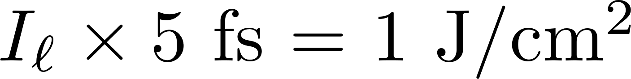
REQUIREMENTS FOR ATTOSECOND PULSE GENERATION:
FINAL PULSES WITH ZERO CEO AND CEP
PULSE DURATION < 50 fs
REPETITION RATE 1 kHz or more
AMPLITUDE STABILITY
STABILIZATION OF FREQUENCIES
PULSE ENERGY?

Slide 3
Chirped pulse amplification
A bit of pre-history
A bit of history
No longer balanced dispersion-Kerr, but huge dispersion/no Kerr

Slide 6
SIMPLE AMPLIFIER CHAIN
3 LENS BEAM EXPANSION
Saturation? Yes for ns; NO for fs.
Below Pcr? Always – except approach of Aande Kuhn
< 2 % shot-to-shot variation.
70%
6
Notes:
Harmonic generation!
----- Meeting Notes (3/31/14 13:20) -----
page number! show pictures part by part
6

Slide 7
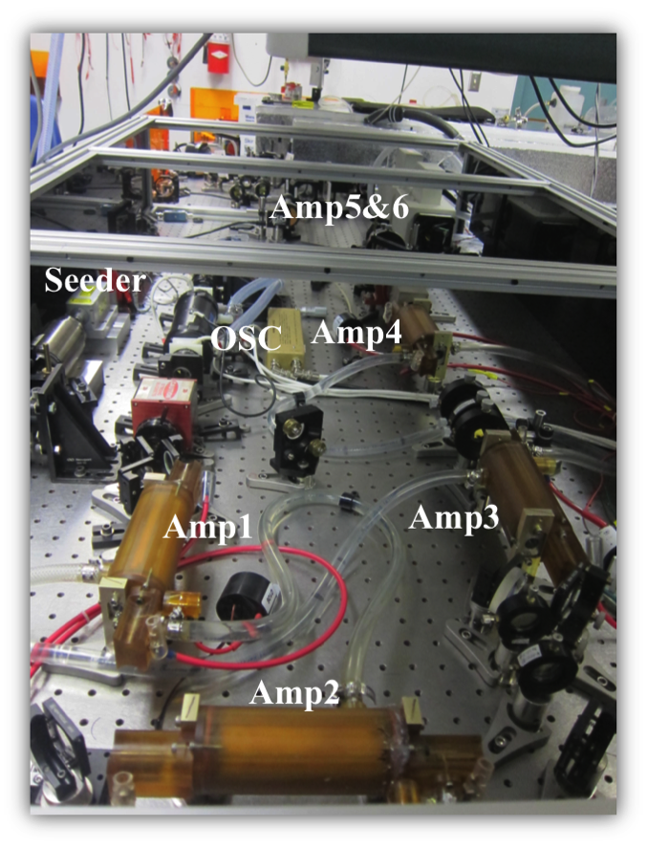
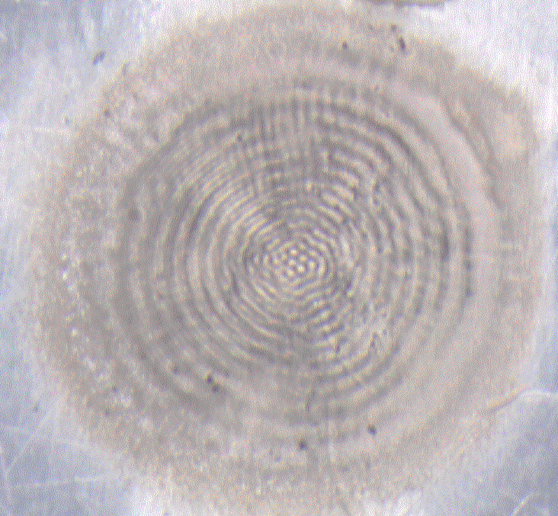
Standard pulse amplifier chain
Notes:
Harmonic generation!
----- Meeting Notes (3/31/14 13:20) -----
page number! show pictures part by part
7

Slide 8
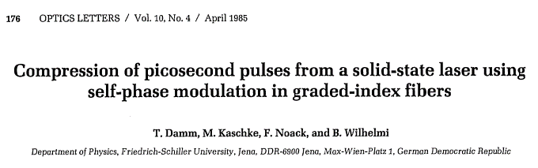
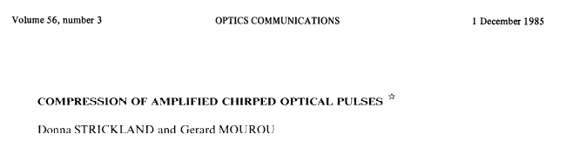
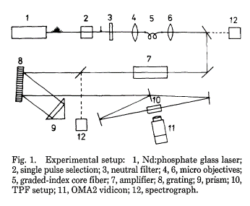
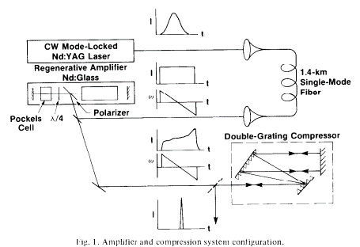
A BIT OF HISTORY

Slide 9
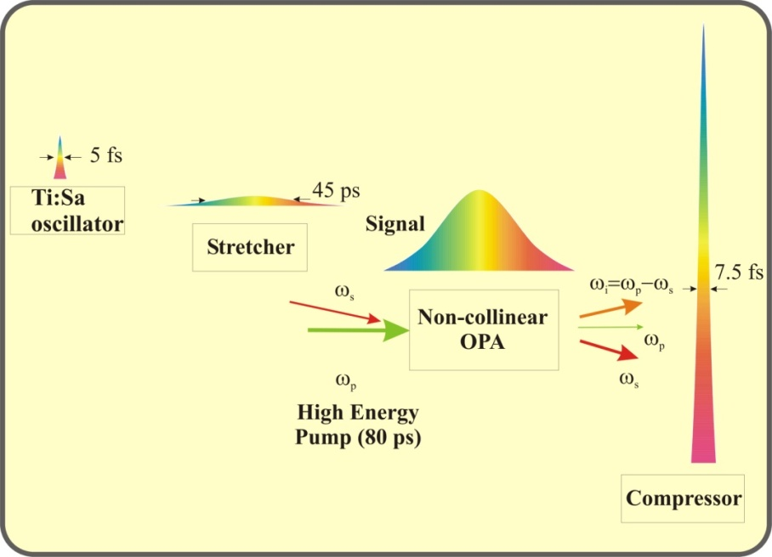
chirped pulse optical amplifiers

Slide 10
Generation of High Power Ultrashort Pulses
(800 nm, )
From Oscillator
Into Stretcher
From Stretcher
Into Amplifier
From Amplifier
Into Compressor
From Compressor
Stretching
Amplification
Compression
3200 microns
30 microns

Slide 11
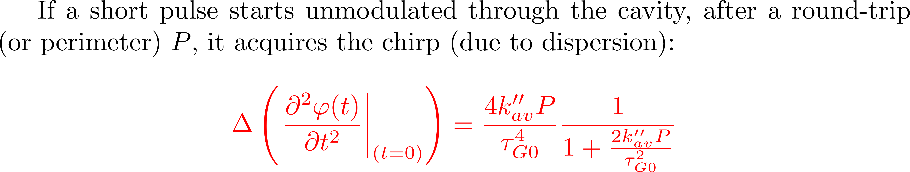
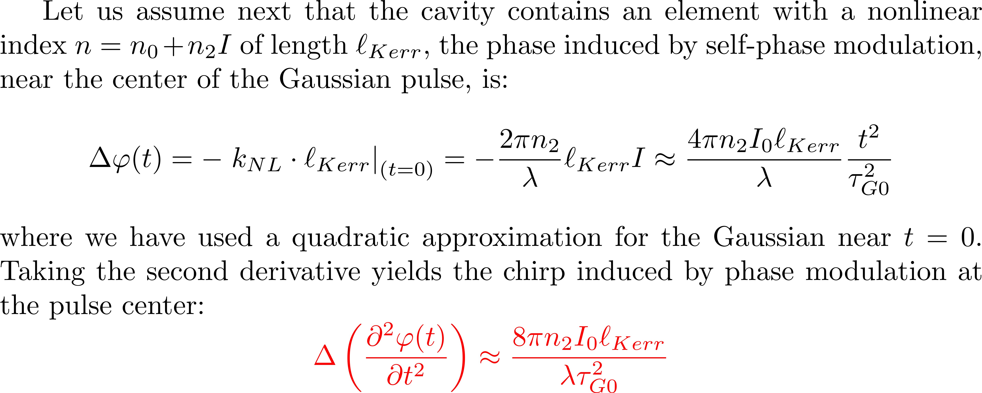

Slide 12
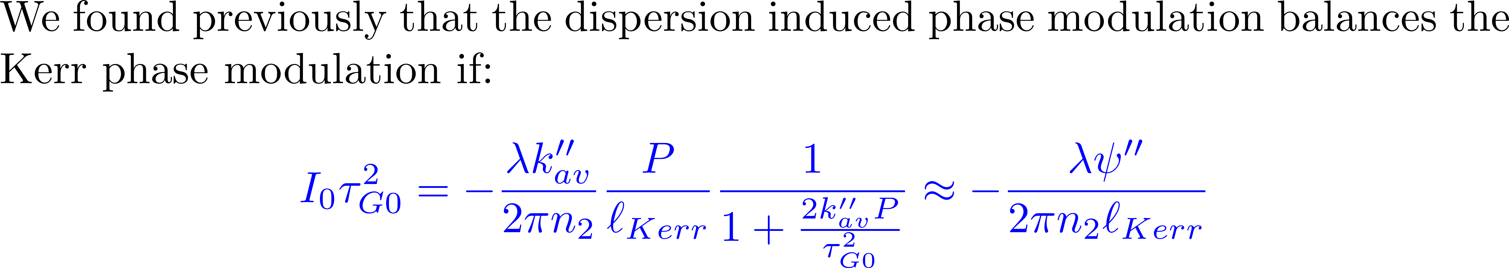
OSCILLATORS: SHORT PULSES REQUIRES SMALL DISPERSION/LARGE KERR EFFECT

Slide 13
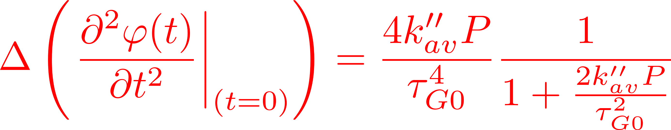
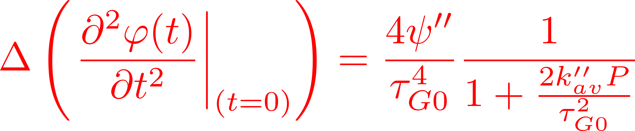
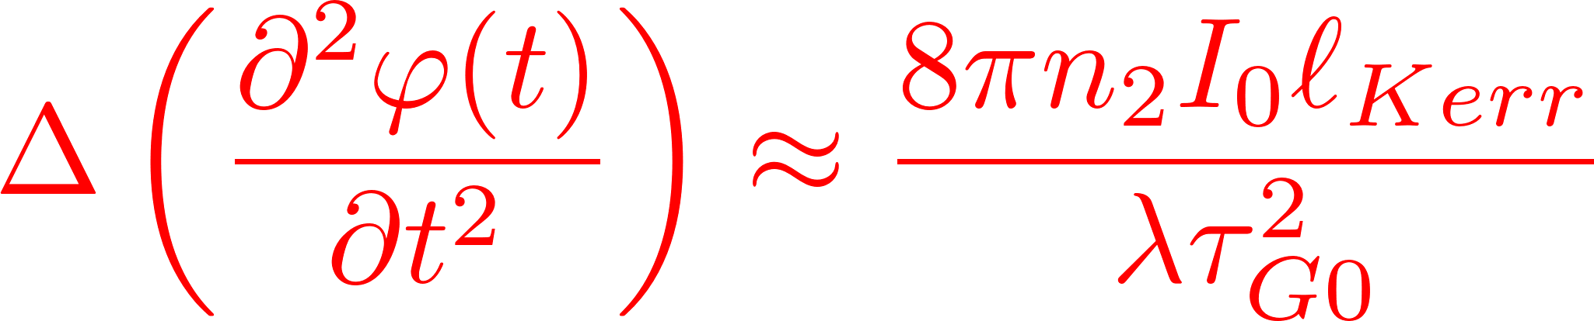
NO LONGER INFINITESIMAL CHANGE/CAVITY ROUND-TRIP
AMPLIFIERS REQUIRE HUGE DISPERSION AND NEGLIGIBLE KERR EFFECT

Slide 14
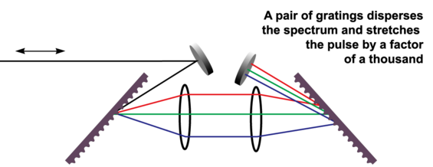
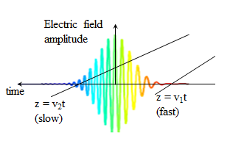

Stretcher
Stretching causes group velocity dispersion, thereby imparting a linear chirp.
14

Slide 15
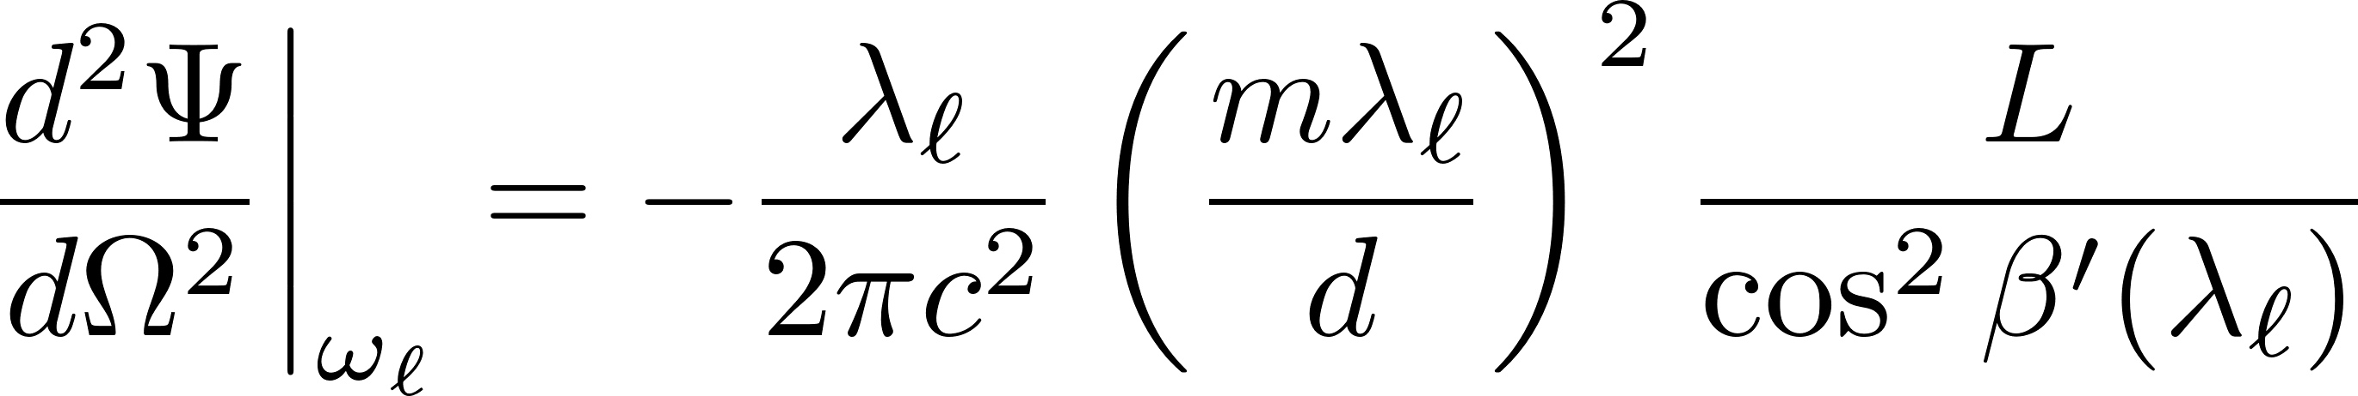
GRATING PAIR NEGATIVE DISPERSON

Slide 16

GRATING PAIR POSITIVE DISPERSON

Slide 18
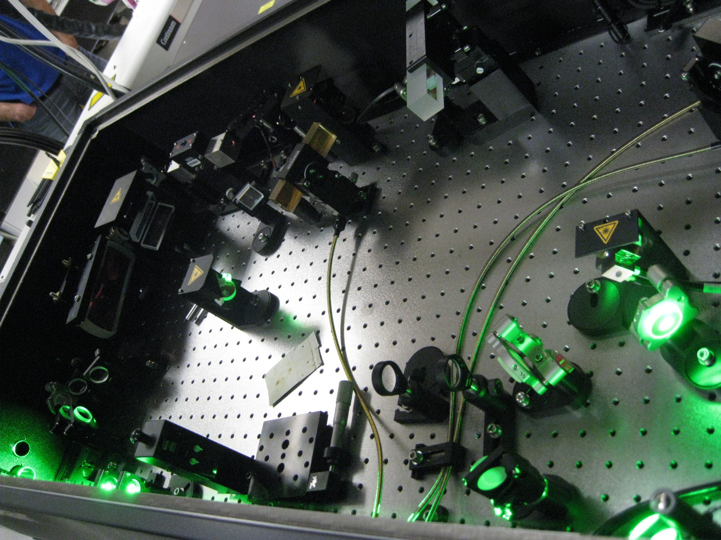
Gratings are expensive – one is sufficient

Slide 19
Gratings are expensive – one is sufficient

Slide 20
Stretcher

Slide 21


Use of Faraday Isolator as circulator
p-pol
PBS
PBS
p-pol
Stretcher
Faraday Rotator
λ/2
p-pol
s-pol
s-pol
s-pol
Regenerative Amplifier
MP Amplifier, Compressor, Target
21

Slide 22
HOW TO AMPLIFY THE STRETCHED PULSE?
REGENERATIVE AMPLIFIER
Typical 2 Pockel’s cells design

Slide 23
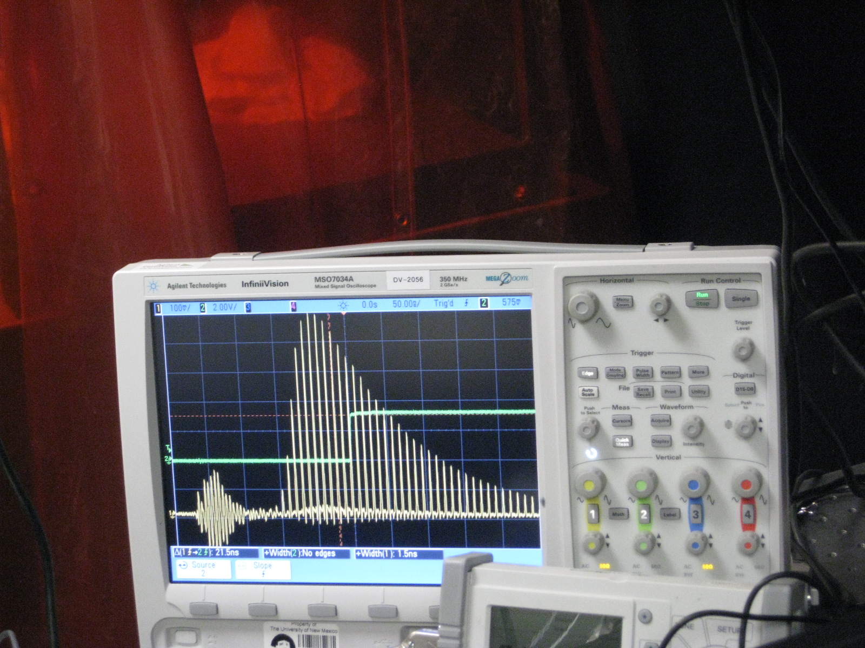

Slide 24
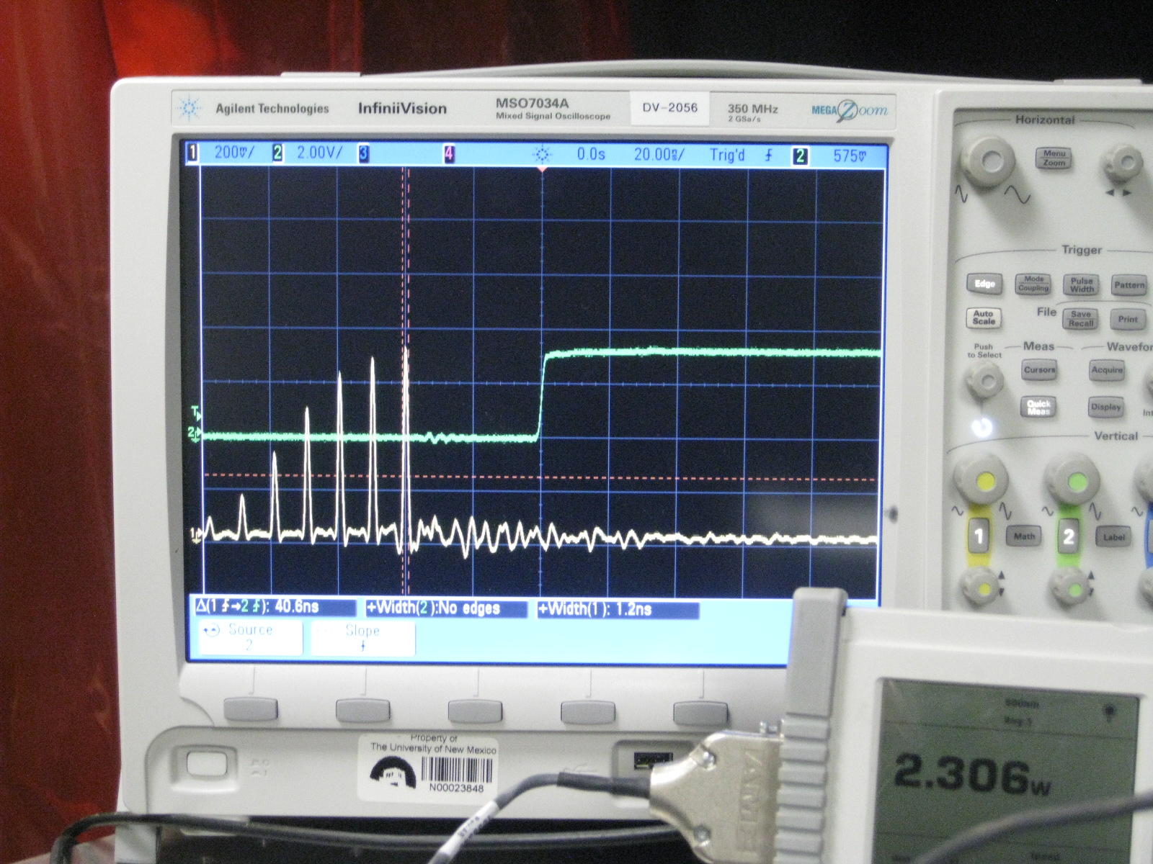

Slide 26
REGENERATIVE AMPLIFIER
Single Pockel’s cell design
EM₁
QWP
Pulsed Pump @ 8 Hz
532 nm, 1 W
Flat M
Pockels Cell
TFP
+ Lens
On for about 440 ns per amplification cycle
Ti:Sapphire
s-pol
Pockels Cell operates as a quarter wave plate with an applied voltage of around 550 V.
Seed Pulses In
Amplified Pulses Out
EM₂
26

Slide 27
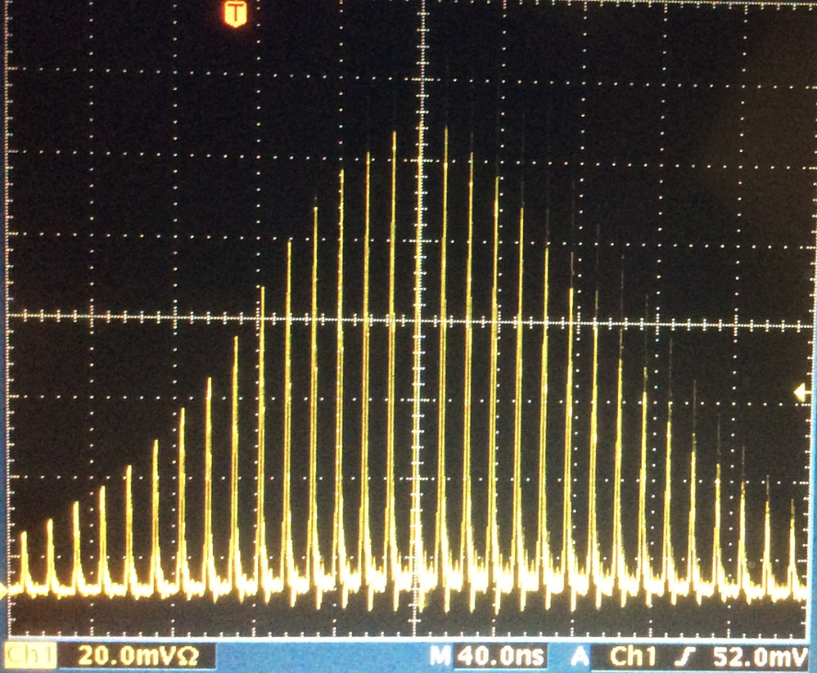
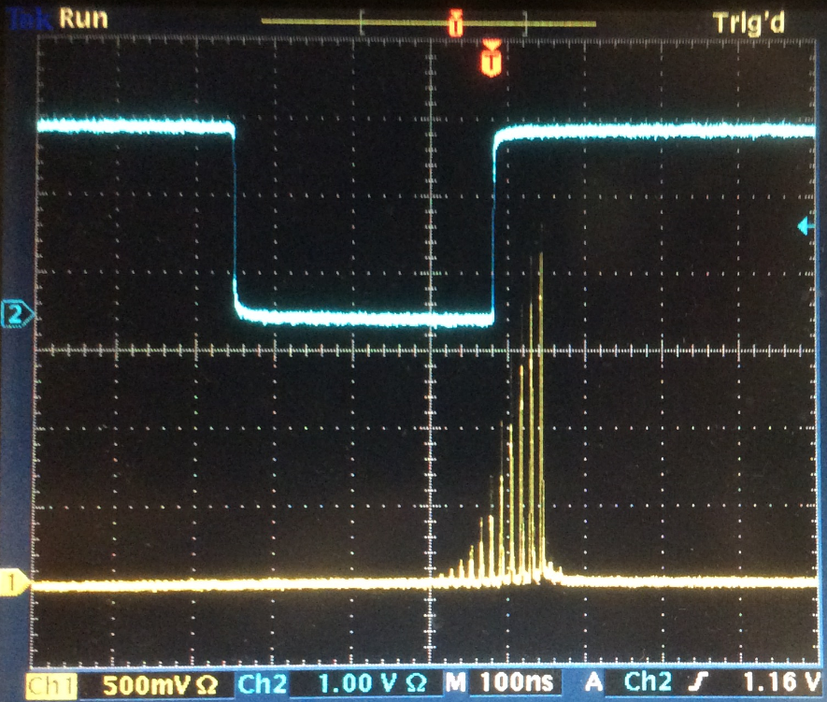
Regenerative Amplification – Intracavity Gain
The goal is to stop the Pockels Cell at the height of the gain shown here. This will give most of the energy to a single pulse.
27

Slide 28
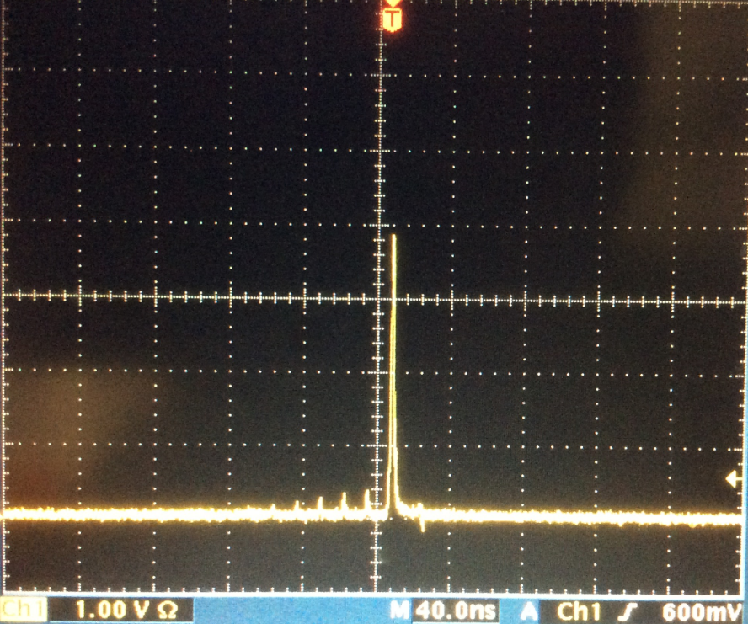
Single Pulse Amplification
This pulse has now absorbed the lion’s share of the energy available in the regenerative amplifier system.
Note the much higher scale than the pulses shown on the previous slide. Additional filtration was also added to protect the detector.
28

Slide 29
High repetition rate is a challenge

Slide 30
Major challenge: Thermal lensing.
Solution: cavity of 6 f_{T}
REGENERATIVE
AMPLIFIER
Thermal lens
f_{T}
f_{T}

Slide 31
Bow Tie Amplifier
In from Regenerative Amplifier
Ti:Sapphire
Out to Compressor

Slide 32
After amplification: compressor
(1 pair of gratings)

Slide 33
Problems with inversion gain:
Spontaneous emission noise
Spectral narrowing
Possible solution:
Optical Pulse Chirped Parametric Amplifier
OPCPA

Slide 34
Tuning the crystal length for optimum short pulse compression
LONG CRYSTALS = HIGHER CONVERSION
LONG CRYSTALS = NARROWER BANDWIDTH
The obvious solution for short pulses: short crystals? Not always!
One can use long crystals to compress pulses down
to femtoseconds.
THE GENERATED PULSES ARE SHORTER THAN
THE FUNDAMENTAL, AND THAN THE INVERSE
BANDWIDTH OF THE SECOND HARMONIC PROCESS.
Where does one get the bandwidth?
From the amplitude modulation of the pump,
as the pump is depleted at a faster rate than
the pump risetime.

Slide 35
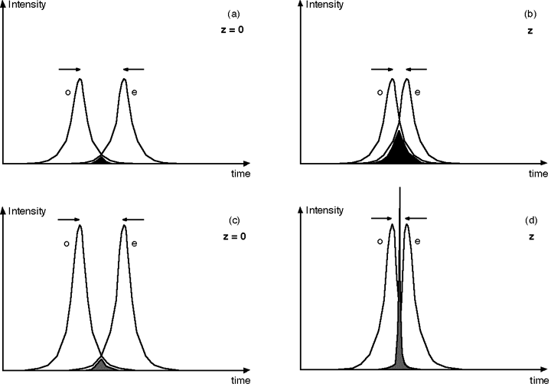
Compression in SHG
Motion of pulses in the frame of reference of the second harmonic
Weak pulses: the second harmonic broadens as the
overlap of the two fundamental pulses increases

Slide 36
Compression in SHG
Motion of pulses in the frame of reference of the second harmonic
Strong pulses
The trick: sum frequency group velocity between that of fundamental o and fundamental e

Slide 37
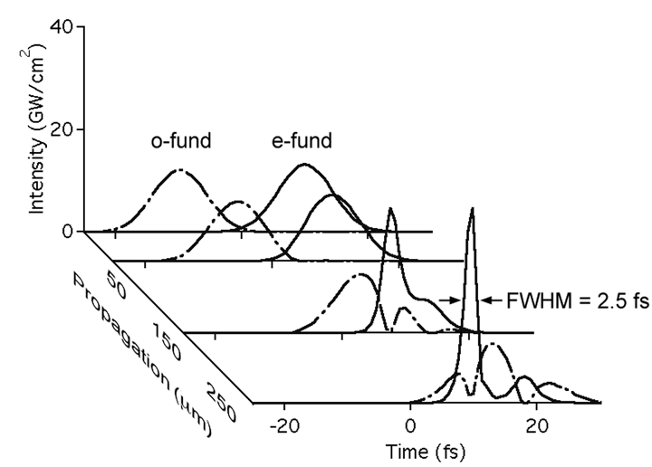

Slide 38
Find the angles? SNLO
CHIRP AMPLIFICATION

Slide 39
There are two solutions to the narrow bandwidth
of Periodically Poled crystals:
1. Pole the crystal “non-periodically”
“ENGINEERABLE COMPRESSION OF ULTRASHORT PULSES BY USE OF
SECOND HARMONIC GENERATION IN CHIRPED-PERIOD-POLED
LITHIUM NIOBATE”, Optics Letters 22, 1341 (1997)
“SIMULTANEOUS FEMTOSECOOND-PULSE COMPRESSION AND SHG
IN APERIODICALLY POLED KTiOPO₄”, Optics Letters 24, 1071 (1999)
2. Convert the spectrum piece by piece
x
Periodically poled
crystal of period
changing with x.

Slide 40

Other solution: use many crystals for each wavelength range
FOPA: Frequency domain optical
parametric amplification (Faux-pas)
B. E. Schmidt et al. Nat. Commun. 5, 3643 (2014)
energy
front
grating
f
Laser source
wavefront
f
Interplay of temporal and spatial chirp, resulting in changes in wavefront shape
group delays and central wavelength.

Slide 41
LASER DAMAGE
CHIRPED PULSE AMPLIFICATION
SHORT
PULSE
LINEAR
DISPERSION
(+)
LINEAR
DISPERSION
(-)
AMPLIFIED
SHORT
PULSE
GAIN
If the parametric gain is sufficiently broad for the short
pulse, it is also sufficiently broad for the dispersed pulse.
THE PARAMETRIC GAIN HAS NO ENERGY STORAGE:
THE DURATION OF HAVE TO BE MATCHED
PUMP
SIGNAL
PUMP DEPLETION: “DIP” IN PUMP.
TECHNICAL CHALLENGE: PUMP 100 ps OR LESS
SIGNAL STRETCHED TO > 100 ps.

Slide 42
Synthesizer principles
I_{λ}
Parallel synthesis
Pro:
Shorter „beam path“
Simple narrow bandwidth mirrors
Contra:
Interferometric stability needed
Very sensitive → high rep.rate
Broad bandwidth mirrors after beam combination
Similar principle: frequency domain OPA
Serial synthesis
Pro:
No special requirements on stability
Insensitive
Contra:
Longer „beam path“
Broad bandwidth mirrors
λ
S.-W. Huang et al. Nat. Photon 5, 475 (2011)
C. Manzoni et al. Opt. Lett. 37, 1880 (2012)
  B. E. Schmidt et al. Nat. Commun. 5, 3643 (2014)
D. Herrmann et al., Opt. Exp. 18, p. 18752 (2010)
  A. Harth et al. Opt. Express 20, 3076 (2012)
Notes:
42

Slide 43
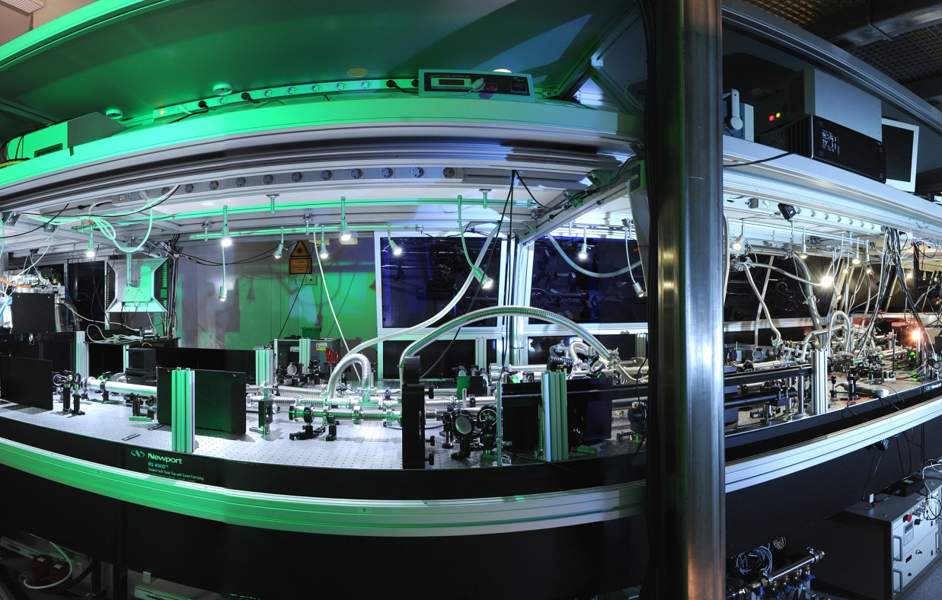
Multi-10-TW sub-5-fs Optical Parametric Synthesizer
− Relativistic intensity sub-5-femtosecond laser pulses
and their applications
Laszlo Veisz¹, Daniel Rivas¹, Gilad Marcus¹, Xun Gu¹, Daniel Cardenas¹, Jiancai Xu¹, Julia Mikhailova¹, Alexander Buck^{1,2}, Tibor Wittmann¹, Christopher M. S. Sears¹, Daniel Herrmann³, Olga Razskazovskaya², Vladimir Pervak², Ferenc Krausz^{1,2}
¹ Max-Planck-Institut für Quantenoptik, Hans-Kopfermann-Str. 1, 85748 Garching, Germany
² Ludwig-Maximilians-Universität München, Am Coulombwall 1, 85748 Garching, Germany
³ Lehrstuhl für BioMolekulare Optik, Department für Physik, Ludwig-Maximilians-Universität,Oettingenstrasse 67, 80538 München, Germany
Notes:
43

Slide 44
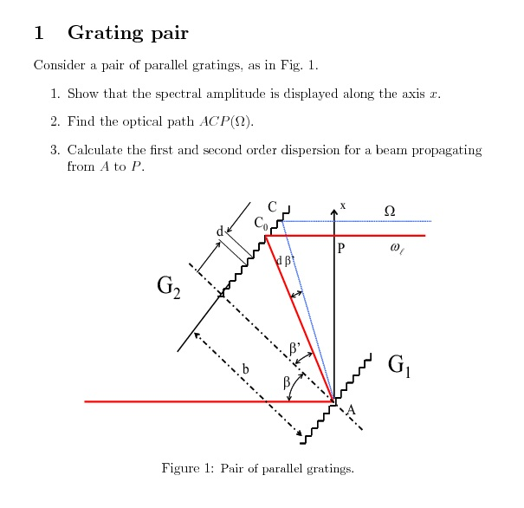
(b) Calculate the second order dispersion of the pair of gratings. That gives
the pulse broadening and chirp introduced by the pair of gratings.

Slide 45
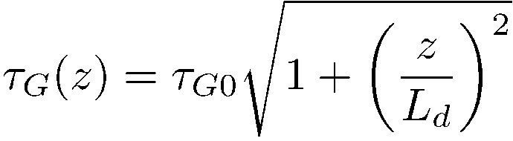
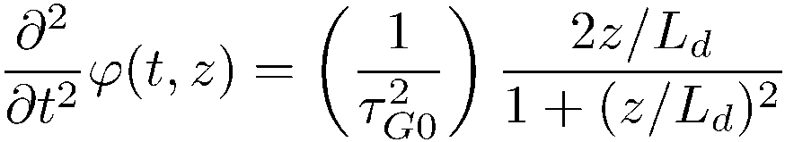
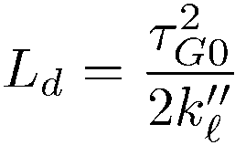
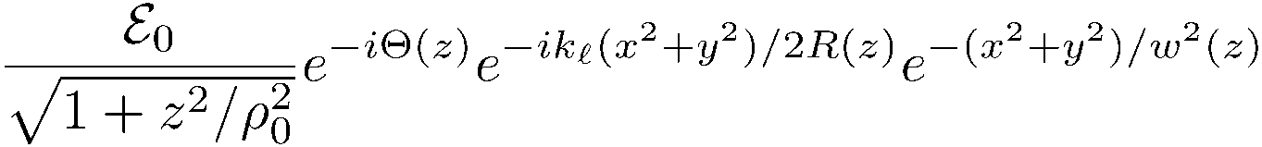
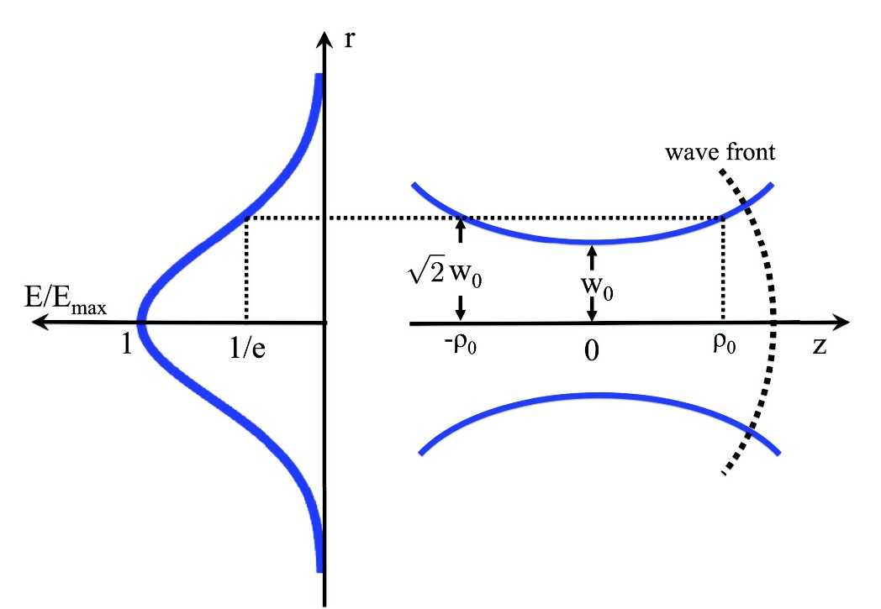
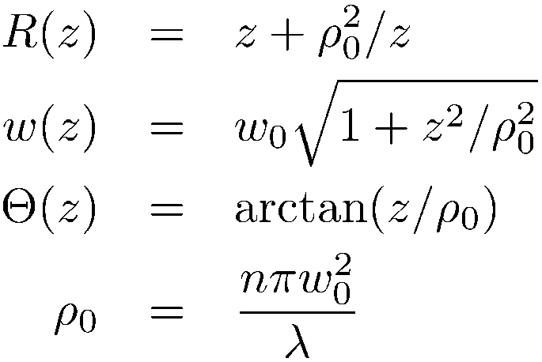
TIME
SPACE

