Slide 1
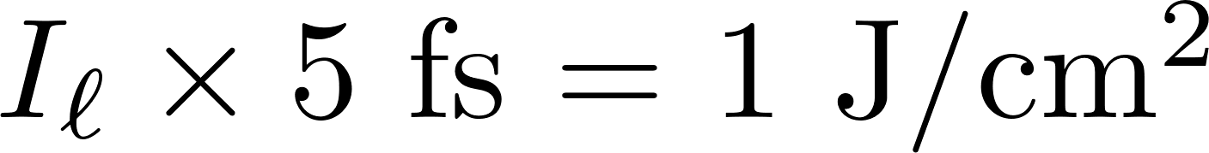
REQUIREMENTS FOR ATTOSECOND PULSE GENERATION:
FINAL PULSES WITH ZERO CEO AND CEP
PULSE DURATION < 50 fs
REPETITION RATE 1 kHz or more
AMPLITUDE STABILITY
STABILIZATION OF FREQUENCIES
PULSE ENERGY?

Slide 2
Evolution of a single pulse
What follows applies to conventional tabletop lasers, fiber lasers, microresonator lasers
Constraint is that the pulses are so short that the pulse shaping mechanism is limited to Kerr effect and dispersion.
The pulse evolution generally converges towards a steady state solution, designated as “solitons”
Because of the anomalous dispersion, k′′0, the high frequency components produced in the trailing part of the pulse, travel faster than the low frequency com-ponents of the pulse leading edge. Therefore, the tendency of pulse broadening owing to the exclusive action of group velocity dispersion can be counterbalanced.
Approach: the chirp produced in the pulse center by the nonlinearity and the second order dispersion are of equal magnitude (but of opposite sign)

Slide 3
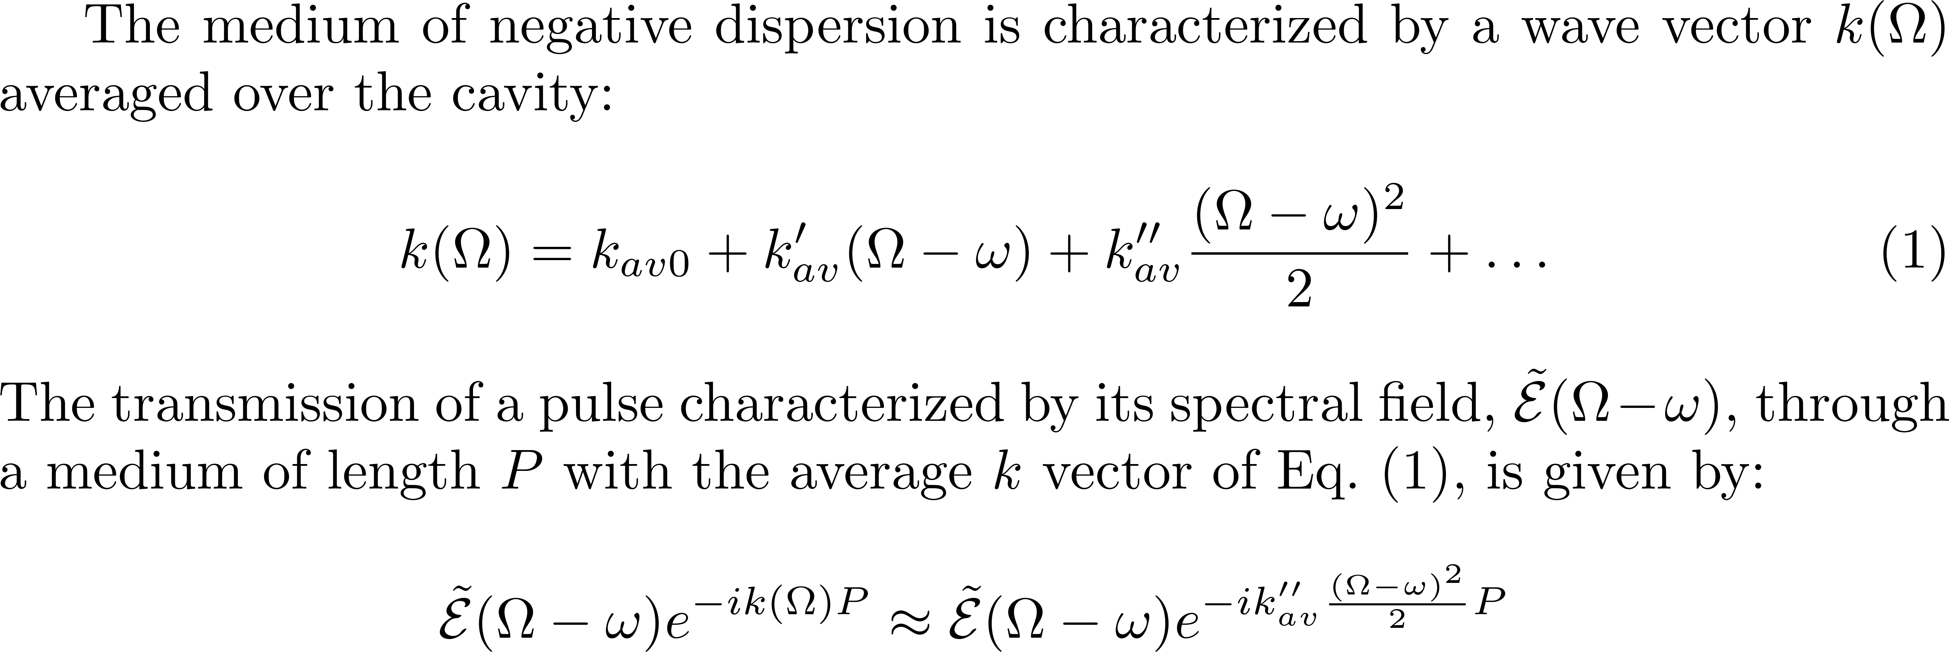
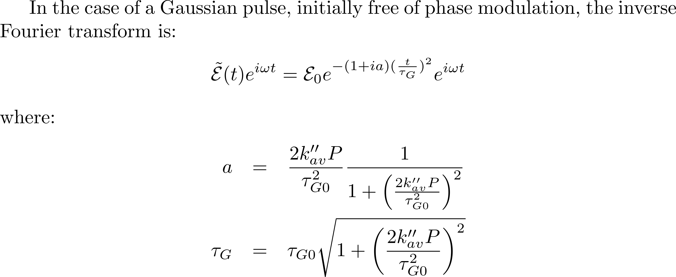

Slide 4
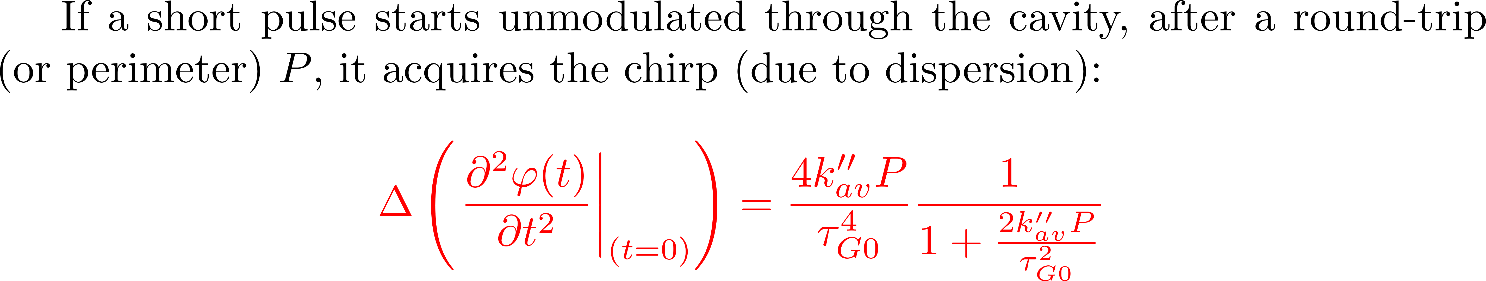
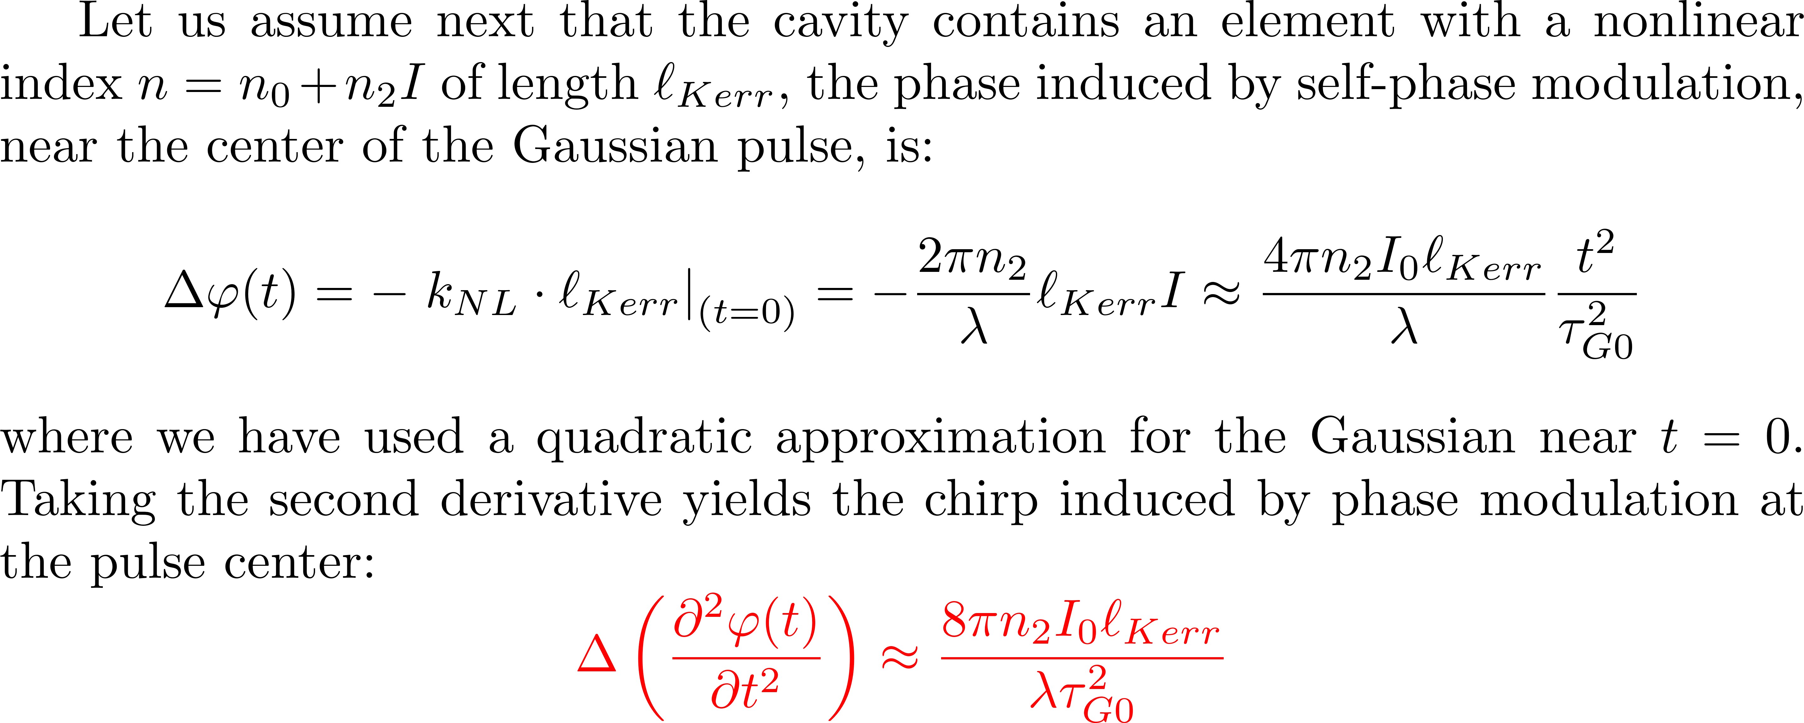

Slide 5
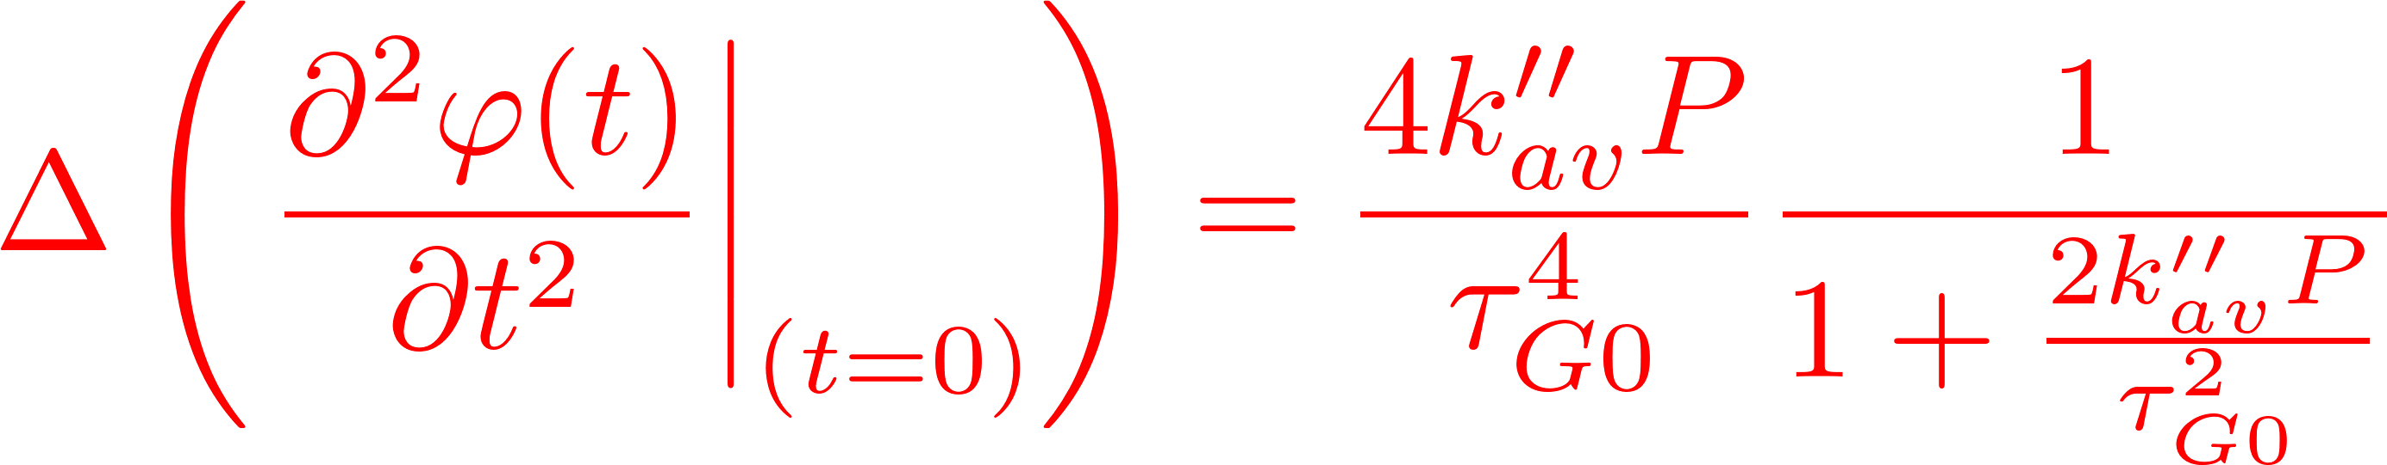
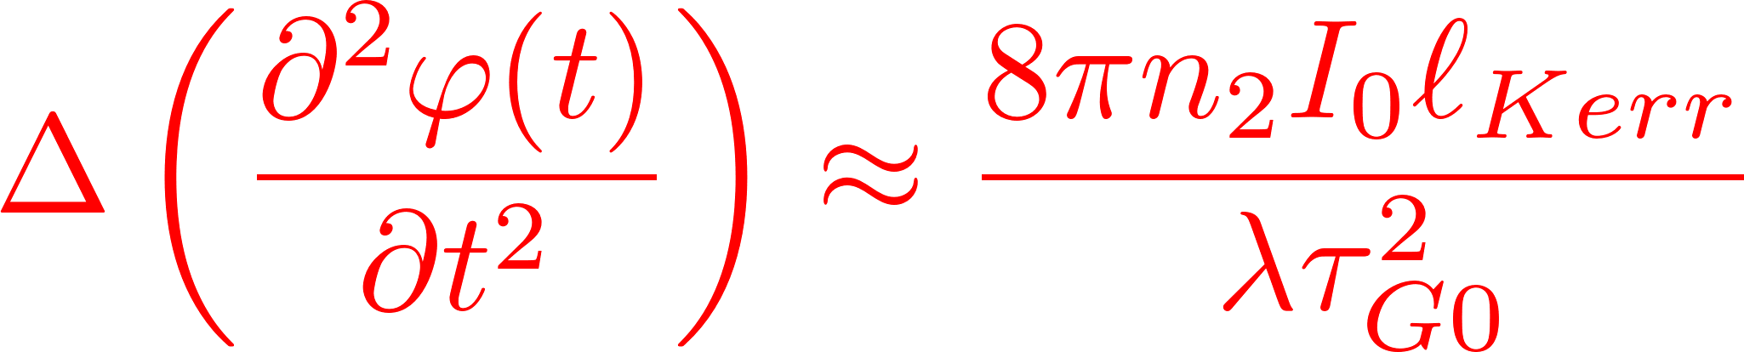
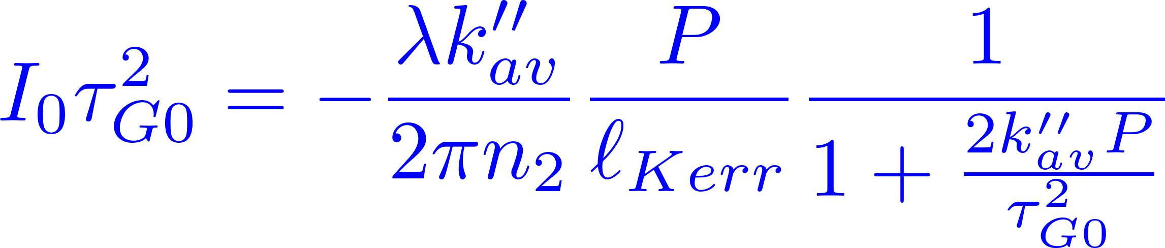
Evolution of a single pulse
IF THEY CANCEL EACH OTHER

Slide 6
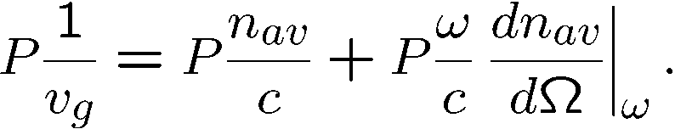
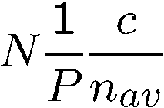
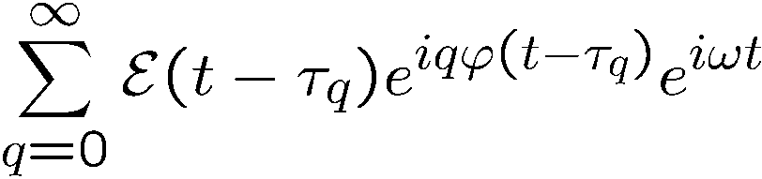
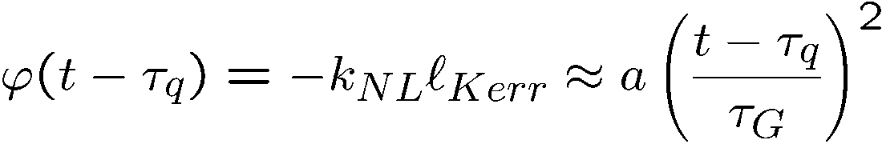
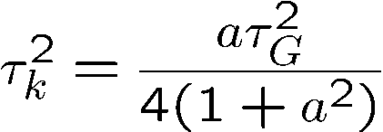
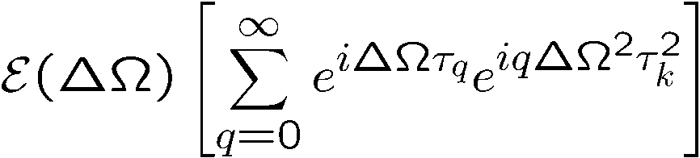
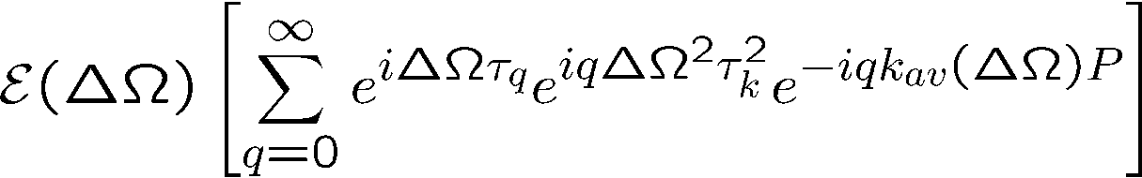

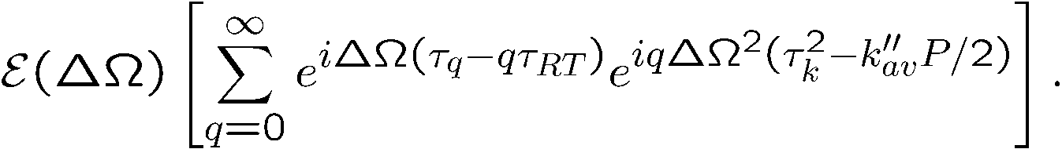
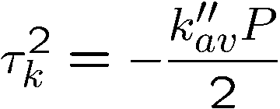
How unequally spaced modes
lead to a perfect frequency comb
Group delay
Phase delay
Cavity modes:
not equally spaced because n_{av =} n_{av}(ω)
Unequally spaced modes, is contradictory to the fact that comb teeth are equally spaced.
A cavity with ONLY Kerr modulation generates the pulse train:
where
F.T.
where
dispersion

Slide 7
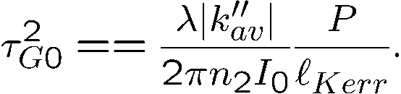
Two related questions:
Which mechanism makes the
As a pulse circulates in the cavity,
unequally spaced cavity modes
does it evolve towards a steady state?
equidistant?
Balance phase modulation by Kerr effect
and phase modulation by dispersion
How unequally spaced modes
Evolution of a single pulse in an ``ideal'' cavity
lead to a perfect frequency comb
SAME
CONDITION

Slide 8
5 fs Ti:sapphire laser (2 optical cycles)
Optics Letters Vol. 24, Issue 6, pp. 411-413 (1999)

Slide 9
SOLITONS

Slide 10
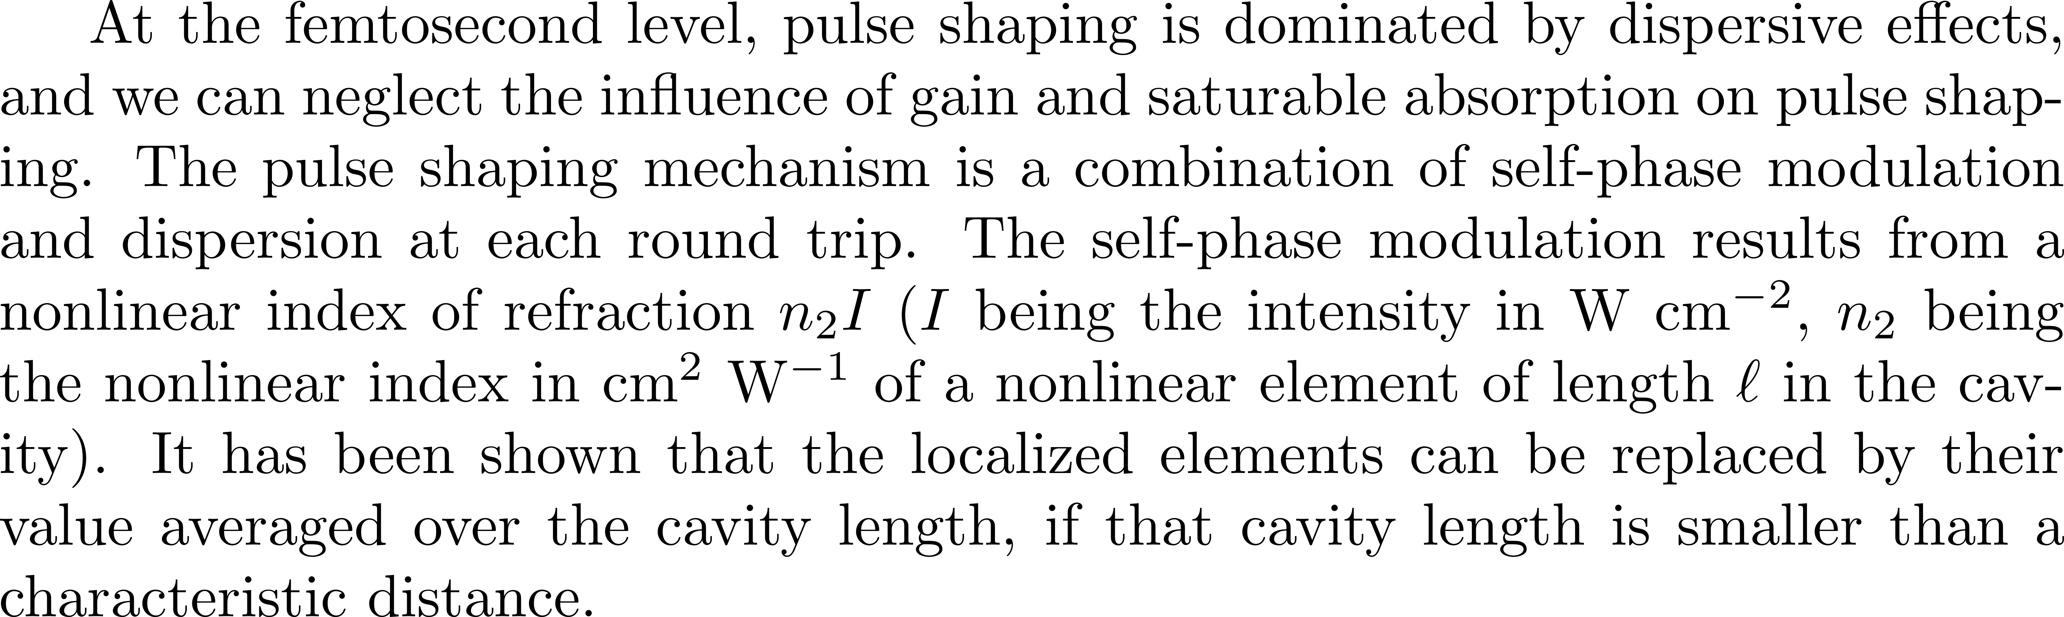
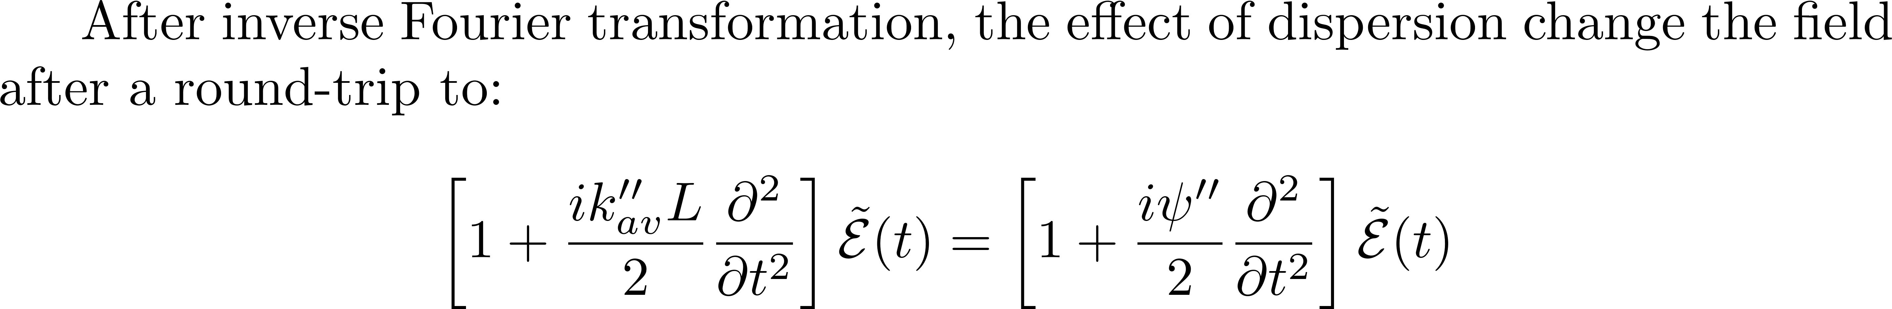
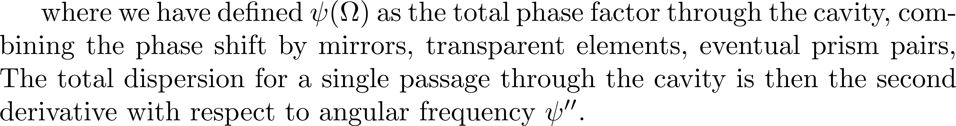
Solitons in a laser cavity

Slide 11
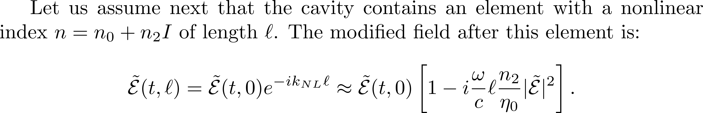
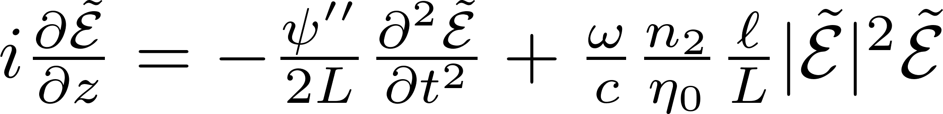
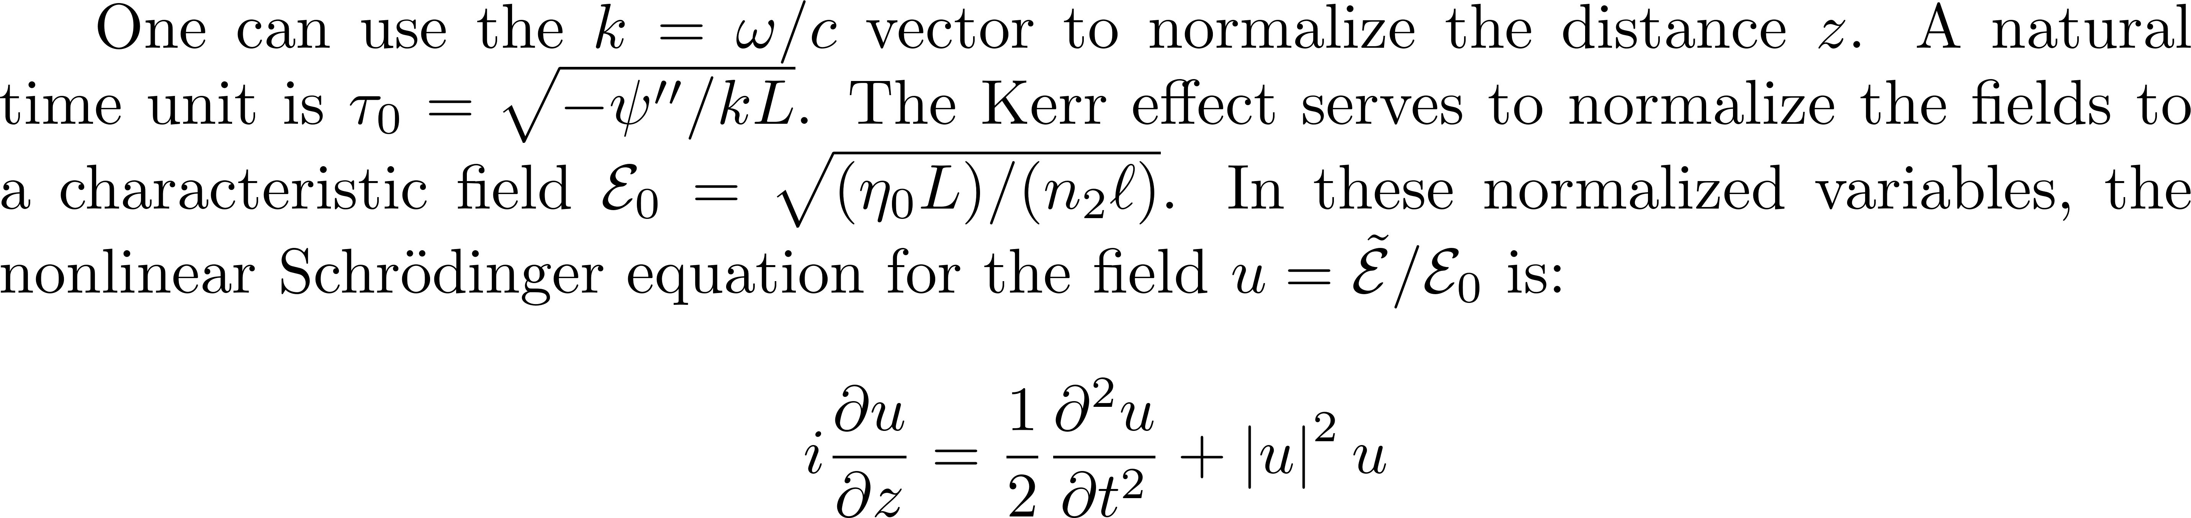
To get

Slide 12
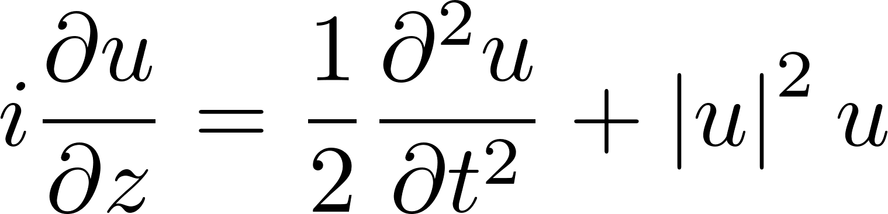
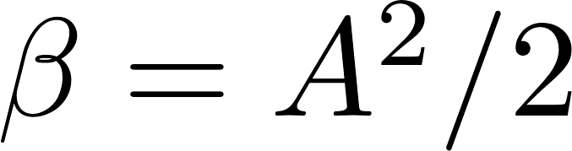
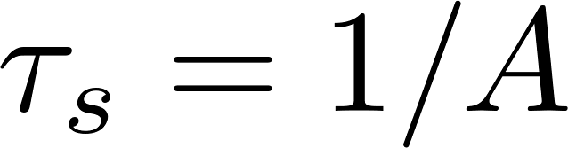
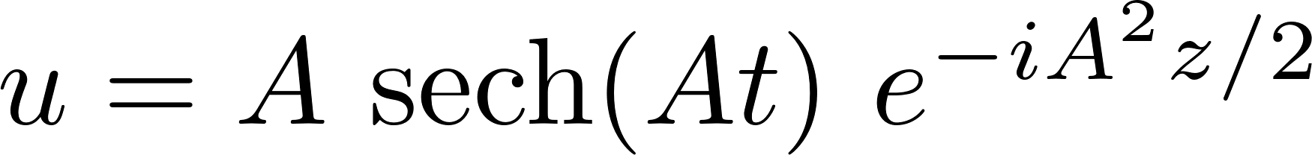
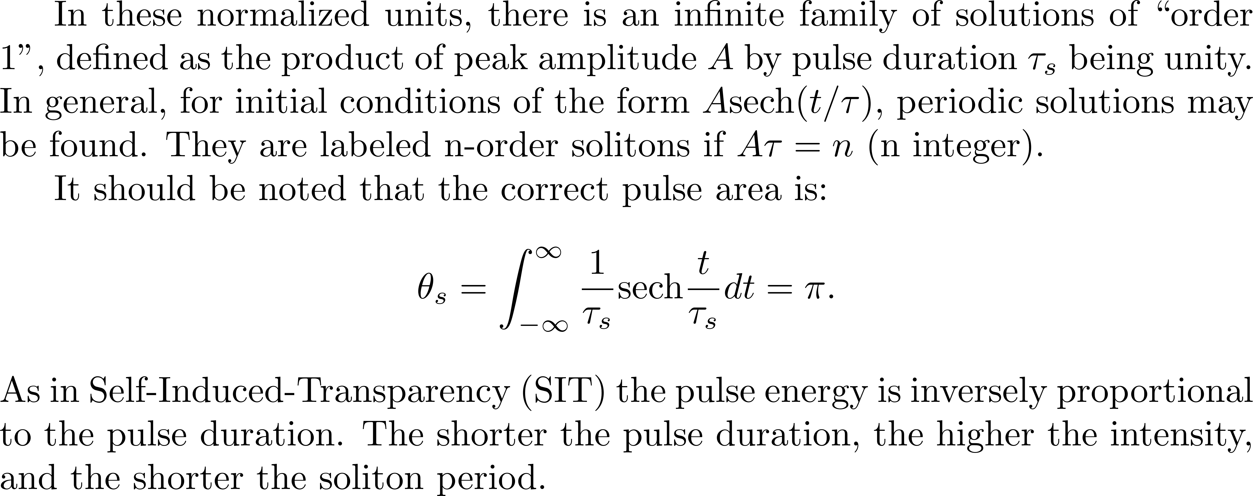
The first order soliton

Slide 13
The first order soliton

Slide 14
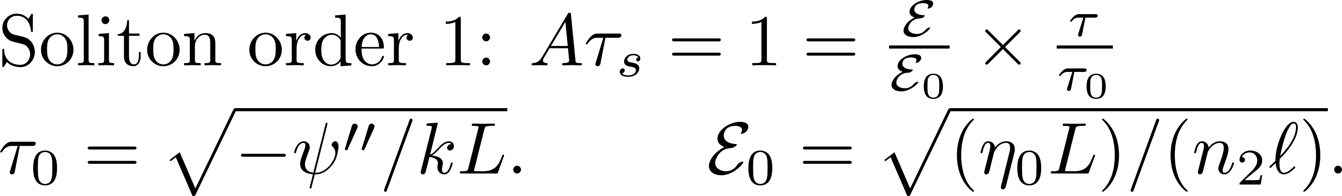
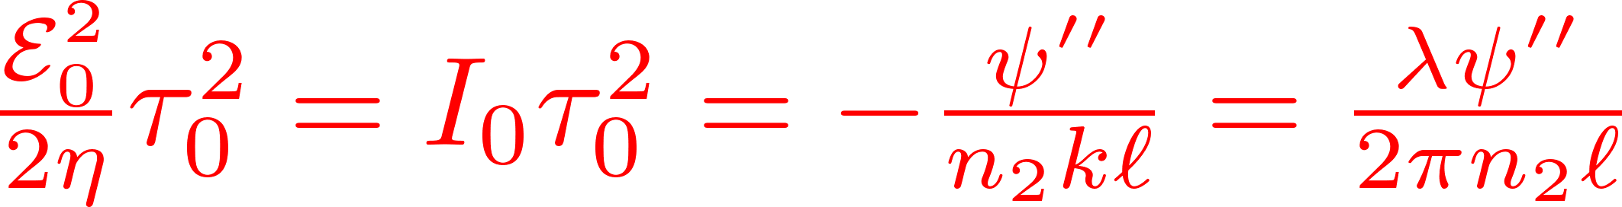
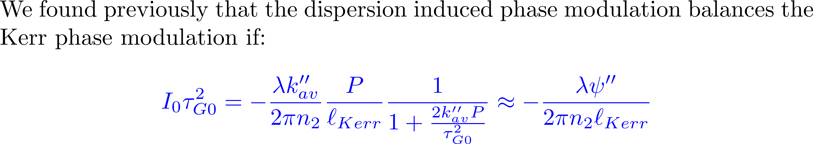
The first order soliton

Slide 15
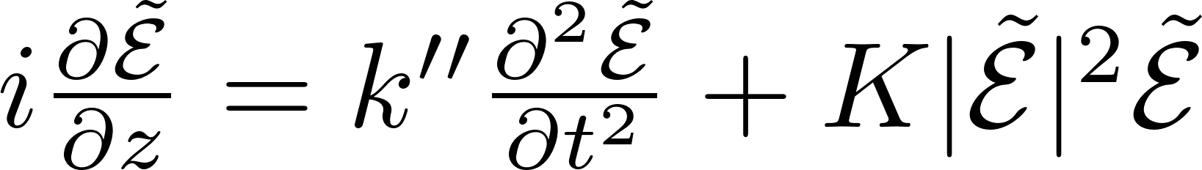
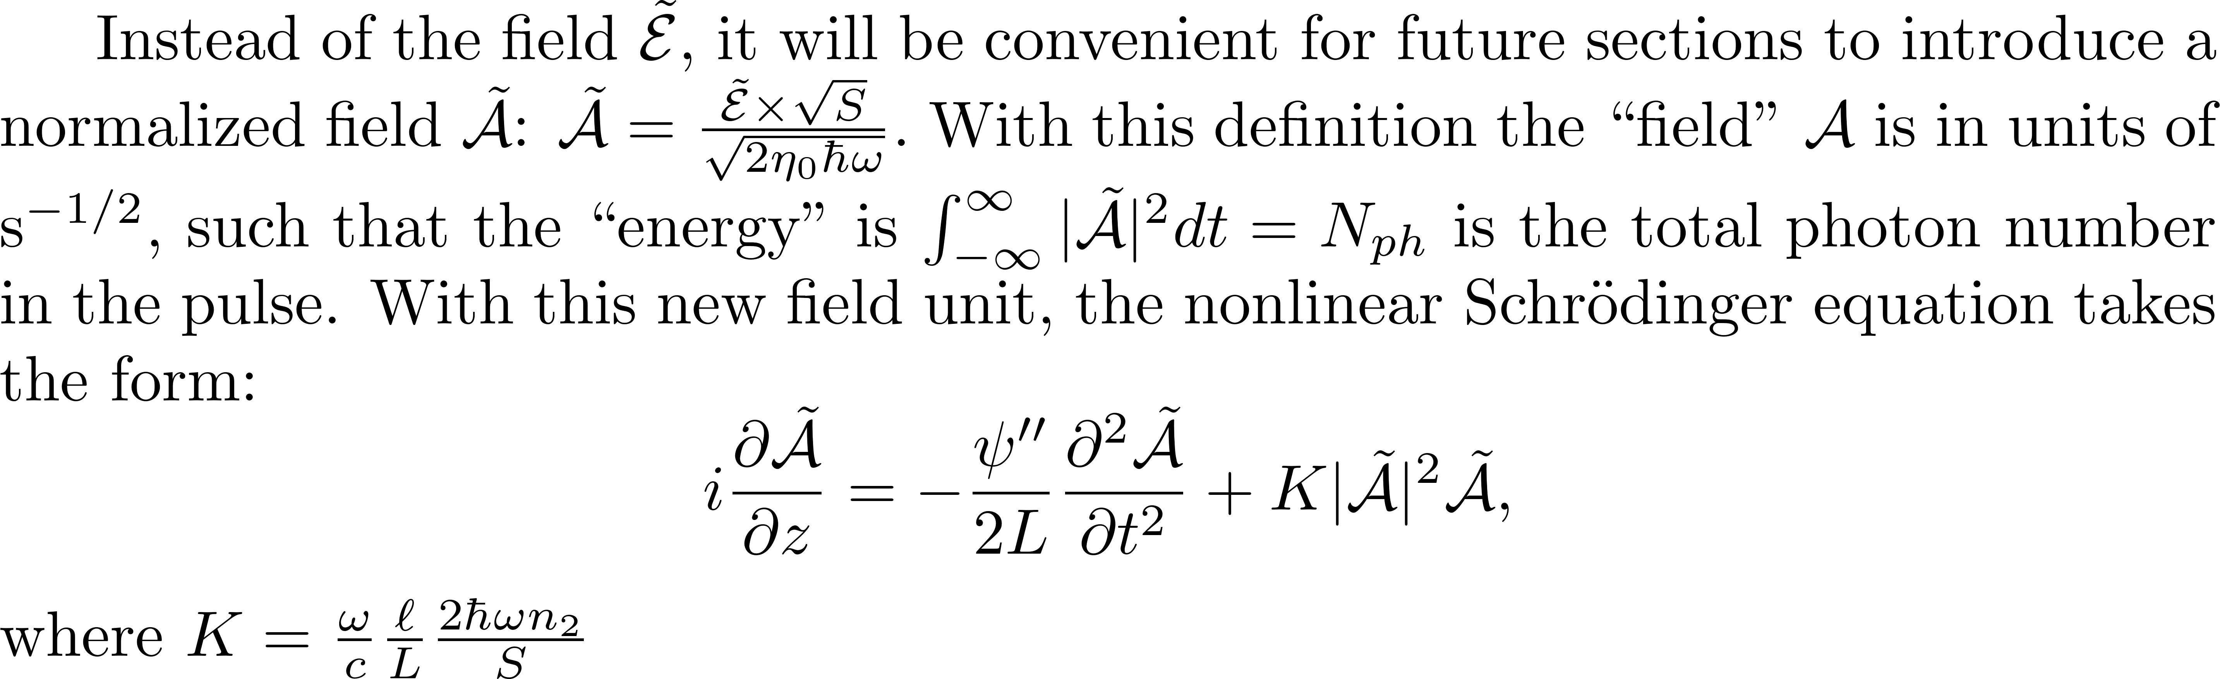

Slide 16
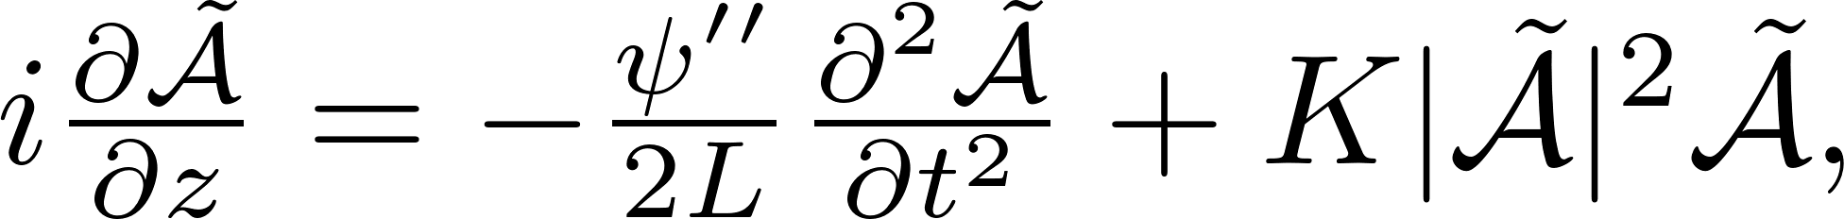
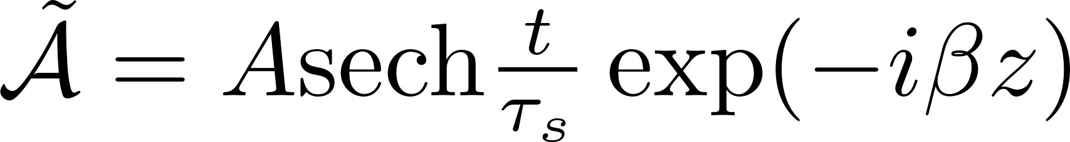
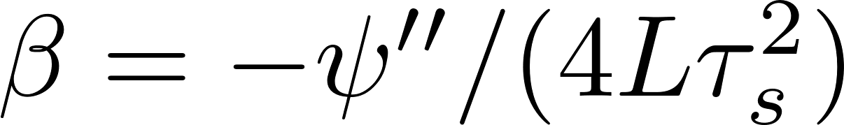
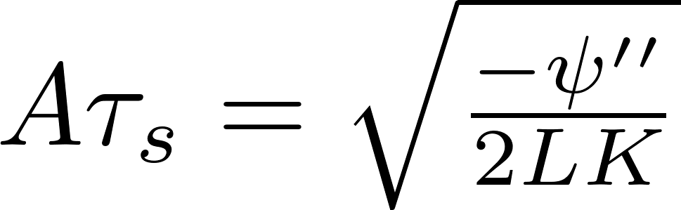

Slide 17
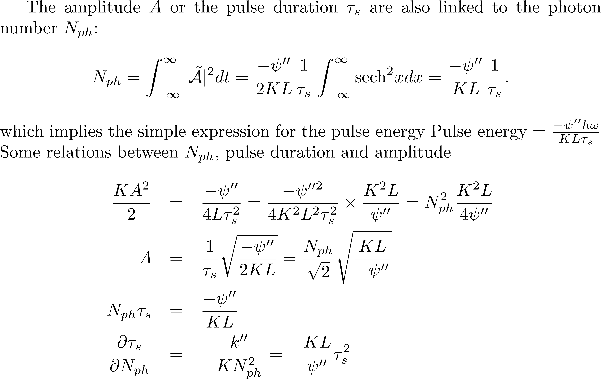
Links between all parameters

Slide 18
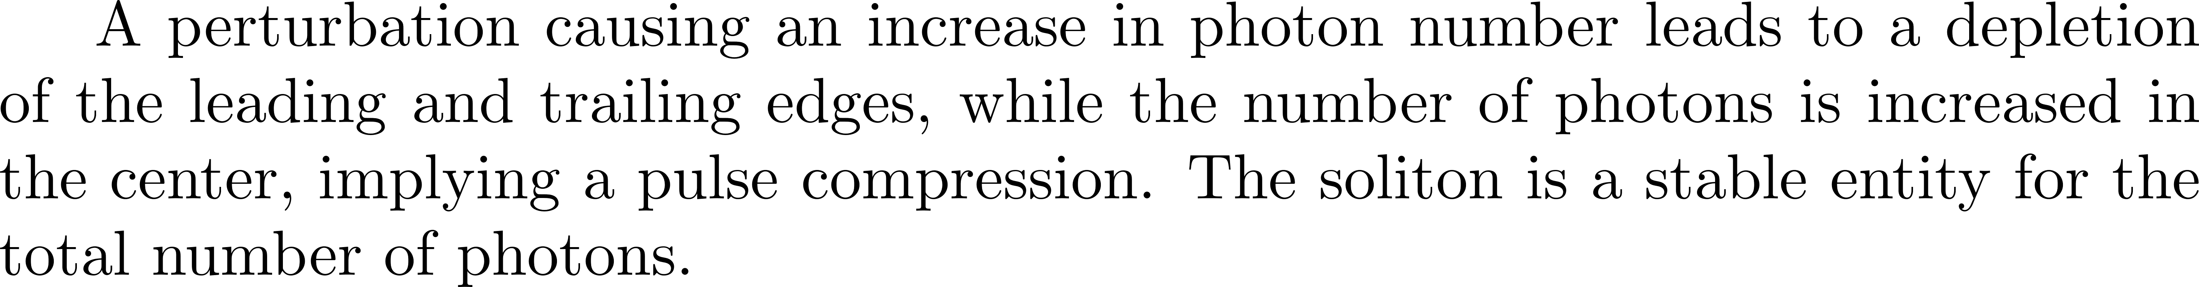
Conclusion of lengthy calculations…

Slide 19
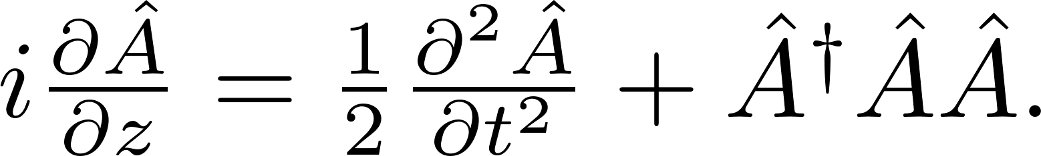
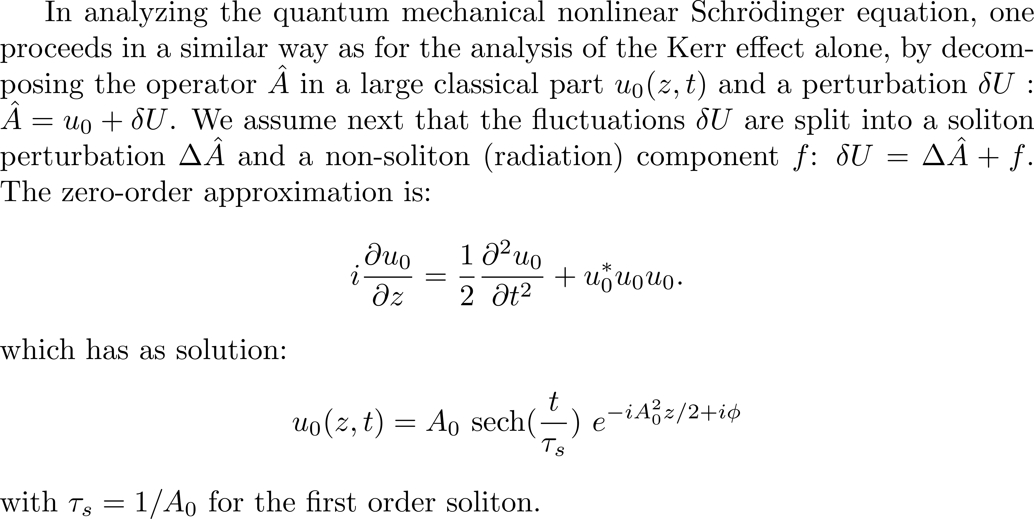
QUANTUM SOLITONS

Slide 20
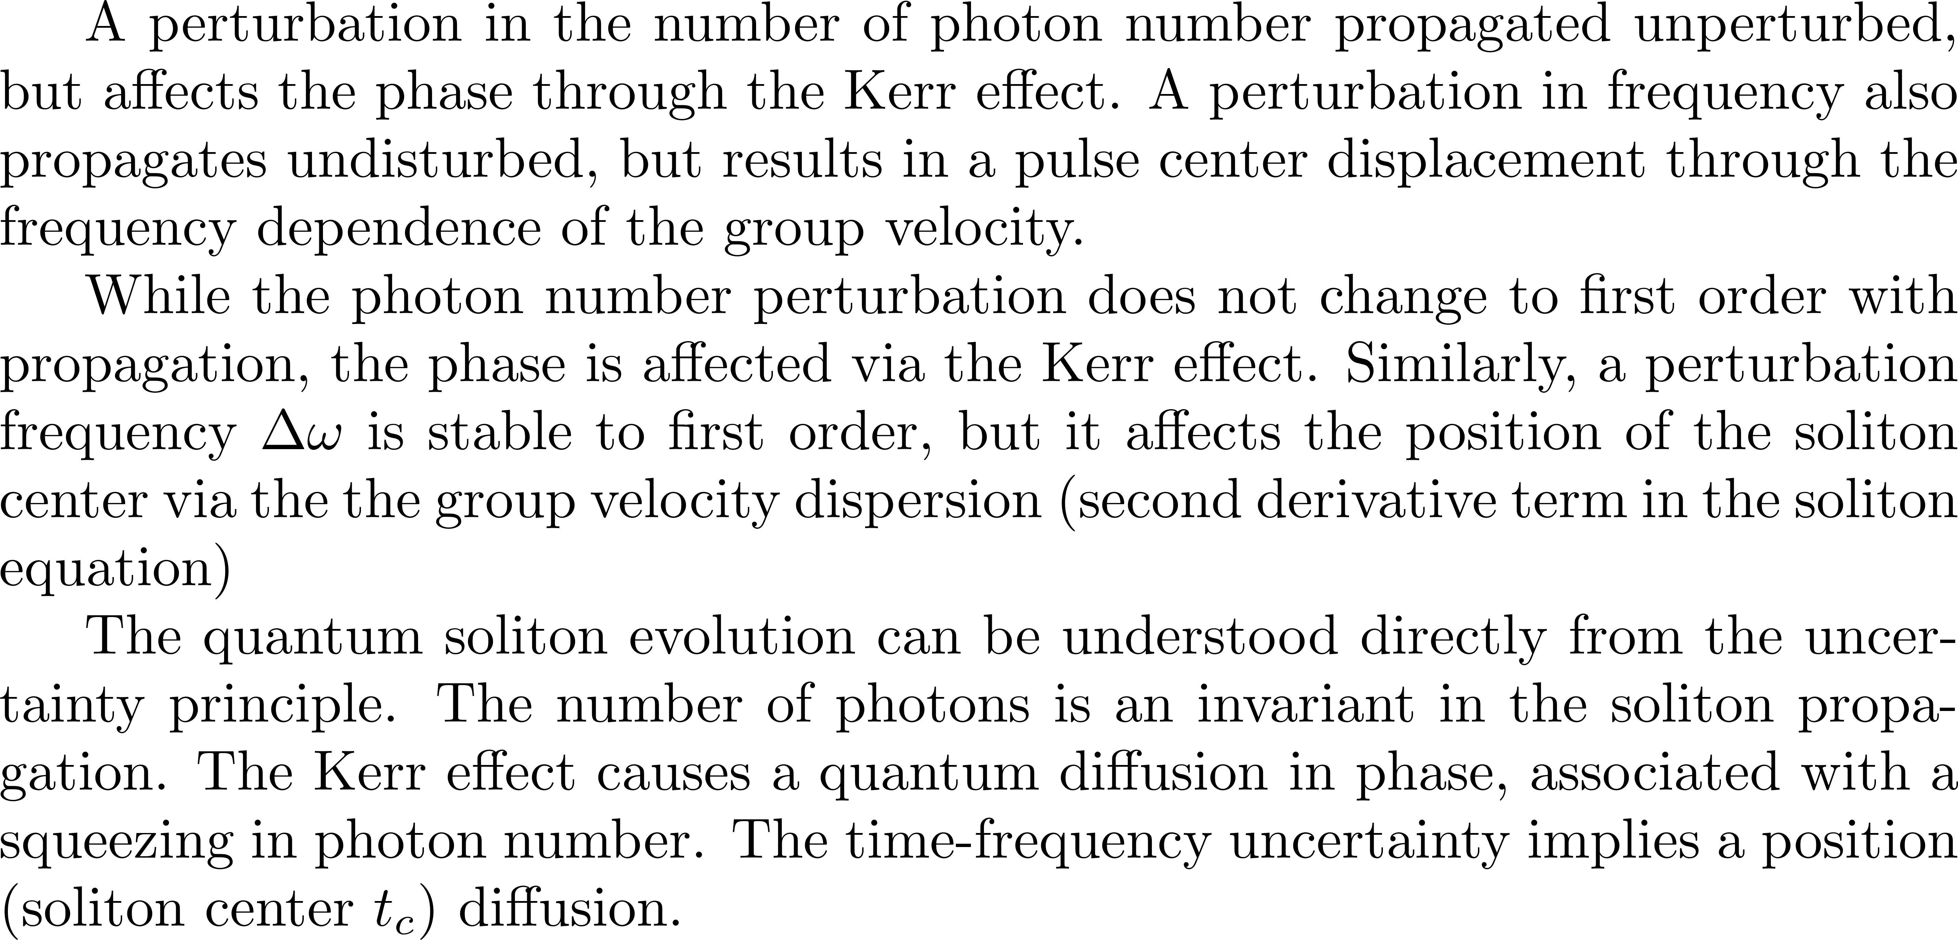

Slide 21
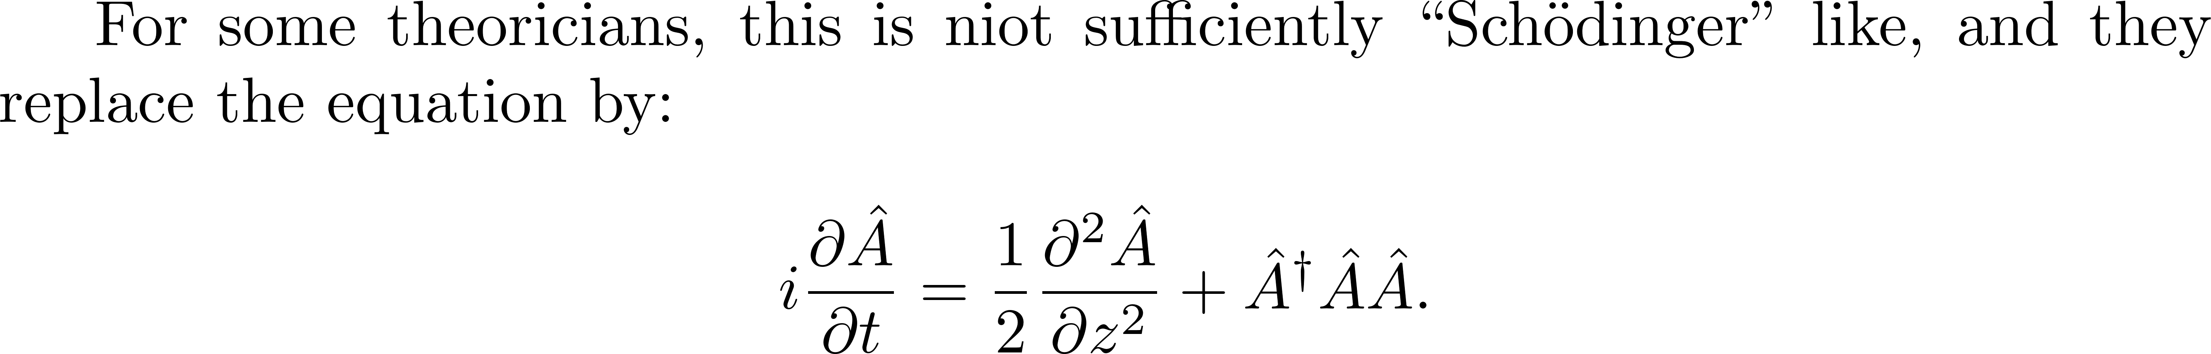
QUANTUM SOLITONS
I object! This is totally unphysical!
Justification:
“Running space coordinate”

Slide 22

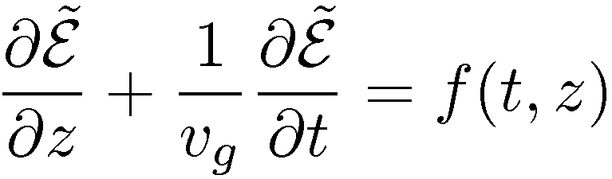

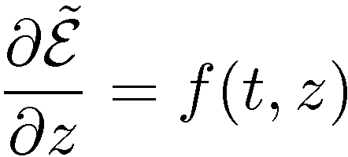
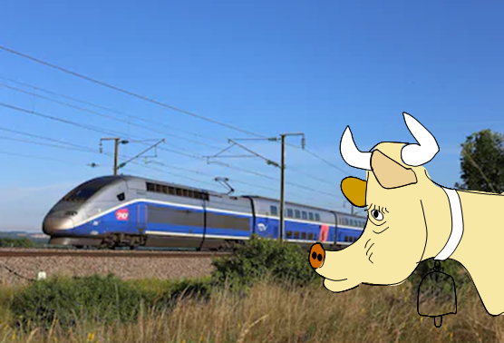
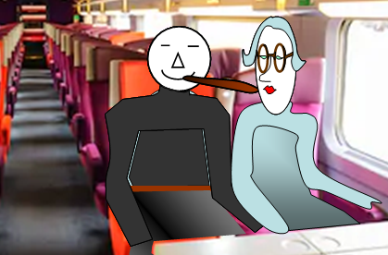
What the retarded frame of reference means
In the laboratory frame:
t=0
t
t=0
t’=0
In the retarded frame:
z
t’
The observer in the laboratory frame
is the cow that watches the TGV go by.
There is no way she can tell what is
happening inside [(i.e. f(t,z)].
For that, she must be in the retarded frame
which means inside the TGV,
or galloping next to it.

Slide 23
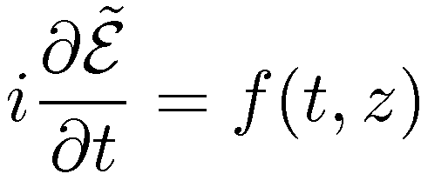
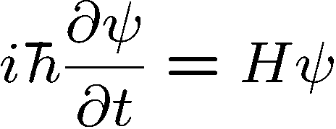
Retarded frame
HERESIE says the quantum physicist!
It should be:
Why?
Because the Schroedinger equation is
If it is not “quantum”, forget it.

Slide 24


Retarded frame
“Running space coordinate”

Slide 25


Retarded frame
“Running space coordinate”
Alleluia!
and the quantum physicist is happy
The cow-watching-the-TGV-is-not.
?
?
What is the physical meaning of the
?
“Running space coordinate”???
The rails are moving opposite to the train velocity so that the TGV is at standstill?

Slide 26
STABILIZATION

Slide 27
LOCK-IN AMPLIFIER: STABILIZATION TO A MAXIMUM
(Time picture)
Transmission through a Fabry-Perot
TIME
TIME

Slide 28

HIGHER FREQUENCY, PHASE MODULATION

Slide 29


Slide 30
Stabilization to a reference cavity
Mode-locked laser
(Reference Pulse)

Slide 31
Laser spectrum
Reference cavity modes
Frequency
Requires stabilization of cavity length and dispersion...

Slide 32
Locking the average frequency
PZT1
Ti:S laser
PZT2
Isolator
1st order beam
AOM
To main
experiment
BS
BS
Reference Cavity
PM
L2
L1
PD1
Servo1
Low-pass filter

Slide 33
Error signal #1 : Locking the average frequency
(Transmission)
(Reflection)

Slide 34
Error signal #2 : Locking the repetition frequency: fr
Grating
PD2
PD1
Servo2,
control
fm= 10.7MHz
To PM
-
+
frequency

Slide 35
PZT1
Ti:S laser
PZT2
Isolator
1st order beam
AOM
To main
experiment
BS
BS
Reference Cavity
PM
L2
L1
Grating
In from
L.O.
PD2
PD1
Servo1,
Servo2,
fm= 10.7MHz
To PM
-
+

Slide 36
Characterizing the stabilization:
  -relative stability of the fs comb
Mode-locked laser
fm= 10.7 MHz
CW laser
fm= 16.1 MHz
grating
KLM laser
m-1
m
m+1
CW laser
n
Frequency
PBS
BS
Error signals

Slide 37
Counting mode number m = 3,212,199
of the fs comb.
Measured frequency
(gate time = 730 msec)
Histogram
bin size = 430 Hz
The reference cavity drift of 1.48 kHz/ per second. The cavity frequency is slowly increasing, indicating that
the cavity length is actually shrinking.·
Shrinkage due to the optical contact of the end mirrors; the surfaces are slowly pulled in over a period of several years to decades.
The drift rate corresponds to a cavity length change of 2 x 10⁻¹² /second or roughly 86 nm per day.

Slide 38

Travelling wave AO (Phase modulator)
Frequency modulator (stabilization)
Beam deflector
How to tune frequency without deflecting?

Slide 39

Travelling wave AO (Phase modulator)

Slide 40


Standing wave AO (Amplitude modulator)
Mode-locker

Slide 41

BACK TO THE END OF THE AMPLIFICATION CHAIN:
SHAPING AT THE HIGH POWER LEVEL

Slide 42





Slide 43



Slide 44


