Slide 1
AMPLIFYING FREQUENCY COMBS/SHORT PULSES
WHY DO WE NEED LINEAR AMPLIFICATION?
I. THE NEED OF MATCHING COMPRESSOR AND STRETCHER
II. THE NEED TO CONTROL TIMING
NON LINEARITIES FOR PULSE CONTROL
Second harmonic compression
Negative Kerr effect
Parametric amplification
Optical Parametric Oscillator
Contrast enhancement (back to PW systems)

Slide 2
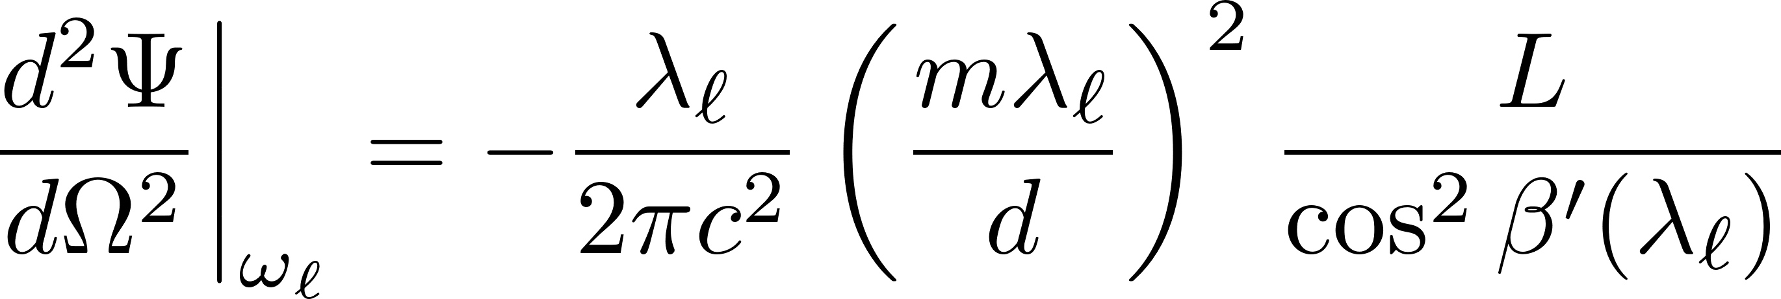
WHY DO WE NEED LINEAR AMPLIFICATION?
I. THE NEED OF MATCHING COMPRESSOR AND STRETCHER

Slide 3
GRATING PAIR NEGATIVE DISPERSON

Slide 4
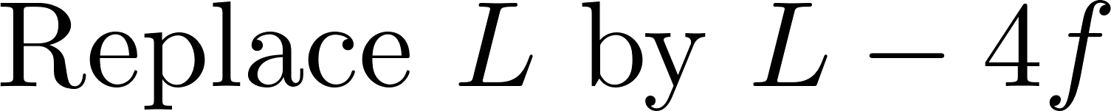

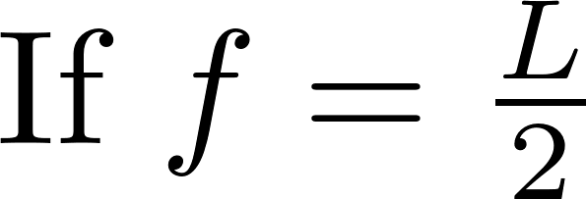
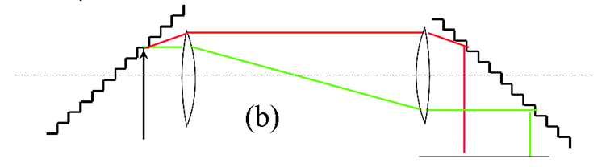

GRATING PAIR POSITIVE DISPERSON

Slide 5
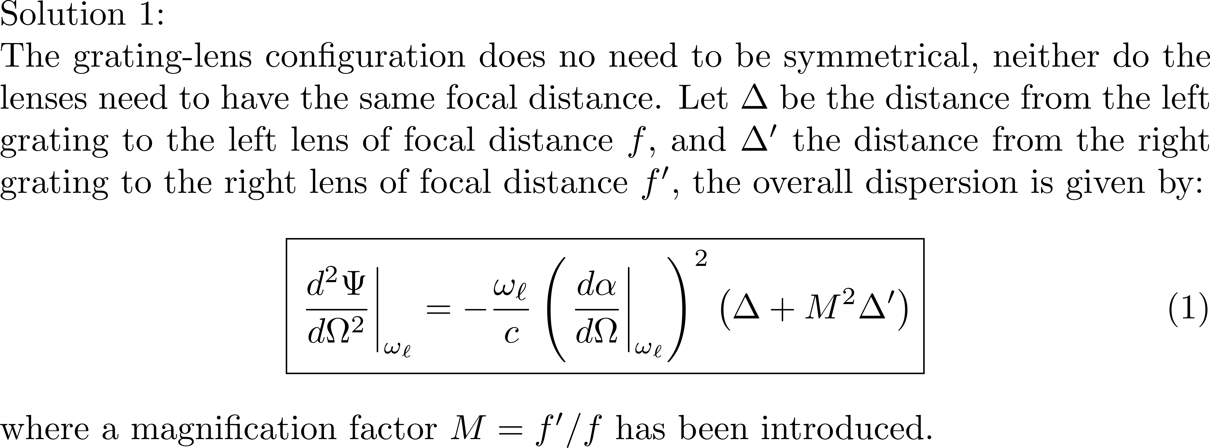

Slide 8
II. THE NEED TO CONTROL TIMING

Slide 9
GROUP VELOCITY APPLIES ONLY TO LINEAR DIELECTRICS
Saturable absorber
time
time
Saturable gain
time
time

Slide 10
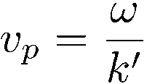
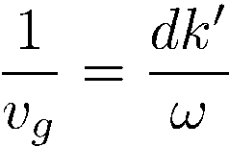
Pulse velocities in uniform, isotropic saturable gain media
k = k’ – i α
Phase velocity
Group velocity?
Usually described as
(even with complex k!)
Wrong!
Numerous “slow light” papers dedicated to this concept!
Basov – Soviet Physics JETP 23:16-22 (1966)
Superluminal pulse velocity in an amplifier.
Pulse generated by Q-switching: exponential rise.
Pulse front amplified, pulse tail not because of saturation or depletion.

Slide 11
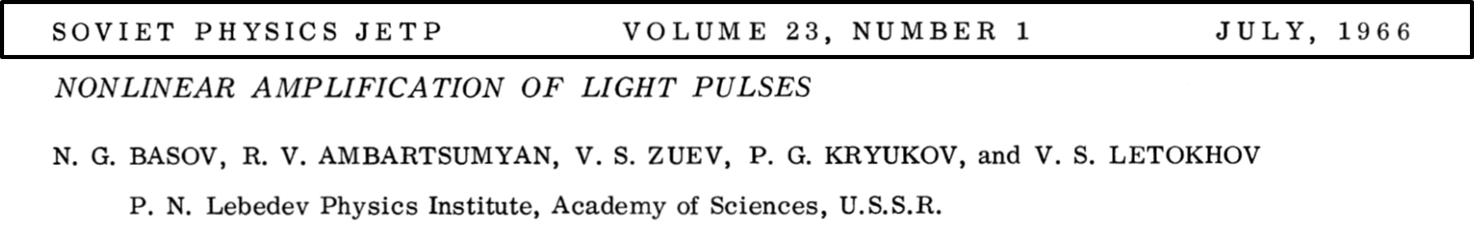
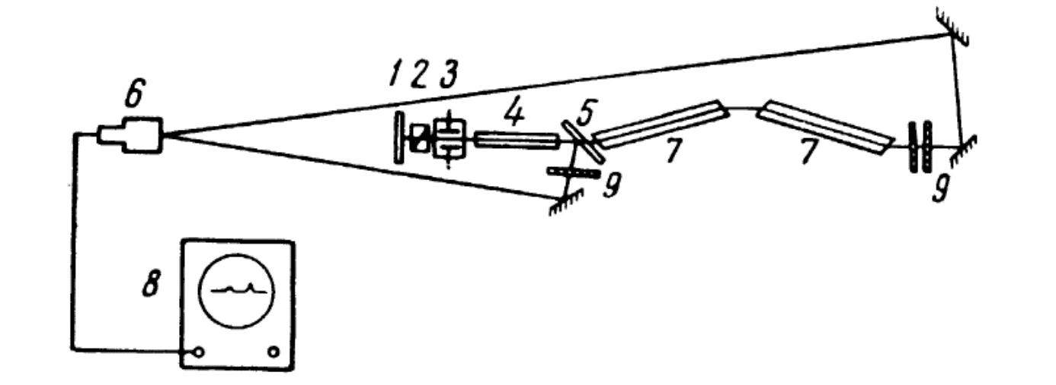
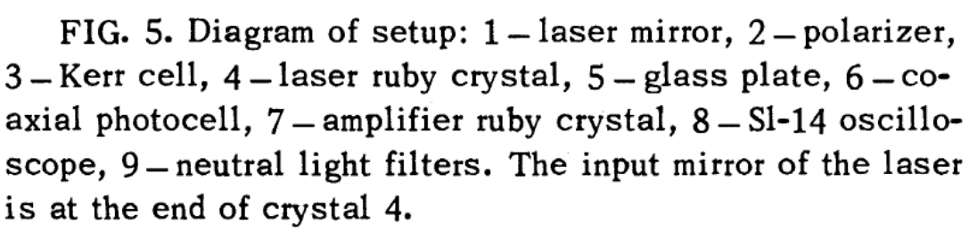

Slide 12
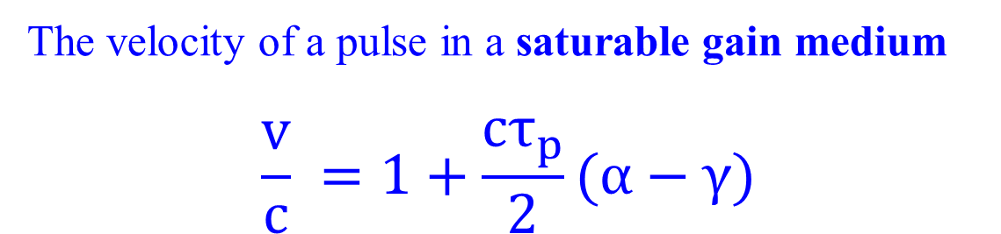
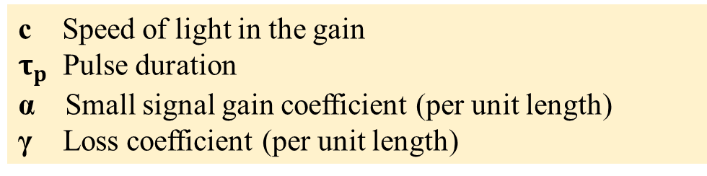
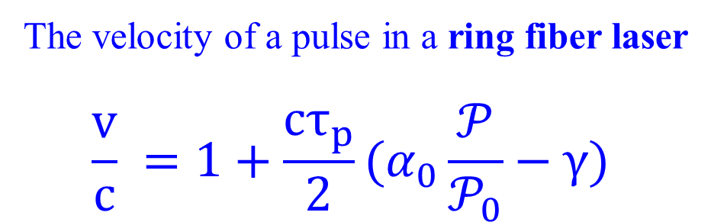
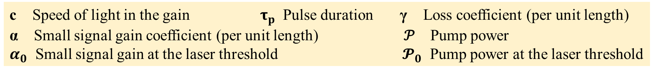

Slide 13
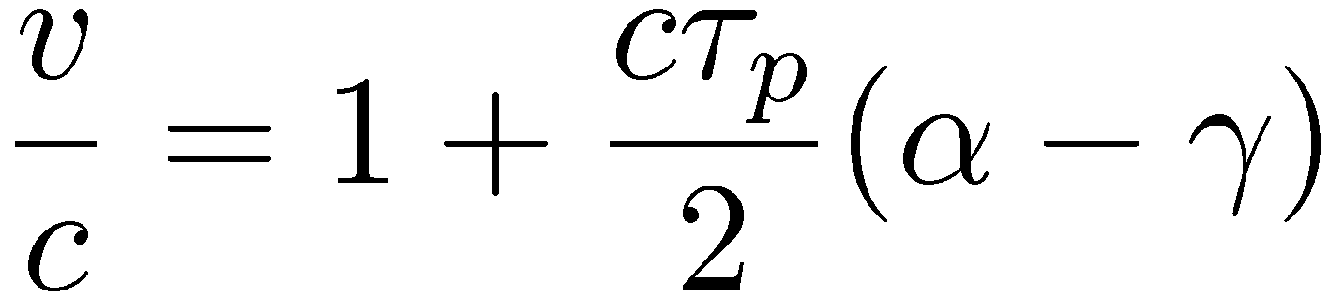
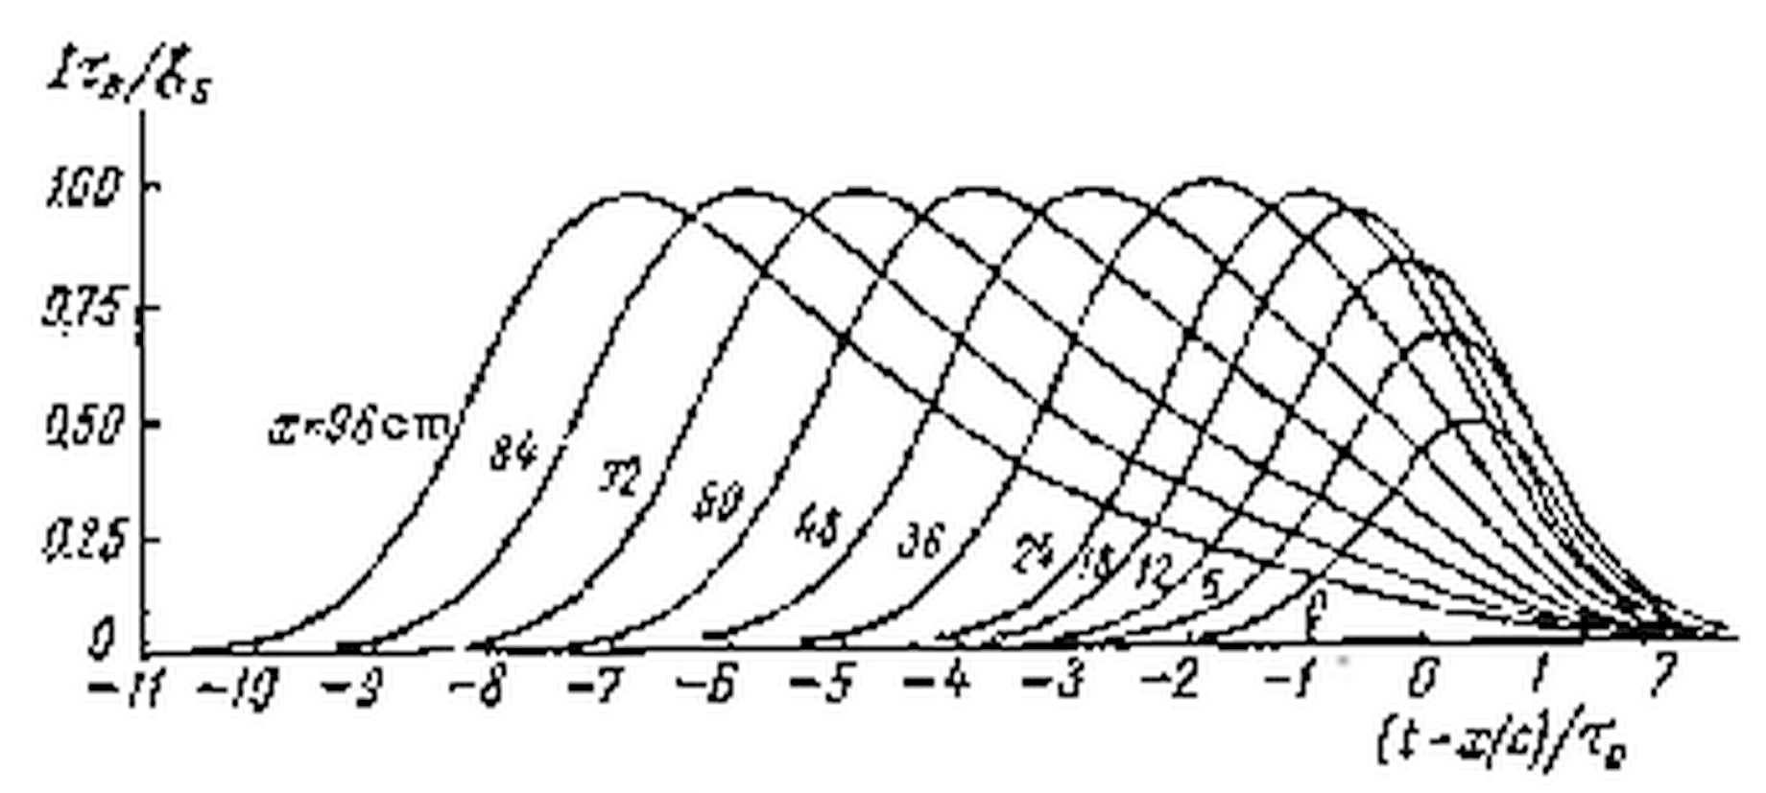

Slide 17
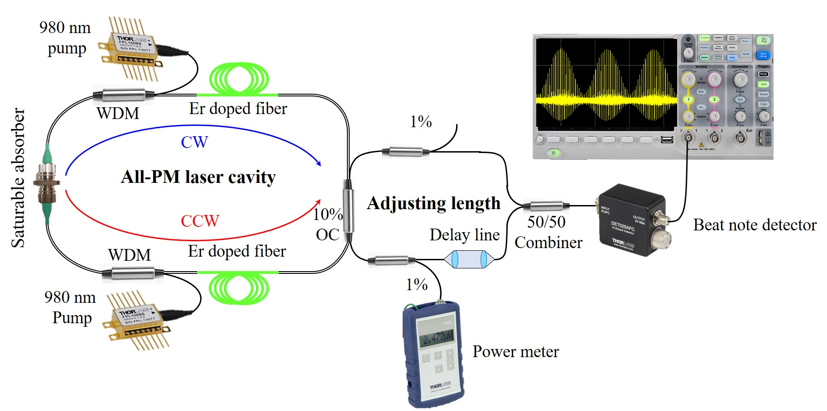
Example of pulse velocity >> c in a fiber laser

Slide 18
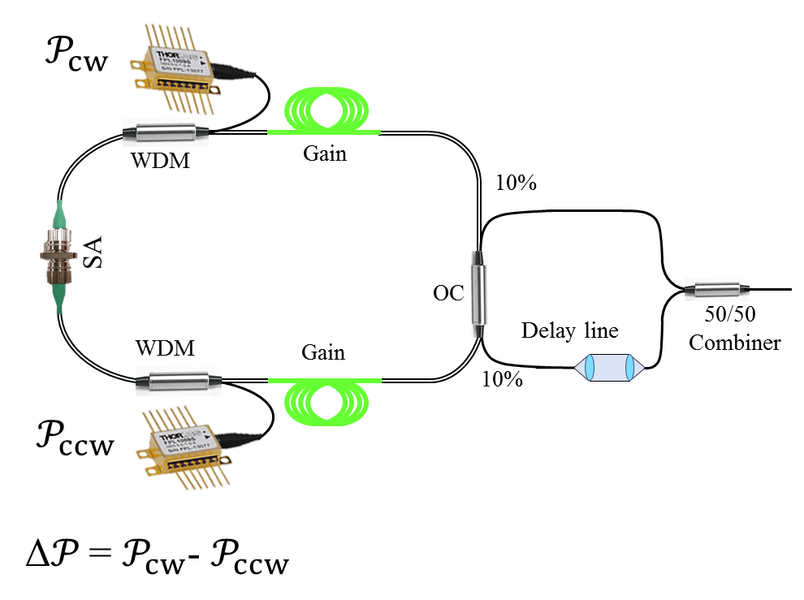
Beat note frequency vs displacement in the delay line

Slide 19
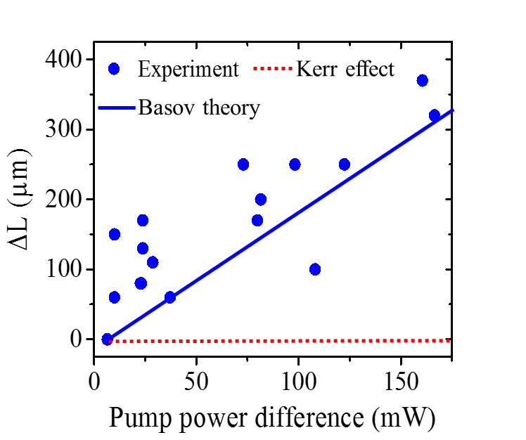

Slide 20
NON LINEARITIES FOR PULSE CONTROL
Second harmonic compression
Negative Kerr effect
Parametric amplification
Optical Parametric Oscillator
Contrast enhancement (back to PW systems)

Slide 21
Tuning the crystal length for optimum short pulse compression
LONG CRYSTALS = HIGHER CONVERSION
LONG CRYSTALS = NARROWER BANDWIDTH
The obvious solution for short pulses: short crystals? Not always!
One can use long crystals to compress pulses down
to femtoseconds.
THE GENERATED PULSES ARE SHORTER THAN
THE FUNDAMENTAL, AND THAN THE INVERSE
BANDWIDTH OF THE SECOND HARMONIC PROCESS.
Where does one get the bandwidth?
From the amplitude modulation of the pump,
as the pump is depleted at a faster rate than
the pump risetime.

Slide 22
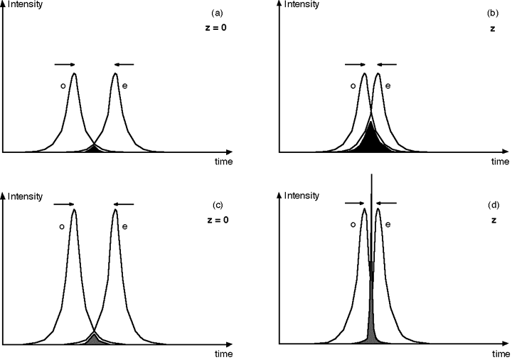
Compression in SHG
Motion of pulses in the frame of reference of the second harmonic
Weak pulses: the second harmonic broadens as the
overlap of the two fundamental pulses increases

Slide 23
Compression in SHG
Motion of pulses in the frame of reference of the second harmonic
Strong pulses
The trick: sum frequency group velocity between that of fundamental o and fundamental e

Slide 24
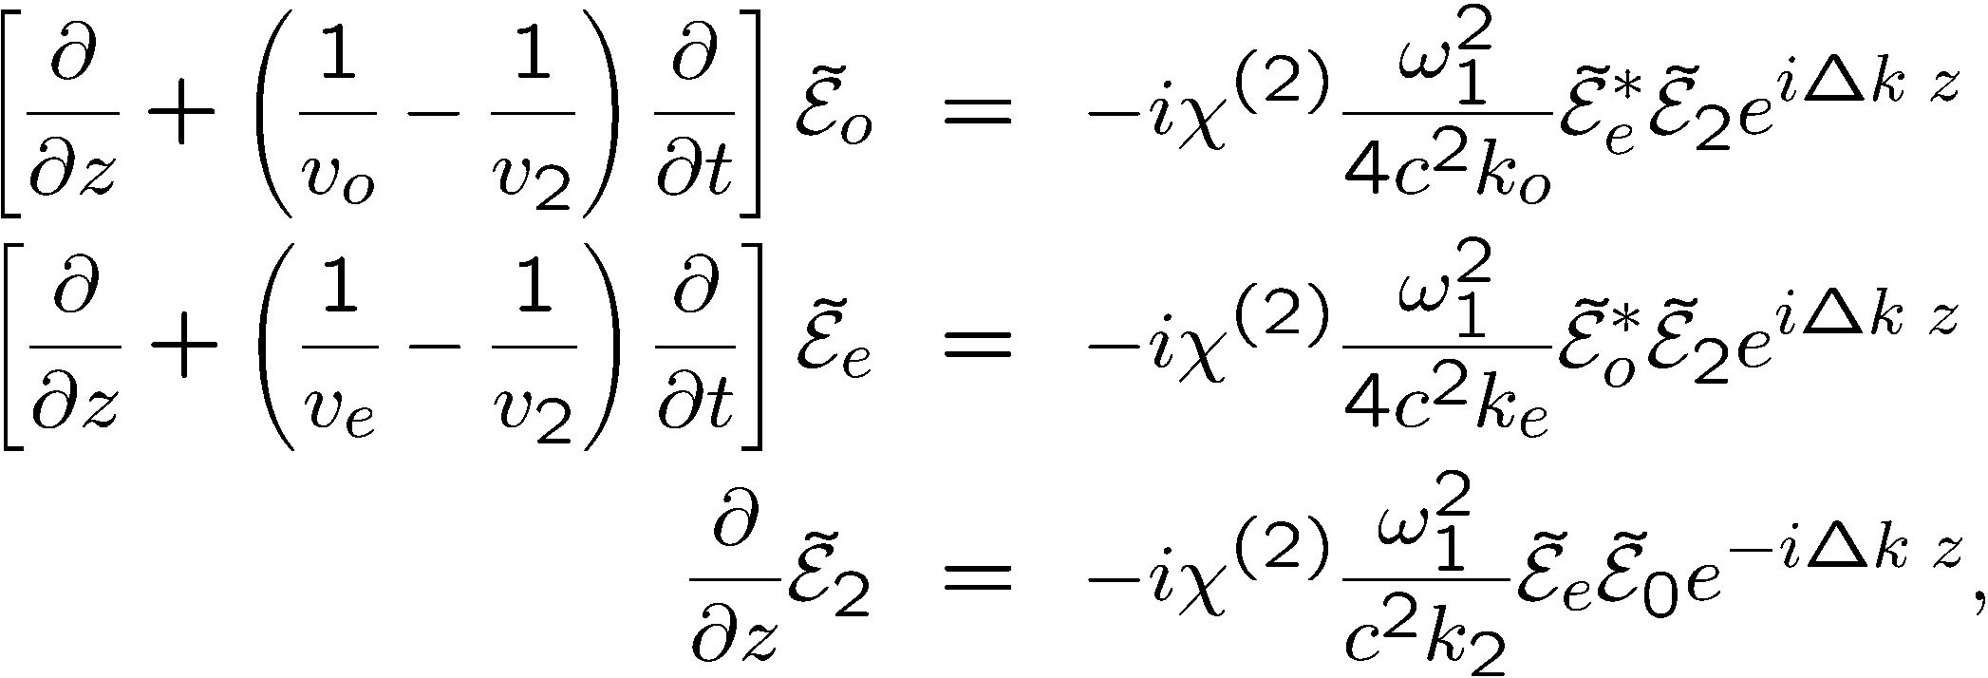
Time dependent SHG

Slide 25
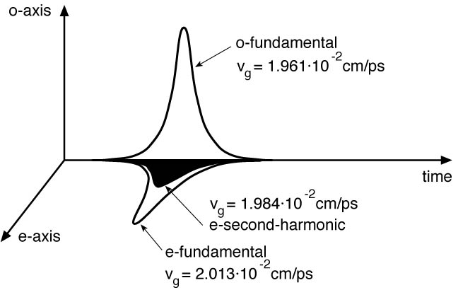

Slide 26
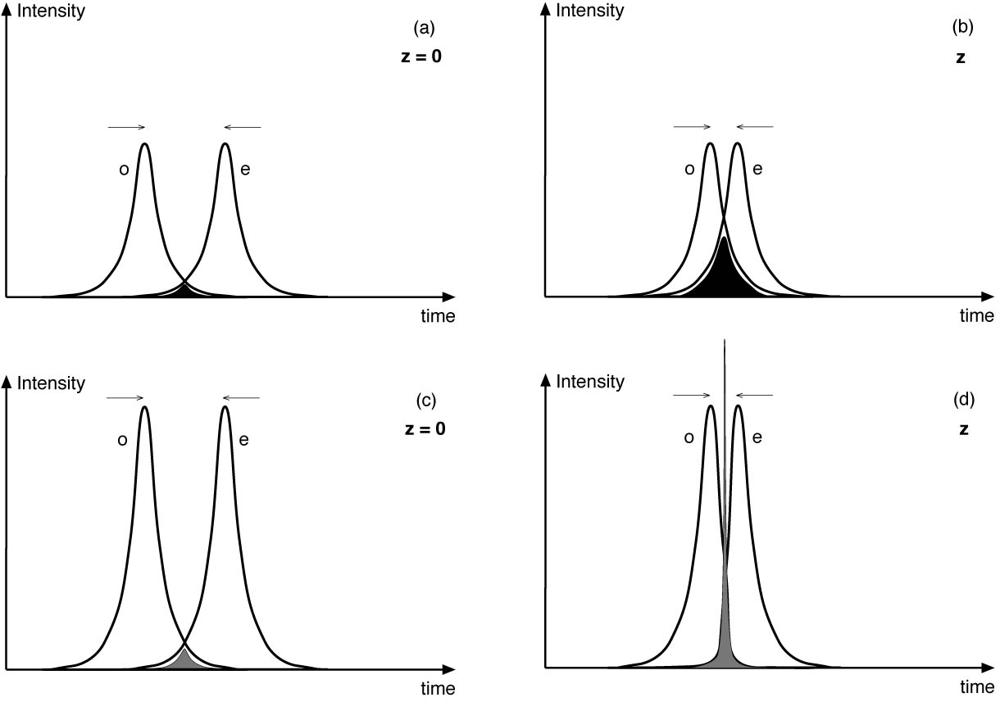
Motion of pulses in the frame of reference of the second harmonic
Weak pulses: the second harmonic broadens as the
overlap of the two fundamental pulses increases
Intense pulses: the overlap of the fundamental pulses remains
small, because of their depletion through efficient SHG

Slide 27
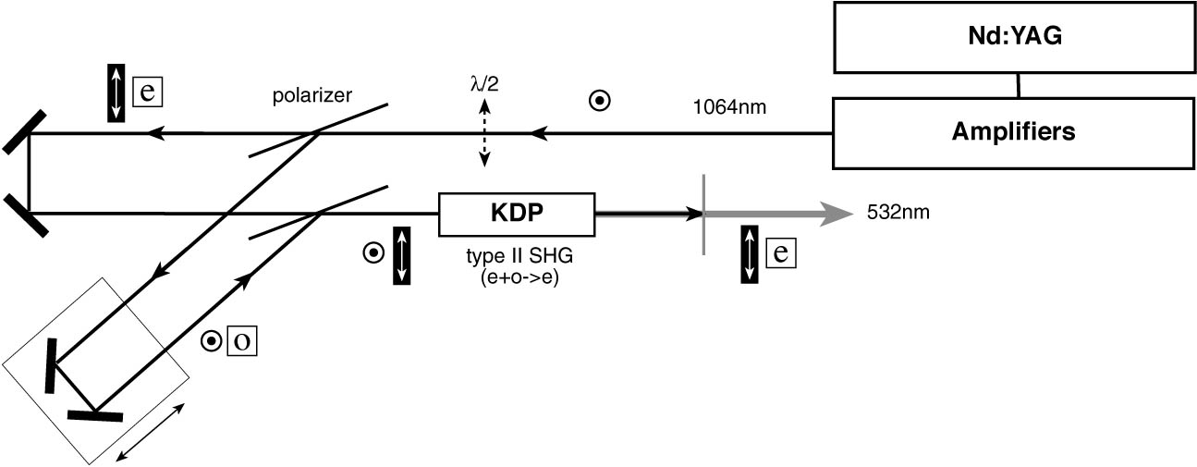

Slide 28
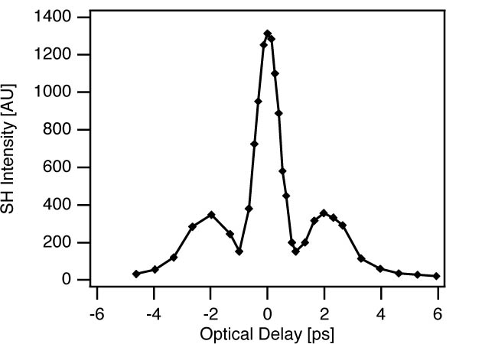

Slide 29
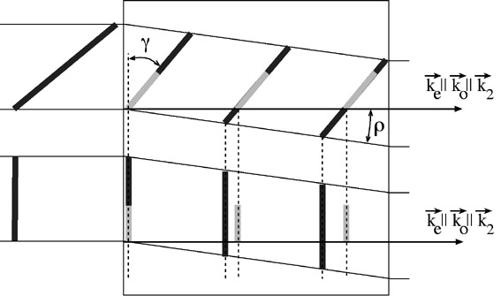
Adjusting group velocities through energy tilt
The lateral walkoff
can be used to adjust
the relative velocities
of the fundamental
and SHG
With energy tilt
fundamental
Without
energy
tilt
Second harmonic

Slide 30
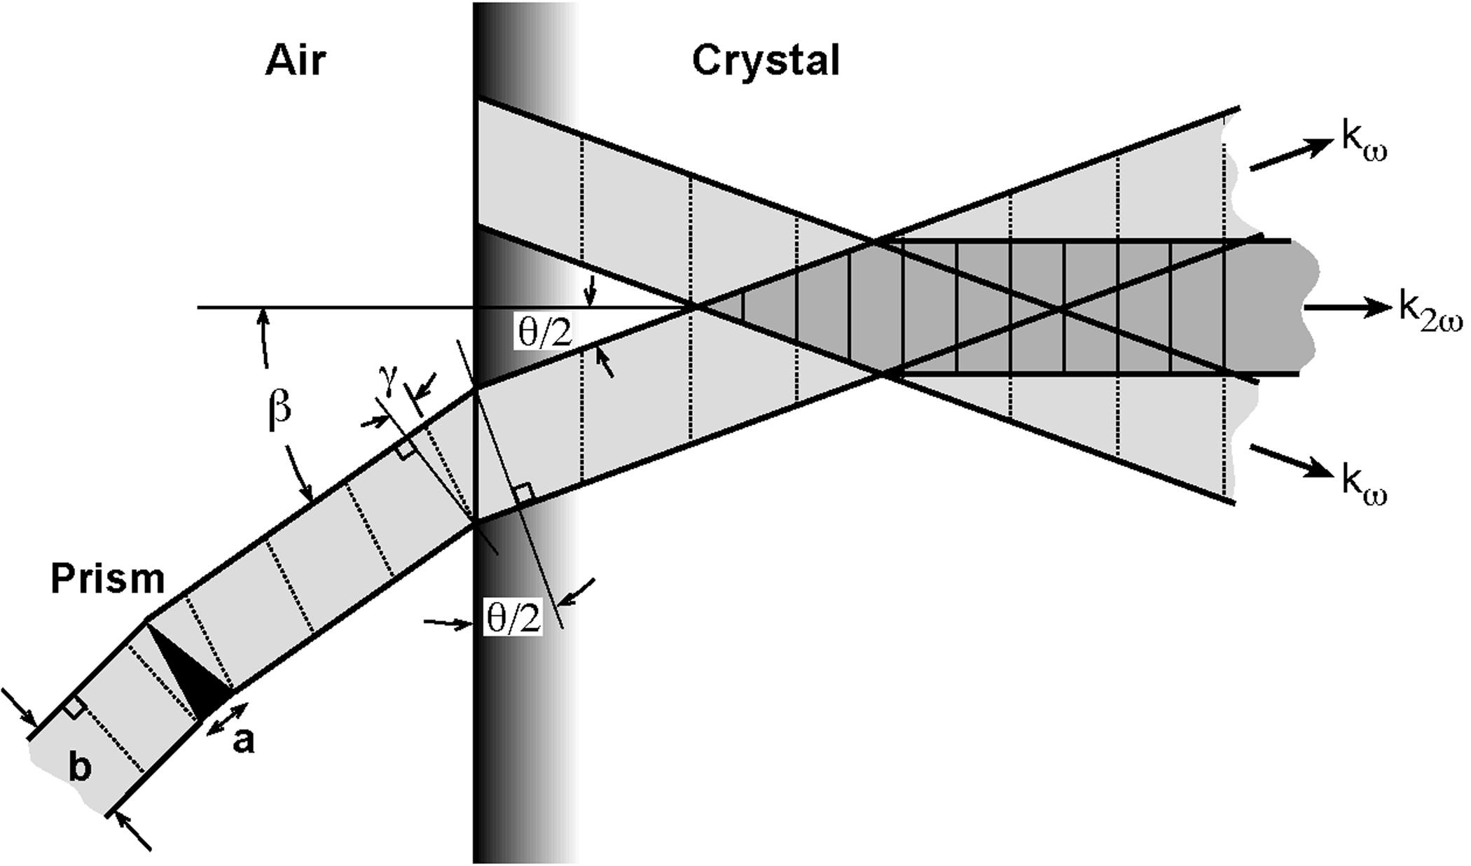
Adjusting group velocities through energy tilt and noncolinear geometry
Type II SHG of 800 nm in BBO
θ = 2^{ο}
β = 3.22^{ο}
“Pre-tilt” γ = 0.62^{ο}
SF10 prism: a/b = 0.2

Slide 31
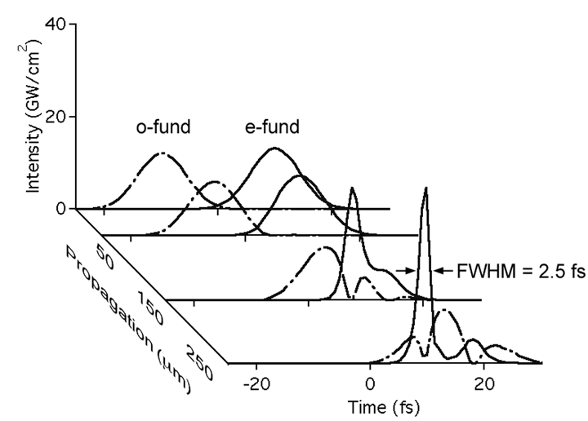

Slide 32
Find the angles? SNLO
CHIRP AMPLIFICATION

Slide 34
NON LINEARITIES FOR PULSE CONTROL
Second harmonic compression
Negative Kerr effect
Parametric amplification
Optical Parametric Oscillator
Contrast enhancement (back to PW systems)

Slide 35
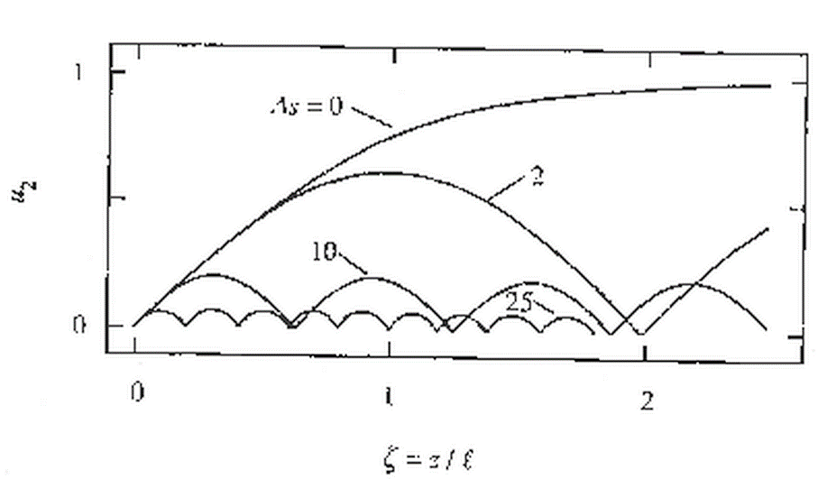

Slide 36

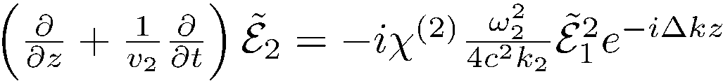
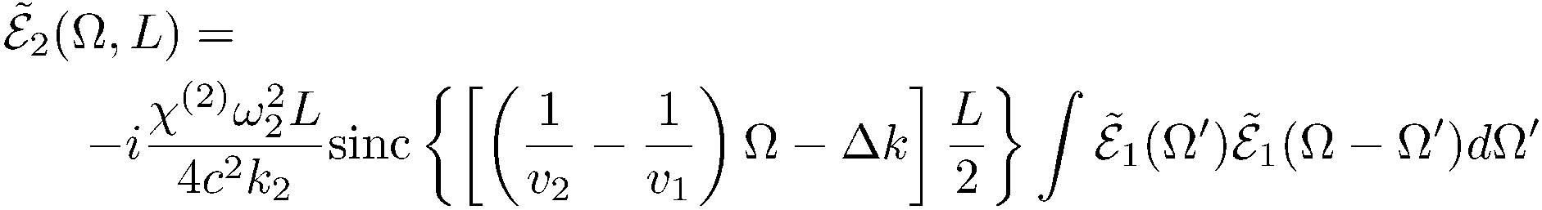
Next simplest case: SHG weak pulse vs frequency
Integration:
The solution is of the form:

Slide 37
Second harmonic intensity versus Δk
What does it mean?
Depletion of fundamental
Depletion of fundamental
Nonlinear phase shift
OPTICS LETTERS / Vol. 17, No. 1 / January 1, 1992

Slide 38
NON LINEARITIES FOR PULSE CONTROL
Second harmonic compression
Negative Kerr effect
Parametric amplification
Optical Parametric Oscillator
Contrast enhancement (back to PW systems)

Slide 39
SHG in periodically poled crystals
Other solution to the narrow bandwidth
of Periodically Poled crystals:
Convert the spectrum piece by piece
x
Periodically poled
crystal of period
changing with x.

Slide 40
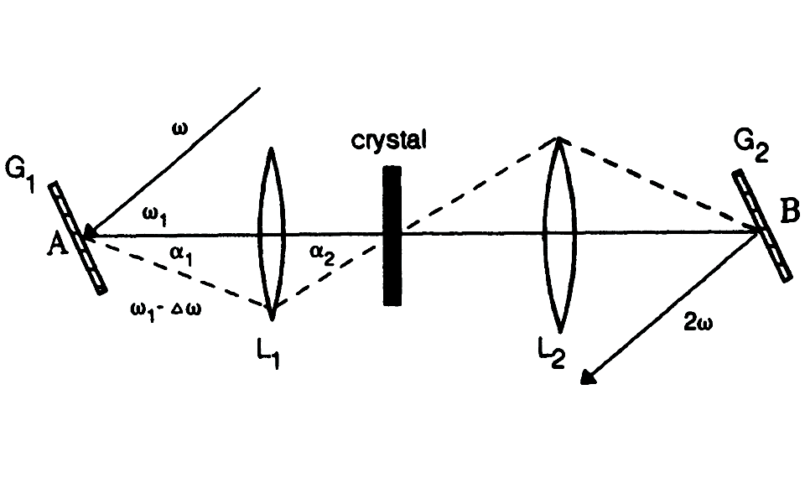
SHG in crystals
SHG in periodically poled crystals
Other solution to the narrow bandwidth
of Periodically Poled crystals:
Convert the spectrum piece by piece
x
Periodically poled
crystal of period
changing with x.

Slide 41
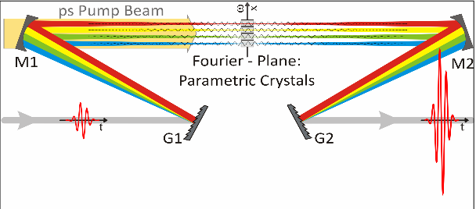
FOPA

Slide 42

Other solution: use many crystals for each wavelength range
FOPA: Frequency domain optical
parametric amplification (Faux-pas)
B. E. Schmidt et al. Nat. Commun. 5, 3643 (2014)
energy
front
grating
f
Laser source
wavefront
f
Interplay of temporal and spatial chirp, resulting in changes in wavefront shape
group delays and central wavelength.

