Slide 2
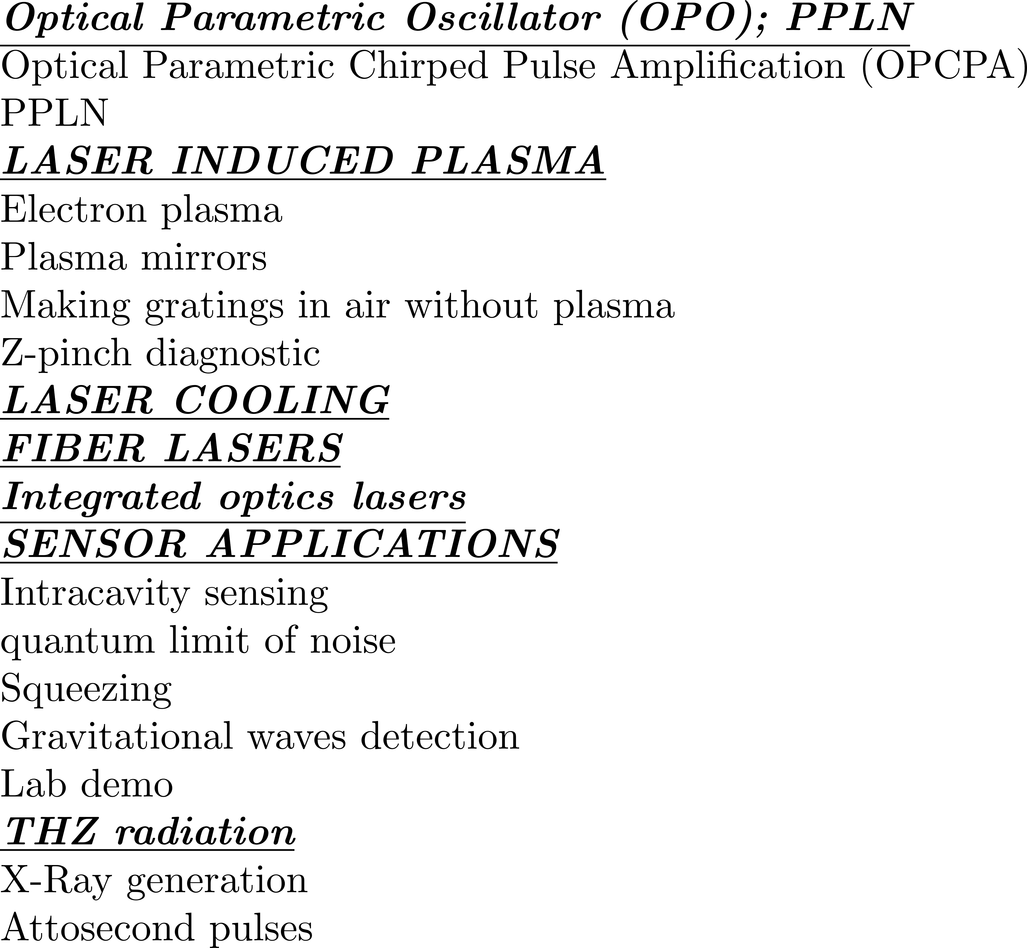

Slide 3
AMPLIFYING FREQUENCY COMBS/SHORT PULSES
WHY DO WE NEED LINEAR AMPLIFICATION?
I. THE NEED OF MATCHING COMPRESSOR AND STRETCHER
II. THE NEED TO CONTROL TIMING
NON LINEARITIES FOR PULSE CONTROL
Second harmonic compression
Negative Kerr effect
Parametric amplification
Optical Parametric Oscillator
Contrast enhancement (back to PW systems)

Slide 4
NON LINEARITIES FOR PULSE CONTROL
Second harmonic compression
Negative Kerr effect
Parametric amplification
Optical Parametric Oscillator
Contrast enhancement (back to PW systems)

Slide 5
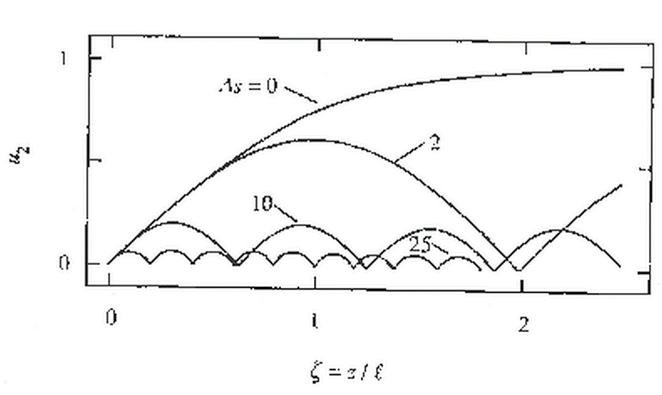

Slide 6
Next simplest case: SHG weak pulse vs frequency
Integration:
The solution is of the form:

Slide 7
Second harmonic intensity versus Δk
What does it mean?
Depletion of fundamental
Depletion of fundamental
Nonlinear phase shift
OPTICS LETTERS / Vol. 17, No. 1 / January 1, 1992

Slide 8
NON LINEARITIES FOR PULSE CONTROL
Second harmonic compression
Negative Kerr effect
Parametric amplification
Optical Parametric Oscillator
Contrast enhancement (back to PW systems)

Slide 9
SHG in periodically poled crystals
Other solution to the narrow bandwidth
of Periodically Poled crystals:
Convert the spectrum piece by piece
x
Periodically poled
crystal of period
changing with x.

Slide 10
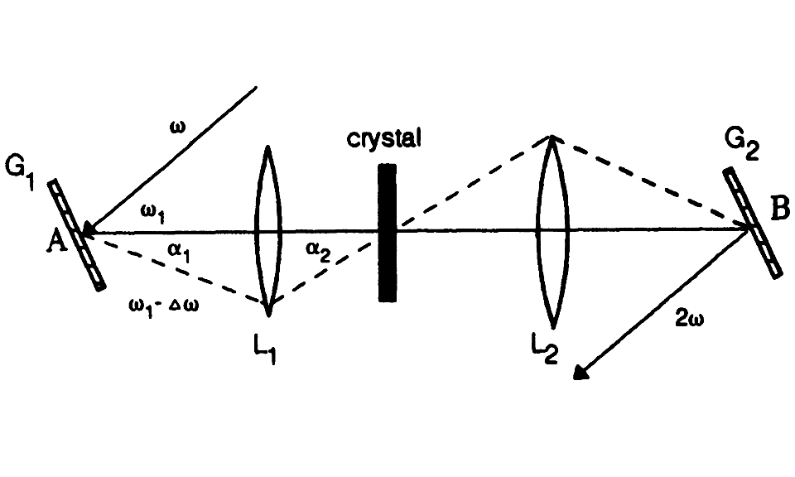
SHG in crystals
SHG in periodically poled crystals
Other solution to the narrow bandwidth
of Periodically Poled crystals:
Convert the spectrum piece by piece
x
Periodically poled
crystal of period
changing with x.

Slide 11
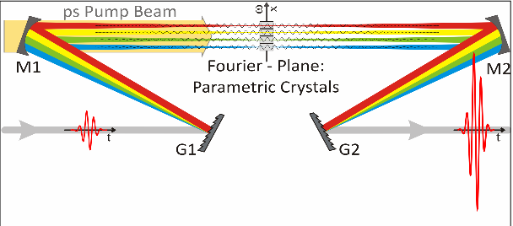
FOPA

Slide 12
Other solution: use many crystals for each wavelength range
FOPA: Frequency domain optical
parametric amplification (Faux-pas)
B. E. Schmidt et al. Nat. Commun. 5, 3643 (2014)
energy
front
grating
f
Laser source
wavefront
f
Interplay of temporal and spatial chirp, resulting in changes in wavefront shape
group delays and central wavelength.

Slide 13
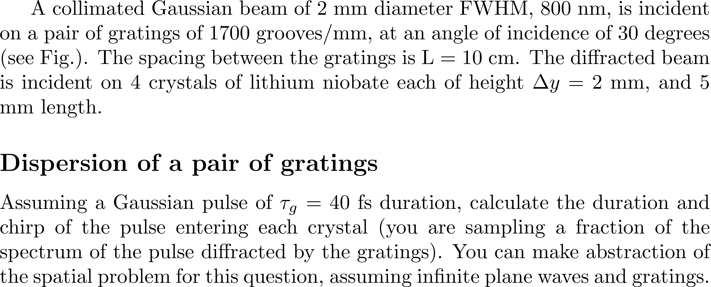

Slide 14
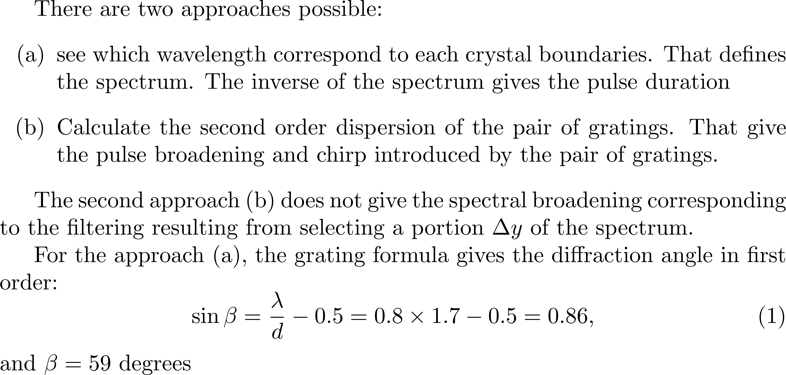

Slide 15
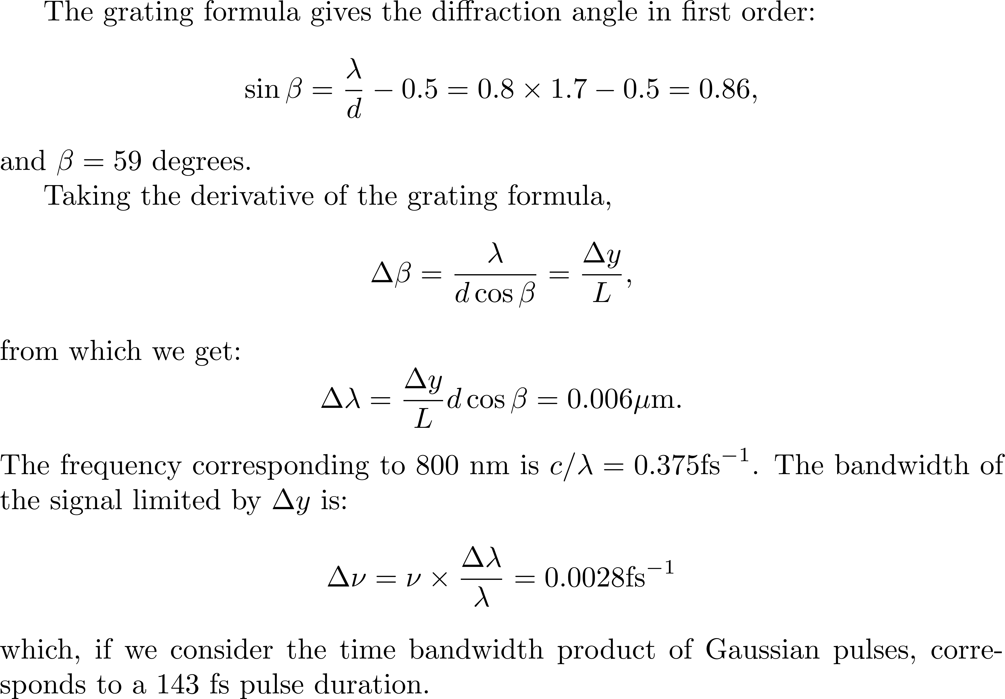

Slide 17
5 mm

Slide 21
Synthesizer principles
I_{λ}
Parallel synthesis
Pro:
Shorter „beam path“
Simple narrow bandwidth mirrors
Contra:
Interferometric stability needed
Very sensitive → high rep.rate
Broad bandwidth mirrors after beam combination
Similar principle: frequency domain OPA
Serial synthesis
Pro:
No special requirements on stability
Insensitive
Contra:
Longer „beam path“
Broad bandwidth mirrors
λ
S.-W. Huang et al. Nat. Photon 5, 475 (2011)
C. Manzoni et al. Opt. Lett. 37, 1880 (2012)
B. E. Schmidt et al. Nat. Commun. 5, 3643 (2014)
D. Herrmann et al., Opt. Exp. 18, p. 18752 (2010)
A. Harth et al. Opt. Express 20, 3076 (2012)
Notes:
21

Slide 22
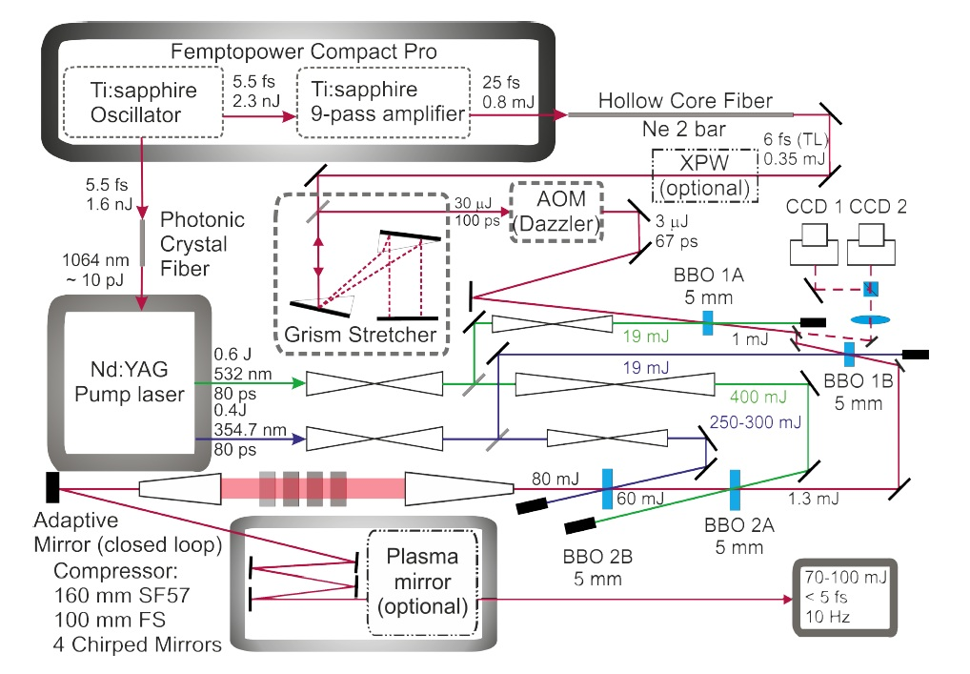
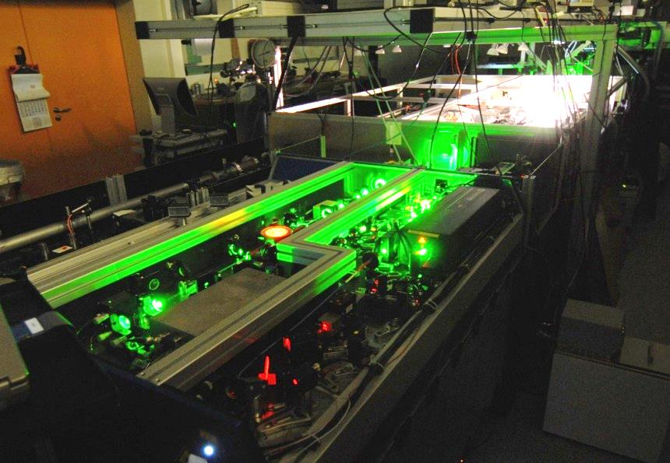
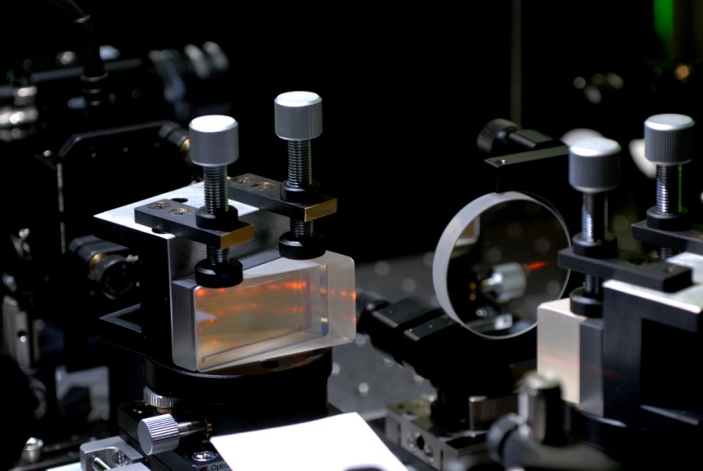
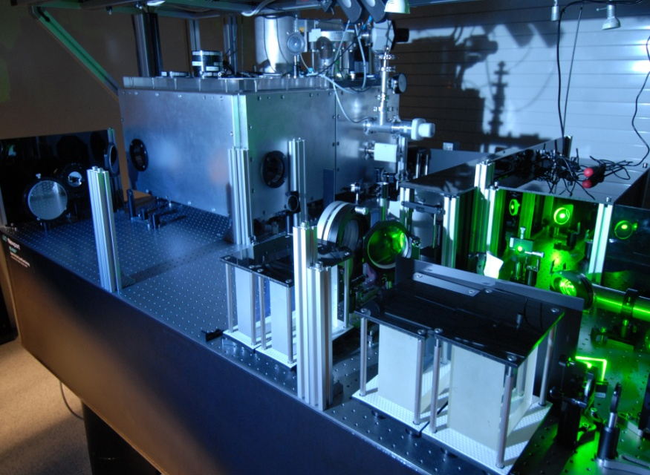
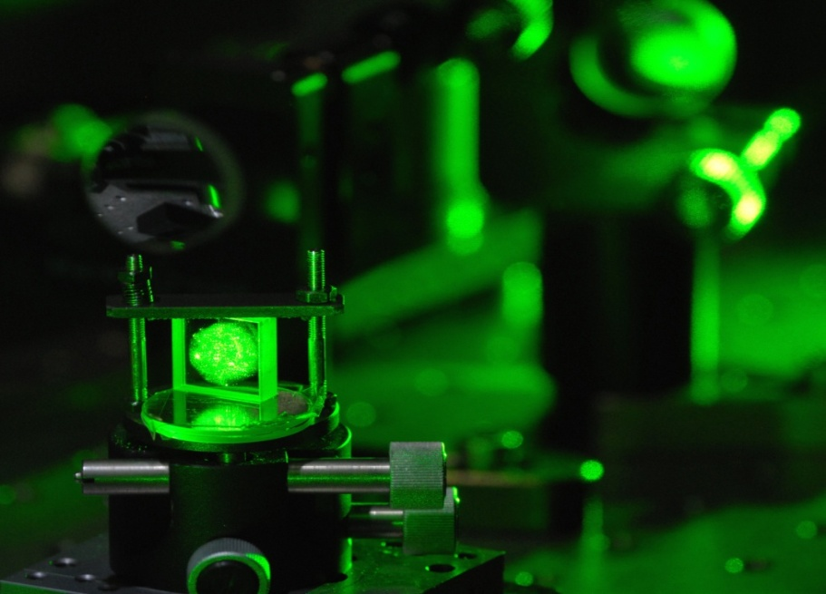
Setup of the <5 fs LWS-20
Femtopower Compact Pro
Front end & hollow-core fiber
Ti:Sa Front End
Grism stetcher
1064 nm
10 nJ
Fiber amplifier
0.5 J
532 nm
80 ps
0.35 J
355 nm
80 ps
Bulk compr.
80 ps Nd:YAG
pump laser
Dispersion management
Noncollinear OPCPA stages
85-130 mJ
60-80 mJ
BBO-based OPA stage
Phase
meter

Slide 23
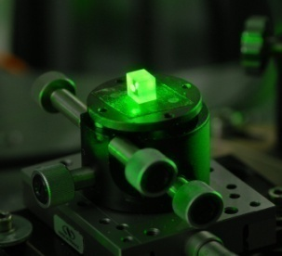
Principle of optical parametric synthesizer
1.8 µJ
Seed
1,3 mJ
1,5 mJ
67 mJ
101 mJ
532 nm
19 mJ
355 nm
19 mJ
532 nm
400 mJ
355 nm
300 mJ
Notes:
23

Slide 24
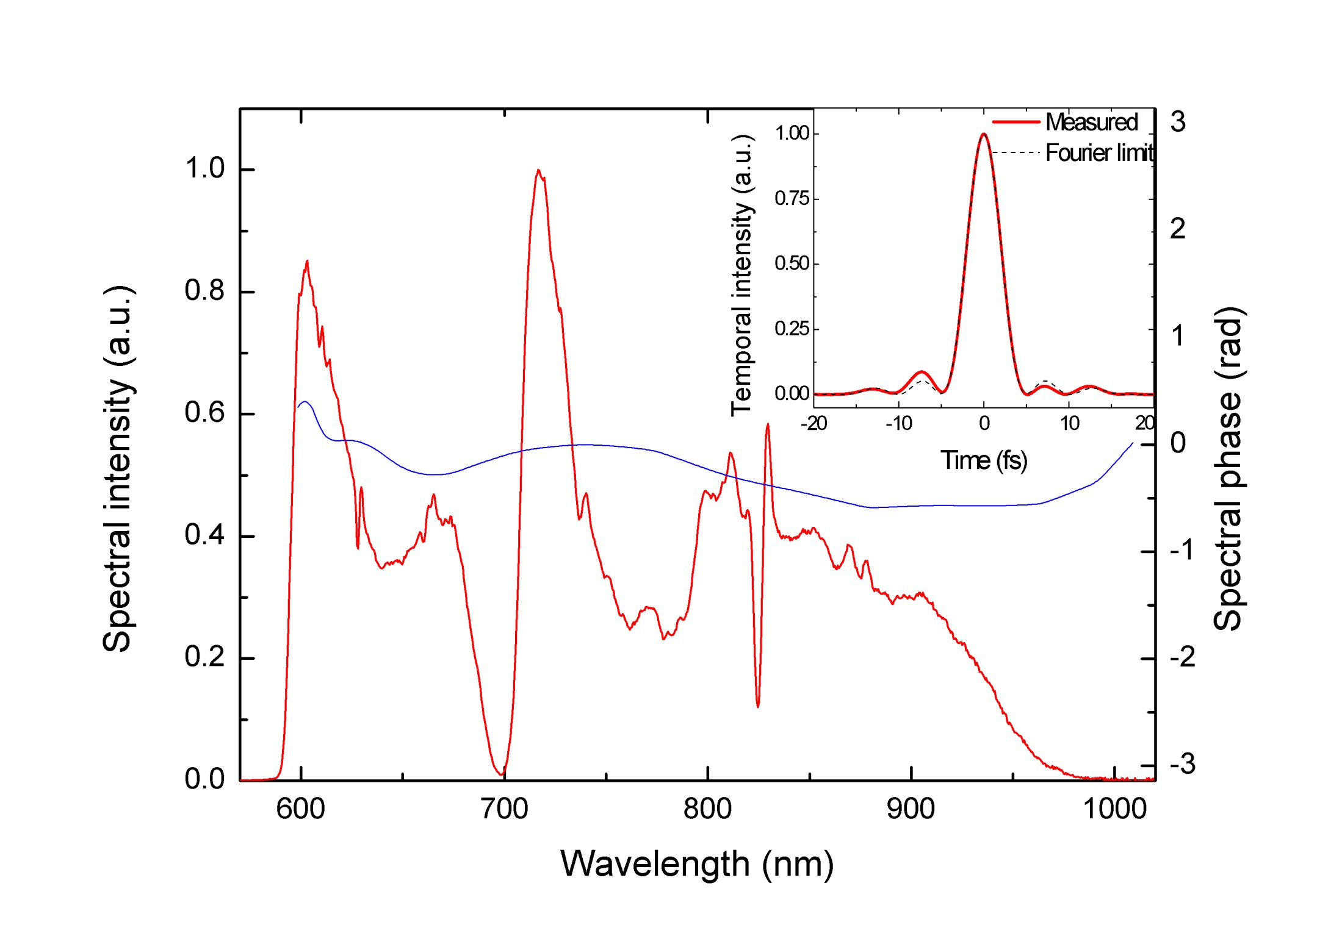
Compression
FWHM:
4.5 fs
Dazscope evaluation
FWHM Fourier limit: 4.5 fs
FWHM pulse duration: 4.5 fs
SHG AC and FROG shows also this duration!
Best FWHM Fourier limit: 3.9 fs

Slide 25
BIG SYSTEMS

Slide 26
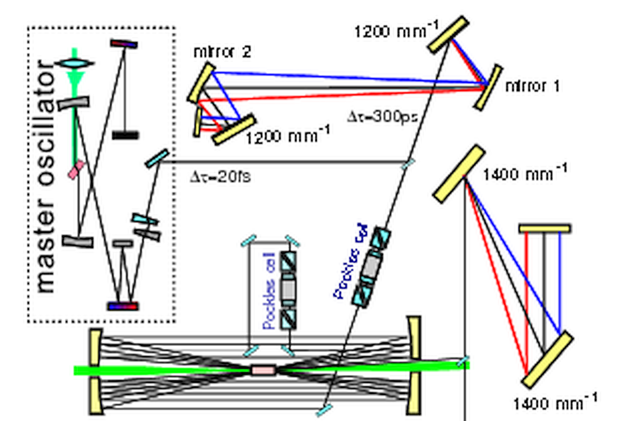
double-CPA multi-terawatt Ti:sapphire laser of the Max Born Institute (Berlin)

Slide 27
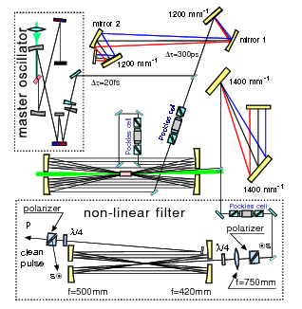
double-CPA multi-terawatt Ti:sapphire laser of the Max Born Institute (Berlin)

Slide 28
EVEN BIGGER SYSTEMS

Slide 29
10 PetaWatt lasers for extreme light applications
Olivier Chalus
Thales

Slide 30
“Fraction” awarded to Thales: 130 Meu
Budget for the US “ELI” in Michigan: 10 Meu?

Slide 31
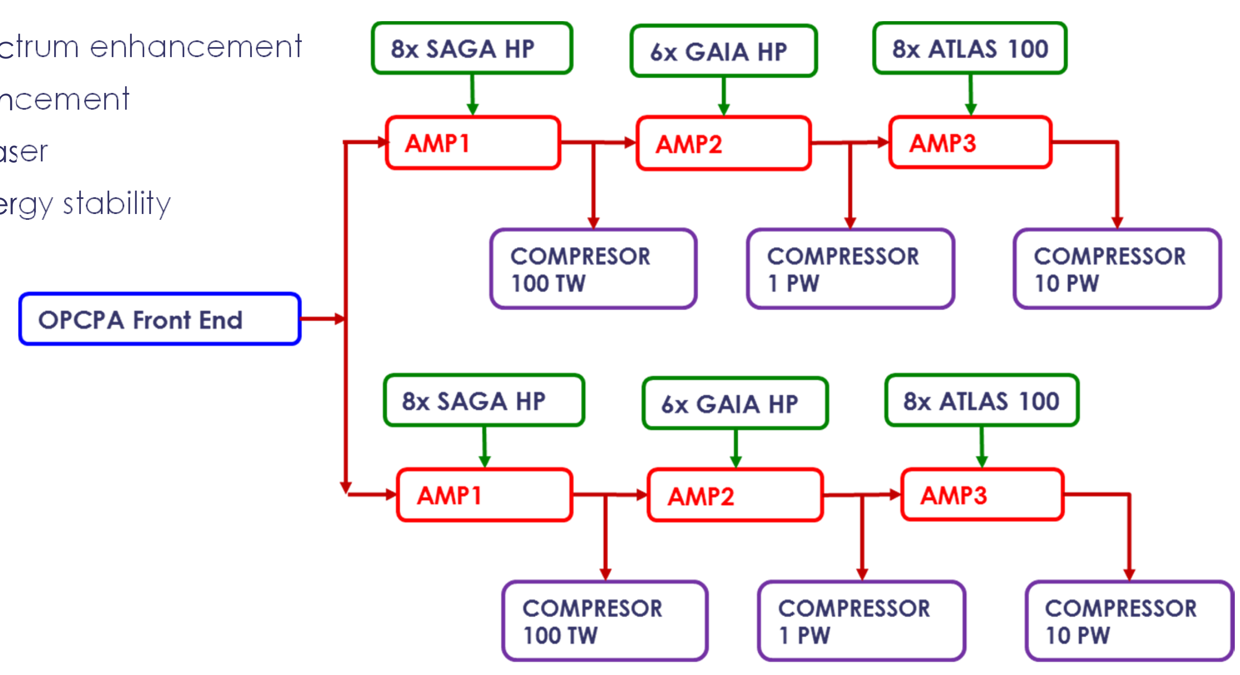
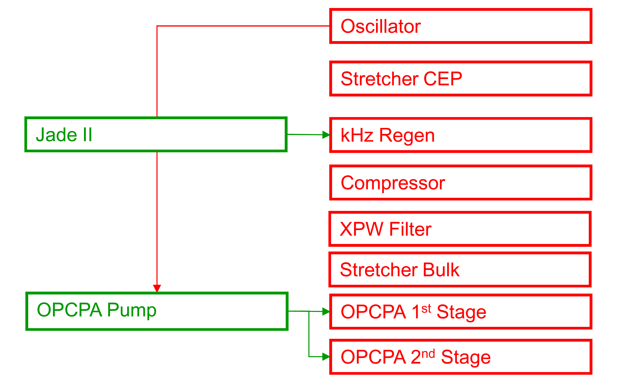
The OPCPA front end
The Roumanian ELI monster:

Slide 33
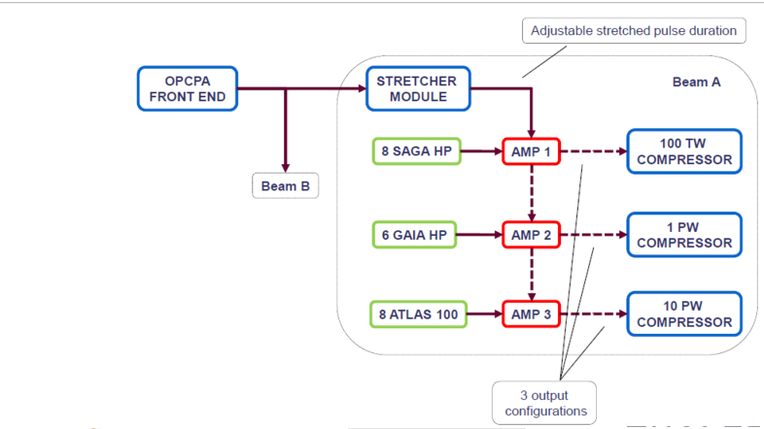

Slide 35
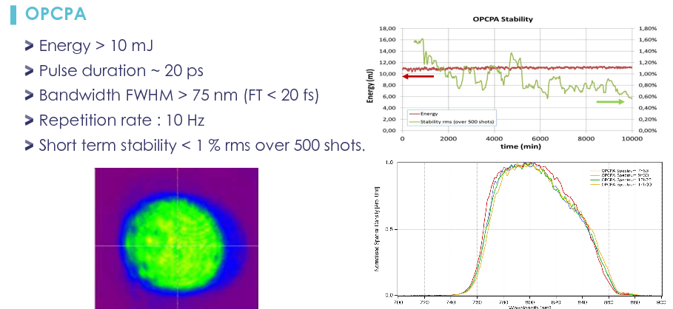

Slide 36
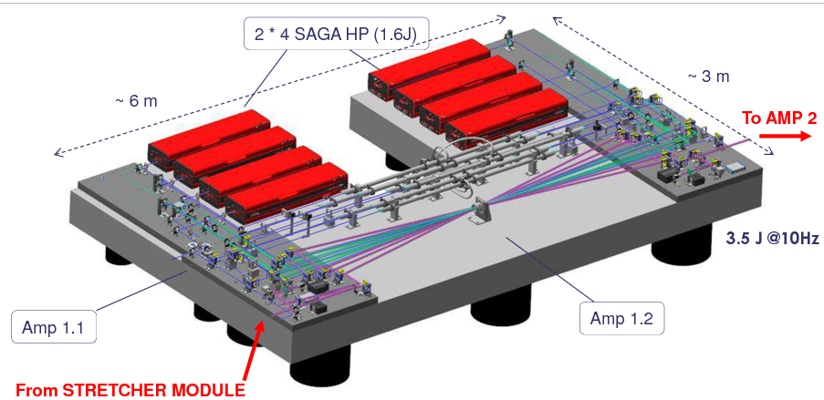

Slide 37
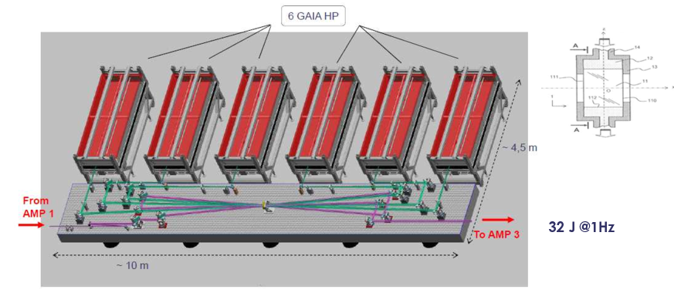

Slide 38
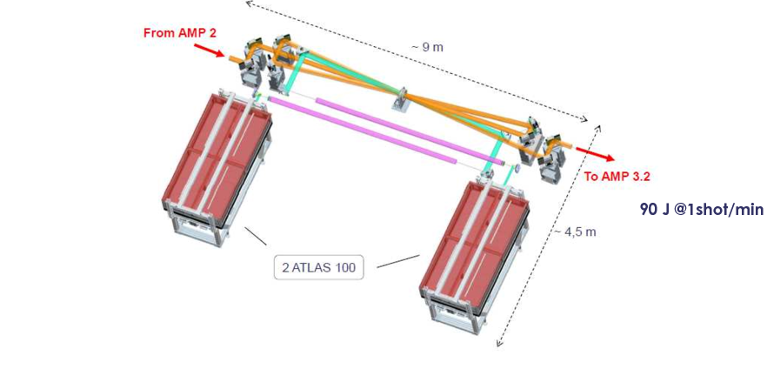

Slide 40
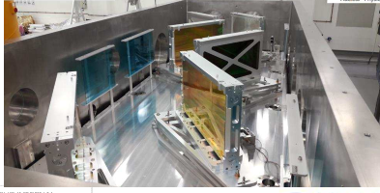

Slide 42
The OPCPA front end
The Roumanian ELI monster:

Slide 43
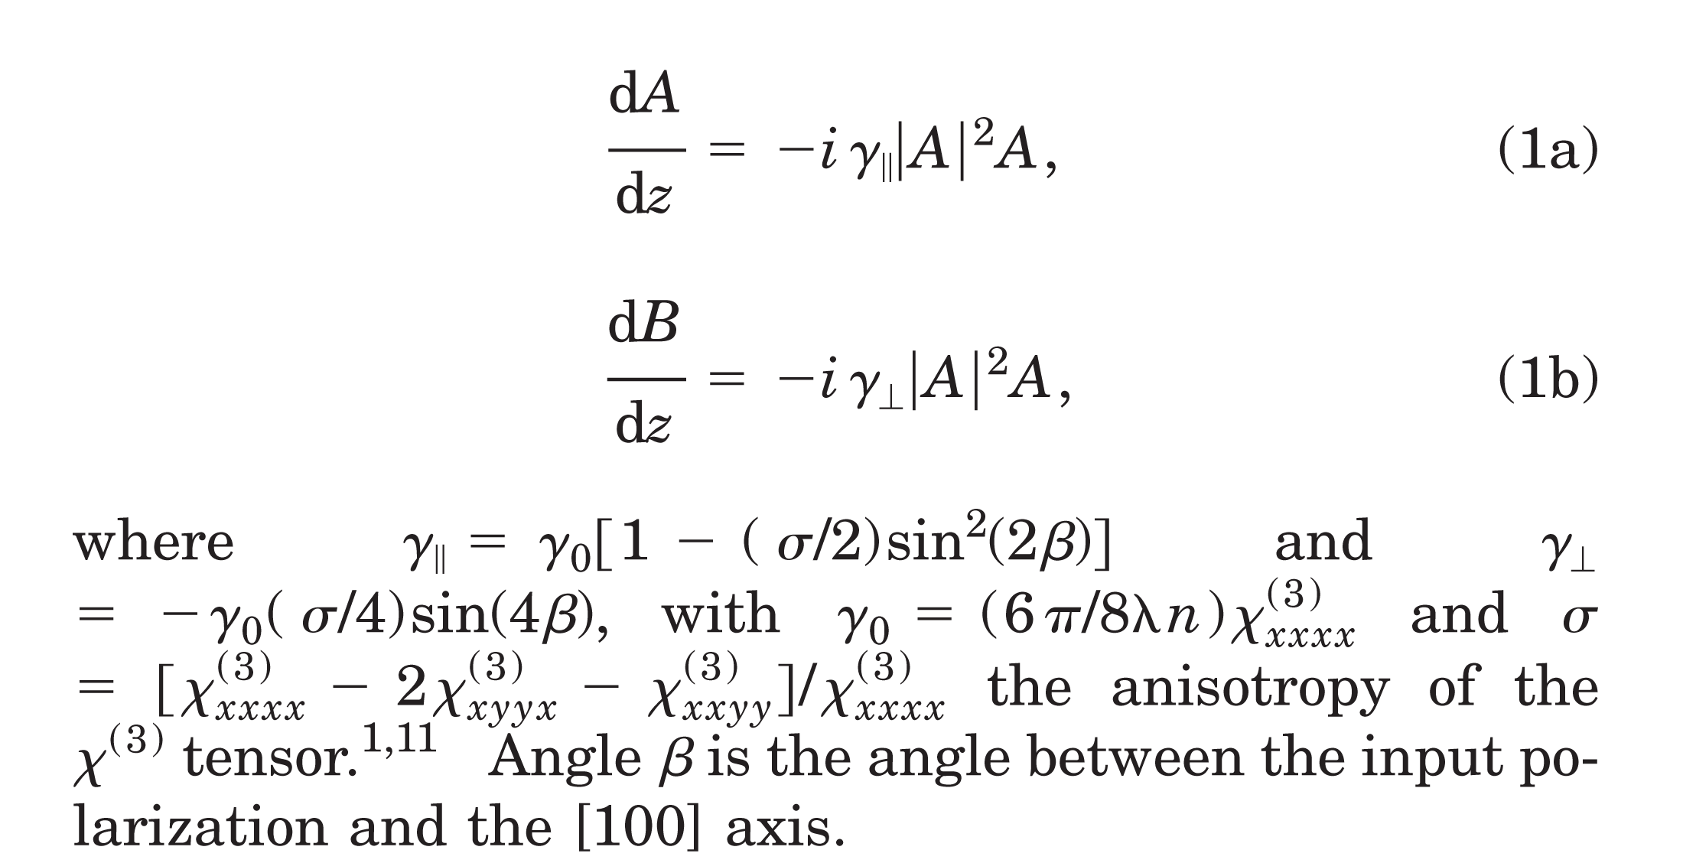
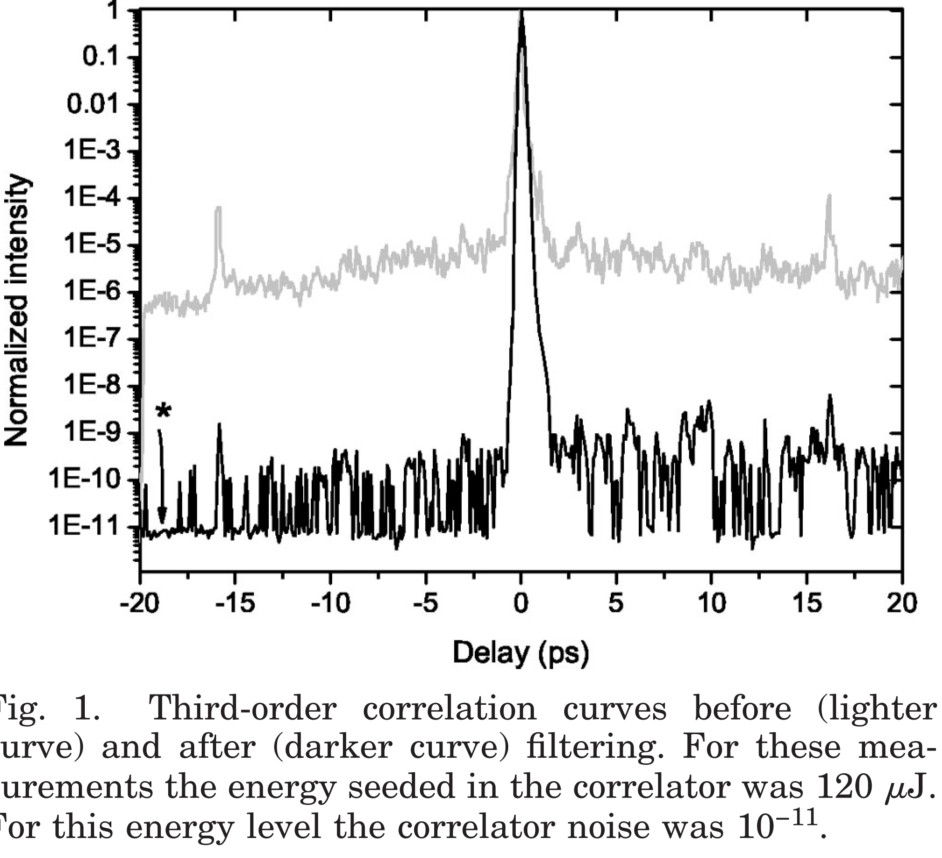
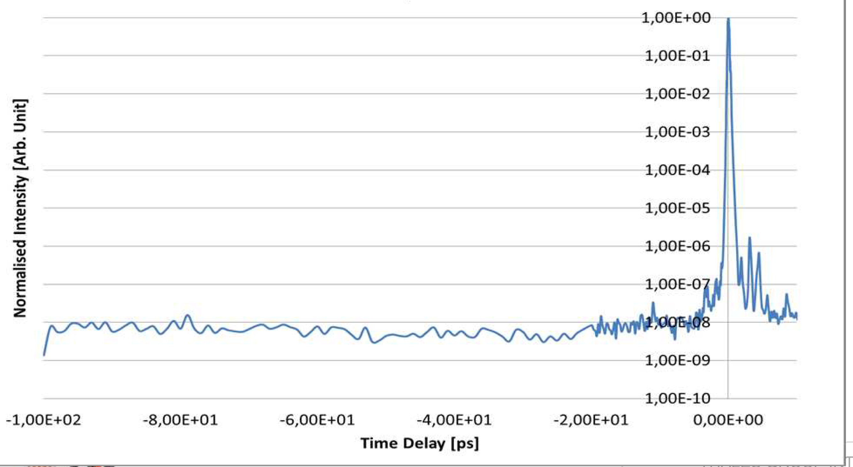
Question from the audience: “What the heck is an XPW?
Highly efficient nonlinear filter for femtosecond pulse contrast enhancement and pulse shortening
Highly efficient nonlinear filter for femtosecond pulse contrast enhancement and pulse shortening
XPW device composed of a pair of crossed polarizers, focusing and collimating lenses with a 2 m focal length, and a BaF2 crystal
Analyzer (cross polarized with the input)
Filter the square profile
The amplifier output profile is relay imaged in this plane
The amplifier output profile is relay imaged in this plane

