Slide 1
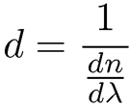
Single pulse
CEP of few cycle pulse
…so short pulses that we do not even know what ω₀ is
We do not know what CEP is, but we know how to control it.
Propagation through glass of thickness d, the group delay is:
For Δ(CEP) = 2π, (group minus phase) delay = T = λ₀ /c:
We are still assuming that we can define a carrier frequency,
hence make the decomposition:

Slide 2
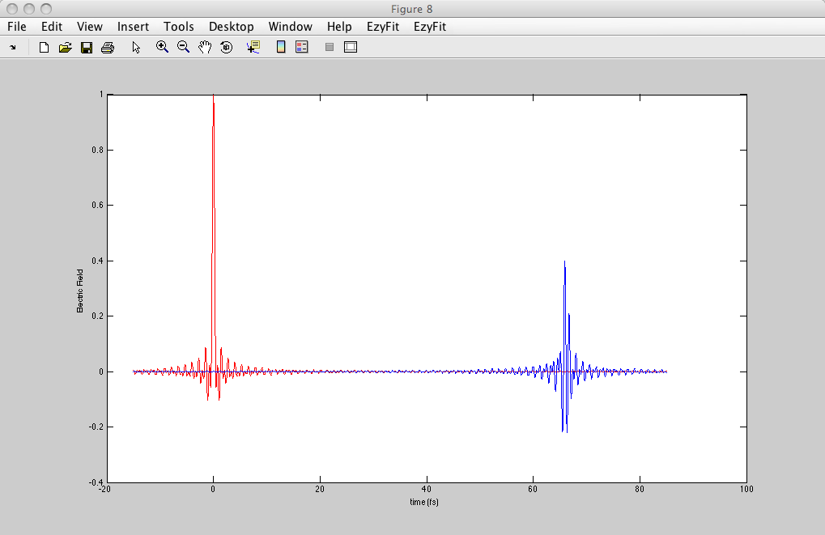
Single pulse
CEP of few cycle pulse: example
FREQUENCY
TIME
E
ω₀ = 0.75π 10¹⁵s⁻¹ (800 nm)
ω₀
Ω
13 μm of BK7
Electric field
0
0
20
Time (fs)
40
60

Slide 3
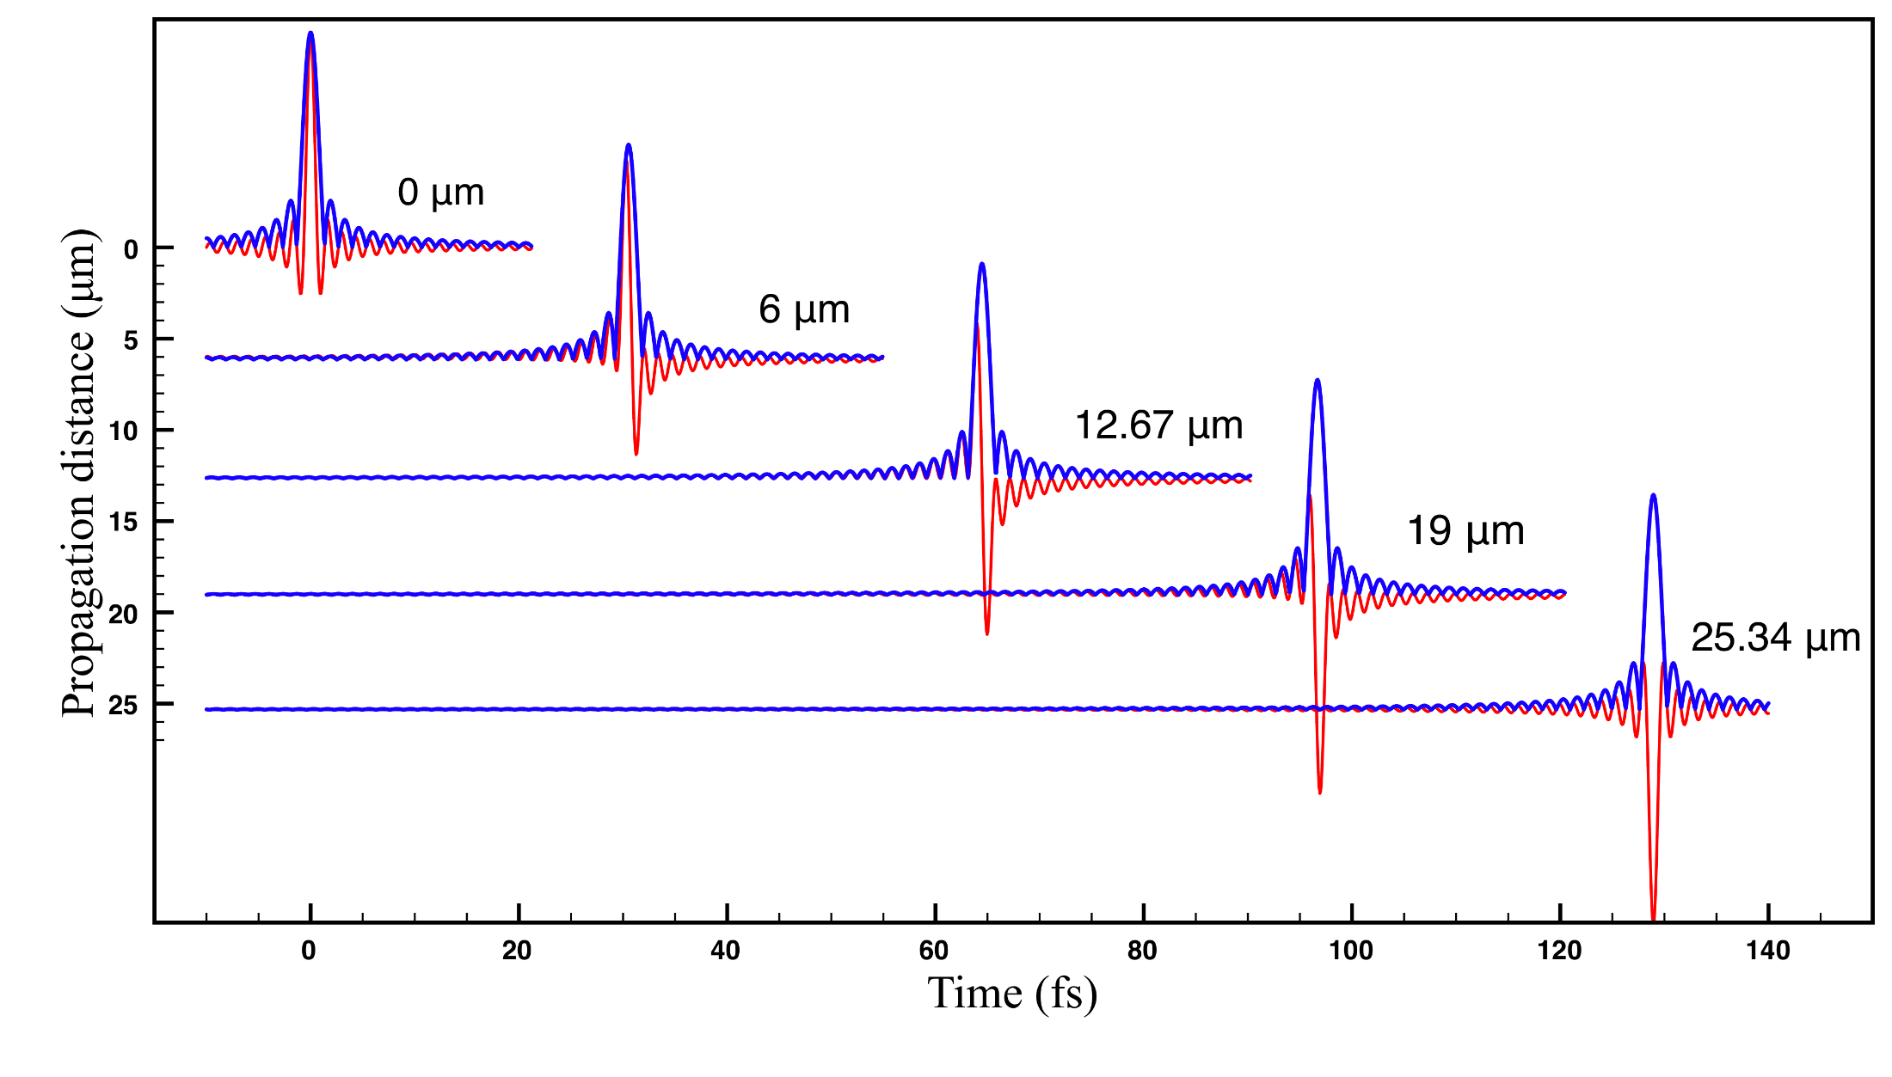
CEP of a single cycle sinc: the traditional (wrong) approach

Slide 4
Single pulse
CEP of few cycle pulse
We have to return to Maxwell's propagation equation:
In frequency

Slide 5
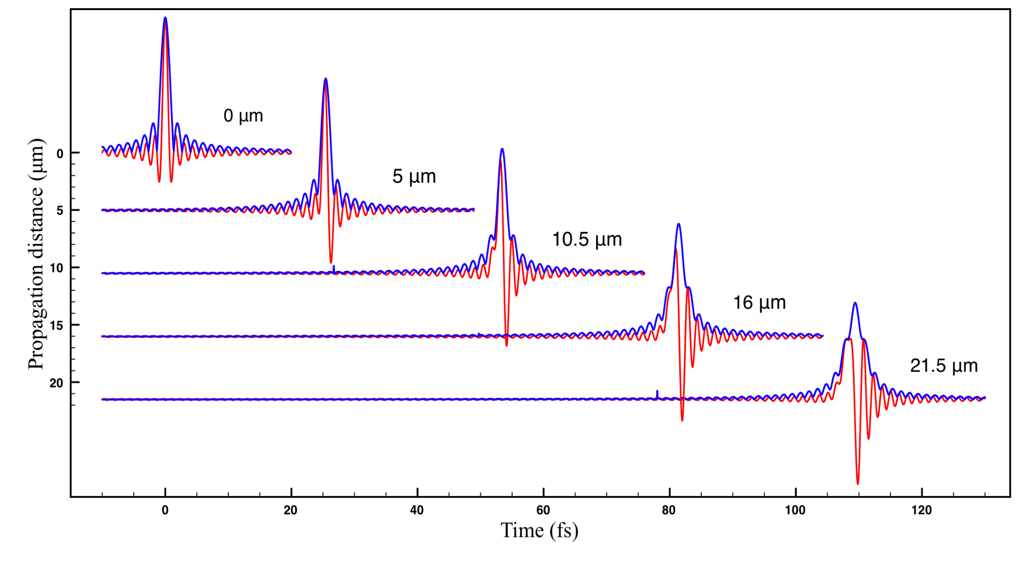
Single pulse
CEP of a single cycle sinc
Definition of CEP: difference between phase φ(t) at peak of amplitude
and phase φ(t) at peak of real field
CEP = 0.319
CEP = 0.613
CEP = 1.012
CEP = 1.321

