Slide 1
NONINEAR SCHROEDINGER EQUATION IN TIME

Slide 2
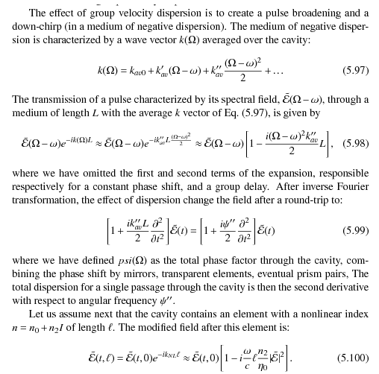
NONINEAR SCHROEDINGER
EQUATION IN TIME

Slide 3
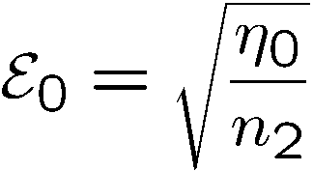
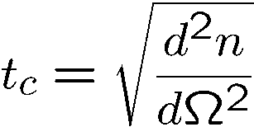
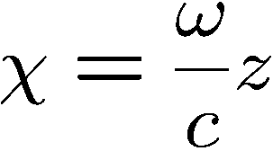
Equation in the retarded frame
Characteristic field:
Characteristic time:
Normalized distance:
Solitons: solutions of the eigenvalue equation

Slide 4
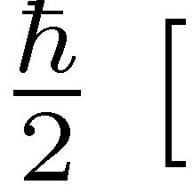
Why non-linear Schroedinger equation?
]
Multiply by

Slide 6
Solution of the normalized NL Schroedinger equation
The standard form is:
Trial solution
In these normalized units, there is an infinite family of solutions of ``order 1'', defined as the product of peak amplitude A by pulse duration τ_{s} being unity.
But the correct “pulse area” is:

Slide 7
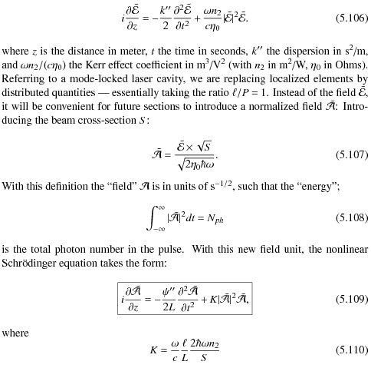
NONINEAR SCHROEDINGER
EQUATION IN TIME
NOT NORMALIZED SOLUTIONS

Slide 8
NONINEAR SCHROEDINGER
EQUATION IN TIME
NOT NORMALIZED SOLUTIONS

Slide 9
The actions of nonlinearity and GVD exactly compensate each other.

Slide 10
The actions of nonlinearity and GVD exactly compensate each other.
From the soliton equation we got:

Slide 11
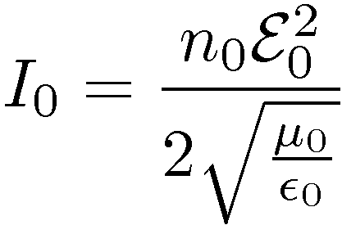
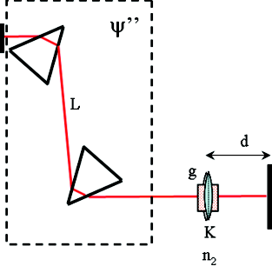
Another nearly equivalent approach is Gaussian time cavity
K is Kerr lensing in space and time!
Non-linear index:
In time:
Time lens:
L
d
K

Slide 12
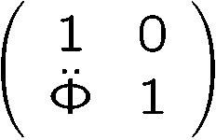
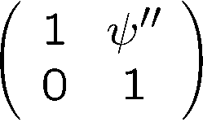
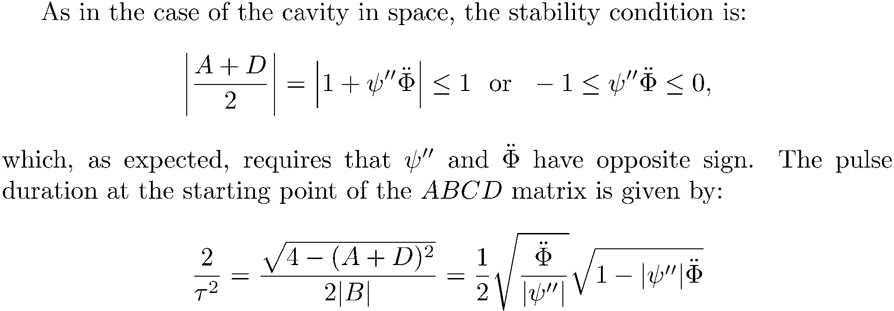
Time empty cavity
Lens matrix:
Matrix for dispersion:
Time lens:

Slide 13
From Gaussian beams/ABCD matrices we got:
Time lens:
From the soliton equation we got:
From GVD and dispersion compensating each other we got:

Slide 14
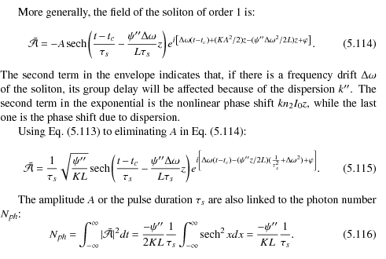
NONINEAR SCHROEDINGER
EQUATION IN TIME
NOT NORMALIZED SOLUTIONS

Slide 15
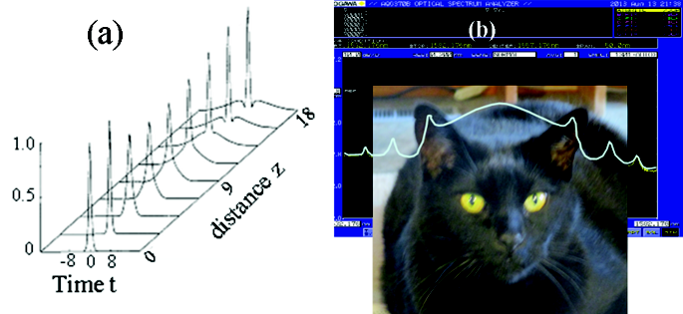
SOLITON STABILITY
A perturbation causing an increase in photon
number leads to a depletion of the leading and trailing edges, while the number of
photons is increased in the center, implying a pulse compression. The soliton is a
stable entity for the total number of photons. An increase in peak intensity should
result in a larger Kerr effect, hence a phase shift.
First order solitons are stable, in the sense that if a soliton of order > 0:5 or < 1:5
(area between pi/2 and 3pi/2) is launched, it will evolve towards a single soliton
or order one. The threshold for soliton formation is higher if a chirped pulse
is launched.

Slide 16
The laser as an orthodontist
The laser cavity having dispersion,
How can the modes of the frequency comb be exactly equally spaced?

Slide 17
The laser as an orthodontist
Tuned cw laser
D
Mode locked laser
λ
FREQUENCY
TUNABLE
LASER
MODE-LOCKED
LASER
Frequency counter
SPECTROMETER
FREQUENCY
COUNTER
Round
-trip
frequency
200
101 884 000 Hz
-
100
wavelength
ORTHODONTIST
Rep. Rate
700
800
900
Wavelength [nm]

Slide 19
The actions of nonlinearity and GVD exactly compensate each other.

Slide 20
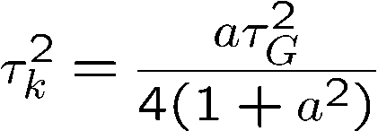
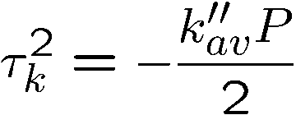
The laser as an orthodontist
The laser cavity having dispersion,
How can the modes of the frequency comb be exactly equally spaced?
Procedure: 1) write the quadratic spectral chirp coefficient induced by Kerr effect:
Multiply the chirped frequency spectrum by the dispersion:
at each round-trip, to find the condition:

Slide 21
Evolution of a single pulse in an ``ideal'' cavity
P = perimeter of the cavity
Dispersion
Kerr-induced chirp
Kerr effect

Slide 22
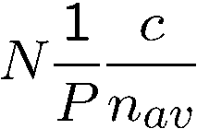
How unequally spaced modes
lead to a perfect frequency comb
Group delay
Phase delay
Cavity modes:
not equally spaced because n_{av =} n_{av}(ω)
A cavity with ONLY Kerr modulation generates the pulse train:
where
F.T.
where
dispersion

Slide 23
Two related questions:
Which mechanism makes the
As a pulse circulates in the cavity,
unequally spaced cavity modes
does it evolve towards a steady state?
equidistant?
Balance phase modulation by Kerr effect
and phase modulation by dispersion
How unequally spaced modes
Evolution of a single pulse in an ``ideal'' cavity
lead to a perfect frequency comb
SAME
CONDITION

Slide 24
MODE-LOCKING: how to put these modes in phase?
Active mode-locking: couple modes with AO modulator (frequency domain)
Active mode-locking: shutter (time domain)
Passive mode-locking: Saturable absorber (or Kerr lensing)

Slide 25
ACTIVE MODE LOCKING

Slide 26
Fig:
a) Schematic setup of a non-resonant acousto-optic modulator. A transducer generates a sound wave, at which a light beam is partially diffracted. The diffraction angle is exaggerated.
b) Acousto-optic deflection of light. The frequency of the diffracted beam is up-shifted in this geometry.

Slide 27
Output coupler
Fig:
Mirror m1
He-Ne
a)
Circulating pulse
L
L
AOM
RRM
Mirror m2
0th order shift
1st order shift
He-Ne
b)
Frequency shifted pulse will be
Injected back
He-Ne
c)
Injected pulse must overlab with circulating pulse

Slide 28
Fig:
Mirror m1
He-Ne: SP 125
Circulating pulse
L
L
Mirror m3
AOM
RRM
Mirror m2
0th order shift
1st order shift
SF-P
BS
~
Osc.
Osc.
RF gen.
(40-45 MHz)
Experimental layout: (SP 125: Spectra Physics 125 HeNe Gas Laser, AOM: Intra-Action AOM, RF gen.: RF frequency synthesizer, RRM: Retroreflecting mirror, SF-P: Scanning Fabry-Perot interferometer, Osc. : Oscilloscope, SA: Spectrum Analyzer).

Slide 29
Observation of the modes with a scanning Fabry-Perot

Slide 30
Fig.
Scanning Fabry Perot output. Top: optical tansmission T vs. frequency f ; Bottom: Corresponding Piezo voltage V vs. time t.

Slide 31
A purely dispersive mechanism, creates the soliton
FIBER
dispersion
Phase
Phase
dispersion
modulation
Phase
dispersion
dispersion
modulation
modulation
Phase
modulation
Dispersion
LASER
Are phase manipulations sufficient for mode-locking?
NO!
Intensity dependent losses are needed.

Slide 32
B
A
With aperture no cw lasing possible
K
d₁
Brabec, Curley, Spielmann, Wintner and Schmidt
JOSA B 10:1029—1034 (1993)
d₂
2/3 < d₁/d2 < 3/4
Use stability range where the two curved mirrors are closest
Want sub 10 fs?
Stingl, Lenzner, Spielmann and Krausz, Optics Letters 20:602-604 (1995)

Slide 33
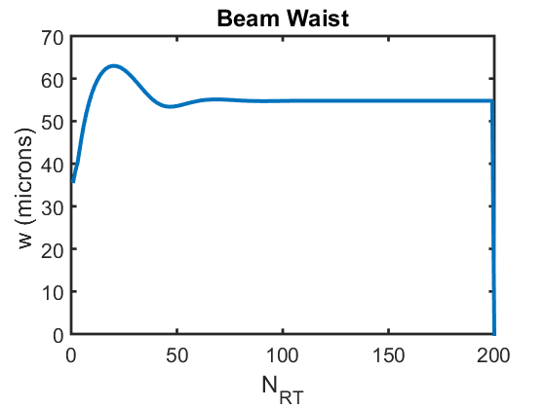
Results of the cavity in space
B
A
K
The higher the peak intensity, the stability criterium decreases from +1 (limit) to -1 (waist 0 at B)
There is a stable solution for a broad range of intensities

Slide 34
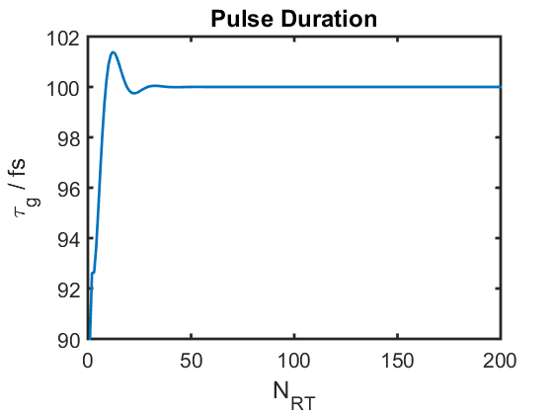
Cycling the ABCD matrix of a time cavity with Kerr lens [f_{T} = f_{T}(I)]
Pulse duration versus round-trip stabilizes to 100 fs
There is a stable solution for a broad range of intensities

Slide 35
The coupled solution
Ensemble of stable solutions of ABCD in space
Coupling imposed by common energy
Ensemble of stable solutions of ABCD in time
Only one stable solution for given dispersion

Slide 36
The right tool for a given measurement
An overview
THE PULSE TRAIN
TOOLS: Simple analog oscilloscope and frequency doubling crystal.
Electronic Spectrum analyzer
Spectrometer
What to look for?
Both fundamental and second harmonic: a straight line.
No sideband and higher harmonics
Continuous spectrum, central wavelength

Slide 37
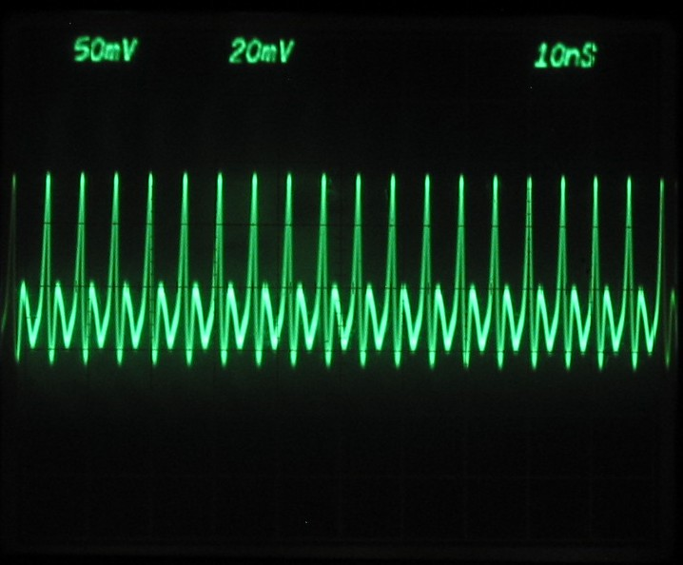
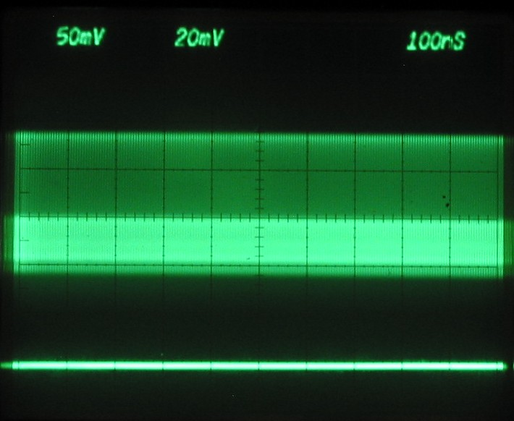
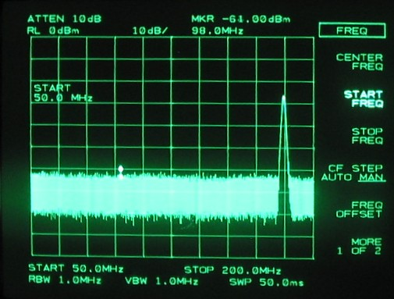
The frequency comb as seen by the experimentalist
THE PULSE TRAIN
Both fundamental and second harmonic: a straight line.
Electronic Spectrum analyzer

Slide 38
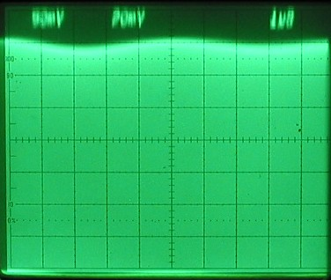
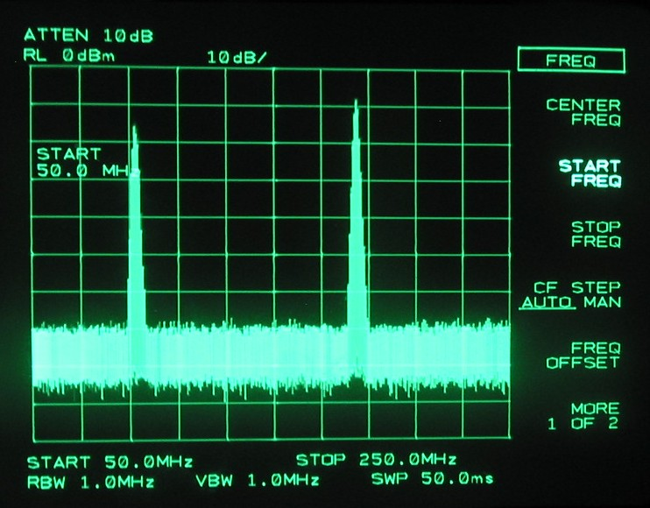
The frequency comb as seen by the experimentalist
THE PULSE TRAIN
What we should not see:
Modulation of the train on a μs scale
Q-switched-mode-locked train
(Shows as a sideband on spectrum
analyzer on a 100 KHz scale)

