Slide 1
Development of sub-ns GW peak power Nd:YAG laser system at 266nm for UV filament research
Xiaozhen Xu, Chengyong Feng
and Jean-Claude Diels
Department of Physics and Astronomy &
Center for High Tech Materials
The University of New Mexico

Slide 2
Outline
Project Goal
Introduction of pulse compression through Stimulated Brillouin Scattering (SBS) process
High energy SBS pulse compression setup and results
Current UV source performance and its limitation
On-going work
Summary

Slide 3
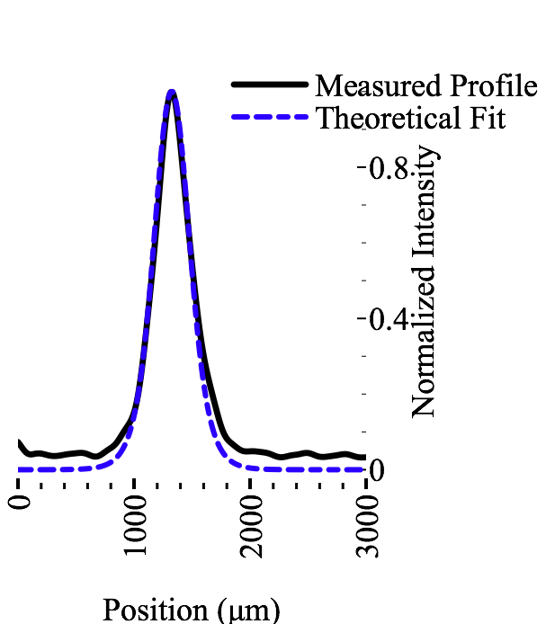
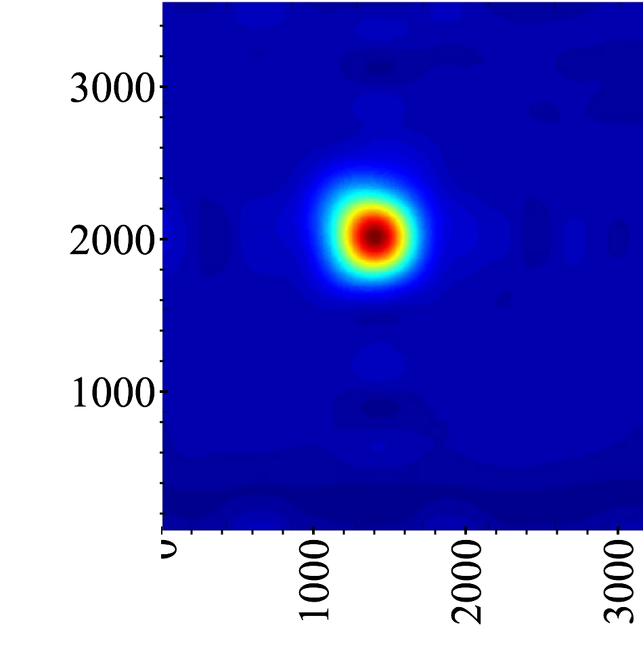
Project Goal
Simulation: ns single UV filament propagates up to 100s of m in air.
360 μm
(μm)
(μm)
Opt. Comm. 281, 3356-3360(2008), O. Chalus, A. Sukhinin, A. Aceves, J.-C. Diels
PRA, 65, 013806 (2001), J. Schwarz and J.-C. Diels
Goal: Reliable UV source with 1GW peak power

Slide 4
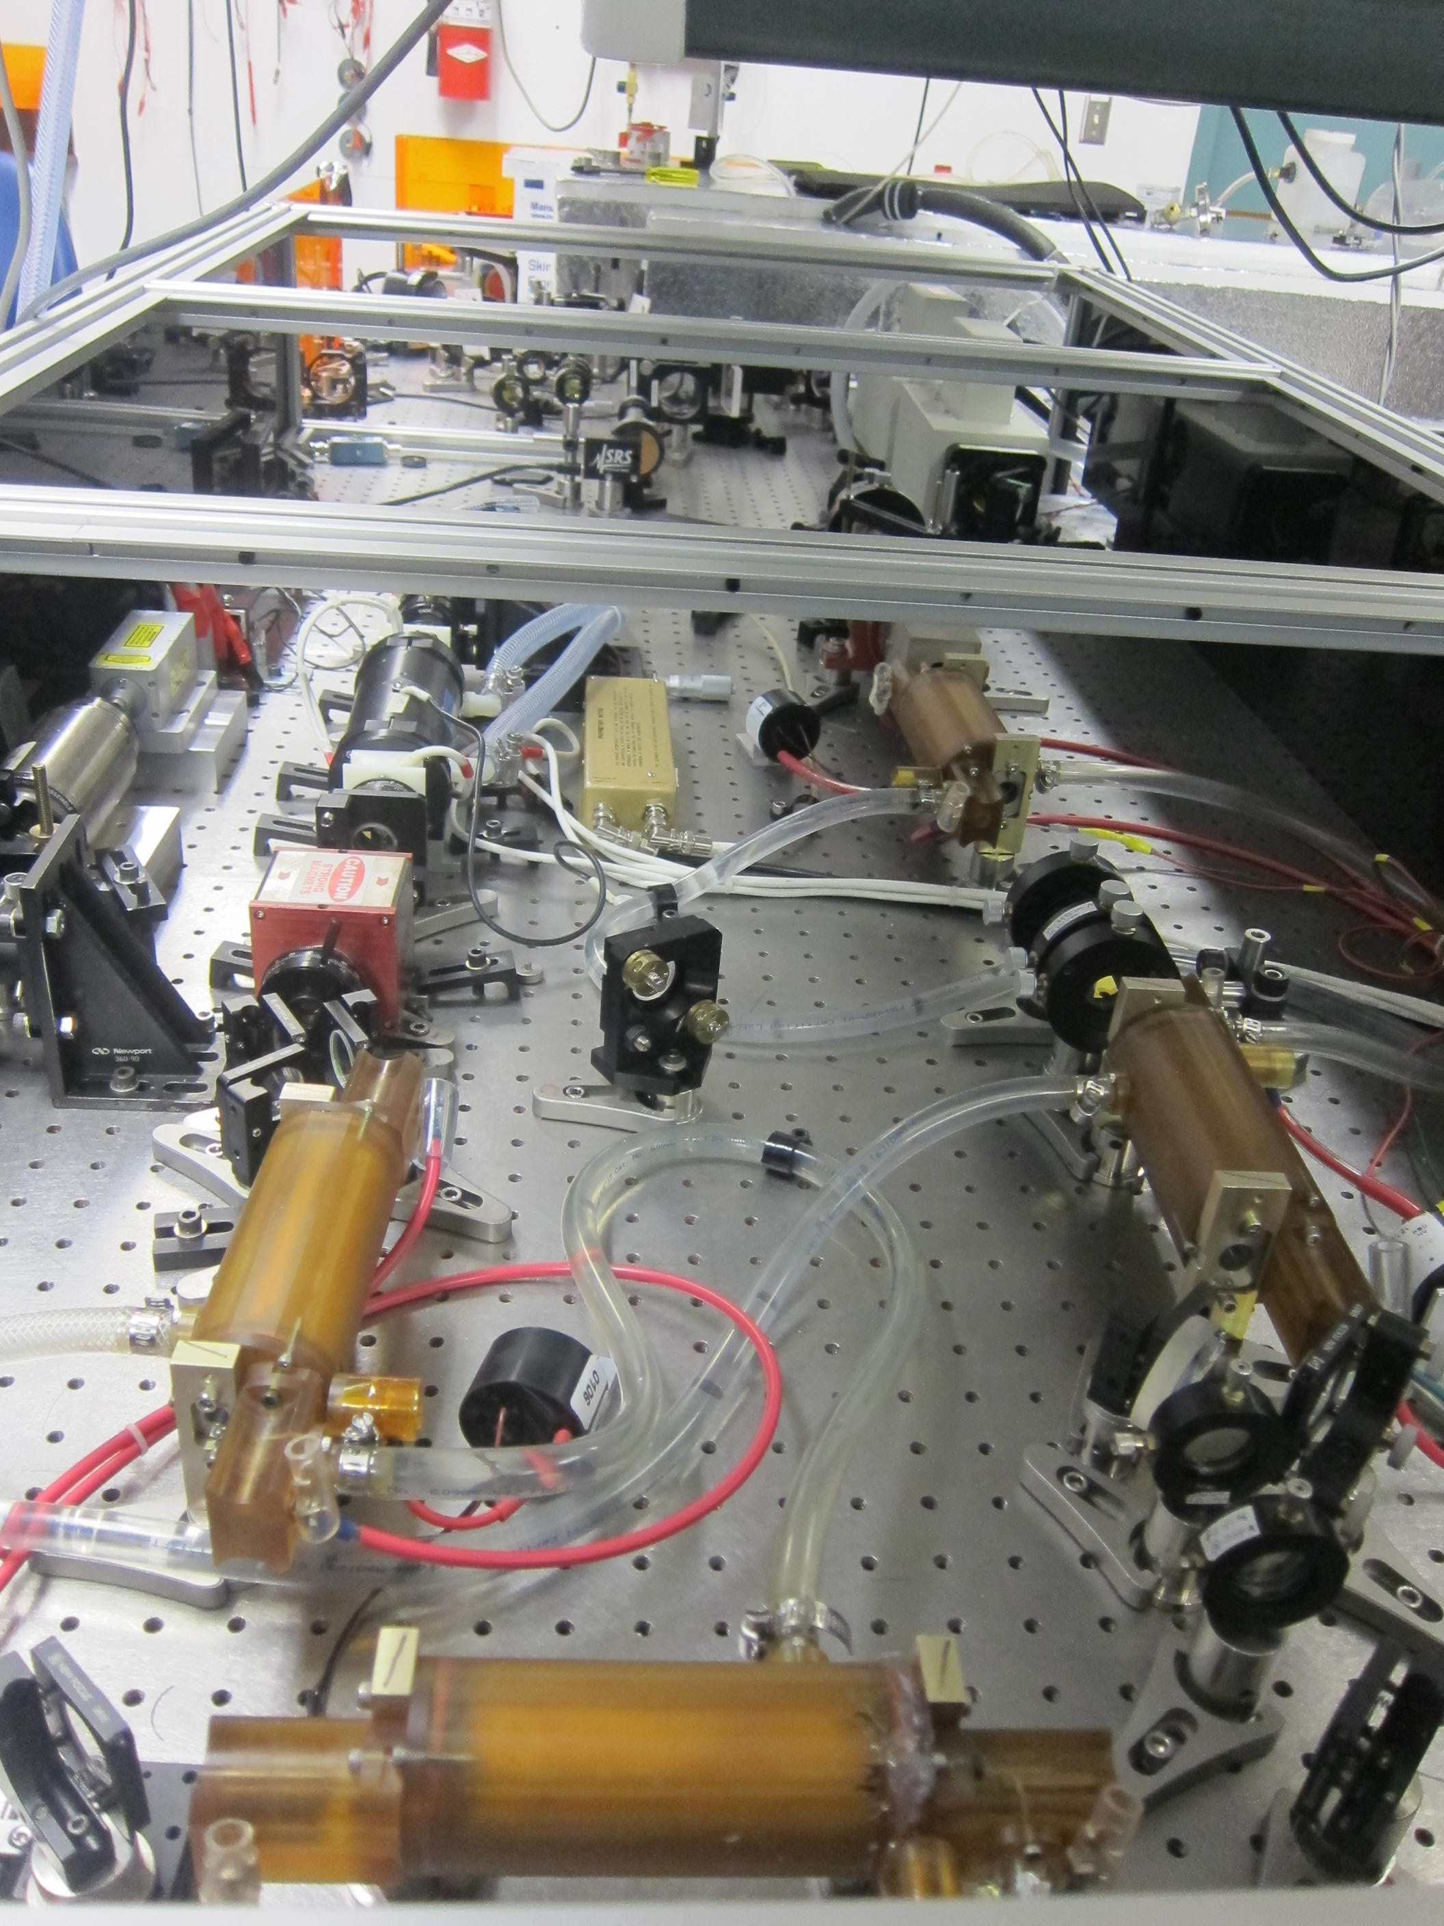
UV filament source
1GW @266nm
5J/pulse, 5ns, 1.25Hz
Amp5&6
Seeder
OSC
Amp4
70% conversion efficiency from 1064nm to 266nm is impossible!!!
Amp1
Amp3
Amp2
Nd:YAG laser system
7J/pulse, 10ns, 1.25Hz @1064nm

Slide 5
UV filament source
1GW @266nm
0.1-1J/pulse, Sub-ns, 1.25Hz
Amp5&6
Seeder
OSC
Amp4
Pulse compressor with relatively high energy conversion efficiency
Amp1
Amp3
Amp2
Nd:YAG laser system
7J/pulse, 10ns, 1.25Hz @1064nm

Slide 6

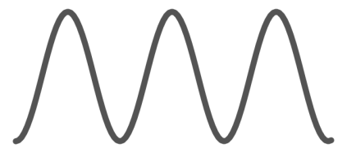
Physical picture of pulse compression through SBS process
SBS
Pulse compression
SBS medium
Two beam interference
Pump:
Stokes:
Acoustic
wave
Input pulse
z=0
z=L
Transmitted pulse
Positive
feedback
Time
Electrostriction
Compressed pulse
z
Distance
[1] R. Boyd, Nonliner Optics 3rd edition, Academic Press 2008
[2] D.T. Hon, Opt. Lett. 5,516-518 (1980)
[3] C. Brent Dane, W. A. Neuman, and L.A. Hackel, IEEE J. Quan. E. 30, 1907(1994)

Slide 7
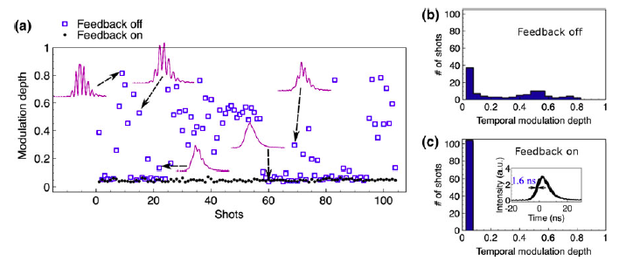
100% Single axial mode operation with new cavity control method
Single longitudinal and transverse mode operation of the laser system is a prerequisite for pulse compression by Stimulated Brillouin Scattering process

Slide 8
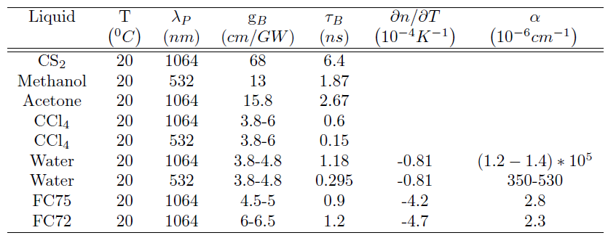
SBS medium selection for high energy pulse compression
SBS occurs in all states of matter: gases, liquids, solids and plasmas
Liquid is more appropriate for high power application

Slide 9
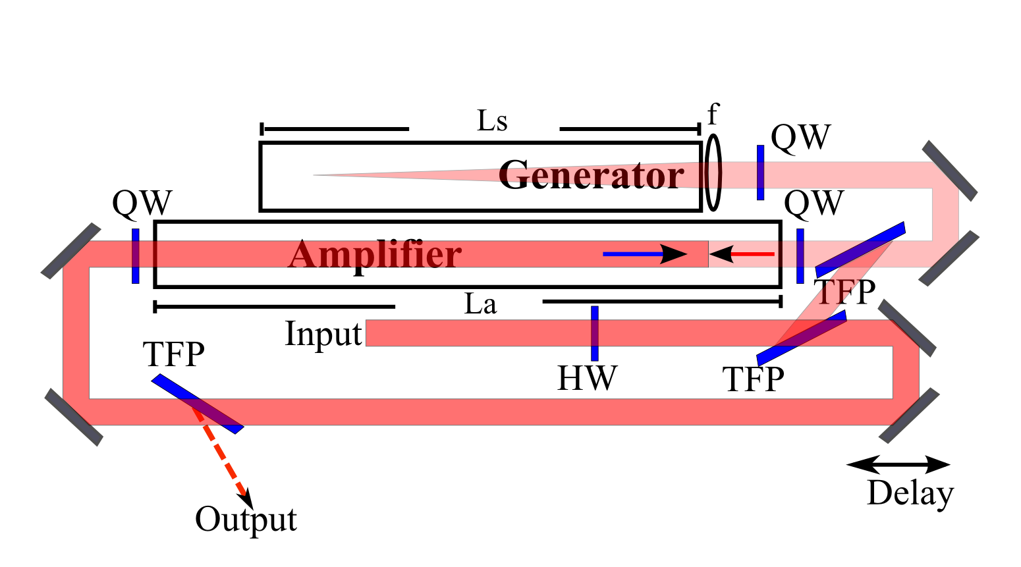
SBS setup for high energy pulse compression
HW: Half wave plate QW: Quarter wave plate TFP: Thin film polarizer
f: Focal lens Ls: Generator length La: Amplifier length
Depleted
pump
Scalable to high energy>1J
With controllable seed energy and timing
[1] C. Brent Dane, W. A. Neuman, and L.A. Hackel, IEEE J. Quan. E. 30, 1907(1994)

Slide 10
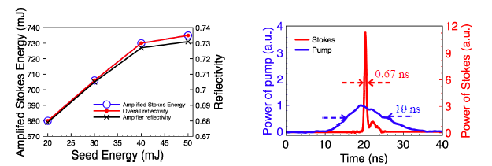
High energy SBS compression results
10ns pulse has been compressed to 670ps
Overall efficiency of 73.5% has been achieved
Peak power has been increased 11 times
XiaozhenXu, ChengyongFeng, and Jean-Claude M. Diels. High energy pulse compression through two-pulse interaction mediated by stimulated brillouin scattering in liquid uorocarbon. In CLEO: 2013, page CM3L.4. Optical Society of America, 2013.

Slide 11
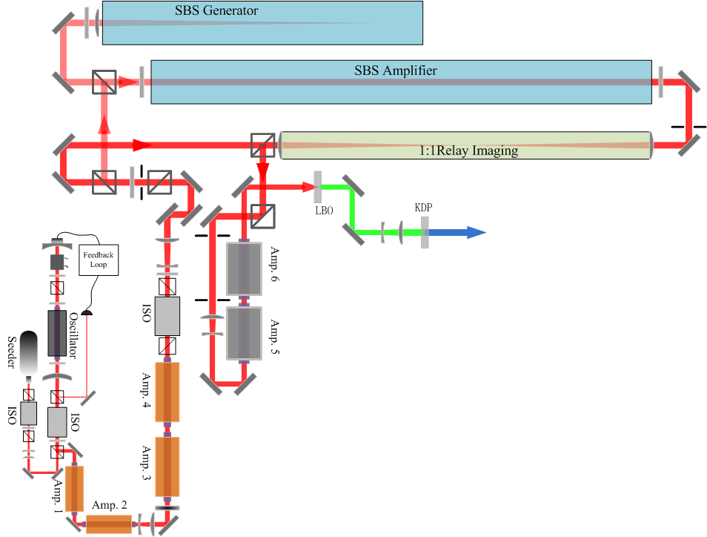
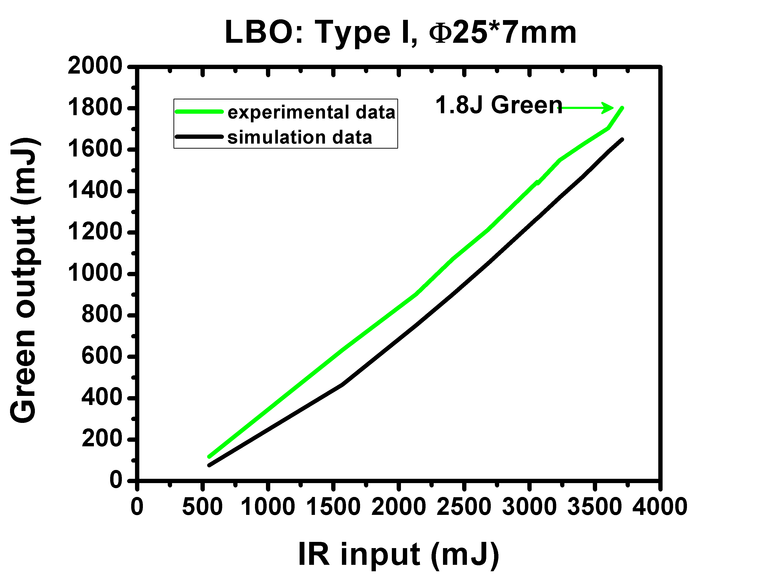
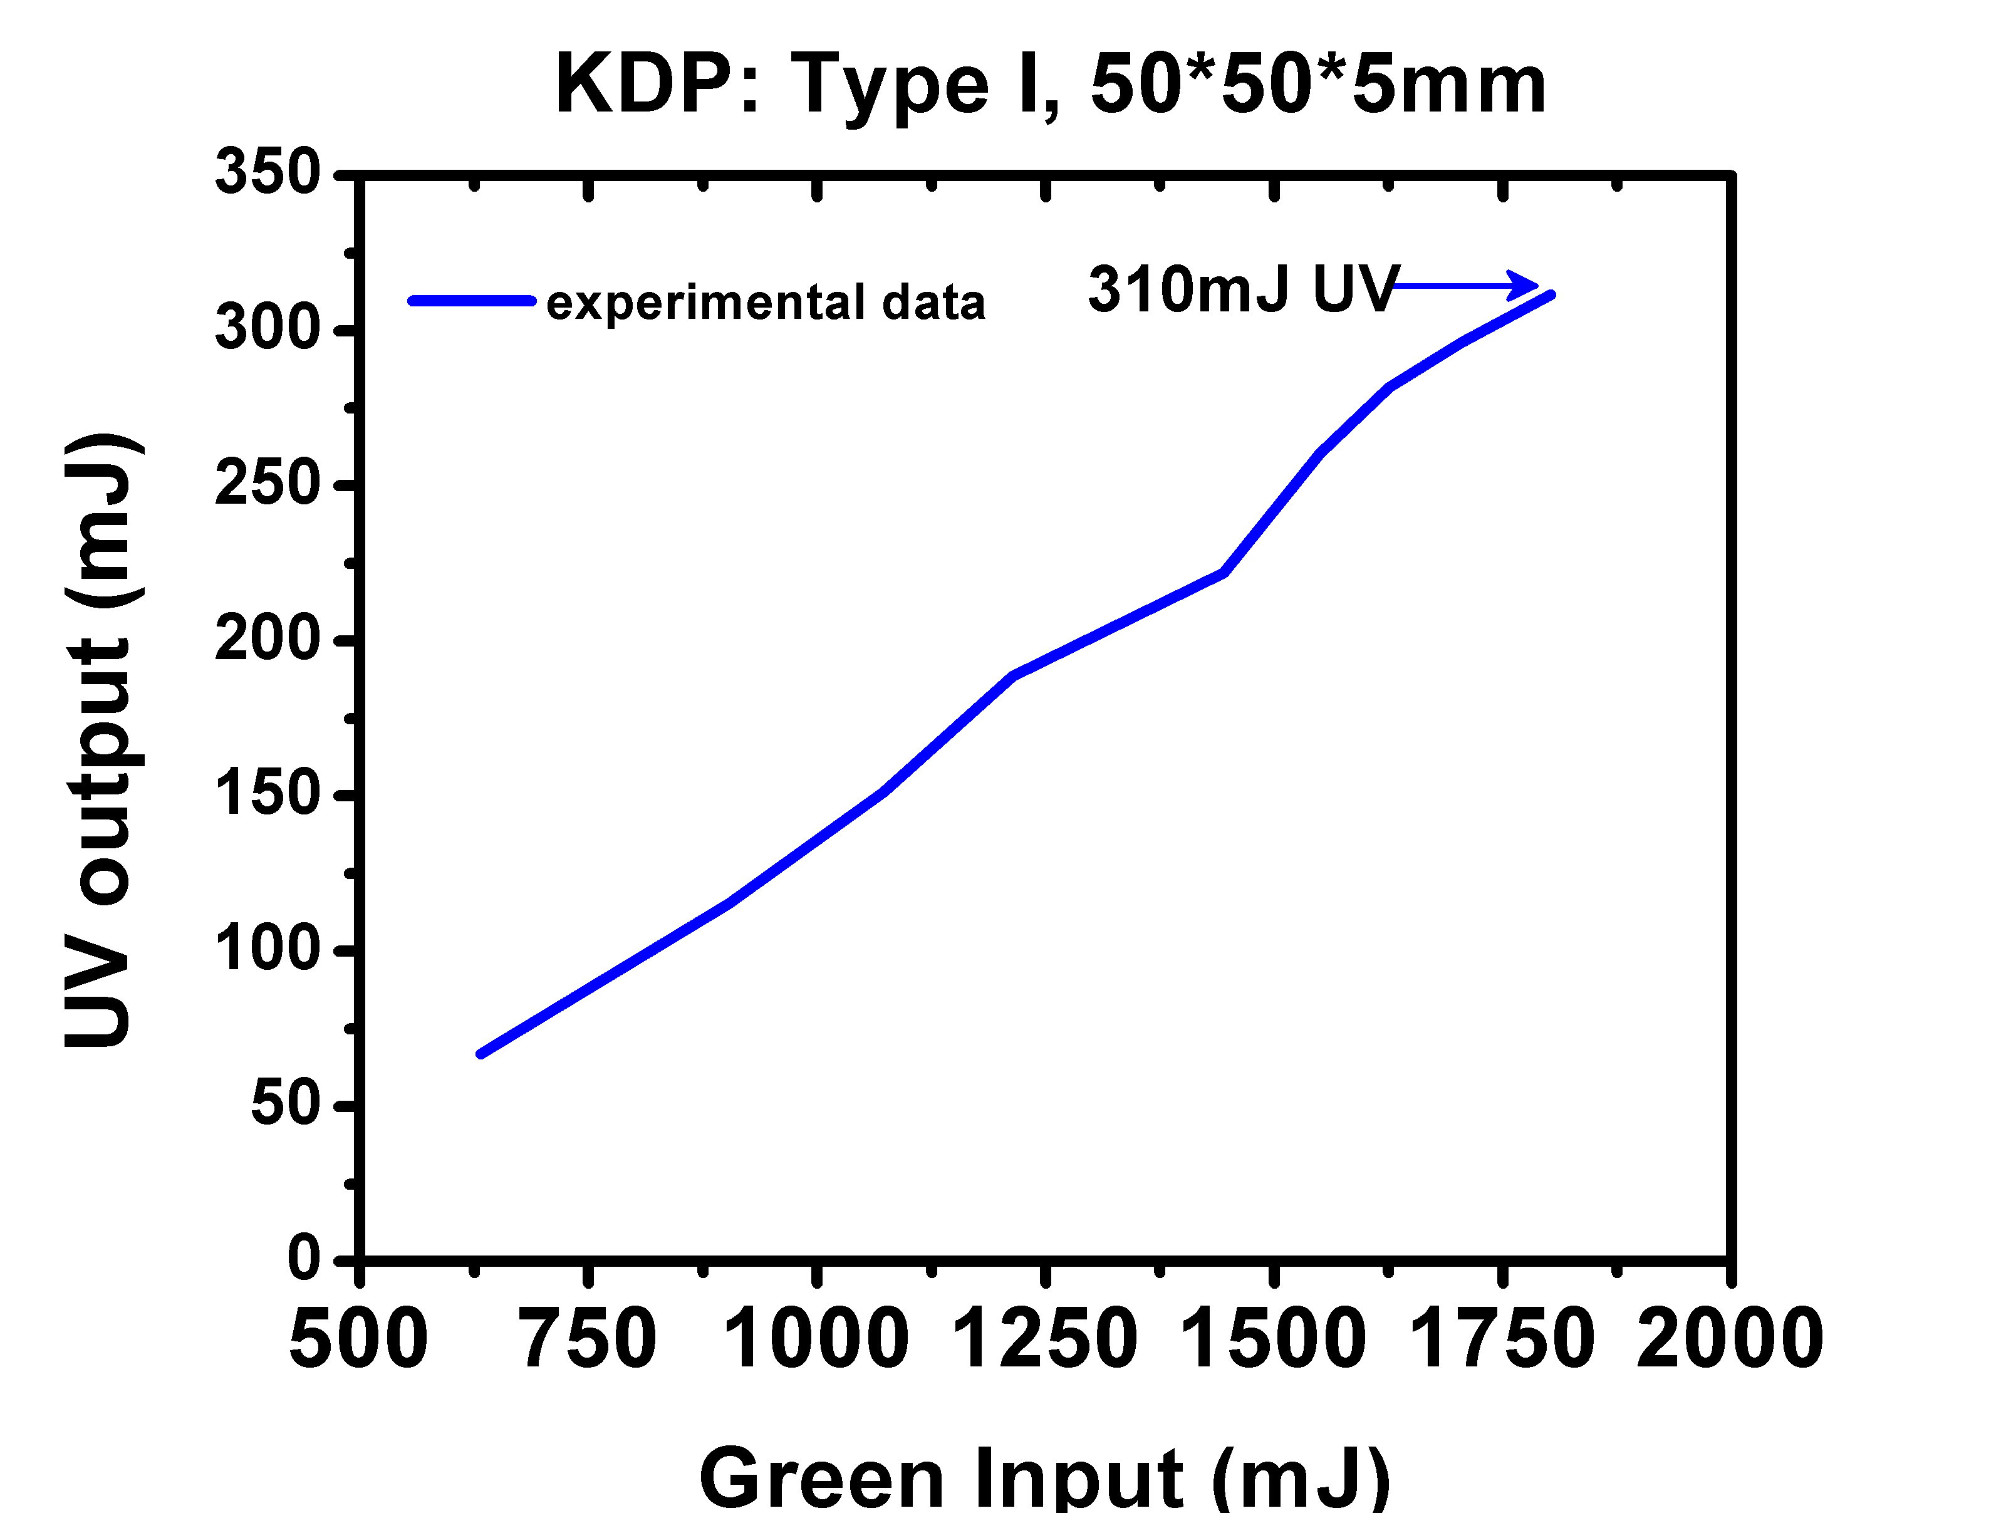
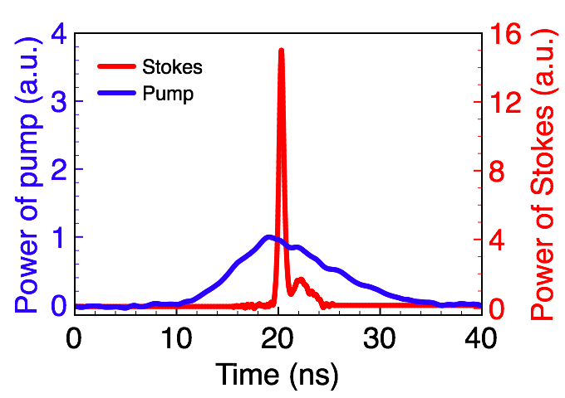
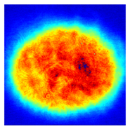
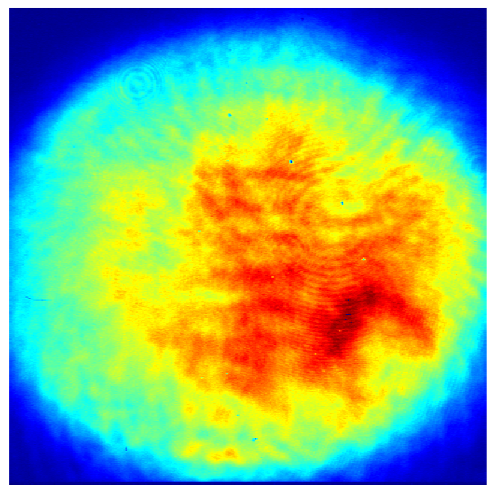
UV laser system
670ps pulse width, 730mJ energy @1064nm
670ps pulse width, 3.7J energy @1064nm
10ns pulse width, 1J energy @1064nm
FWHM:
670ps
FWHM:
10ns

Slide 12
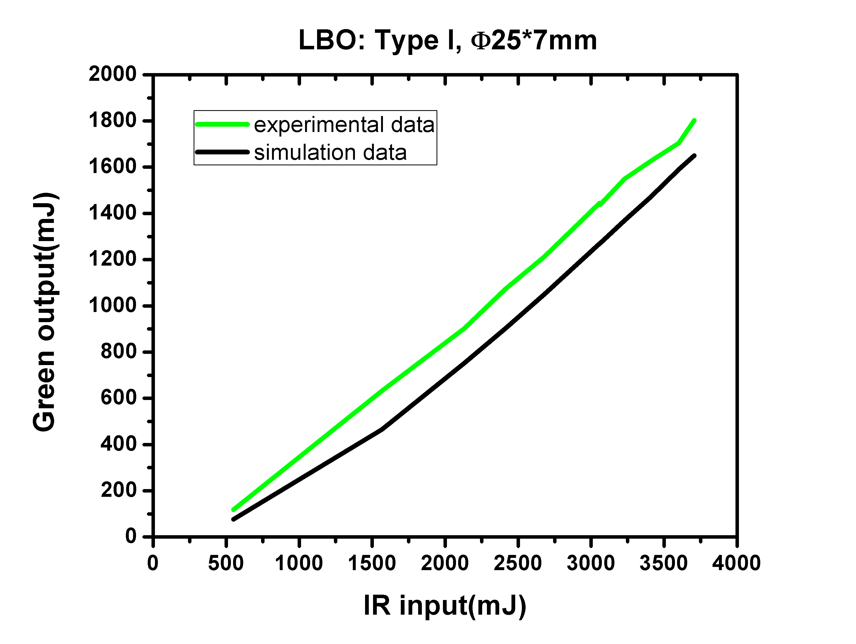
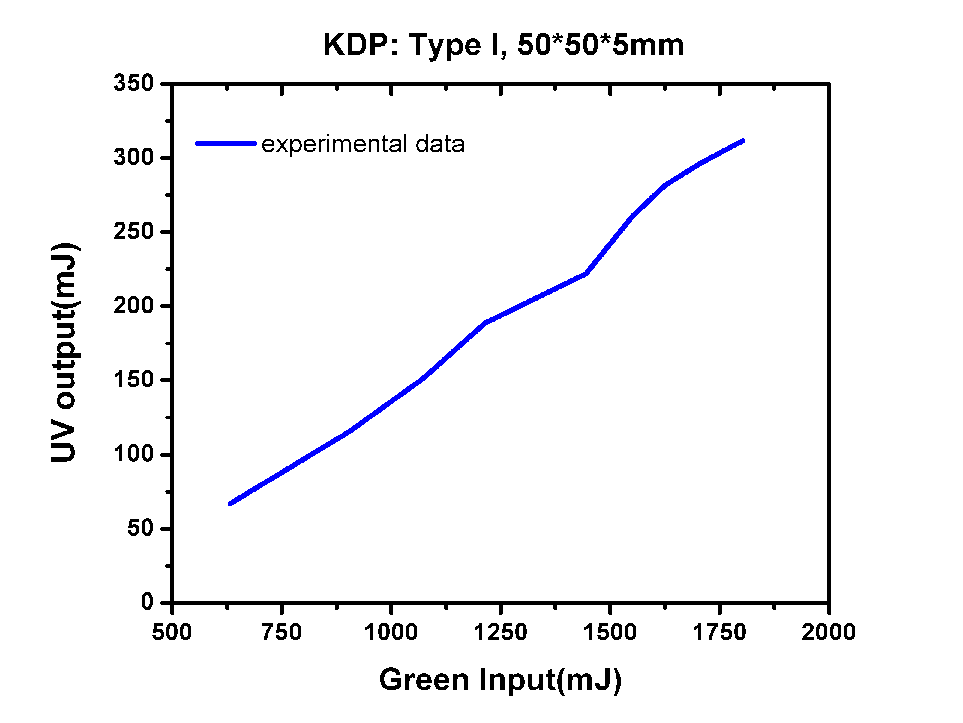
UV laser system
UV peak power @ 500-600MW
New KDP crystal 50*50*10mm could push this close to 1GW

Slide 13
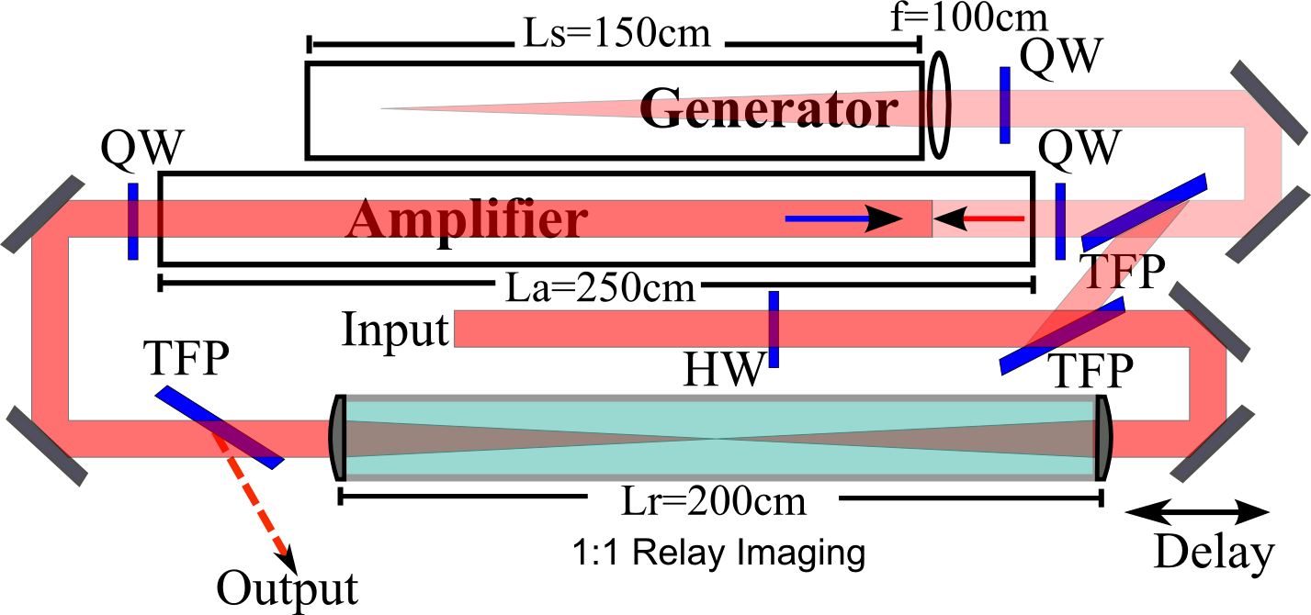
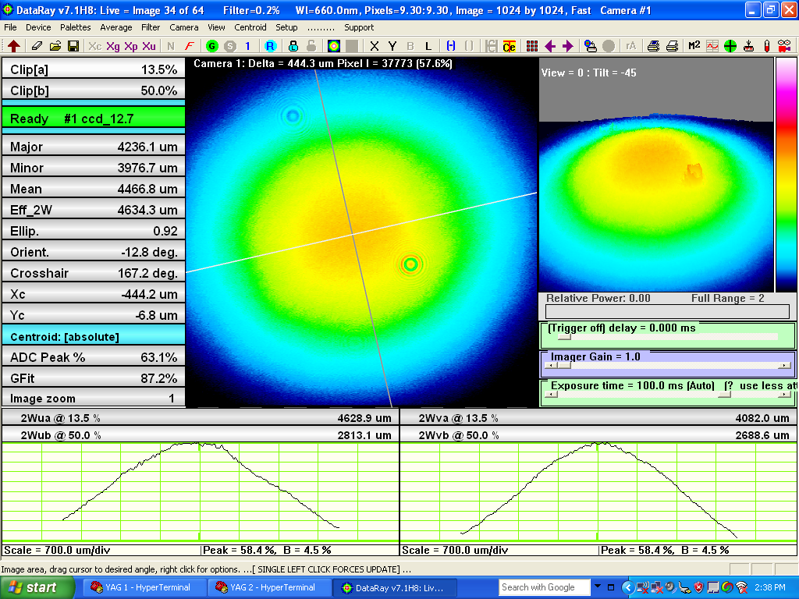
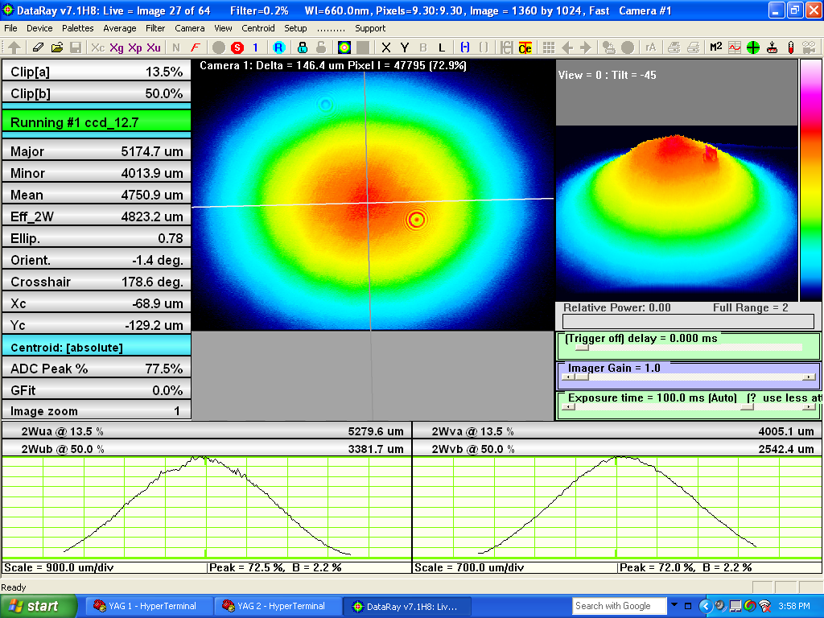
Current UV source limitation:
Aberration from amplifier cell
Generator-Amplifier setup gains the advantage of high energy capacity but also looses the phase conjugation property

Slide 14
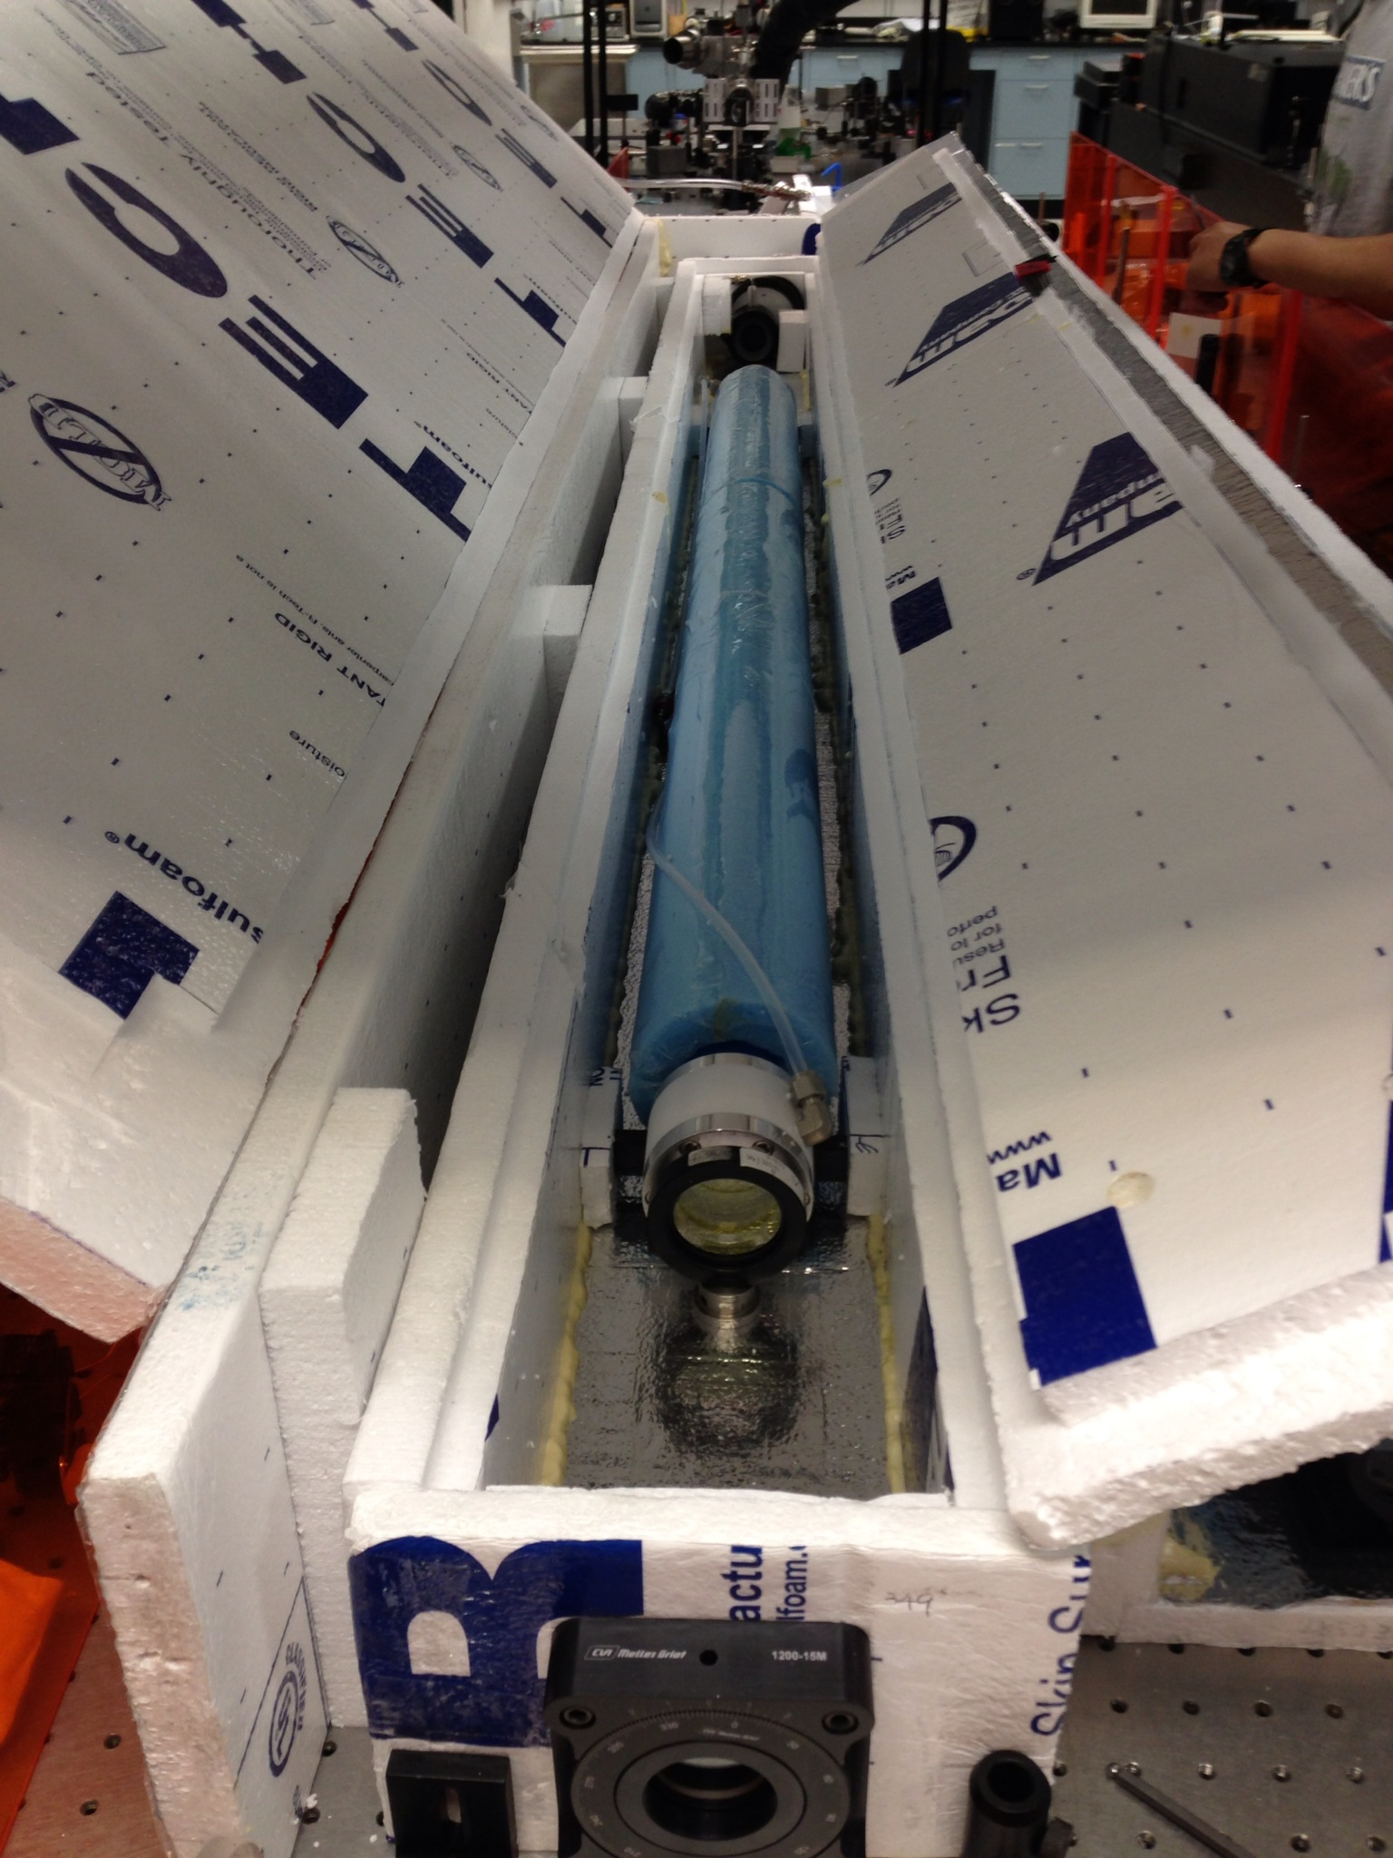
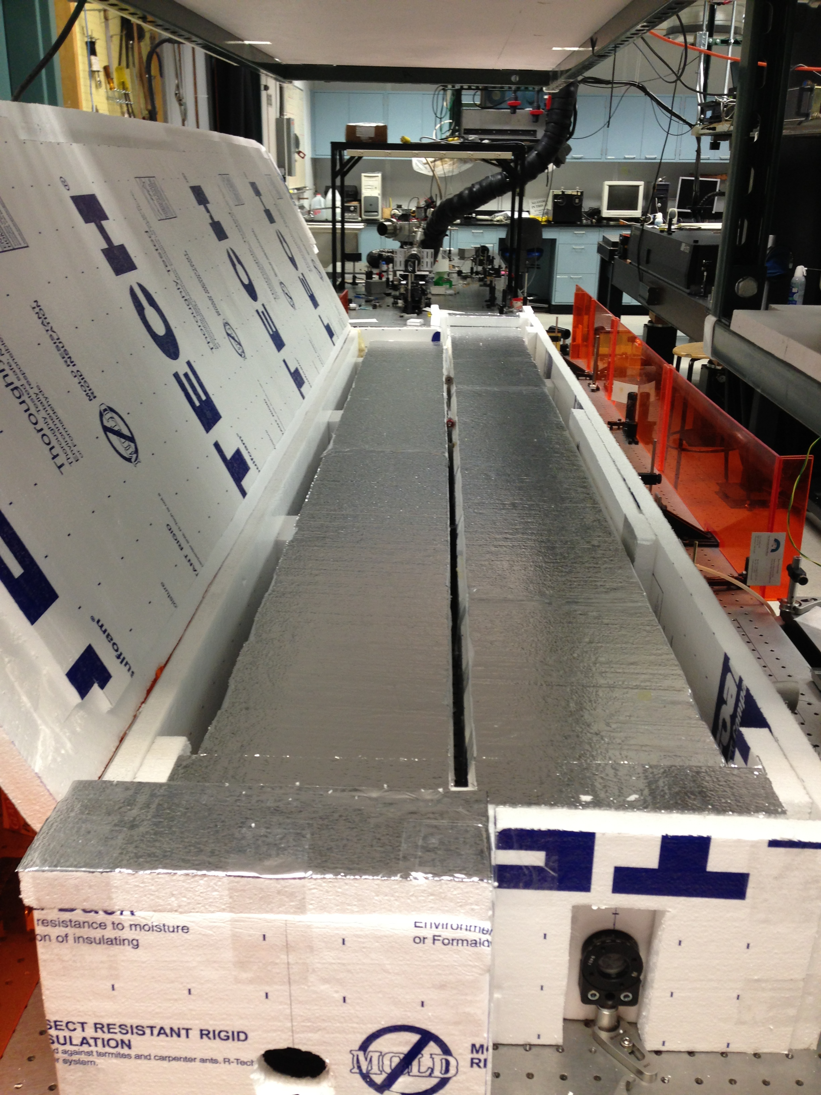
Current UV source limitation :
Aberration from amplifier cell

Slide 15
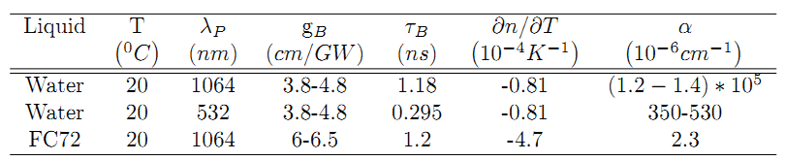
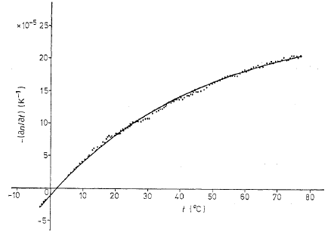
Pulse compression in water
[1] G. Abbate, et al. The temperature dependence of the refractive index of water. J. Phys. D: Appl. Phys. 11, 1167 (1978)
Notes:
Heavy water in list as backup
2nd version water cell picture

Slide 16
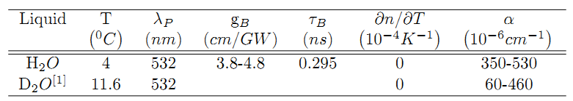
Pulse compression in water
Cooling Liquid
2” OD
Distilled water
2.5 m
Ver. 1.0
2.5 m
Cooling Liquid
2.75” ID
Distilled water
2.7 m
Ver. 2.0
[1] A. C. Tam, et al. Optical absorptions of light and heavy water by laser optoacoustic spectroscopy. Appl. Opt.. 18, 3348 (1979)
Notes:
Heavy water in list as backup
2nd version water cell picture

Slide 17
Pulse compression in water:
Single cell setup
QW
M
Wedge
BIPLANAR PHOTOTUBE
Hamamatsu R1328U-52
TFP
CCD
M
Input beam

Slide 18
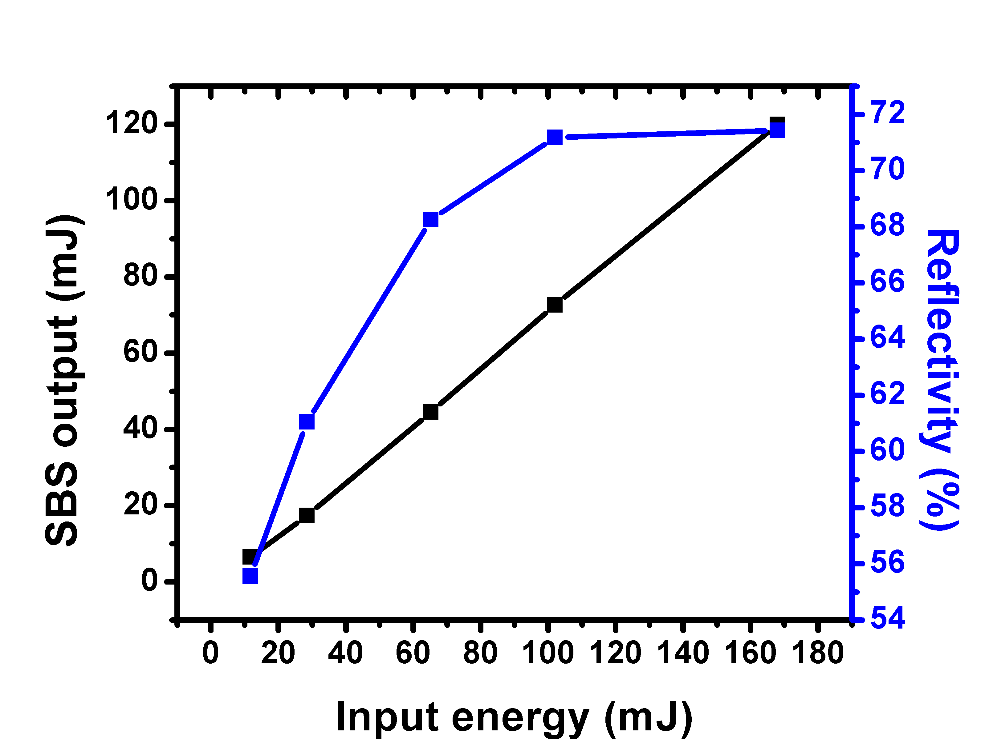
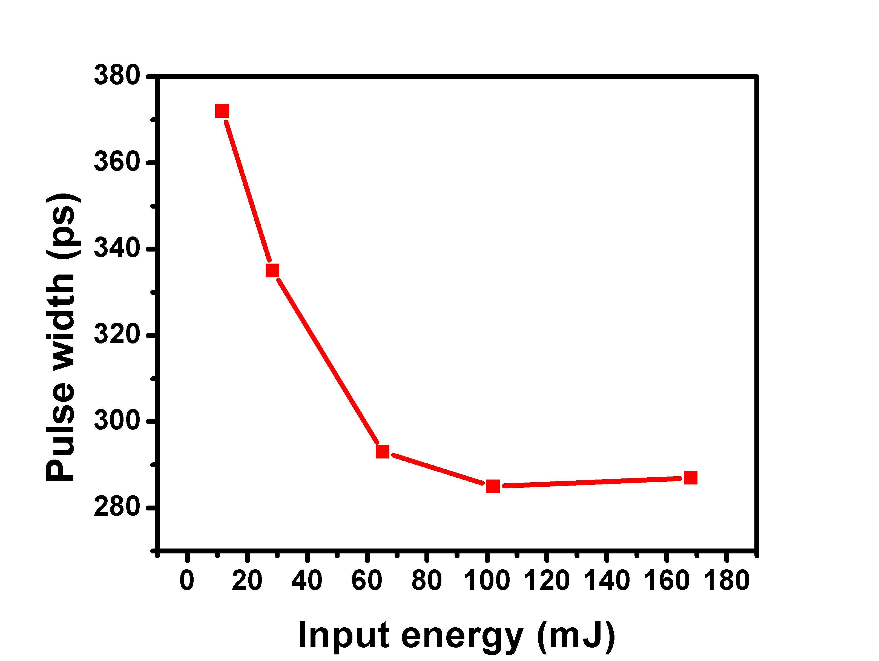
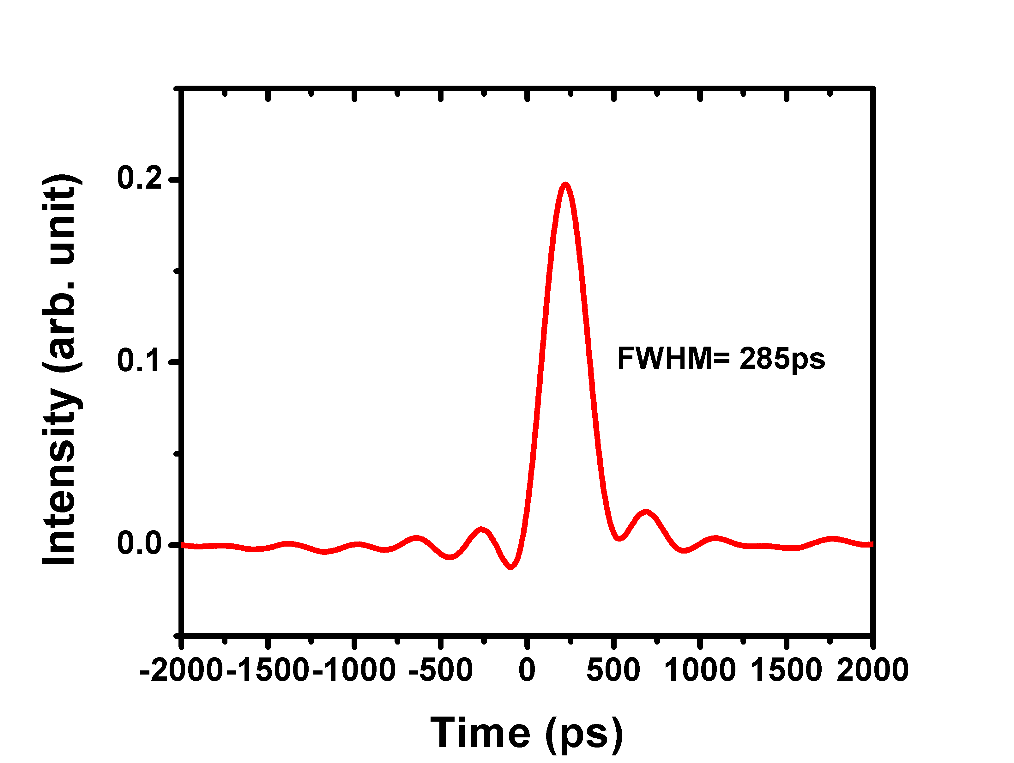
Pulse compression in water:
@ room temperature
SBS reflectivity saturates around 72%
Compressed pulse goes below the phonon lifetime of 295ps
The pulse width could be even shorter after the amplification stage

Slide 19
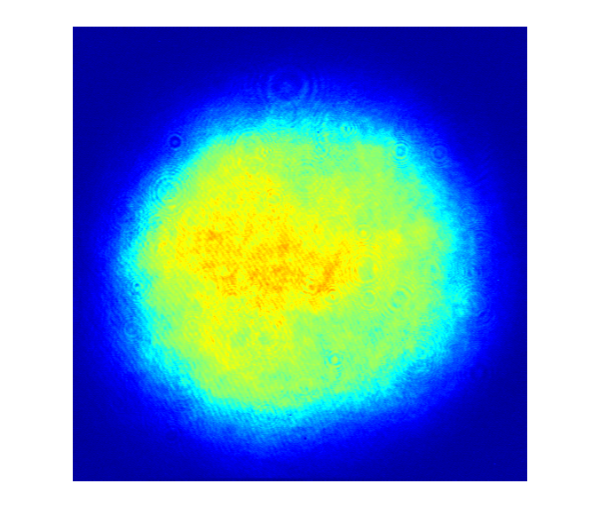
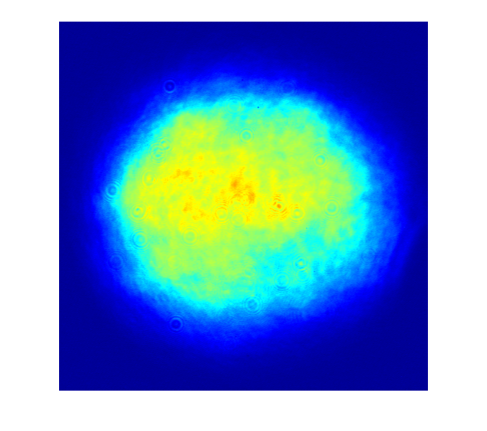
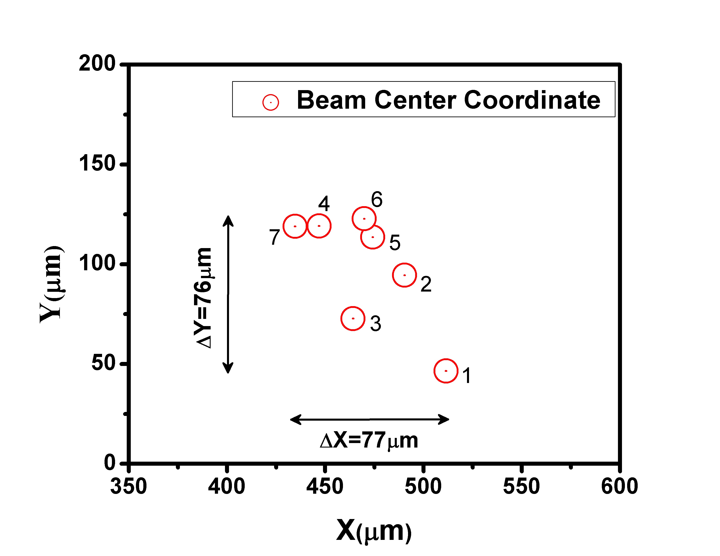
Pulse compression in water:
Distortion free test
Input profile before SBS cell
Profile at 7m away from the exit of SBS cell
Laser pointing stability

Slide 20
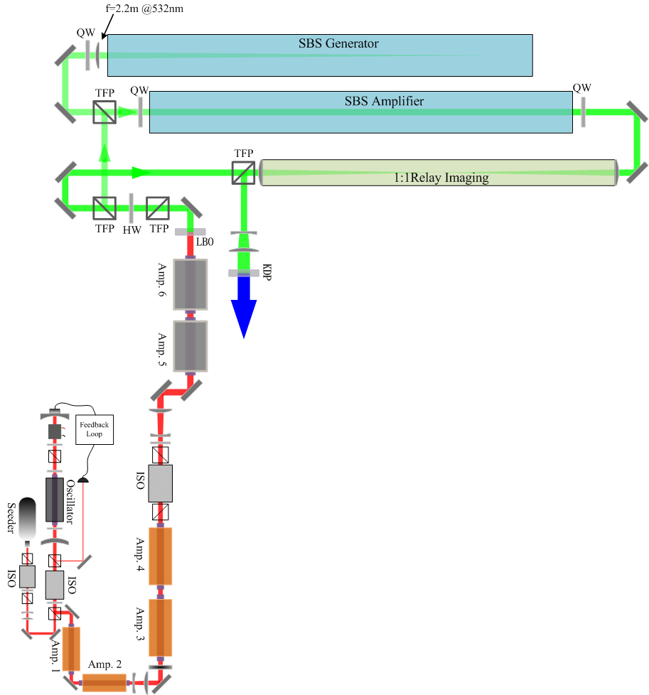
On-going work
New LBO (13.5*13.5*12.5mm) ➔ 3J, 10ns @532nm
Water @4⁰C ➔ 2J, 250ps @532nm
New KDP (50*50*10mm) ➔ 300mJ 200-250ps @266nm
1 GW peak power 266 nm source, generate and study sub-ns UV filament!

Slide 21
Summary
We developed a new method for stable single axial mode operation of an injection seeded Nd:YAG laser at low repetition rate
We investigated pulse compression through SBS process with generator-amplifier setup both theoretically and experimentally
We realized a UV source with sub GW to 1 GW peak power but also found its limitation in application of filament research
We did preliminary pulse compression experiments in Water and confirmed its better spatial and temporal performance

Slide 22
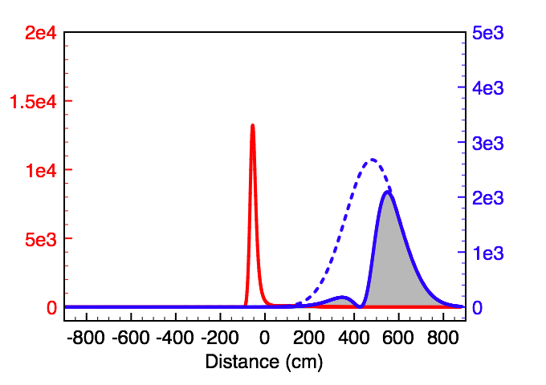
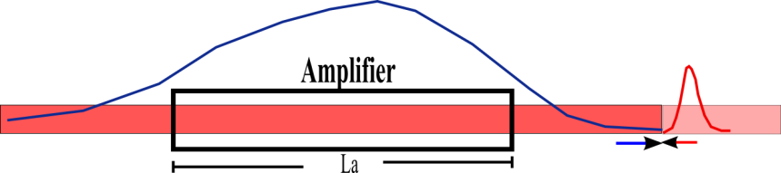
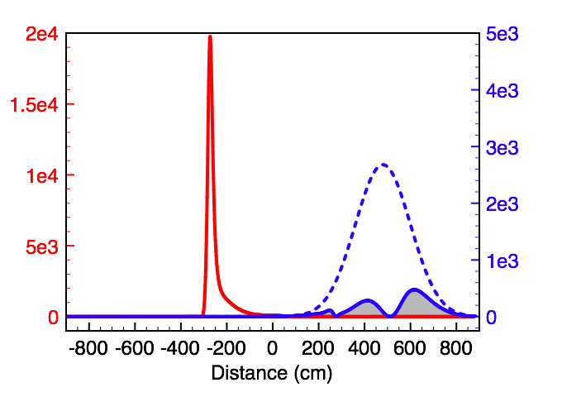
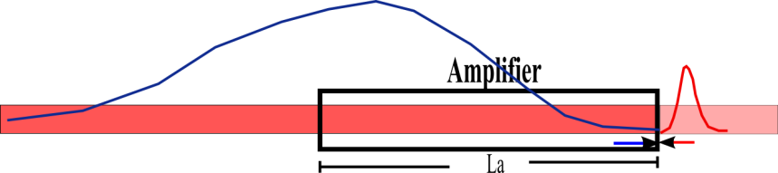
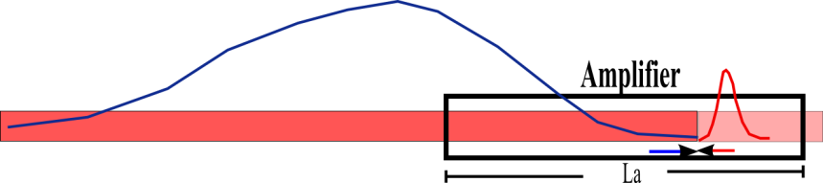
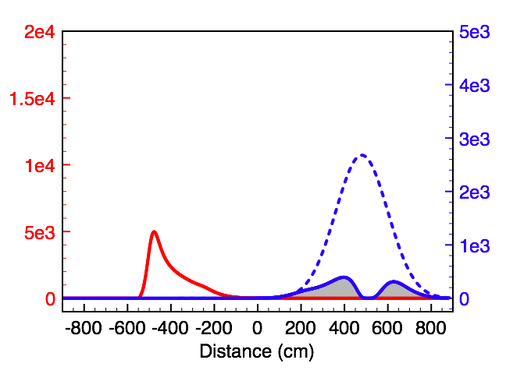
What’s important in this setup:
1) Interaction length/timing control
Delay 1: Stokes seed comes
too late---Lower efficiency
(b) Delay 2: Stokes seed comes
at the right time---Perfect
(c) Delay 3: Stokes seed comes too early---Effective
interaction length becomes shorter such that
amplified Stokes peak power decreases and
more energy goes to pulse tail
Notes:
What’s important in this setup:1) Interaction length: timing control

Slide 23
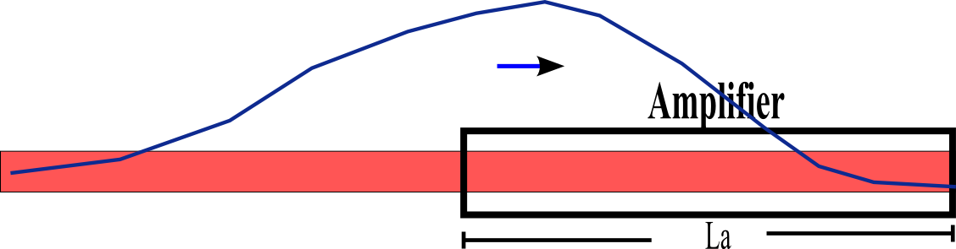
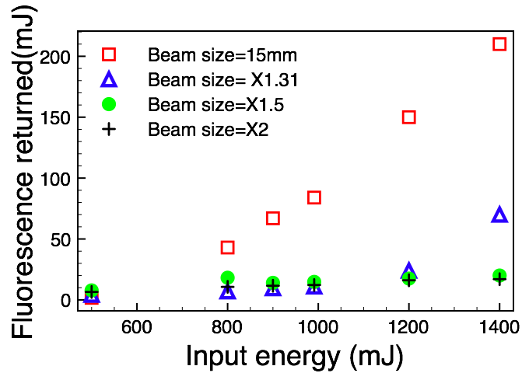
What’s important in this setup:
2) Beam size control
The magnification of 1.31 has been chosen to adapt limited optics size as well as the laser configuration
Notes:
What’s important in this setup:2) beam sizecontrol
Seed taking away
Brillouin scattering from pump

Slide 24
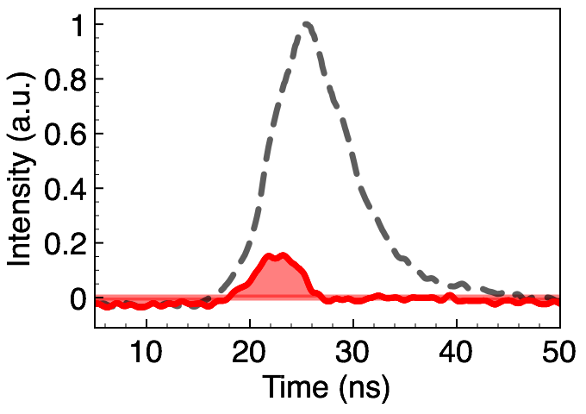
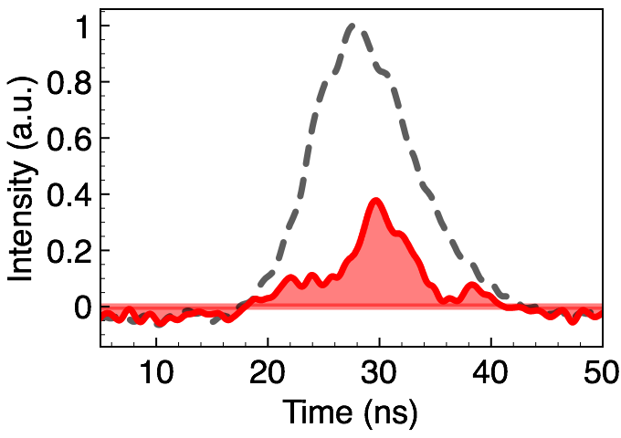
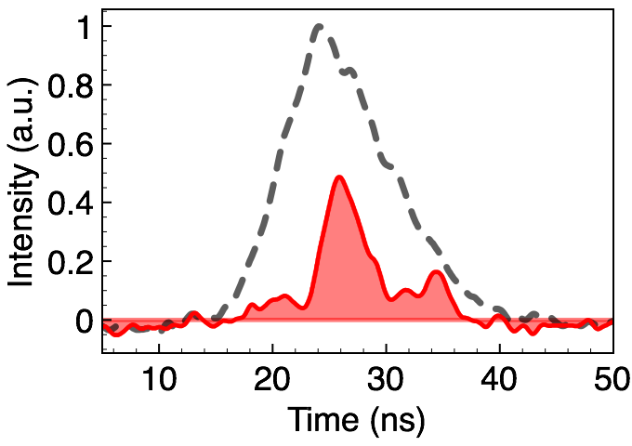
(a) Es=8mJ,E_{T}=60mJ
(b) Es=40mJ, E_{T}=550mJ
(c) Es=40mJ, E_{T}=1010mJ

