Slide 1
LIGHT-MATTER INTERACTION
The Wigner distribution
Moments
Define the instantaneous frequency in time and frequency Wigner applied to pulse measurements
Time bandwidth product
Time-Bandwidth product to Uncertainty relations
A SHORT DIGRESSION TO QUANTUM MECHANICS

Slide 2


If it is not “quantum”, forget it.
Today, everything is quantum, even:
UPS Quantum View
Your package has been delivered.
Delivery Time:
09:39 AM
Delivery Date:
Even dishwashing soap is “Quantum”!
Monday, 06/17/2019
…and they do not even satisfy Schroedinger equation!
Fortunately, physicists are rational people and do not fall for the “fashion”.
THINK AGAIN!

Slide 3
LIGHT-MATTER INTERACTION
The Wigner distribution
Moments
Define the instantaneous frequency in time and frequency Wigner applied to pulse measurements
Time bandwidth product
Time-Bandwidth product to Uncertainty relations
Uncertainty relations to Schroedinger equation
Particle wave duality
Uncertainty relations
The double slit experiment

Slide 4
THE WIGNER REPRESENTATION
Eugene Paul Wigner, born in Budapest, Hungary, on November 17, 1902.
Won the 1963 Nobel Prize in Physics for his foundational contributions to symmetry principles in quantum mechanics and nuclear physics.
PhD 1925 TH Berlin
Left Germany in 1030 → Princeton University
Manhattan Project at the University of Chicago during World War II, from 1942 to 1945.
Atoms for Peace Award, in 1960.
Krzysztof Antoni Wódkiewicz
(21 February 1949 – Zabrzu^{[3]}14 November 2008

Slide 5
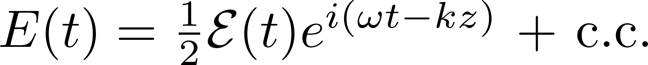
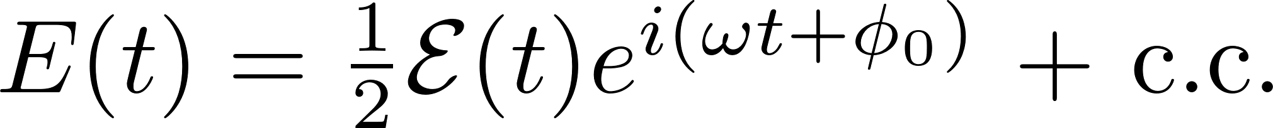
Different representations of a signal
Carrier to envelope phase and carrier to envelope offset
Carrier to envelope phase: a definition independent of a carrier and envelope
Carrier to envelope offset: it is a frequency, and exists only in combs
No carrier, but envelopes in time and frequency: the Wigner representation

Slide 6


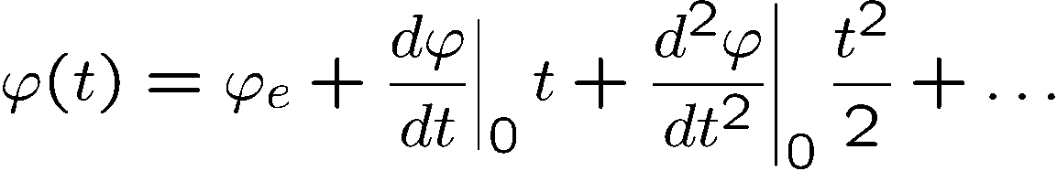
Description of an optical pulse
How to get to complex notations the easy way
Real electric field:
Fourier transform:
Positive and negative frequencies: redundant information
Eliminate
Relation with the real physical measurable field:
Instantaneous frequency
Notes:
we summarize the essential notations and definitions.
Inside the laser typically, only one pulse circulate. A complex representation
of the field amplitude is particularly convenient in dealing with
propagation problems of electromagnetic pulses.

Slide 7
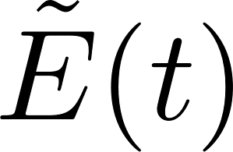



Wigner Distribution
Ref: L. Praxmeier and K. Wodkiewicz. Time and frequency description of optical pulses.
arXiv:physics, 0502079v2:1–12, 2005.
Pulse measurements?
You can measure I(t) – that does not give you
You can measure I(Ω) – that does not give you.
Can we replace the notion amplitude-phase by intensity in time vs intensity in frequency?
Space-time analogy:
Beam measurements?
You can measure I(x,y) – that does not give you
You can measure I(k_{x}, k_{y}) – that does not give you.
-> Wigner function plot I(x, y) vs I(kx, ky)

Slide 8
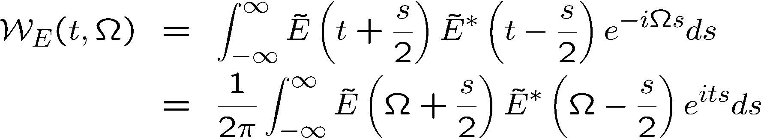
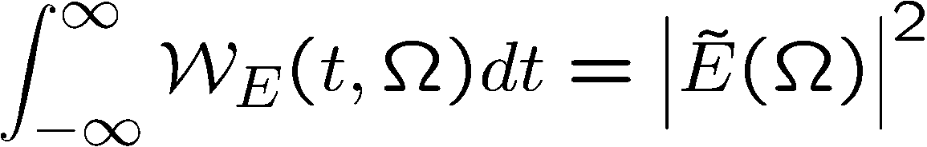
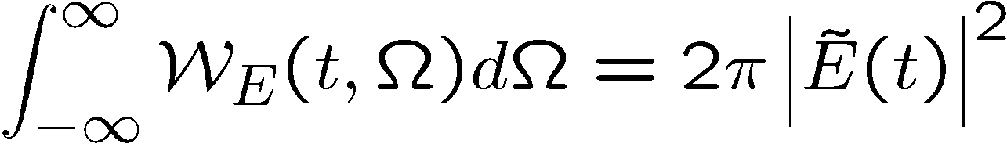
TIME-FREQUENCY
Pulse duration, Spectral width
Two-D representation of the field: Wigner function

Slide 9
Wigner Distribution
Gaussian
Chirped Gaussian

Slide 10
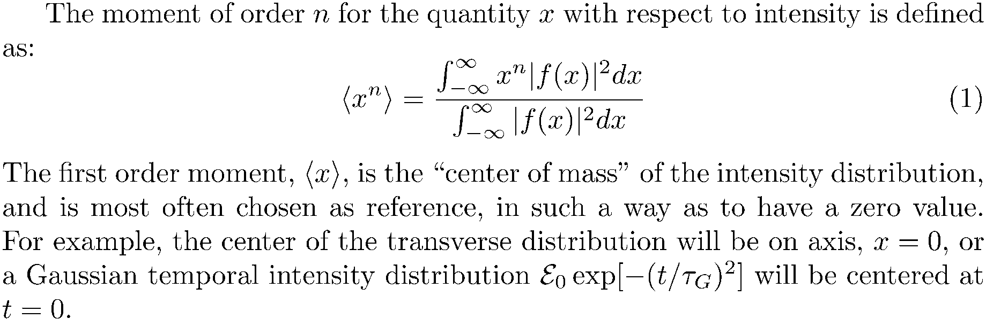
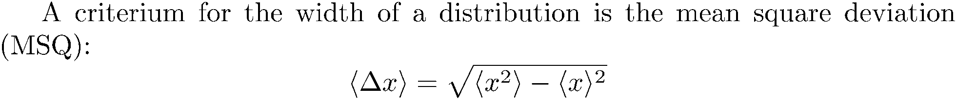
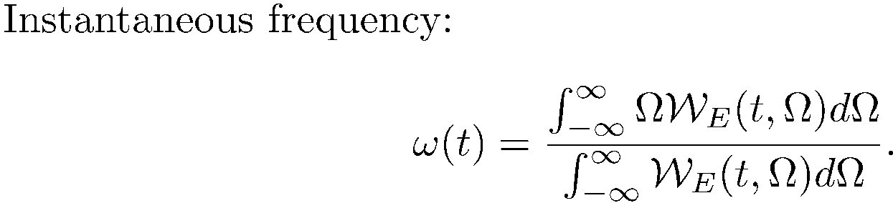

Slide 11
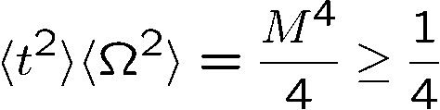
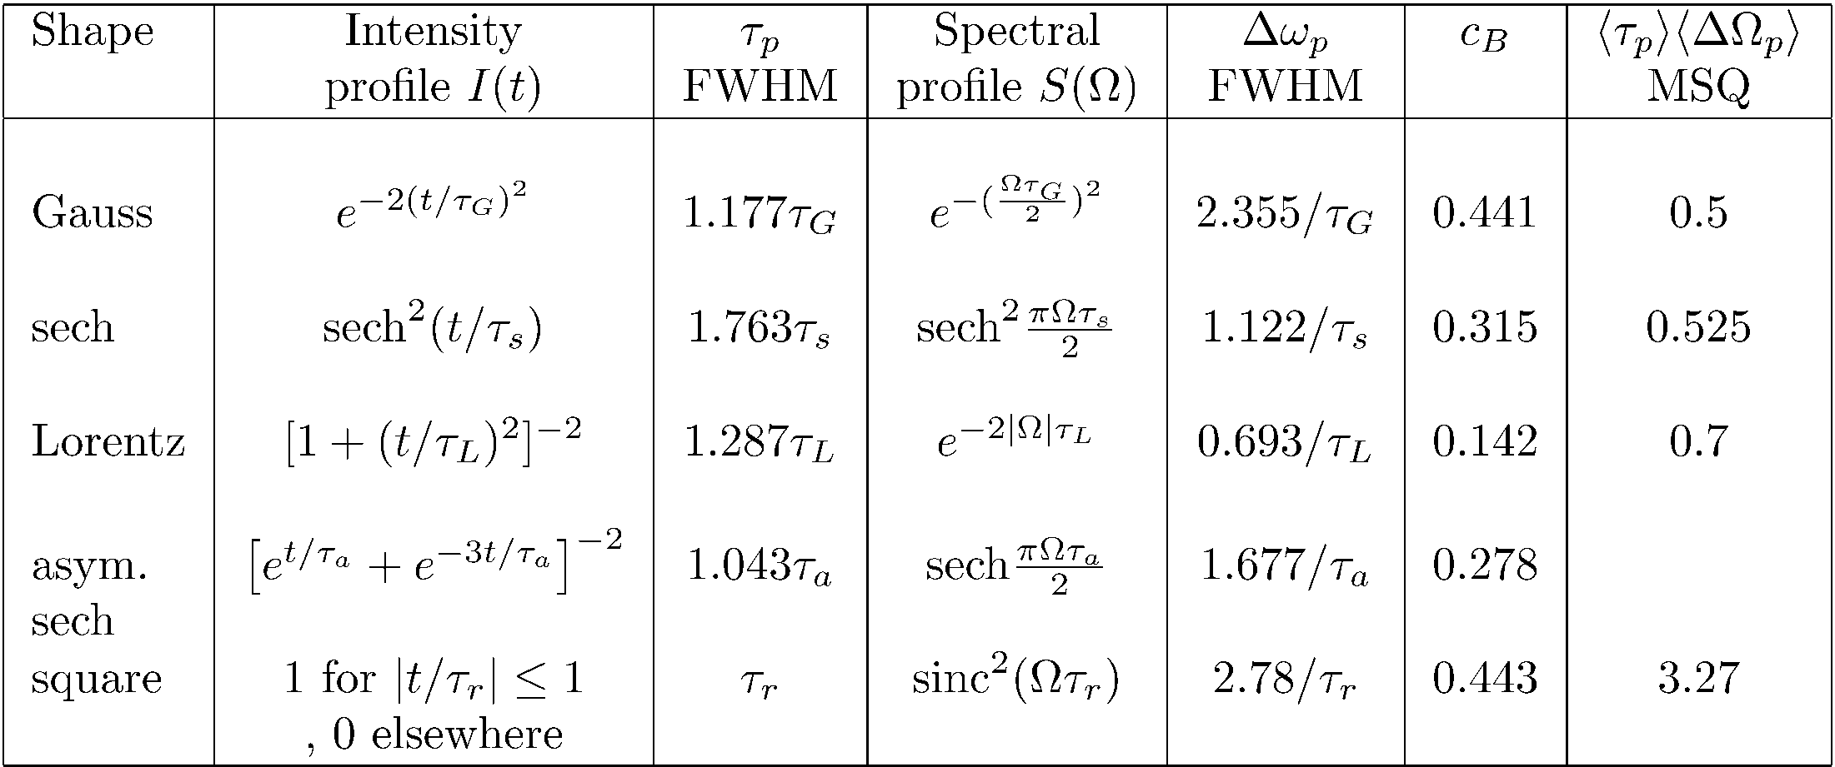
Uncertainty relation
Only holds for the pulse widths defined as
the mean square deviation

Slide 12
LIGHT-MATTER INTERACTION
The Wigner distribution
Moments
Define the instantaneous frequency in time and frequency Wigner applied to pulse measurements
Time bandwidth product
Time-Bandwidth product to Uncertainty relations
Uncertainty relations to Schroedinger equation
Particle wave duality
Uncertainty relations
The double slit experiment
LASER-MATTER INTERACTION
Bloch Vector Model
Coherent propagation
Photon Echoes
Free induction decay
Coherent transients
From transients to steady state

Slide 13
You have I(t) and I(Ω), how do you reconstruct the field in amplitude and phase?
THE WIGNER distribution
Ref: L. Praxmeier and K. Wodkiewicz. Time and frequency description of optical pulses.
arXiv:physics, 0502079v2:1–12, 2005.
Pulse measurements?
You can measure I(t) – that does not give you
You can measure I(Ω) – that does not give you.
Can we replace the notion amplitude-phase by intensity in time vs intensity in frequency?
Space-time analogy:
Beam measurements?
You can measure I(x,y) – that does not give you
You can measure I(k_{x}, k_{y}) – that does not give you.
-> Wigner function plot I(x, y) vs I(kx, ky)

Slide 14
TIME-FREQUENCY
Pulse duration, Spectral width
Two-D representation of the field: Wigner function

Slide 15
Wigner Distribution
Gaussian
Chirped Gaussian

Slide 16
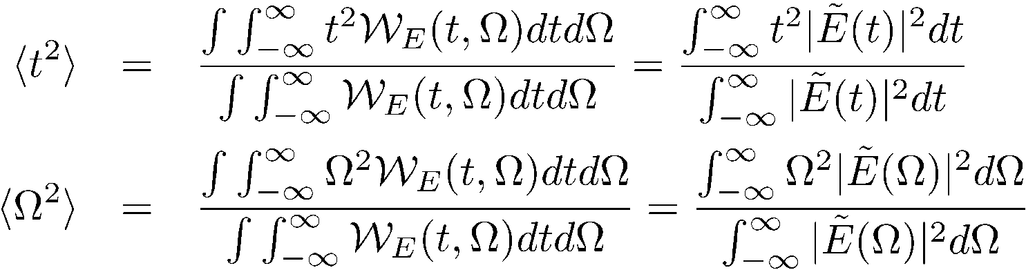
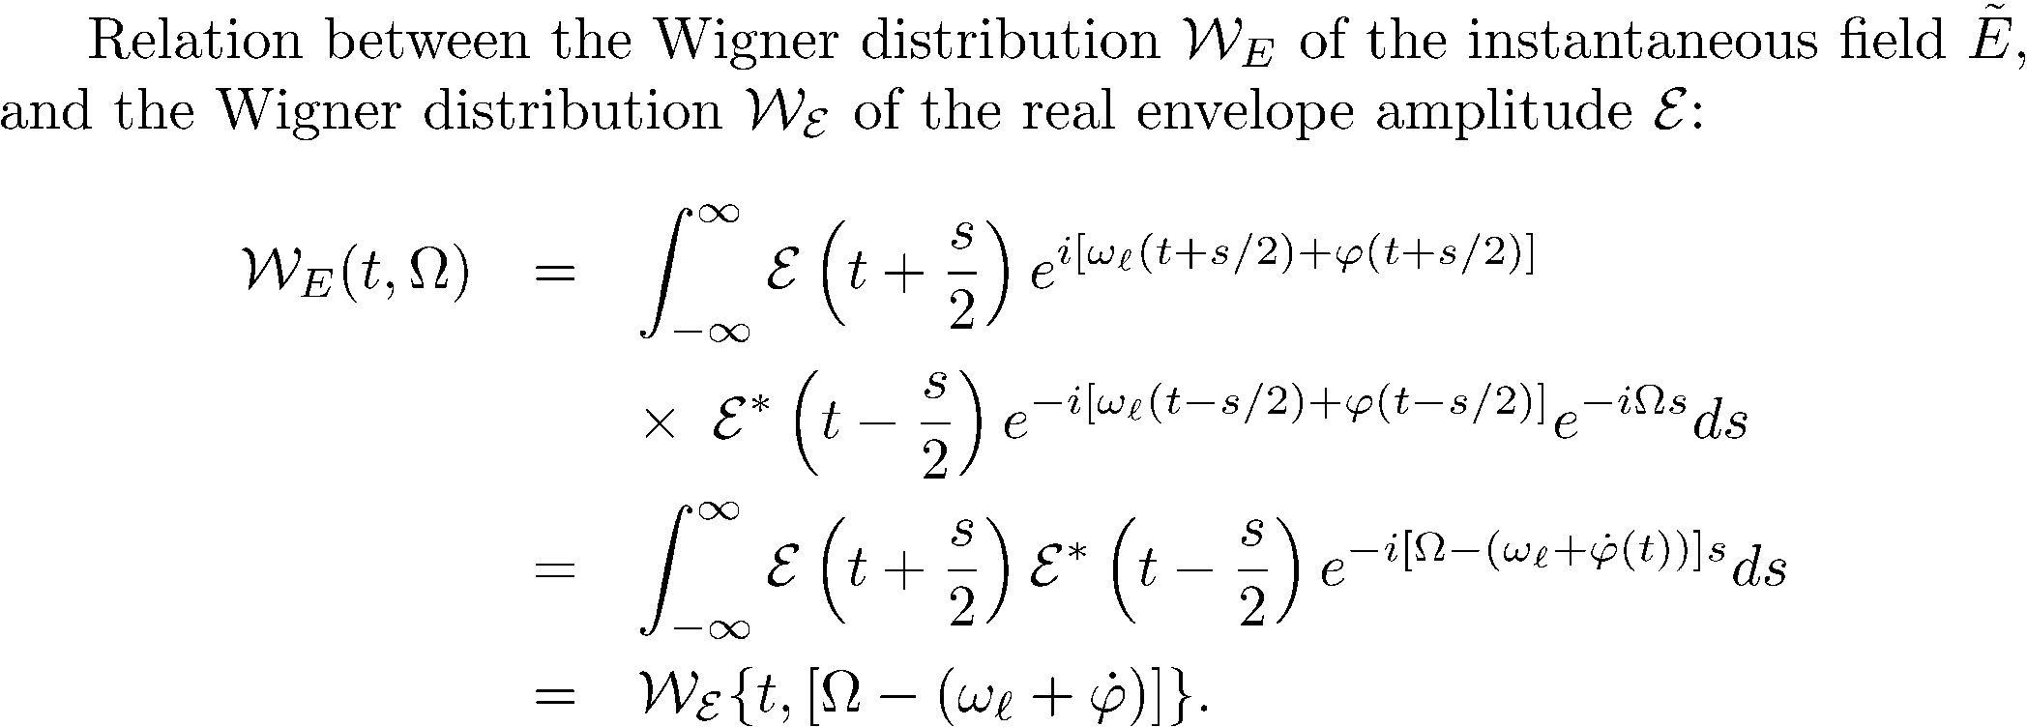
Wigner Distribution
Second moments

Slide 17
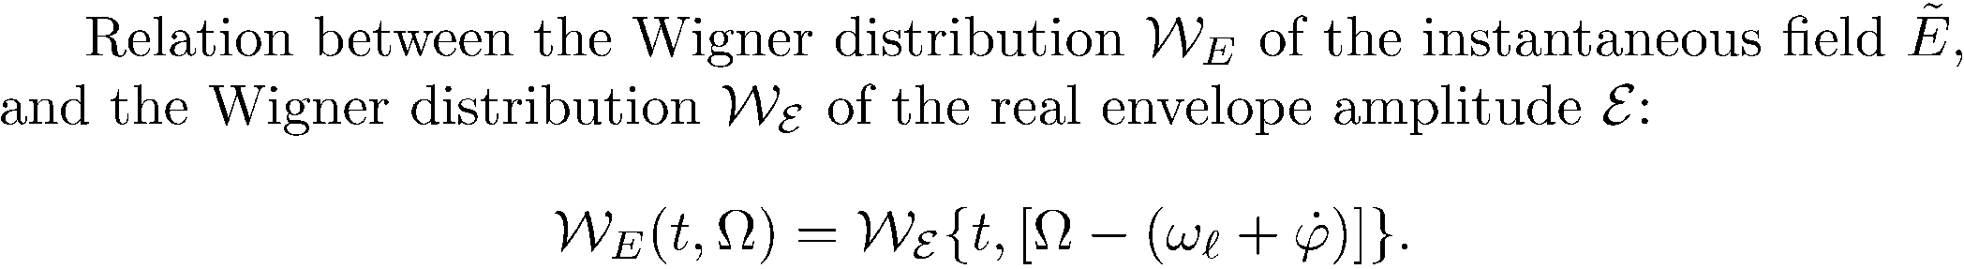

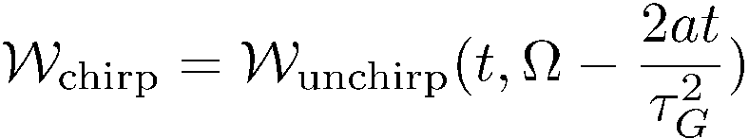
Unchirped Gaussian

Slide 18
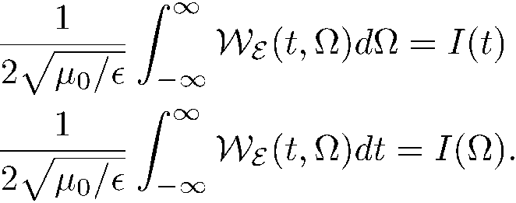
The intensity and spectral intensities are directly proportional to frequency
and time integrations of the Wigner function.
2
2
2
2
1
1
1
1
Frequency
Frequency
Frequency
Frequency
0
0
0
0
-1
-1
-1
-1
-2
-2
-2
-2
-2
-2
-1
-1
0
0
1
1
2
-2
2
-2
-1
-1
0
0
1
1
2
2
Time
Time
Time
Time
Unchirped Gaussian

Slide 19
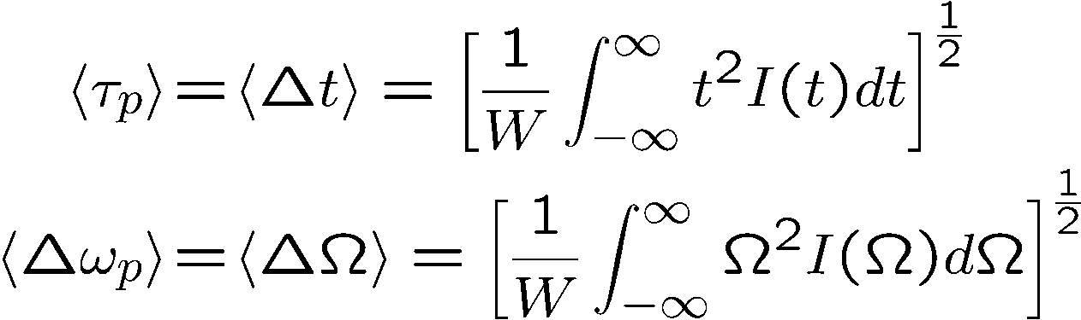
Wigner Distribution
Second moments
Gaussian
Chirped Gaussian

Slide 20
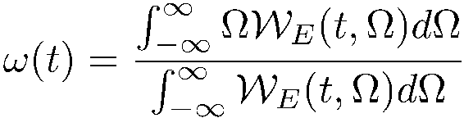
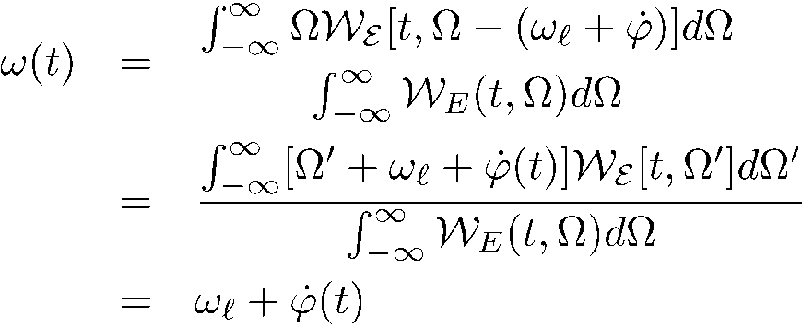

Wigner Distribution
Second moments
Instantaneous frequency: is it the derivative of the phase, or the center of gravity of the spectrum?
where we used the fact that

Slide 21
LIGHT-MATTER INTERACTION
The Wigner distribution
Moments
Define the instantaneous frequency in time and frequency Wigner applied to pulse measurements
Time bandwidth product
Time-Bandwidth product to Uncertainty relations
Uncertainty relations to Schroedinger equation
Particle wave duality
Uncertainty relations
The double slit experiment
LASER-MATTER INTERACTION
Bloch Vector Model
Coherent propagation
Photon Echoes
Free induction decay
Coherent transients
From transients to steady state

Slide 22
TIME-FREQUENCY
Pulse duration, Spectral width
Can a measurement provide a two-D representation of the field (Wigner function)
The FROG
Frequency Resolved Optical Gating

Slide 23
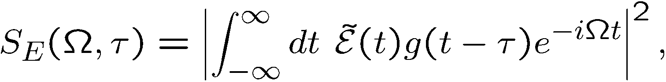
The FROG
Frequency Resolved Optical Gating
It is a time gated spectrum, measuring a two D function:
References:
Advantage: the raw data give a nice representation
Disadvantage: considerable iterations
FROG Trebino,
Kluwer, 2002
Adam S. Wyat
PhD Thesis
University of Oxford
(2007)

Slide 24
Spectrograms for Linearly Chirped Pulses
Negatively chirped Unchirped Positively chirped
Frequency
Time
Frequency
Delay
Like a musical score, the spectrogram visually displays the frequency vs. time (and the intensity, too).
Notes:
24

Slide 25
As in all measurements, there is competition between accuracy in amplitude or phase
Algorithms exist to retrieve E(t) from its spectrogram.
The spectrogram essentially uniquely determines the waveform intensity, I(t), and phase, φ(t).
There are a few ambiguities, but they’re “trivial.”
The gate need not be—and should not be—much shorter than E(t).
Suppose we use a delta-function gate pulse:
= The Intensity.
No phase information!
Notes:
25

Slide 26
LIGHT-MATTER INTERACTION
The Wigner distribution
Moments
Define the instantaneous frequency in time and frequency Wigner applied to pulse measurements
Time bandwidth product
Time-Bandwidth product to Uncertainty relations
Uncertainty relations to Schroedinger equation
Particle wave duality
Uncertainty relations
The double slit experiment
LASER-MATTER INTERACTION
Bloch Vector Model
Coherent propagation
Photon Echoes
Free induction decay
Coherent transients
From transients to steady state

Slide 27
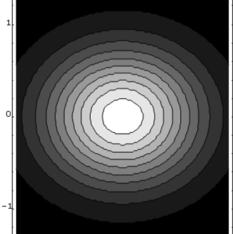
Minimum uncertainty
wave packet
Frequency
Time
“Pure state”
2
1
Frequency
0
-1
-2
-2
-1
0
1
2
Time

Slide 28
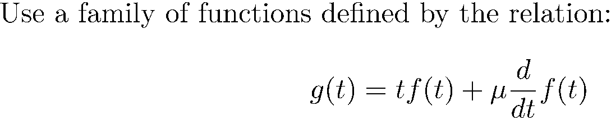

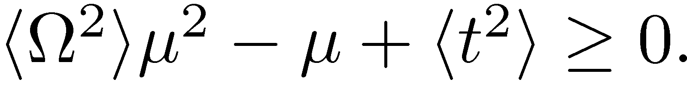
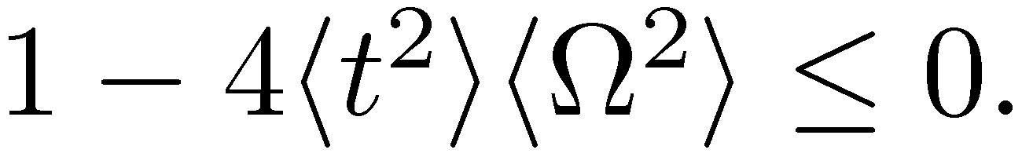
DERIVATION OF THE TIME-BANDWIDTH RELATIONS
Energy:
0
No roots implies

Slide 29
Wigner Distribution
Quantum Mechanics in 5 slides
Second moments
Instantaneous frequency: is it the derivative of the phase, or the center of gravity of the spectrum?
Uncertainty relation
where we used the fact that

Slide 30
LIGHT-MATTER INTERACTION
The Wigner distribution
Moments
Define the instantaneous frequency in time and frequency Wigner applied to pulse measurements
Time bandwidth product
Time-Bandwidth product to Uncertainty relations
Uncertainty relations to Schroedinger equation
Particle wave duality
Uncertainty relations
The double slit experiment
LASER-MATTER INTERACTION
Bloch Vector Model
Coherent propagation
Photon Echoes
The double slit experiment
Uncertainty relations
Coherent transients
From transients to steady state

Slide 31

Uncertainty relation
In space:
Only holds for the pulse widths defined as
the mean square deviation
Equality only holds for a Gaussian pulse (beam) shape free of any
phase modulation, which implies that the Wigner distribution for a
Gaussian shape occupies the smallest area in the time/frequency
plane.

Slide 32











Quantum Mechanics: just add particle-wave duality:
Particle of energy W Wave of frequency
Particle of momentum p Wave of wave vector k
The Heisenberg uncertainty relation is contained directly in:
and
No need for quantum mechanics – just the wave particle duality!
Particle Wave
Energy W
Momentum p

Slide 33


Photon number – phase uncertainty
Small number of photons: small uncertainty.
P(n)
Small number of photons: large phase uncertainty.
Large number of photons: small phase uncertainty.
n
time

Slide 34
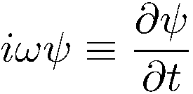
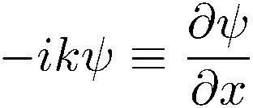
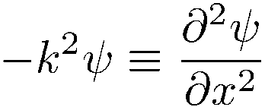
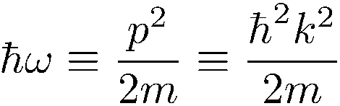
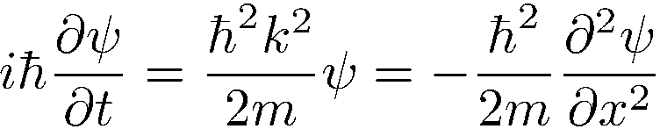
Particle wave duality, uncertainty principle, even leads to Schroedinger equation
The Wigner function in optics told us that:
and
Combine with particle-wave duality:
Particle Wave
Energy W
Momentum p
Particle-wave duality calls for a wave equation.
Differentiation with respect to t multiplication by ω
Differentiation with respect to x multiplication by k

Slide 35
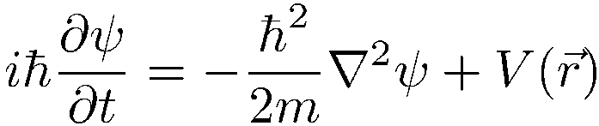
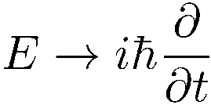


Slide 36
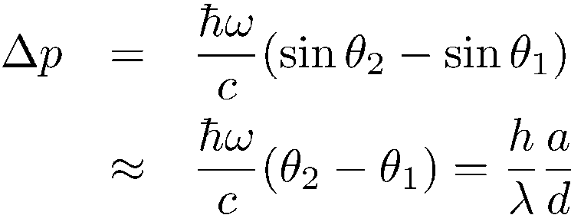
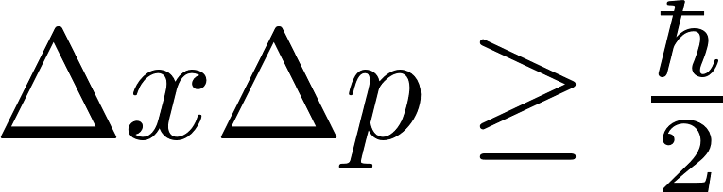
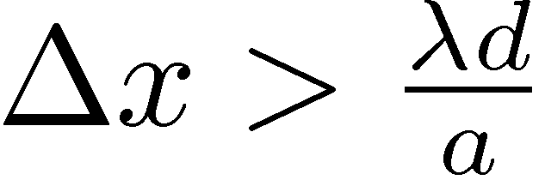
Double slit: a Gedanken experiment
You measure the momentum on the slitted screen each time a photon is detected on P
Δ(photon momentum)
P
θ₂
=
but
a
θ₁
=
The uncertainty is larger than the fringe spacing!
d

Slide 37
SUPERPOSITION OF WAVES
y
Waves of (nearly) the same k vector, same frequency:
Young’s double-slit experiment
P
S₁
a
S₂
Young’double-slit as a spectrometer: to each λ corresponds an angle θ,

