Slide 1
Nested parenthesis

Slide 2
Polarization dependence

Slide 3
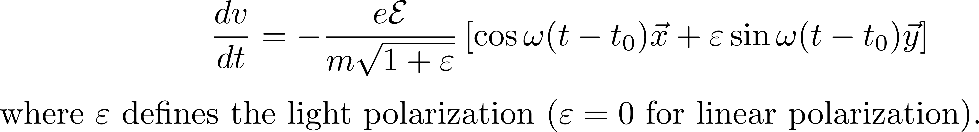
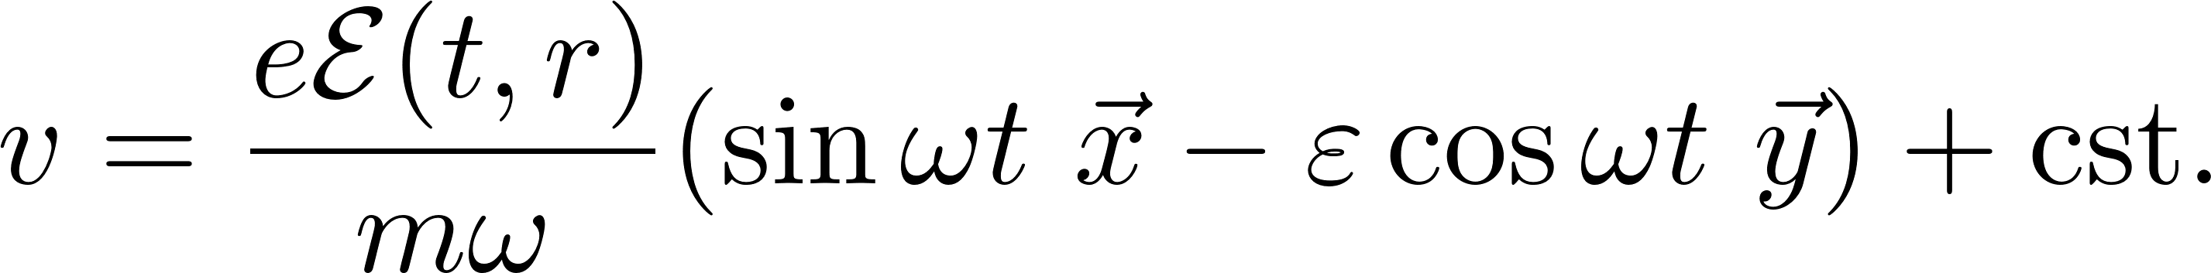
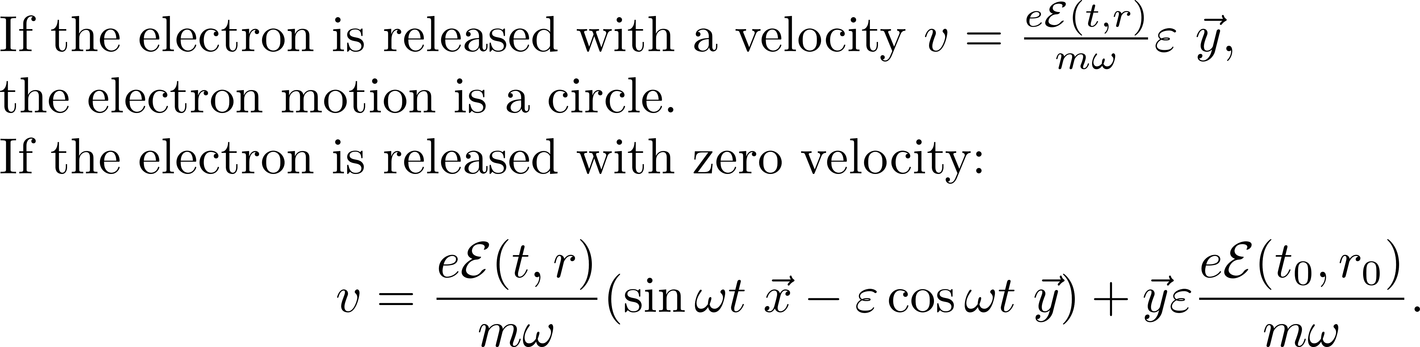
Polarization dependence
TRAJECTORY IN CIRCULAR POLARIZATION

Slide 4
EXPLOITING THIS PROPERTY TO GENERATE SINGLE ATTOSECOND PULSES

Slide 5
EXPLOITING THIS PROPERTY TO GENERATE SINGLE ATTOSECOND PULSES
Opening a little parenthesis: review of polarization

Slide 6
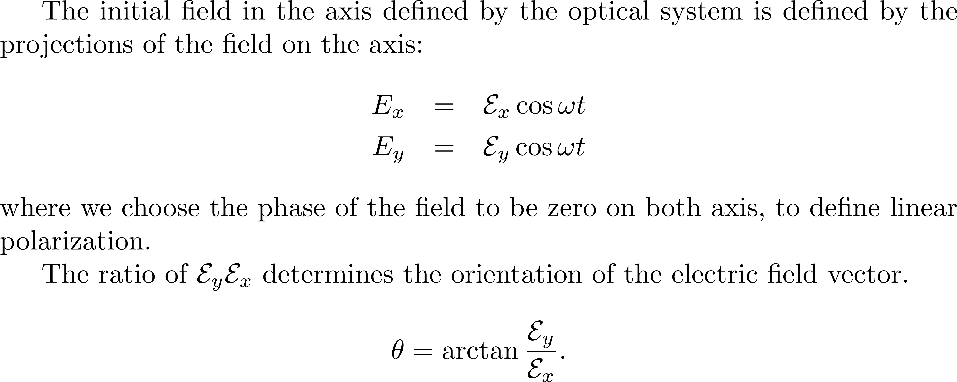

Slide 7


The rich man polarization manipulator
P
y
p
x
p
?
y
s
x

Slide 8
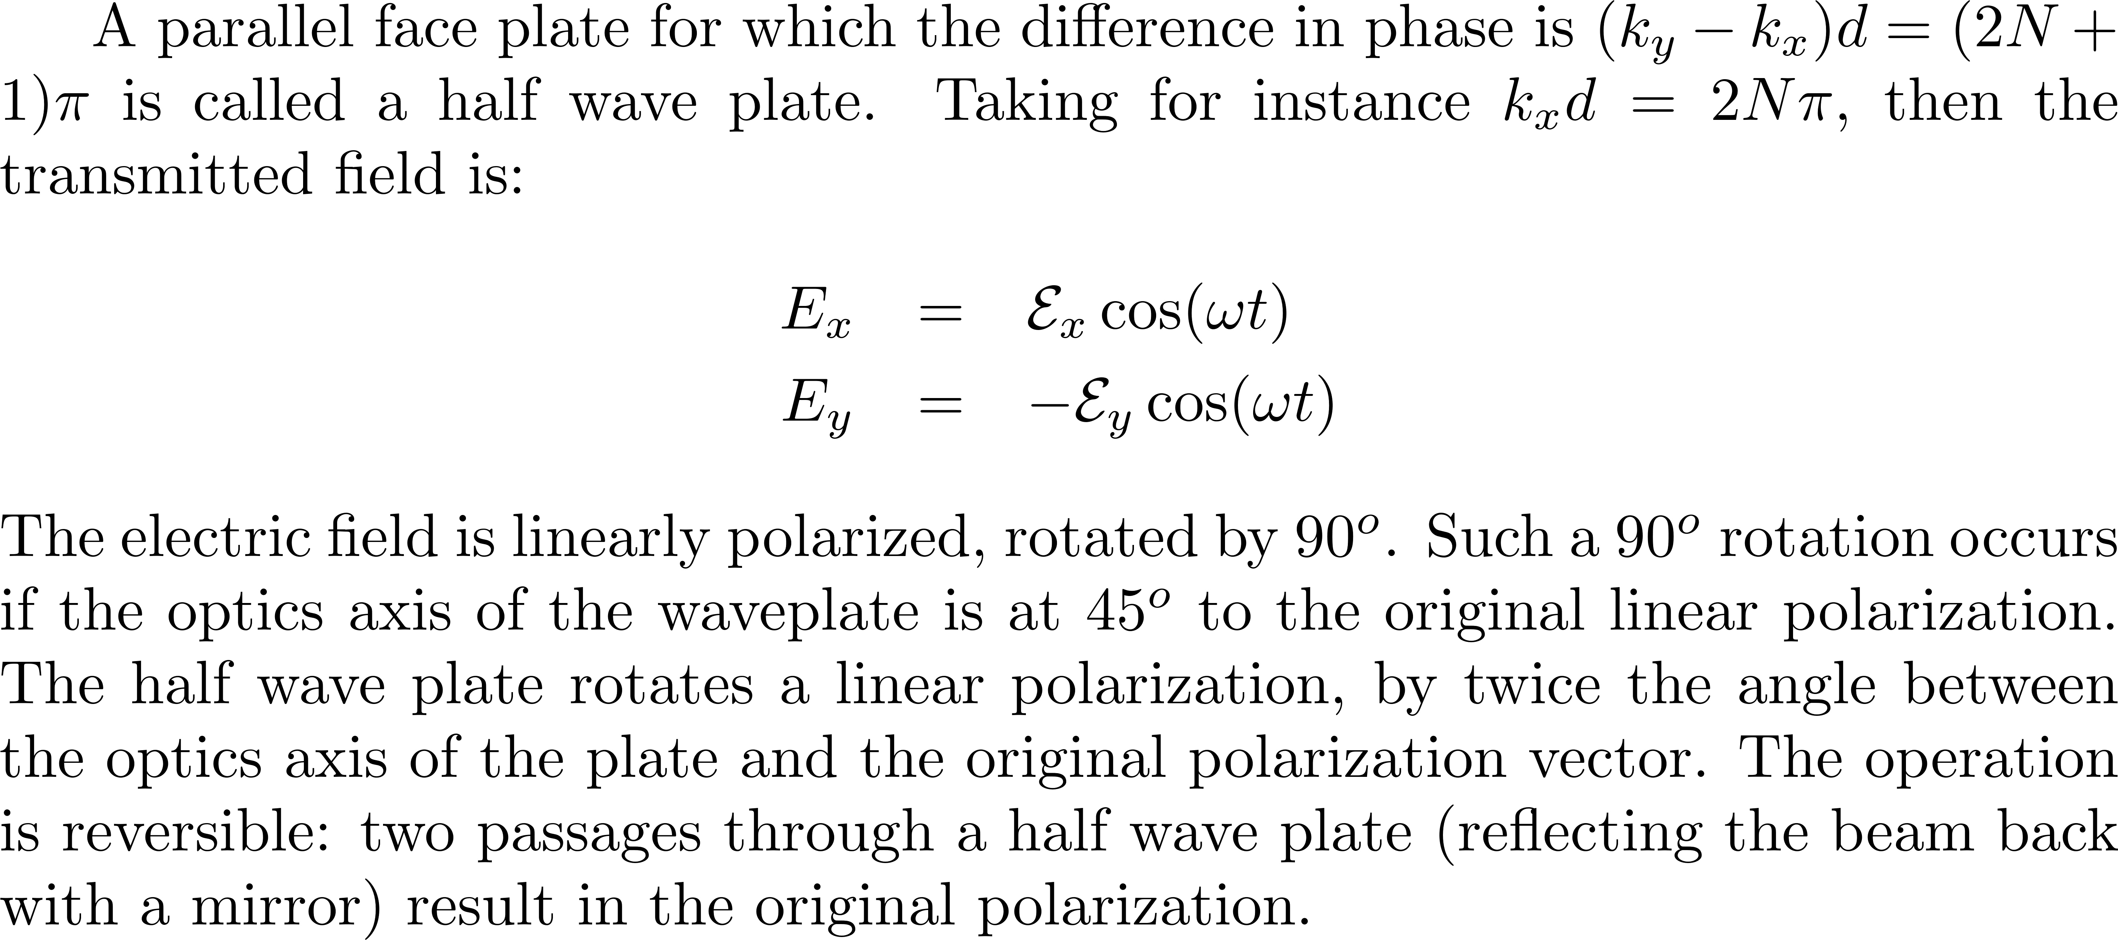
Half wave plate

Slide 9
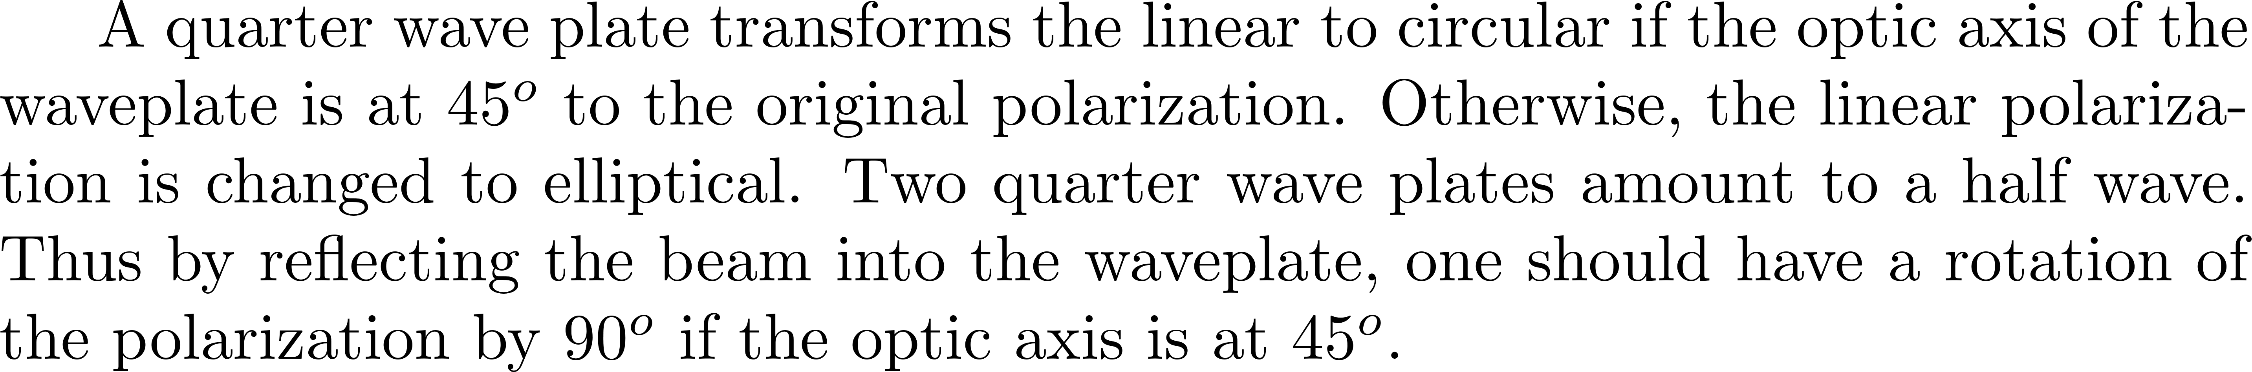
An electro-optical modulator is a waveplate induced by an electric field. An electric field can also orient molecules (Kerr cell). The Kerr cell was used to demonstrate the first Q-switched ruby laser. The orientation can be much faster using intense and ultrashort light pulses. A fast shutter can be made on this principle.
Stresses also introduce anisotropy in indices. This is used in fiber (nonlinear polarization mode-locking).

Slide 10
Zero order waveplates
A zero order waveplate is a piece of MICA or very thin quarz crystal
s
Slow
Birefringent polymer
Quarter wave
p
Fast
Lower temperature dependence (0.15nm/°C), and lower dispersion compared with zero-order quartz wave plates.
s
Slow
Half wave
Cheapest large aperture zero-order waveplate:
p
Fast
Food wrap!

Slide 11
Multiple order waveplates
11 10 9 8 7 6 5 4
s
Fast
A zero wave multiple order plate
p
11 10 9 8 7 6 5 4 3 2 1
Slow
Can be quarter wave, or half wave at different wavelengths
Needed for type I SHG

Slide 12
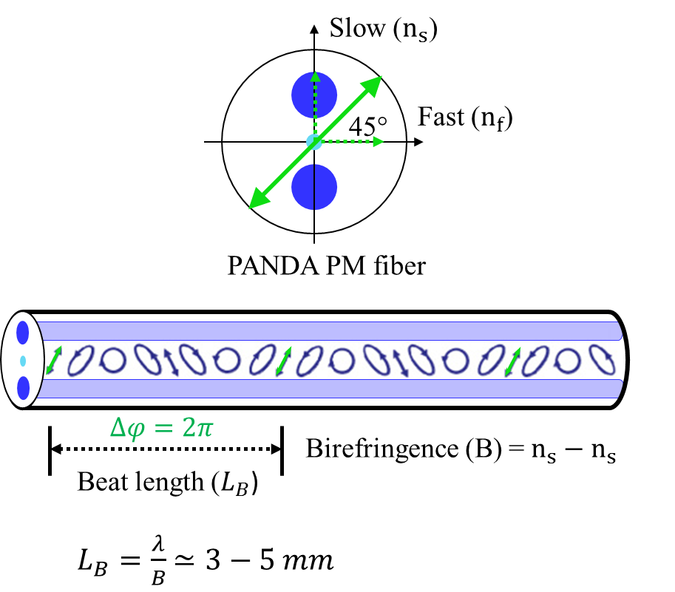
Polarization maintaining fibers: example of MULTIPLE order waveplate!

Slide 13
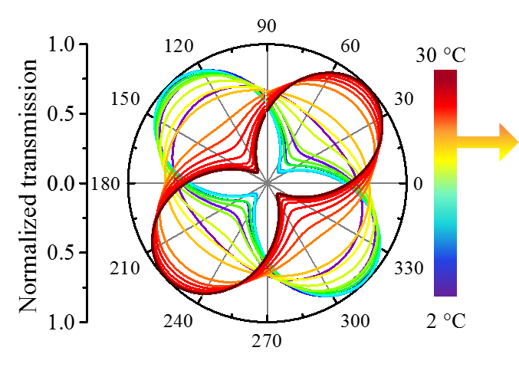
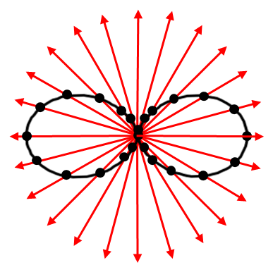
Measurement of the polarization ellipse
+
+
+
D
+
+
+
+
Rotating polarizer
Case of linear polarization
Polarization changing with fiber temperature

Slide 14
EXPLOITING THIS PROPERTY TO GENERATE SINGLE ATTOSECOND PULSES

Slide 15
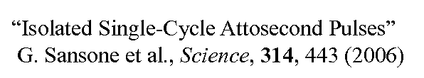
POLARIZATION GATING
47 π/2
0 order λ/4
(M λ/4)

Slide 16
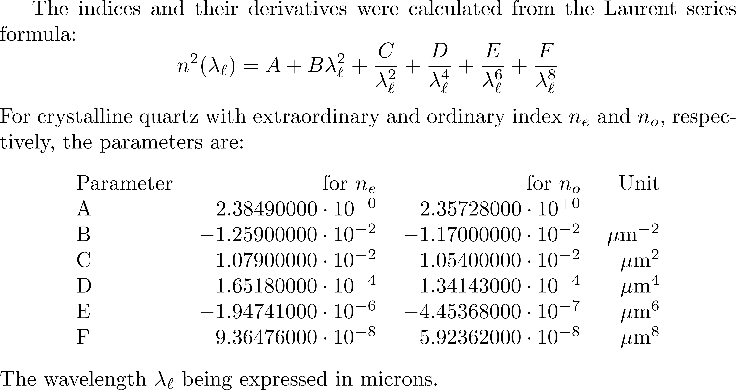

Slide 17
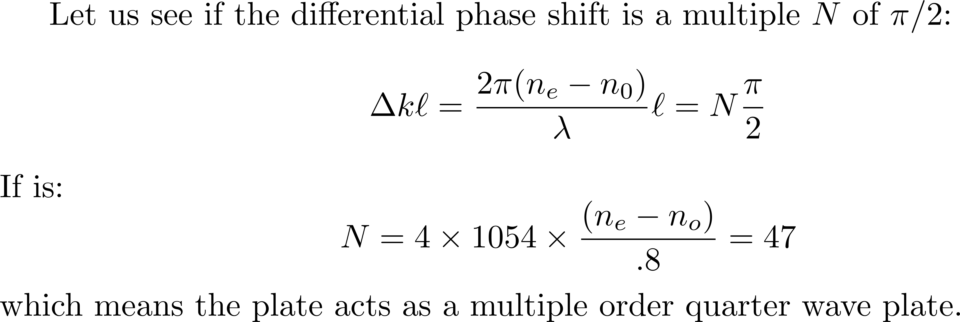
What is the state of polarization of radiation at 800 nm after transmission?

Slide 18
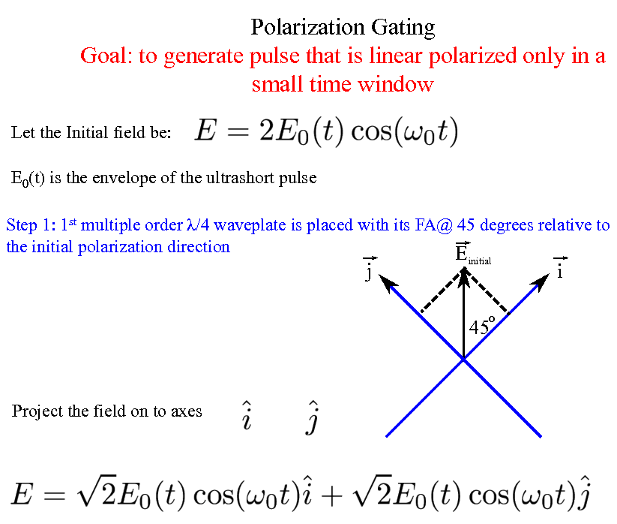

Slide 19
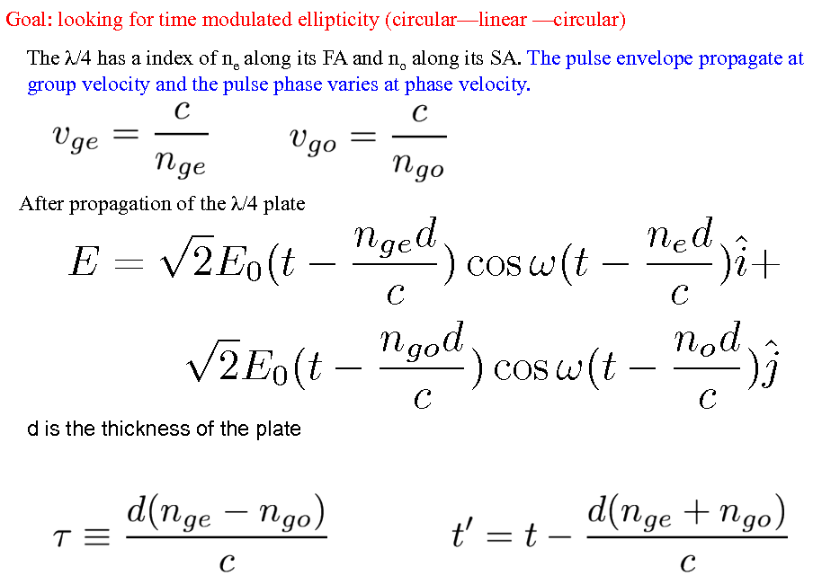

Slide 20
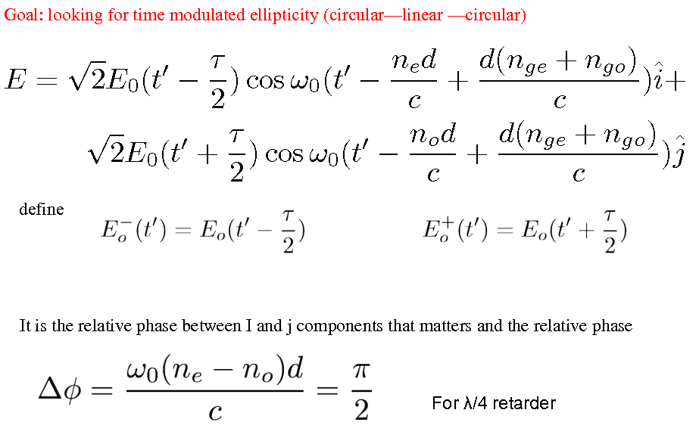

Slide 21
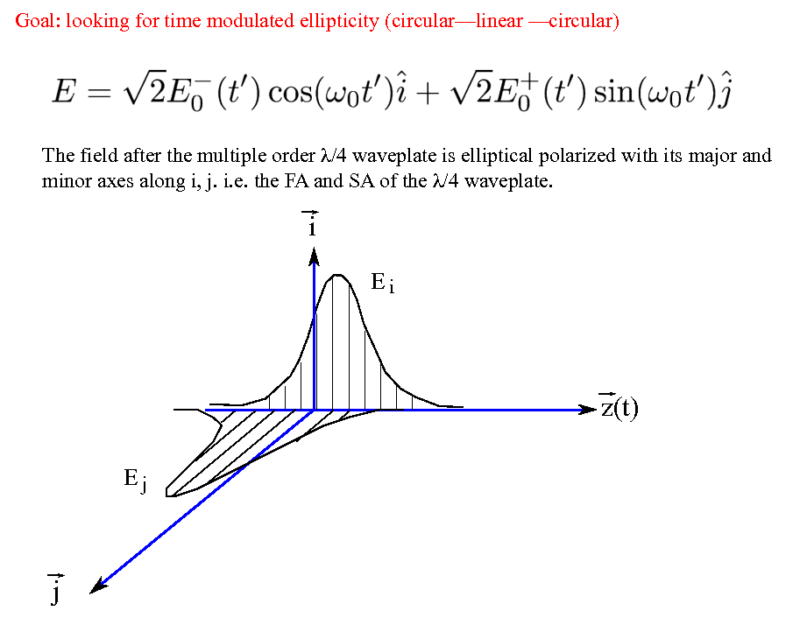

Slide 22
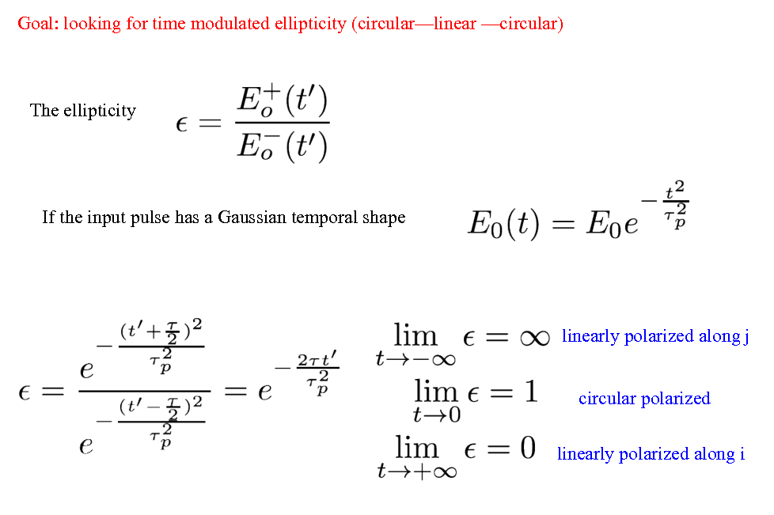

Slide 23
47 π/2
(M λ/4)
Next step: a zero-order λ/4

Slide 24
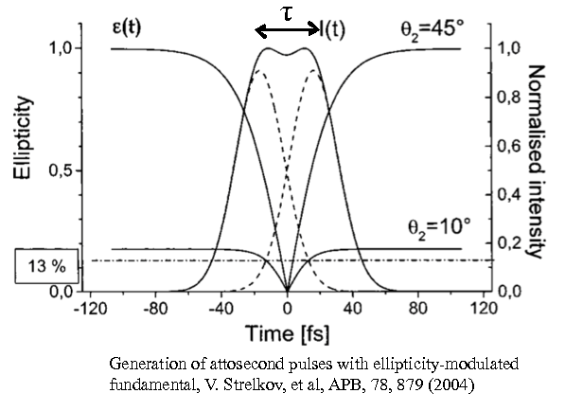

Slide 26
Since we are on the topic of POLARIZATION
Opening another little parenthesis:
The molecular washing machine (or dryer)

Slide 27
MEASURING PULSES
Oscilloscope: Electron gun, 2 platetd to seep horizontally, signal to sweep vertically
Streak camera: Photoelectrons generated ln photocathode, accelerated along z, swept along y

Slide 28
Optical Centrifuge for Molecules
Joanna Karczmarek,1 James Wright,2 Paul Corkum,1 and Misha Ivanov11SIMS NRC, 100 Sussex Drive, Ottawa, Ontario, Canada K1A 0R62Ottawa-Carleton Chemistry Institute, Carleton University, Ottawa, Ontario, Canada K1S 5B6
PHYSICAL REVIEW LETTER 82:3420
Forced Molecular Rotation in an Optical Centrifuge
D. M. Villeneuve,1,* S.A. Aseyev,1 P. Dietrich,1,2 M. Spanner,1 M.Yu. Ivanov,1 and P. B. Corkum1
1National Research Council of Canada, 100 Sussex Drive, Ottawa, Ontario, Canada K1A 0R6
2Freie Universität Berlin, Arnimallee 14, D-14195 Berlin, Germany
PHYSICAL REVIEW LETTER 85:542

Slide 29
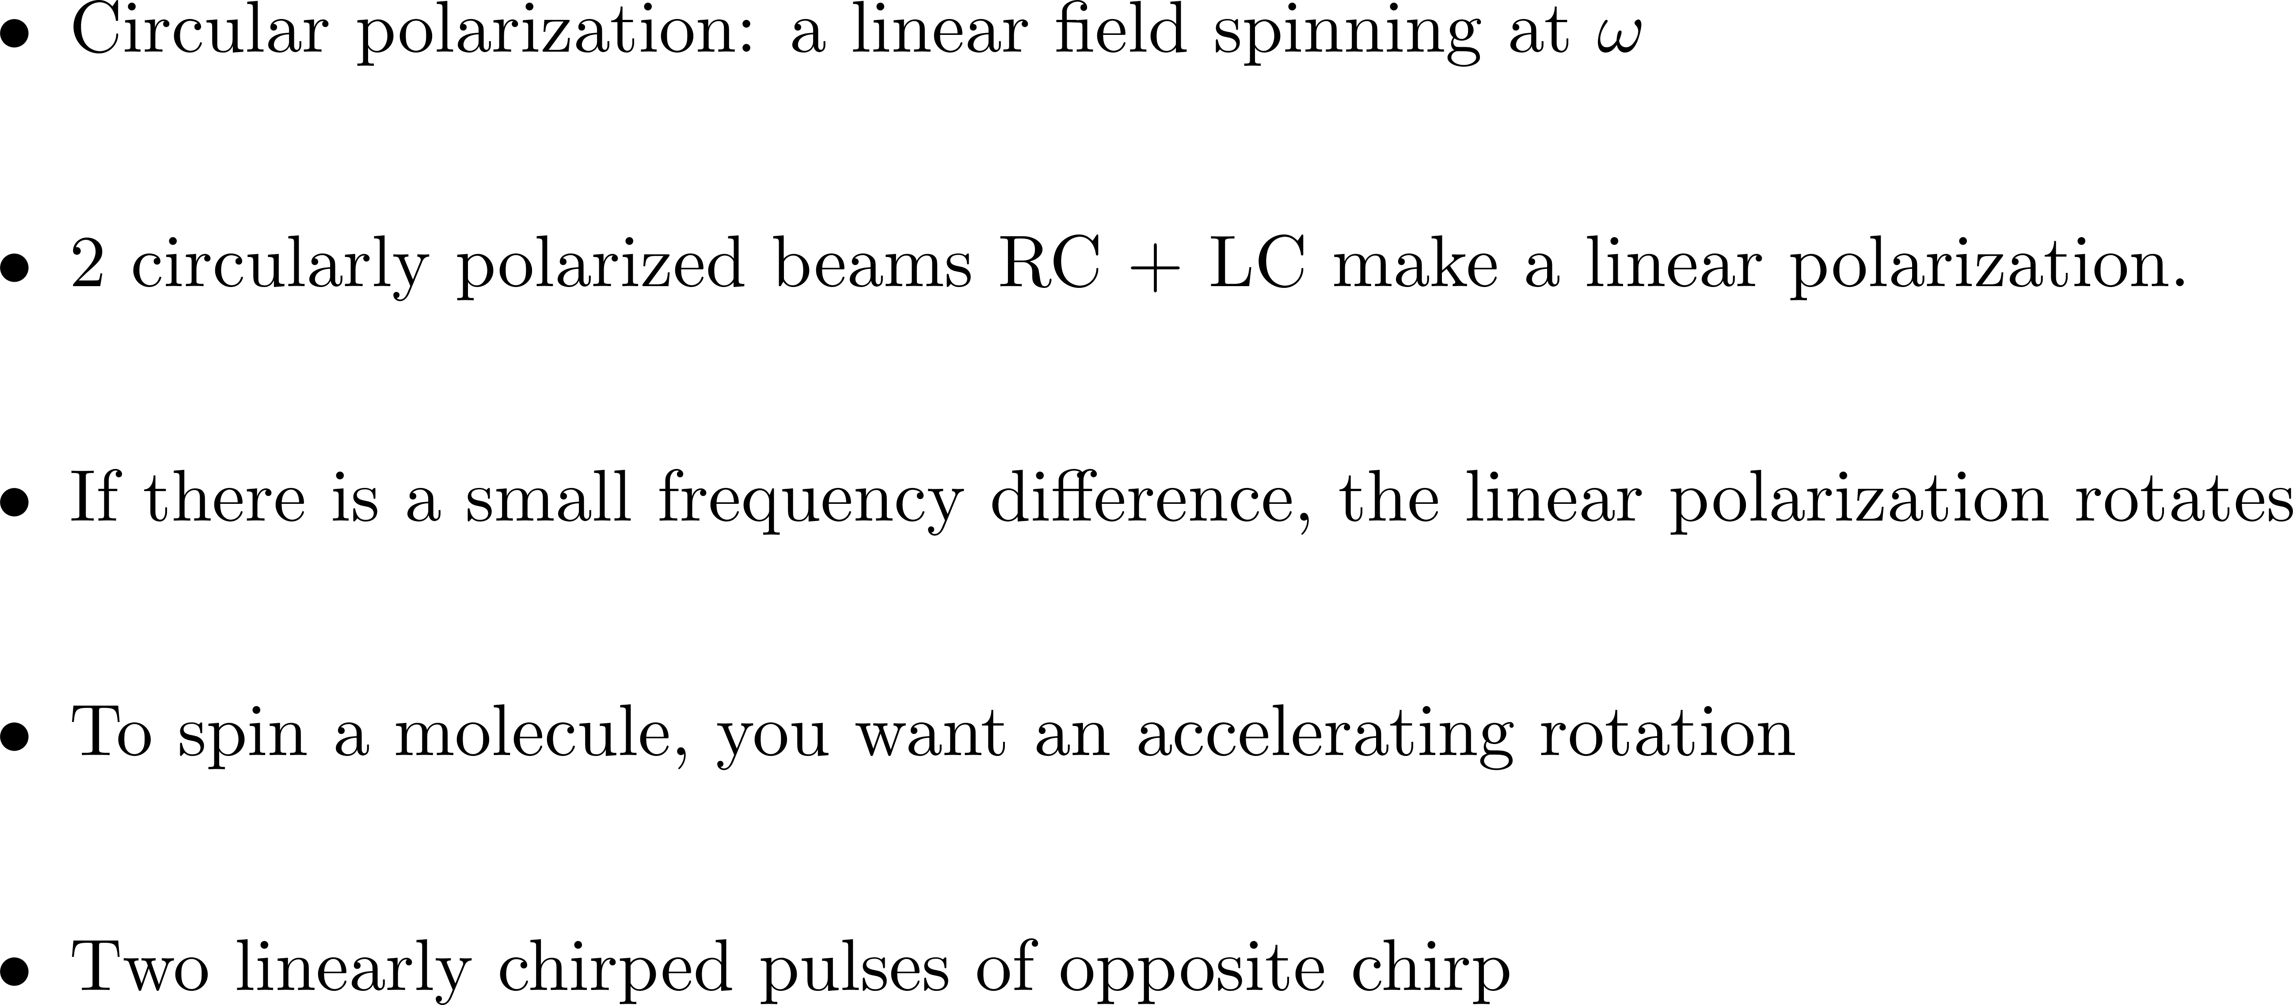

Slide 30
DISPERSION
ε(ΔΩ,0)
n(Ω)
or
k(Ω)
ε(ΔΩ,0)e^{-ik(ΔΩ)z}

Slide 31

Background: Ultrafast Phenomena Chapter 3.
Analogy
Fast acceleration: falls off tangentially
Slow acceleration: will dissociate if I_{p} is reached

Slide 33

Measuring the spectrum
“Pump”
Alignment pulse
“Probe”
HHG pulse
Ti:sapphire CPA
1 TW, 27 fs @ 50 Hz
(60fs, 5x10¹³ W/cm²)
(30fs, 1.5x10¹⁴ W/cm²)
Space
H15
23.3eV
H21
32.6eV
H27
41.9eV
H33
51.2eV
H39
60.5eV

Slide 34

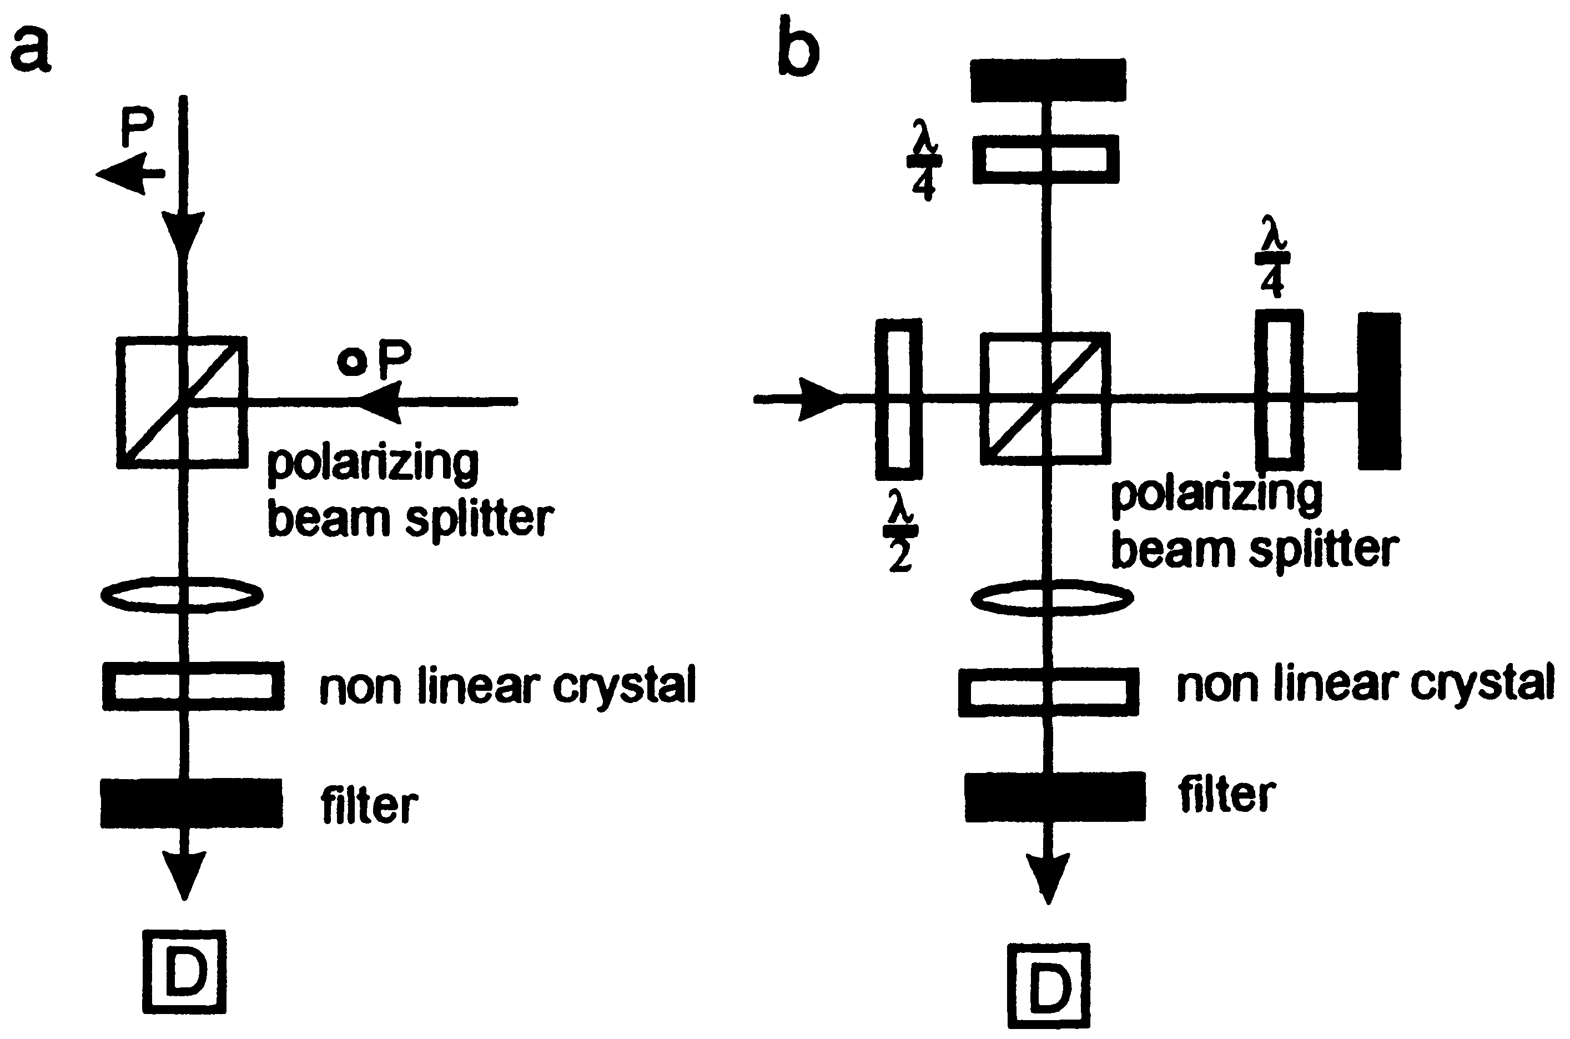
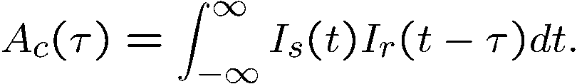
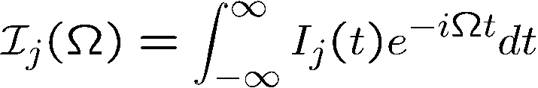

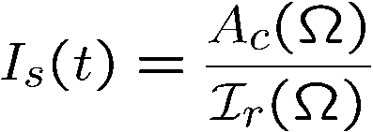
I
Correlations
t
ref
I
s
t
Phase information: parallel polarization and replace the
polarizing beam splitter by a non-polarizing beam splitter.

Slide 35
Measurement of attosecond pulses
It uses all the techniques developed in optics
Atomic ionization produces a replica photoelectron pulse
Measurement of the photo-electron replica is a measurement of the pulse
1/2 mV² =ω_{x} - IP
Streak Camera: PRL 74, 2933 (1995); Science 291, 1923 (2001); PRL 88, 173903 (2002)
SPIDER: PRL 90, 073902 (2003)

Slide 36
Measuring Attosecond (and femtosecond) Pulses
e
Electron time-of-flight

Slide 37
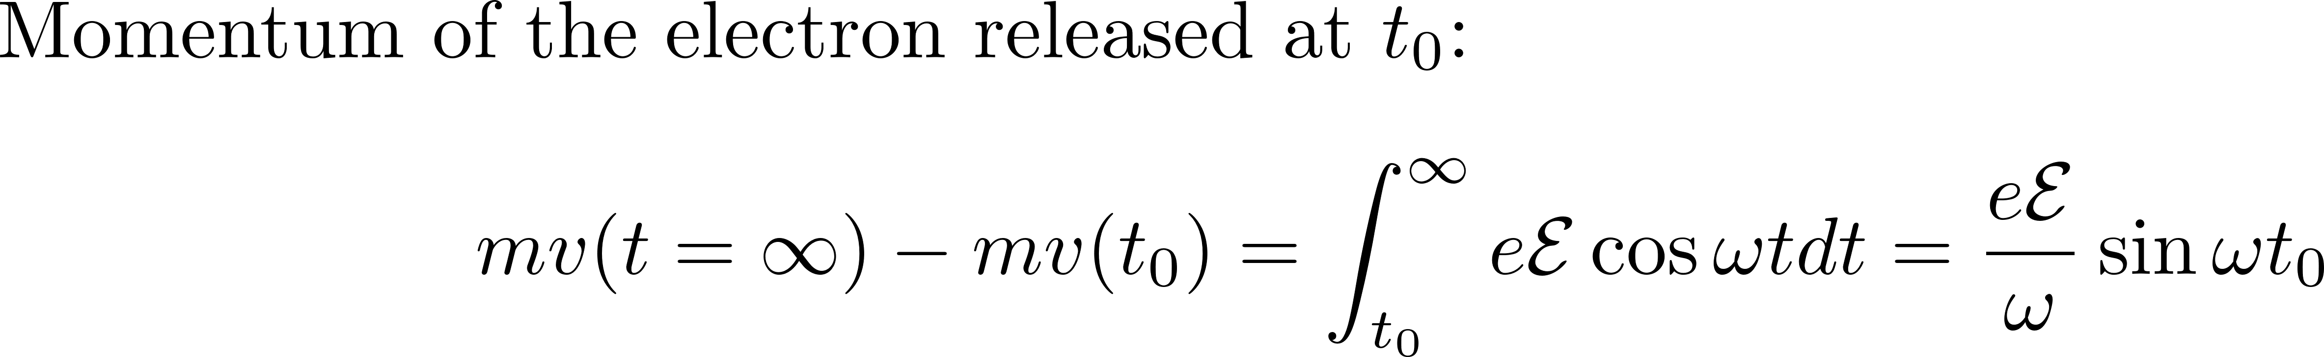
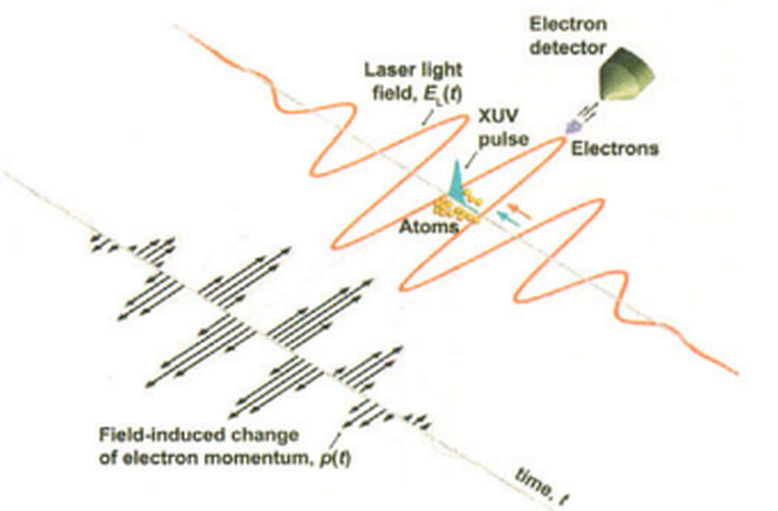
MEASURING FEMTOSECOND PULSES WITH ATTOSECOND PULSES
E. Goulielmakis et al, Science 305:1267 (2004)

Slide 39
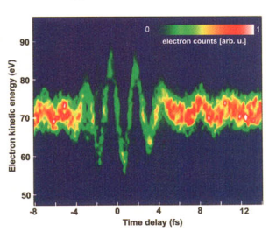
A series of kinetic energy spectra of electrons detached by a 250-as, 93-eV XUV pulse from neon atoms in the presence of an intense < 5-fs, 750-nm laser field, in false-color representation. The delay of the XUV probe was varied in steps of 200 as, and each spec­trum was accumulated over 100 s. The detected electrons were eject­ed along the laser electric field vector with a mean initial kinetic energy of 71.5 eV.
E. Goulielmakis et al, Science 305:1267 (2004)

Slide 40
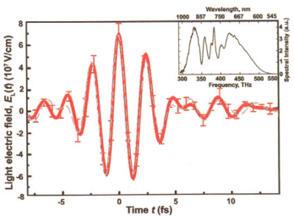
A series of kinetic energy spectra of electrons detached by a 250-as, 93-eV XUV pulse from neon atoms in the presence of an intense < 5-fs, 750-nm laser field, in false-color representation. The delay of the XUV probe was varied in steps of 200 as, and each spec­trum was accumulated over 100 s. The detected electrons were eject­ed along the laser electric field vector with a mean initial kinetic energy of 71.5 eV.
E. Goulielmakis et al, Science 305:1267 (2004)

Slide 41
A HUGE parenthesis
The Wigner distribution
Moments
Define the instantaneous frequency in time and frequency Wigner applied to pulse measurements
Time bandwidth product
Time-Bandwidth product to Uncertainty relations
Uncertainty relations to Schroedinger equation
Particle wave duality
Uncertainty relations
You have I(t) and I(Ω), how do you reconstruct the field in amplitude and phase?
THE WIGNER distribution

Slide 42
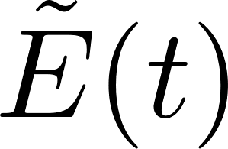



You have I(t) and I(Ω), how do you reconstruct the field in amplitude and phase?
THE WIGNER distribution
Ref: L. Praxmeier and K. Wodkiewicz. Time and frequency description of optical pulses.
arXiv:physics, 0502079v2:1–12, 2005.
Pulse measurements?
You can measure I(t) – that does not give you
You can measure I(Ω) – that does not give you.
Can we replace the notion amplitude-phase by intensity in time vs intensity in frequency?
Space-time analogy:
Beam measurements?
You can measure I(x,y) – that does not give you
You can measure I(k_{x}, k_{y}) – that does not give you.
-> Wigner function plot I(x, y) vs I(kx, ky)

Slide 43
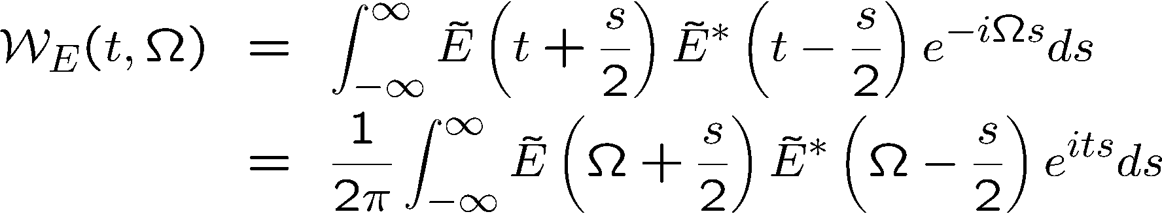
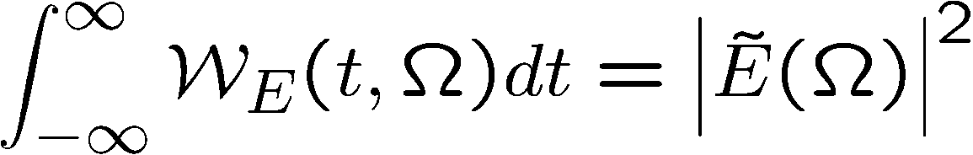
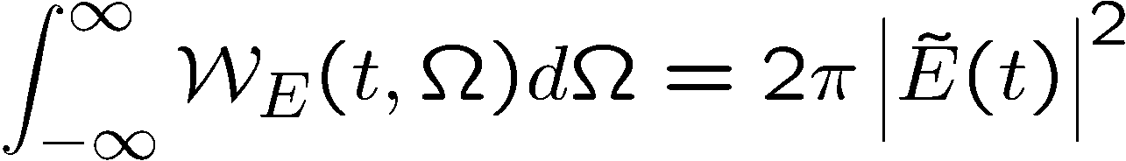
TIME-FREQUENCY
Pulse duration, Spectral width
Two-D representation of the field: Wigner function

Slide 44
Wigner Distribution
Gaussian
Chirped Gaussian

Slide 45
2
2
1
1
Frequency
Frequency
0
0
-1
-1
-2
-2
time
-2
-2
-1
-1
0
0
1
1
2
2
Time
Time
Unchirped Gaussian

Slide 46
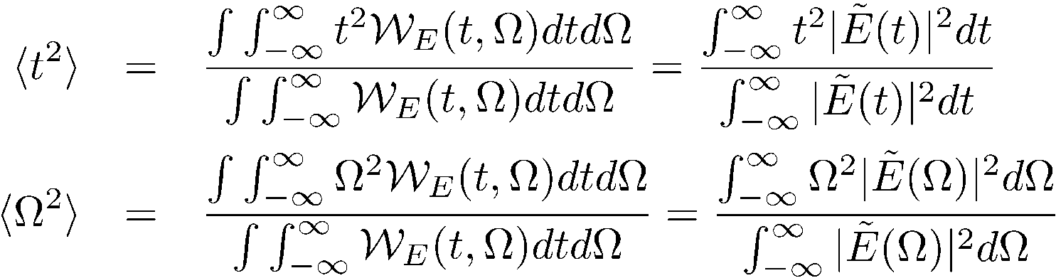
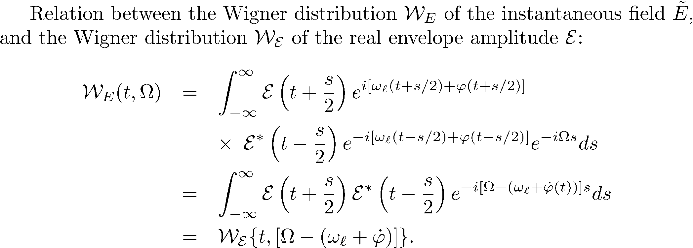
Wigner Distribution
Second moments

Slide 47
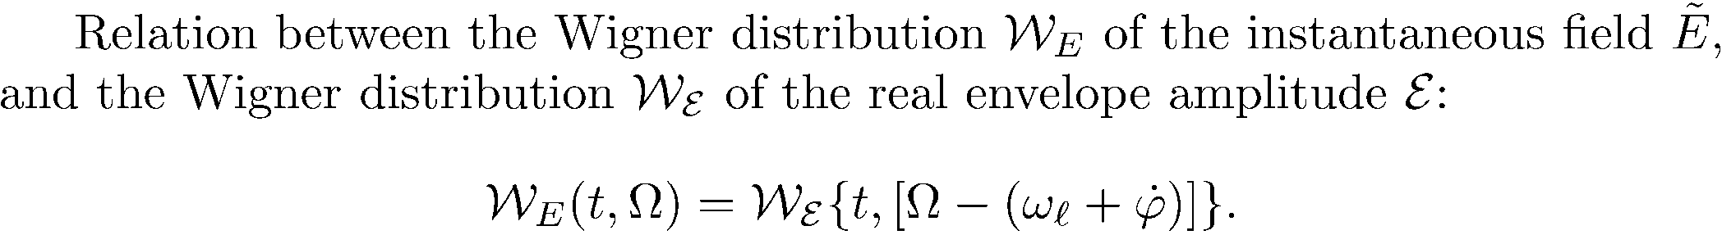

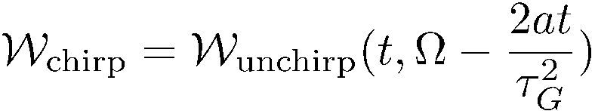
Unchirped Gaussian

Slide 48
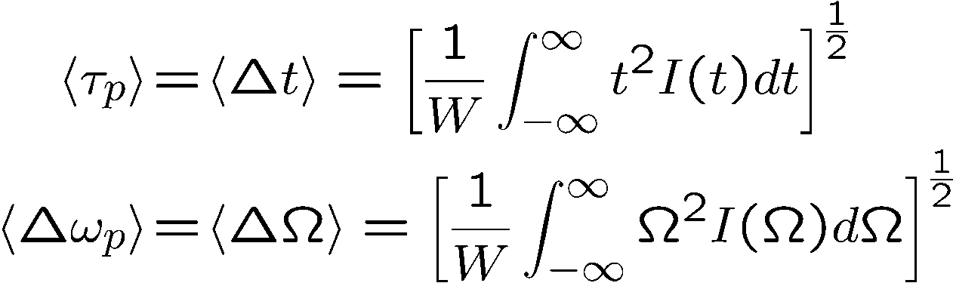
Wigner Distribution
Second moments
Gaussian
Chirped Gaussian

Slide 49
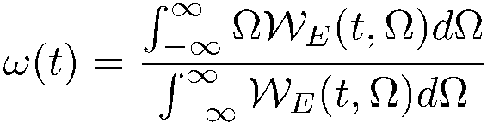
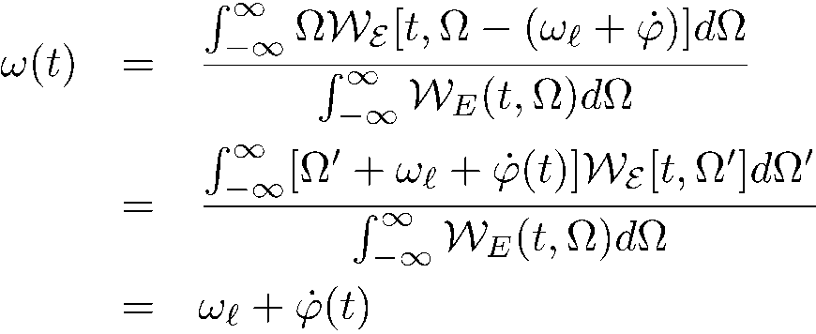

Wigner Distribution
Second moments
Instantaneous frequency: is it the derivative of the phase, or the center of gravity of the spectrum?
where we used the fact that

Slide 50
A HUGE parenthesis
The Wigner distribution
Moments
Define the instantaneous frequency in time and frequency Wigner applied to pulse measurements
Time bandwidth product
Time-Bandwidth product to Uncertainty relations
Uncertainty relations to Schroedinger equation
Particle wave duality
Uncertainty relations

Slide 51
TIME-FREQUENCY
Pulse duration, Spectral width
Can a measurement provide a two-D representation of the field (Wigner function)
The FROG
Frequency Resolved Optical Gating

Slide 52
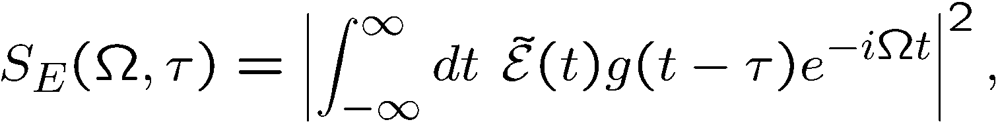
The FROG
Frequency Resolved Optical Gating
It is a time gated spectrum, measuring a two D function:
References:
Advantage: the raw data give a nice representation
Disadvantage: considerable iterations
FROG Trebino,
Kluwer, 2002
Adam S. Wyat
PhD Thesis
University of Oxford
(2007)

Slide 53
Spectrograms for Linearly Chirped Pulses
Negatively chirped Unchirped Positively chirped
Frequency
Time
Frequency
Delay
Like a musical score, the spectrogram visually displays the frequency vs. time (and the intensity, too).
Notes:
53

Slide 54
As in all measurements, there is competition between accuracy in amplitude or phase
Algorithms exist to retrieve E(t) from its spectrogram.
The spectrogram essentially uniquely determines the waveform intensity, I(t), and phase, φ(t).
There are a few ambiguities, but they’re “trivial.”
The gate need not be—and should not be—much shorter than E(t).
Suppose we use a delta-function gate pulse:
= The Intensity.
No phase information!
Notes:
54

Slide 55
A HUGE parenthesis
The Wigner distribution
Moments
Define the instantaneous frequency in time and frequency Wigner applied to pulse measurements
Time bandwidth product
Time-Bandwidth product to Uncertainty relations
0
Uncertainty relations to Schroedinger equation
Particle wave duality
Uncertainty relations

Slide 56
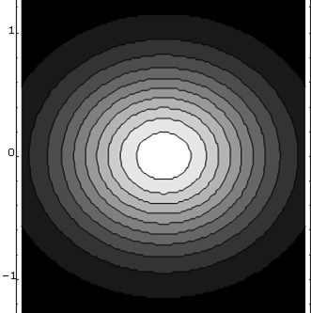
Minimum uncertainty
wave packet
Frequency
Time
“Pure state”
2
1
Frequency
0
-1
-2
-2
-1
0
1
2
Time

Slide 57
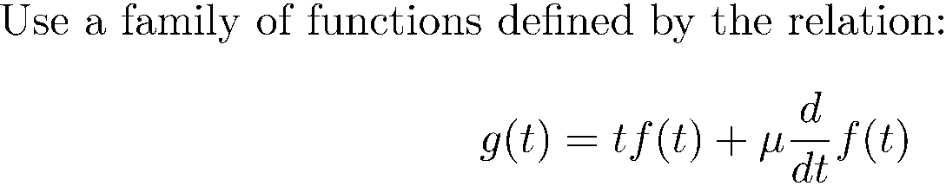

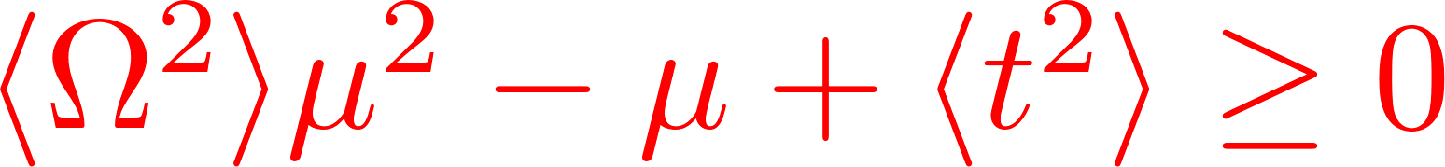
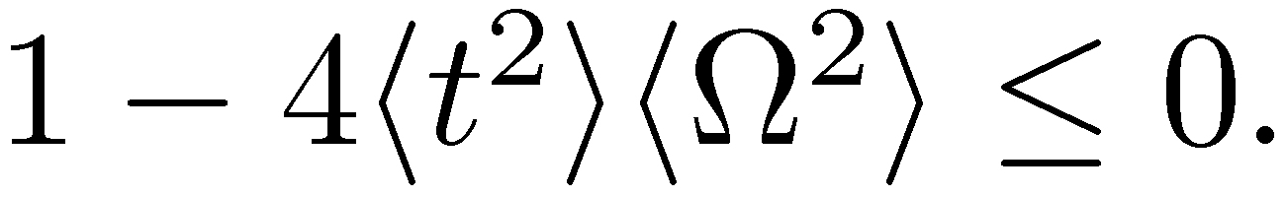
DERIVATION OF THE TIME-BANDWIDTH RELATIONS
Energy:
0
No roots implies

Slide 58
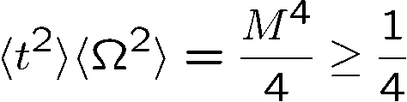
Wigner Distribution
Time bandwidth product
Second moments
Instantaneous frequency: is it the derivative of the phase, or the center of gravity of the spectrum?
Uncertainty relation
where we used the fact that

Slide 59

Uncertainty relation
In space:
Only holds for the pulse widths defined as
the mean square deviation
Equality only holds for a Gaussian pulse (beam) shape free of any
phase modulation, which implies that the Wigner distribution for a
Gaussian shape occupies the smallest area in the time/frequency
plane.

Slide 60
A HUGE parenthesis
The Wigner distribution
Moments
Define the instantaneous frequency in time and frequency Wigner applied to pulse measurements
Time bandwidth product
Time-Bandwidth product to Uncertainty relations
Uncertainty relations to Schroedinger equation
Particle wave duality
Uncertainty relations

Slide 61








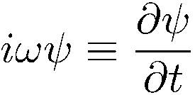
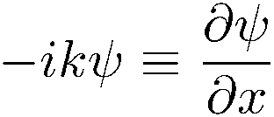
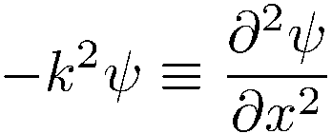
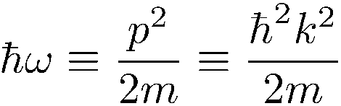
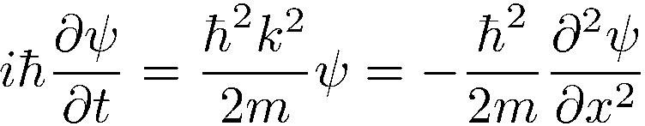
Particle wave duality, uncertainty principle, even leads to Schroedinger equation
The Wigner function in optics told us that:
and
Combine with particle-wave duality:
Particle Wave
Energy W
Momentum p
Particle-wave duality calls for a wave equation.
Differentiation with respect to t multiplication by ω
Differentiation with respect to x multiplication by k

Slide 62
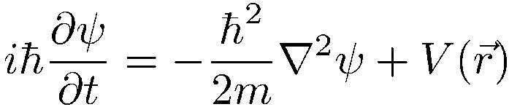


End of a HUGE parenthesis

Slide 63
BACK TO Goulielmakis
“Synthesized light transients” A. Wirth, … F Krausz, F. Goulielmakis, Science, 334:195-200 (2011)

Slide 64

A single pulse can also be synthesized in the frequency domain
E
We start from two pulses, bandwidth limited, of different frequency
TIME
FREQUENCY

Slide 65
Principle of the attosecond synthesizer of
Dr. Eleftherios Goulielmakis
100 microjoule, 1 kHz, 800 nm
Ω
Capillary
Ω
Beam splitters
Ω
Chirped mirrors
Ω
Recombine + phase adjust
Ω

Slide 66

“Synthesized light transients” A. Wirth, … F Krausz, F. Goulielmakis, Science, 334:195-200 (2011)

Slide 67

“Synthesized light transients” A. Wirth, … F Krausz, F. Goulielmakis, Science, 334:195-200 (2011)

Slide 68
Principle of the attosecond synthesizer of
Dr. Eleftherios Goulielmakis
100 microjoule, 1 kHz, 800 nm
Ω
Capillary
Ω
Beam splitters
4 components
Ω
Chirped mirrors
Ω
Recombine + phase adjust
Ω

Slide 69

4 components

Slide 70
90
80
70
Energy (eV)
60
50
40
-10
-8
-6
-4
-2
0
2
4
6
8
10
Delay (fs)

Slide 71
8
6
4
Electric fields (10⁷ V/cm)
2
0
-2
-10
-8
-6
-4
-2
0
2
4
6
8
10
Time (fs)

Slide 75

Free electron trajectories x(t) in a monochromatic electromagnetic n the frame oscillating at the ﬁeld frequency in which the electron moves in straight lines.
Free electron trajectories x(t) in a monochromatic electromagnetic ﬁeld in the laboratory frame;
The nucleus motion is a sine curve. An electron leaves the nucleus with a velocity given by the tangent to the sine function. It may recollide with the nucleus if the tangent encounters the sine function. Each kinetic energy at the impact with the nucleus can be reached along two trajectories corresponding to slightly different emission times: the short (S) and long (L ) trajectories.

Slide 76

Most generated here: T/4 to T/2

