Slide 1
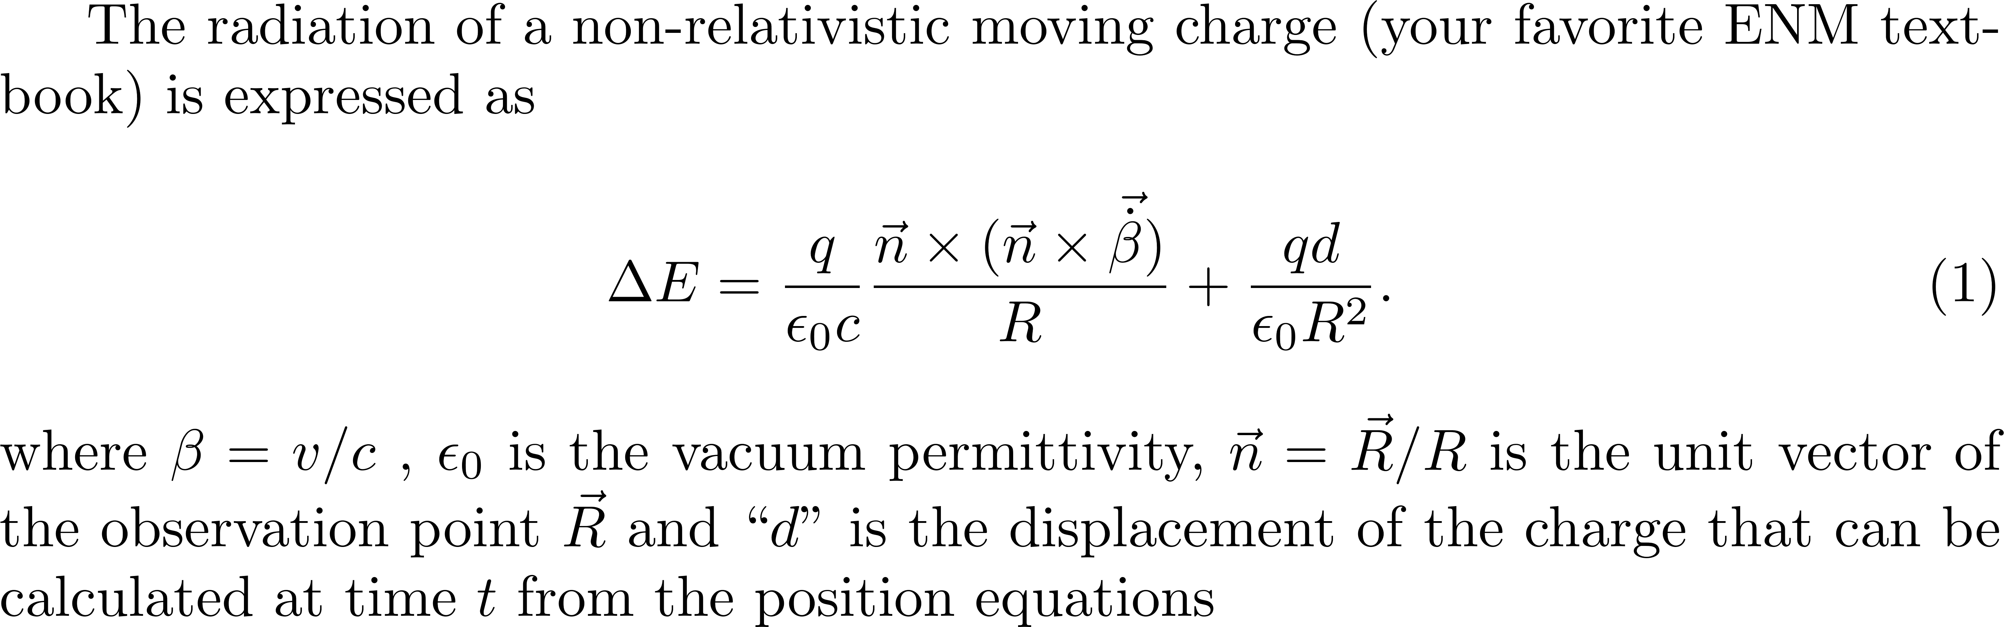
What does the moving electron do to the applied field?
Dipole term

Slide 2

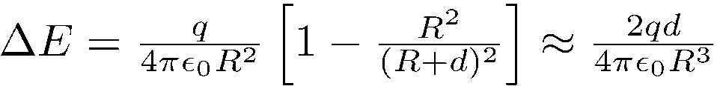
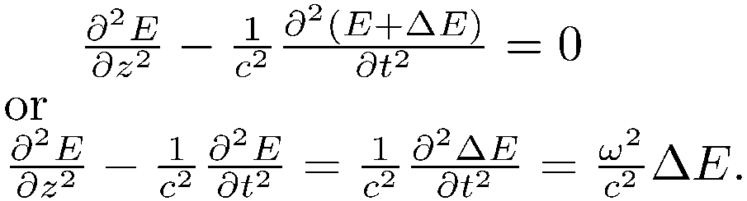
The classical oscillator and Maxwells equations
The classical approach is to calculate the motion of the bound electron, modeled as a dipole. The electron is at a (small) distance d from the positive ion. It oscillates with the applied electric field.
This is the classical oscillator model.
Under the influence of an optical oscillating field at ω the motion of the electron follows the frequency of the applied field, in phase, and is thus
At a point of observation at a distance R from the dipole, the field due to the dipole is
Putting that in Maxwell's propagation equation
R
-
d
+

Slide 3
POLARIZATION FREE AND BOUND ELECTRON
What happens when you focus and intense light pulse?
You modify Maxwell’s propagation equation
You create a plasma: ions – electrons
Plasma resonance.
What does the light do to the plasma,
and the plasma to the light?
it depends on the initial conditions

Slide 4
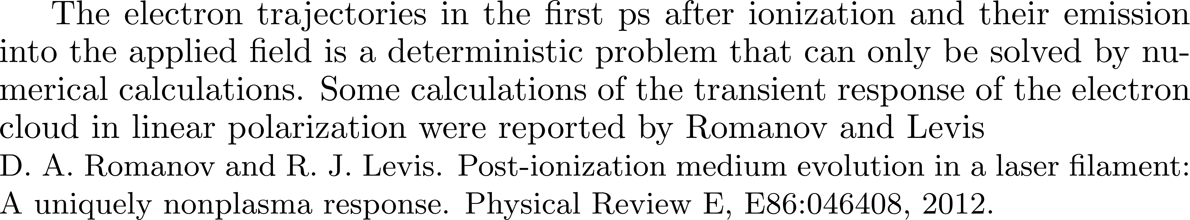
The cumulative polarization response of a medium that is being tunnel ionized by a laser pulse with rectangular envelope. The laser electric field oscillations are shown for comparison, not to scale

Slide 5
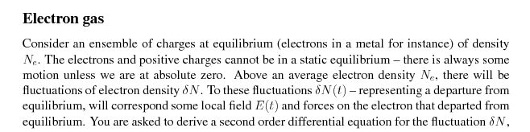
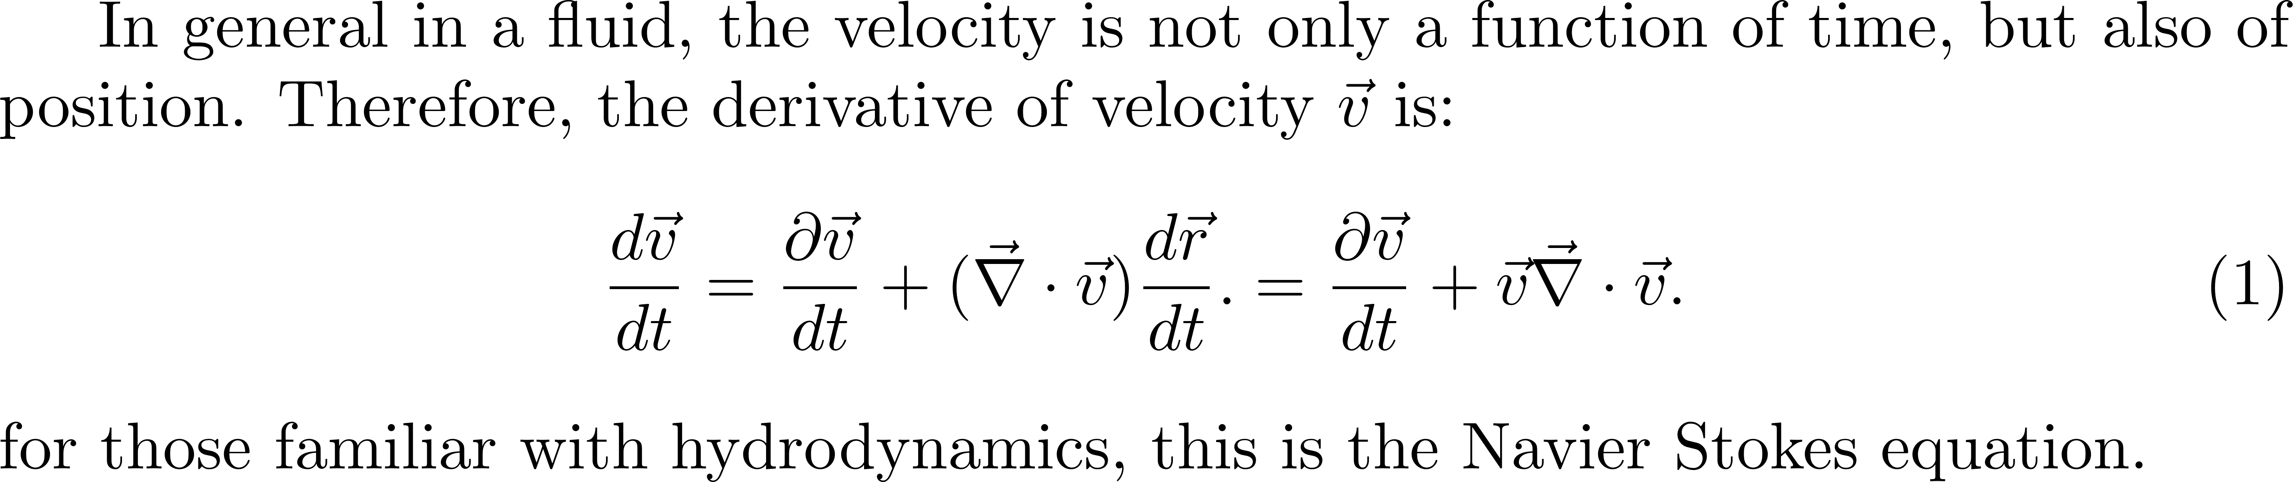

Slide 6
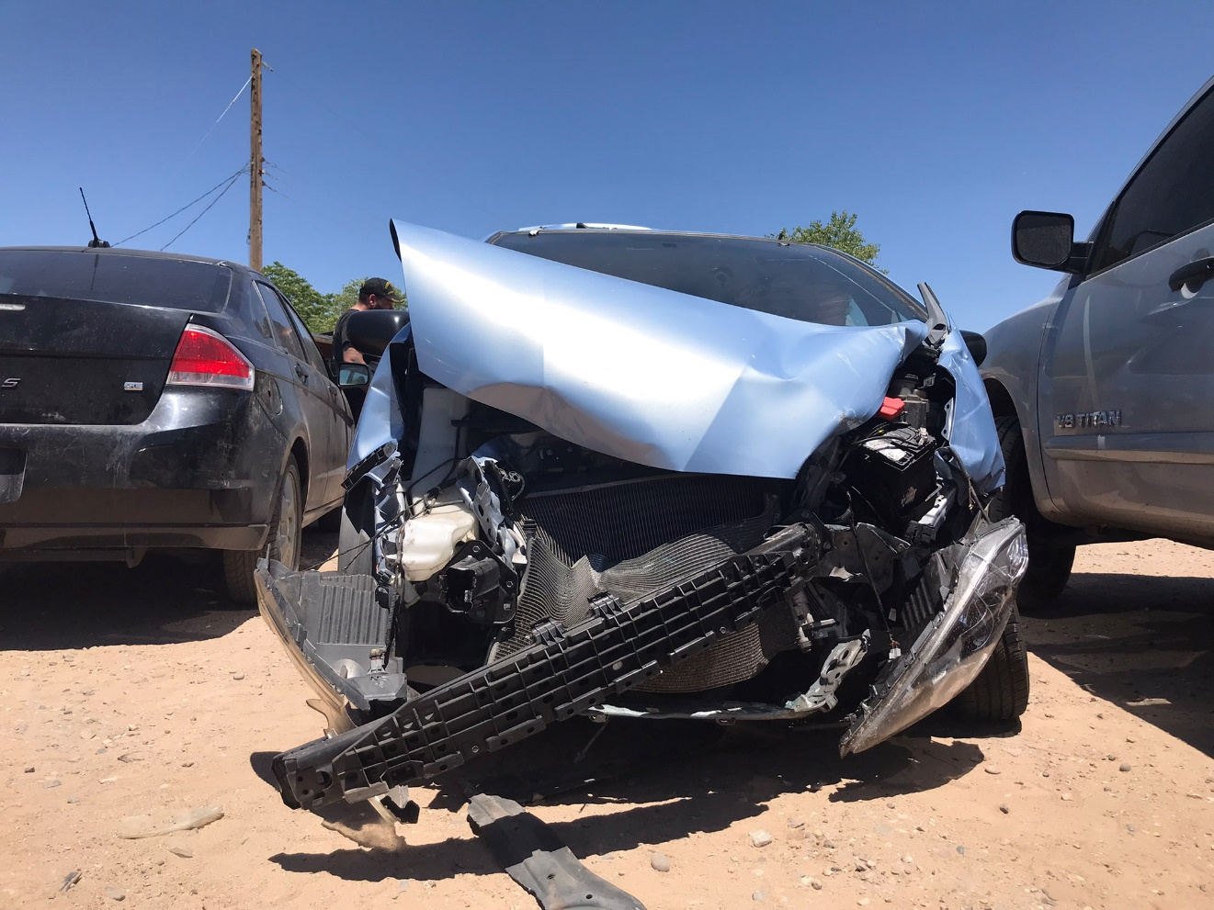
Compressible fluid: traffic

Slide 7
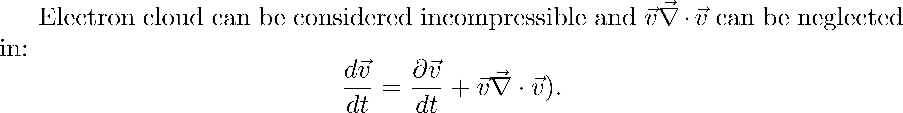
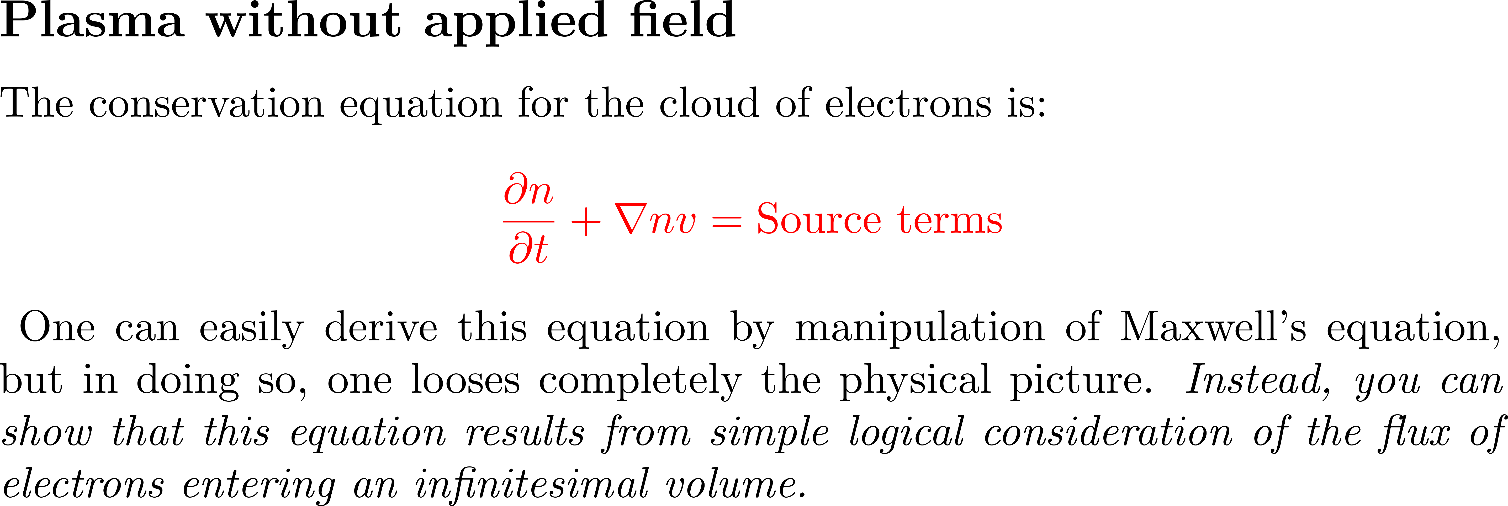

Slide 8
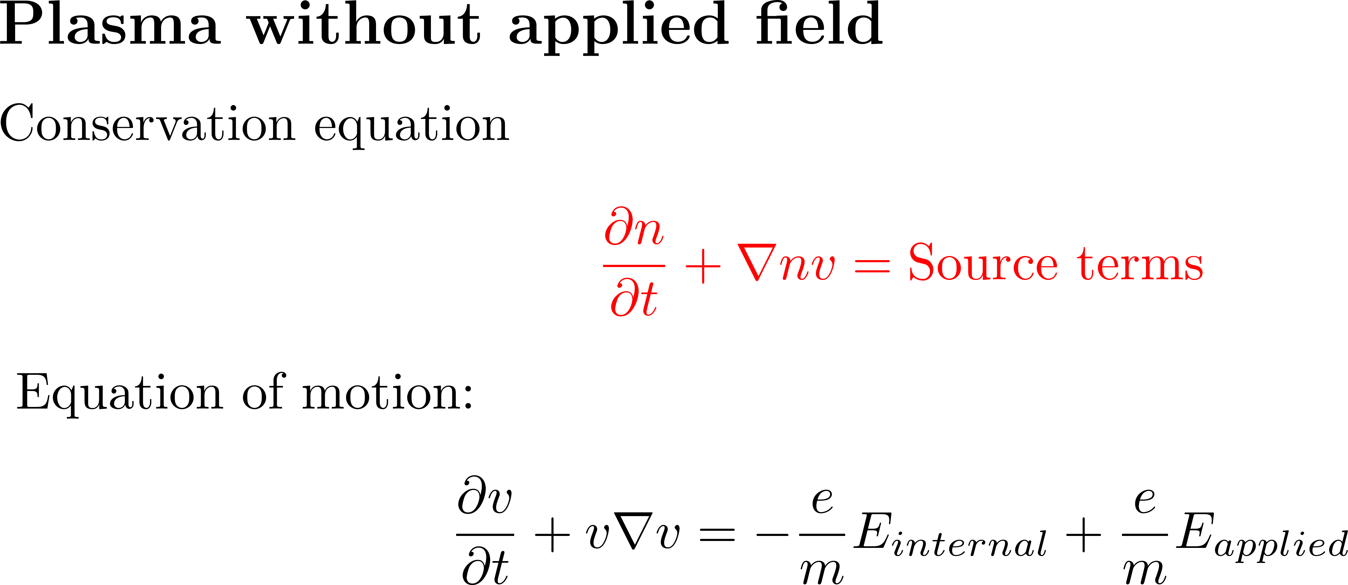
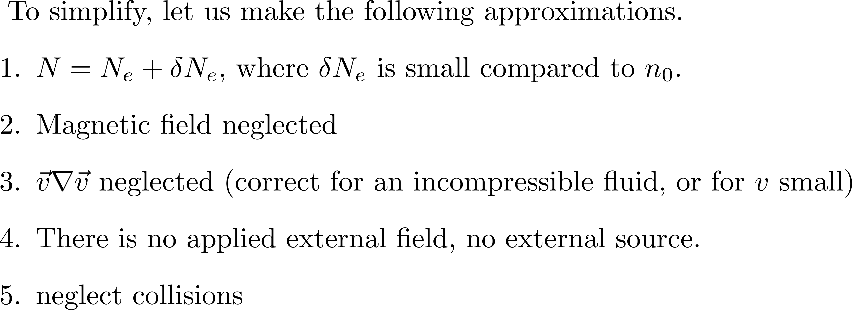

Slide 9
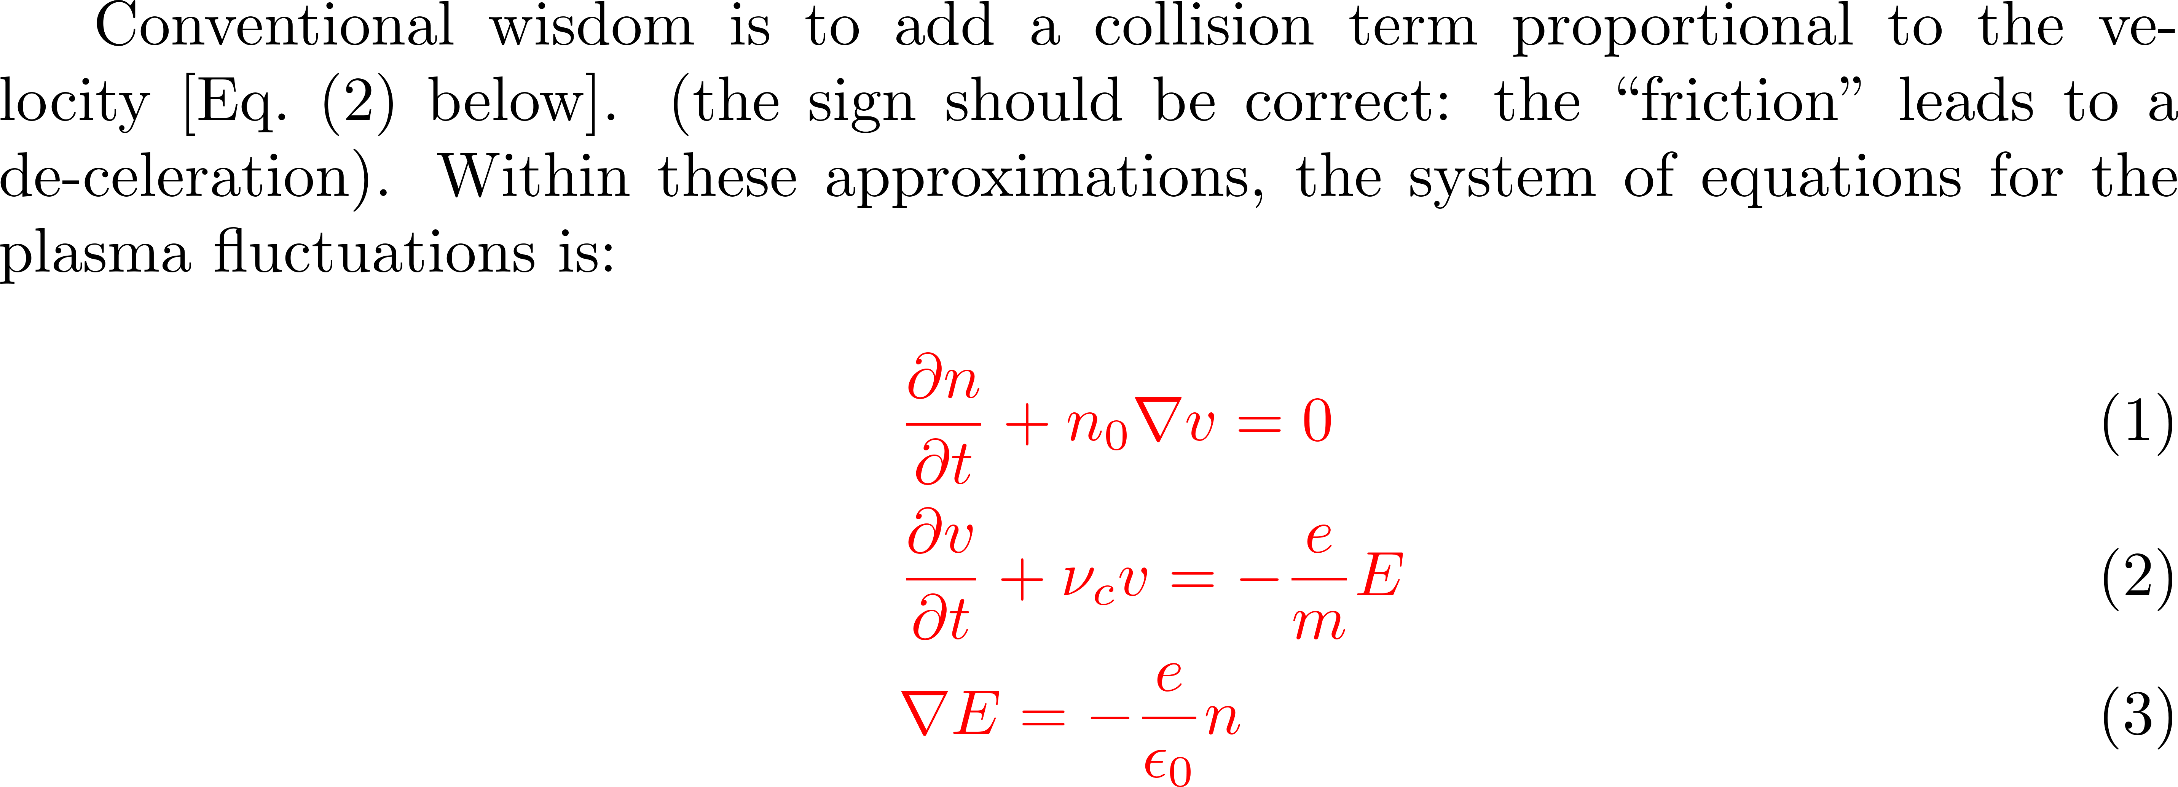
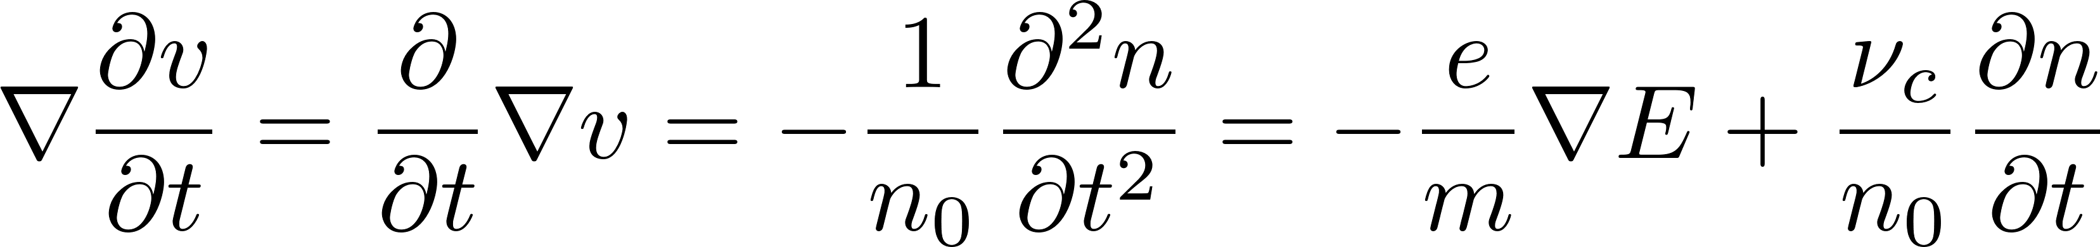
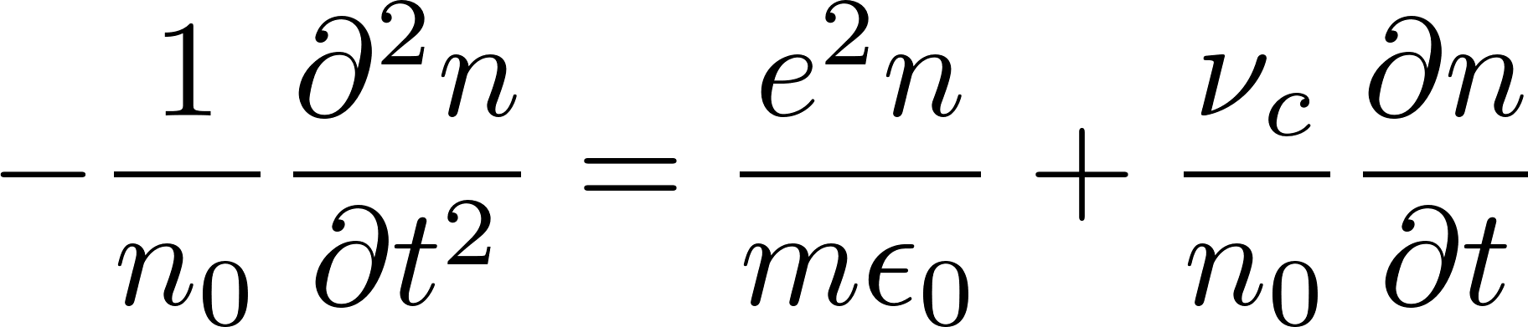
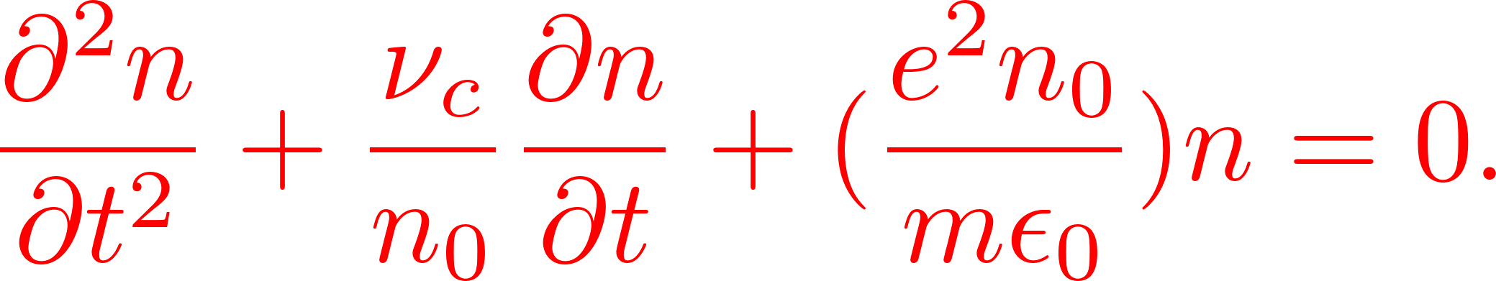

Slide 10
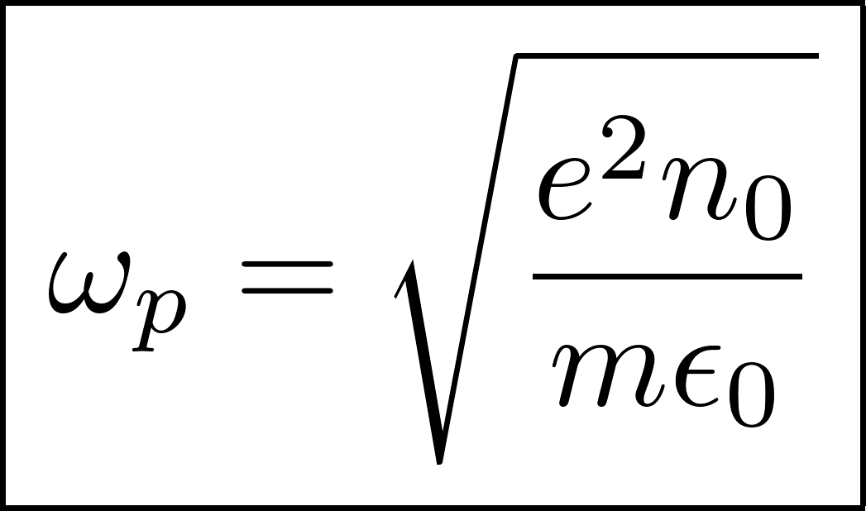
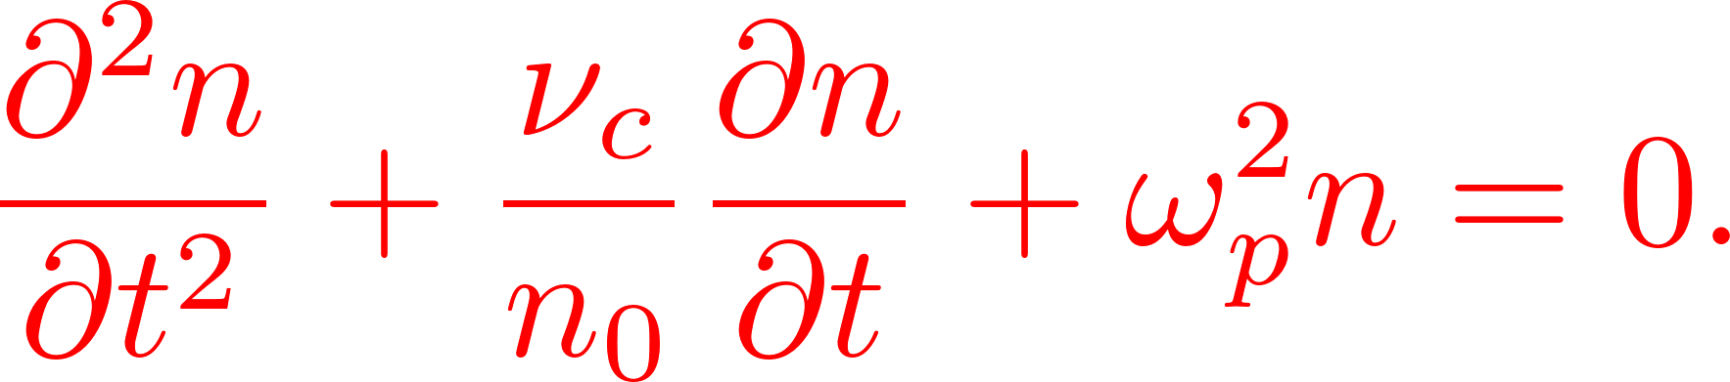

Slide 11
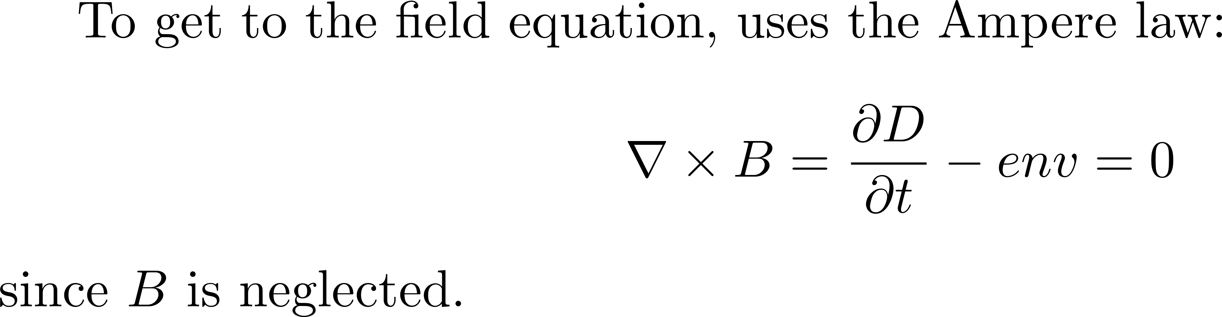
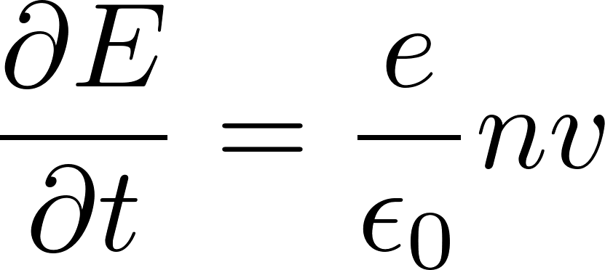
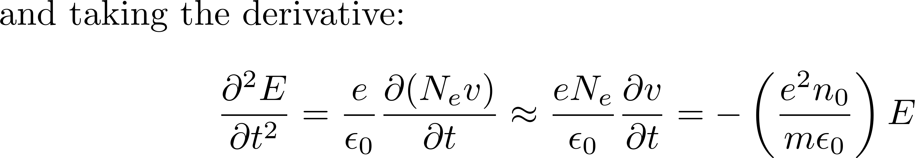
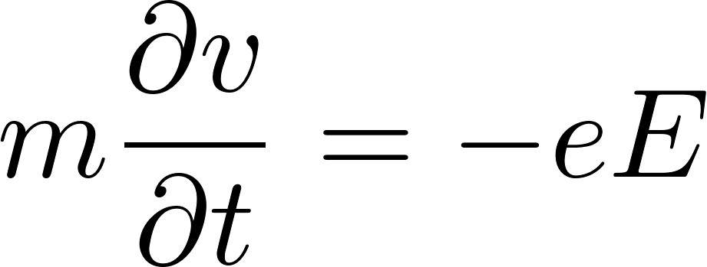
FIELD EQUATION

Slide 12
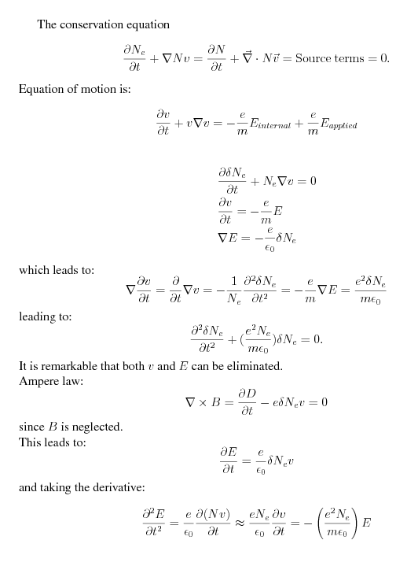

Slide 13
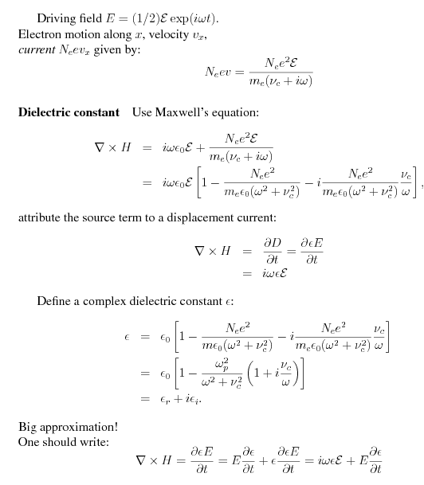

Slide 14
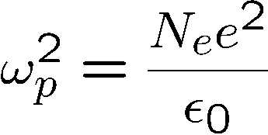
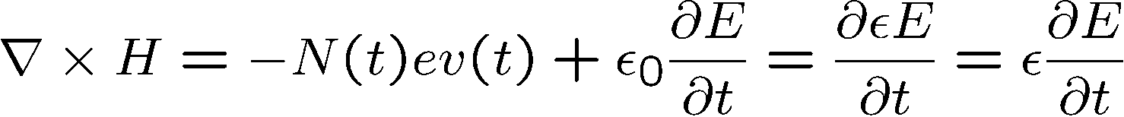
What is wrong with the Dude Drude
The plasma frequency defined by
represent a real frequency:
the frequency for density fluctuations of electrons.
The characteristic period is ps, longer than the duration of a short pulse (fs)
The Drude model is isotropic. At 800 nm, the ionization is anisotropic (tunnel)
With Drude, no difference between linear and circular polarization.
The error in the classical derivation:
Taking the ε out of the time derivative is not the right approach.

Slide 15



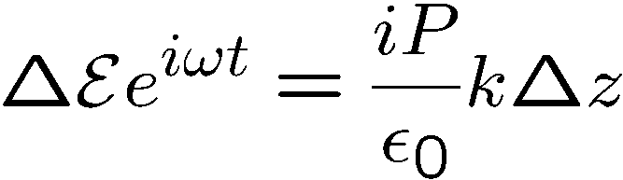

Classical light-matter interaction
Bound-electron: the oscillator model
Motion of the “spring” (polarization)
In phase with the force (E-field)
Below resonance: “index of refraction”
+
=
Time
P
Time

Slide 16
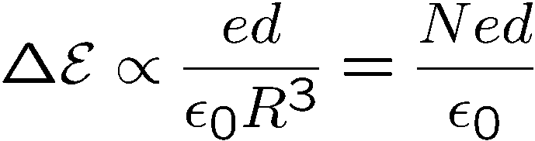

Classical light-matter interaction
Bound-electron: the oscillator model
Field of radiating electron
Below resonance: “index of refraction”
At resonance: “absorption”
+
=
+
=
Time
Time
P
P
Time
Time

Slide 17
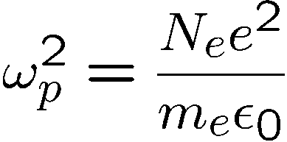


Classical light-matter interaction
“Free”-electron: the Drude model (plasma)
Below resonance: “index of refraction”
At resonance: “absorption”
“Negative index of refraction”
+
=
+
=
+
Time
Time
=
Time
P
P
P
Time
Time
Time

