Slide 1
Creating an inversion with rate equations
Connections between physical parameters
Saturation, self saturation, mutual saturation

Slide 2
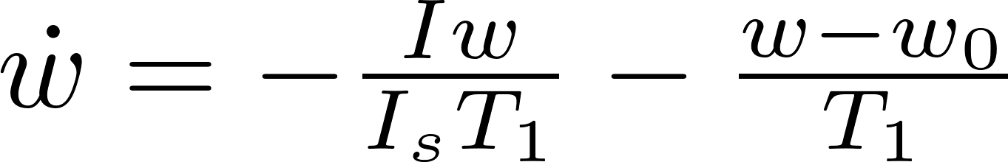
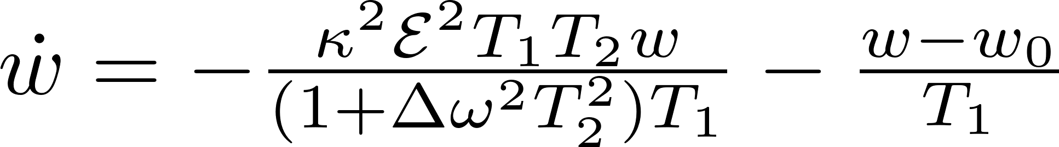
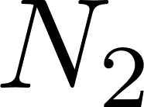
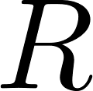
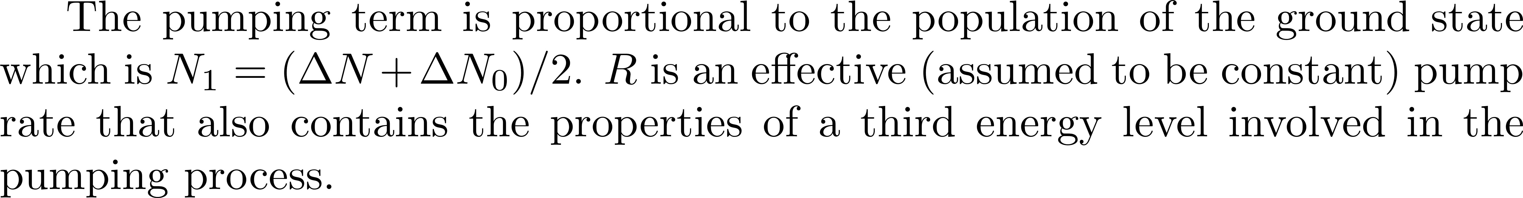
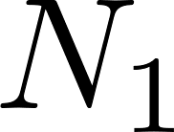
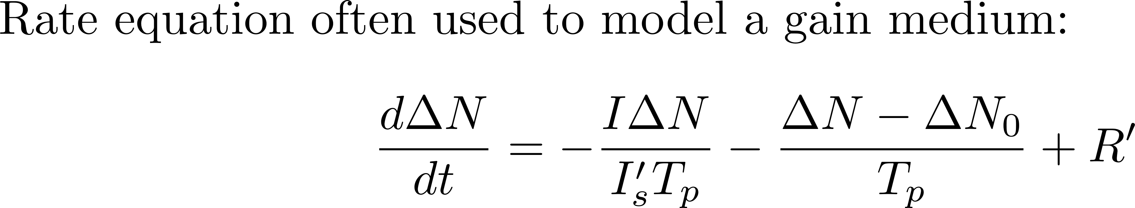
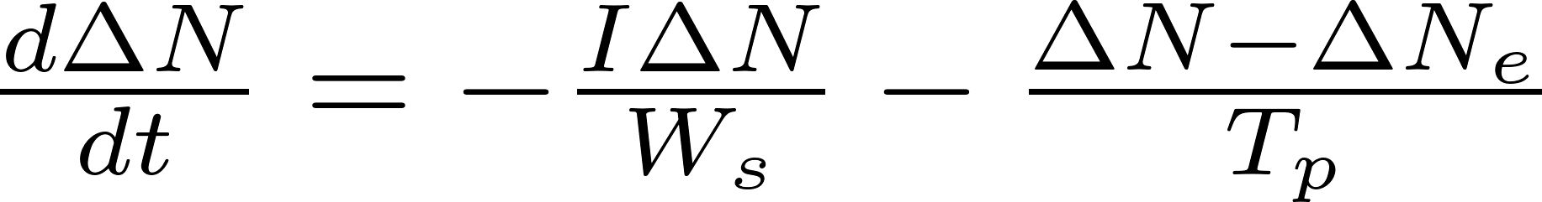
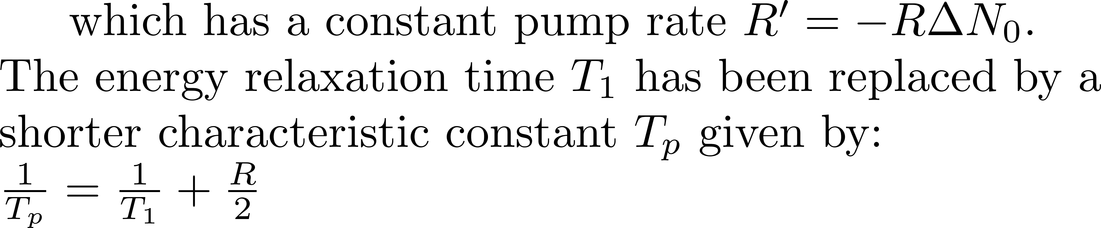
Creating an inversion with rate equations

Slide 3
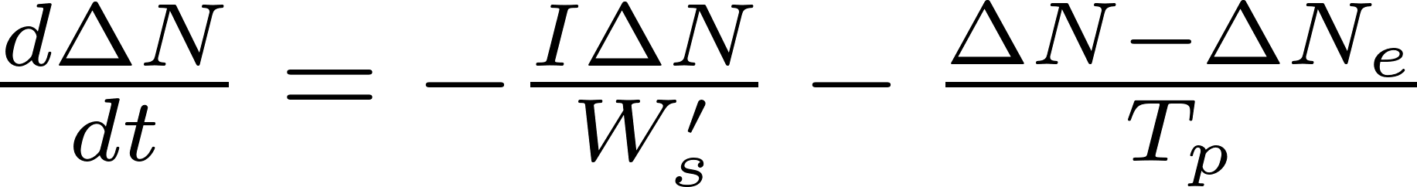
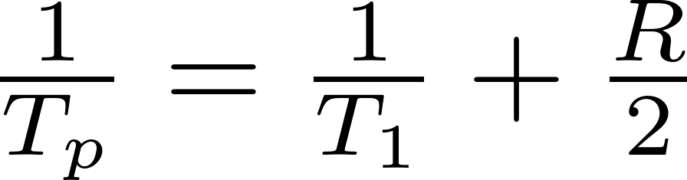
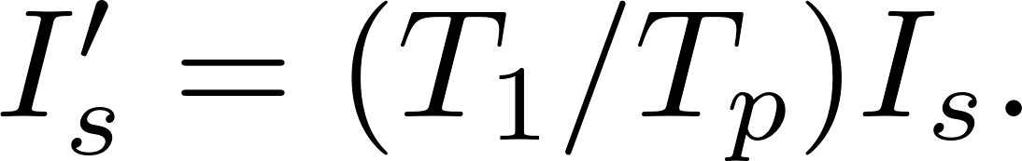
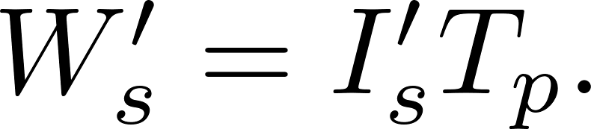
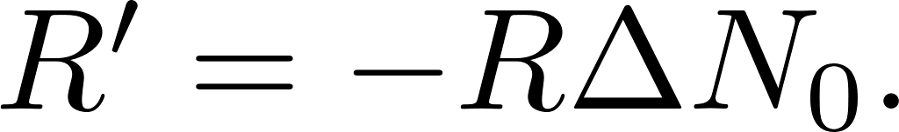
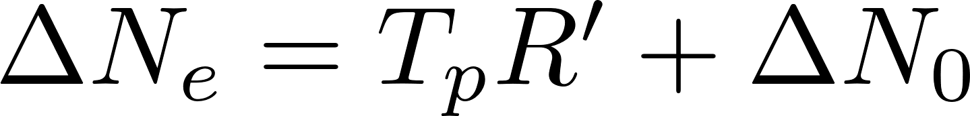
Creating an inversion with rate equations
From the 3 level rate equation with pumping we arrived at the 2 level Eq,

Slide 4
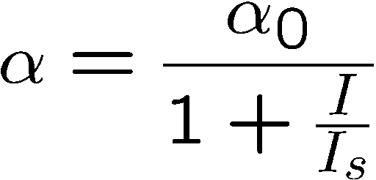

Saturation
Gain saturation
Stabilizes
Absorption saturation
Starts mode-locking
I
0
time

Slide 5


Saturation starts mode-locking
The ideal “saturation absorption” curve:
Pulse energy

Slide 6
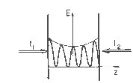
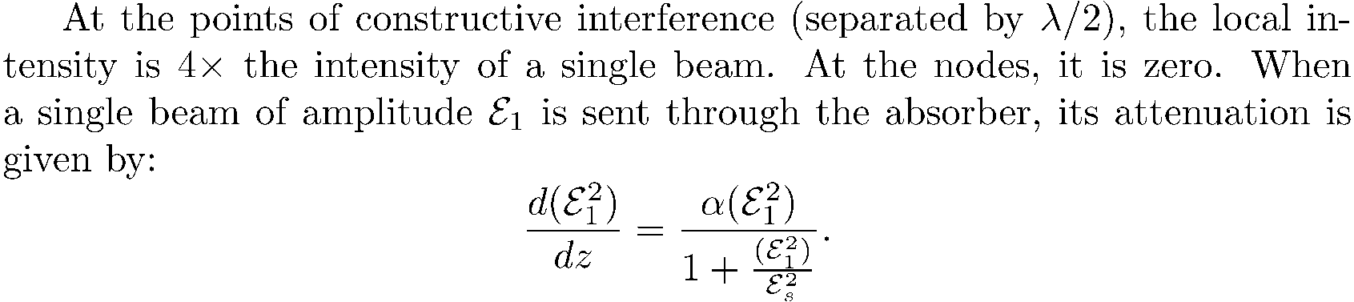
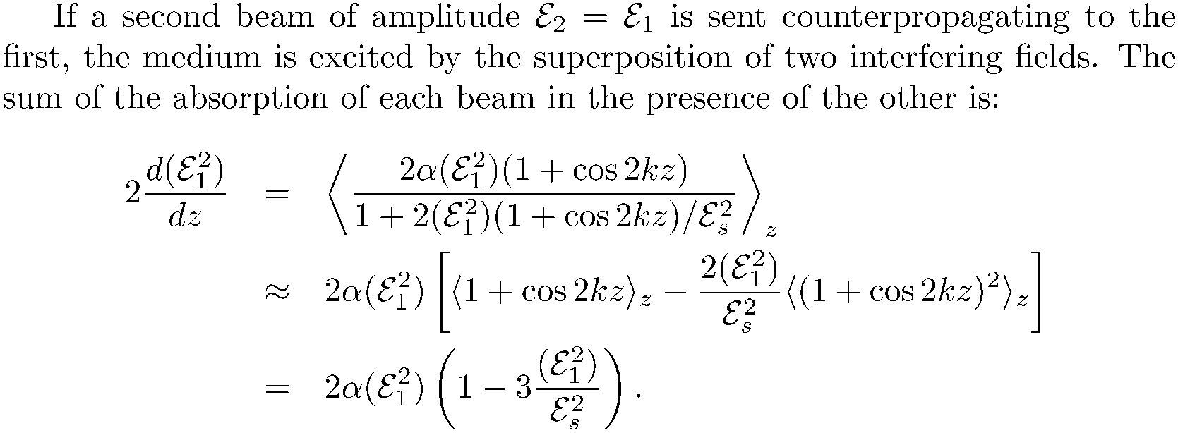
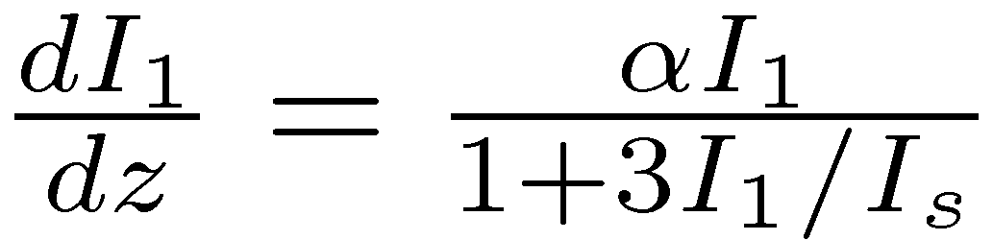
Mutual saturation

Slide 7
Simple model of a mode-locked laser

Slide 8
Model of laser with long relaxation time

Slide 9
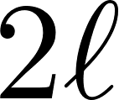
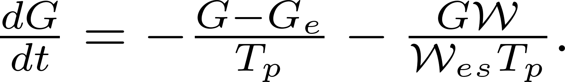
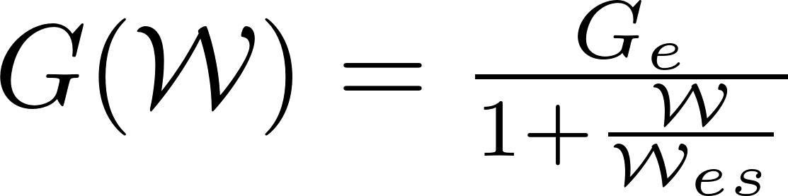
Energy evolution. Pulse shorter than the energy relaxation rate

Slide 10
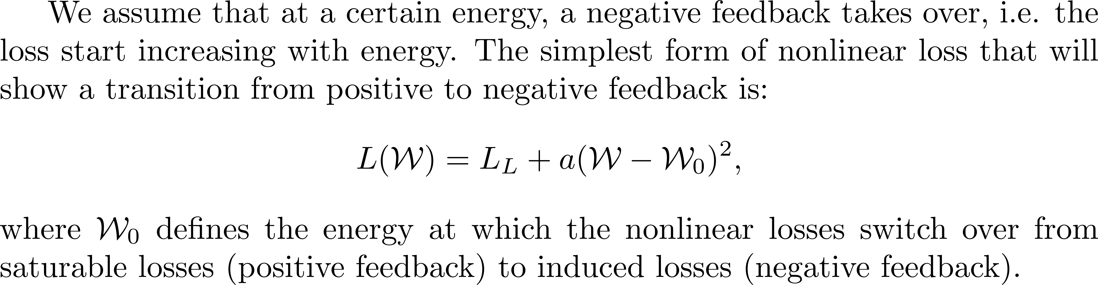
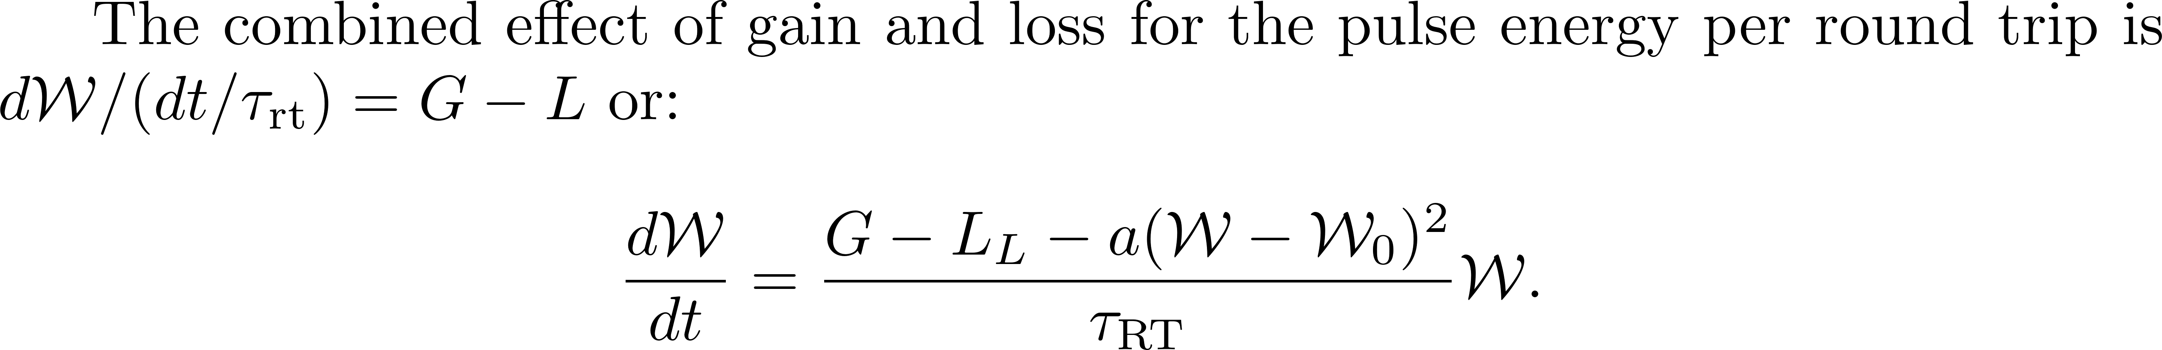
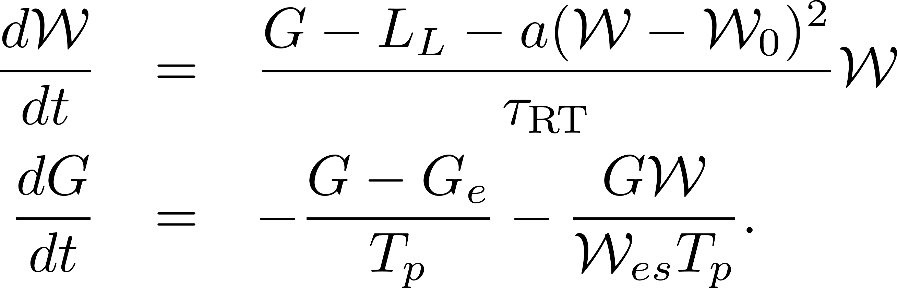

Slide 11
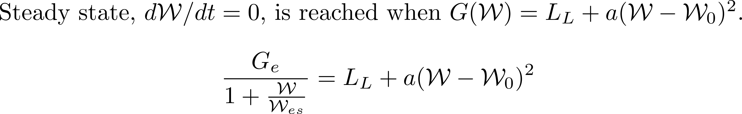
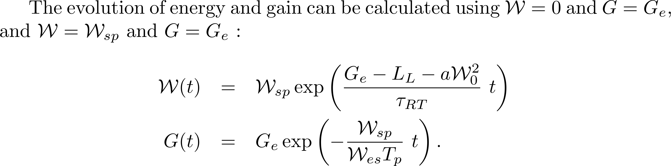

Slide 12
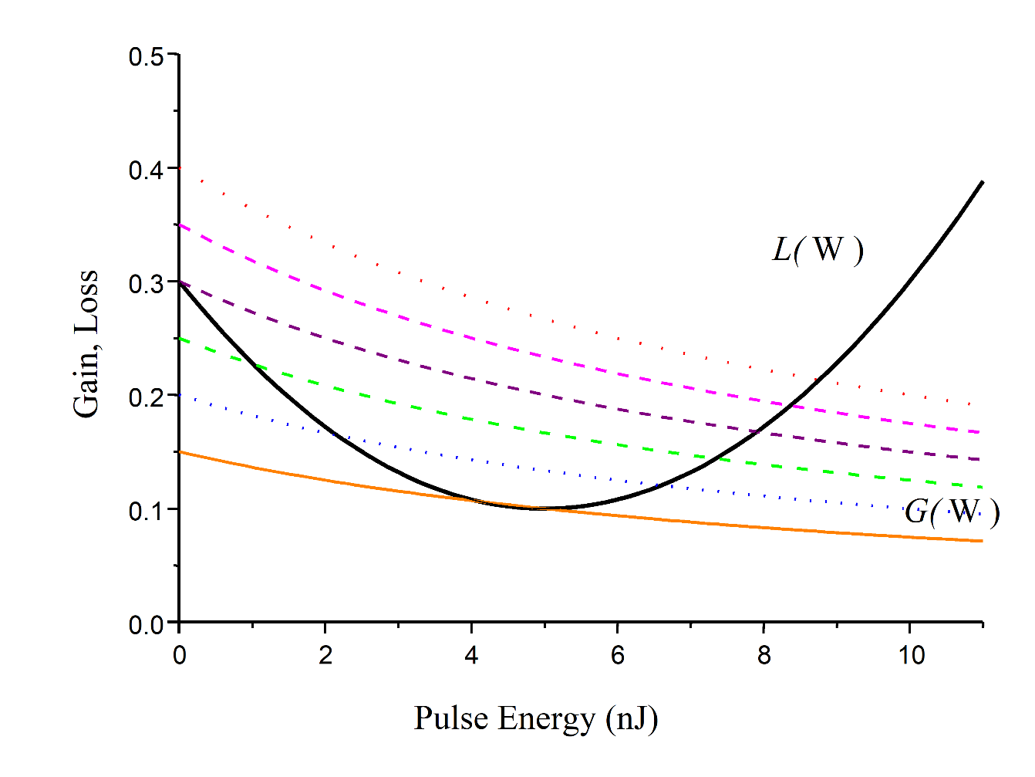
Laser with a short lifetime gain medium

Slide 13
More on saturation: induced gratings

Slide 14
Mutual saturation

Slide 15
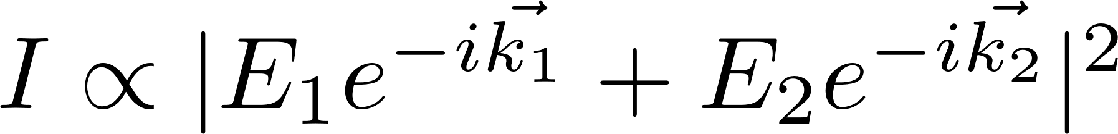

Slide 16
Saturation changes the group velocity, and
couples intracavity pulses in amplitude
Application: creating two pulse trains of exactly the same repetition rate.
B
A
t₁
z
t₂
t₃
t₄
t₅
t =- z/c
t
t = z/c

Slide 17
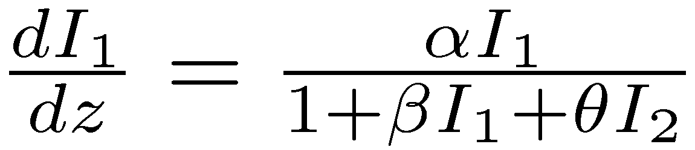
Mutual saturation
Application creating two pulse trains of exactly the same repetition rate.
In a ring cavity
or in a linear cavity
GAIN
GAIN
ABSORBER
ABSORBER

Slide 18
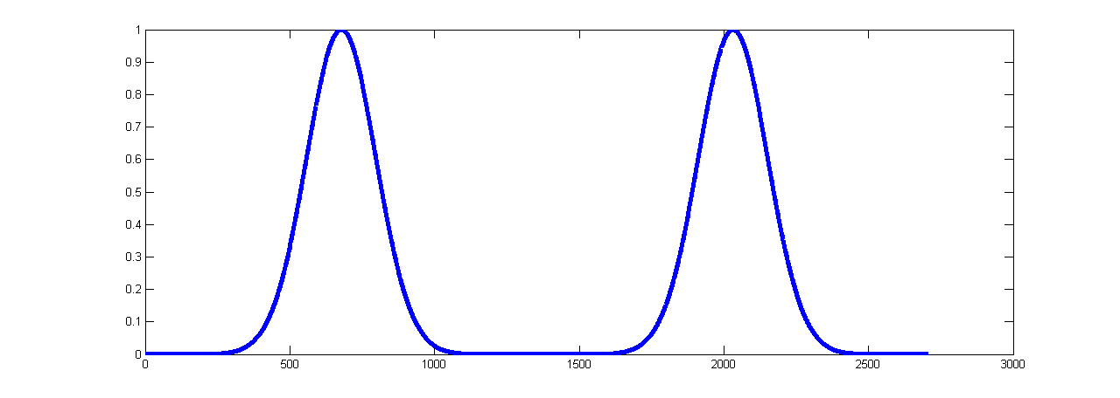
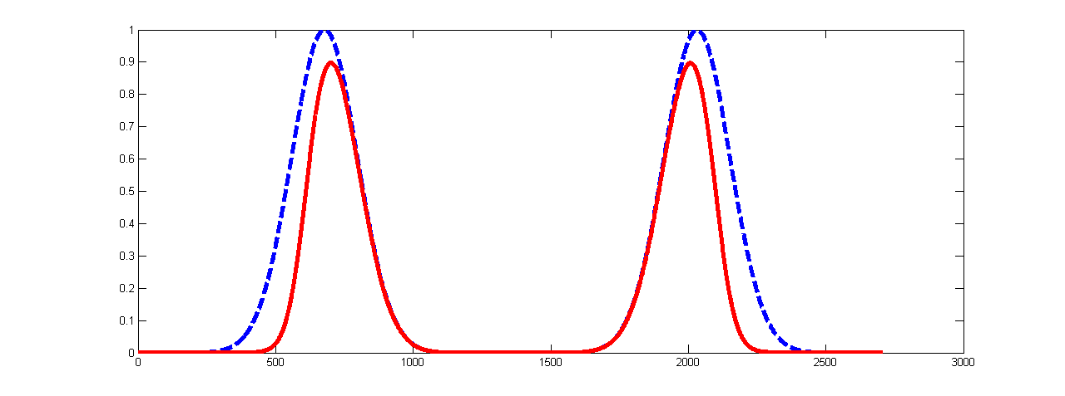
Propagation axis z
z-ct
z-ct

Slide 19
Ideal laser medium versus ideal amplifier medium
Short lifetime media
Long lifetime media
Dye laser, semiconductor lasers
Crystalline host lasers
Ti:sapphire, alexandrite, forsterite etc…
High gain, low power
Low gain, high power
Operation dominated by gain, loss modulation
“robust” operation
“Soliton” type operation possible, but
strong tendency to Q-switching
Pulse energy independent of repetition rate
> 1 nJ/pulse difficult (VECSL)
Average power independent of repetition rate
→ High energy/pulse with long cavities

Slide 20
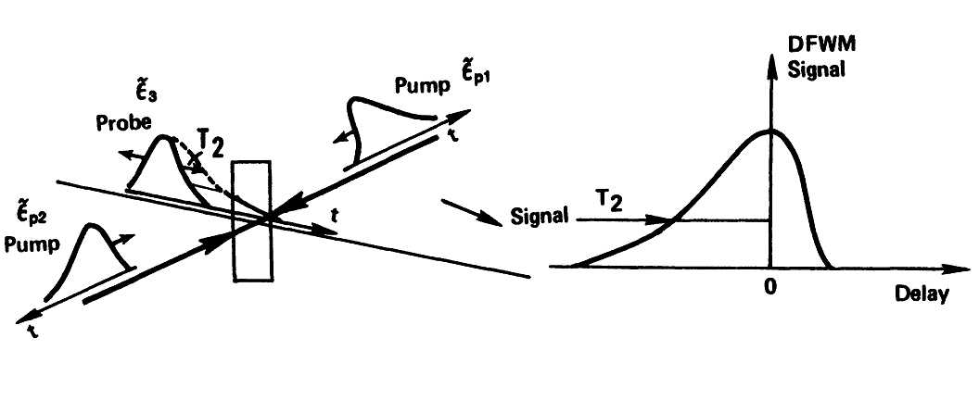

Slide 21
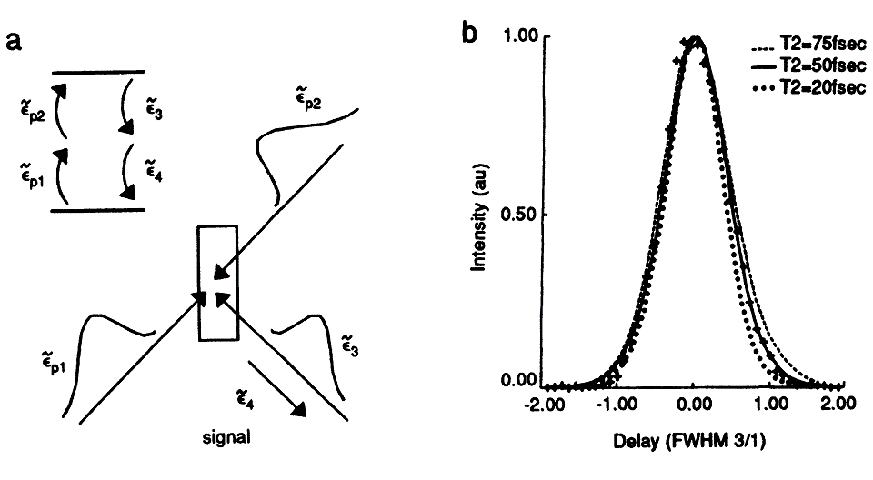

Slide 22
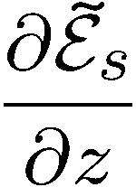
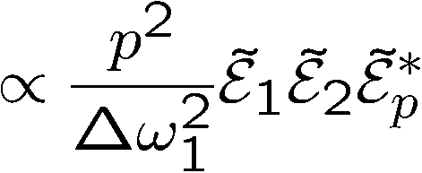
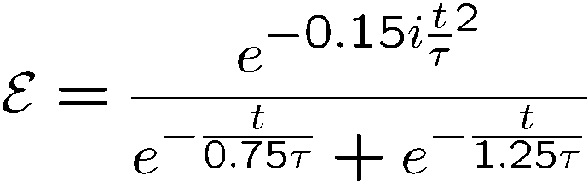


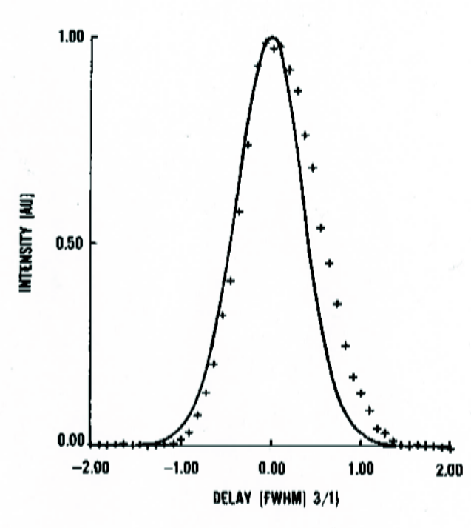


Exciting pulse:
G
FWHM = 76 fs = 1.72 τ
A
D
Delay
(units of FWHM of intensity autocorrelation)

Slide 23
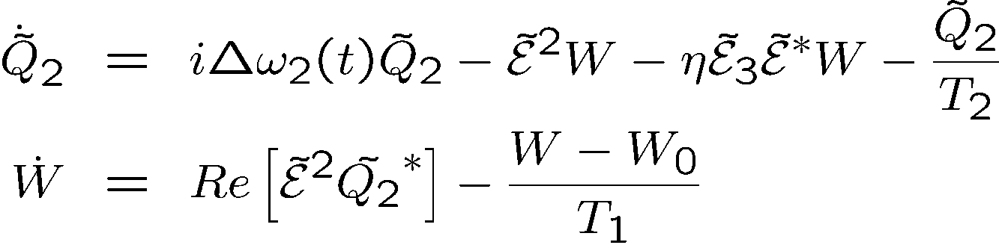
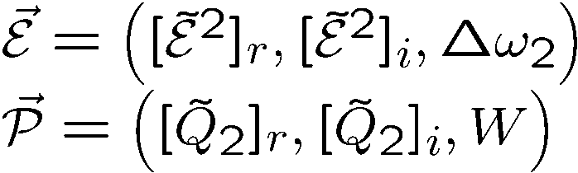
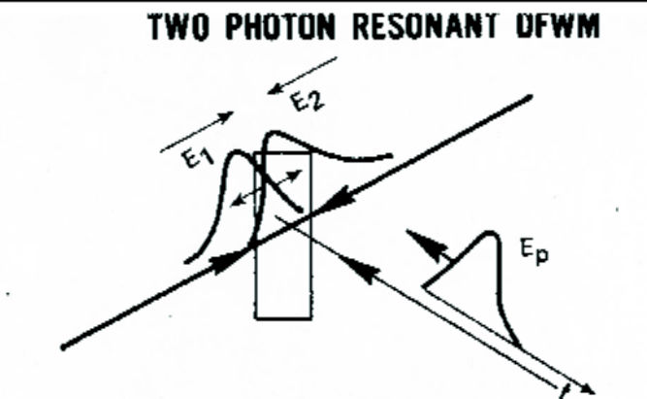
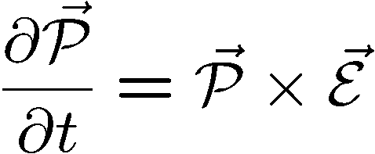
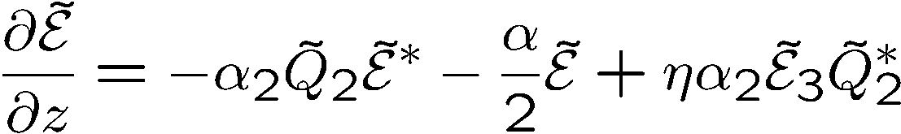

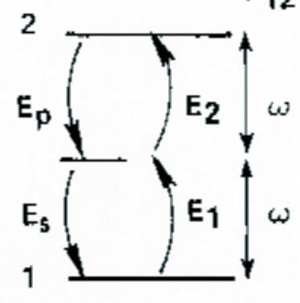

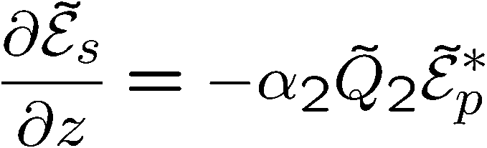



Two-photon absorption and DFWM
W
i
r

Slide 24
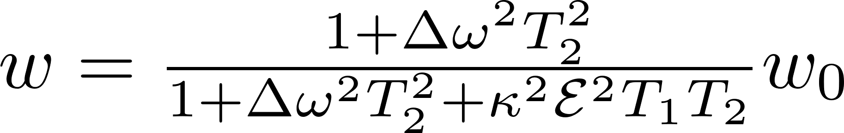
Back to saturation and line broadening
We derived the steady state expression for the population difference as an approximation from the exact quantum mechanical interaction:
Historically, a “spring” model , or electron oscillator was used. A summary is given in the broadening.pdf file.
Broadening.pdf

Slide 25
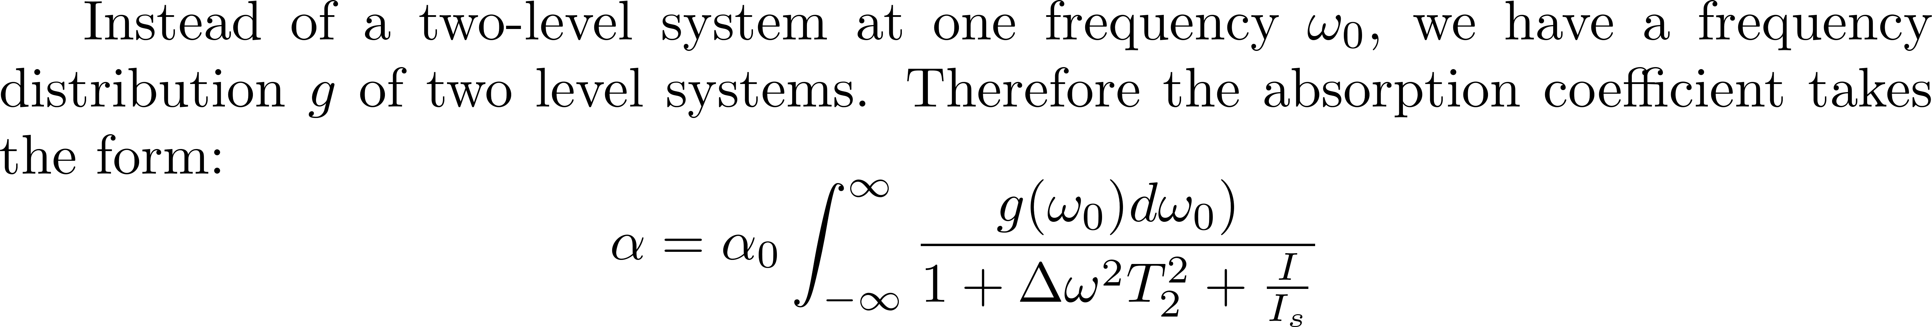
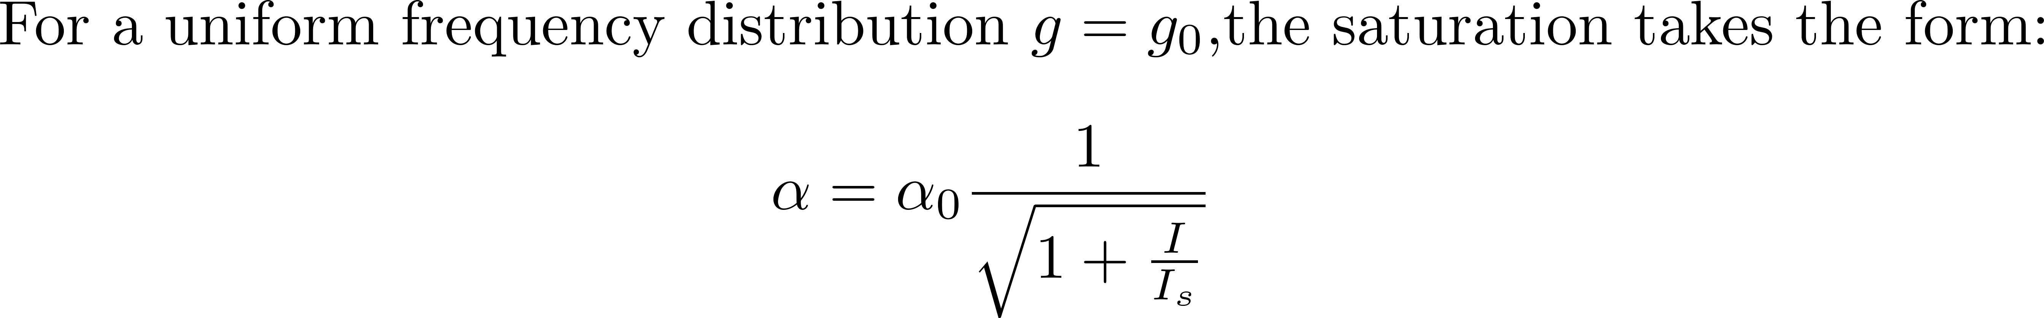
Saturation

Slide 26
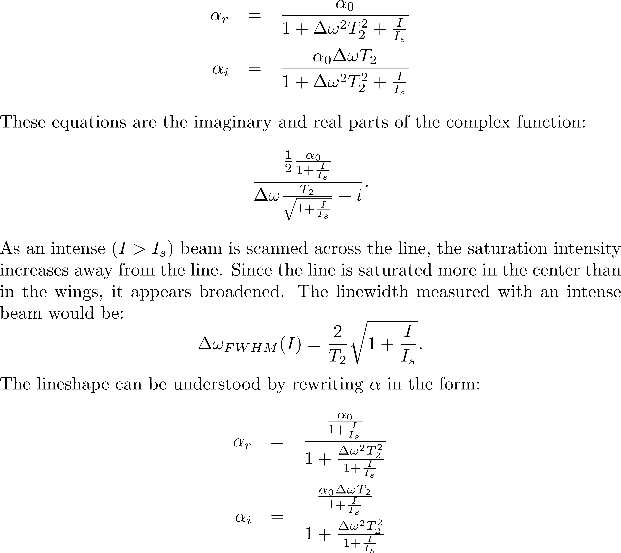
Saturation

Slide 27





Saturation of inhomogeneous broadened lines
Frequency
PZT

Slide 28
Ideal laser medium versus ideal amplifier medium
Short lifetime media
Long lifetime media
Dye laser, semiconductor lasers
Crystalline host lasers
Ti:sapphire, alexandrite, forsterite etc…
High gain, low power
Low gain, high power
Operation dominated by gain, loss modulation
“robust” operation
“Soliton” type operation possible, but
strong tendency to Q-switching
Pulse energy independent of repetition rate
> 1 nJ/pulse difficult (VECSL)
Average power independent of repetition rate
→ High energy/pulse with long cavities

Slide 29
Einstein coefficients

Slide 30




RATE EQUATIONS – preview of Einstein coefficients

Slide 31

EINSTEIN COEFFICIENTS AND HISTORY
Before 1960, the concept of a plane wave propagating with an intensity I did not exist.
You talked of an electromagnetic energy density ρ trapped in a cavity.

Slide 32


BLACK BODY RADIATION TO RATE EQUATIONS
Planck’s constant: result of fitting blackbody radiation
Boltzman: Probability that a particle in a gas has energy ε_{j} is exp[-ε_{j}/kT]
Boltzman: Probability that a particle in a gas has energy 2ε_{j} is exp[-2ε_{j}/kT]…
…
Make the sum of all probabilities up to Nε_{j} and you have the distribution function for the energy density:.
The discovery of Planck: exact fitting of the blackbody distribution function if you make
It seems now obvious to us that this meant that light was made of quanta of energy: the photon.
Obvious only to Einstein.
Not obvious to Planck, who, to his death, did not believe in the photon.
Maxwell’s equations were the success of the 19th Century.. They are continuous. Ether was firmly believed in up to 1920 (Sagnac).

Slide 33



BLACK BODY RADIATION TO RATE EQUATIONS
Planck’s constant: result of fitting blackbody radiation
Boltzman: Probability that a particle in a gas has energy ε_{j} is exp[-ε_{j}/kT]
Boltzman: Probability that a particle in a gas has energy 2ε_{j} is exp[-2ε_{j}/kT]…
…
Make the sum of all probabilities up to Nε_{j} and you have the distribution function for the energy density:.
More details: getting to that coefficient
Modes in a linear laser cavity: we want the phase shift in a round-trip (2L) to be multiple of 2π.
The total number of modes allowed between ν = 0 and ν is the number of points or volume of a sphere of radius

Slide 34




Ratio of spontaneous emission to stimulated emission rate
It seems now obvious to us that this meant that light was made of quanta of energy: the photon.
Obvious only to Einstein.
Not obvious to Planck, who, to his death, did not believe in the photon.
Maxwell’s equations were the success of the 19th Century.. They are continuous. Ether was firmly believed in up to 1920 (Sagnac).
Einstein approach: the radiation in equilibrium with two level systems, with populations N₂ and N₁.
Other approach: Spontaneous emission is stimulated emission, stimulated by the vacuum fluctuation

Slide 35





Slide 36


Slide 37


Slide 38


Slide 39


Slide 40



