Slide 1
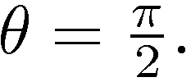
We are looking at n waves emitted by the source, over a time of n T_{0.}
Triangle of velocities:
Detector duck being hobbled at frequency
Distance between emitter and
Wave emitting duck moving at velocity emitting frequency
receiver
u
c
Time intervals between waves
There is a transverse Doppler shift:

