Slide 1
LONG CAVITY, HIGH ENERGY/PULSE, ULTRASHORT PULSES
CAN YOU MAKE MODE-LOCKED LASERS WITH SHORT CAVITY?

Slide 2
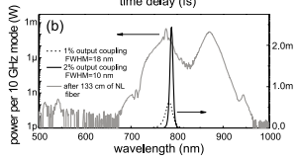
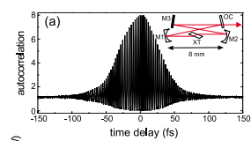

Slide 3
from fo servo/
(AOM driver)
175 kHz bandwidth
Verdi 8W pump
532 nm
From slow PZT driver
AOM
Intra-action
from fast PZT servo (52 kHz bandwidth- actuator limited)
Mirror mounts:
M2/OC 0.5” Thorlabs
M3 0.5” Lees mounts
Lead rod
1mm thick UV grade fused silica CVI laser
λ/2 @ 532 nm
M3
OC
M1
M2
Optosigma 1”x1” aluminum stages
Singlet
f = 3 cm
2.51 mm path length
Tanya’s burnt crystal
Laser power:
Pump Modelocked
8.5 W 1.1 W
7.5 W 0.95 W
6.5 W 0.86 W
Laser mirrors
OC 1% (750-950 nm) ½” Laser components
M1 – c-cave 1.5 cm ½”
LT F0603013
M2 – c-cave 1.5 cm ½”
LT F0603005
M3 – c-vex 100 cm
6.25mm LT F0603013

Slide 4
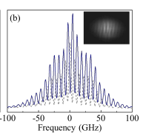
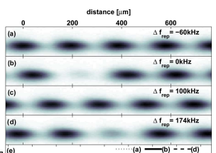

Slide 5
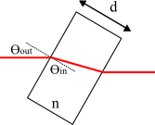
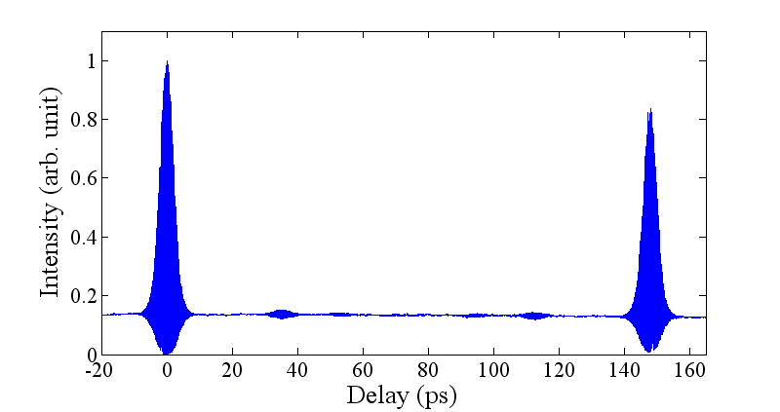
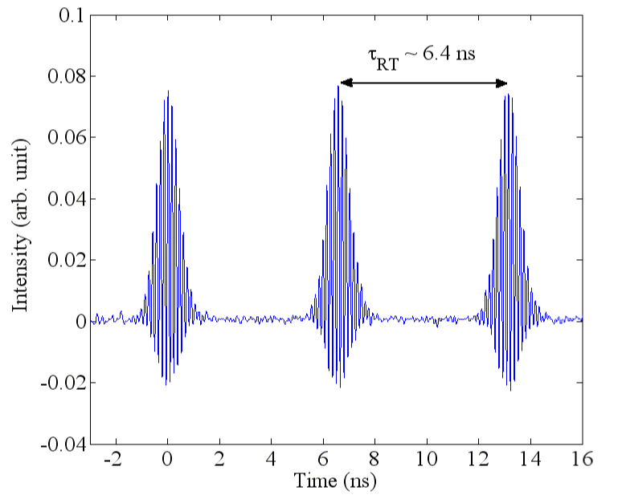
Etalon inside a mode-locked laser: nested comb
Spectrum
analyzer
15.12mm Fused silica
FSR ~ 6.83 GHz
Reflectivity ~ 0.034
Coupling of Fabry-Perot with the laser cavity
Gain medium
Rubidium
cell
Frequency
counter
Auto-correlation
6.8 GHz mode spacing
FP pulses
~ 6.4 ns
~ 1.5 ps
~ 2ns

Slide 6
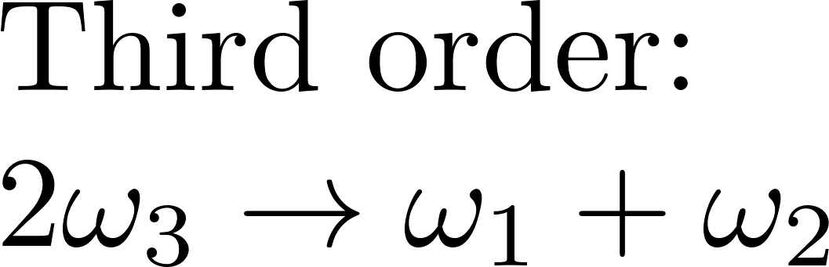
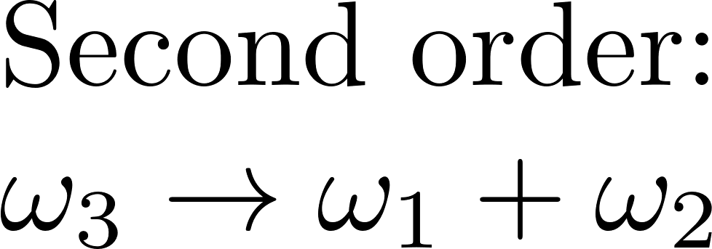

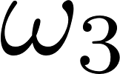

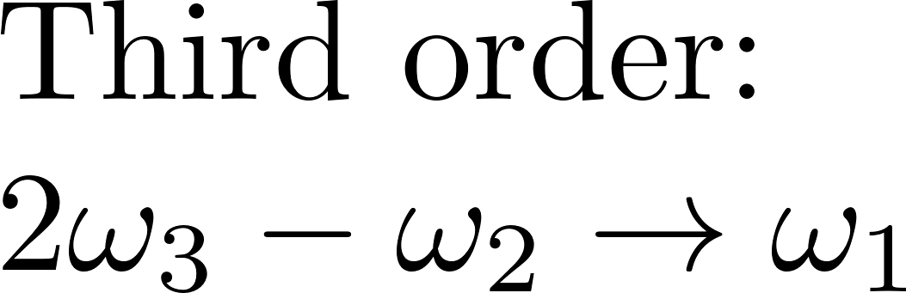
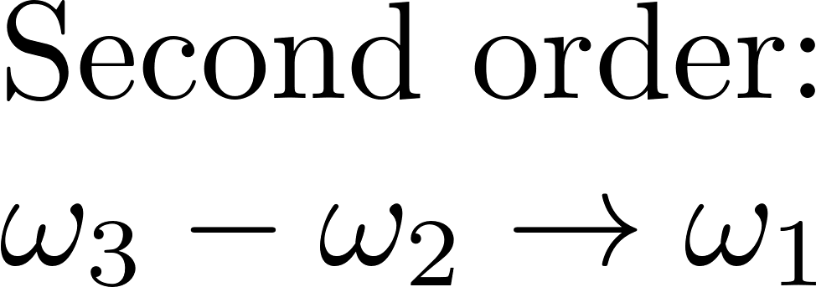
OSCILLATORS BASED ON OPTICAL PARAMETRIC GAIN (OPG)
?
GAIN
?

Slide 7
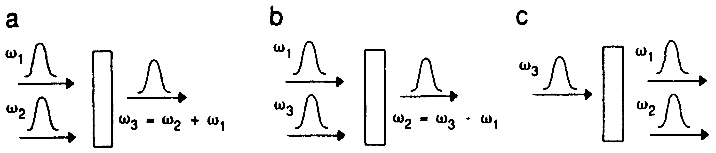
Second order:
Second harmonic, difference frequency, optical parametric oscillation
LOSS
GAIN
GAIN
SF
DF
OPG
or OPO or OPA

Slide 8
Second harmonic, difference frequency, optical parametric oscillation
What is the difference between population inversion gain
and optical parametric gain?
Population inversion OPG
Lasts after the pump Instantaneous
Energy dissipation no dissipation in matter
(relaxation mechanisms)
Analogy?

Slide 9




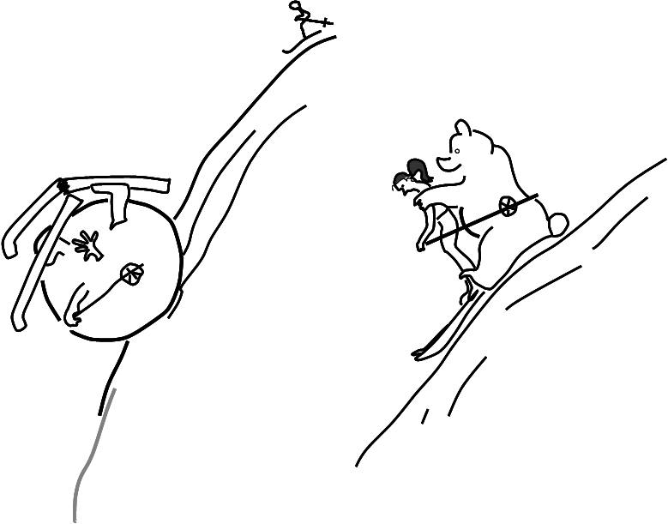
Analogy: population inversion gain versus optical parametric gain
I_{p}
I_{p}
TIME
TIME
G
A
I
N
G
A
I
N
TIME
TIME

Slide 10
Phase matching
Phase matching in second harmonic generation
TYPE I
Fundamental
Second harmonic
Phase matching
dE₂
= a E₁²
SHG
dz
E₂
Different wavelengths
dE₁
= -a E₂E₁*
dz
ENERGY EXCHANGE ALWAYS
FROM 1 TO 2
Distance z

Slide 11
Phase matching
Phase matching in second harmonic generation
TYPE II
SHG
dE₂
Phase matching
= a E_{o}E_{e}
dz
dE_{o}
= -a E₂E_{e}*
E_{o}
dz
dE_{e}
= -a E₂E_{o}*
dz
E_{e}
THE SIGN OF ENERGY
EXCHANGE CAN CHANGE
Distance z

Slide 12
Phase matching with periodically poled crystals
Use the orientation for
maximum NL coefficient.
Periodically reverse the sign
of the coefficient (a),
when
SHG
E₂
sin Δk z = sin (k₂ - 2k₁z)
changes sign
Distance z
dE₂
= a E₁²
dz
Advantage: Large nonlinearity
dE₁
= -a E₂E₁*
dz
Disadvantage: Periodic structure
Narrow band

Slide 13
(a)
(b)
(c)

Slide 14
Application: Absolute calibration of light sources
The signal and idler photons are produced in exact pairs in
entangled quantum mechanical states. The entangled states make possible
some interesting physics.
The parametric down conversion process can also be seeded by externally injecting
additional signal or idler photons. This results in the production of additional
entangled state photons in the conjugate beam.
OPA
OPG
Seeded Parametric
Down Conversion

Slide 15
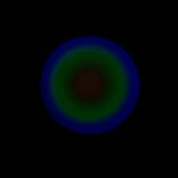
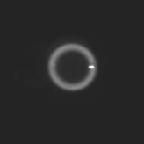
Application: Absolute calibration of light sources
OPG OPG + OPA
spontaneous parametric down conversion (PDC)
stimulated or seeded parametric down conversion (PDC)
images of broad band
background produced
by spontaneous PDC
images of seeded PDC against a
narrow band ring of spontaneous
PDC
OPG = amplification of the vacuum fluctuation
(source known = calibration source)
Seed to measure the gain
Compare seed with ring
Ring intensity = vacuum photon x gain

Slide 16
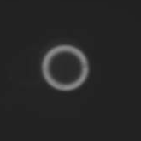
ν_{s}(IR OFF)
ν_{s}(IR ON)
seed
Pump laser

Slide 17
SECOND ORDER OPO FOR FREQUENCY COMB GENERATORS
CRYSTAL
PUMP FREQUENCY COMB
IN TIME DOMAIN, EACH PUMP PULSE CREATES A SIGNAL

Slide 18
SECOND ORDER OPO FOR FREQUENCY COMB GENERATORS
Beat note detector
D_{b}
Lithium niobate modulator
OPO cavity
Gain
7 W pump beam 532 nm
PPLN
MQW
No spontaneous emission noise
Creation of correlated frequency combs of the same repetition rate.
Adjustable CEO difference between combs
Piezo

Slide 19
THIRD ORDER OPO FOR FREQUENCY COMB GENERATORS
GLASS
PUMP FREQUENCY COMB
IN TIME DOMAIN, EACH PUMP PULSE CREATES A SIGNAL
EXAMPLE: A FIBER LASER GYRO

Slide 20
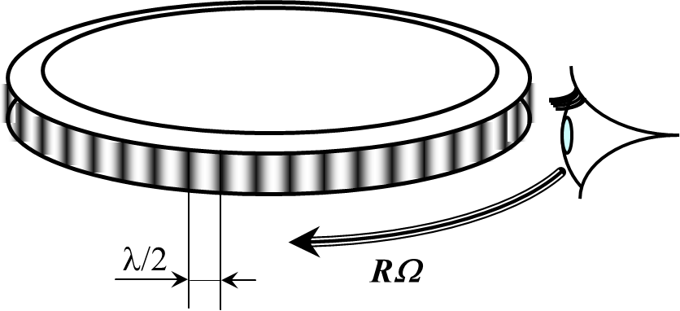

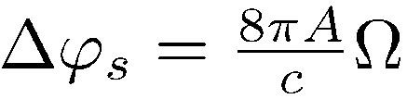
LASER GYRO EFFECT
4A
Ω
=
R Ω
=
Δν
Pλ
λ/2

Slide 21

LASER GYRO EFFECT
Best description of a laser gyro:
DOPPLER SHIFT SEEN BY THE OBSERVER
RΩ
Other description: There is a different phase shift (Sagnac phase shift) in the 2 senses of rotation
ν(1 - )
c
R
Fiber optic gyro (FOG):
phase accumulates with Nb of coils
Ω
Laser gyro:
RΩ
ν(1 - )
c
4A
Ω
Δν = 2RΩ
ν
=
R Ω
=
c
λ/2
Pλ

Slide 22
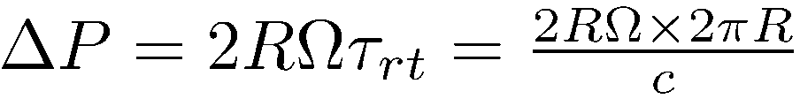
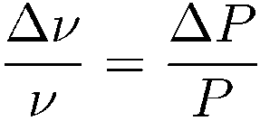
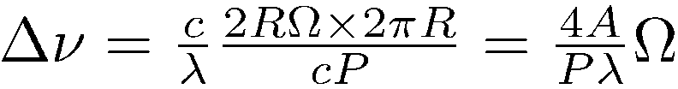



LASER GYRO EFFECT
RΩ
For the laser to be at resonance, you need an integer number of wavelenths.

Slide 23
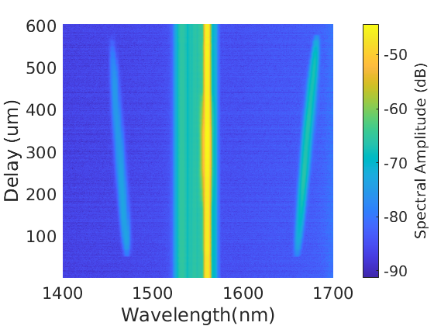
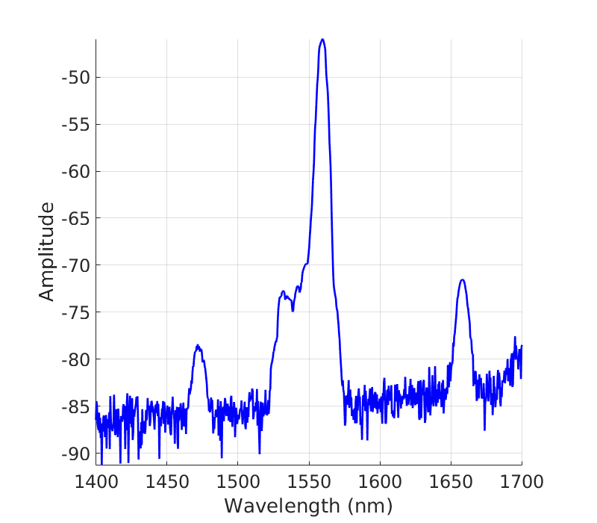
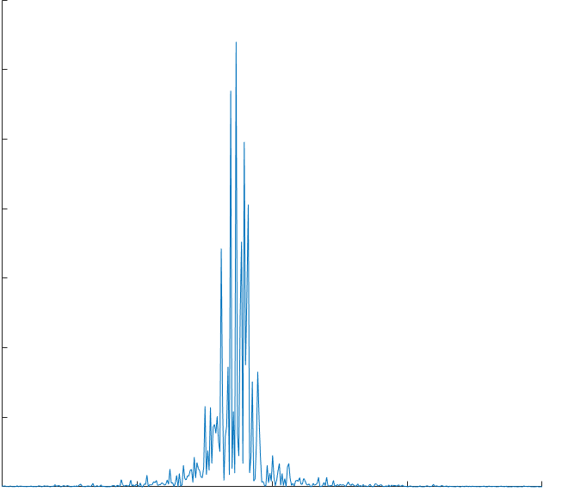
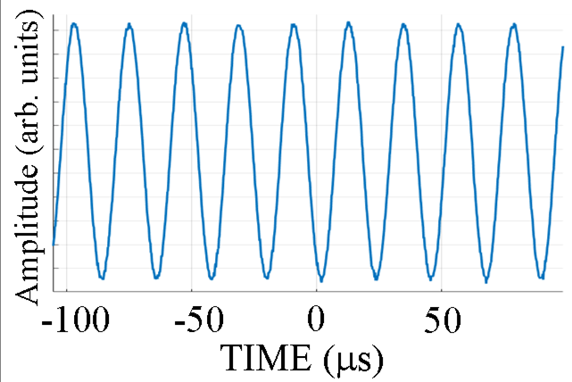
1.21 m
The fiber ring OPO
0.471m
O
O
HNLF
OPO
Spectrum
1.06 m
WDM
50/50
Pump
Beat note detector
Fourier transform
45
50
55
60
Frequency (kHz)

Slide 24
1.21 m
THIRD ORDER OPO FOR FREQUENCY COMB GENERATORS
0.471m
HNLF
Noisy combs in macroscopic cavities!
OPO
1.06 m
WDM
Scale matters!
50/50
Pump
Beat note detector
Fourier transform
45
50
55
60
Frequency (kHz)

Slide 25
THIRD ORDER OPO FOR FREQUENCY COMB GENERATORS
Noisy combs in macroscopic cavities!
Scale matters!
Considerably less noise in
MICROCOMB GENERATION

Slide 26

THIRD ORDER OPO FOR MICRORESONATOR COMB GENERATORS
MICRO-
RESONATOR
CW PUMP
INTENSITY ENHANCED IN RESONATOR
GENERATION OF FREQUENCIES AT THE RESONATOR RESONANCES BY FWM
Description in frequency domain rather than time domain

Slide 27

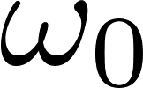


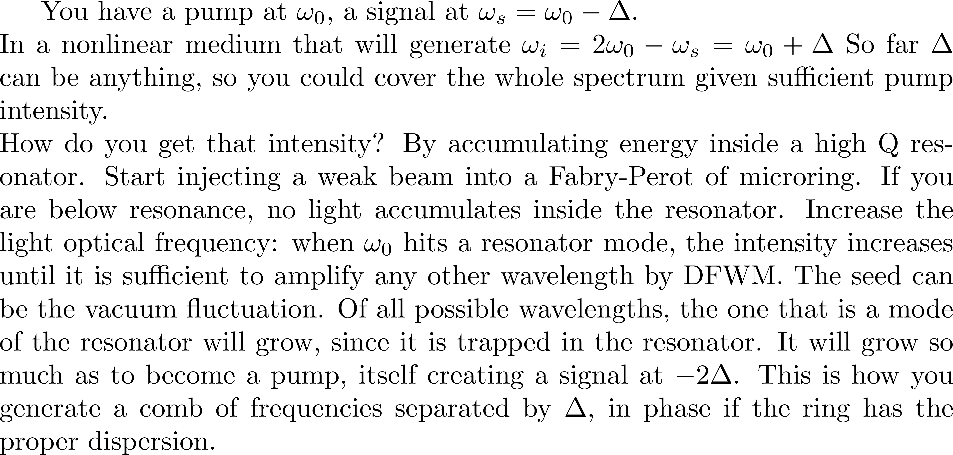
Generating new frequencies

Slide 28
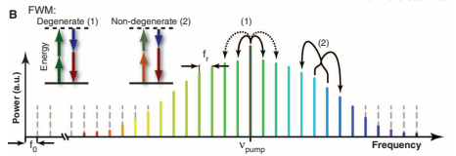
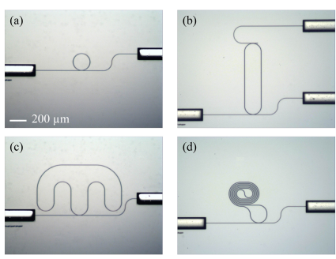
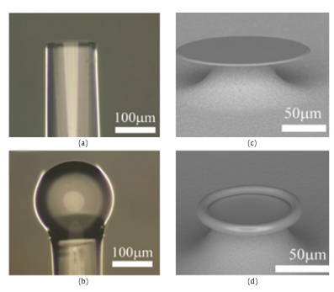
THIRD ORDER OPO FOR MICRORESONATOR COMB GENERATORS
pump
frequency
Each sideband can become a source of FWM, leading to cascaded FWM.
frequency
Kippenberg, Hozwarth and Diddams, Science 332:555 (2011)

Slide 29
Dispersion should be small?
It should match the self phase modulation

Slide 30
PHASE MODULATION
E(t) = ε(t)e^{iωt-kz}
n(t)
or
k(t)
ε(t,0)
ε(t,0) e^{ik(t)d}
d
DISPERSION
ε(ΔΩ,0)
n(Ω)
or
k(Ω)
ε(ΔΩ,0)e^{-ik(ΔΩ)z}

Slide 31
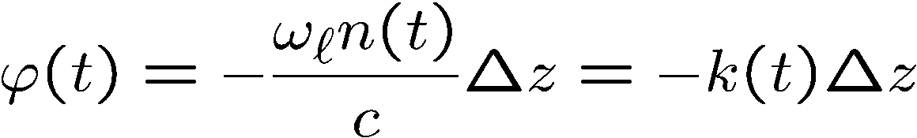


Propagation in the time domain
PHASE MODULATION
E(t) = ε(t)e^{iωt-kz}
n(t)
or
k(t)
ε(t,0)
ε(t,0) e^{ik(t)d}

Slide 32
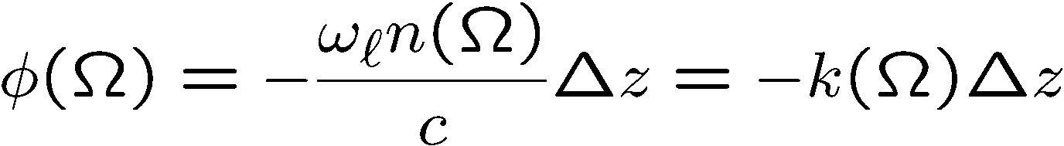
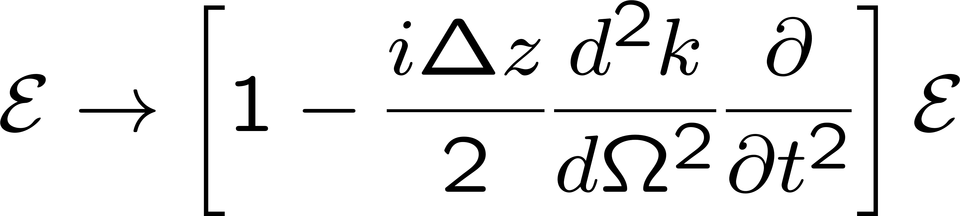
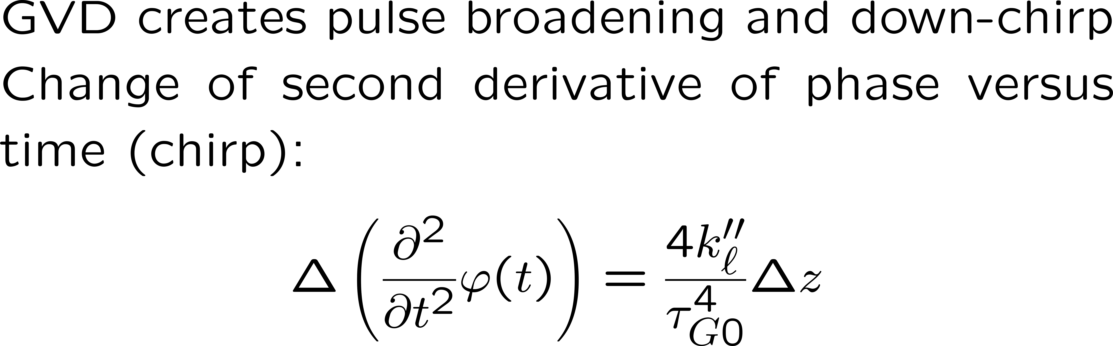
Propagation in the frequency domain
DISPERSION
ε(ΔΩ,0)
n(Ω)
or
k(Ω)
ε(ΔΩ,0)e^{-ik(ΔΩ)z}
Retarded frame and taking the inverse FT:

Slide 34
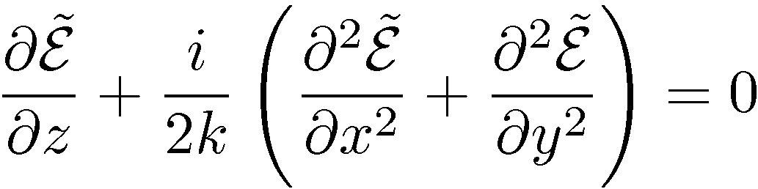
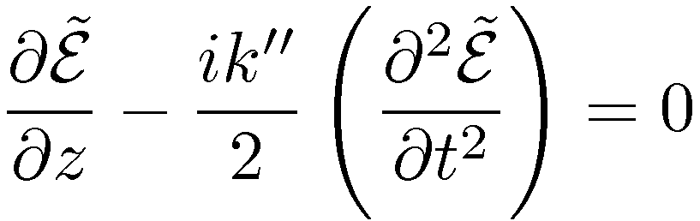
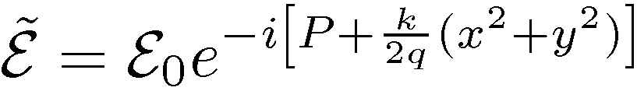
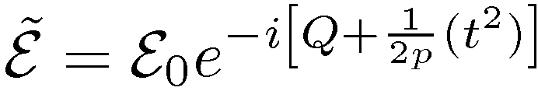
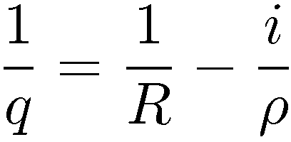
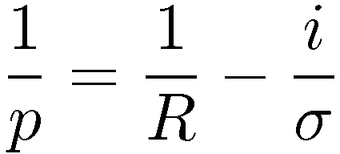
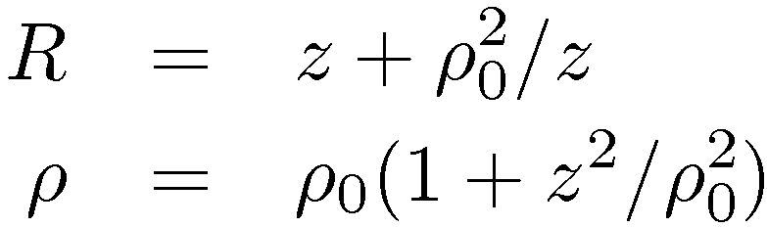
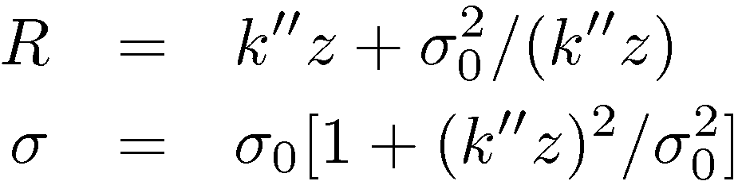
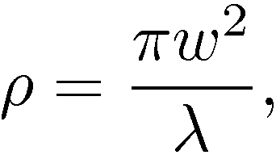
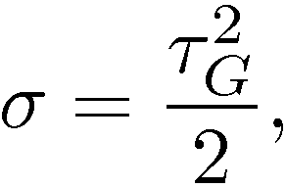
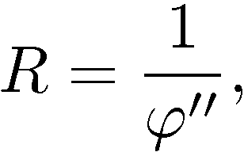
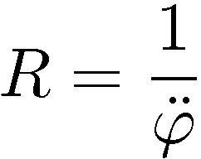
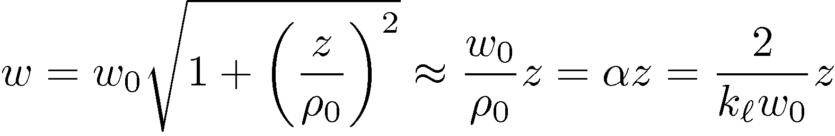
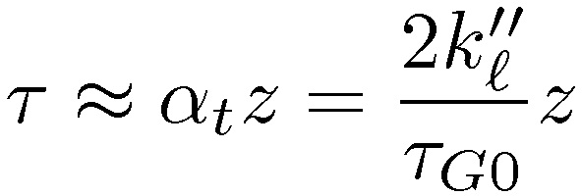
Time-space analogy
Gaussian beams
Gaussian pulses
Geometric optic
Propagation in a straight line
making an angle α with the optics axis

Slide 35
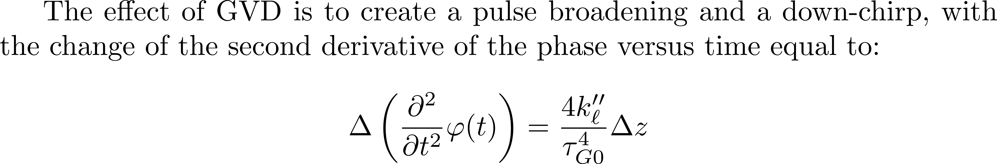


The actions of nonlinearity and GVD exactly compensate each other.

Slide 36

The actions of nonlinearity and GVD exactly compensate each other.

Slide 37
A purely dispersive mechanism, creates the soliton
FIBER
dispersion
Phase
Phase
dispersion
modulation
Phase
dispersion
dispersion
modulation
modulation
Phase
modulation
Dispersion
LASER

Slide 38

A purely dispersive mechanism, creates the soliton
Nonlinear index leads to
phase modulation
Electric field
amplitude
time
(a)
z = v₄t
z = v₃t
z = v₂t
z = v₁t
distance z

Slide 39

A purely dispersive mechanism, creates the soliton
Electric field
amplitude
(b)
Upchirped pulse in
Negative dispersion
medium
time
z = v₂t
(slow)
z = v₁t
(fast)

Slide 40










PHASE MODULATION
DISPERSION

Slide 41








Equation in the retarded frame
Normalized distance:
Characteristic field:
Characteristic time:
Solitons: solutions of the eigenvalue equation

Slide 42



The resonators (laser cavity, microresonator) having dispersion,
How can the modes of the frequency comb be exactly equally spaced?
Procedure: 1) write the quadratic spectral chirp coefficient induced by Kerr effect:
Multiply the chirped frequency spectrum by the dispersion:
at each round-trip, to find the condition:
J. Phys. B: At. Mol. Opt. Phys. 42 (2009) 183001 (25pp)

Slide 43


Two related questions:
Which mechanism makes the
As a pulse circulates in the cavity,
unequally spaced cavity modes
does it evolve towards a steady state?
equidistant?
Balance phase modulation by Kerr effect
and phase modulation by dispersion
How unequally spaced modes
Evolution of a single pulse in an ``ideal'' cavity
lead to a perfect frequency comb
SAME
CONDITION

Slide 44


Evolution of a single pulse in an ``ideal'' cavity
Dispersion
Kerr-induced chirp
Kerr effect

Slide 45







How unequally spaced modes
lead to a perfect frequency comb
Group delay
Phase delay
Cavity modes:
not equally spaced because n_{av =} n_{av}(ω)
Unequally spaced modes, is contradictory to the fact that comb teeth are equally spaced.
A cavity with ONLY Kerr modulation generates the pulse train:
where
F.T.
where
dispersion

Slide 46
STABILIZATION

Slide 48
Cavity (electronically) stabilized to a reference cavity
Isolator
Ti: Sapphire
Output
coupler
PZT2
PZT1
Pick-off mirror
1st order beam
AOM
BS
PM
Reference cavity
fm= 10.7 MHz.
Grating
PD2
PD1
Servo #2:
Group mode control
fm= 10.7MHz
Servo #1:
Average frequency control
To PM
J. Jones & J.-C. Diels,
PRL 86:3288—3291
(2001)
-
0.6
+
Voltage
0.0
-0.6
Frequency
Frequency

Slide 49

Travelling wave AO (Phase modulator)
Frequency modulator (stabilization)
Beam deflector
How to tune frequency without deflecting?

Slide 50

Travelling wave AO (Phase modulator)

Slide 51


Standing wave AO (Amplitude modulator)
Mode-locker

