Slide 1
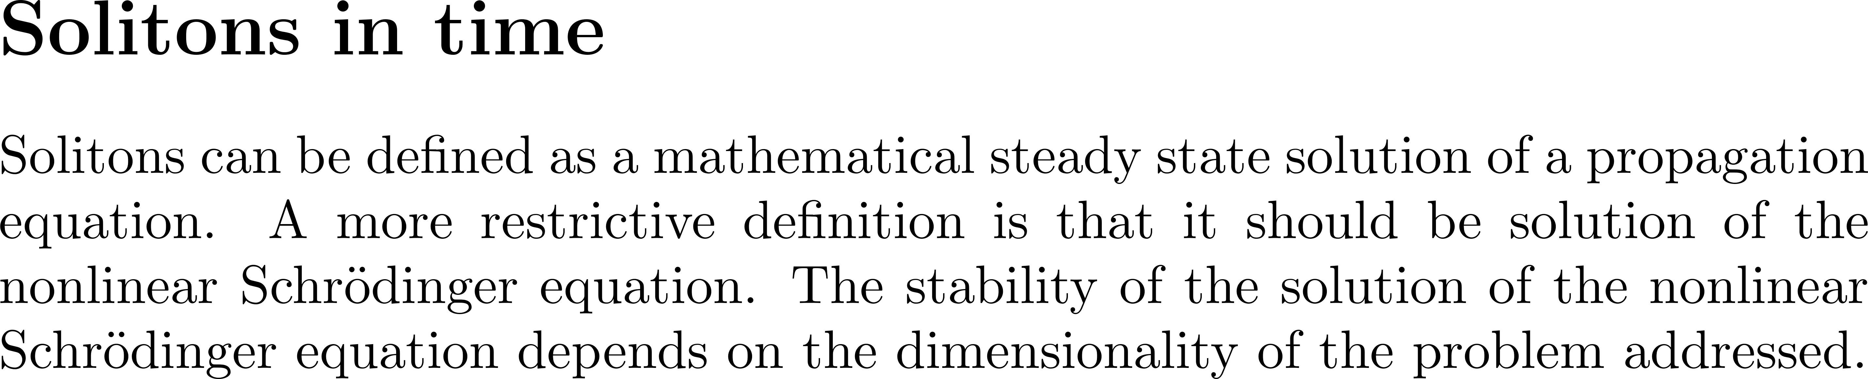
Pulse compression by propagation

Slide 2
The speed of light is highest in vacuum: $c = 299 792 458$ m/s\ix{Speed of light}.
As it propagates through matter,
it is slowed down by the interaction with atoms and molecules, resulting in a
velocity $v = c/n$ where $n$ is the index of refraction.\ix{index of refraction}\ix{Wave velocity}.
There are numerous mechanisms resulting in an intensity dependent wave velocity.
The oldest one involves water waves, and relates to the fist observation of solitons.
``Solitary propagation'' was discovered long before the mathematical equation even existed,
by the engineer
and shipbuilder John Scott Russell (1808-1882)~\cite{Russell1844} who named it ``{\em the wave of translation}''.
In 1834 he was riding by the Grand Union Canal at Hermiston, Glasgow, and
observed that when a canal boat stopped, its bow wave continued onward at a well-defined elevation of the water at constant speed.
It was only in the 1960's that the name ``soliton'' was coined when the
phenomenon was rediscovered by the American physicist Martin Kruskal.
Details of the early history of the soliton can be found in a book by Robin K. Bullough~\cite{Bullough88}.
The soliton took up so much importance in all areas of physics and laser optics
that a recreation of the observation of John Russell was organized for the 150th anniversary
of his observation. It Failed at the first attempt!

Slide 4
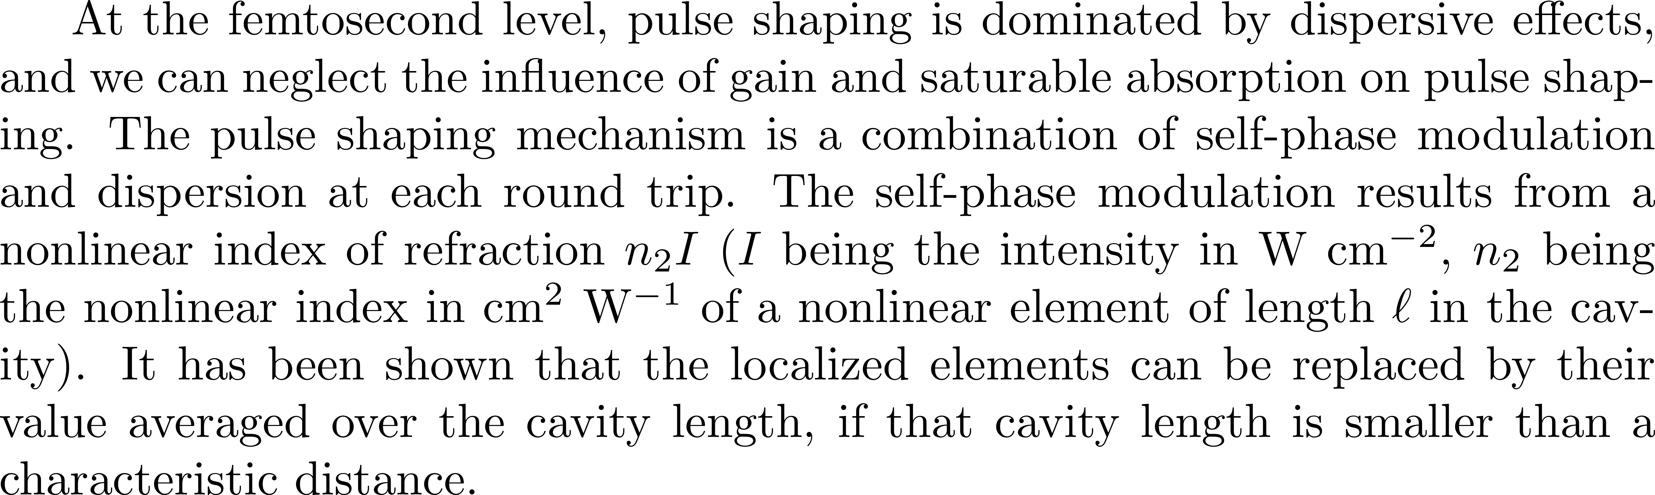
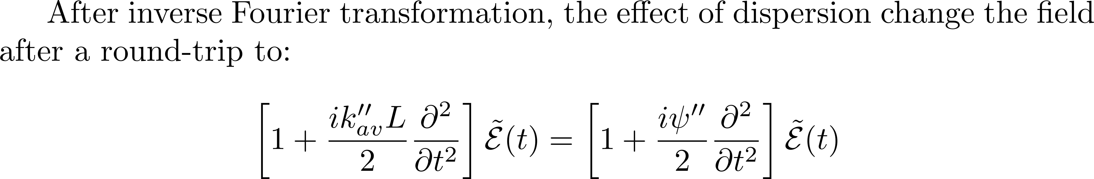
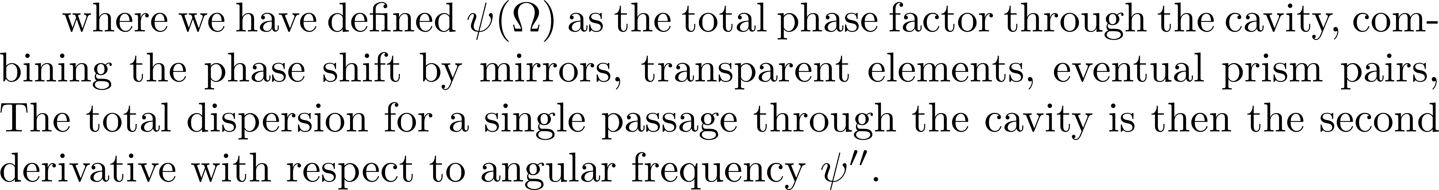
Solitons in a laser cavity

Slide 5
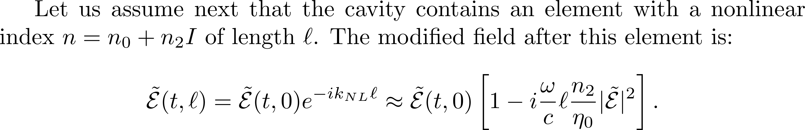
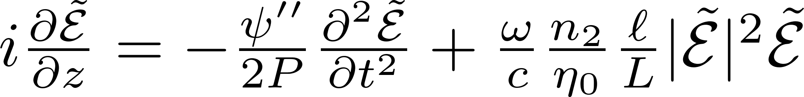
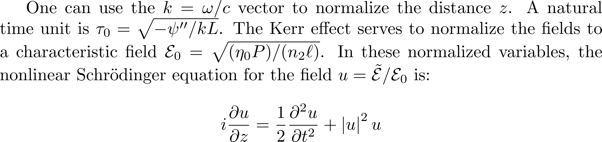
To get

Slide 6
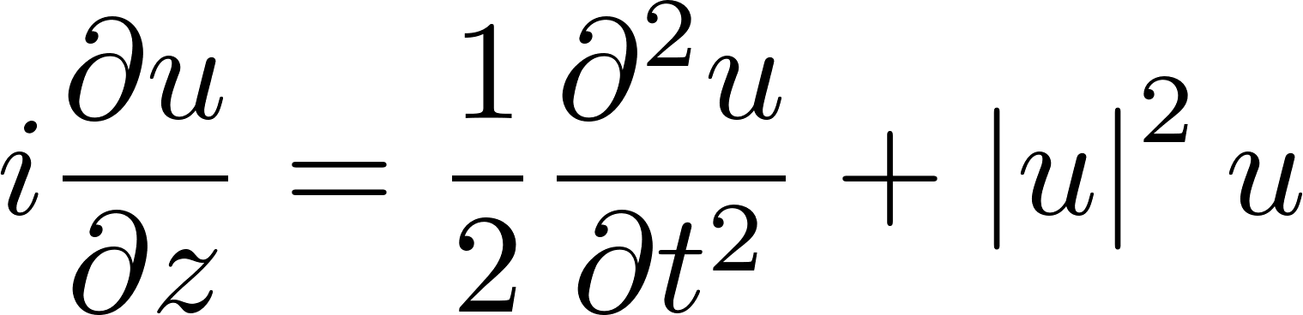
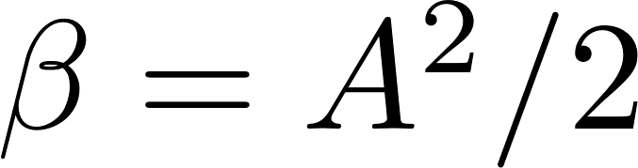
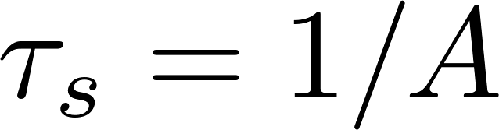
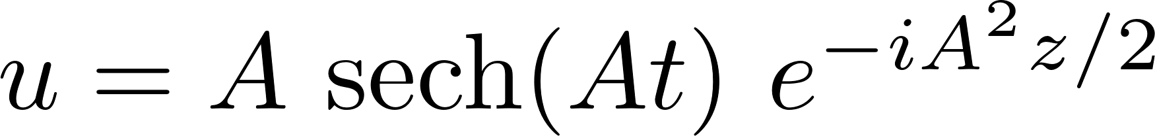
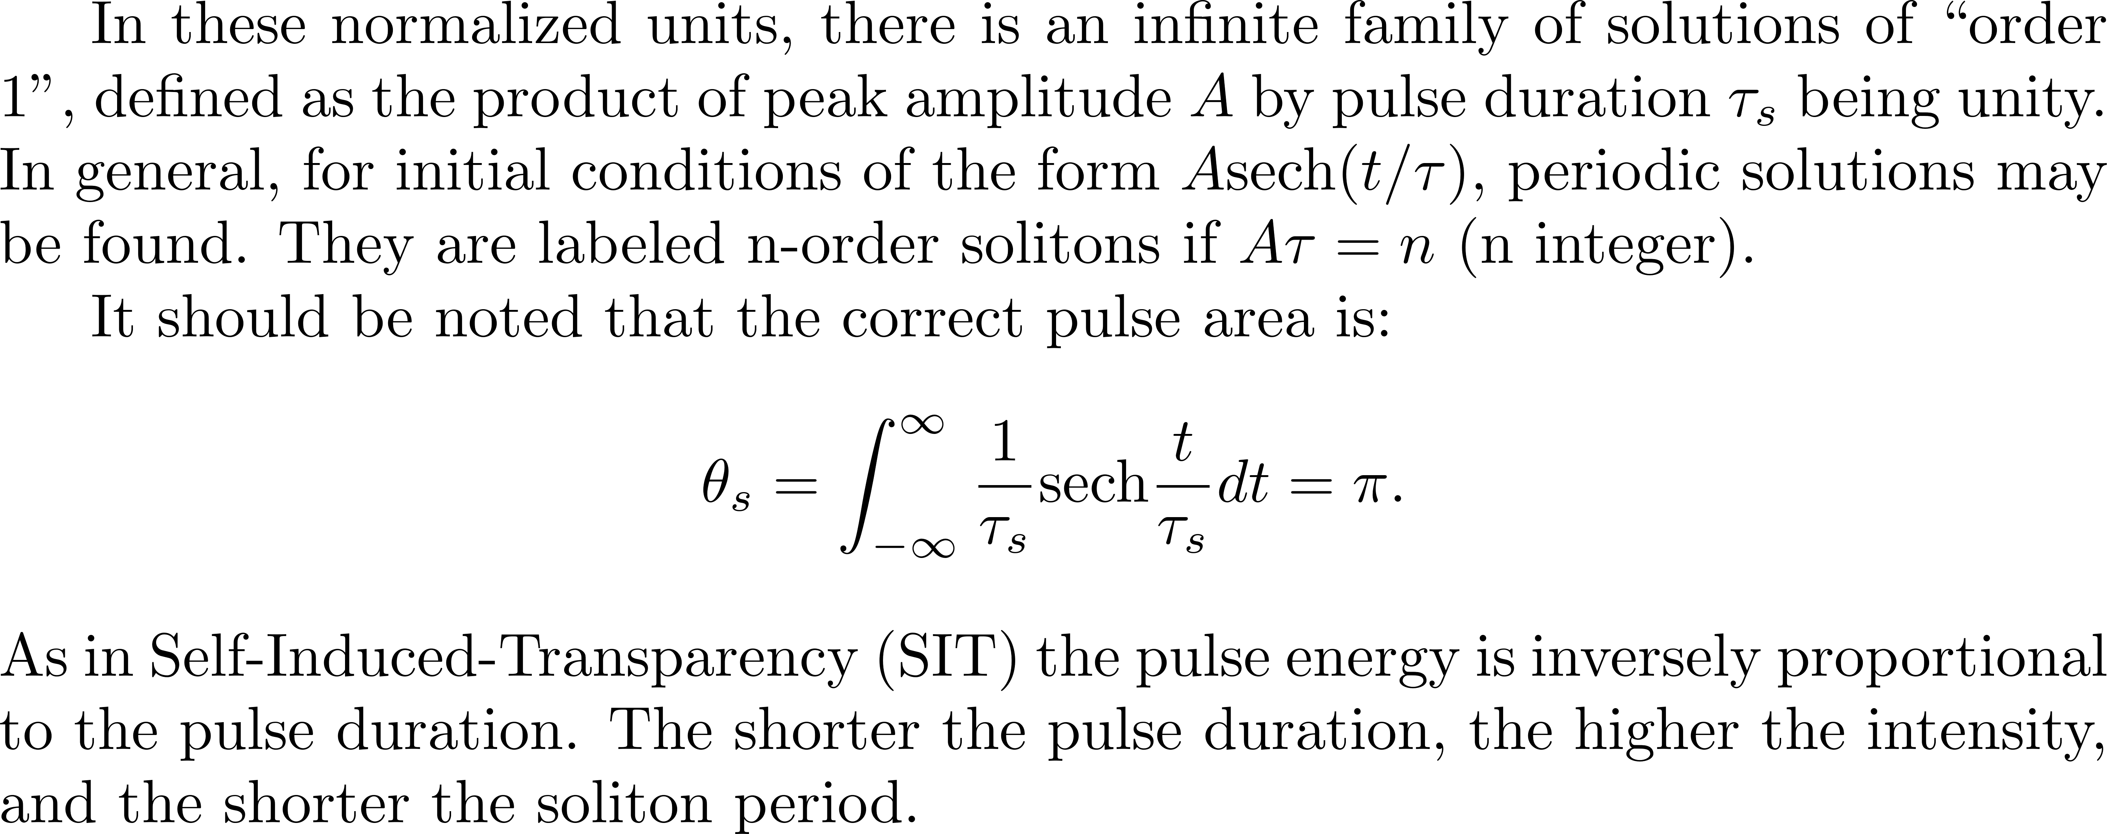
The first order soliton

Slide 7
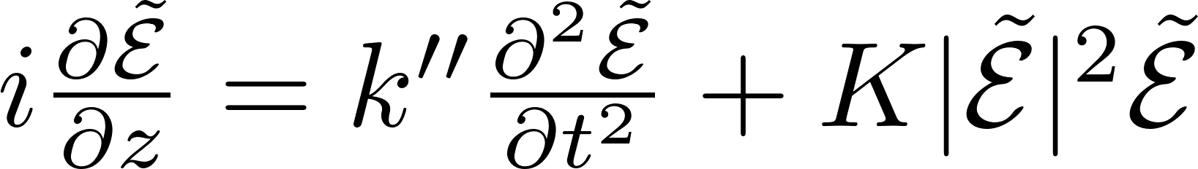
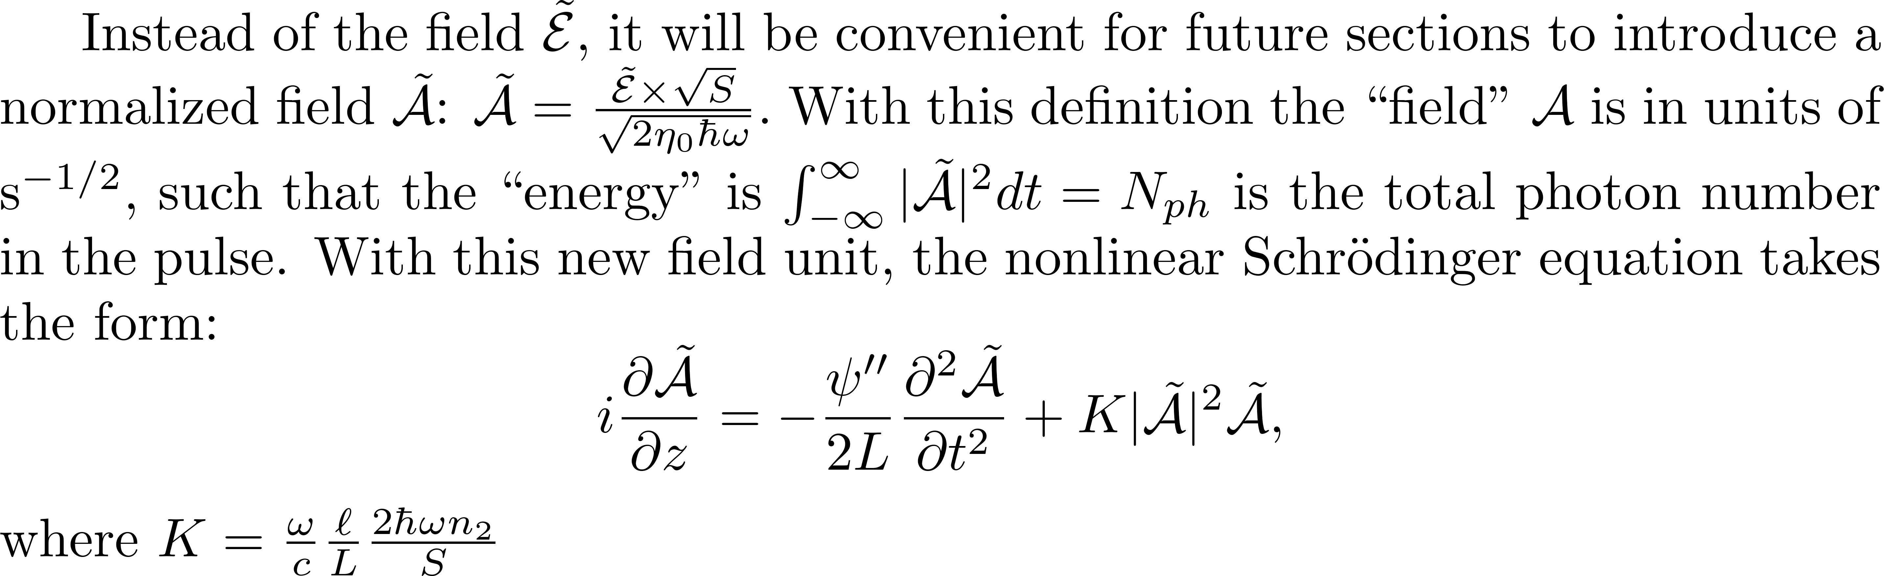

Slide 8
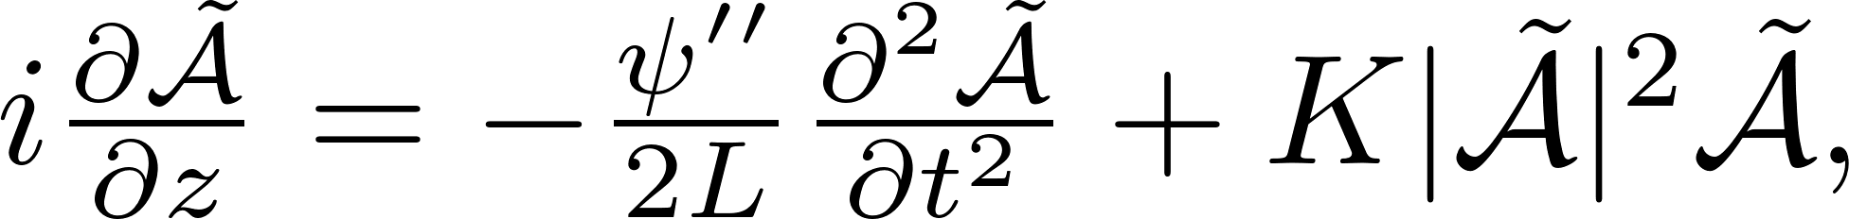
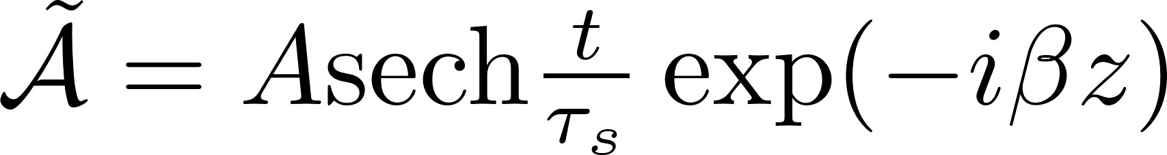
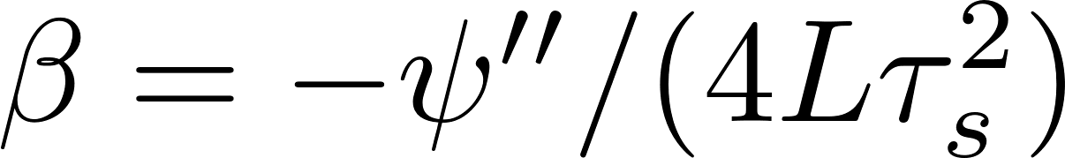
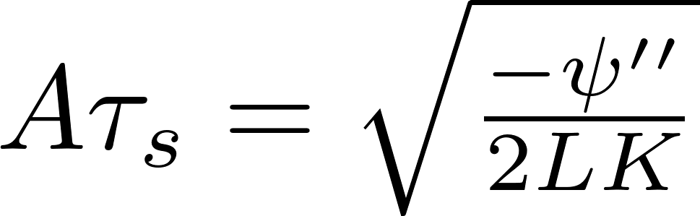

Slide 9
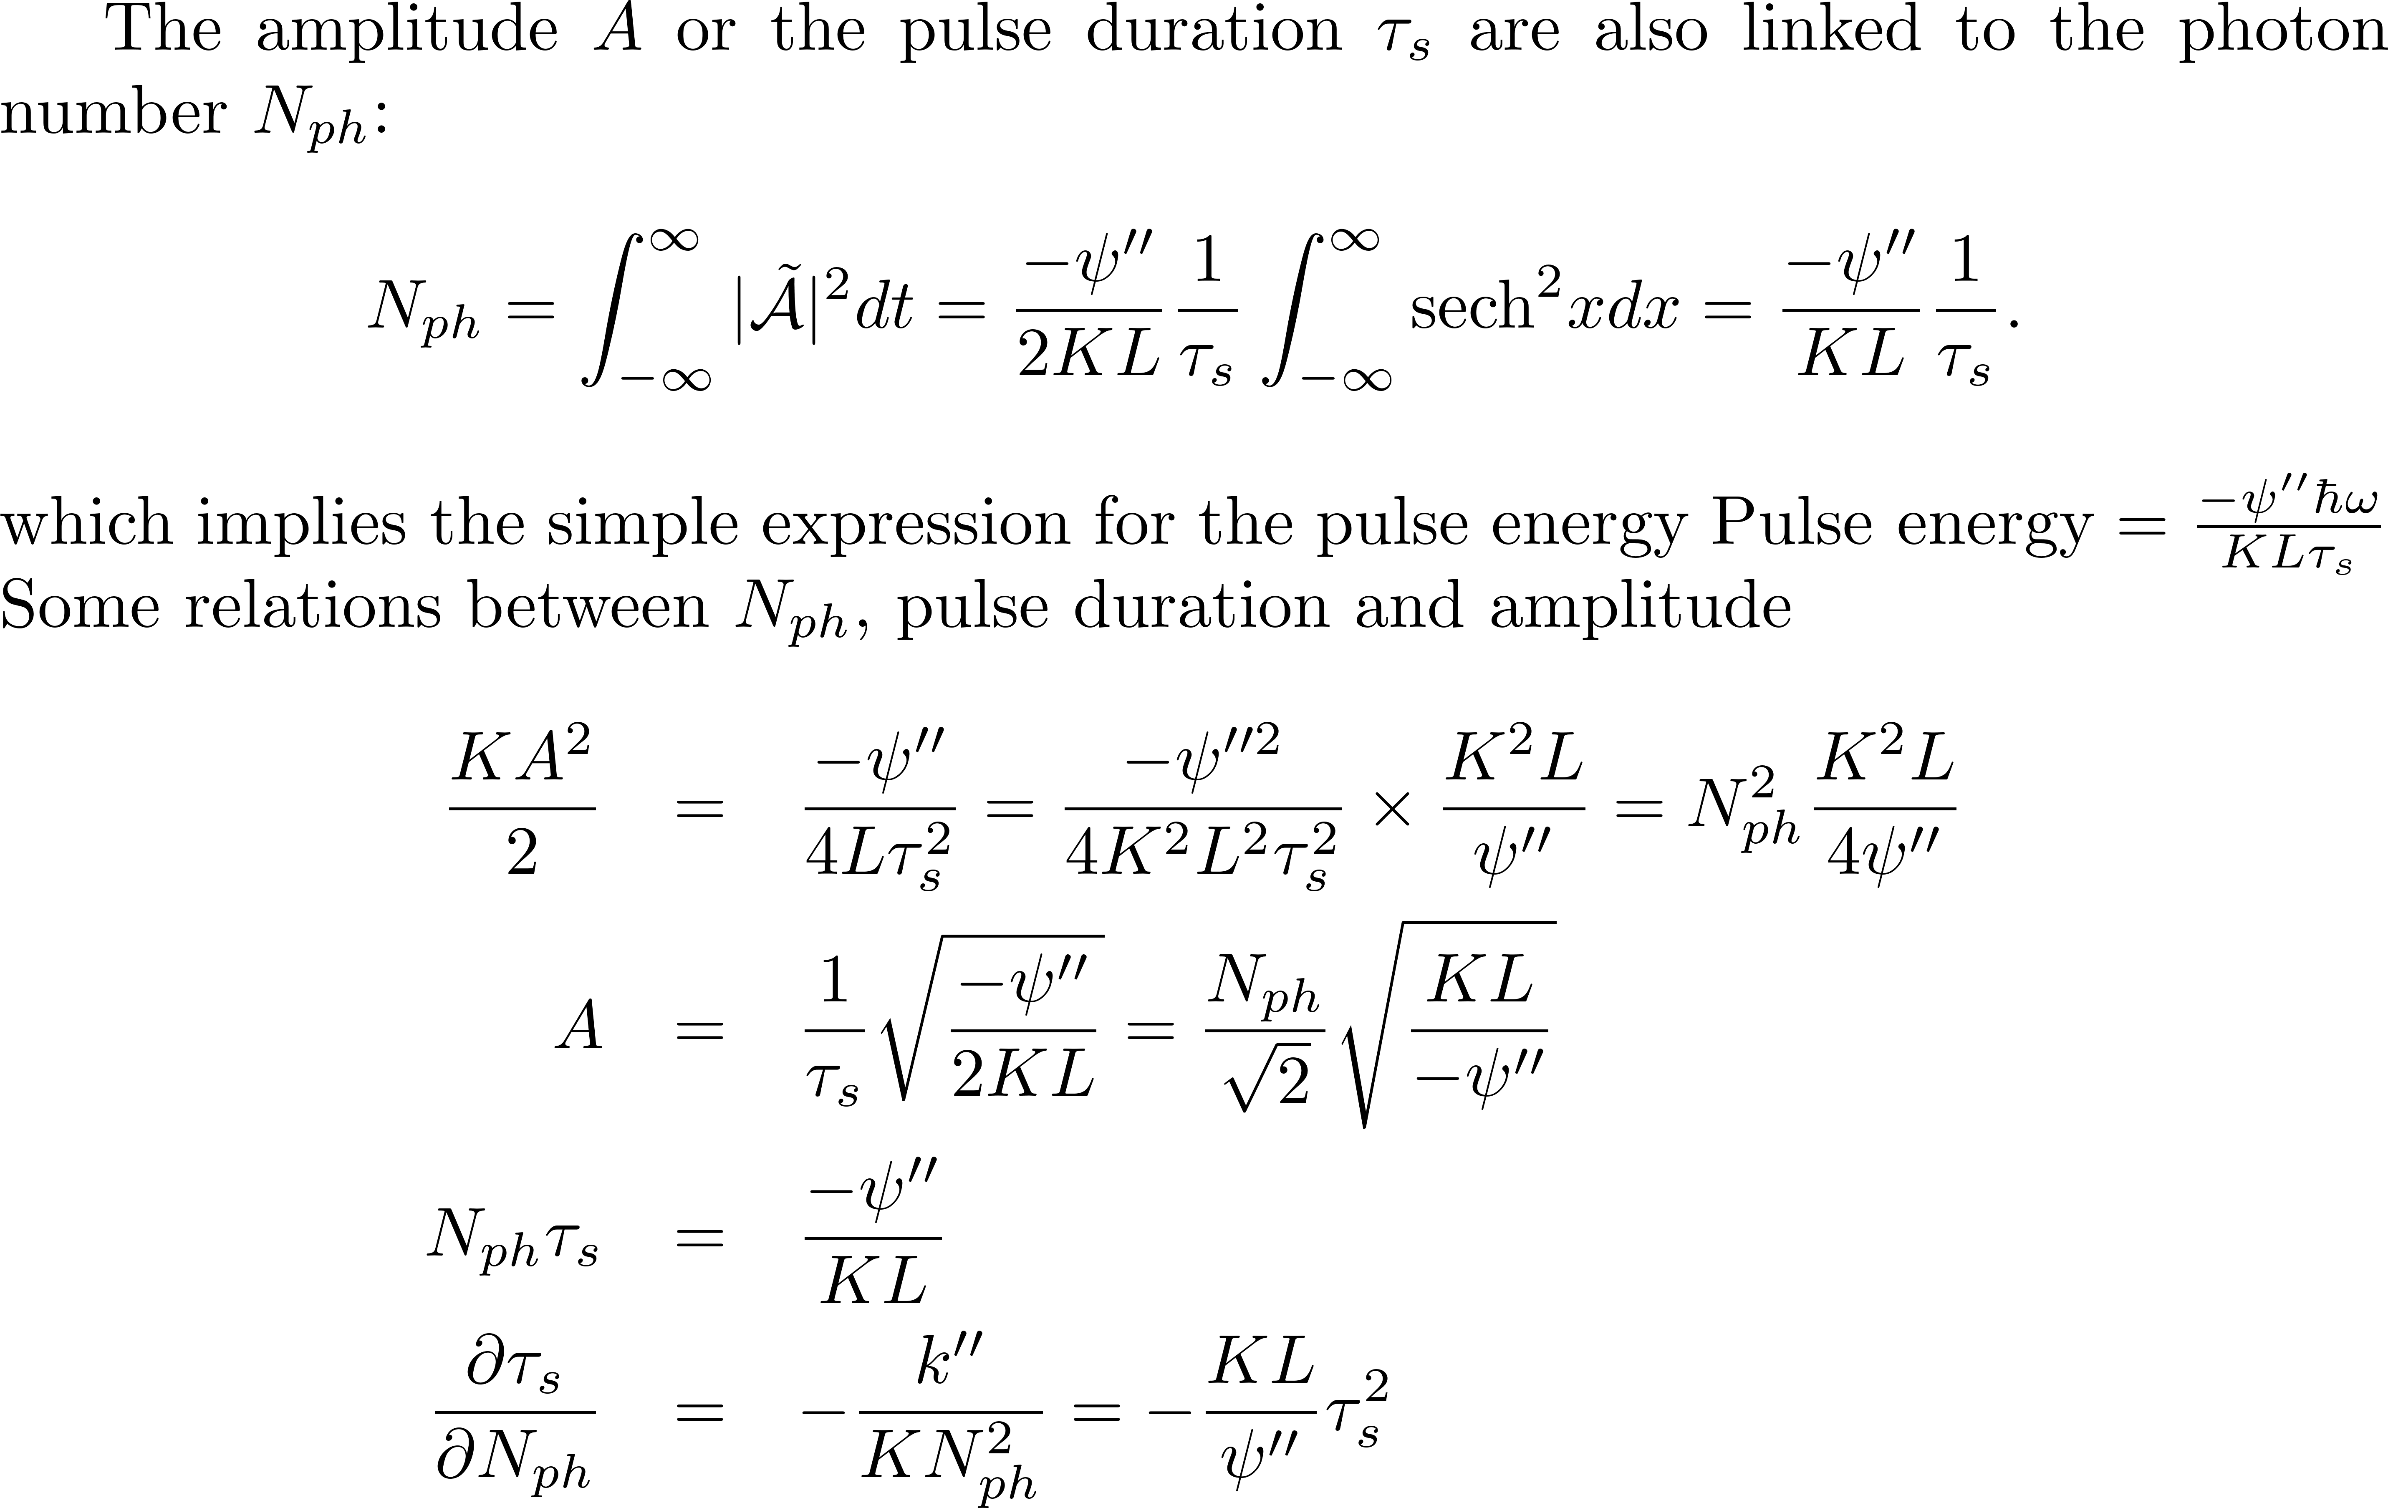
Links between all parameters

Slide 10
Stability of solitons

Slide 12
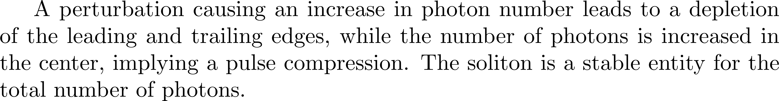
Conclusion of lengthy calculations…

Slide 13
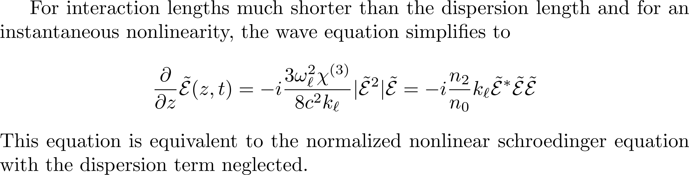
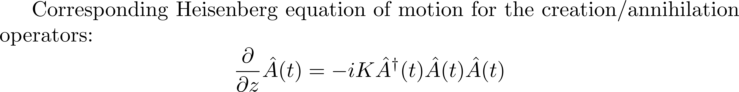
QUANTUM SOLITONS
The classical soliton is invariant as it propagates, while the quantum soliton undergoes phase diffusion and wave-packet spreading.
The phase spreading is basically due to the Kerr effect, and can be used for squeezing the photon number.

Slide 14
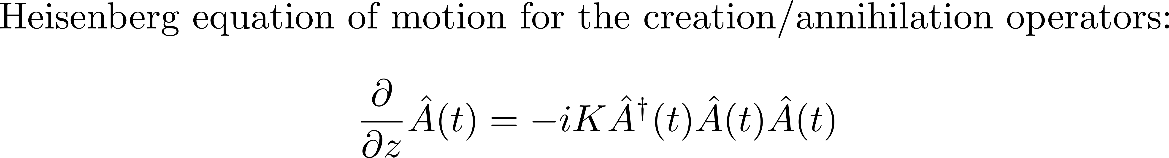
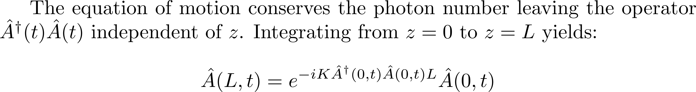
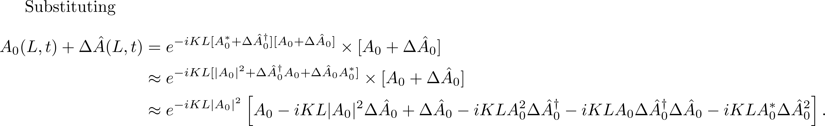
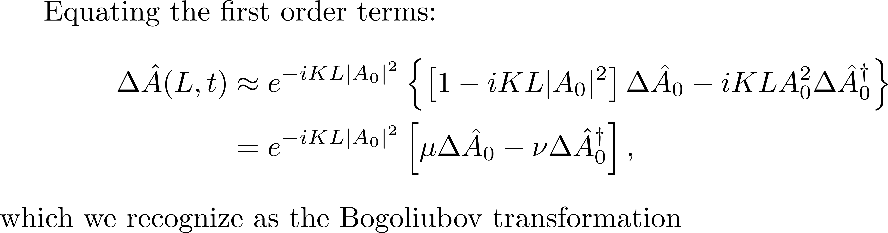

Slide 15
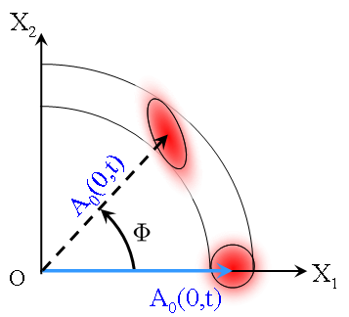
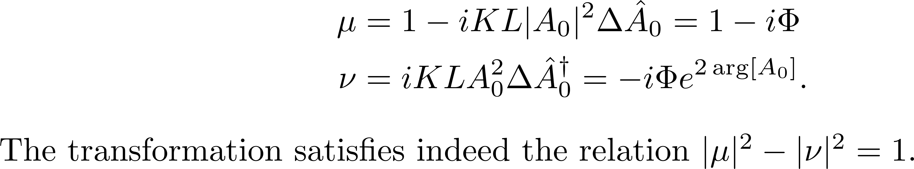

Slide 16
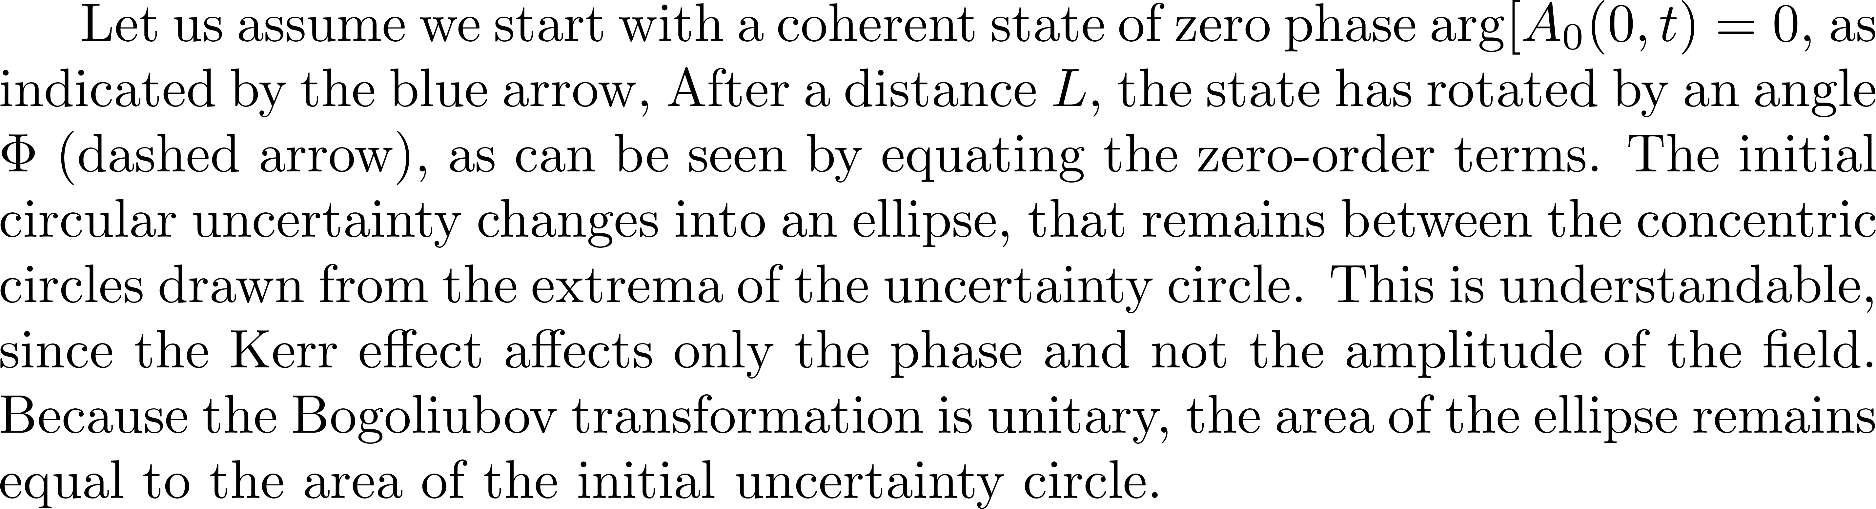

Slide 17
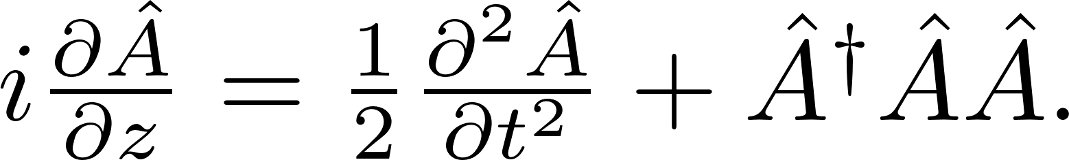
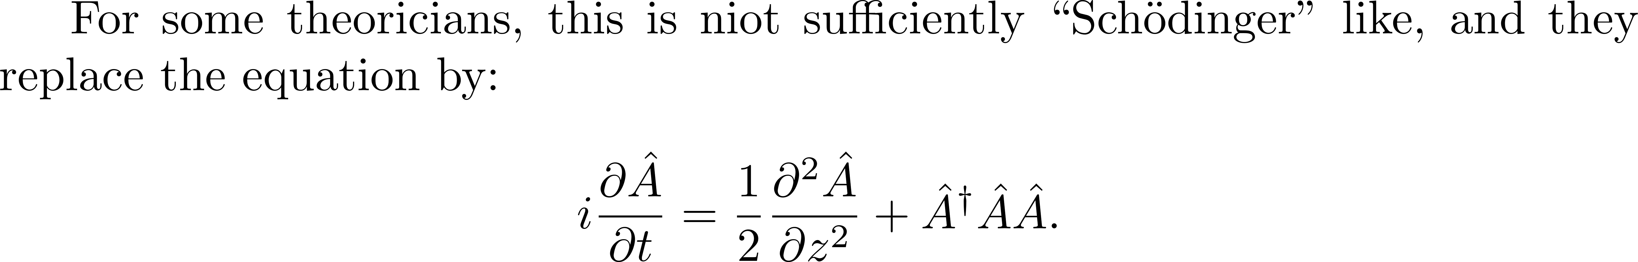
QUANTUM SOLITONS
I object! This is totally unphysical!
Justification:
“Running space coordinate”

Slide 18

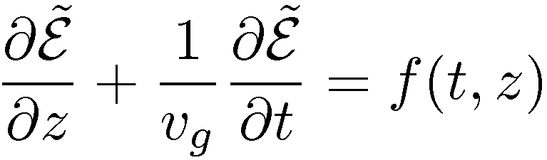

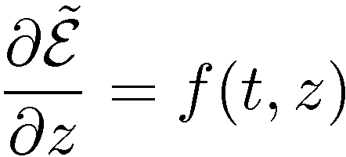
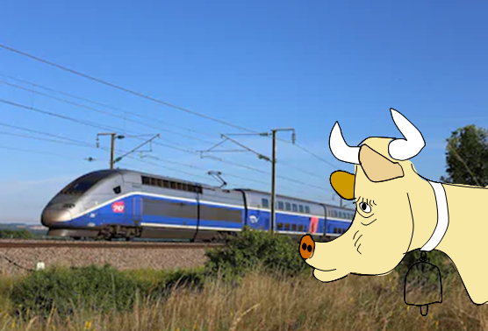
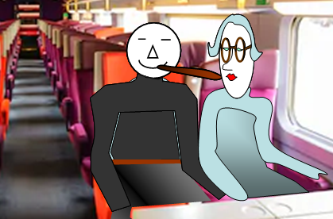
What the retarded frame of reference means
In the laboratory frame:
t=0
t
t=0
t’=0
In the retarded frame:
z
t’
The observer in the laboratory frame
is the cow that watches the TGV go by.
There is no way she can tell what is
happening inside [(i.e. f(t,z)].
For that, she must be in the retarded frame
which means inside the TGV,
or galloping next to it.

Slide 19
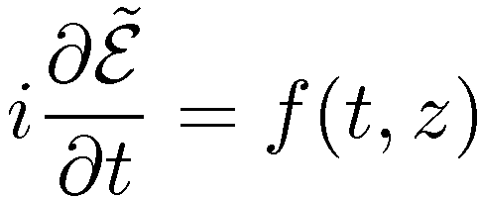
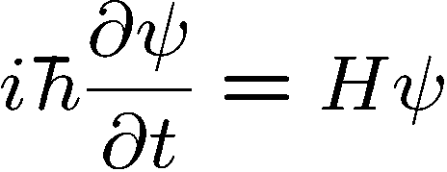
Retarded frame
HERESIE says the quantum physicist!
It should be:
Why?
Because the Schroedinger equation is
If it is not “quantum”, forget it.

Slide 20
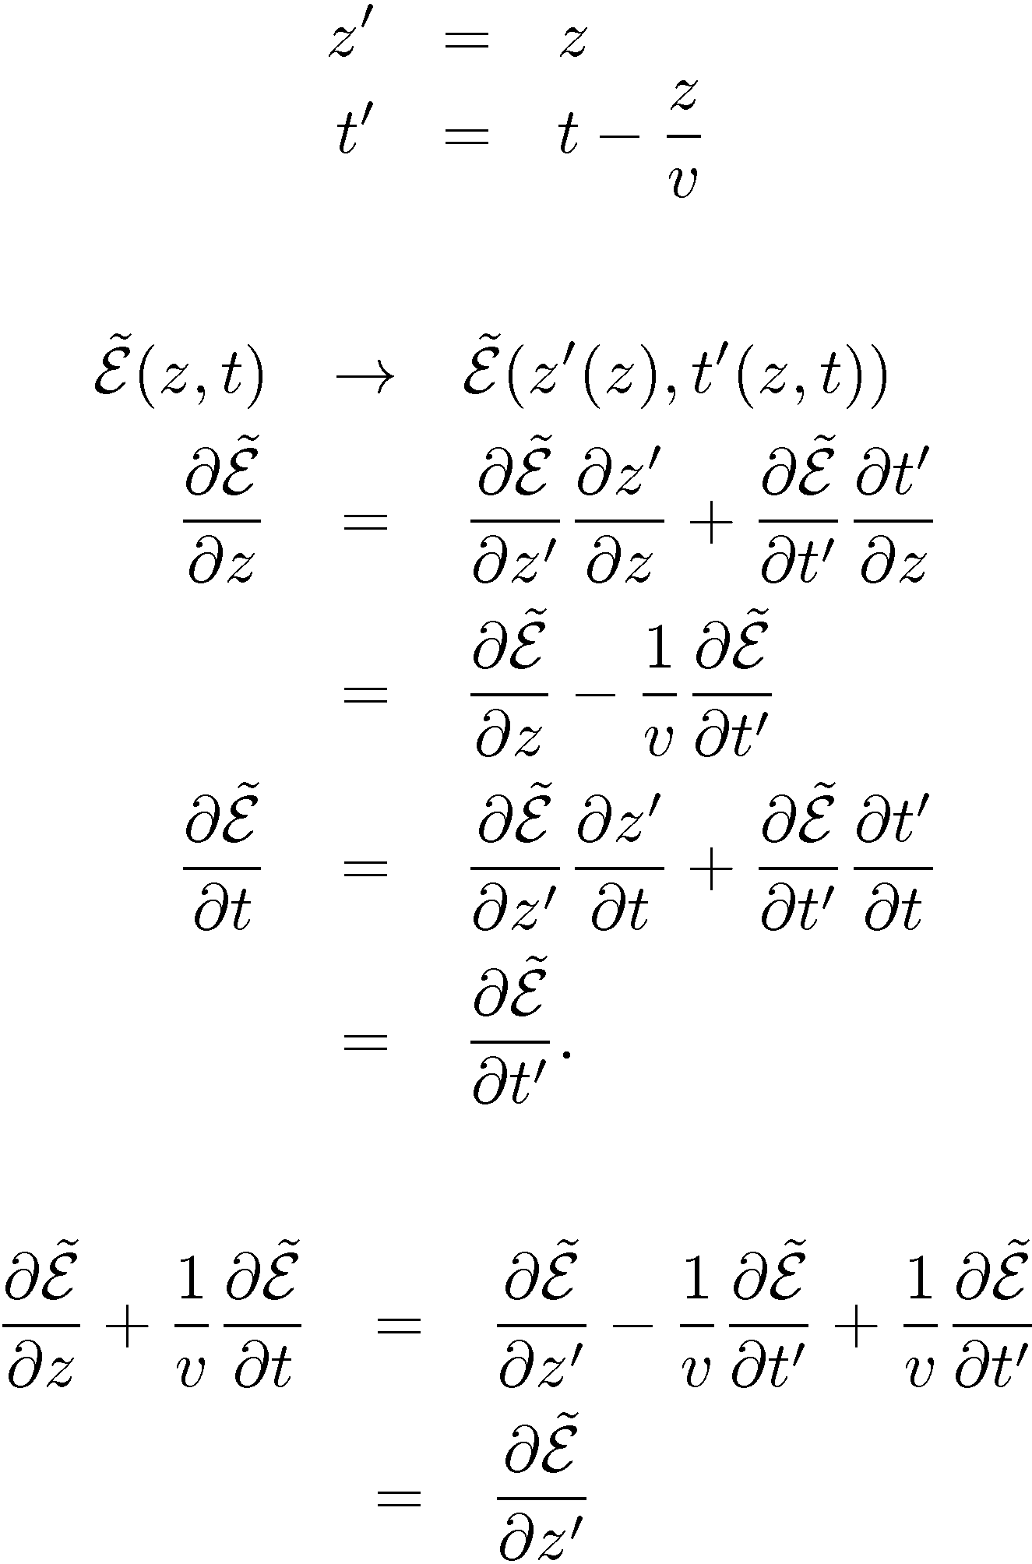
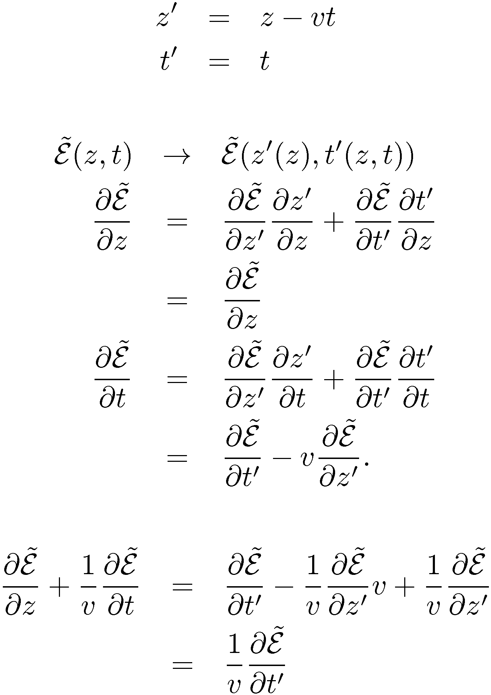
Retarded frame
“Running space coordinate”

Slide 21
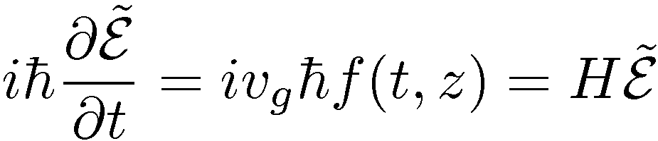
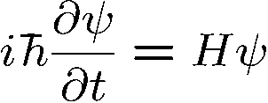
Retarded frame
“Running space coordinate”
Alleluia!
and the quantum physicist is happy
The cow-watching-the-TGV-is-not.
?
?
What is the physical meaning of the
?
“Running space coordinate”???
The rails are moving opposite to the train velocity so that the TGV is at standstill?

Slide 22
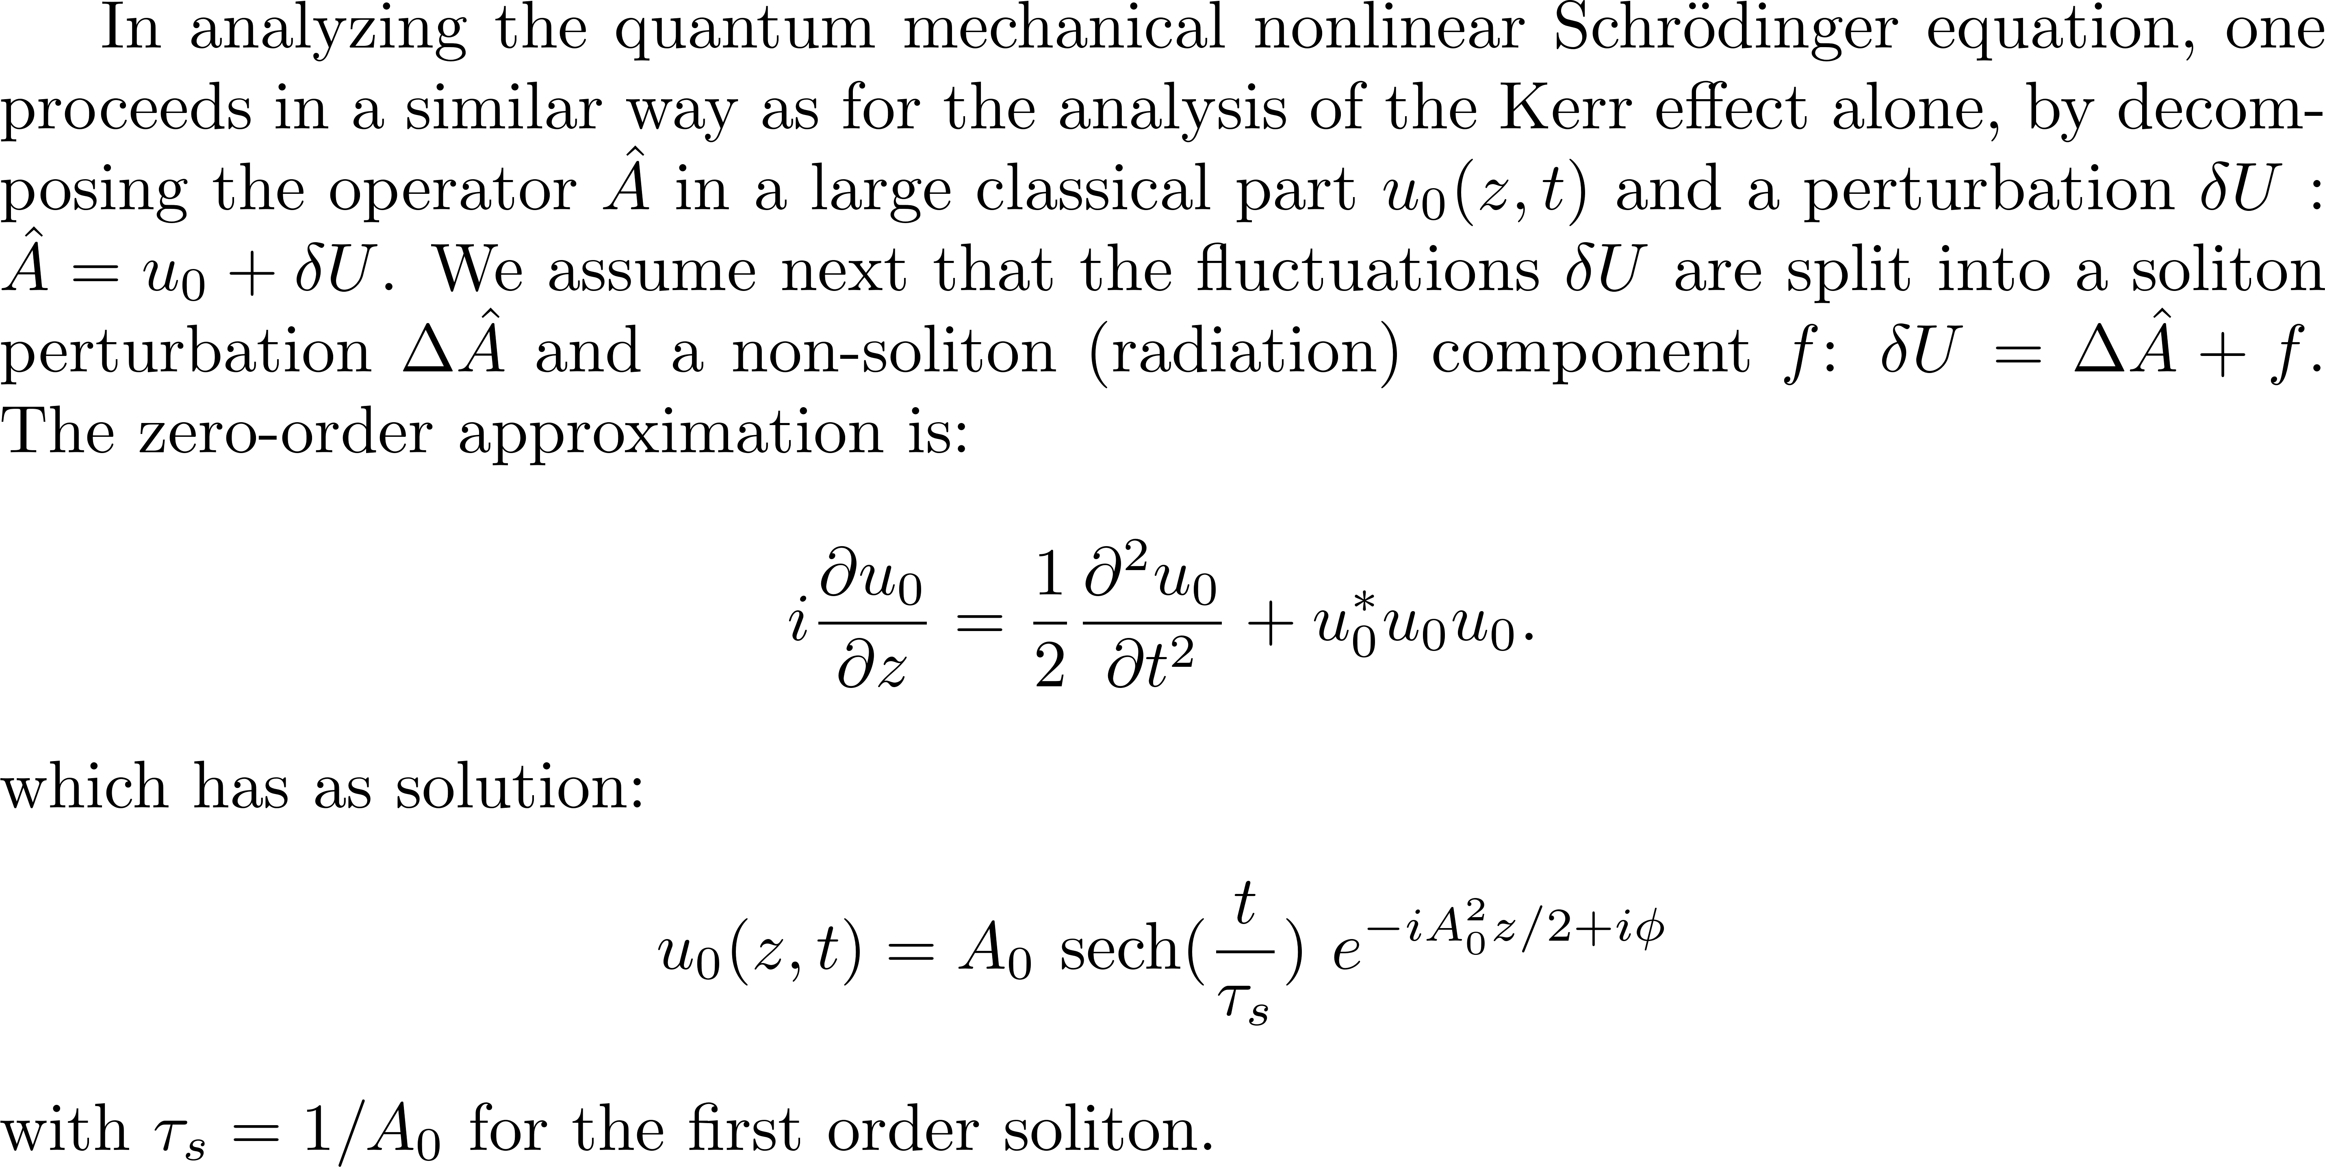
QUANTUM SOLITONS

Slide 23
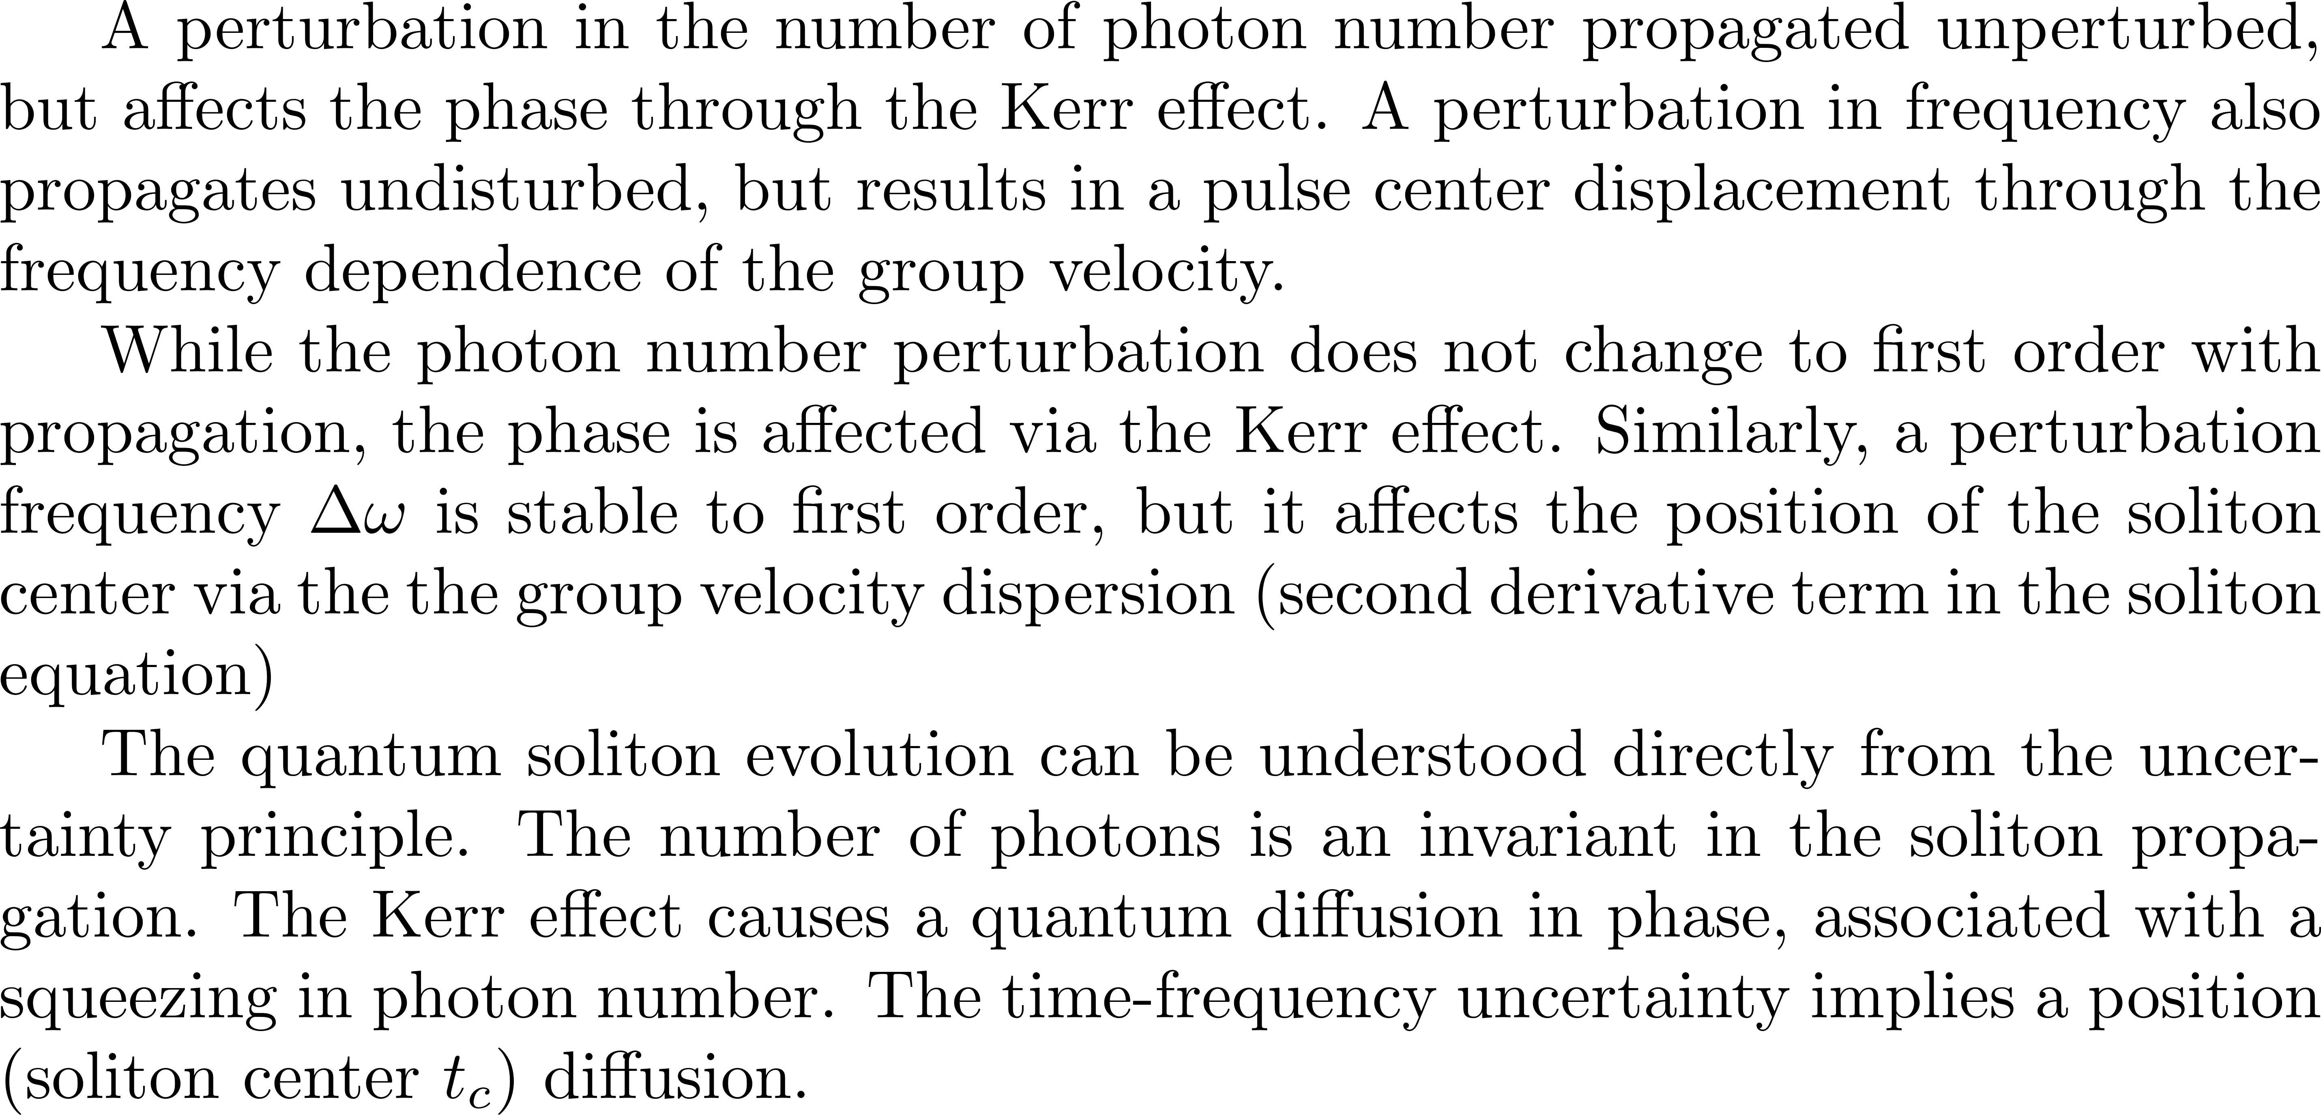

Slide 24
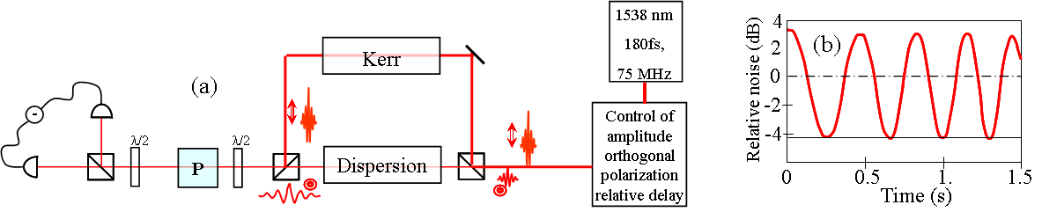
Fiorentino et al, Phys. Rev. A64:031801® (2001)

Slide 25

How to get beyond the quantum limit? By squeezing.
Squeezing demonstration: “Soliton squeezing in a Mach-Zehnder fiber interferometer” to an active cavity
Fiorentino et al, Phys. Rev. A64:031801® (2001)
Simplified sketch of that experiment (not including all polarizing elements)
Phase squeezing
4
Beat
signal
2
0
F
Relative noise
-
-2
D₁
-4
time
Photon number squeezing
-6
0
0.5
1.
1.5
D₂
Time (s)
K
DL
DL
PUMP LASER
E
OPO
O
M
EO

Slide 26
Recommended course of Franz Kaertner:
https://ocw.mit.edu/courses/electrical-engineering-and-computer-science/6-977-ultrafast-optics-spring-2005.

