Slide 1
THE FREE ELECTRON
Creation of free electrons
Above Threshold Ionization ATI
Tunneling
The free electrons
Recollision
re-radiation
The electron plasma

Slide 2
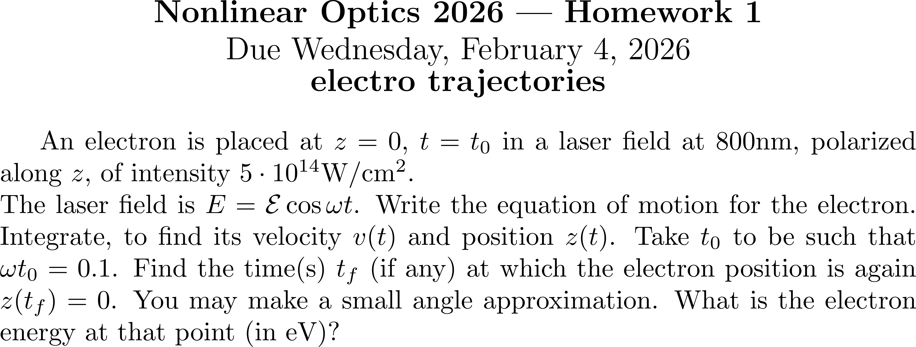

Slide 3
Creation of free electrons
Above Threshold Ionization ATI
Tunneling
E
?
?
r
Does he bound electron absorbs preponderantly the minimum of photons necessary for the atom to be ionized or are there additional absorption of pho­tons in the continuum?

Slide 4

Creation of free electrons by ATI
Above Threshold Ionization ATI
E
Kinetic energy of the ionized electron
r
Does he bound electron absorbs preponderantly the minimum of photons necessary for the atom to be ionized or are there additional absorption of pho­tons in the continuum?

Slide 5
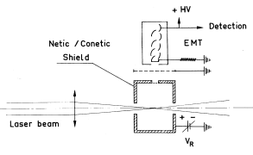
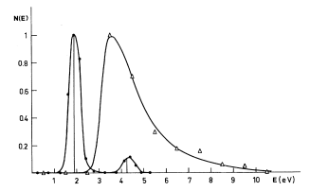
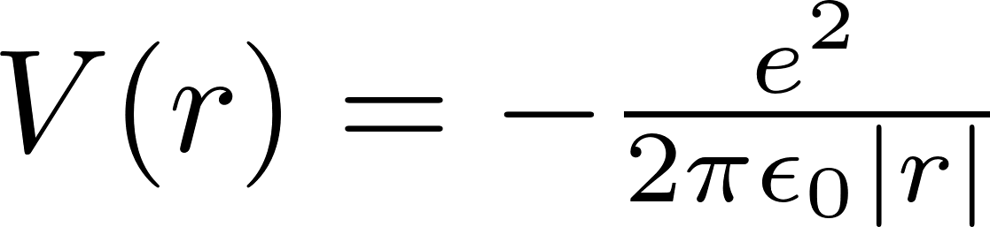
Creation of free electrons
Above Threshold Ionization ATI
V
Kinetic energy of the ionized electron
2.34 eV
r
1.17 eV
2.34 eV

Slide 6
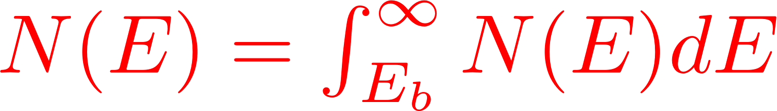

Grounded mesh
Adjustable potential barrier E_{b}
Shielded box at V_{R}
2.34 eV
1.17 eV
2.34 eV

Slide 7
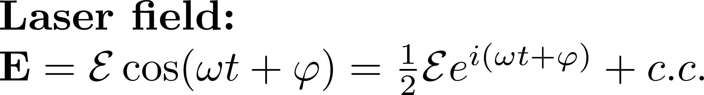
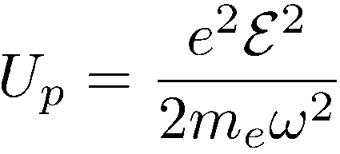
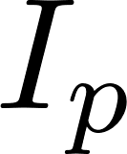
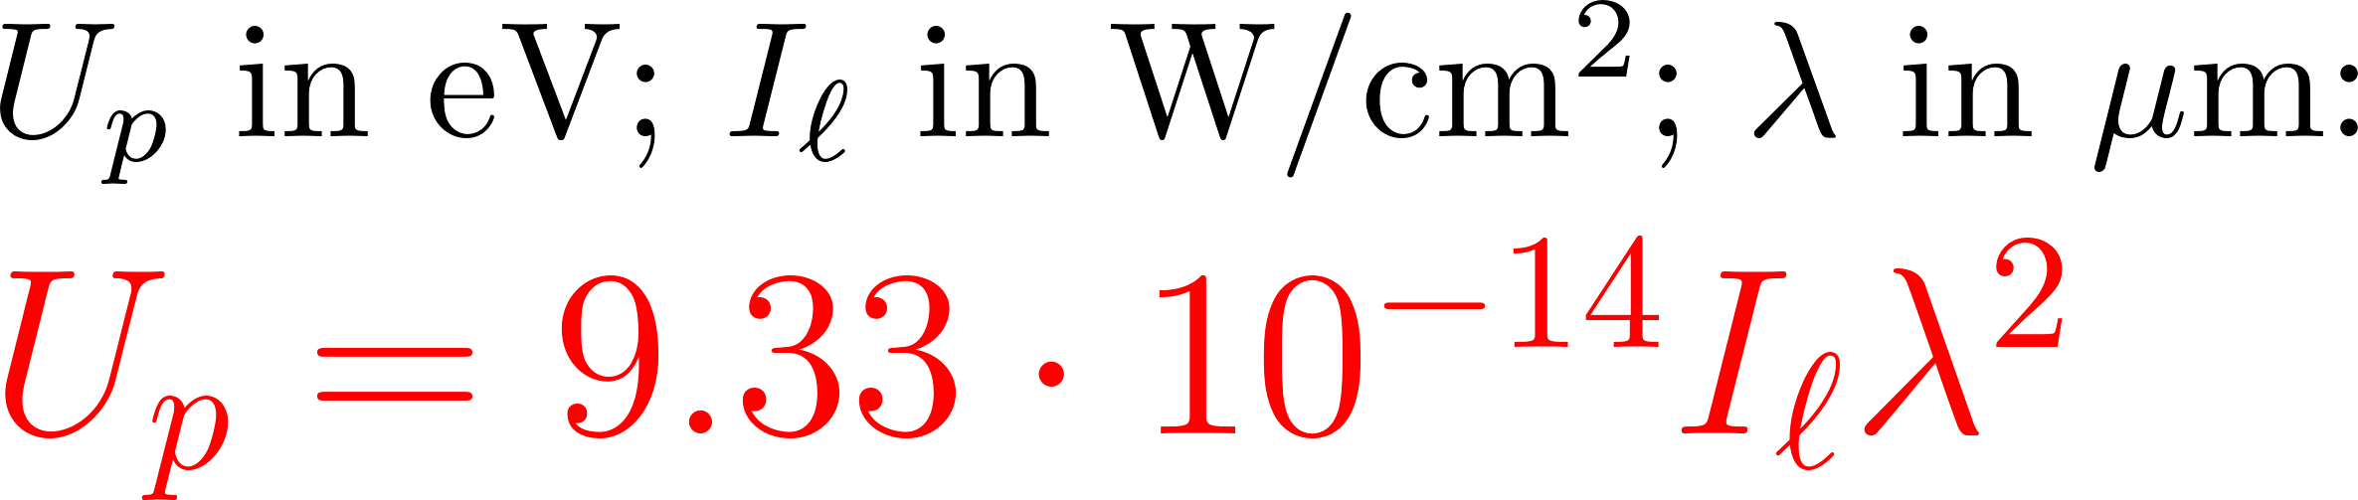
Above Threshold Ionization ATI
V
Average energy of the electron in the light field
Kinetic energy of
the ionized electron
r
2.34 eV
1.17 eV
2.34 eV

Slide 8
Grounded mesh
Adjustable potential barrier E_{b}
Shielded box at V_{R}
2.34 eV
That was the instrument in 1966 --there has been some refinements since.
1.17 eV
2.34 eV

Slide 9
Velocity Map Imaging (VMI)
Original design: Andre T. J. B. Eppink and David H. Parker, Rev. Sci. Instrum. 68, September 1997
Molecular
Beam
Window
Laser Beam
MCP +
Phosphor
screen
Lens
CCD
Electrostatic Lenses
Goal: mapping of all electrons (ions) of the same initial velocity vector onto the same point in the MCP plane,

Slide 10
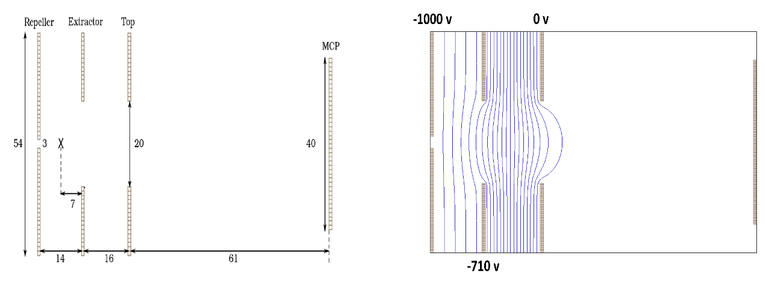
(a)
(b)
Figure(3): (a) Eppink’s Geometry (dimensions in mm) (b) Potential Contours [1], [2]

Slide 11
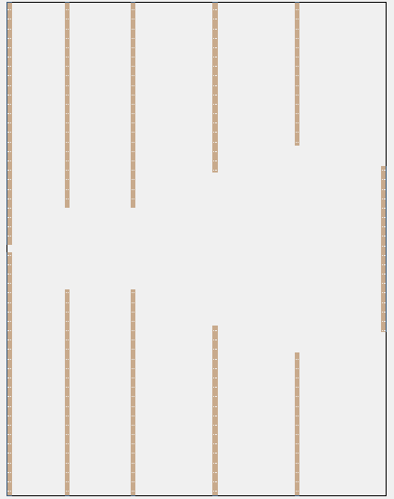
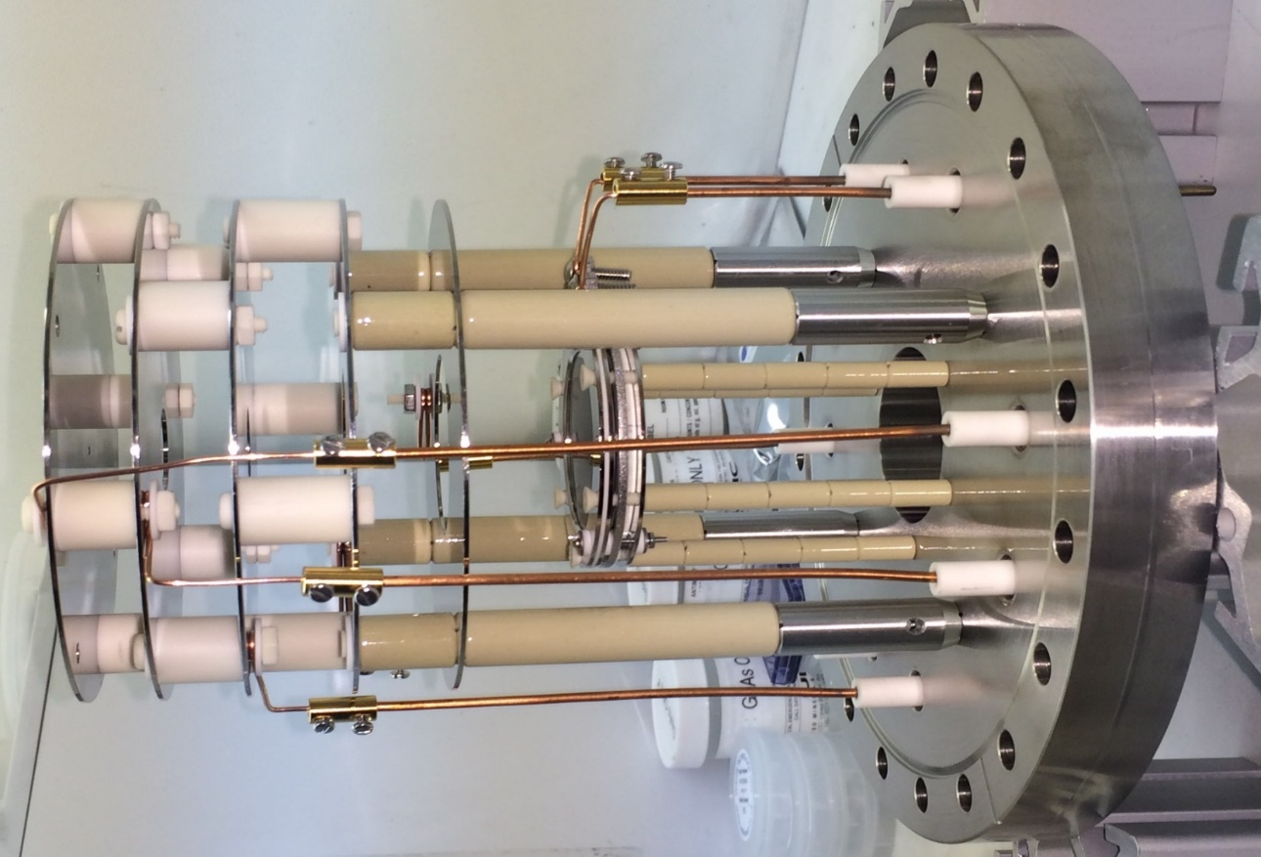
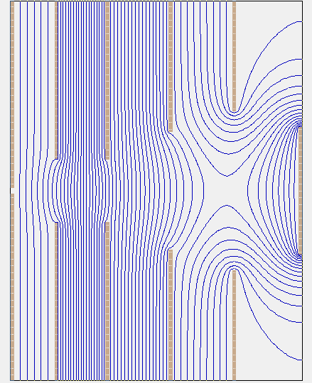
13mm
15mm
19mm
19mm
20mm
(a)
2mm
.
20mm
37.5mm
44mm
40mm
120mm
5
4
3
2
1
6.5mm
92mm
-10 kV
-8238 V
-2810 V
2245 V
5000 V
(b)
MCP
Phosphor screen
0 V
Repeller
Electrodes

Slide 12
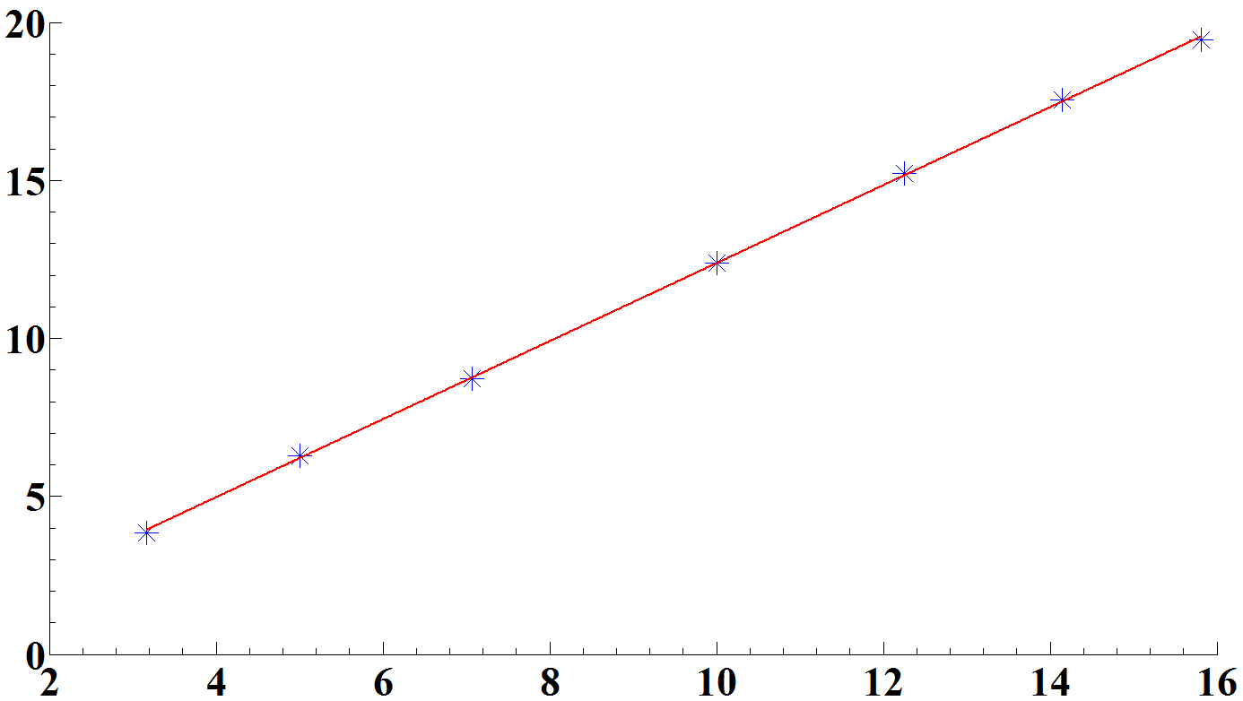
Position of electron on the focal plane as a function of its velocity (simulation SIMION 8.1 )
(a)
(b)
R (mm)
E^{1/2} (eV^{1/2})
-10 kV
-8238 V
-2810 V
2245 V
5000 V
0 V

Slide 13
Feed trough 8”
Window - 4.5” CF
(top)
Zyla
CCD
CF 4.5”
Ion gauge
Manipulator
Thermocouple Gauge 1.33” CF
Adaptor
8” CF to 4.5” CF
8 “ CF
12” flange
8 “ CF
Adaptor 8” CF to 4.5” CF
CF 4.5”
Ion gauge
Main
Chamber
Second
chamber
Manipulator
8” CF
8” CF
8 “ CF
8” CF
8” CF valve
Window - 4.5” CF
ISO 250 F
8 “ CF
Hipace 300
8 “ CF
Hipace 1500
Adaptor
8” CF to 4.5” CF
Laser
beam
Adaptor
8” CF to ISO 100 F
(bottom)

Slide 14
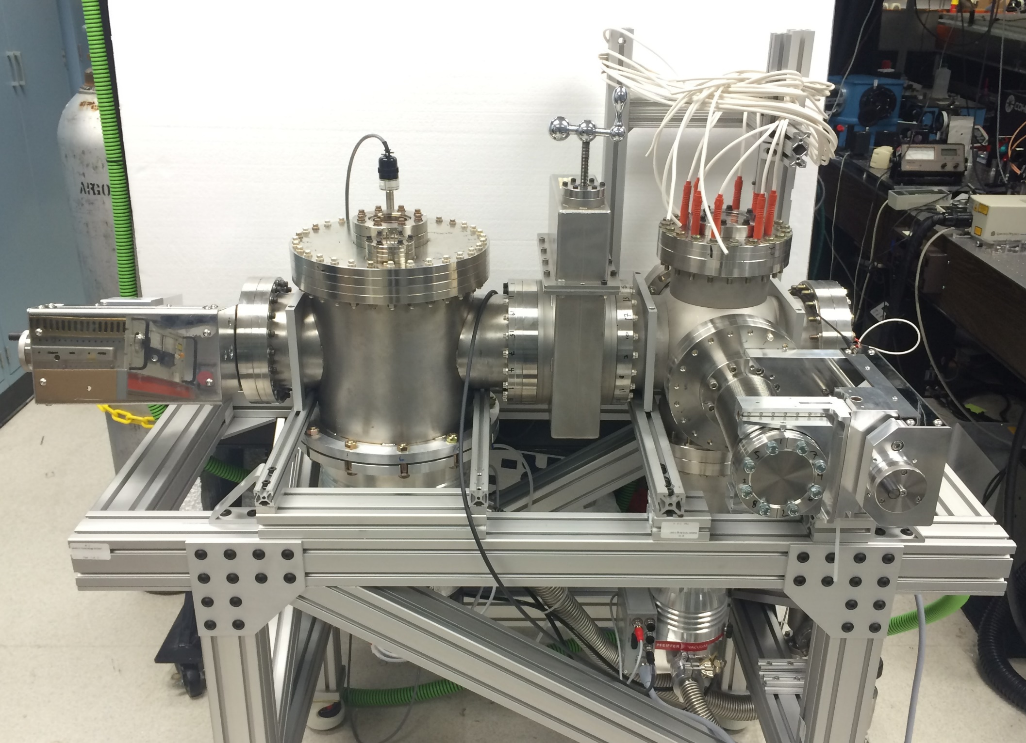
Main
Chamber
Gas
Manipulator
Second
Chamber
Valve
Mirror
Manipulator
Hipace 1500
Hipace
300

Slide 15
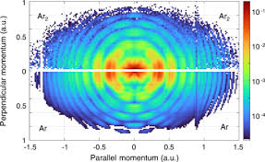
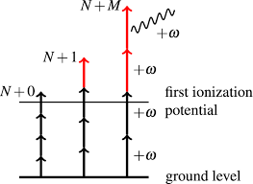
Above Threshold Ionization ATI
as seen by the VMI

Slide 16
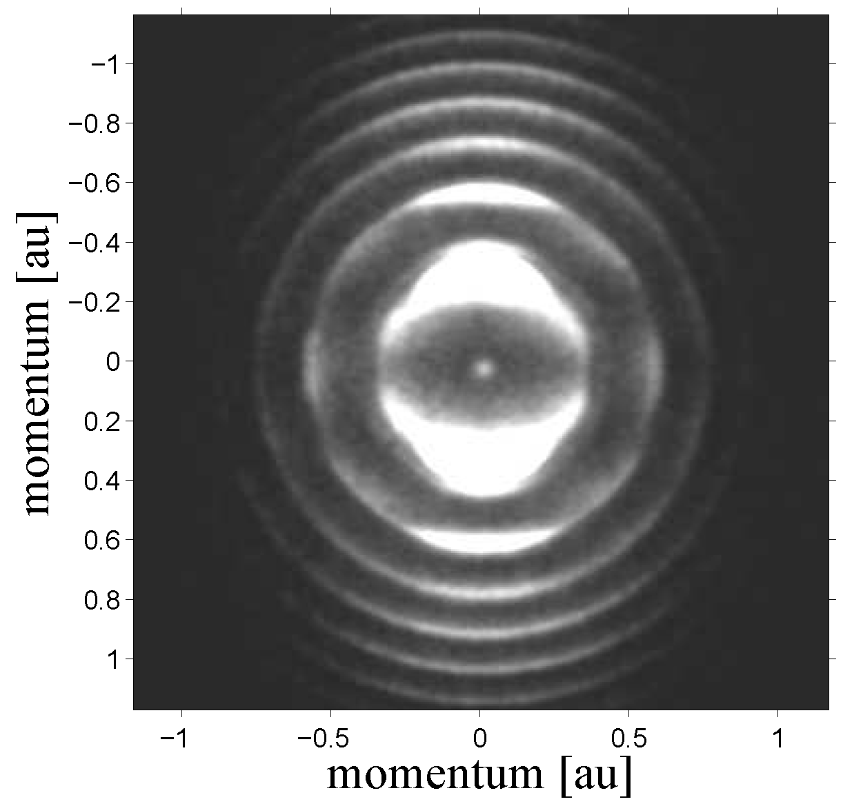
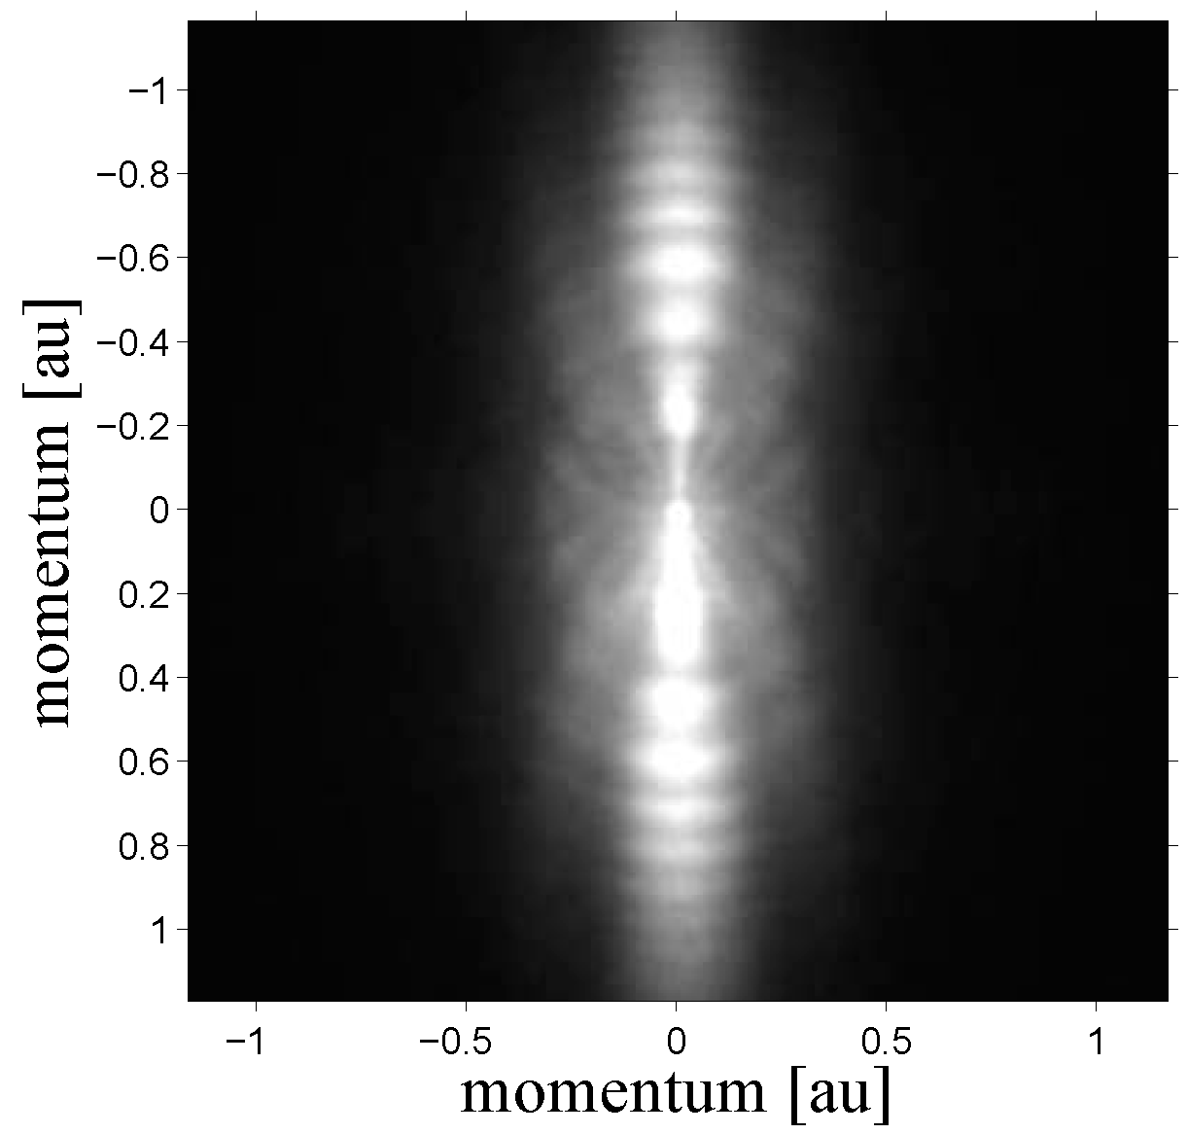
ATI versus Tunnel Ionization as seen by the VMI
Multiphoton
Tunnel
Ar 400 nm
Ar 800 nm

Slide 17
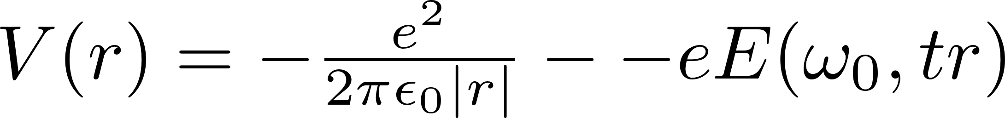
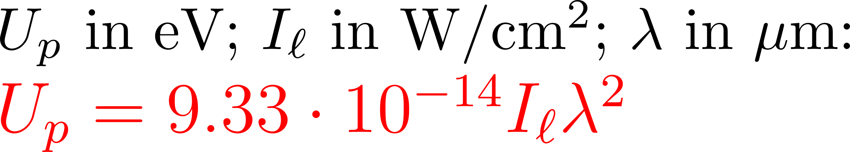
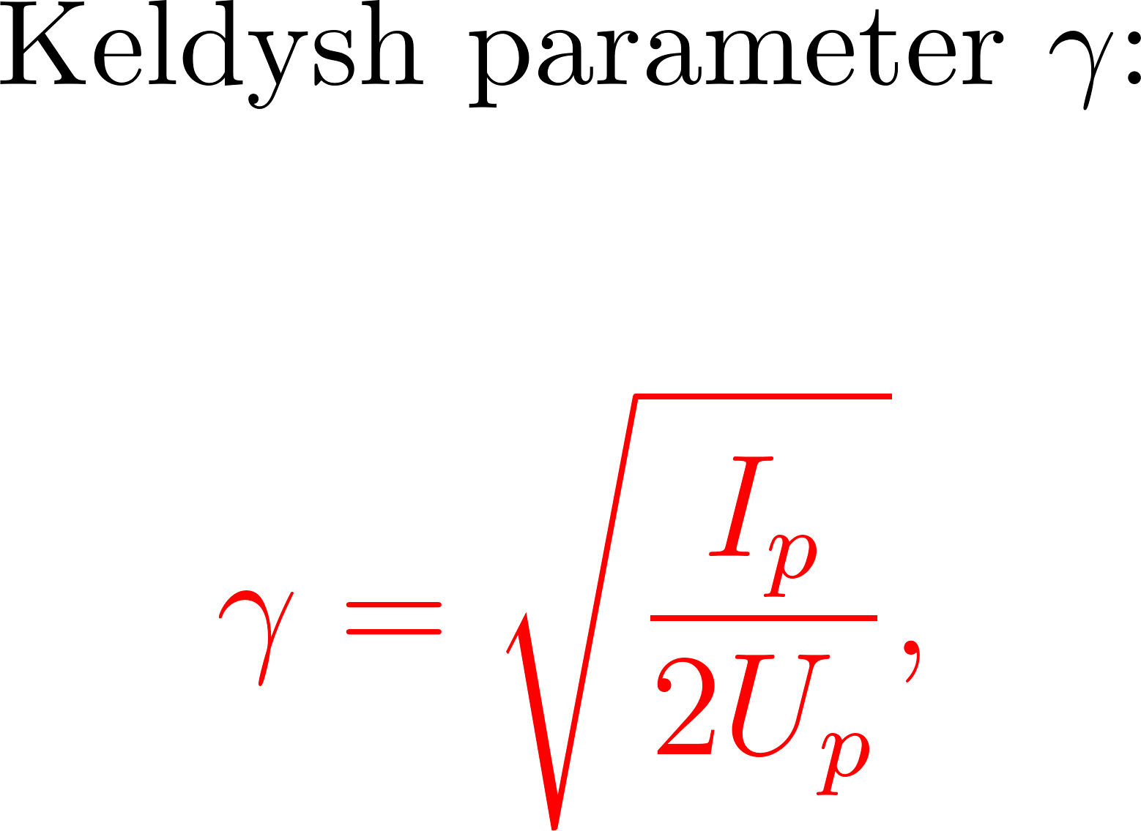
Tunneling
Average energy of the electron in the light field
γ >> 1 : Multiphoton (ATI) regime
γ << 1 : Tunneling regime

Slide 18
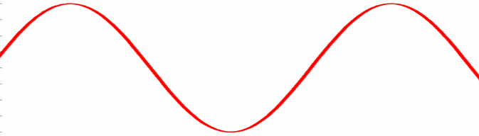
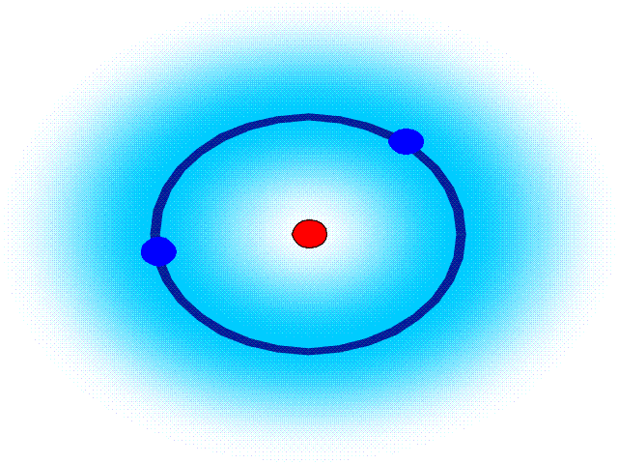
Tunnel ionization
tunnel
tunnel
nucleus
Notes:
18

Slide 19
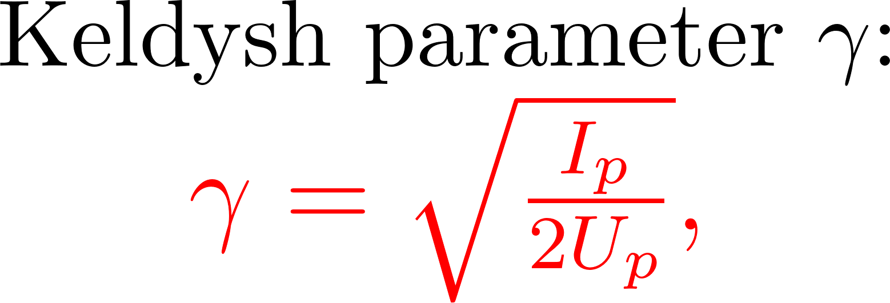
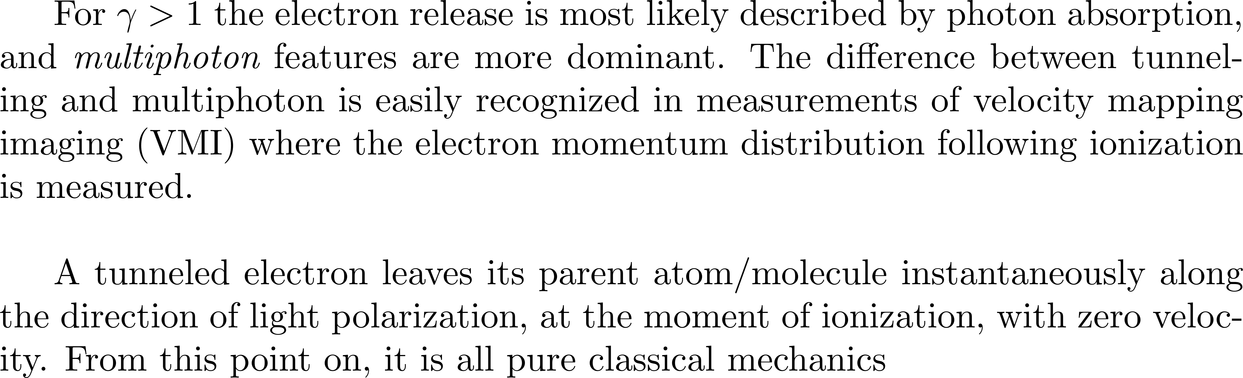
The Keldysh parameter

Slide 20
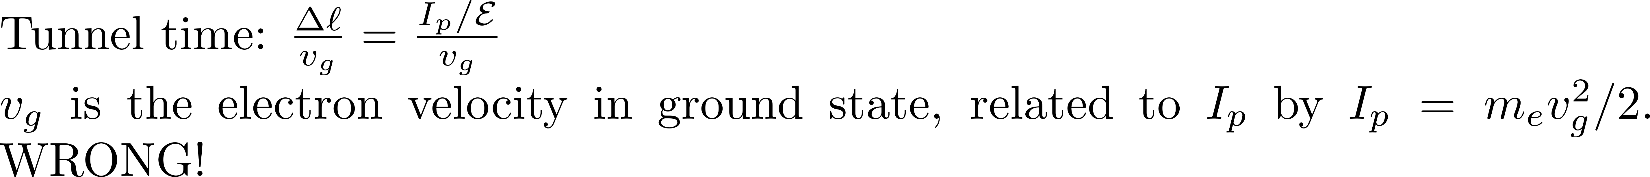
The Keldysh parameter
A wrong explanation gives the correct result
You will find in respectable references that γ is the ratio of the tunnel time to the light period.

Slide 21
no return to sender
recollision
After tunneling: all Newton mechanics
directly
to the detector
recollision
possible
Corkum, PRL 71, 1994 (1993)

Slide 22
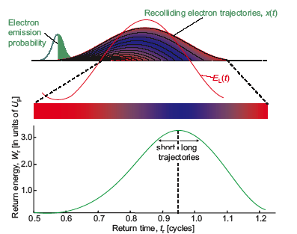
Short and long trajectory
Notes:
22

Slide 23
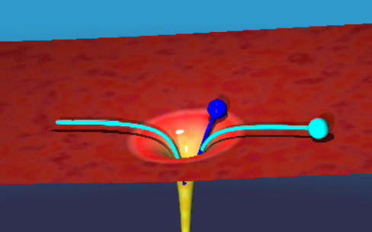
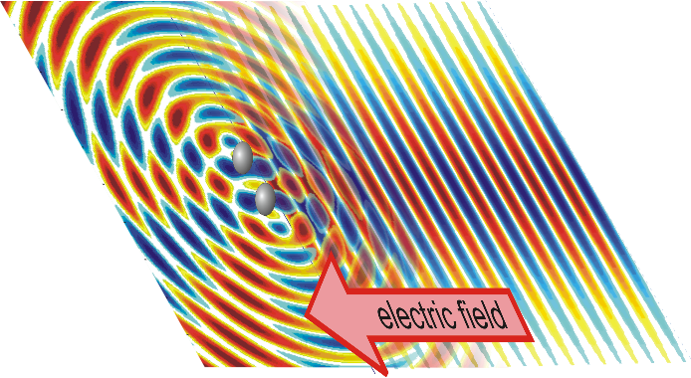
Upon recollision
recombination → high harmonic radiation
inelastic scattering → excitation, multiple ionization
elastic scattering → laser induced electron diffraction, hot electrons
Notes:
23

Slide 25

Even a 100fs pulse has many cycles.
One attosecond pulse generated at every half cycle → attosecond pulse train!
Time
Only odd harmonics are generated
Frequency
The maximum photon energy is given by the cut-off of the harmonic plateau. This can be calculated by examining the maximum energy the ionized electron can gain in the field of the laser.

Slide 26
Polarization dependence

Slide 27
Polarization dependence

Slide 28
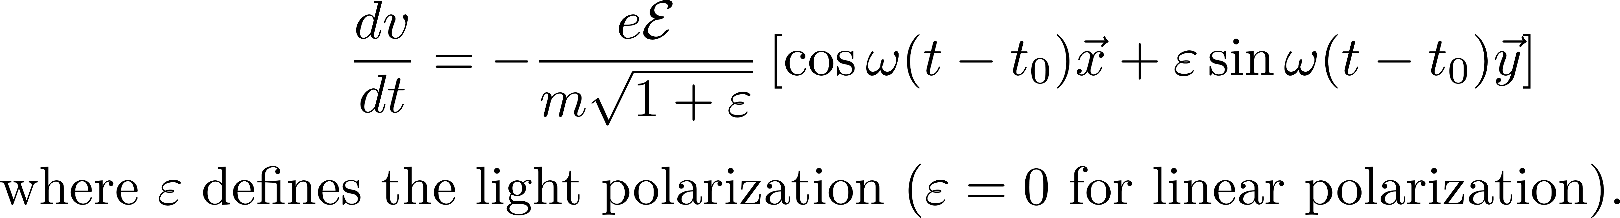
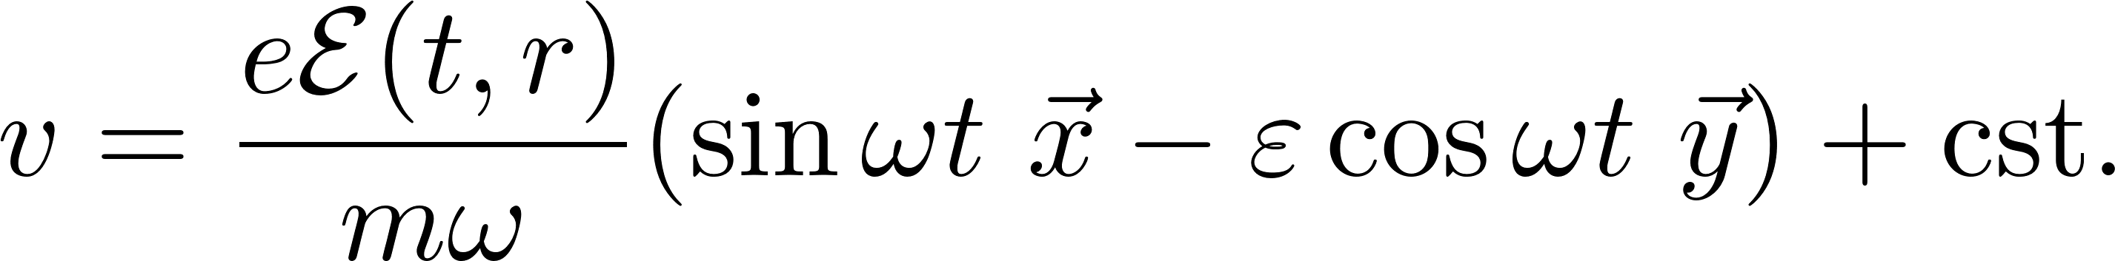
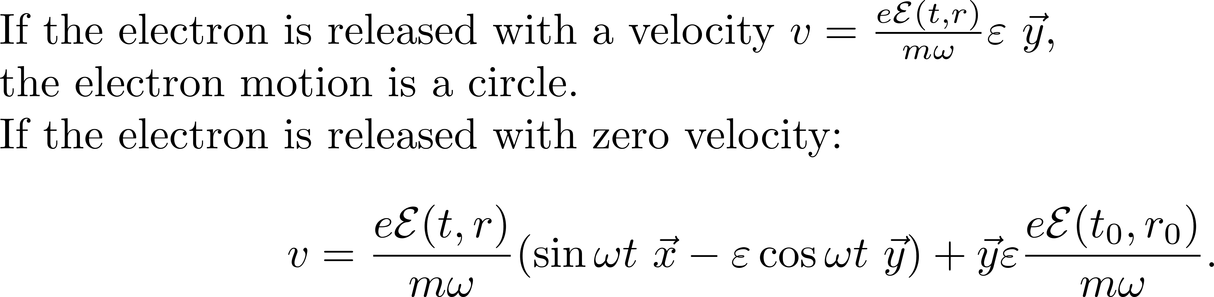
Polarization dependence
TRAJECTORY IN CIRCULAR POLARIZATION

Slide 29
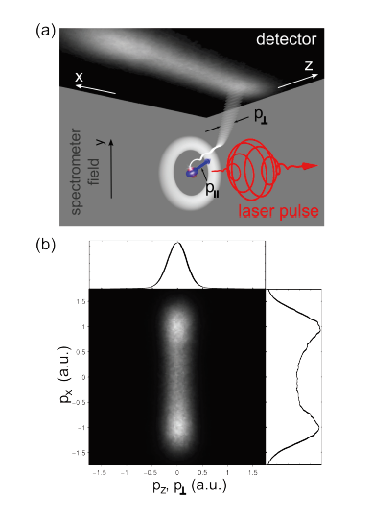
Momentum distribution of electrons
in circular and linear polarization
Circular polarization:
doughnut momentum distribution.
The radius is the drift velocity
Linear polarization
The electron remains close to the atom

Slide 30
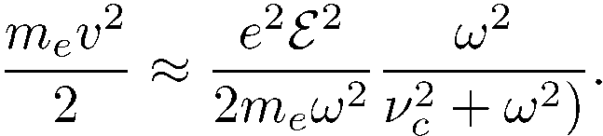
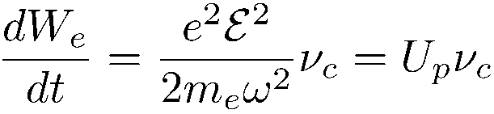
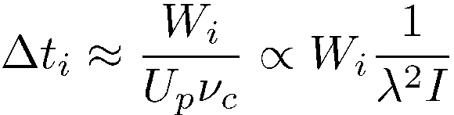
What happens to the electron kicked out of the atom?
Onset of avalanche
Average kinetic energy of the electron:
The electron acquires energy from the wave, only when it collides with the atoms, when the abrupt change in the velocity direction causes the oscillation energy to go over into an energy of random translational motion.
Rate of growth of average electron energy
Time Δt_{i} to reach the ionization energy W_{i}.

Slide 31
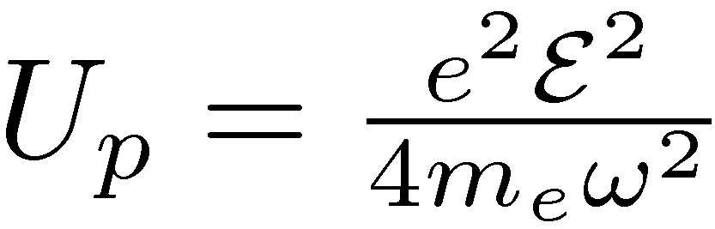
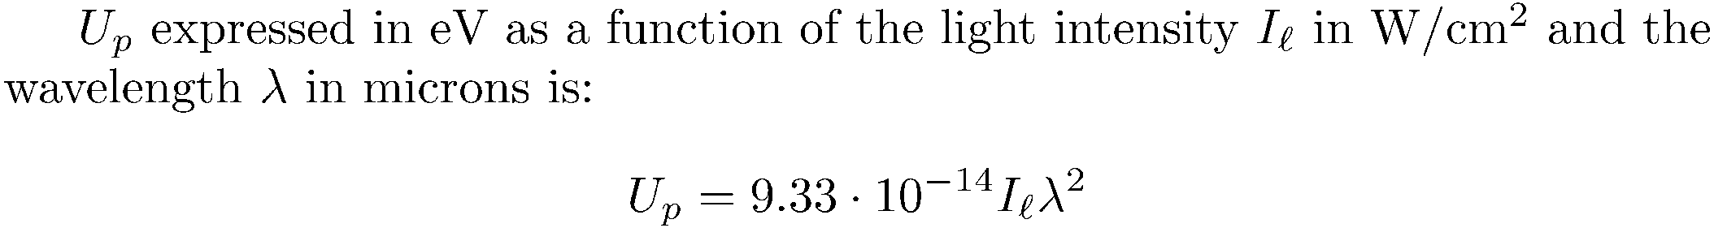

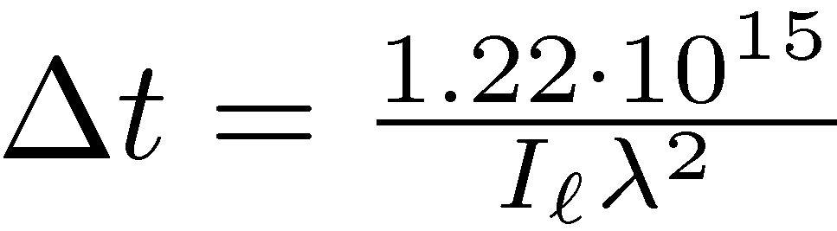
The average kinetic energy of a free electron oscillating in the laser field
Collision time 0.1 ps⁻¹
To reach 12.2 eV:
In ps

Slide 32
TIME TO AVALANCHE: WAVELENGTH DEPENDENCE
intensity 0.5 TW/cm²
we can calculate the temperature of an electron plasma in a constant field
14
12.2 eV
266 nm
12
10
800 nm
8
Electron Temperature (eV)
Avalanche
breakdown
6
4
2
0
50
100
150
200
Time (ns)

Slide 33
THE BOUND ELECTRON LINEAR RESPONSE VERSUS THE ELECTRON PLASMA RESPONSE.

Slide 34


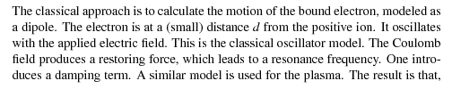
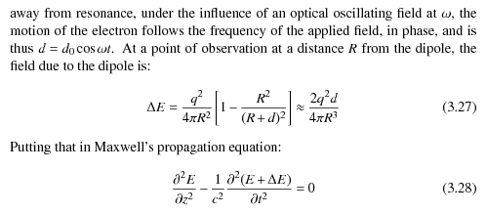
P in phase with E but 90 degree out of phase with ??

Slide 35
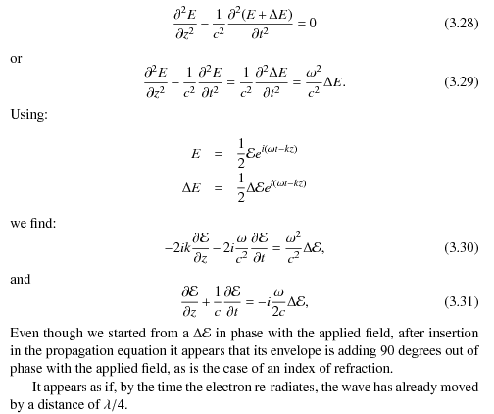

Slide 36



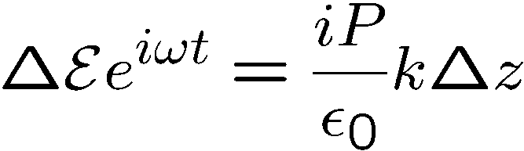

Classical light-matter interaction
Bound-electron: the oscillator model
Motion of the “spring” (polarization)
In phase with the force (E-field)
Below resonance: “index of refraction”
+
=
Time
P
Time

Slide 37
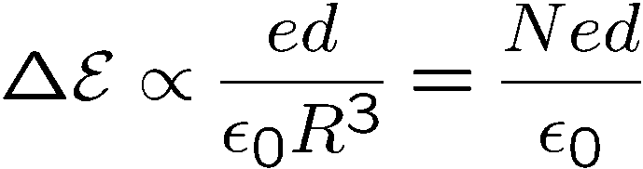

Classical light-matter interaction
Bound-electron: the oscillator model
Field of radiating electron
Below resonance: “index of refraction”
At resonance: “absorption”
+
=
+
=
Time
Time
P
P
Time
Time

Slide 38
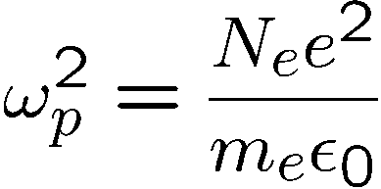


Classical light-matter interaction
“Free”-electron: the Drude model (plasma)
Below resonance: “index of refraction”
At resonance: “absorption”
“Negative index of refraction”
+
=
+
=
+
Time
Time
=
Time
P
P
P
Time
Time
Time

