Slide 1
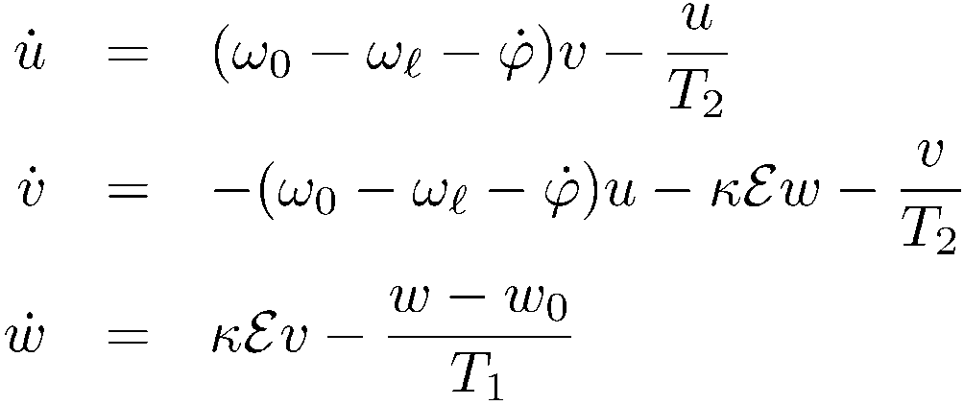
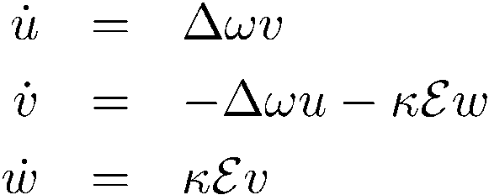








no relaxation
Propagation
w
u
v

Slide 2


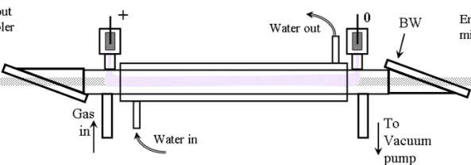
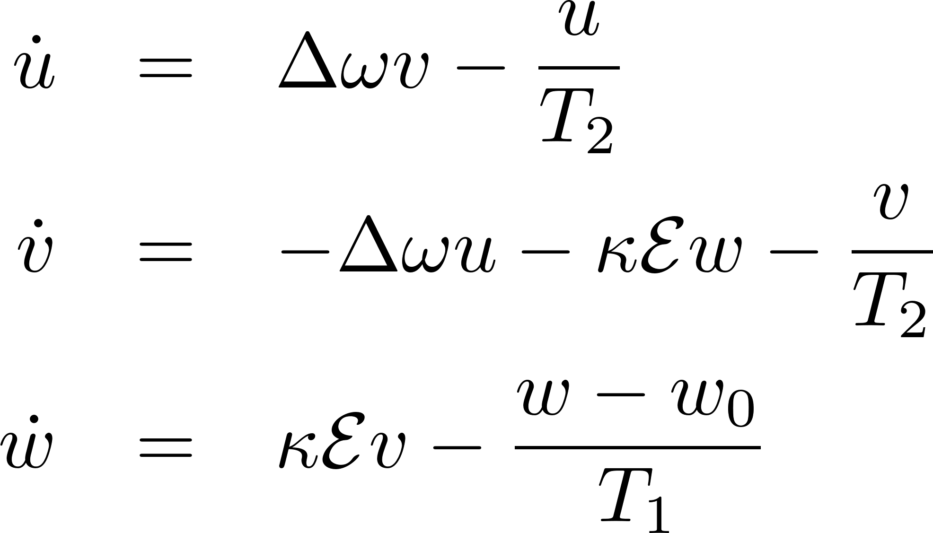
FREE INDUCTION DECAY
w
E
w
E
E
u
t
u
v
v
HP CO2
HOT CO2

Slide 3
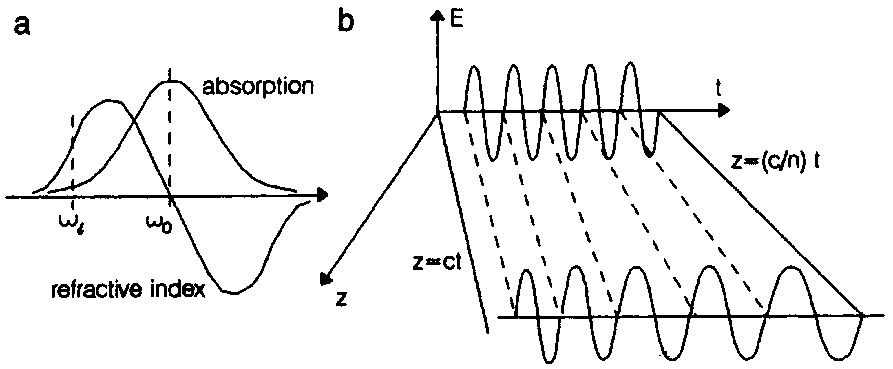
In time, even the light frequency is not conserved
There are more conservation laws than just the “area theorem”

Slide 4

The AREA THEOREM, SIT, the 2π pulse

Slide 5
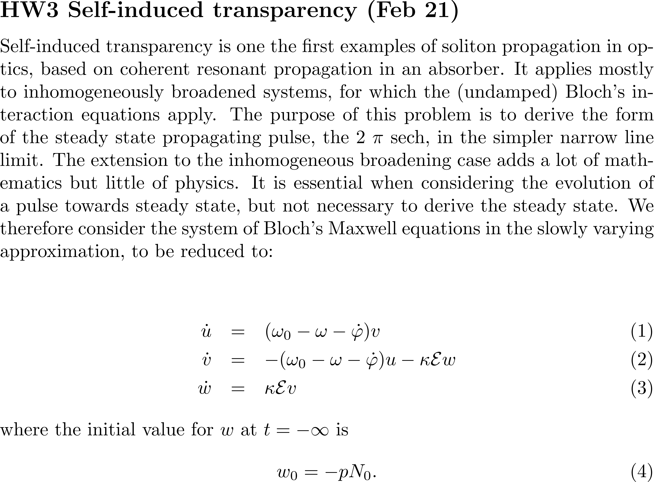

Slide 6
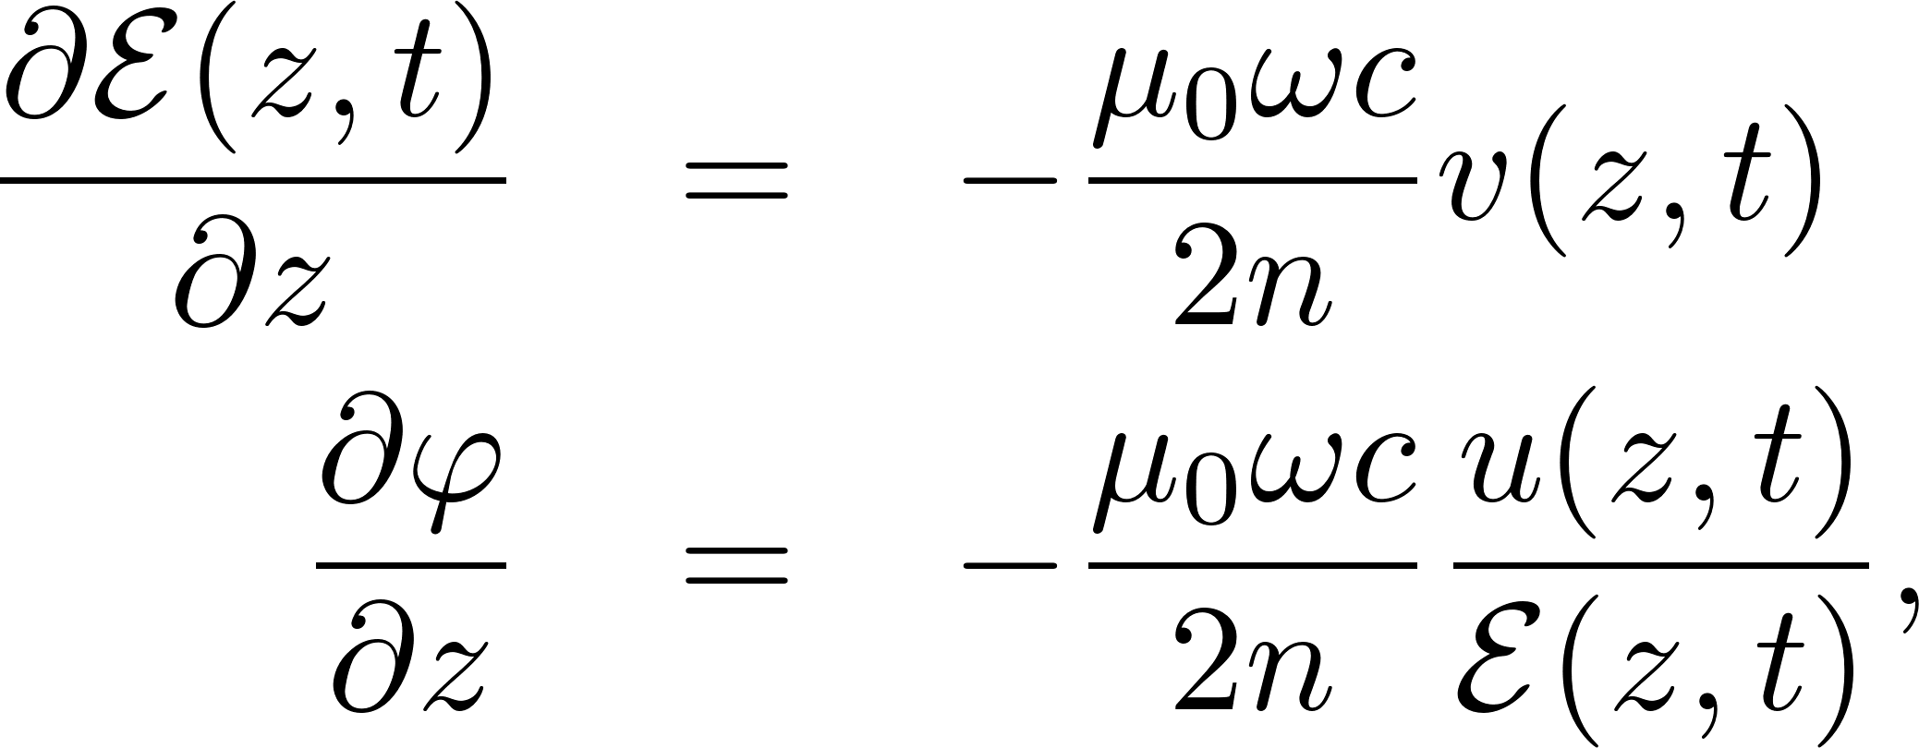


Slide 7
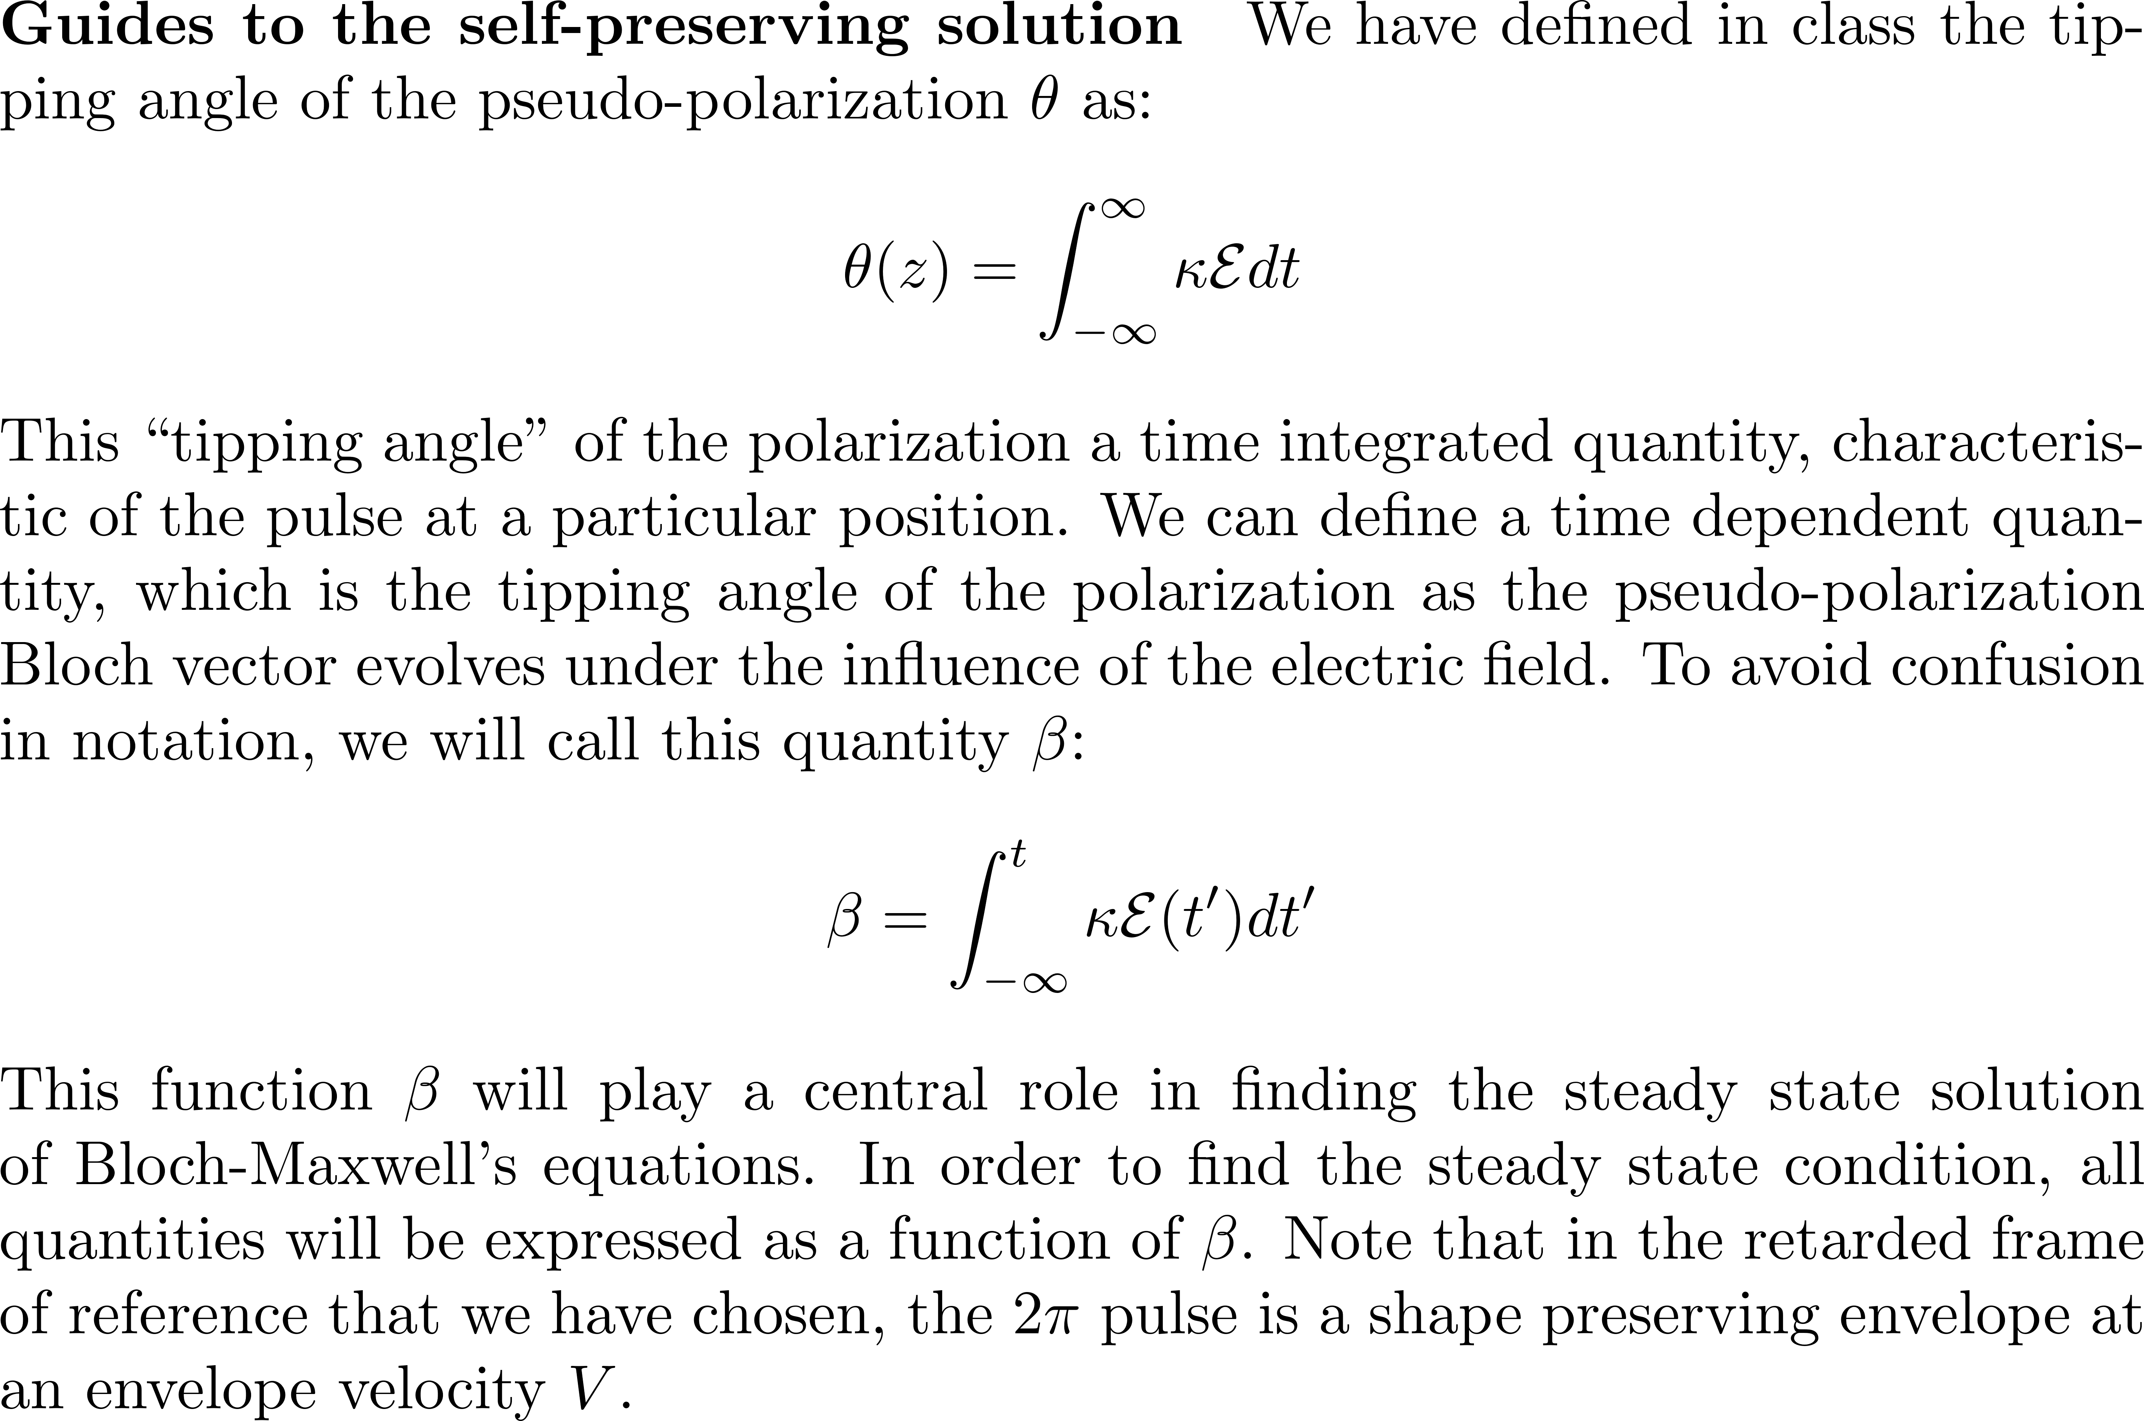

Slide 8
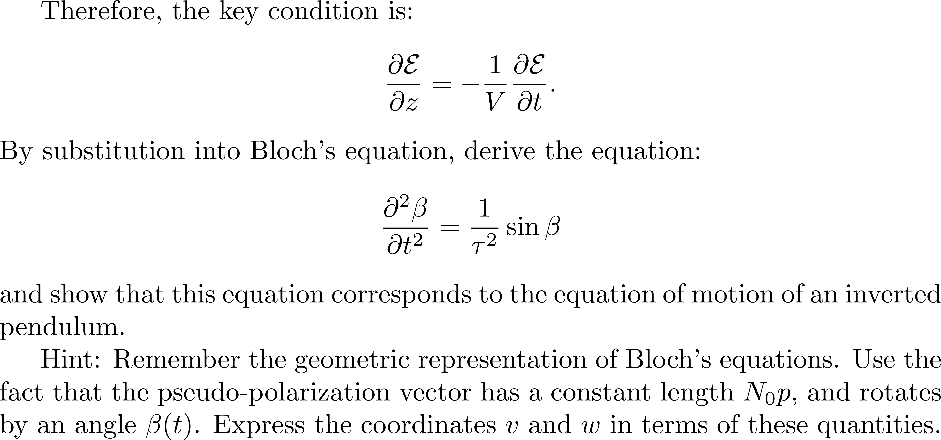

Slide 9
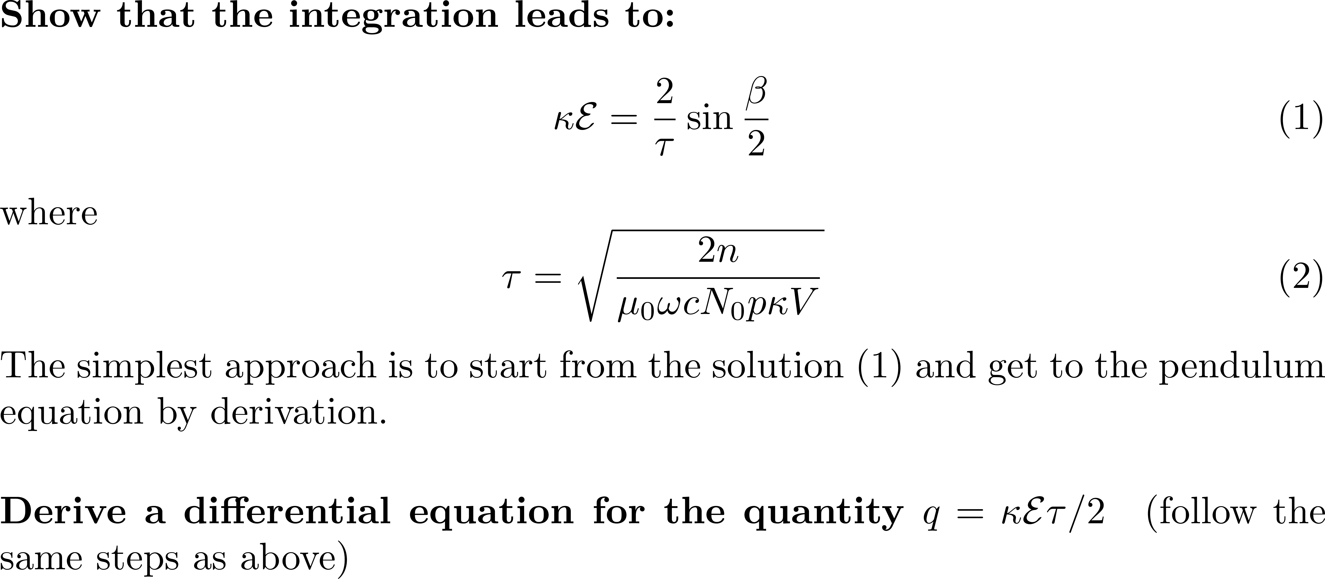


Slide 10

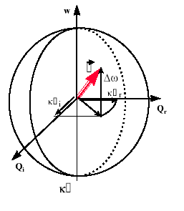
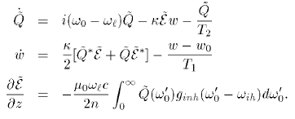
Pseudo-polarization vector
rotating around

Slide 11



Slide 12


Slide 13
In time, even the light frequency is not conserved
There are more conservation laws than just the “area theorem”

Slide 14

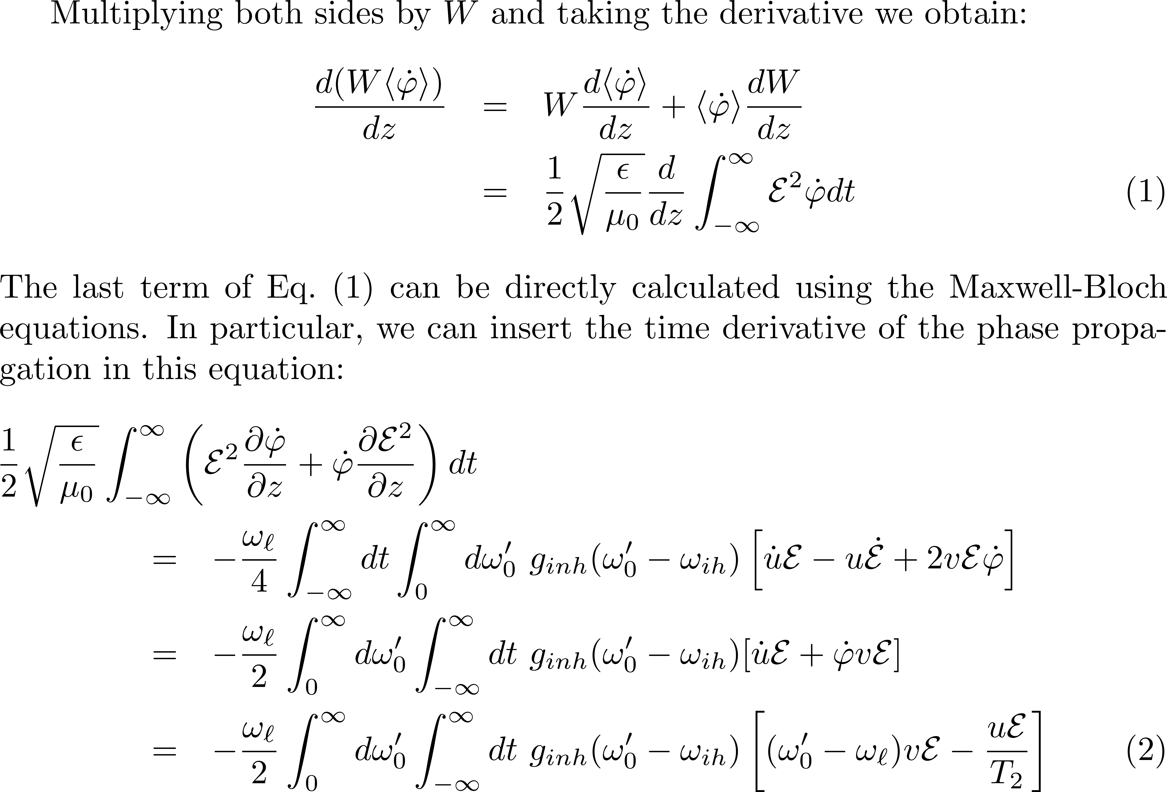

Slide 15



Slide 16


