Slide 1
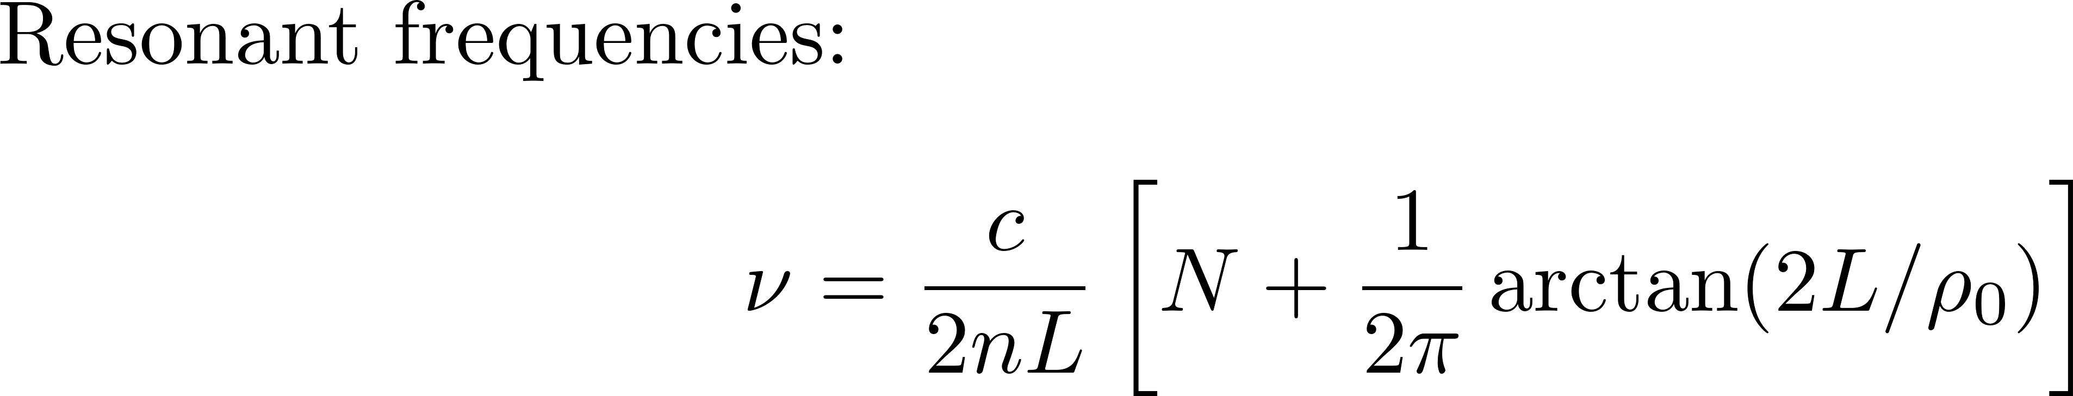
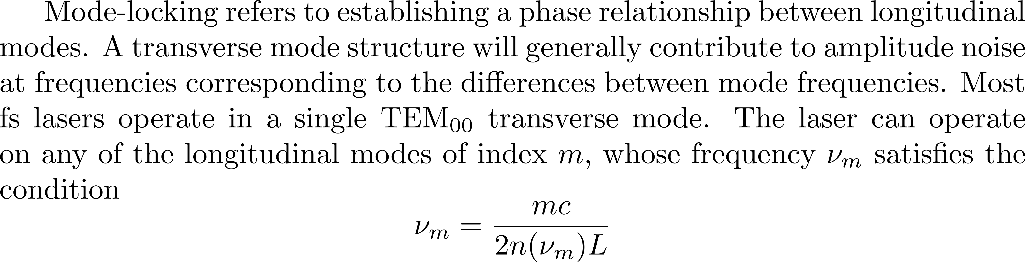
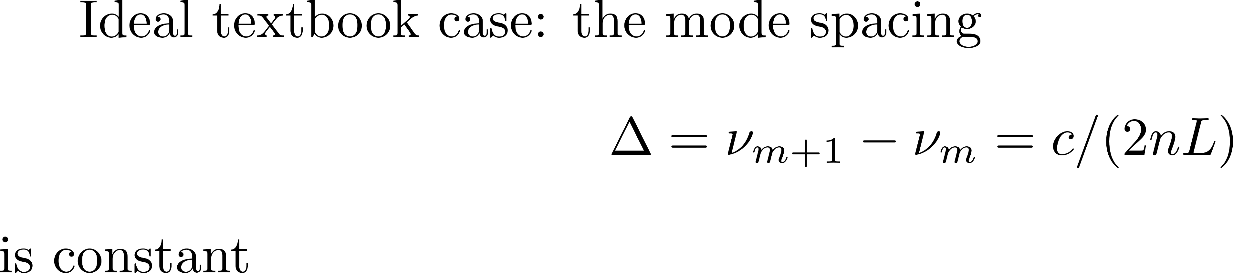
Mode-locking – from textbook approach to reality

Slide 2


M=5

Slide 3
ENERGY CONSERVATION

Slide 4
Equally spaced modes in phase,
make pulses periodic in time
Electric field
amplitude
0
time

Slide 5
Beyond the textbook
Pulse parameters for high field experiments – introducing the CEP
Single pulse --- the CEP and the uncertainty principle
Controlling the CEP
Defining the CEP
Description of a pulse train --- defining the CEO
CEO, the experimentalist definition
Can the CEO be brought under control passively?

Slide 6
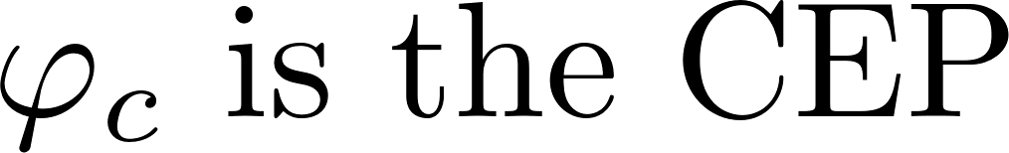
Pulse parameters for high field experiments: the CEP
Two pulses of 2.5 optical cycle.
The blue line is the electric field.
The green dotted line is the seventh power.
ω = 2π/T

Slide 7
Problems with the definition:
The spectrum of Gaussian pulses of a few optical cycles covers zero and negative frequencies.
Therefore, the energy would depend on ϕ_{e}
Is that possible?
Not in a traditional laser, because the low frequency components will diffract away.
Robin K. Bullough has found a “zero cycle” solution that propagates in a two-level medium
Solitons in nonlinear optics: a more accurate description of the 2π pulse in self-induced transparency
Journal of Physics A: Mathematical, Nuclear and General, 6:1337--1345, 1973.
We will assume in the following that such a situation does not occur,

Slide 8
Beyond the textbook
Pulse parameters for high field experiments – introducing the CEP
Single pulse --- the CEP and the uncertainty principle
Controlling the CEP
Defining the CEP
Description of a pulse train --- defining the CEO
CEO, the experimentalist definition
Can the CEO be brought under control passively?

Slide 9

Single pulse
CEP: The uncertainty
Short pulse: what is the carrier?
Long pulse: what is the envelope center?
?
Electric field
Electric field
Time
Time
Electric field
Electric field
?
Frequency
Frequency

Slide 10
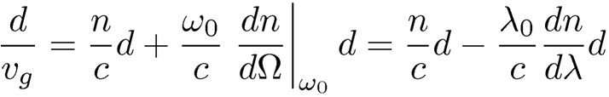
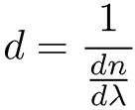
Single pulse
CEP of few cycle pulse
…so short pulses that we do not even know what ω₀ is
We do not know what CEP is, but we know how to control it.
Propagation through glass of thickness d, the group delay is:
For Δ(CEP) = 2π, (group minus phase) delay = T = λ₀ /c:
We are still assuming that we can define a carrier frequency,
hence make the decomposition:

Slide 11
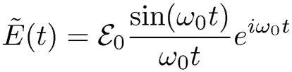
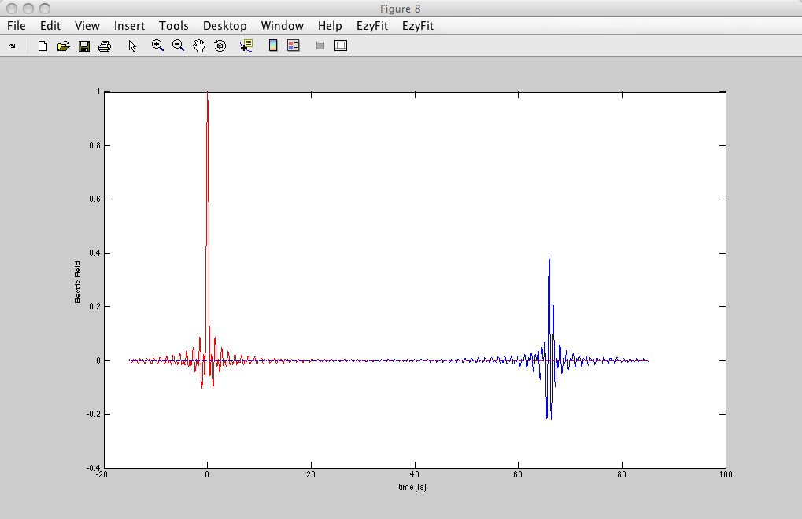
Single pulse
CEP of few cycle pulse: example
FREQUENCY
TIME
E
ω₀ = 0.75π 10¹⁵s⁻¹ (800 nm)
ω₀
Ω
13 μm of BK7
Electric field
0
0
20
Time (fs)
40
60

Slide 12
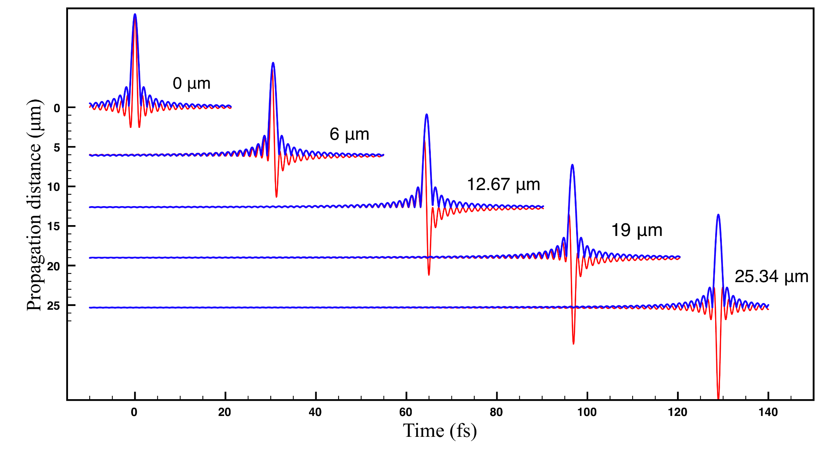
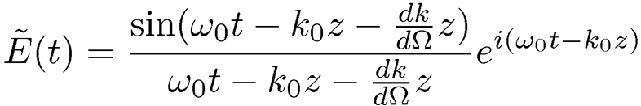
CEP of a single cycle sinc: the traditional (wrong) approach

Slide 13

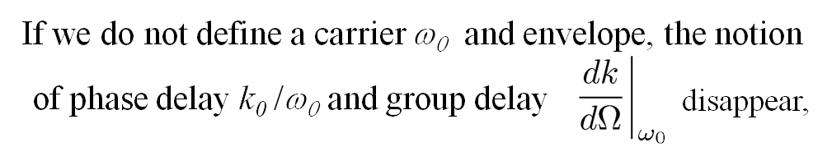
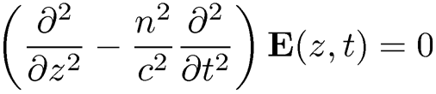
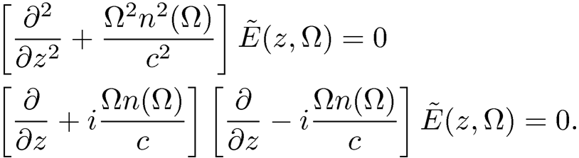

Single pulse
CEP of few cycle pulse
We have to return to Maxwell's propagation equation:
In frequency

Slide 14
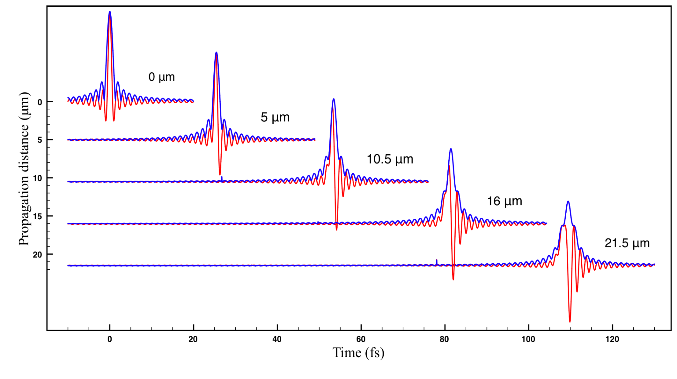
Single pulse
CEP of a single cycle sinc
Definition of CEP: difference between phase φ(t) at peak of amplitude
and phase φ(t) at peak of real field
CEP = 0.319
CEP = 0.613
CEP = 1.012
CEP = 1.321

Slide 15

CEP = 0.52
phase φ(t) at peak of envelope
minus phase φ(t) at peak of envelope
= CEP = 1.04
CEP = 1.73

Slide 16
Beyond the textbook
Pulse parameters for high field experiments – introducing the CEP
Description of a pulse train --- defining the CEO
Single pulse --- the CEP and the uncertainty principle
Controlling the CEP
Defining the CEP
CEO, the experimentalist definition
Can the CEO be brought under control passively?

Slide 17
Train of pulses in time and frequency
CEP and CEO
Do the definitions extend to a train of δ-functions?

Slide 18

Splicing a CW wave:
The spectral resolution of the cw wave is lost
E
TIME
FREQUENCY

Slide 19




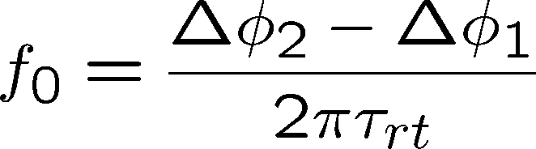

What if… we apply a periodic modulation to the cw wave?
(CEP)
E
TIME
(CEP) = CARRIER TO ENVELOPE PHASE
CEP/
= CEO = CARRIER TO ENVELOPE OFFSET f₀
E
FREQUENCY

Slide 20
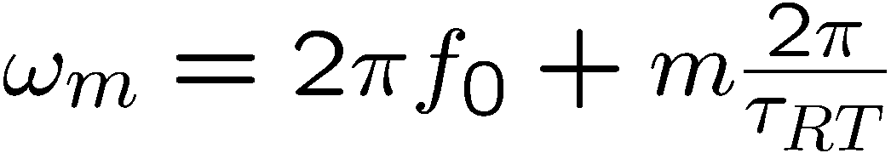
Why is the Δ(CEP) related to the
first tooth of the mode comb?
Δν =1/τ_{Coherence}
Δν_{b} =1/τ
Electric field
ν_{av}
Δϕ_{p}
Frequency
f₀=
1/τ_{RT}
2πτ_{RT}
Phase between
successive
pulses:
Δϕ_{p}

Slide 21
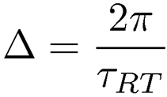

Train of pulses in time and frequency -- CEO
Concluding:
1)
Yes, you can combine high spectral resolution with femtosecond temporal resolution
2) The Carrier to Envelope Phase (CEP) applies to a single pulse –
3) The Carrier to Envelope Phase Offset (CEO) applies to a pulse train
The engine for the pulse train is the mode-locked laser ---
the description of a modulated carrier applies.
Tooth spacing:
What controls the pulse train is the CEO
{
The mode comb does not start at zero but at Ω = 2 π f₀
Mode-locked
laser
Ω
0

Slide 22
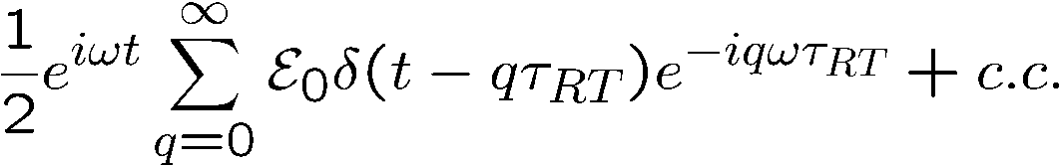
Do the definitions extend to
a train of δ−functions?
ϕ_{e}
τ_{RT}
Electric field
Time
Fourier transform
f_{r} - f₀
-f₀
f₀
Frequency
f_{r} = 1/τ_{RT}
ϕ_{p}
f₀=
ϕ_{p}
ϕ_{e}
ϕ_{e}
2πτ_{RT}
=
(i + 1) -
(i )

Slide 23
Measuring the CEO
The real thing (the laser, the “real comb”)
Evolution of a single pulse in an ``ideal'' cavity
How unequally spaced modes
lead to a perfect frequency comb
The frequency comb as seen by the experimentalist

Slide 24
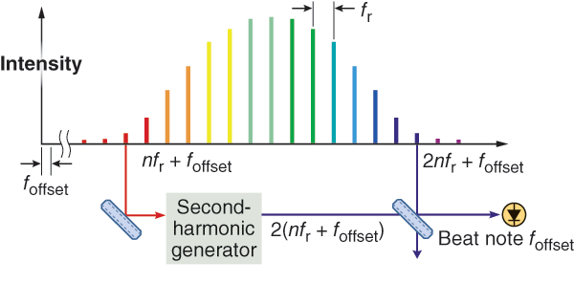
Locking and measurement of CEO
D. J. Jones et al. Science 288, 635-639 (2000)
S. Rausch et al., Ultrafast Phenomena Conf., Snowmass, MB5, 2010.
AOM
Laser
f₀
control
mixer
Control of f₀ to ν_{ref}
Reference
Frequency
ν_{ref}
All pulses have the same CEP!
Control of f₀ to 0
Big shortcoming: method applies only to ultrashort pulses
The CEO exists for a train of any pulse duration!

Slide 25
Measurement of CEO
Other method: interferometry
Generate two pulse trains, one with zero CEO
the other with the CEO f₀ to be determined,
both pulse trains at the same repetition rate.
Make the two pulse trains interfere: beat frequency =
f₀
Beat
fs
pulses
note
A
time
D
B
1
bandwidth of beat note
Coherence time =

Slide 26
Beyond the textbook
Pulse parameters for high field experiments – introducing the CEP
Single pulse --- the CEP and the uncertainty principle
Controlling the CEP
Defining the CEP
Description of a pulse train --- defining the CEO
CEO, the experimentalist definition
Can the CEO be brought under control passively?

Slide 27
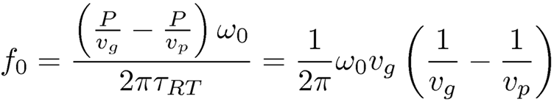
CEO: The experimentalist definition
Given a mode-locked laser, how does one define the CEO?
Does one extend the comb to find the zero frequency? Too difficult
Does one take the CEP of two successive pulses, and divide by the RT time?
Definition of CEP too fuzzy so far
Origin of the CEO in the laser:

Slide 28
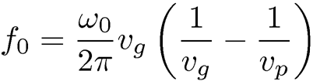


Measurement of the CEO in a cavity
We need only to measure
and
Cavity with two pulses/cavity round-trip.
Measurement of group delay: monitor the repetition rate with a frequency counter
on detector D1, while changing the cavity length with a PZT or dc on modulator.
Measurement of phase: monitor the beat note on D, applying a difference of index
Δn seen by either pulse through the modulator.
.
.
A
Phase adjust
2
MQW
delay
Modulator
GAIN
D₁
REF
D

Slide 29
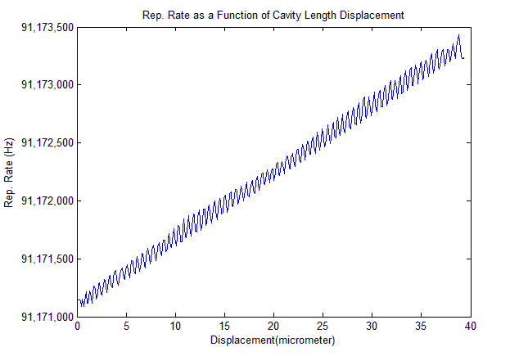
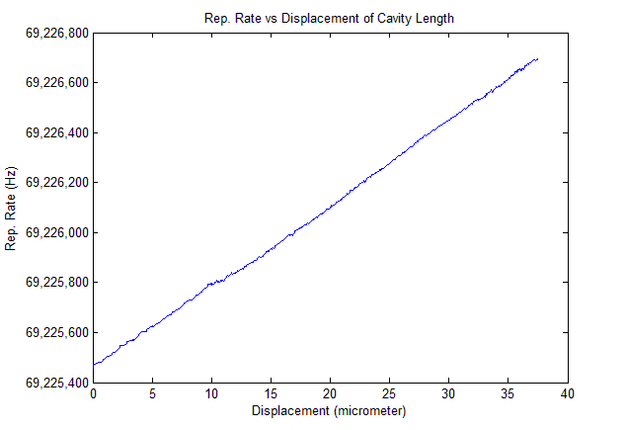
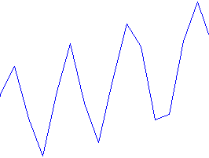
Use MQW as saturable absorber
Monitor the repetition rate as the cavity is being expanded
MQW
MQW in the middle of a linear cavity
Saturable absorber jet instead of MQW
Period of λ/2

Slide 30
Can the CEO be brought under control?
Traditional approach:
active control through electronics
Can the CEO be brought under control passively?
Locking amplitude and phase by colliding pulse with MQW at cavity end.
MQW

