Slide 1
THE REAL MODE-LOCKED LASER

Slide 2
Tuning the wavelength, the mode and the CEO
Kerr and

Slide 3
The temporal soliton
Kerr effect and dispersion leads to the nonlinear Schroedinger equation
The nonlinear Schroedinger equation leads to a soliton of order 1
The sech shaped pulse rattles back and forth in the cavity, producing a frequency comb

Slide 4
The Kerr lens in time
E(t) = ε(t)e^{iωt-kz}
n(t)
or
k(t)
ε(t,0)
ε(t,0) e^{ik(t)d}
Pulse temporal shape unchanged
Instantaneous frequency or
Positive frequency sweep in the middle

Slide 5
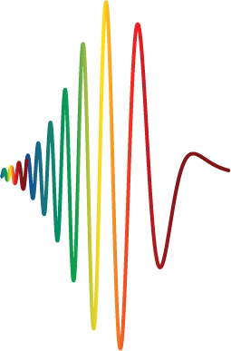
Pulse broadening, dispersion
Positive dispersion creates a positive frequency sweep
E(t)
Broadening
and
chirping
time
Electric field
amplitude
time
z = v₁t
(fast)
z = v₂t
(slow)
z = ct

Slide 6
Pulse compression through chirping,
Positivelky chirped pulse compressed by negative dispersion
E(t)
Chirping
and
compression
time
Electric field
amplitude
z = v₂t
(fast)
z = v₁t
(slow)
time
z = ct

Slide 7
PHASE MODULATION
E(t) = ε(t)e^{iωt-kz}
n(t)
or
k(t)
ε(t,0)
ε(t,0) e^{ik(t)d}
d
DISPERSION
ε(ΔΩ,0)
n(Ω)
or
k(Ω)
ε(ΔΩ,0)e^{-ik(ΔΩ)z}

Slide 8
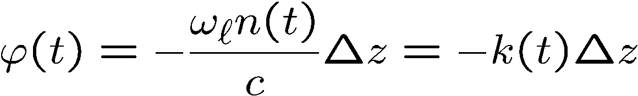


Propagation in the time domain
PHASE MODULATION
E(t) = ε(t)e^{iωt-kz}
n(t)
or
k(t)
ε(t,0)
ε(t,0) e^{ik(t)d}

Slide 9
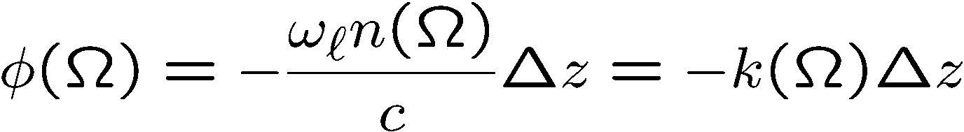
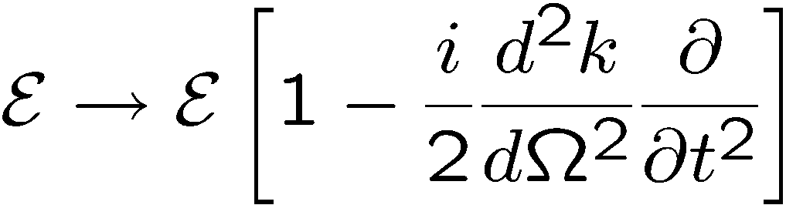
Propagation in the frequency domain
DISPERSION
ε(ΔΩ,0)
n(Ω)
or
k(Ω)
ε(ΔΩ,0)e^{-ik(ΔΩ)z}
Retarded frame and taking the inverse FT:

Slide 10




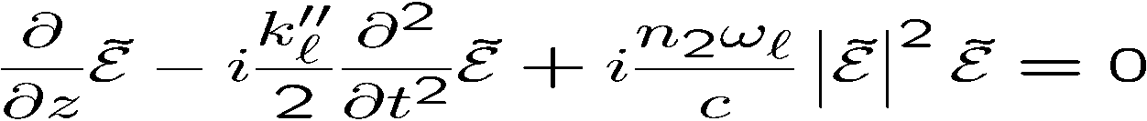


PHASE MODULATION
DISPERSION

Slide 11
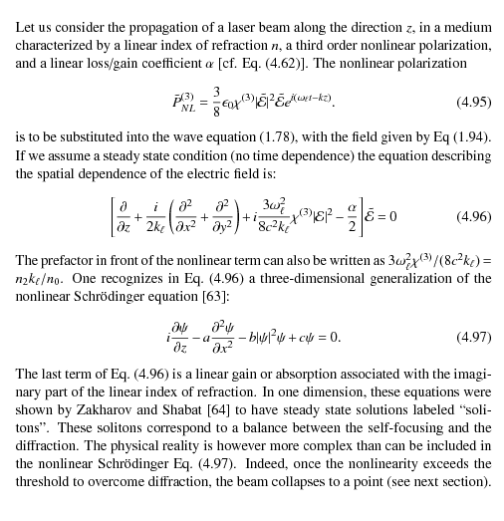
NONINEAR SCHROEDINGER
EQUATION IN SPACE

Slide 12
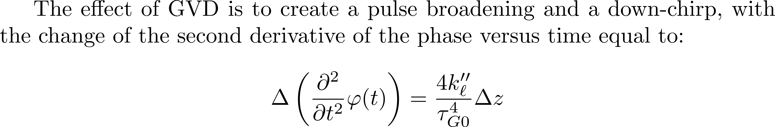
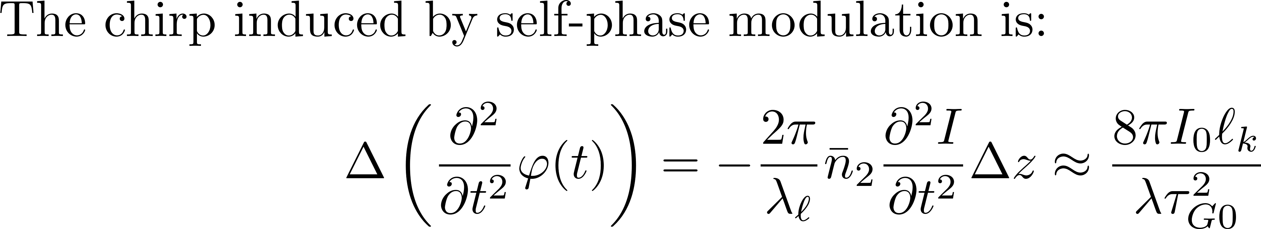
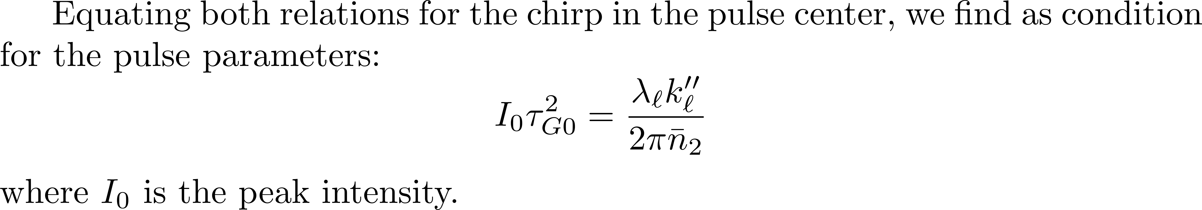
The actions of nonlinearity and GVD exactly compensate each other.

Slide 13
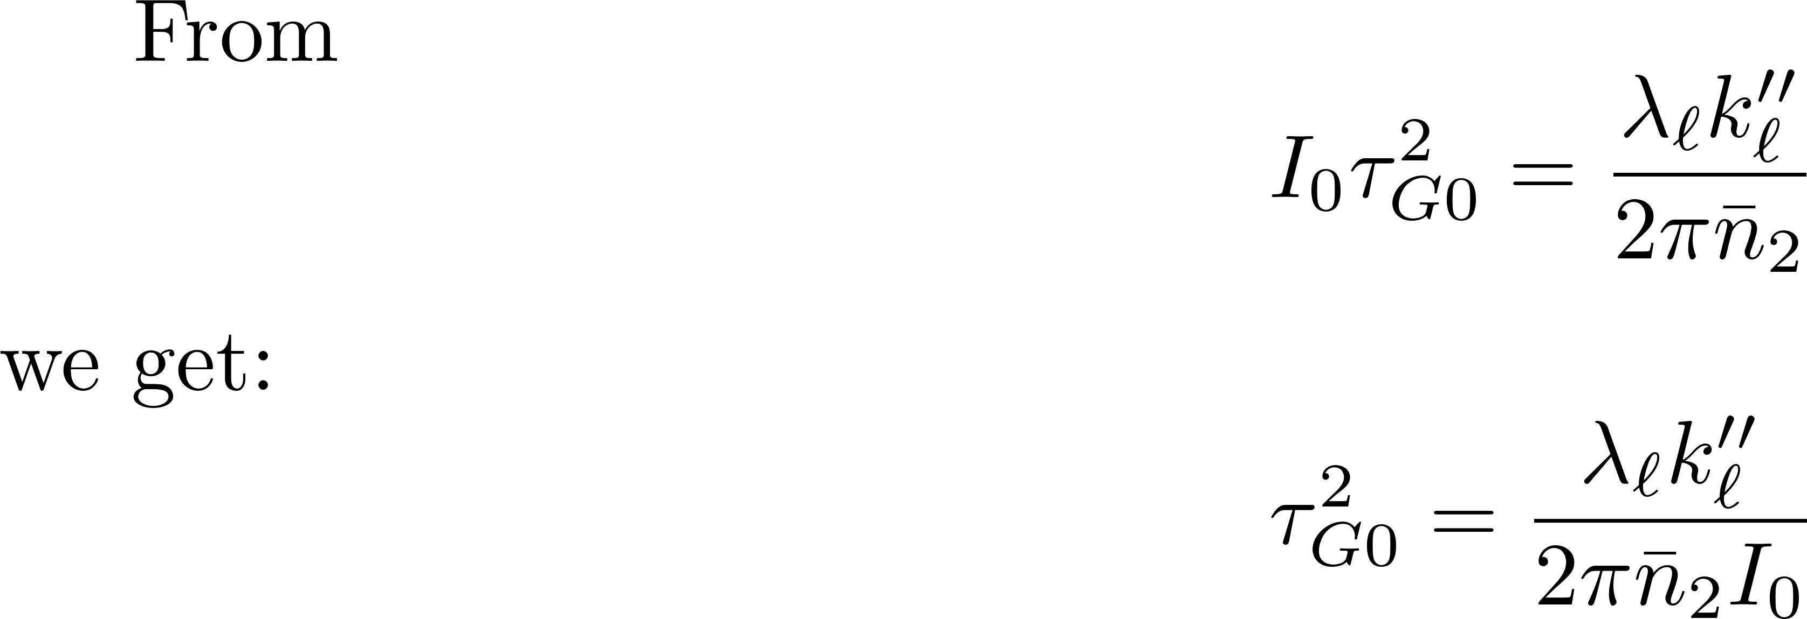
The actions of nonlinearity and GVD exactly compensate each other.

Slide 14
The preceding concepts can be put in a rigorous evolution equation

Slide 15
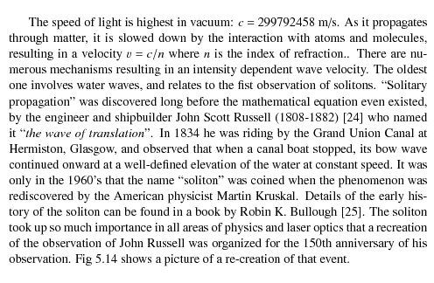
NONINEAR SCHROEDINGER
EQUATION IN TIME

Slide 17
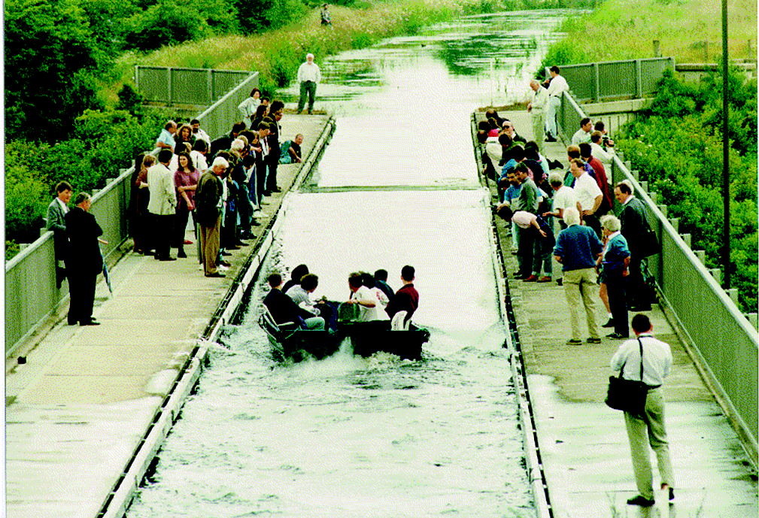

Slide 18
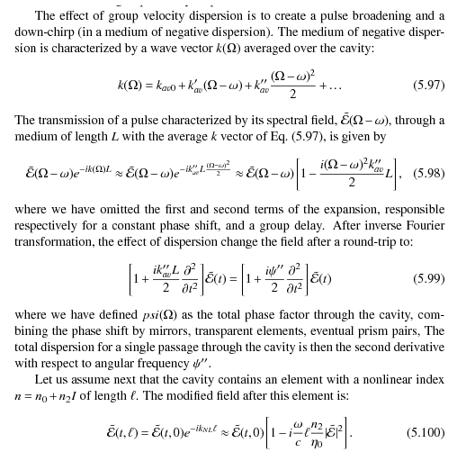
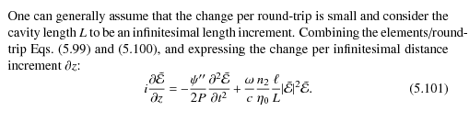
NONINEAR SCHROEDINGER
EQUATION IN TIME

Slide 19
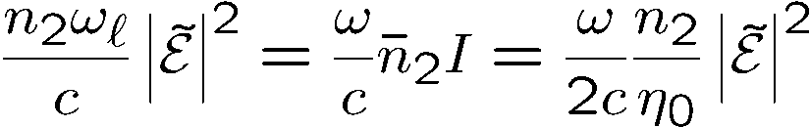
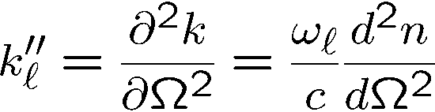
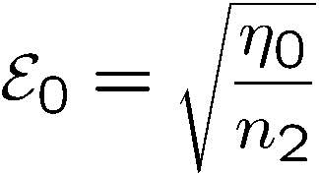
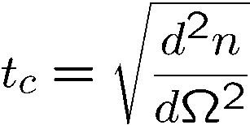
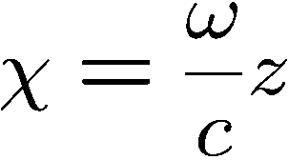

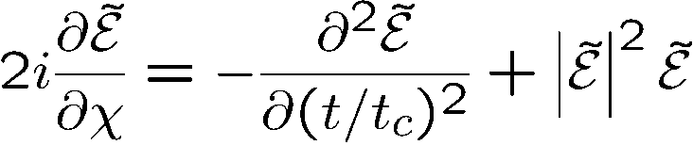

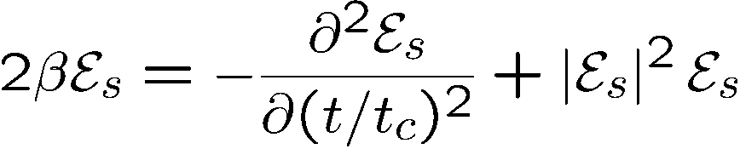
Equation in the retarded frame
Characteristic field:
Characteristic time:
Normalized distance:
Solitons: solutions of the eigenvalue equation

Slide 20
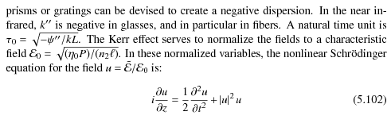

Slide 21
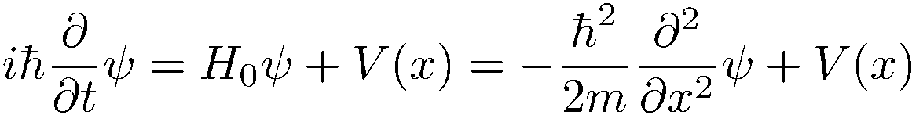
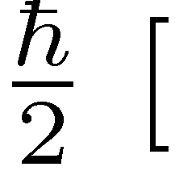
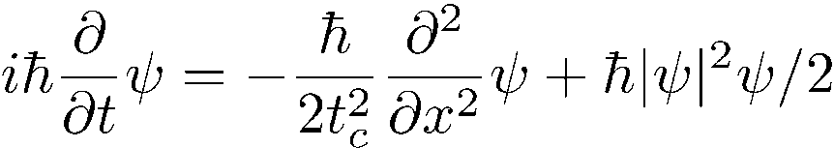
Why non-linear Schroedinger equation?
]
Multiply by

Slide 22
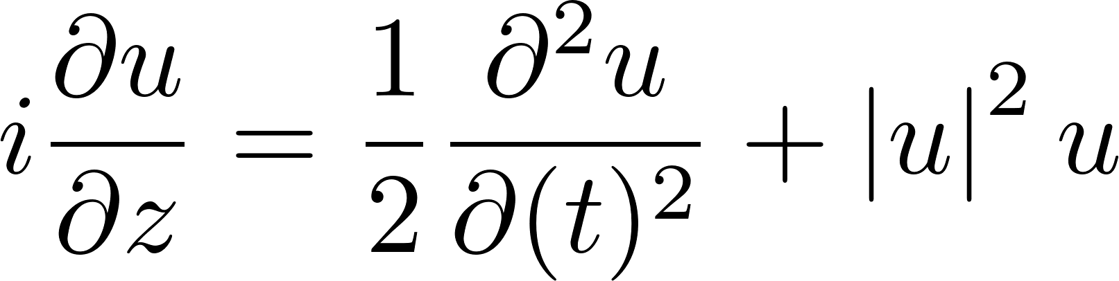
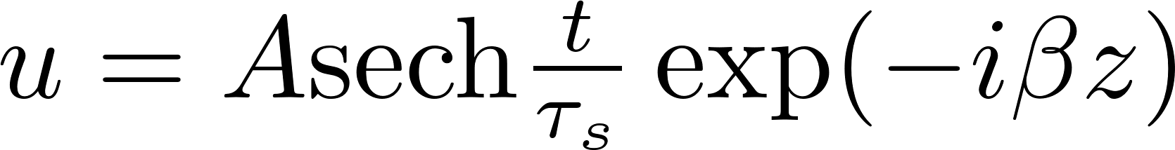
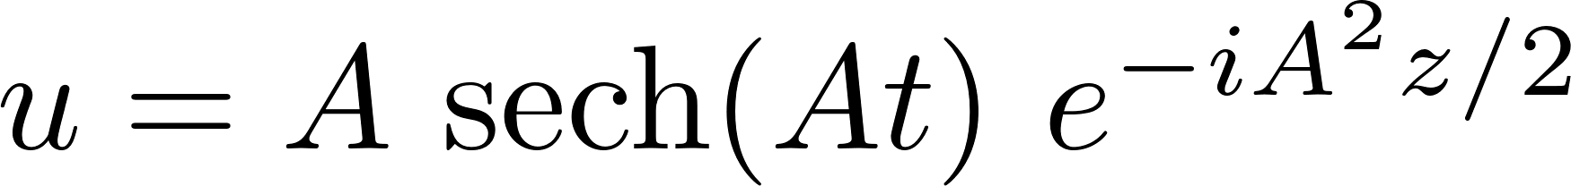
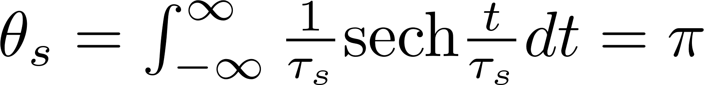
Solution of the normalized NL Schroedinger equation
The standard form is:
Trial solution
In these normalized units, there is an infinite family of solutions of ``order 1'', defined as the product of peak amplitude A by pulse duration τ_{s} being unity.
But the correct “pulse area” is:

Slide 23
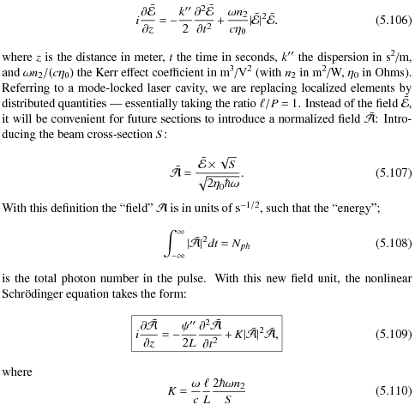
NONINEAR SCHROEDINGER
EQUATION IN TIME
NOT NORMALIZED SOLUTIONS

Slide 24
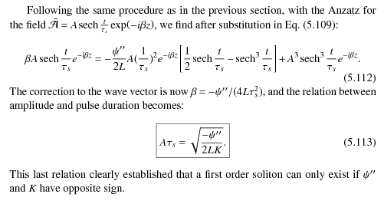
NONINEAR SCHROEDINGER
EQUATION IN TIME
NOT NORMALIZED SOLUTIONS

Slide 25
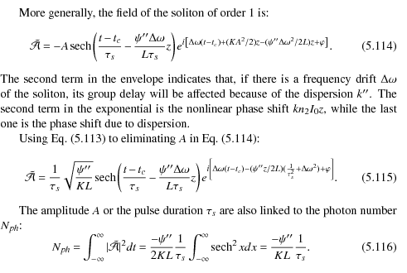

NONINEAR SCHROEDINGER
EQUATION IN TIME
NOT NORMALIZED SOLUTIONS

Slide 26
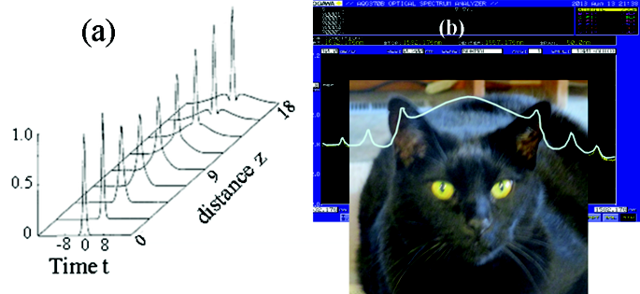
SOLITON STABILITY
A perturbation causing an increase in photon
number leads to a depletion of the leading and trailing edges, while the number of
photons is increased in the center, implying a pulse compression. The soliton is a
stable entity for the total number of photons. An increase in peak intensity should
result in a larger Kerr effect, hence a phase shift.
First order solitons are stable, in the sense that if a soliton of order > 0:5 or < 1:5
(area between pi/2 and 3pi/2) is launched, it will evolve towards a single soliton
or order one. The threshold for soliton formation is higher if a chirped pulse
is launched.

Slide 27
The laser as an orthodontist
The laser cavity having dispersion,
How can the modes of the frequency comb be exactly equally spaced?

Slide 28
The laser as an orthodontist
Tuned cw laser
D
Mode locked laser
λ
FREQUENCY
TUNABLE
LASER
MODE-LOCKED
LASER
Frequency counter
SPECTROMETER
FREQUENCY
COUNTER
Round
-trip
frequency
200
101 884 000 Hz
-
100
wavelength
ORTHODONTIST
Rep. Rate
700
800
900
Wavelength [nm]

Slide 30
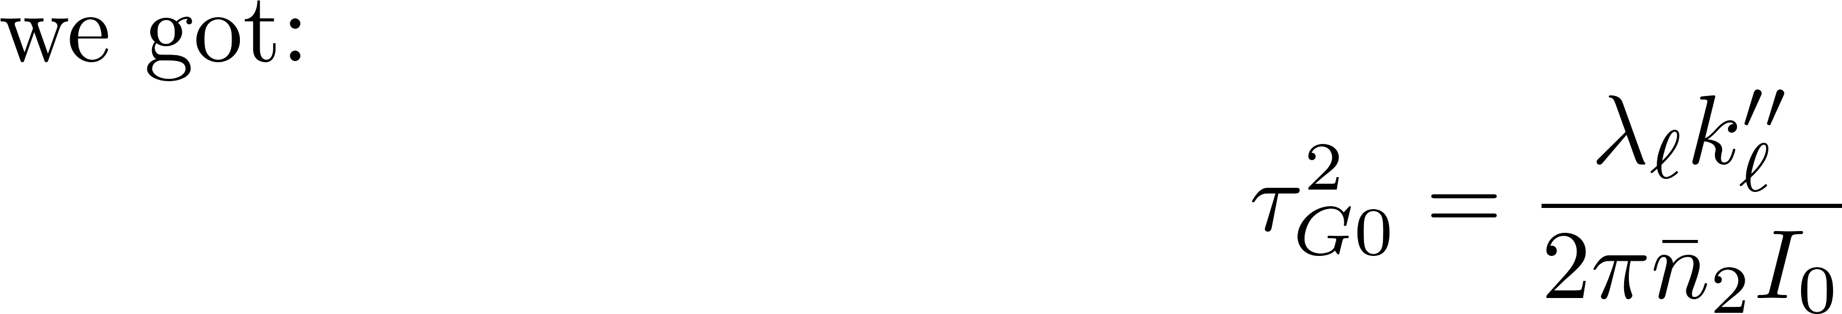
The actions of nonlinearity and GVD exactly compensate each other.

Slide 31
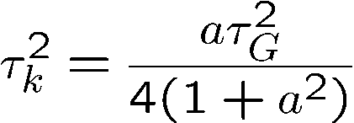

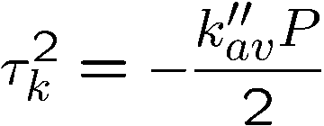
The laser as an orthodontist
The laser cavity having dispersion,
How can the modes of the frequency comb be exactly equally spaced?
Procedure: 1) write the quadratic spectral chirp coefficient induced by Kerr effect:
Multiply the chirped frequency spectrum by the dispersion:
at each round-trip, to find the condition:

Slide 32
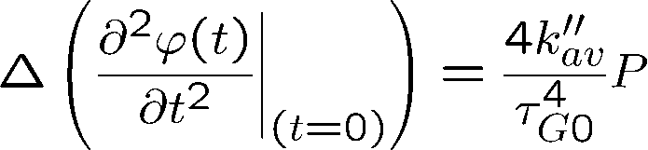
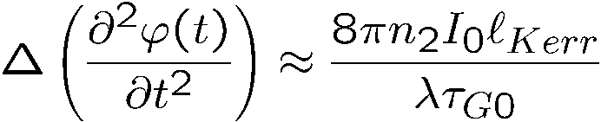
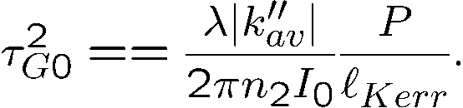
Evolution of a single pulse in an ``ideal'' cavity
P = perimeter of the cavity
Dispersion
Kerr-induced chirp
Kerr effect

Slide 33
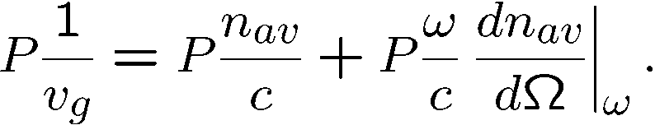
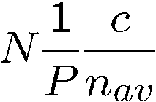
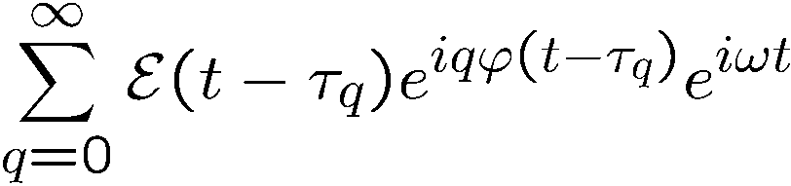
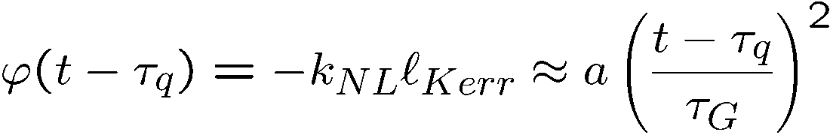
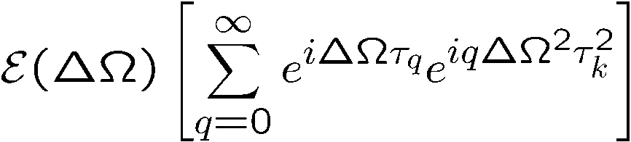
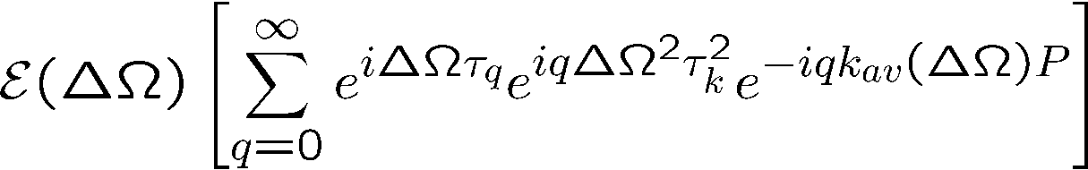

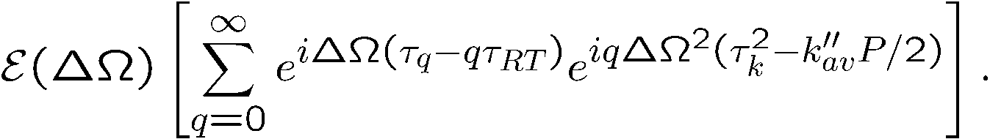
How unequally spaced modes
lead to a perfect frequency comb
Group delay
Phase delay
Cavity modes:
not equally spaced because n_{av =} n_{av}(ω)
A cavity with ONLY Kerr modulation generates the pulse train:
where
F.T.
where
dispersion

Slide 34
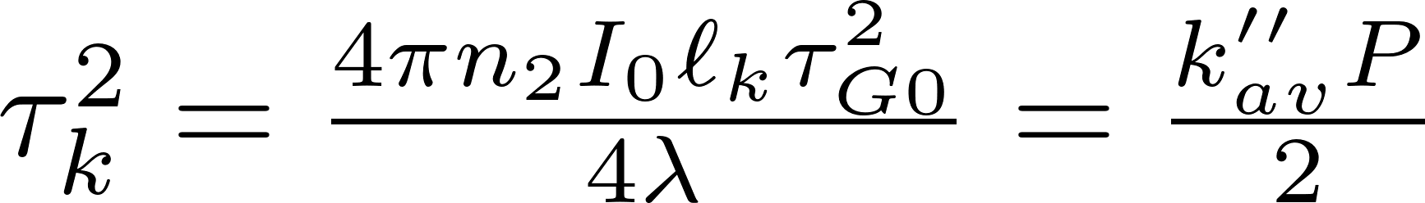
How unequally spaced modes
lead to a perfect frequency comb
Group delay
Phase delay
Cavity modes:
not equally spaced because n_{av =} n_{av}(ω)
A cavity with ONLY Kerr modulation generates the pulse train:
where
F.T.
where
dispersion

Slide 35
Two related questions:
Which mechanism makes the
As a pulse circulates in the cavity,
unequally spaced cavity modes
does it evolve towards a steady state?
equidistant?
Balance phase modulation by Kerr effect
and phase modulation by dispersion
How unequally spaced modes
Evolution of a single pulse in an ``ideal'' cavity
lead to a perfect frequency comb
SAME
CONDITION

Slide 36
The right tool for a given measurement
An overview
THE PULSE TRAIN
TOOLS: Simple analog oscilloscope and frequency doubling crystal.
Electronic Spectrum analyzer
Spectrometer
What to look for?
Both fundamental and second harmonic: a straight line.
No sideband and higher harmonics
Continuous spectrum, central wavelength

Slide 37
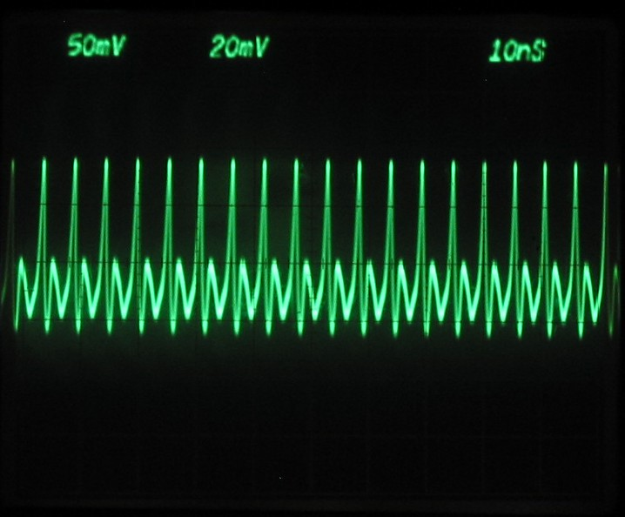
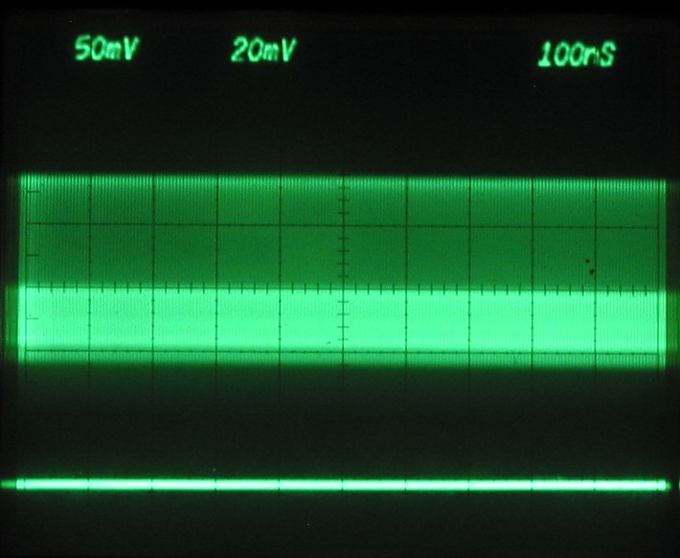
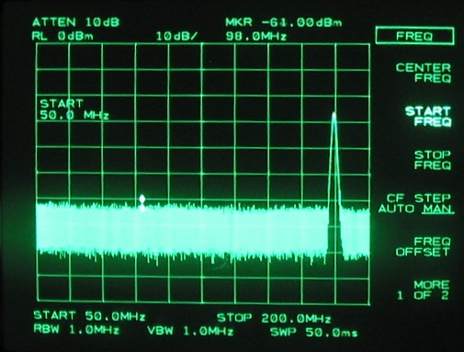
The frequency comb as seen by the experimentalist
THE PULSE TRAIN
Both fundamental and second harmonic: a straight line.
Electronic Spectrum analyzer

Slide 38


The frequency comb as seen by the experimentalist
THE PULSE TRAIN
What we should not see:
Modulation of the train on a μs scale
Q-switched-mode-locked train
(Shows as a sideband on spectrum
analyzer on a 100 KHz scale)

