Slide 1
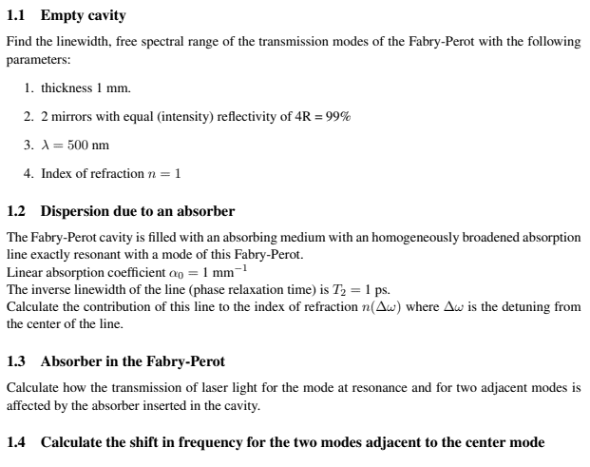
Homework 5

Slide 2
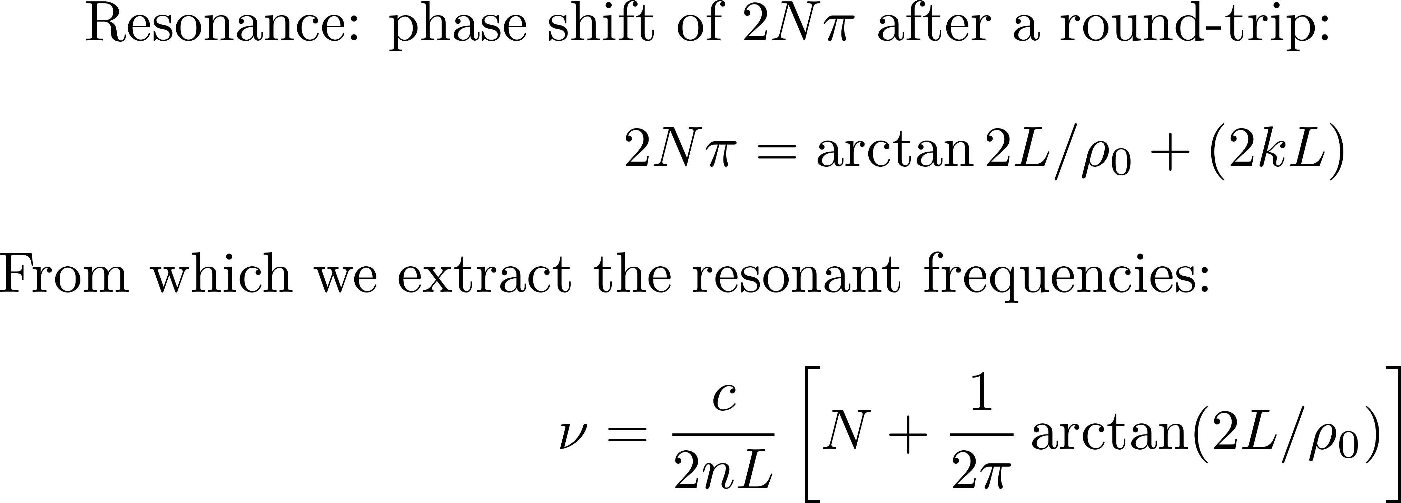
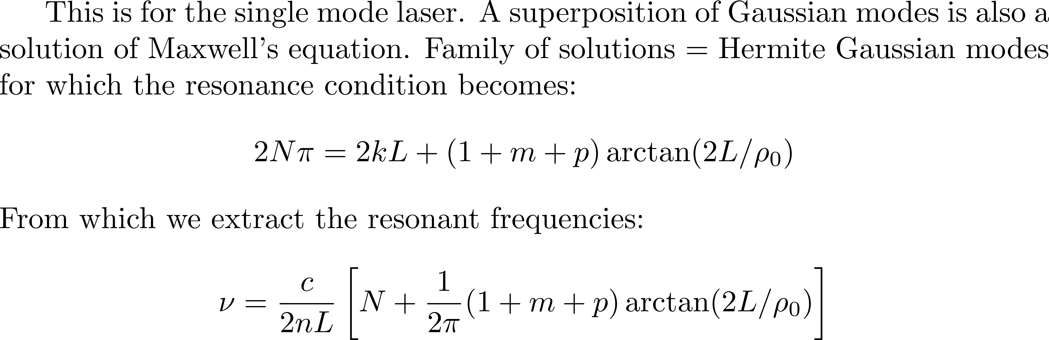
Modes and laser output

Slide 3
Modes and laser output
Longitudinal modes only – let us assume they are equally spaced.
Δ
M
Δ
M
τ
τ
Δ
p
=1/(M )
Δ
Power
p
Δ
Δ
Δ
Power
Spectral Power
Power
Power
1/Δ
1/Δ
1/Δ
1/Δ
1/Δ
1/Δ
1/Δ
1/Δ
1/Δ
1/Δ
Spectral Power
Frequency
Frequency
Frequency
Frequency
Time
Time
Time
Time
Time
Time
Time
Time
(a)
(a)
(b)
(b)
(c)
(a)
Random phase
(c)
(a)
(b)
(b)
(c)
(c)
In phase

Slide 4
Equally spaced modes in phase,
make pulses periodic in time
Electric field
amplitude
0
time

Slide 5
Modes and laser output
Longitudinal modes only – modes in phase but not equally spaced

Slide 6
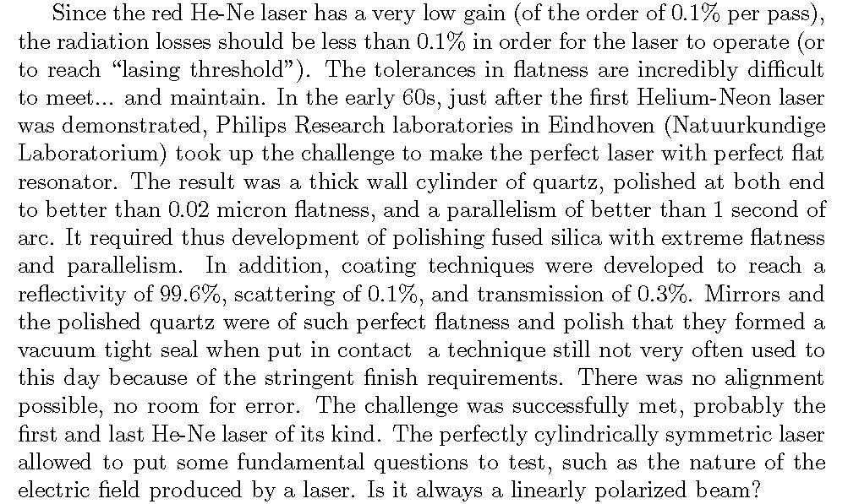
Modes and laser output
Longitudinal modes only – let us start wit narrow line gas lasers

Slide 7
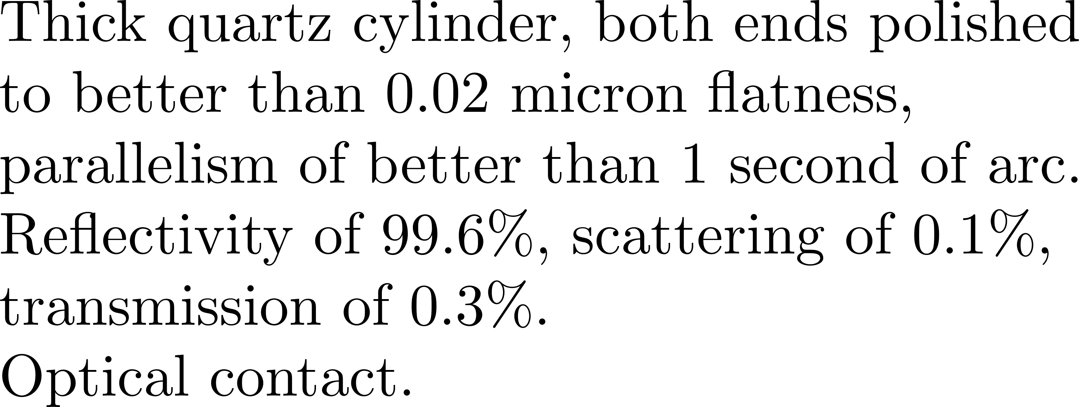
Quartz He-Ne laser from Philips

Slide 8
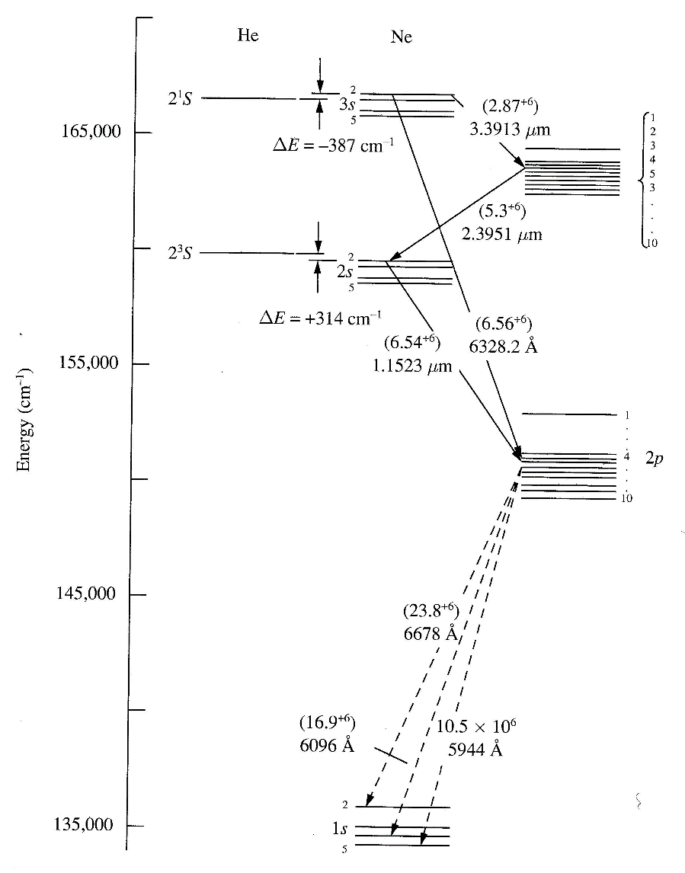
Strongest transitions are at 1.5 μm and 3.39 μm. In the visible, transitions at 543.5 nm (green, measured in vacuum), 594 nm (yellow) and 612 nm (orange) exists. The typical red laser uses
the transition at 632.8 nm (measured in air).
Melles Grillot green laser with retro-reflection
Gain linewidth such that only 1 mode in the 10 cm Philips laser.
Longer lasers: a few modes beating.
Single mode by stabilization (Lamb dip)
How to align? With a He-Ne laser… Chicken and egg.

Slide 9
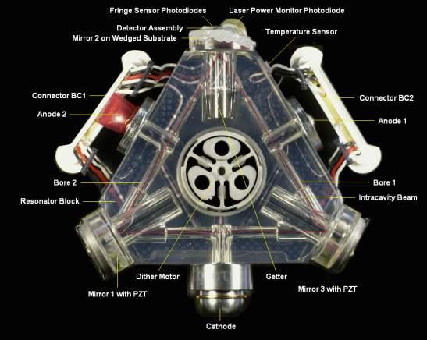
Other single modes He-Ne lase: the laser gyro
Patent 1965?
Took more than 15 years to commercialize.
Why HeNe?
Inhomogeous broadeninig / no gain competition.
Dead band (injection locking)

Slide 10
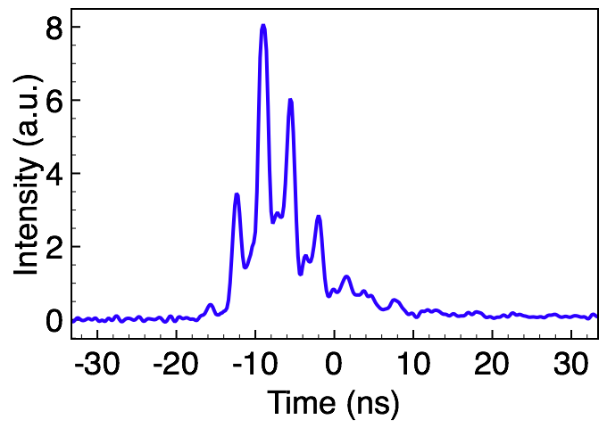
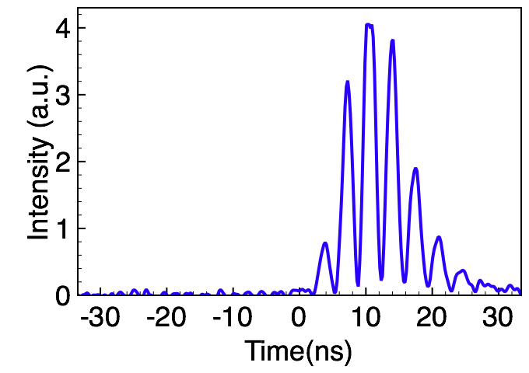
Modes and laser output
Longitudinal modes only – let us still assume they are equally spaced.
Solid state lasers
They are homogeneously broadened. Therefore, if one mode growth he takes the energy from the whole line, and the laser should be single mode
Wrong
Multiple modes
Two modes beating
I_{α} / I_{β}=3.7
How come?

Slide 11
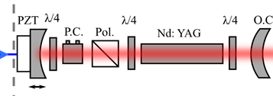
Modes and laser output
Longitudinal modes only – let us still assume they are equally spaced.
Why multimode? Because of the standing waves. After one mode develops, there is still full gain at the antinodes.
Solution to make it single mode: seeding..
Example of Nd:YAG Q-switched

Slide 12
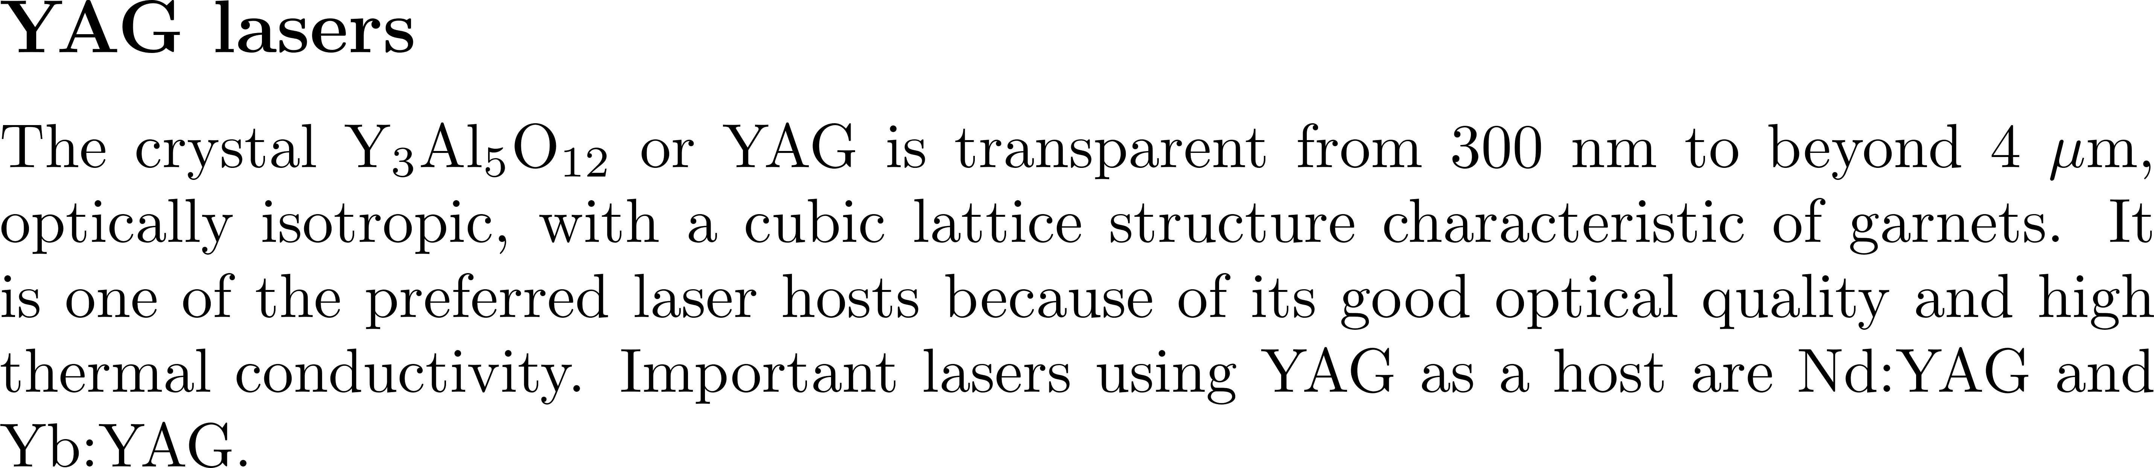
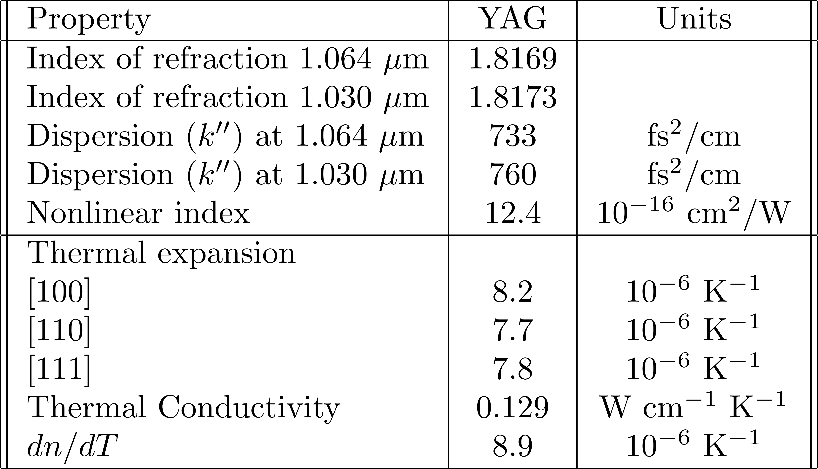
Parenthesis on Nd:YAG

Slide 13
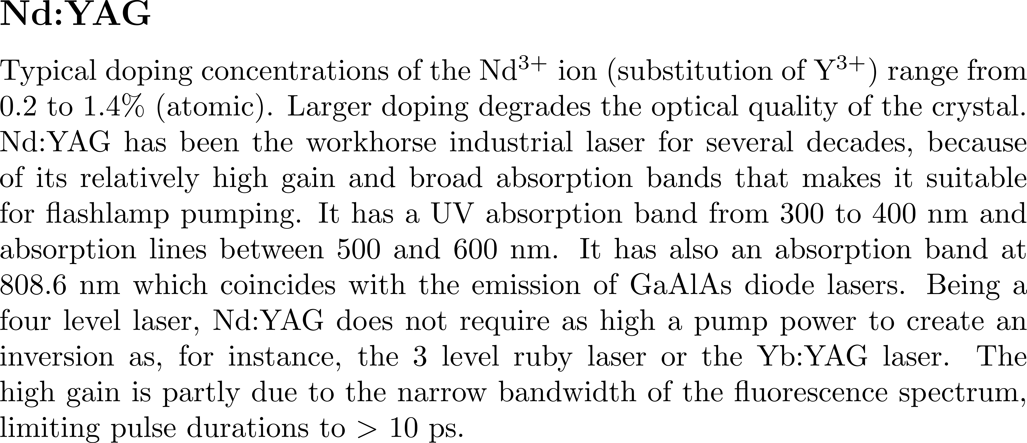

Slide 14
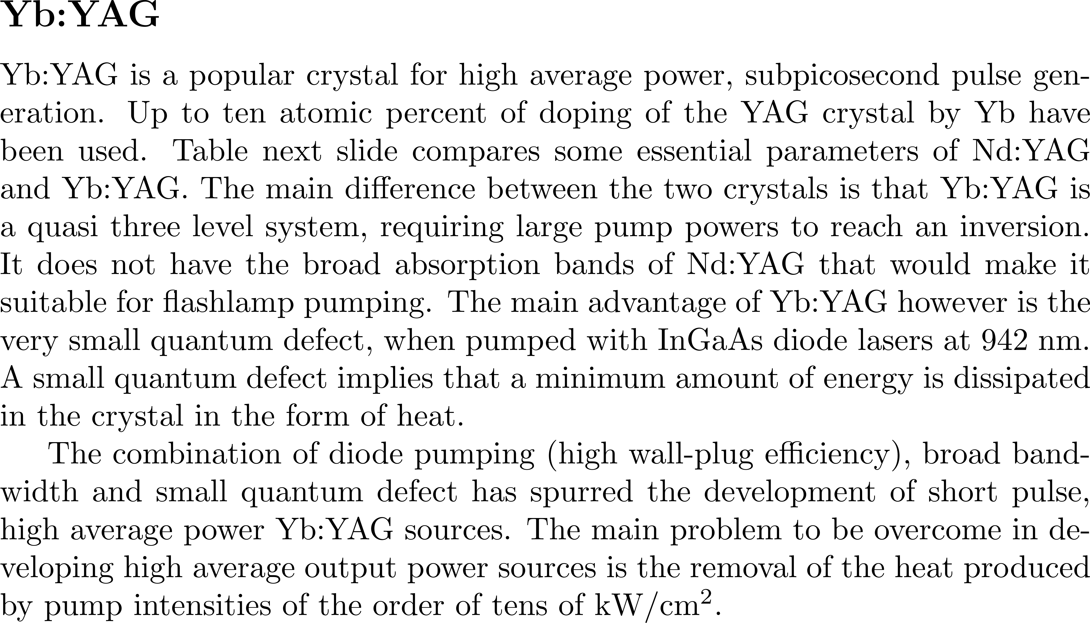

Slide 15
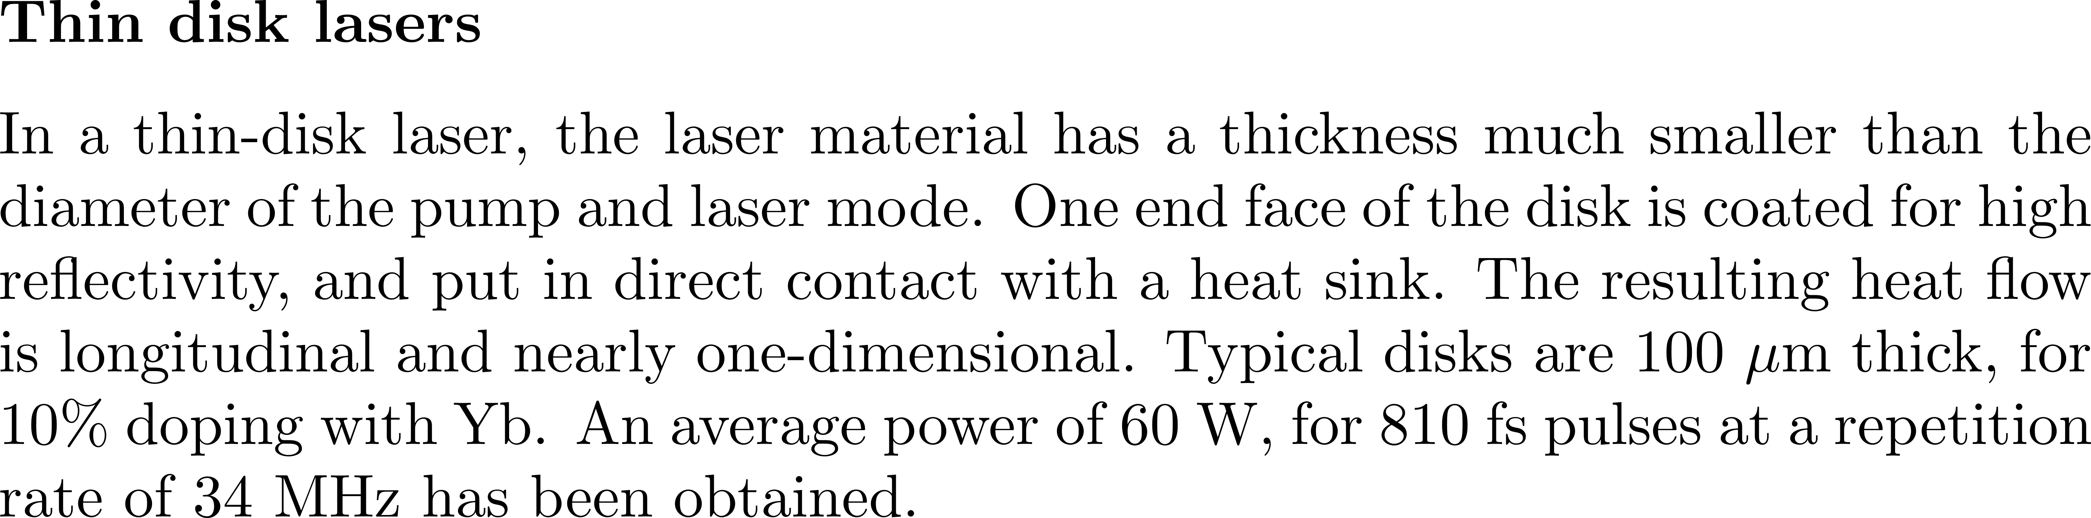
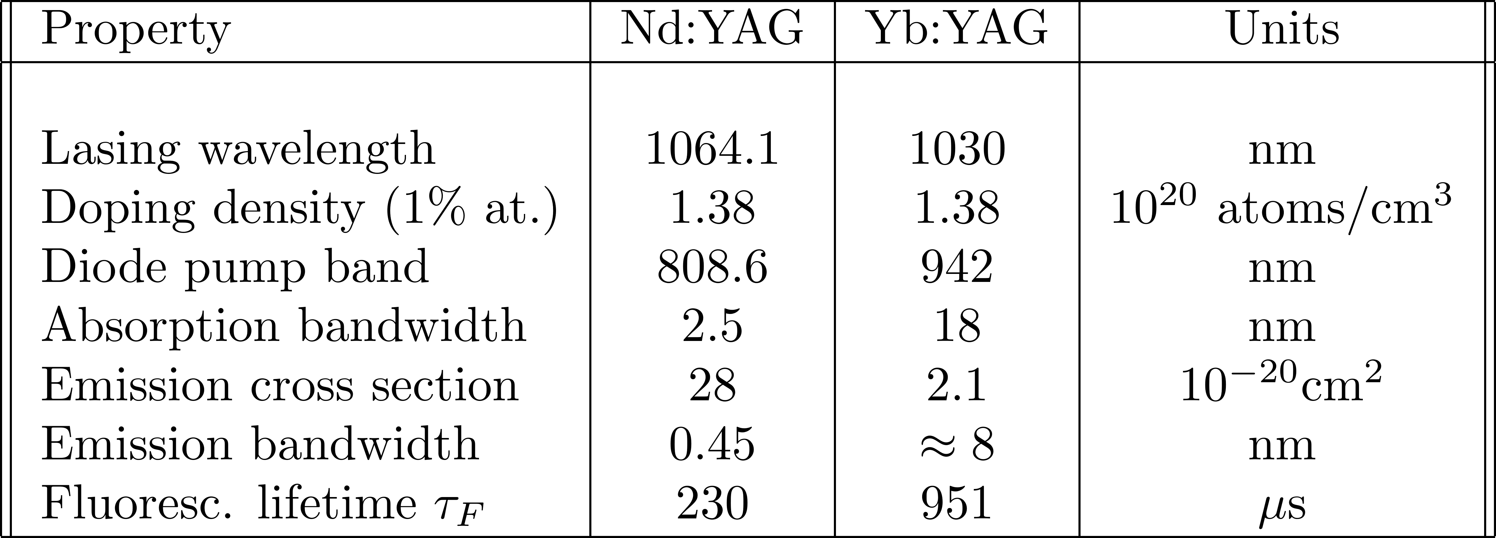

Slide 16
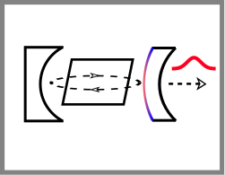
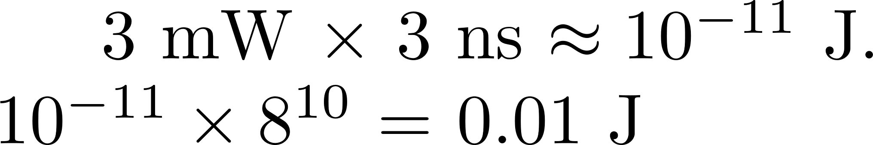
Injection seeding to achieve single mode
Inject with a CW, single mode laser
J.-L. Lachambre, JQEL IEEE, 12:756 – 764, 1976
Lasing starts from spontaneous emission noise.
Any radiation of higher intensity than the spontaneous emission will be amplified and dominate.

Slide 17
Injection seeding to achieve single mode
Inject with a CW, single mode laser
J.-L. Lachambre, JQEL IEEE, 12:756 – 764, 1976
Match the cavity mode to the seed frequency
Reality: cavity length drifts all the time due to noise…
How to keep the cavity mode matched to the seed frequency?

Slide 18
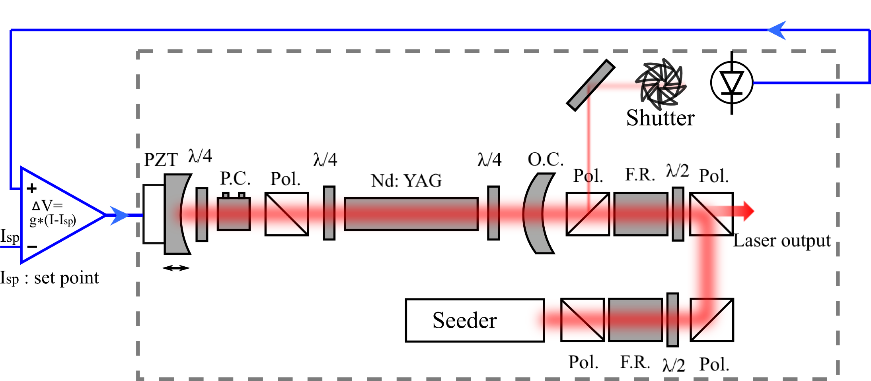
How to keep the cavity mode matched to the seed frequency?
Build-up time minimization:
Use the cavity length information of previous pulse and feedback for the next pulse. Does not work at low repetition rates.
Active lock of cavity length to the seed.
λ/4 : quarter wave-plate
λ/2: half wave-plate
P.C. : Pockels’ cell
Pol.: polarizer
PZT: piezo element
O.C: output coupler
F.R: Faraday rotater

Slide 19
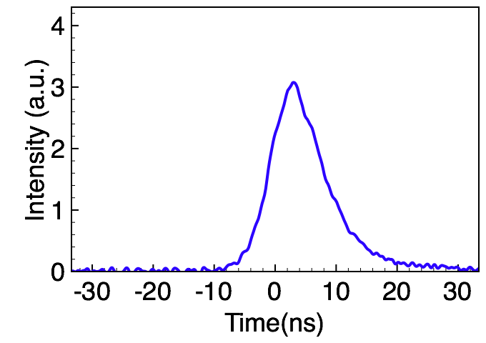
λ/4 : quarter wave-plate
λ/2: half wave-plate
P.C. : Pockels’ cell
Pol.: polarizer
PZT: piezo element
O.C: output coupler
F.R: Faraday rotater
“Single mode”
I_{α} / I_{β}=10⁴

Slide 20
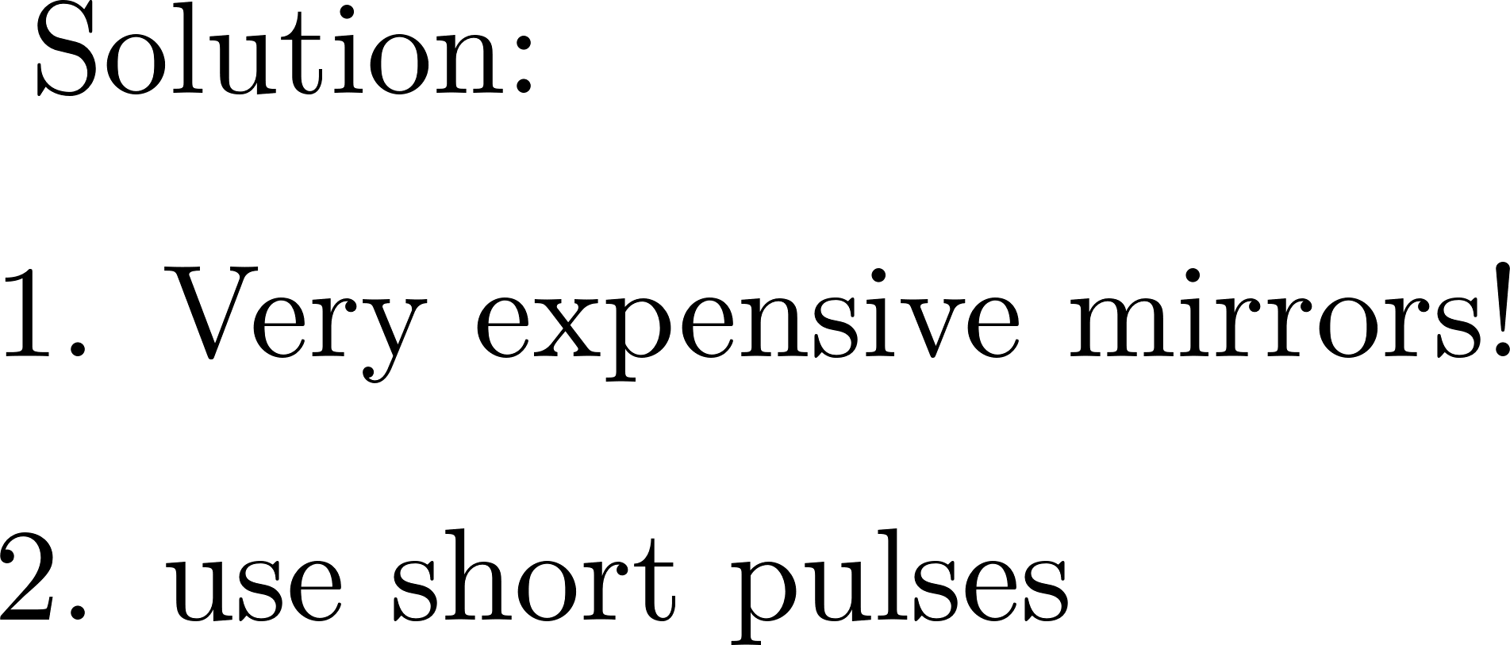
Injection seeding renamed “injection locking in laser gyro’s
Seeding done by the backscattering of the mirrors.

Slide 21
MODE-LOCKING

Slide 22
Modes and laser output
Longitudinal modes only – let us assume they are equally spaced.
Δ
M
Δ
M
τ
τ
Δ
p
=1/(M )
Δ
Power
p
Δ
Δ
Δ
Power
Spectral Power
Power
Power
1/Δ
1/Δ
1/Δ
1/Δ
1/Δ
1/Δ
1/Δ
1/Δ
1/Δ
1/Δ
Spectral Power
Frequency
Frequency
Frequency
Frequency
Time
Time
Time
Time
Time
Time
Time
Time
(a)
Random phase
In phase
(a)
(b)
(b)
(c)
(a)
(c)
(a)
(b)
(b)
(c)
(c)
MODE-LOCKING: how to put these modes in phase?

Slide 23
MODE-LOCKING: how to put these modes in phase?
Active mode-locking: couple modes with AO modulator (frequency domain)
Active mode-locking: shutter (time domain)
Passive mode-locking: Saturable absorber (or Kerr lensing)

Slide 24
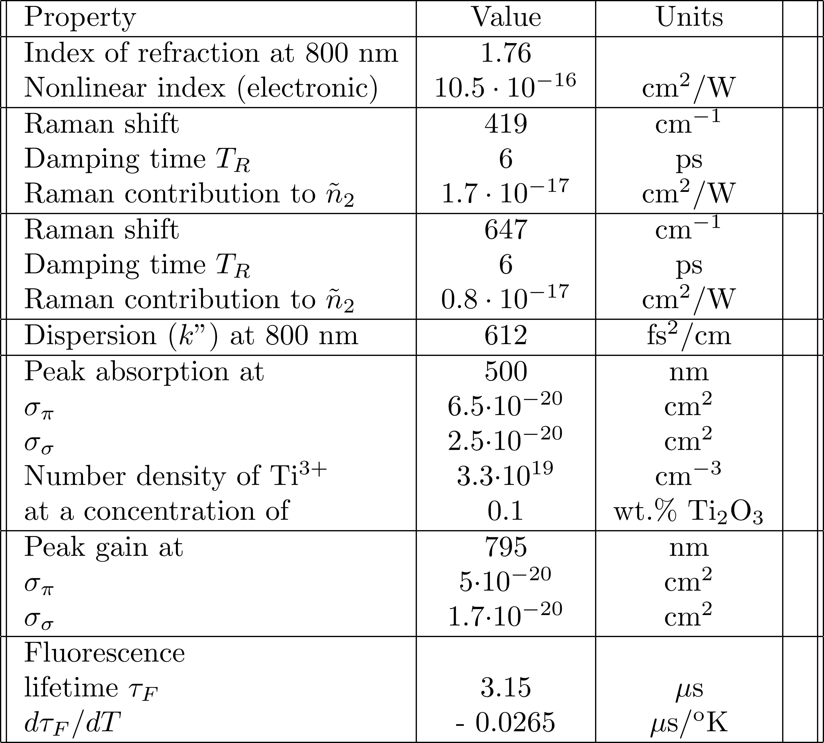

Slide 25
Modes and laser output
Longitudinal modes only – modes in phase but not equally spaced

Slide 26
Tuning the wavelength, the mode and the CEO
Kerr and

Slide 27
The laser as an orthodontist
Tuned cw laser
D
Mode locked laser
λ
FREQUENCY
TUNABLE
LASER
MODE-LOCKED
LASER
Frequency counter
SPECTROMETER
FREQUENCY
COUNTER
Round
-trip
frequency
200
101 884 000 Hz
-
100
wavelength
ORTHODONTIST
Rep. Rate
700
800
900
Wavelength [nm]

Slide 28




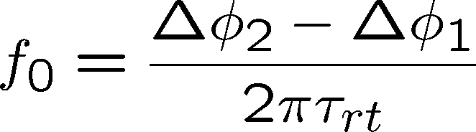


Description of a mode-locked train (or frequency comb)
(CEP)
E
TIME
(CEP) = CARRIER TO ENVELOPE PHASE
CEP/
= CEO = CARRIER TO ENVELOPE OFFSET f₀
E
FREQUENCY

Slide 29
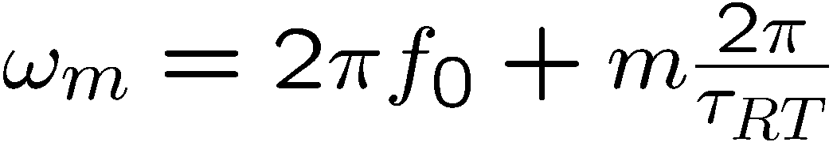
Why is the Δ(CEP) related to the
first tooth of the mode comb?
Δν =1/τ_{Coherence}
Δν_{b} =1/τ
Electric field
ν_{av}
Δϕ_{p}
Frequency
f₀=
1/τ_{RT}
2πτ_{RT}
Phase between
successive
pulses:
Δϕ_{p}

Slide 30
The temporal soliton
Kerr effect and dispersion leads to the nonlinear Schroedinger equation
The nonlinear Schroedinger equation leads to a soliton of order 1
The sech shaped pulse rattles back and forth in the cavity, producing a frequency comb

Slide 31
The Kerr lens in time
E(t) = ε(t)e^{iωt-kz}
n(t)
or
k(t)
ε(t,0)
ε(t,0) e^{ik(t)d}
Pulse temporal shape unchanged
Instantaneous frequency or
Positive frequency sweep in the middle

Slide 32

Pulse broadening, dispersion
Positive dispersion creates a positive frequency sweep
E(t)
Broadening
and
chirping
time
Electric field
amplitude
time
z = v₁t
(fast)
z = v₂t
(slow)
z = ct

Slide 33
Pulse compression through chirping,
Positivelky chirped pulse compressed by negative dispersion
E(t)
Chirping
and
compression
time
Electric field
amplitude
z = v₂t
(fast)
z = v₁t
(slow)
time
z = ct

Slide 34
PHASE MODULATION
E(t) = ε(t)e^{iωt-kz}
n(t)
or
k(t)
ε(t,0)
ε(t,0) e^{ik(t)d}
d
DISPERSION
ε(ΔΩ,0)
n(Ω)
or
k(Ω)
ε(ΔΩ,0)e^{-ik(ΔΩ)z}

Slide 35
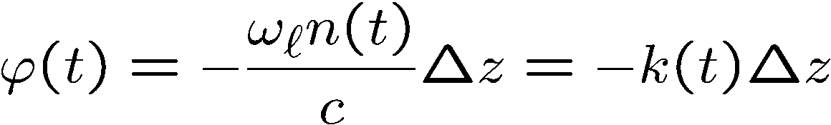


Propagation in the time domain
PHASE MODULATION
E(t) = ε(t)e^{iωt-kz}
n(t)
or
k(t)
ε(t,0)
ε(t,0) e^{ik(t)d}

Slide 36
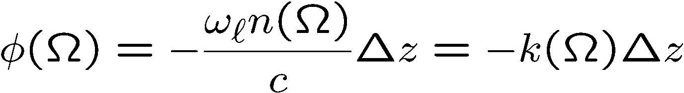
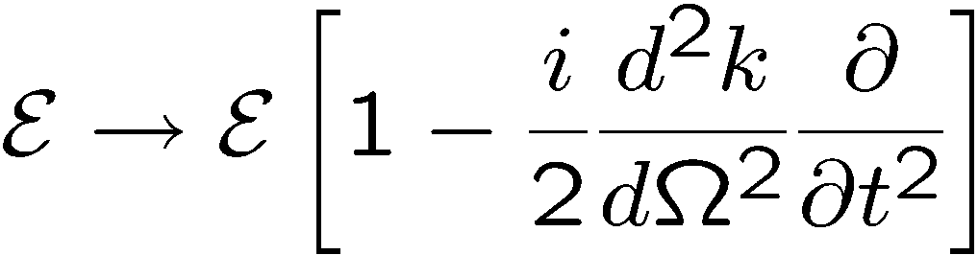
Propagation in the frequency domain
DISPERSION
ε(ΔΩ,0)
n(Ω)
or
k(Ω)
ε(ΔΩ,0)e^{-ik(ΔΩ)z}
Retarded frame and taking the inverse FT:

Slide 37




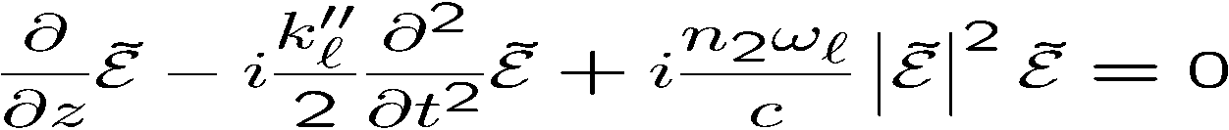


PHASE MODULATION
DISPERSION

Slide 38
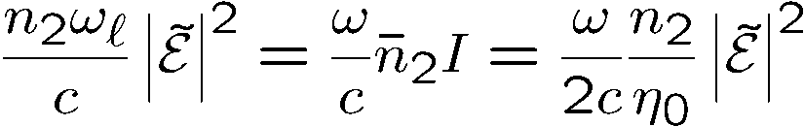
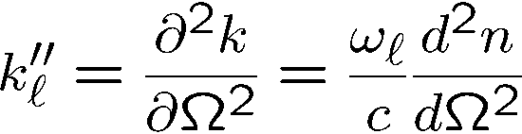
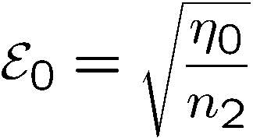
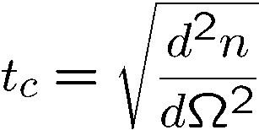
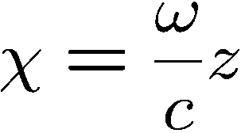

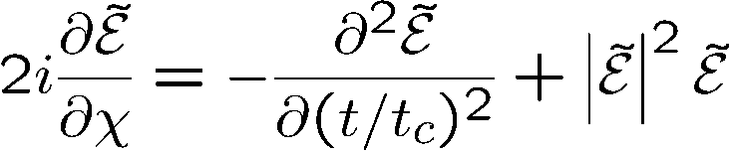

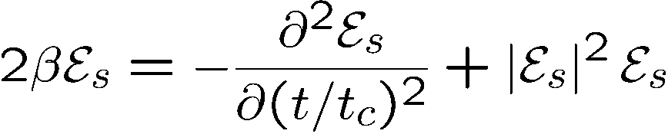
Equation in the retarded frame
Characteristic field:
Characteristic time:
Normalized distance:
Solitons: solutions of the eigenvalue equation

Slide 39
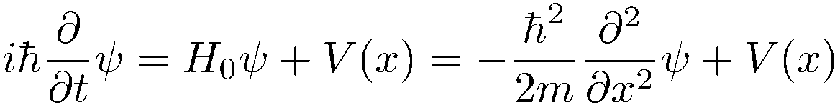
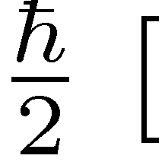
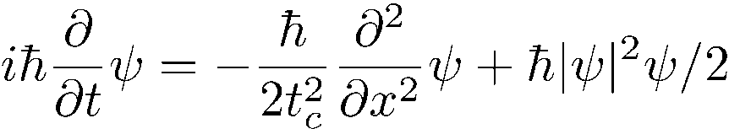
Why non-linear Schroedinger equation?
]
Multiply by

Slide 40
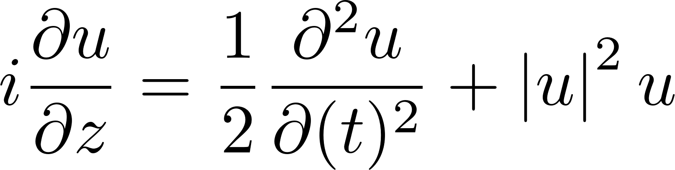
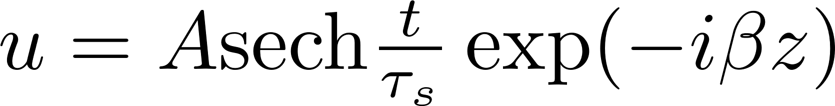
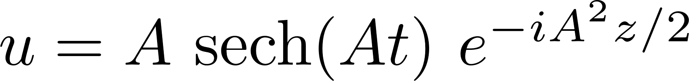
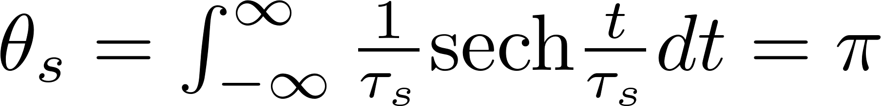
Solution of the normalized NL Schroedinger equation
The standard form is:
Trial solution
In these normalized units, there is an infinite family of solutions of ``order 1'', defined as the product of peak amplitude A by pulse duration τ_{s} being unity.
But the correct “pulse area” is:

