Slide 1
ANOTHER APPROACH TO POLARIZATION GATING

Slide 2
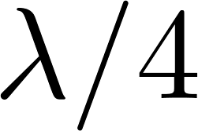
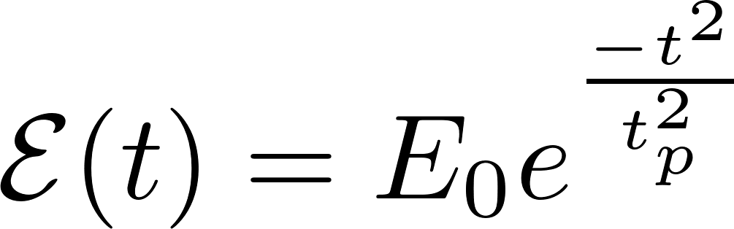
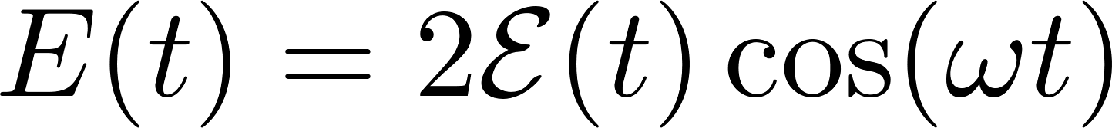
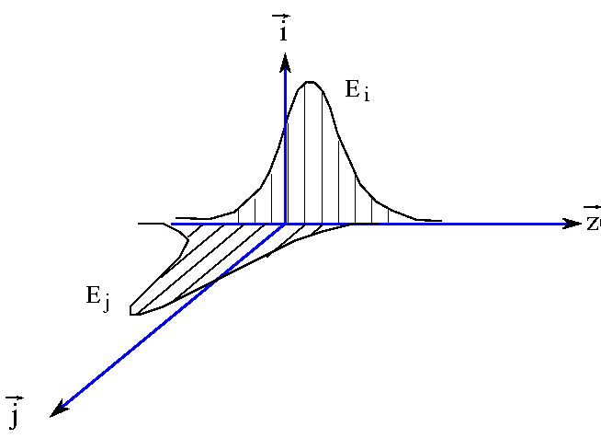
Another polarization gate
Other than the polarization gate using a multiple order wave plate plus a zero order wave plate. Another version will be a multiple order full wave plate
plus a zero order wave plate.
The electric field is first incident on a multiple full wave plate with its polarization axis at 45º with respect to the fast axis of the wave plate.
The wave plate introduces a group delay of 6.2 fs between its e and o components
Fast axis
slow axis
This is a linear polarized pulse with time dependent polarization angle θ w.r.t axis (i.e. different portion of the pulse in time are polarized at different angle ).

Slide 3
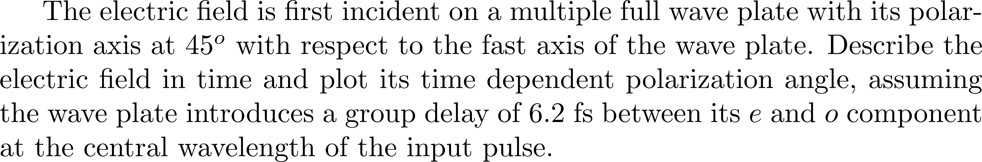
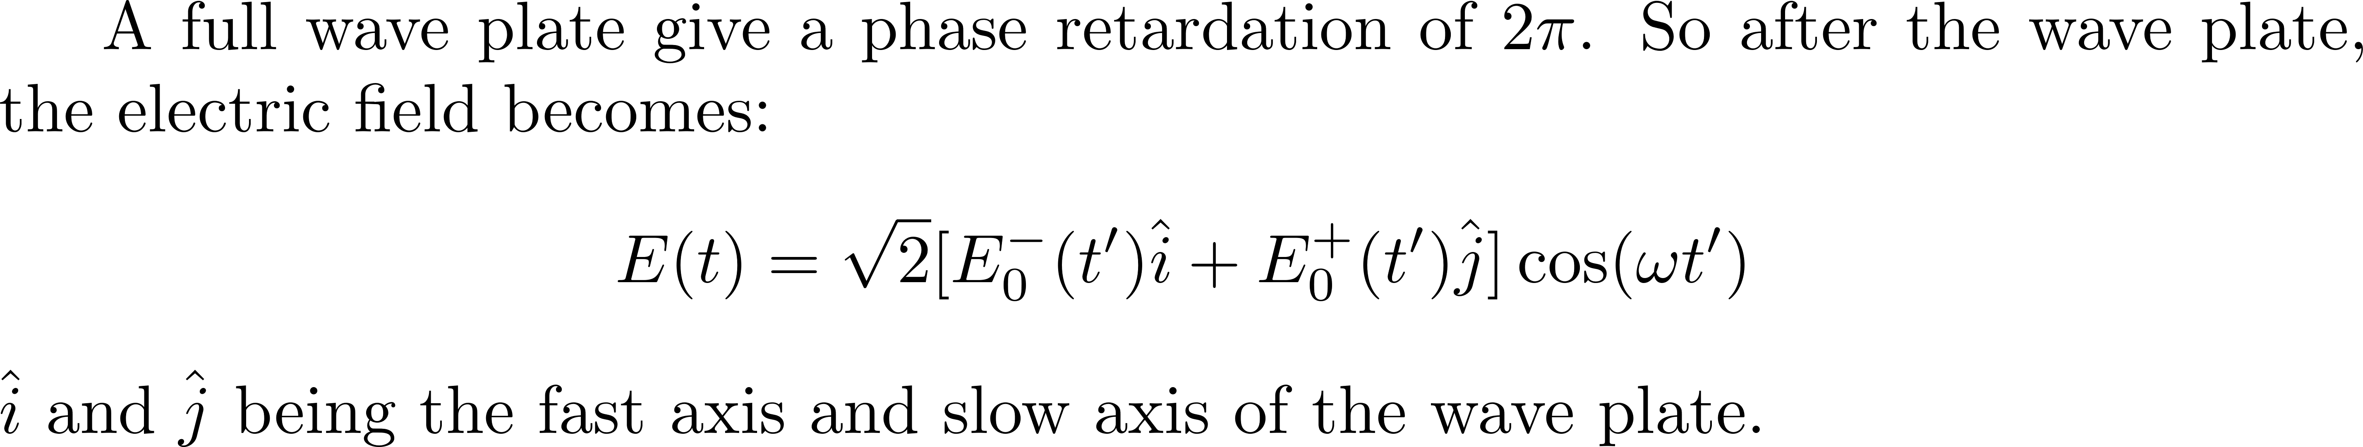
The I and j components travel at a different group delay
3.1 ns
3.1 ns

Slide 4
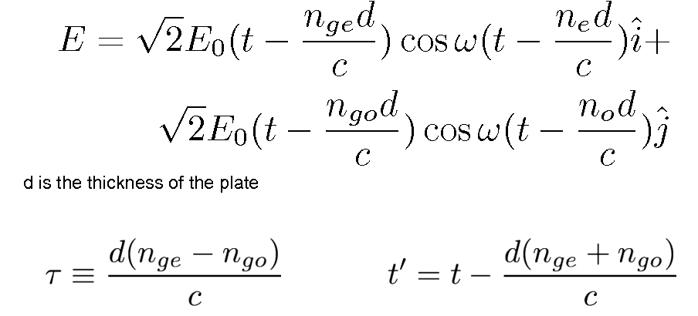
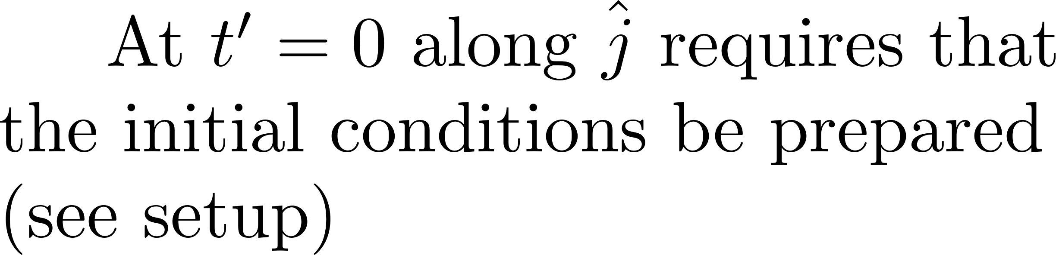
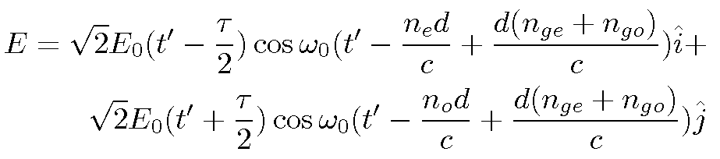
2π phase difference

Slide 5
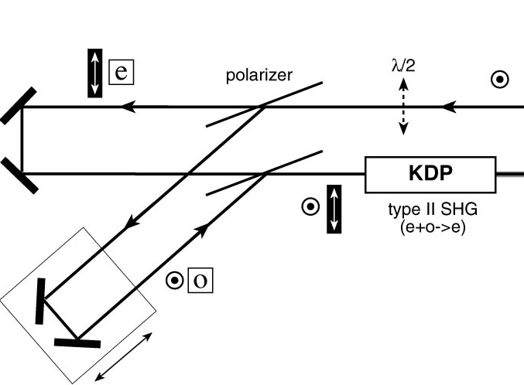
You have to separate the components before introducing the full wave plate

Slide 6
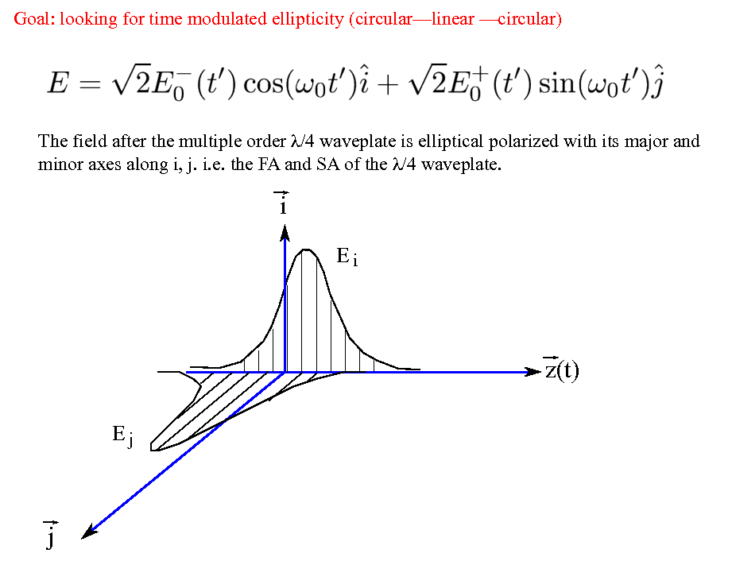
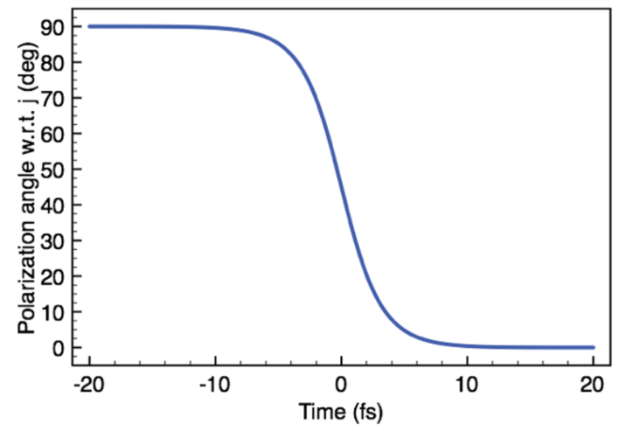
Linear-circular-linear
λ
Field linearly polarized after the multiple order waveplate
λ

Slide 7
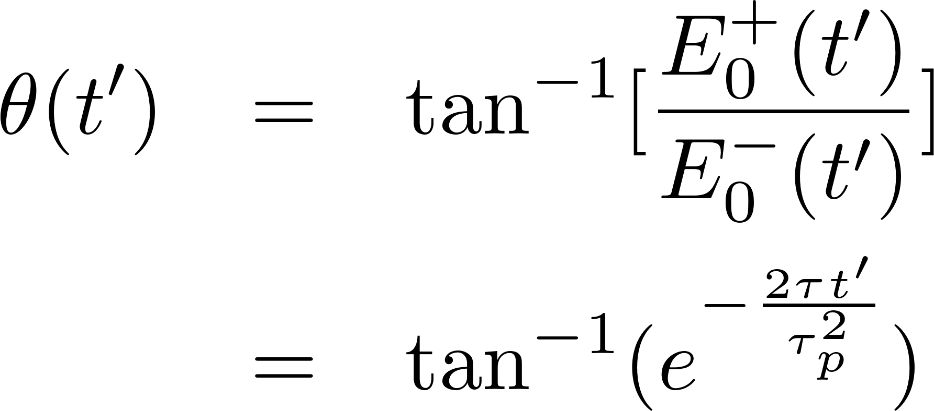
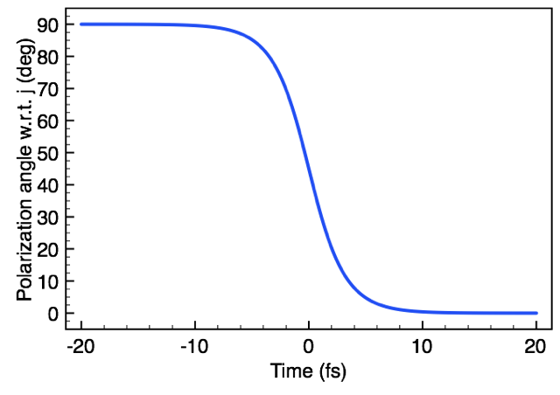

Slide 8
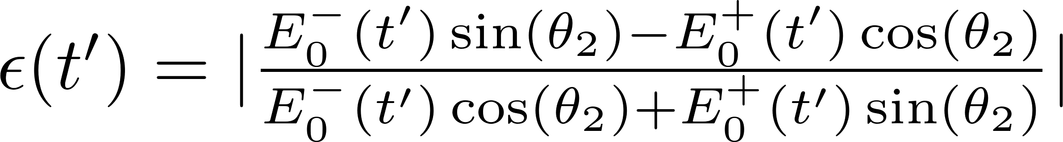
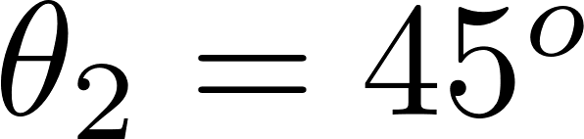
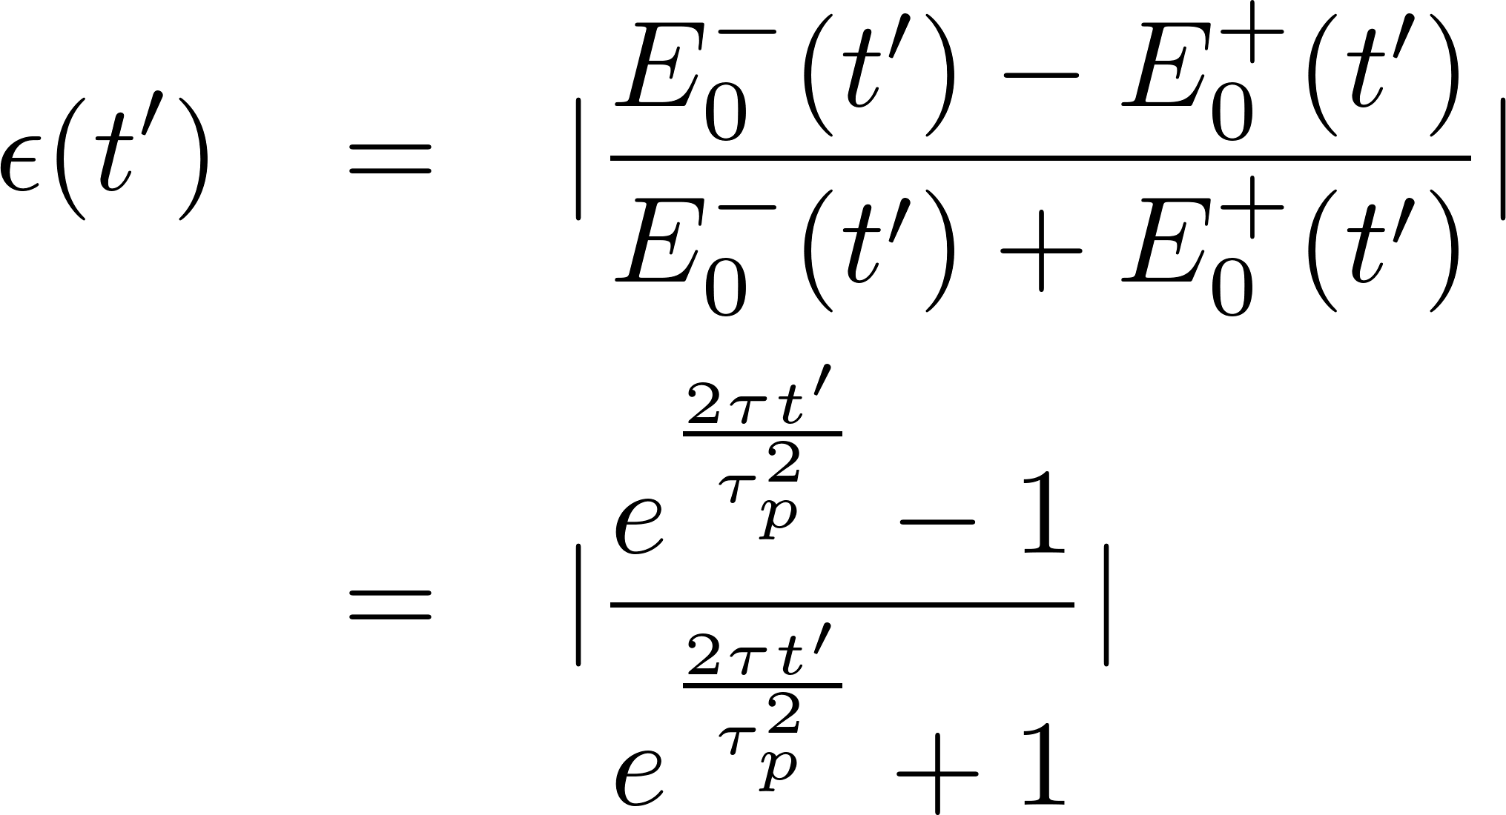
A zero order wave plate is placed at an angle θ₂ with respect to the full wave plate.
Project the electric field onto the F.A. and S.A (x' and y') ) of the zero-order wave plate.
After the wave plate, the electric field becomes:
This is a elliptical polarized pulse with its major and minor axis on x' and y'. Its ellipticity is:
With the ellipticity is:

Slide 9
