Slide 1
Part 1, empty cavity, a quite ordinary Fabry-Perot with “normal” coatings.

Slide 4
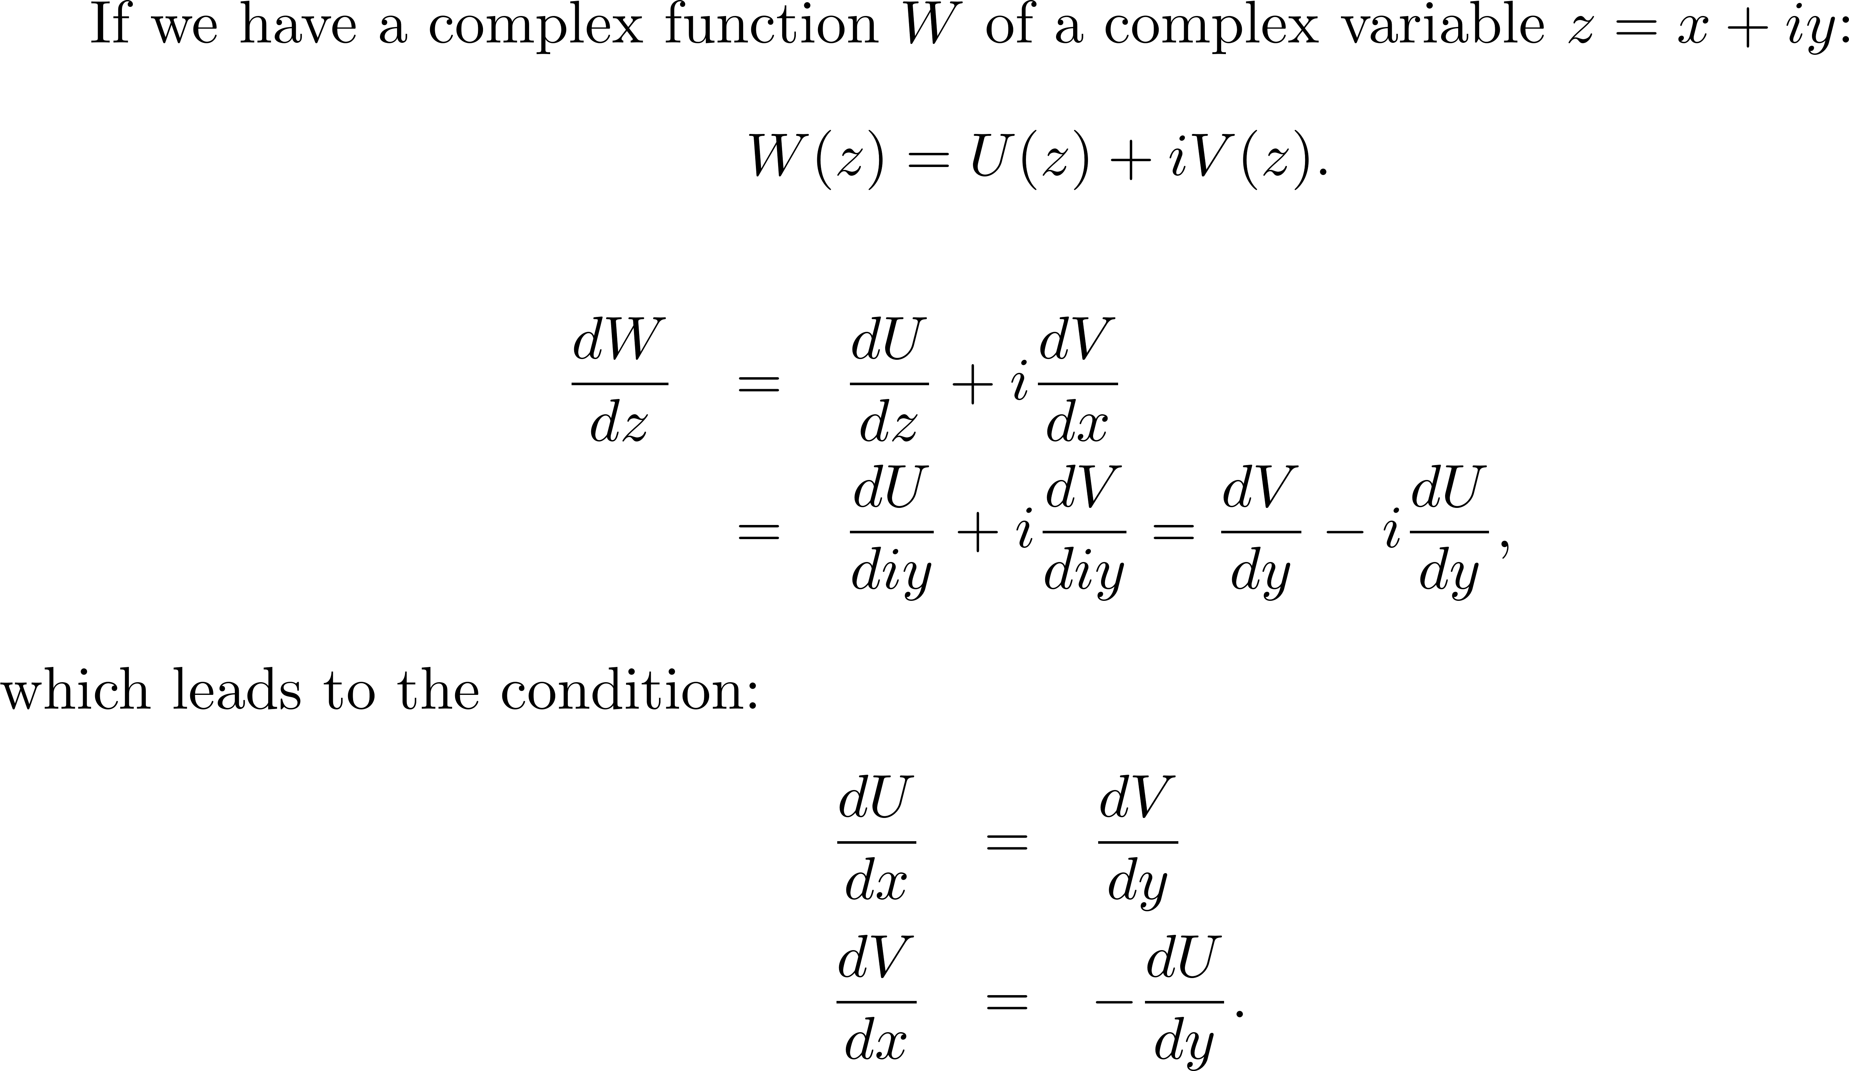
More about real/imaginary parts of a complex function
In the introductory lectures, the polarization was directly introduced as a complex function, of which the real part u represents polarization, the imaginary part v the absorption.
The Kramers-Kroenig relations are the integral form of the Cauchy Rieman condition. The Cauchy Rieman condition is that statement that you should obtain the same derivative independently of the path along which you take the derivative.

Slide 5
The derivation of the Kramers-Kroenig relations as the integral form of the Cauchy Rieman conditionis nicely illustrated on Wikepedia;

Slide 6
The example chosen is nearly always absorption and index of refraction, which are the exponent of the transfer function for propagation of light.
The KK relations apply also to the real part and imaginary parts of any transfer function, for instance that of the Fabry-Perot.

Slide 7
T
$$ψ$$
$$∆ψ$$
0
$$ω$$
$$Ω$$
$$∆Ω$$
$ψ=\tan^{−1}{X}$
phase delay, $\frac{ψ}{Ω}$

Slide 8
Different example of Kramers-Kroenig relation: Gaussian beams

Slide 10
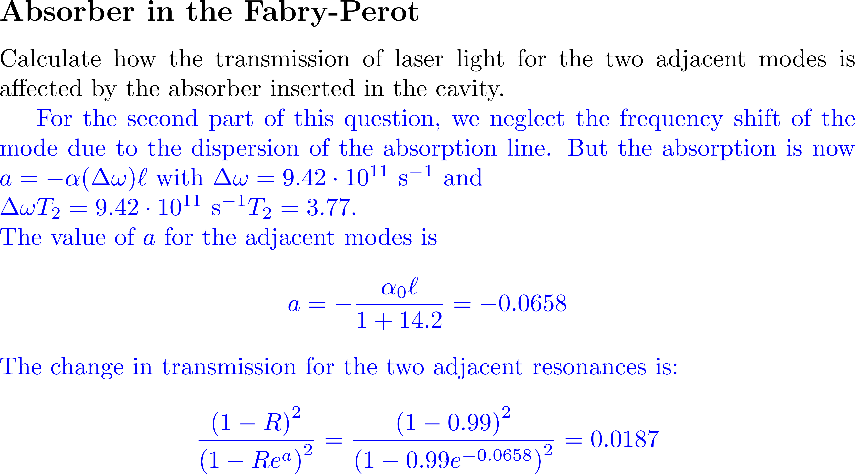

Slide 12
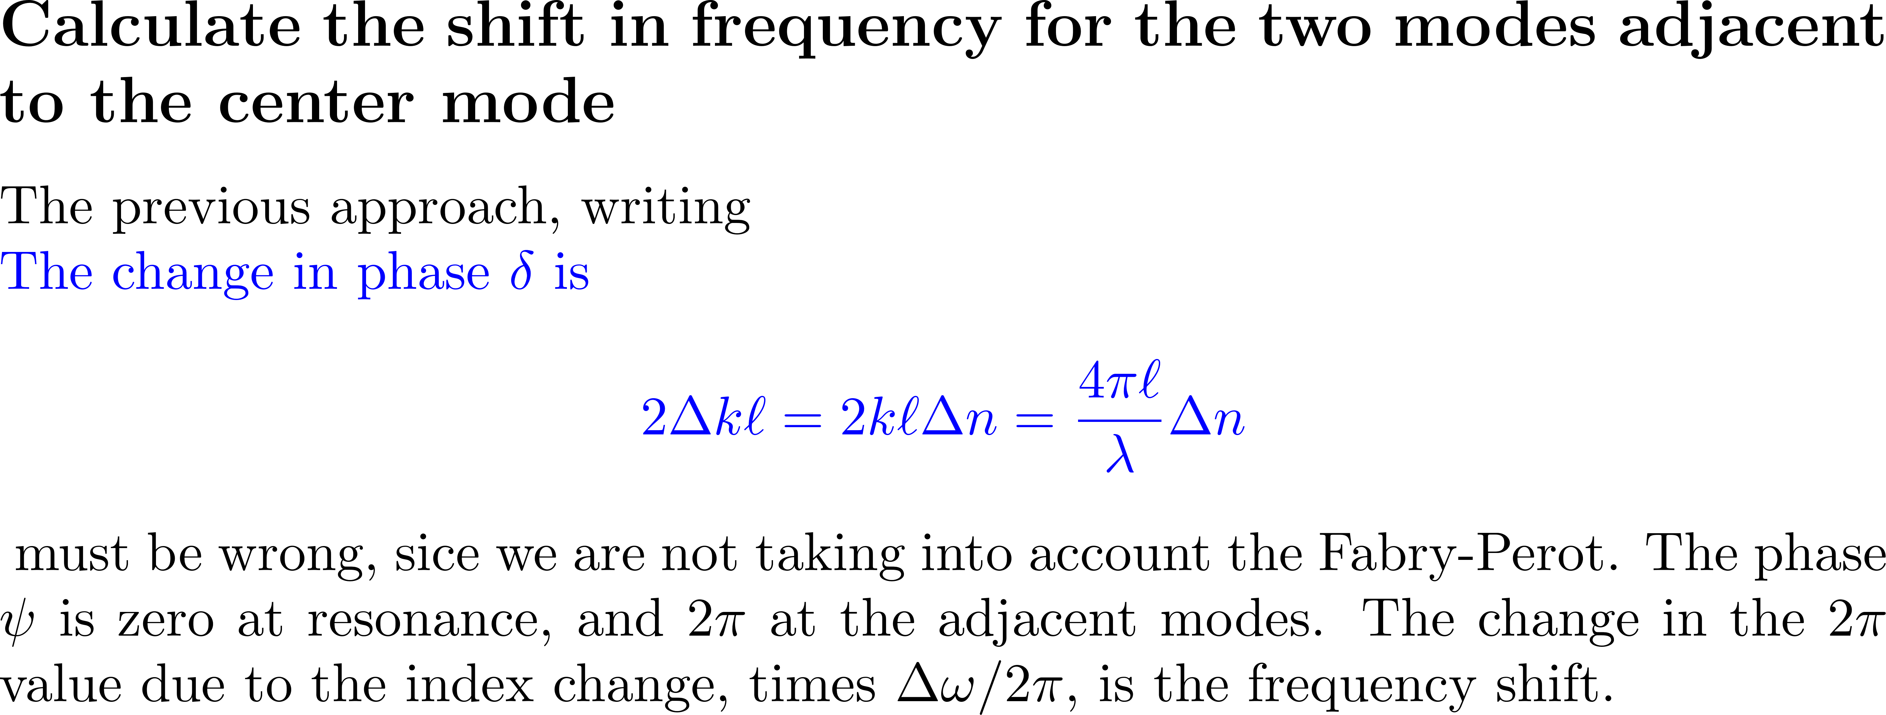

Slide 13
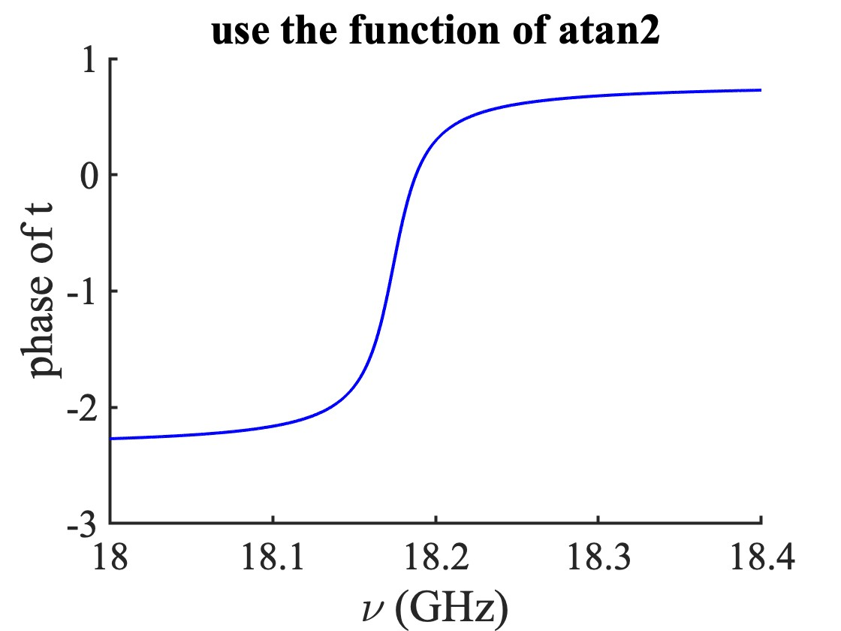
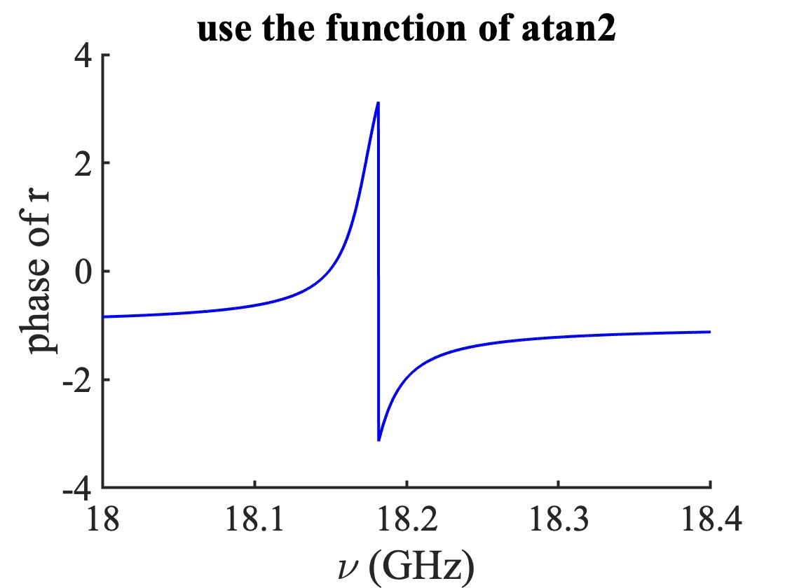
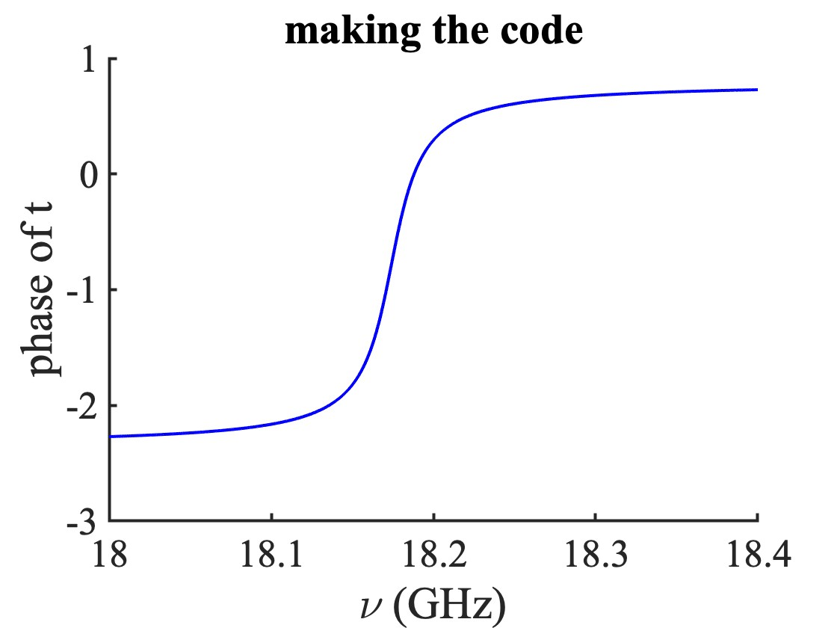
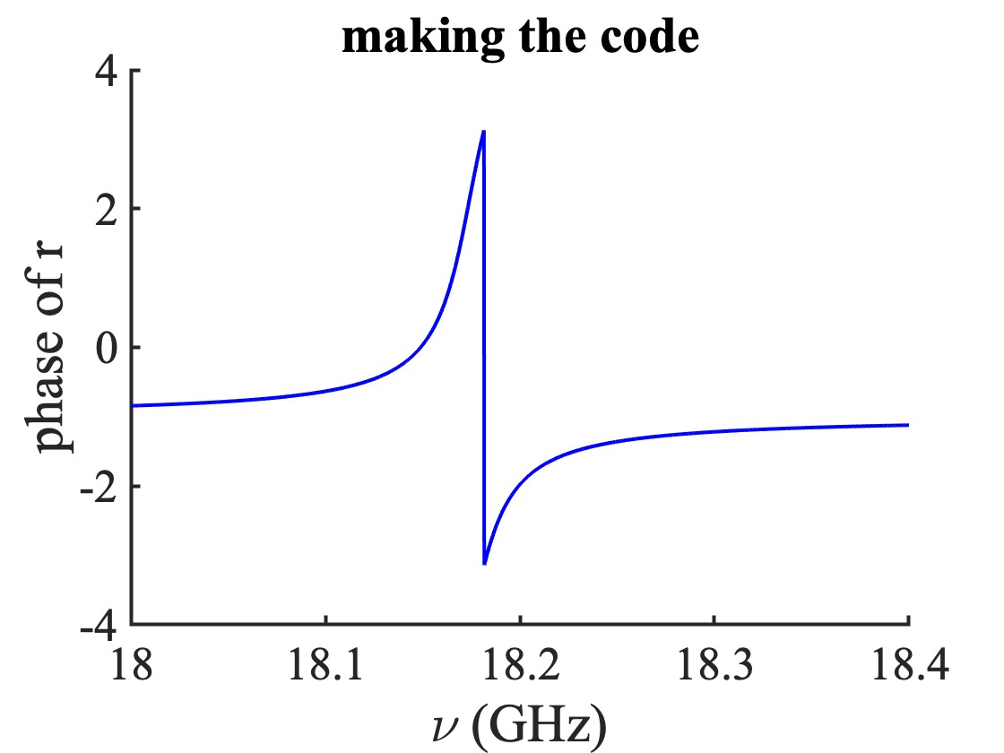
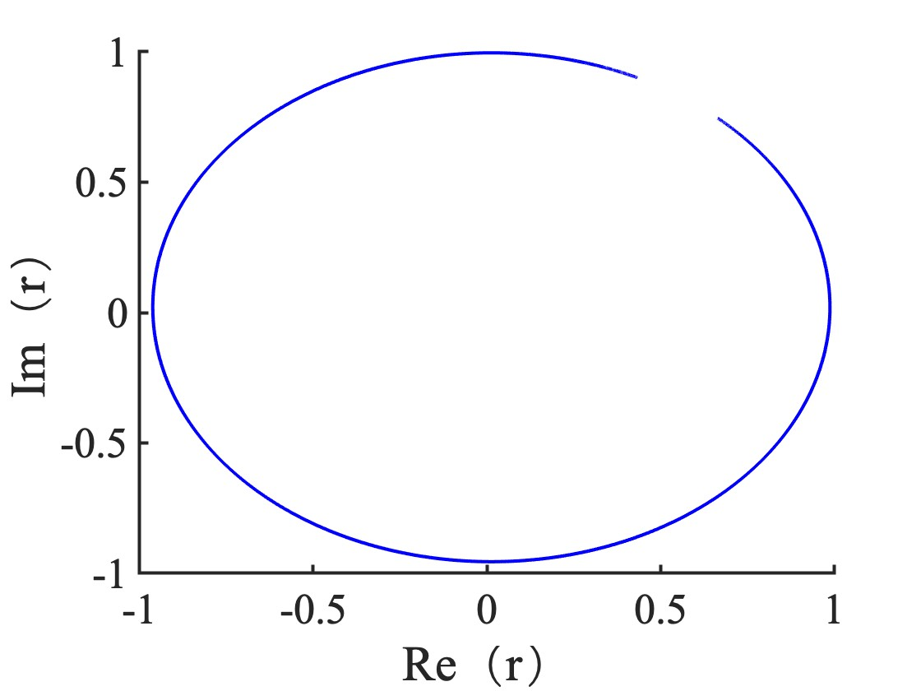
CALCULATE arctan – beware of the determination
$d$ = 6 mm,
$R_{1}$ = 0.99, $R_{2}$ = 0.99975
Starts with: $ν$ = 18 GHz
Ends with: $ν$ = 18.4 GHz
At $ν$= 18.1745 GHz,
$r$ = -0.5222 - 0.7954i
$t=$0.2199 + 0.2154i
10. 26. 2023

Slide 14
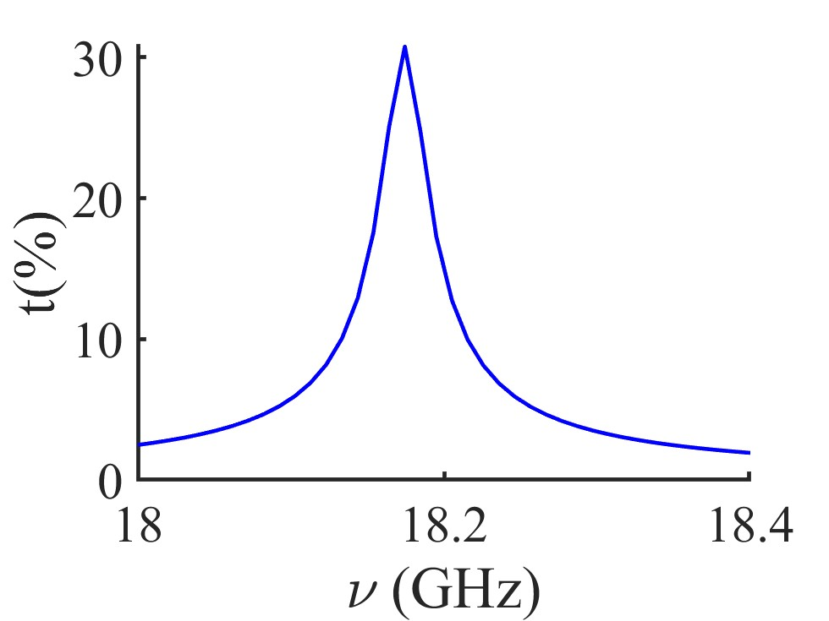
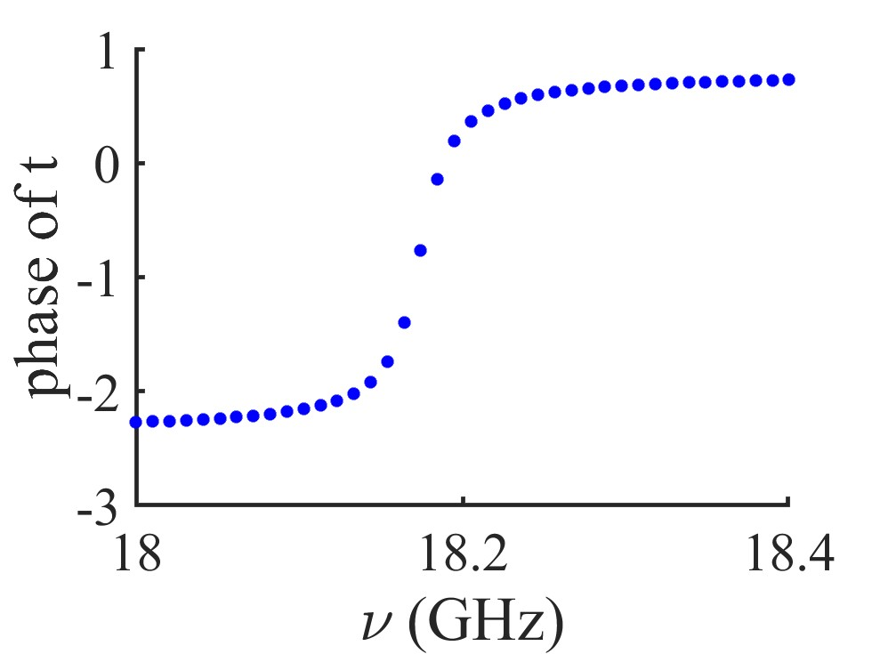
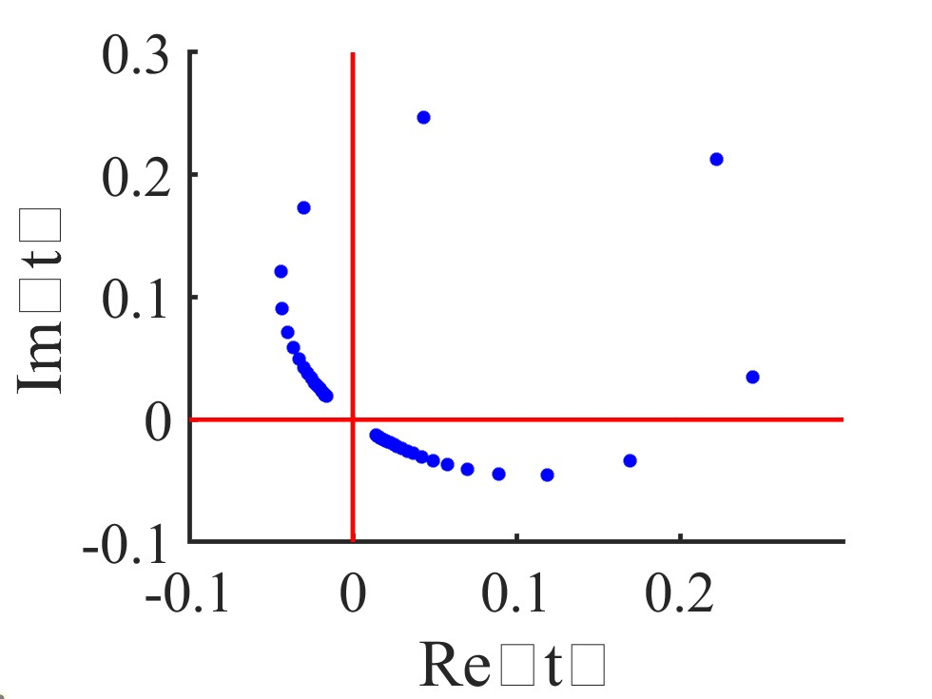
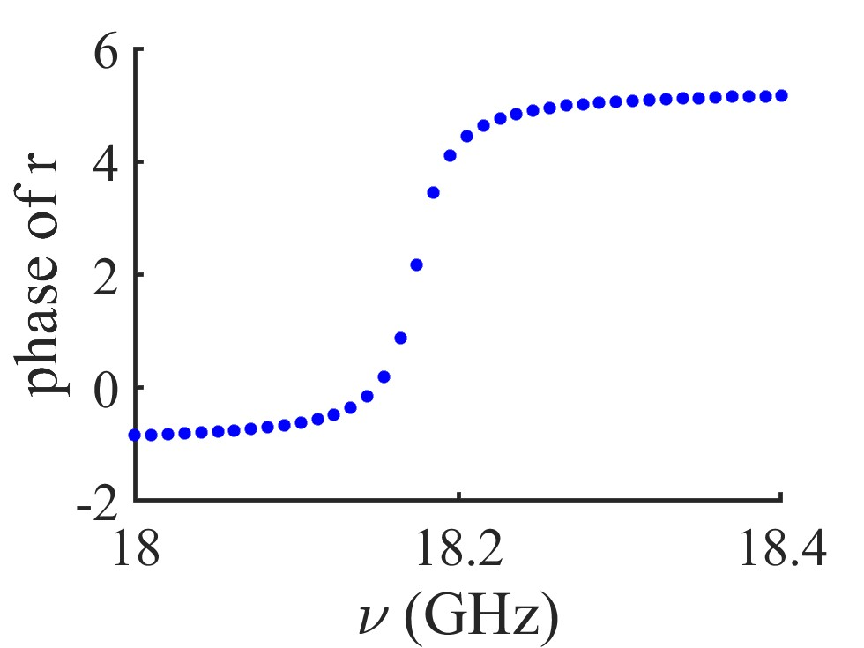
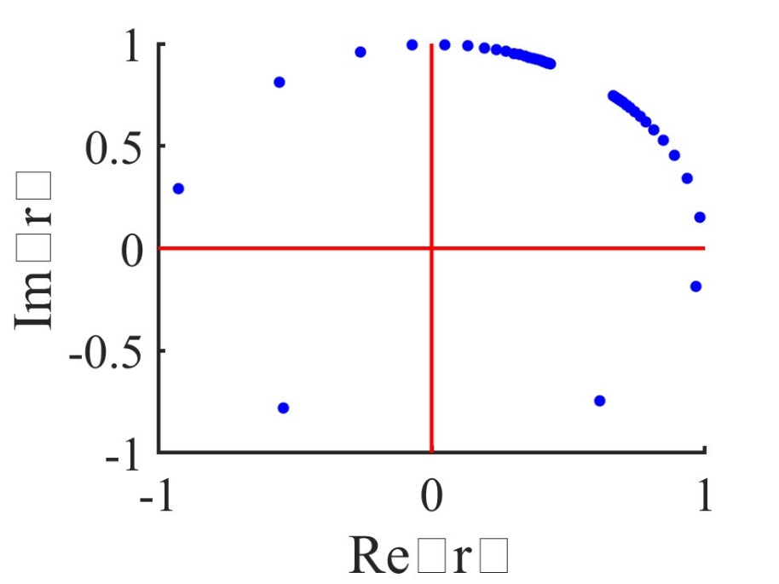
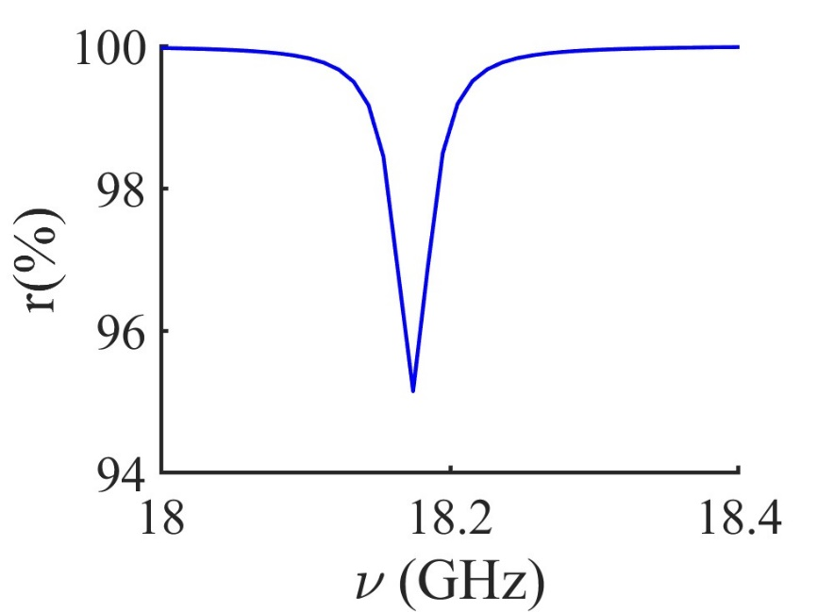
Kramers-Kroenig does not apply to amplitude and phase

Slide 15
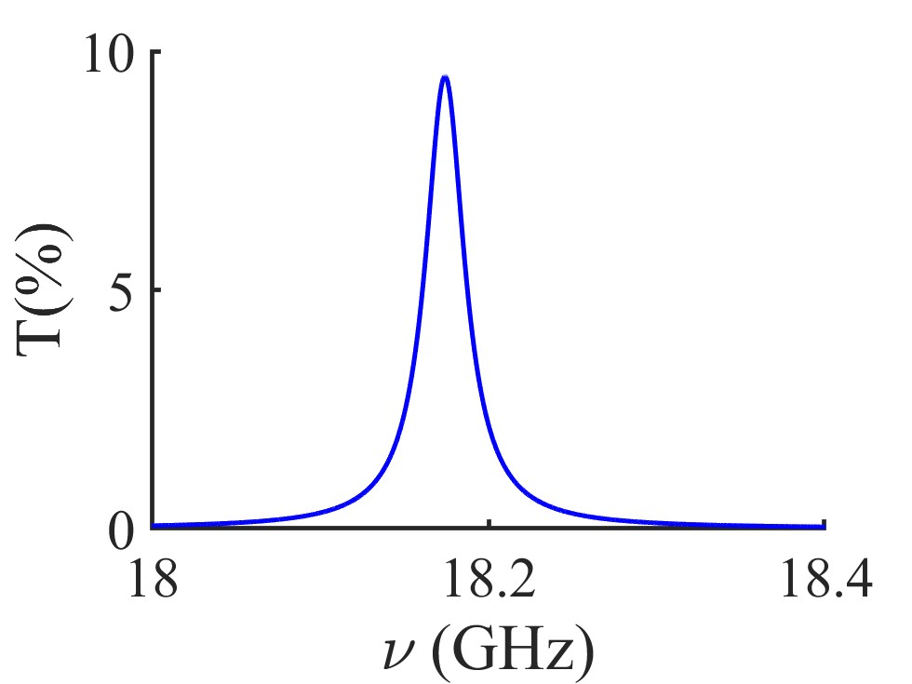
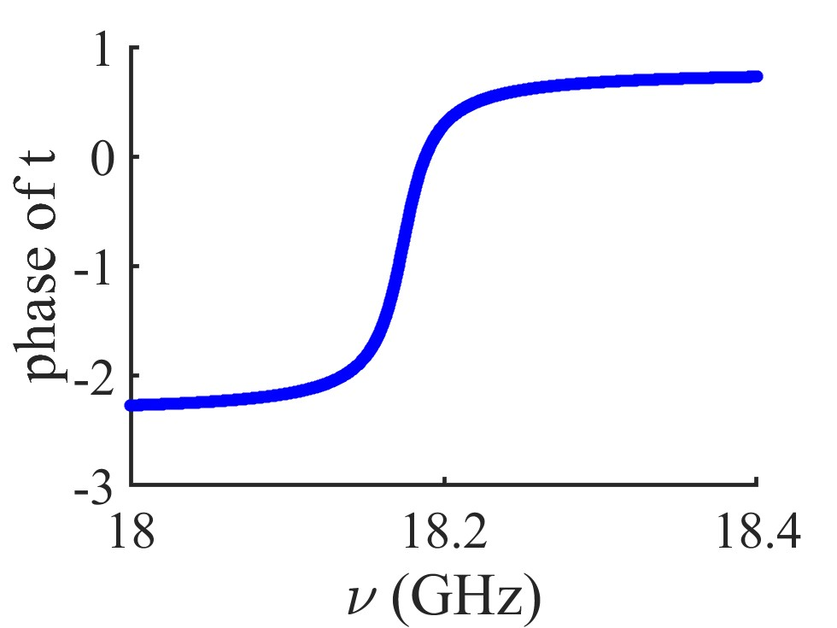
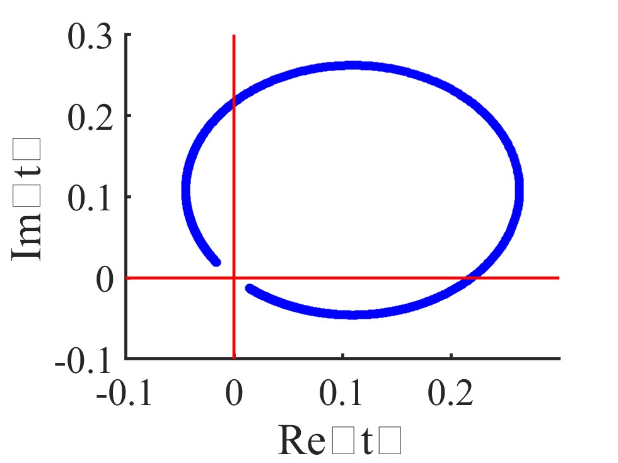
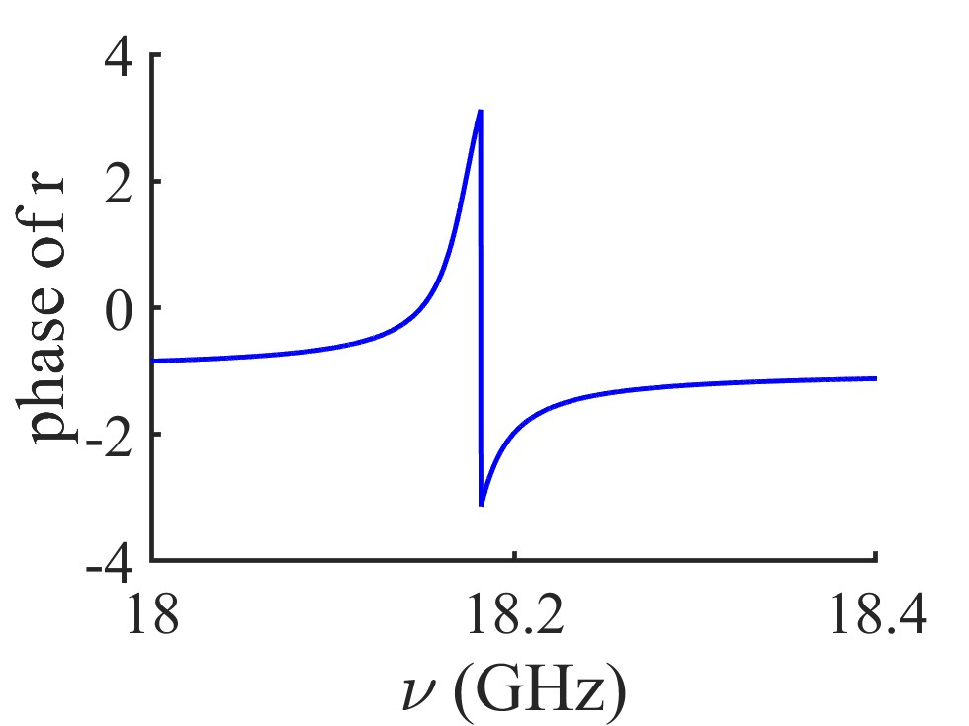
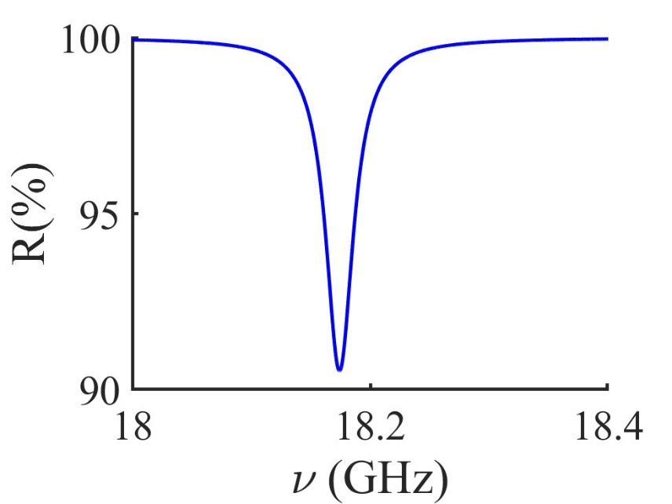
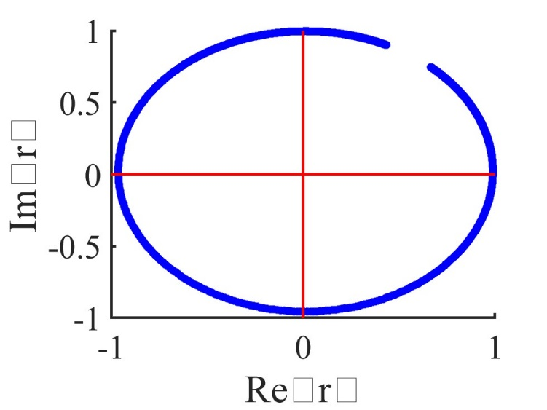
Was the phase determination routine REALLY corrected?
Change N back to 3000

Slide 16
ABOUT TEST

Slide 17
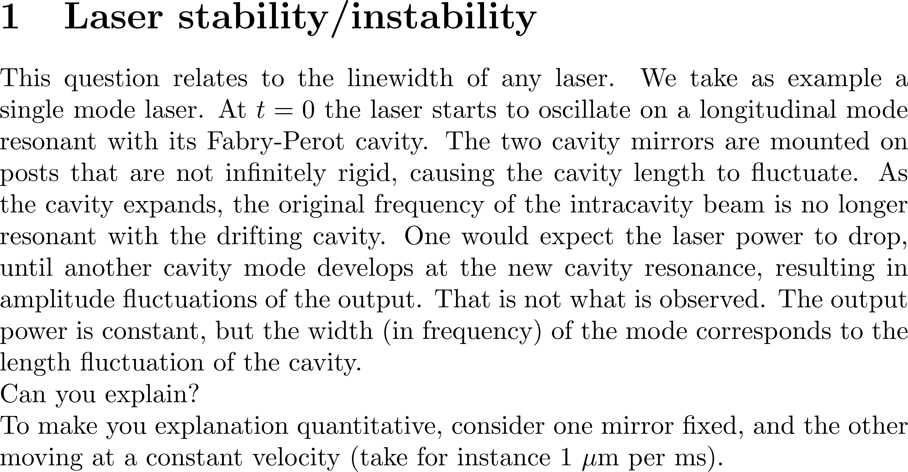

Slide 20
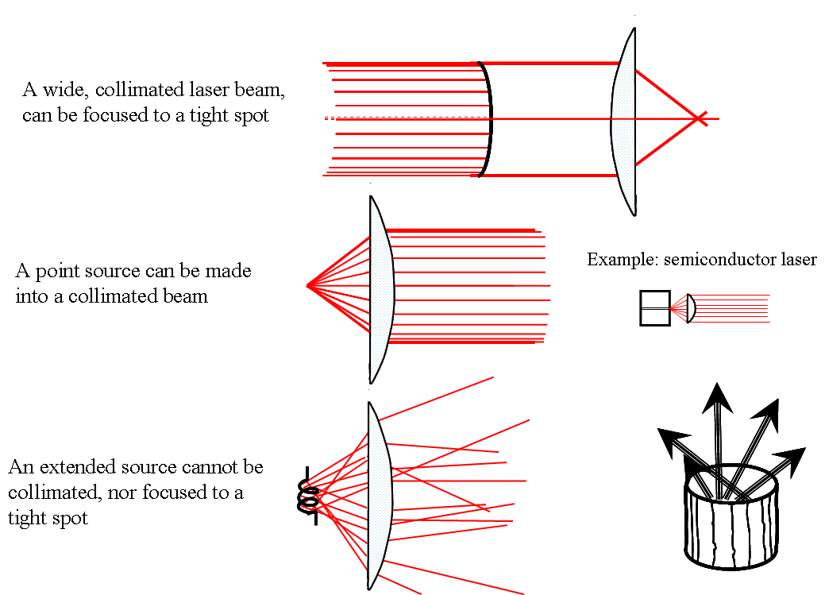
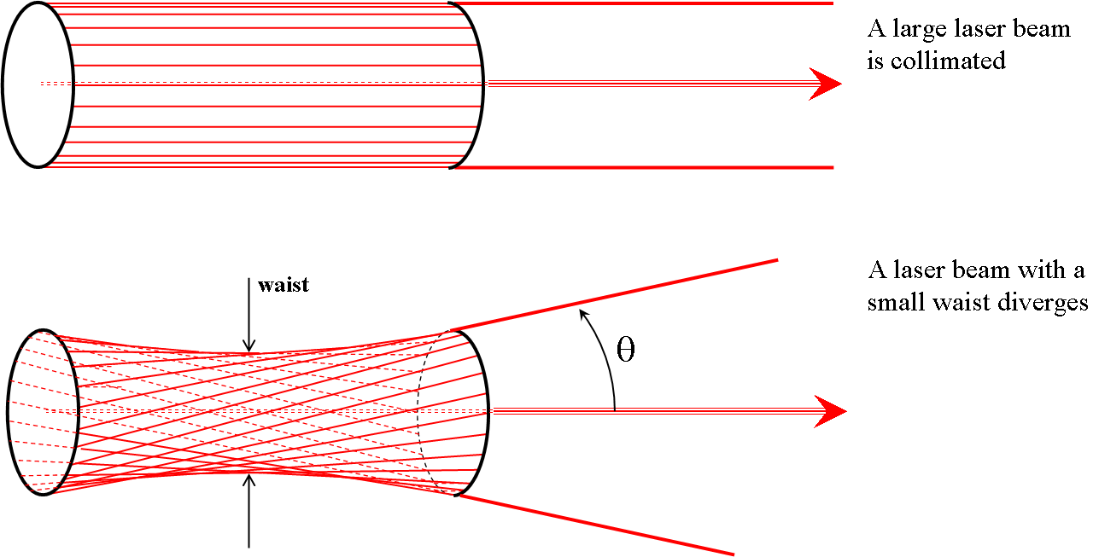

Slide 24
ABOUT THE CO2 LASER

Slide 25
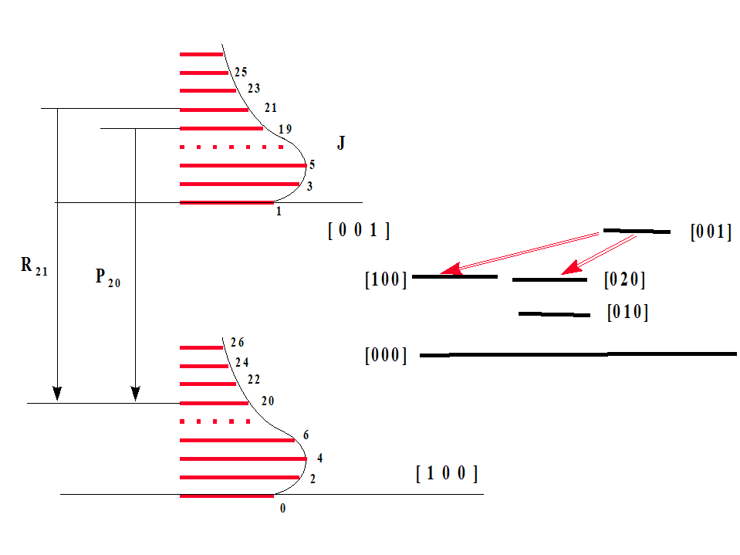

Slide 26
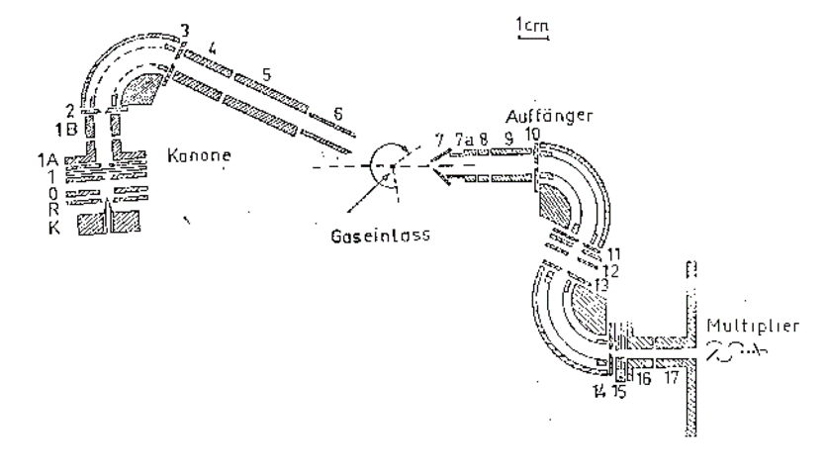

Slide 27
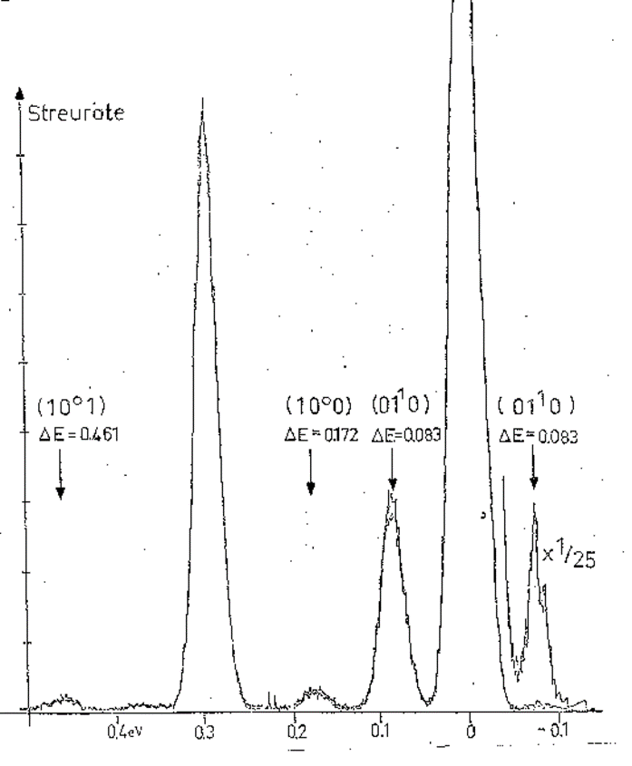
(0 0 1)

Slide 28
CLARIFICATION ABOUT MODE-LOCKING

Slide 30
Mode-locking – from textbook approach to reality

Slide 31
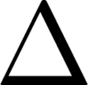
M=5

