Slide 1
Several applications of third order susceptibility, to be complemented by Ameen Zerrad, April 22 (Wednesday) by a talk on optical parametric oscillation.
Solitons: last week 2 p pulse solitons in fibers. Today: solitons in modelocked lasers and in fibers.
April 27 (Monday), solitons in microresonators by Yinjan Zhai.
April 22 (Wednesday), High-harmonic generation and attosecond pulse measurement by Logan Lu
April 27 (Monday), second harmonic generation in two-dimensional materials, by Li Liu
April 29 (Wednesday), Femtosecond Optical Breakdown In Materials. by Ray Aragon

Slide 2
Evolution of a single pulse
What follows applies to conventional tabletop lasers, fiber lasers, microresonator lasers
Constraint is that the pulses are so short that the pulse shaping mechanism is limited to Kerr effect and dispersion.
The pulse evolution generally converges towards a steady state solution, designated as “solitons”
Because of the anomalous dispersion, k′′0, the high frequency components produced in the trailing part of the pulse, travel faster than the low frequency components of the pulse leading edge. Therefore, the tendency of pulse broadening owing to the exclusive action of group velocity dispersion can be counterbalanced.
Approach: the chirp produced in the pulse center by the nonlinearity and the second order dispersion are of equal magnitude (but of opposite sign)

Slide 3
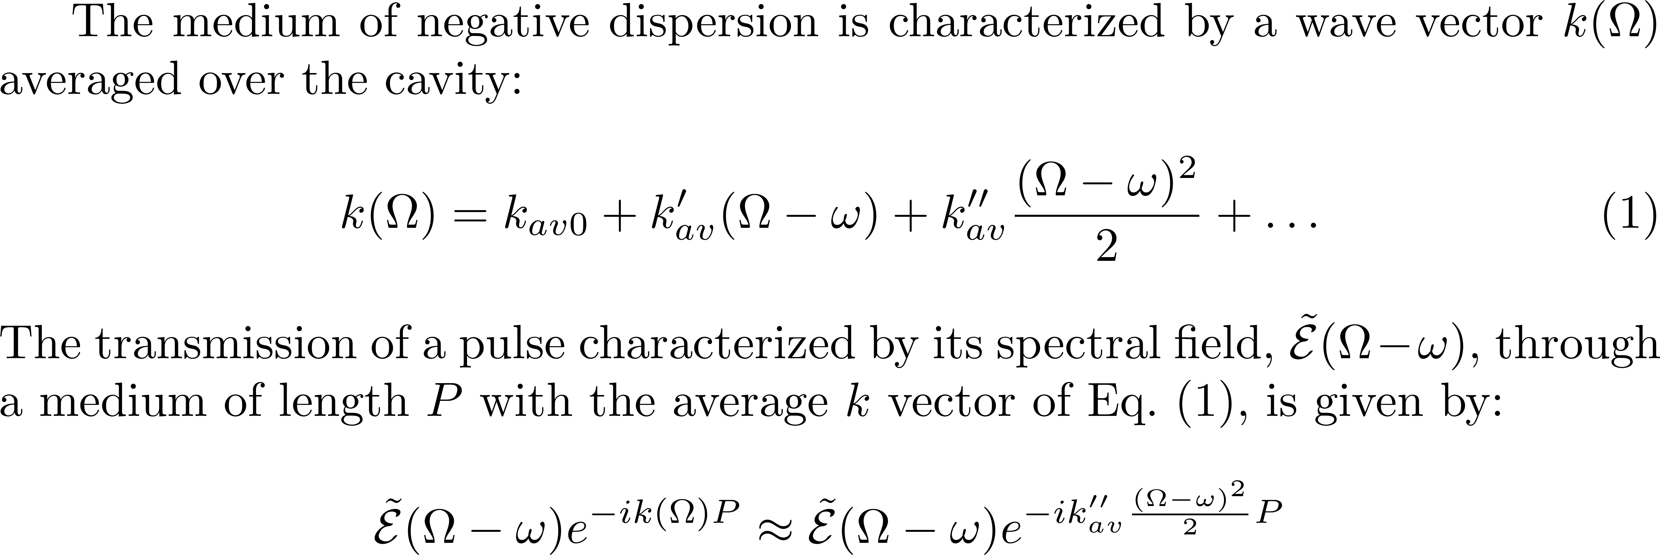
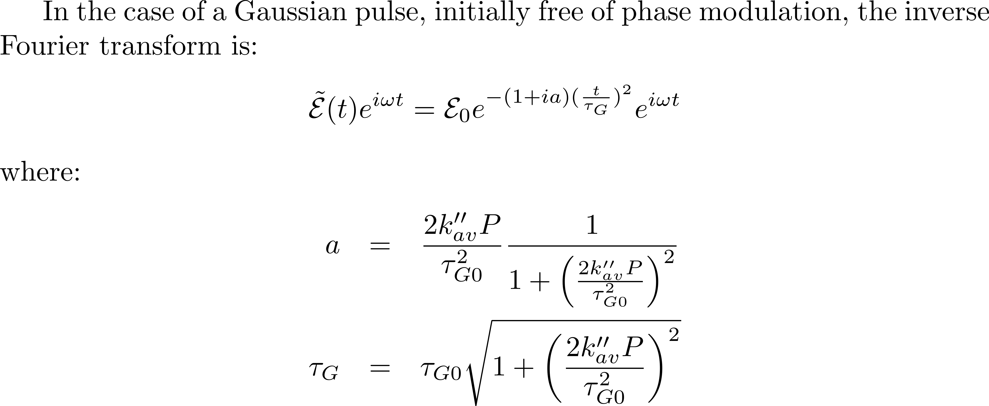

Slide 4
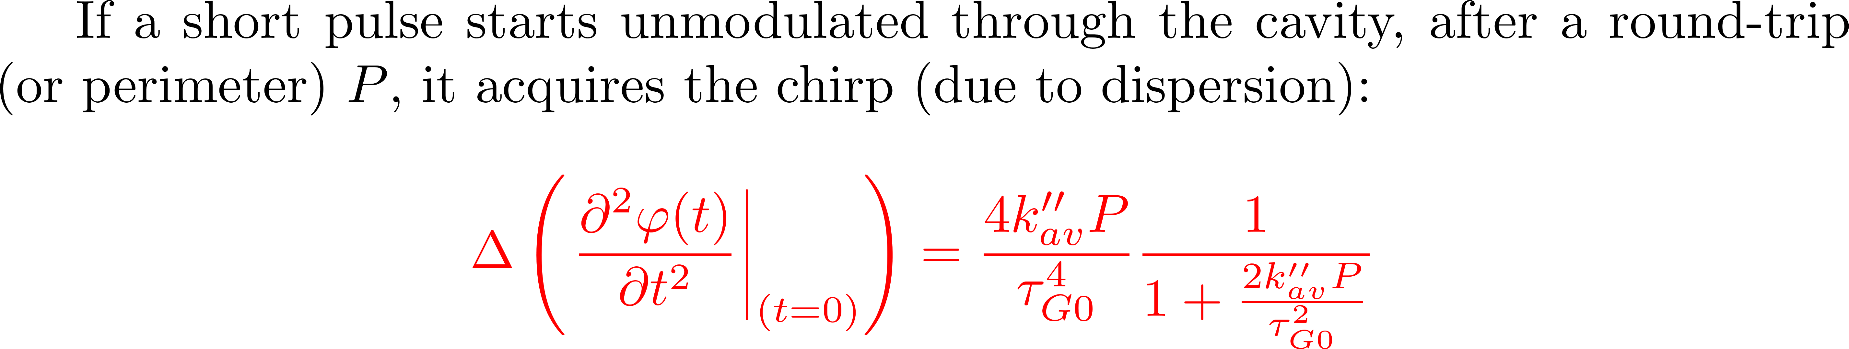
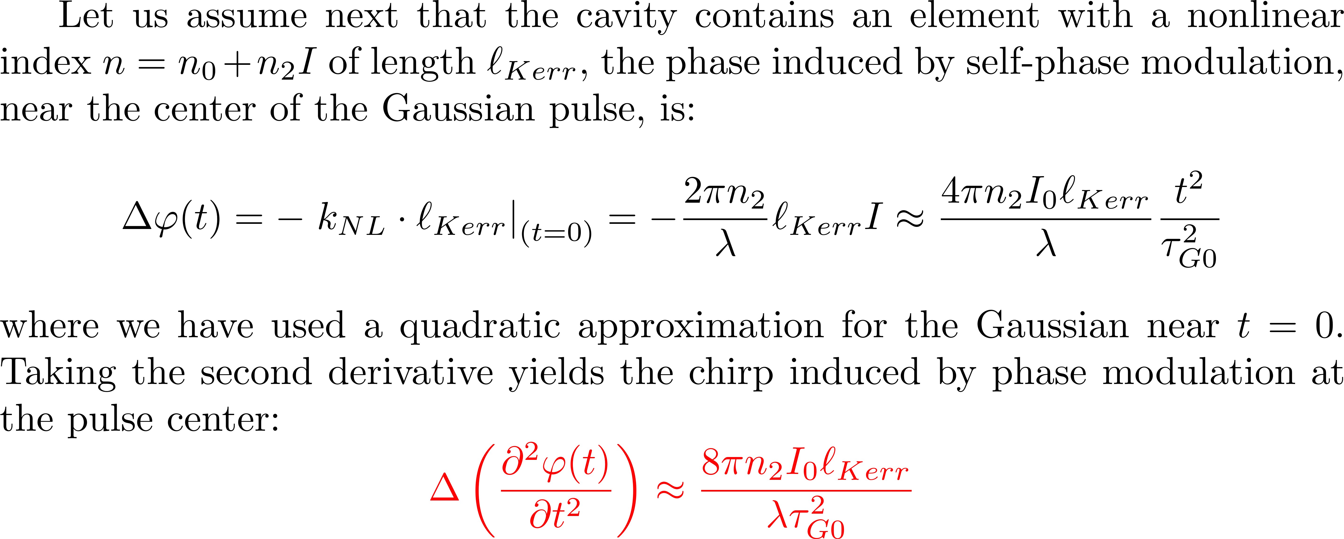

Slide 5
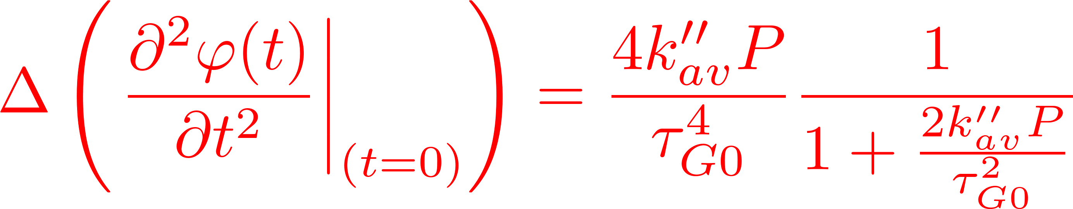
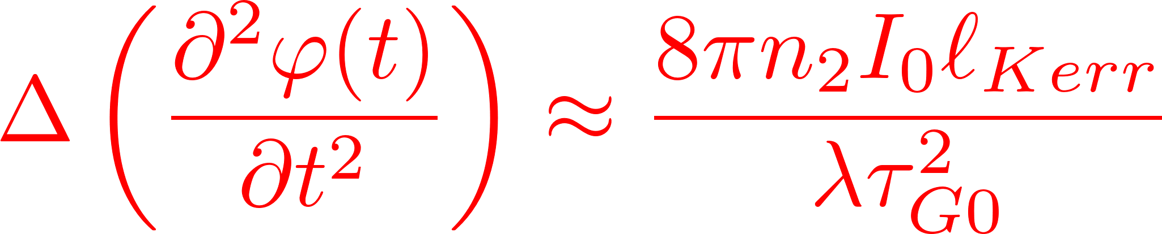
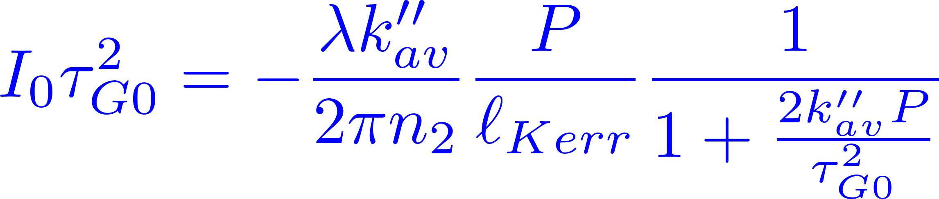
Evolution of a single pulse
IF THEY CANCEL EACH OTHER

Slide 6
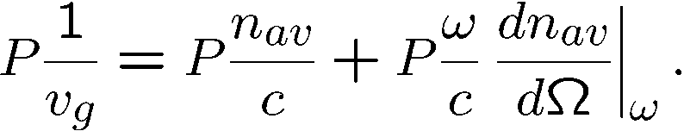
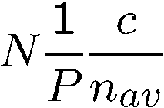
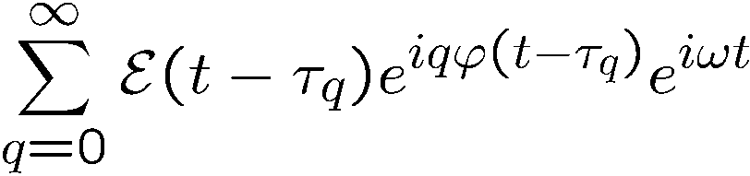
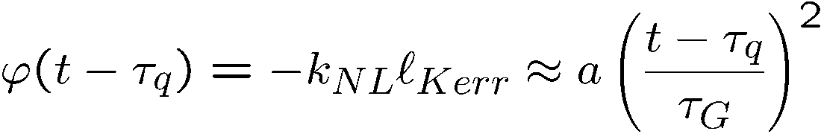
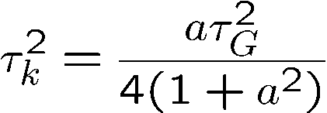
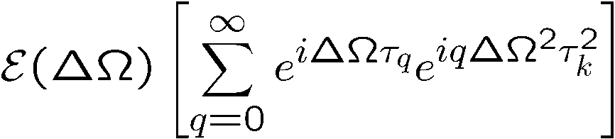
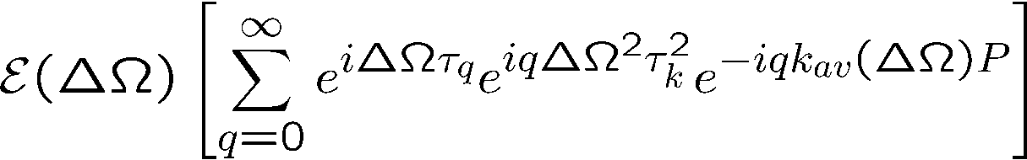

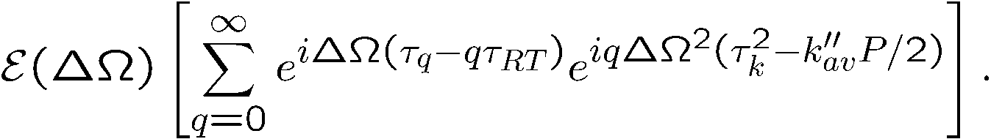
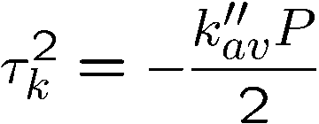
How unequally spaced modes
lead to a perfect frequency comb
Group delay
Phase delay
Cavity modes:
not equally spaced because n_{av =} n_{av}(ω)
Unequally spaced modes, is contradictory to the fact that comb teeth are equally spaced.
A cavity with ONLY Kerr modulation generates the pulse train:
where
F.T.
where
dispersion

Slide 7
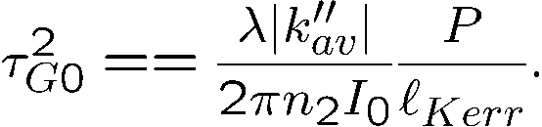
Two related questions:
Which mechanism makes the
As a pulse circulates in the cavity,
unequally spaced cavity modes
does it evolve towards a steady state?
equidistant?
Balance phase modulation by Kerr effect
and phase modulation by dispersion
How unequally spaced modes
Evolution of a single pulse in an ``ideal'' cavity
lead to a perfect frequency comb
SAME
CONDITION

Slide 8
5 fs Ti:sapphire laser (2 optical cycles)
Optics Letters Vol. 24, Issue 6, pp. 411-413 (1999)

Slide 9
SOLITONS

Slide 10
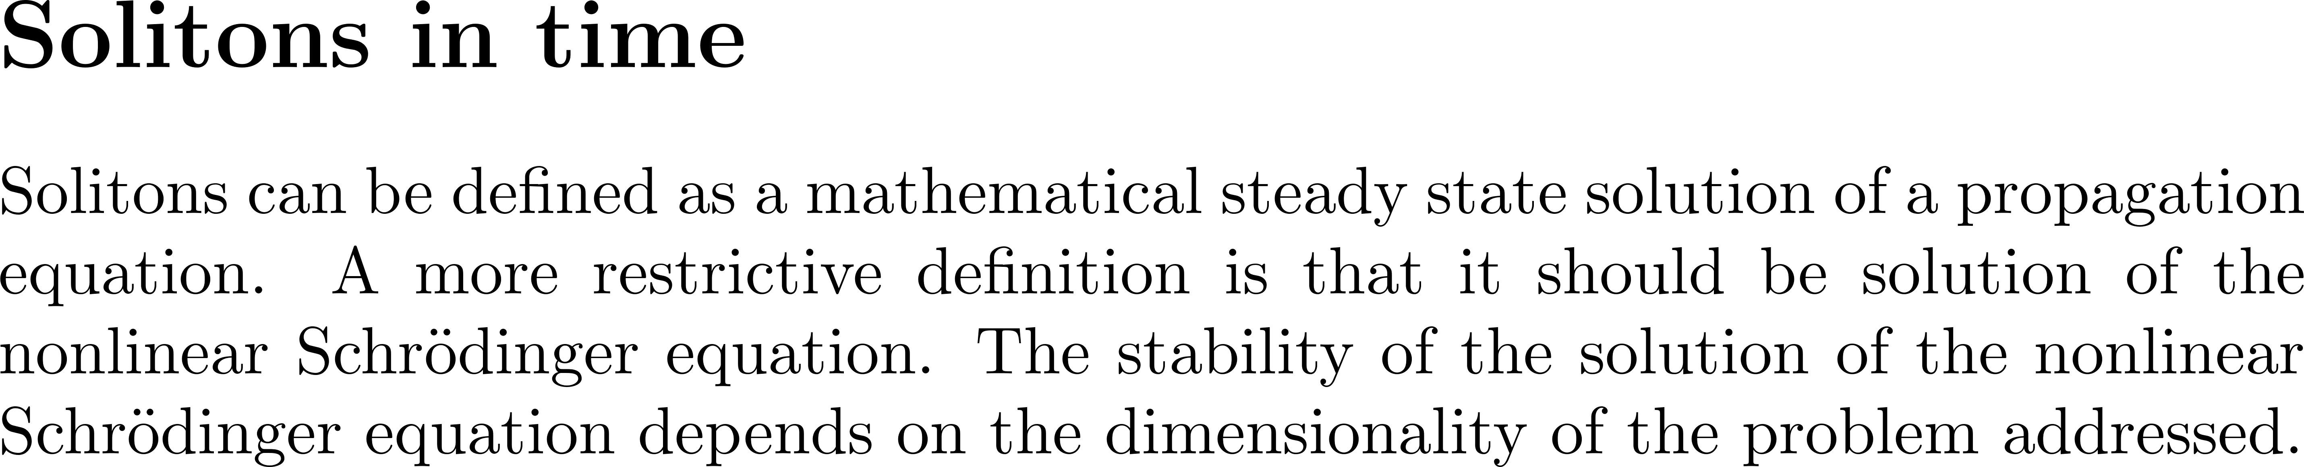
Pulse compression by propagation

Slide 11
The speed of light is highest in vacuum: $c = 299 792 458$ m/s\ix{Speed of light}.
As it propagates through matter,
it is slowed down by the interaction with atoms and molecules, resulting in a
velocity $v = c/n$ where $n$ is the index of refraction.\ix{index of refraction}\ix{Wave velocity}.
There are numerous mechanisms resulting in an intensity dependent wave velocity.
The oldest one involves water waves, and relates to the fist observation of solitons.
``Solitary propagation'' was discovered long before the mathematical equation even existed,
by the engineer
and shipbuilder John Scott Russell (1808-1882)~\cite{Russell1844} who named it ``{\em the wave of translation}''.
In 1834 he was riding by the Grand Union Canal at Hermiston, Glasgow, and
observed that when a canal boat stopped, its bow wave continued onward at a well-defined elevation of the water at constant speed.
It was only in the 1960's that the name ``soliton'' was coined when the
phenomenon was rediscovered by the American physicist Martin Kruskal.
Details of the early history of the soliton can be found in a book by Robin K. Bullough~\cite{Bullough88}.
The soliton took up so much importance in all areas of physics and laser optics
that a recreation of the observation of John Russell was organized for the 150th anniversary
of his observation. It Failed at the first attempt!

Slide 13
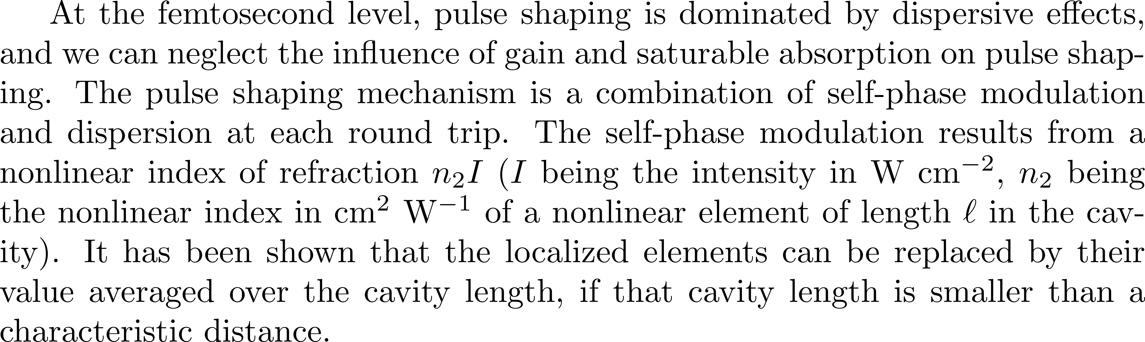
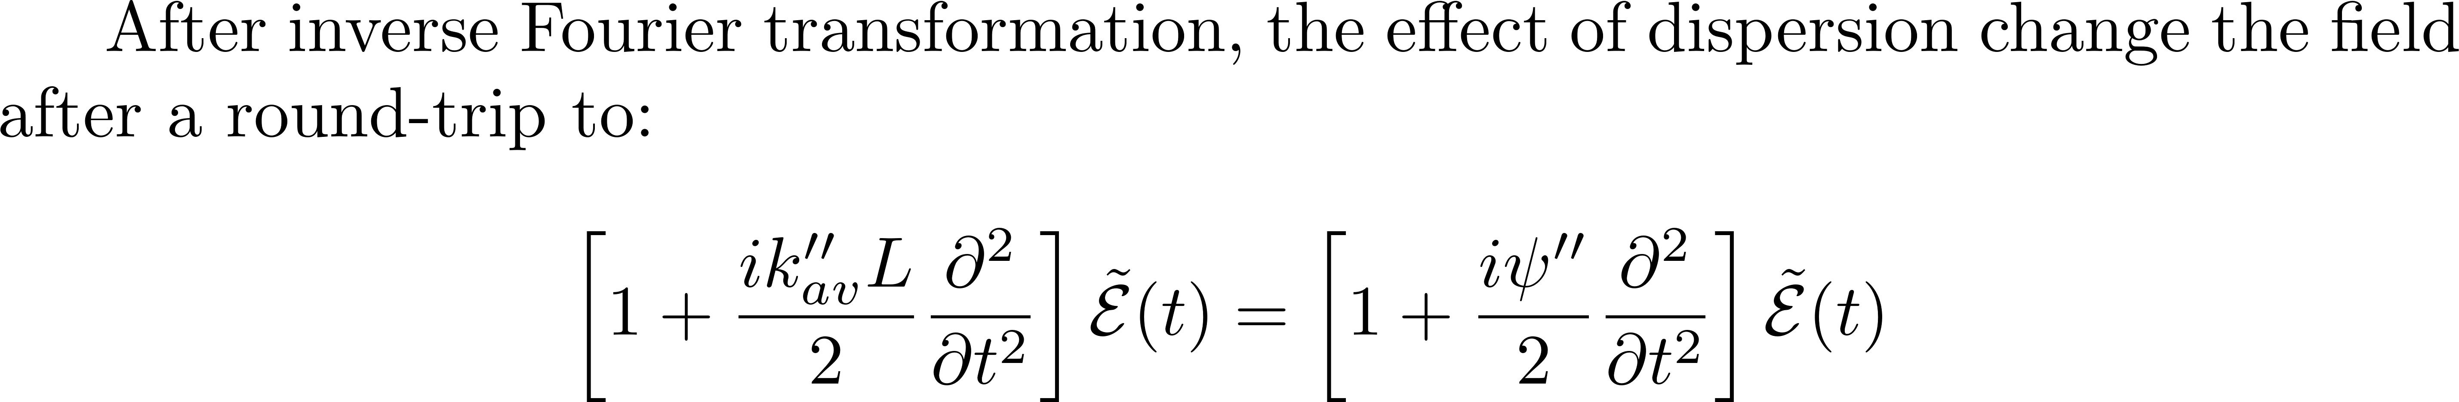
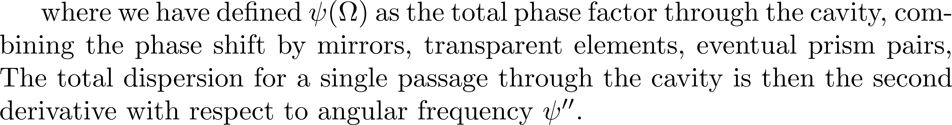
Solitons in a laser cavity

Slide 14
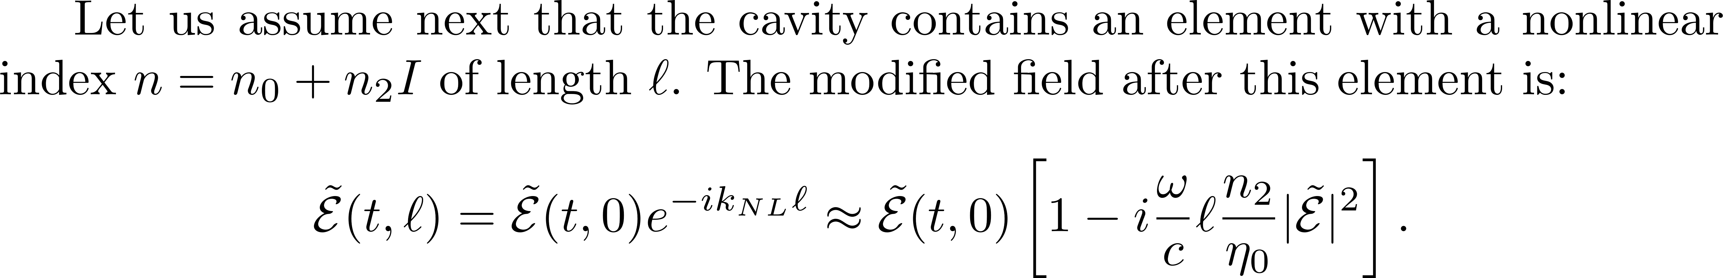
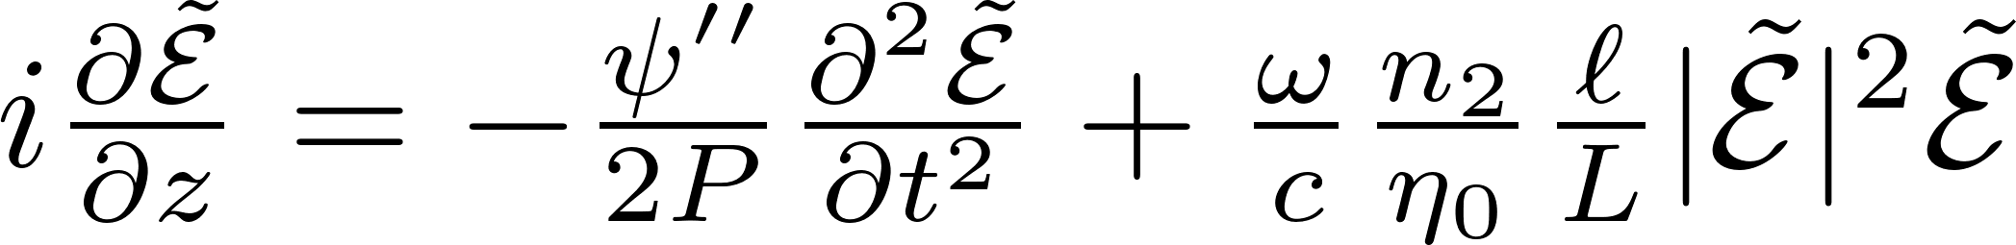
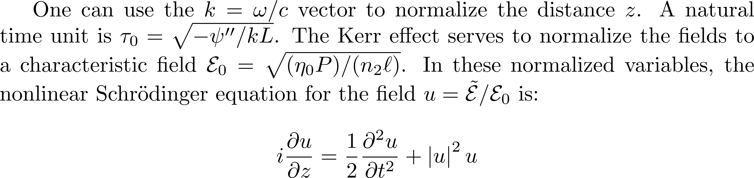
To get

Slide 15
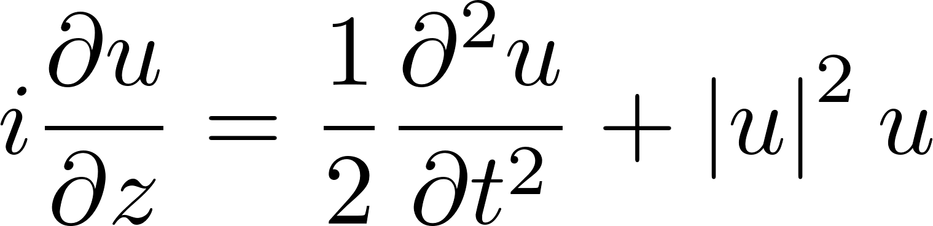
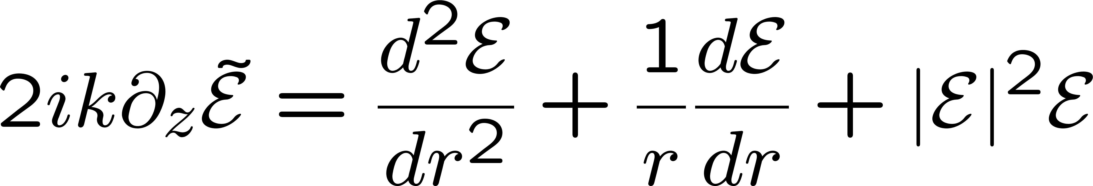
The one dimension nonlinear Schroedinger equation:
Solution: the sech pulse
(stable)
The two dimension nonlinear Schroedinger equation:
Solution: the Townes Soliton
(unstable)

Slide 16
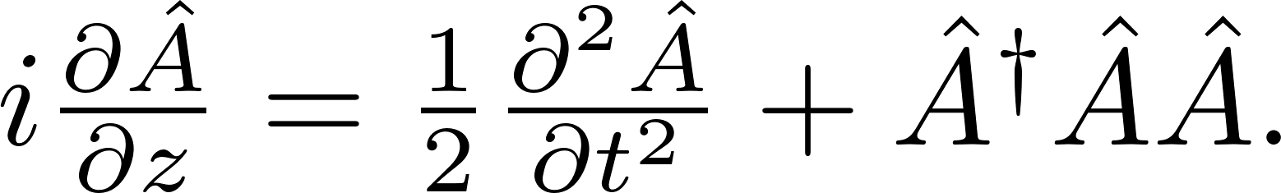
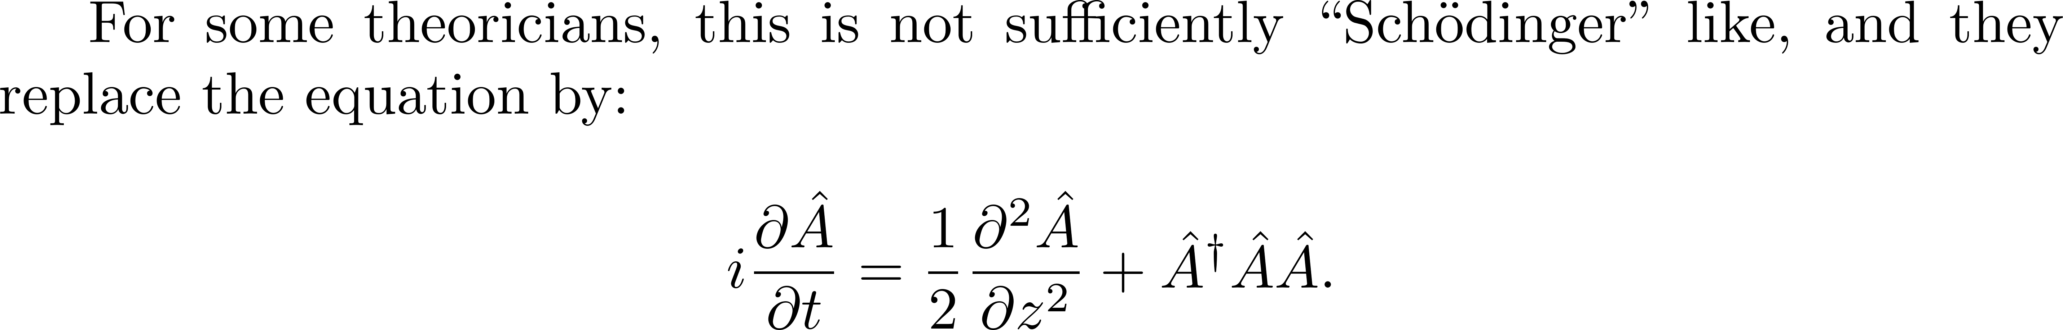
QUANTUM SOLITONS
I object! This is totally unphysical!
Justification:
“Running space coordinate”

Slide 17

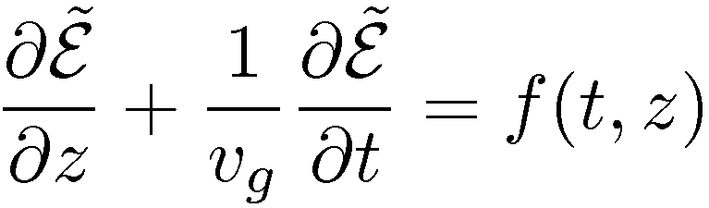

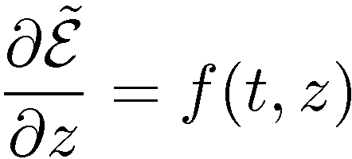
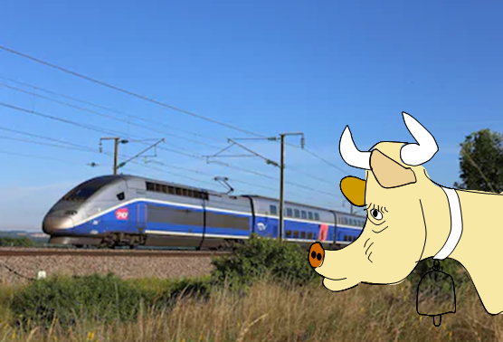

What the retarded frame of reference means
In the laboratory frame:
t=0
t
t=0
t’=0
In the retarded frame:
z
t’
The observer in the laboratory frame
is the cow that watches the TGV go by.
There is no way she can tell what is
happening inside [(i.e. f(t,z)].
For that, she must be in the retarded frame
which means inside the TGV,
or galloping next to it.

Slide 18
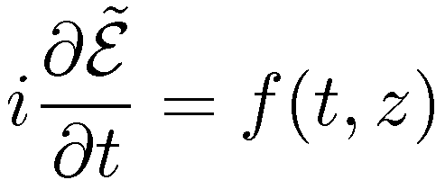
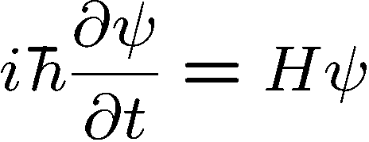
Retarded frame
HERESIE says the quantum physicist!
It should be:
Why?
Because the Schroedinger equation is
If it is not “quantum”, forget it.

Slide 19
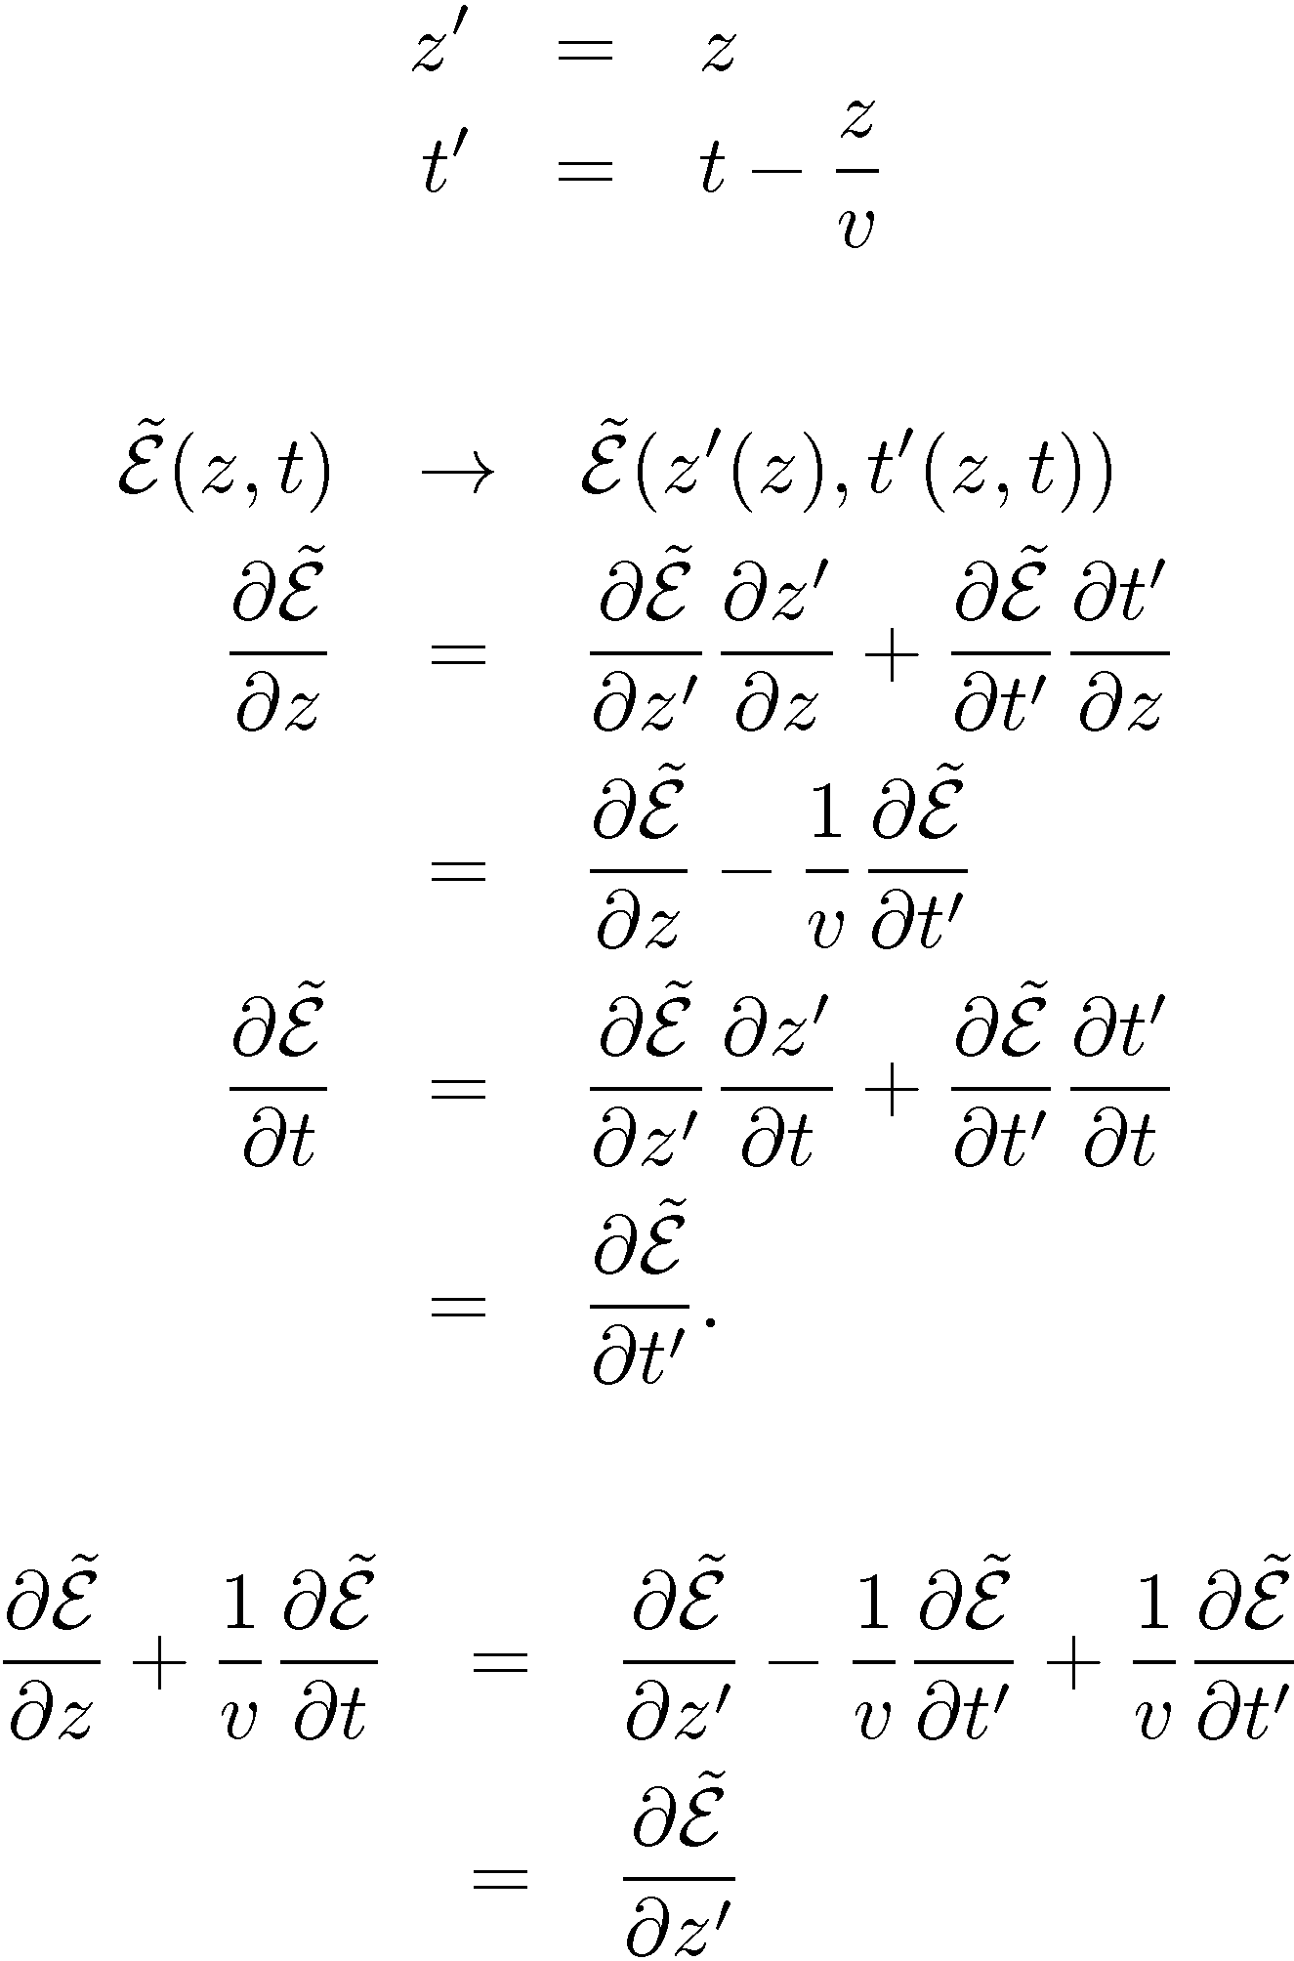
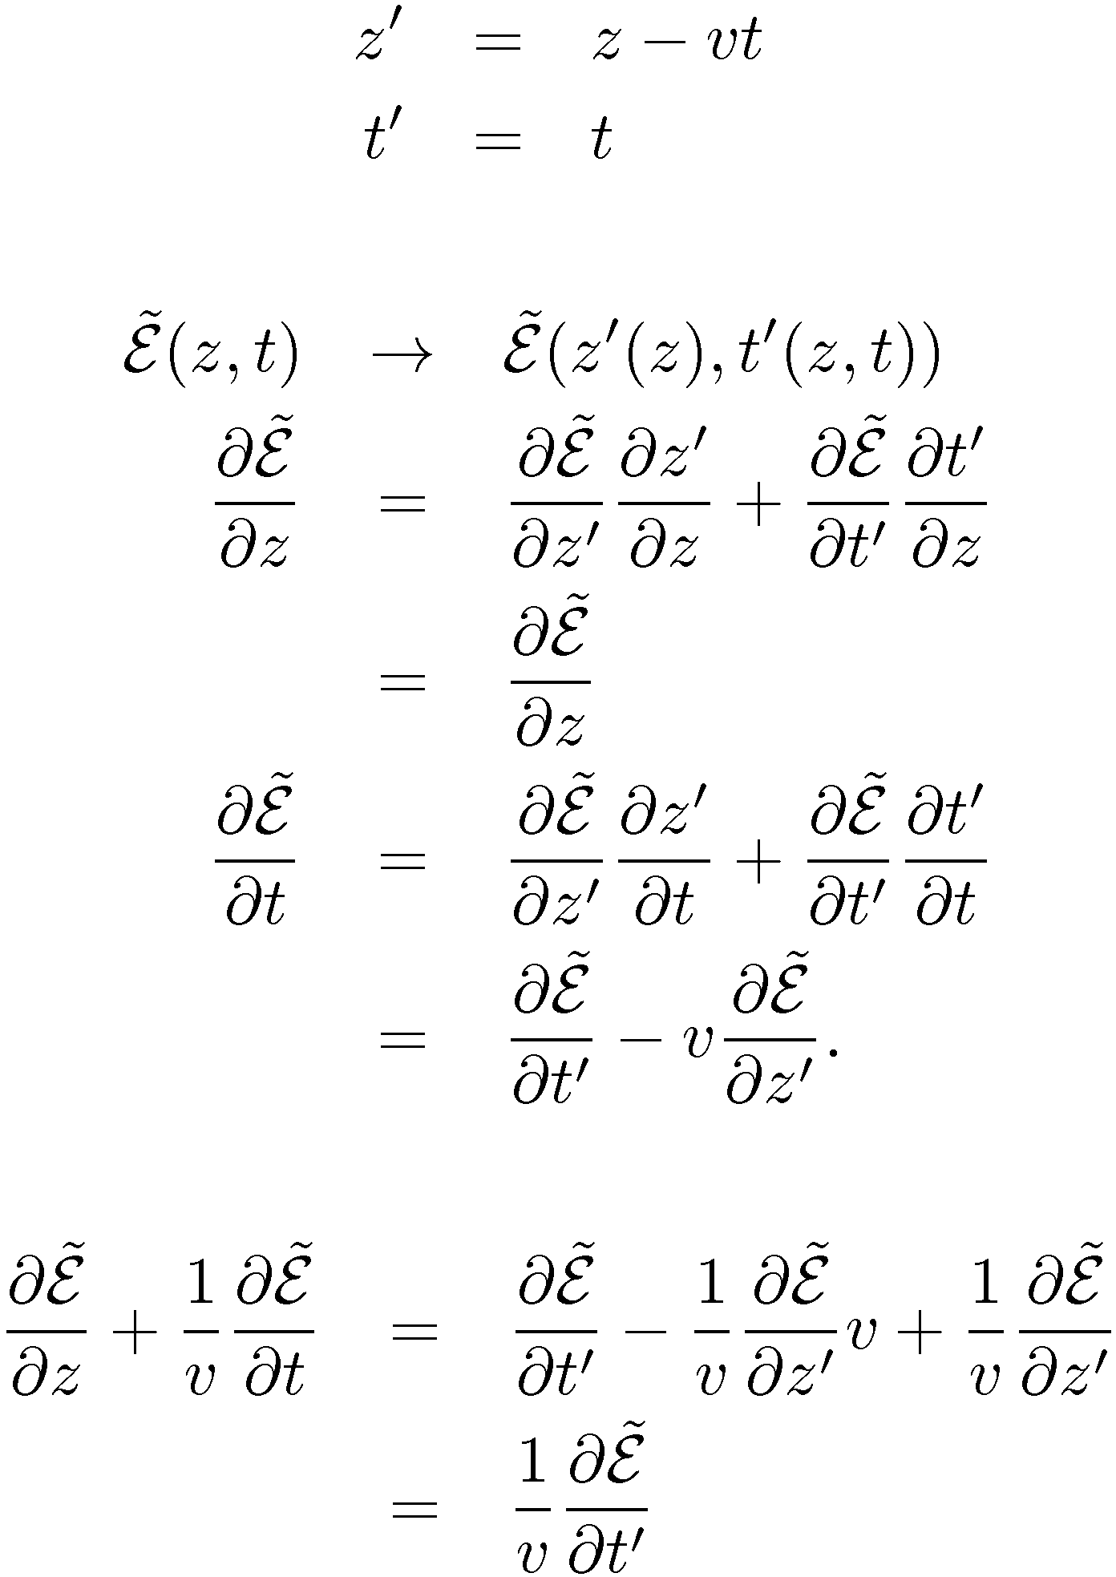
Retarded frame
“Running space coordinate”

Slide 20
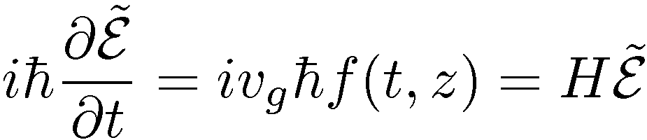
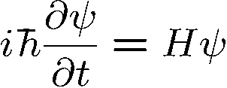
Retarded frame
“Running space coordinate”
Alleluia!
and the quantum physicist is happy
The cow-watching-the-TGV-is-not.
?
?
What is the physical meaning of the
?
“Running space coordinate”???
The rails are moving opposite to the train velocity so that the TGV is at standstill?

Slide 21
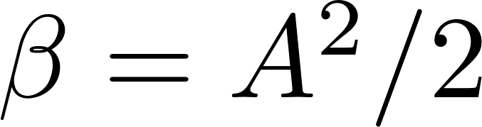
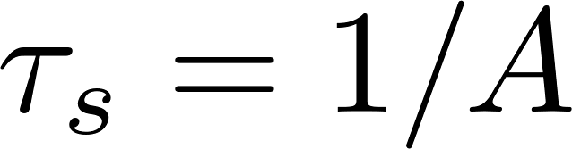
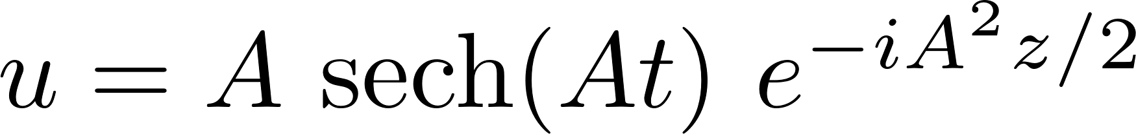
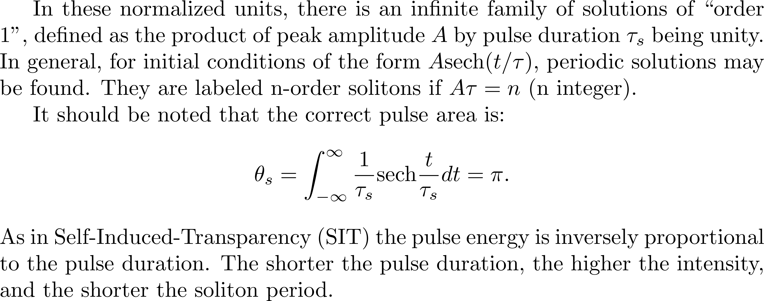
The first order soliton

Slide 22
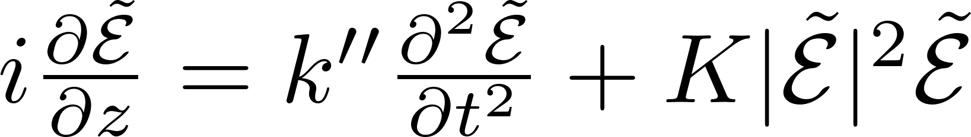
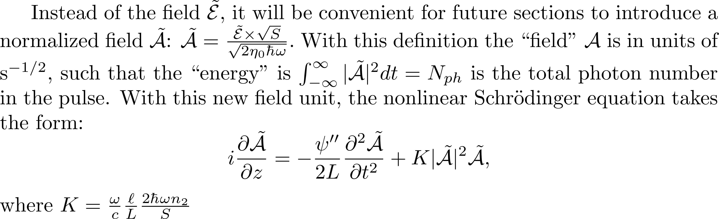
Out with the normalization

Slide 23
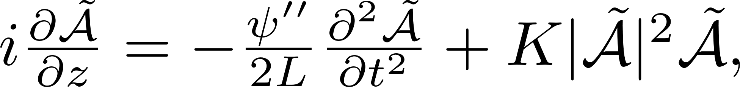
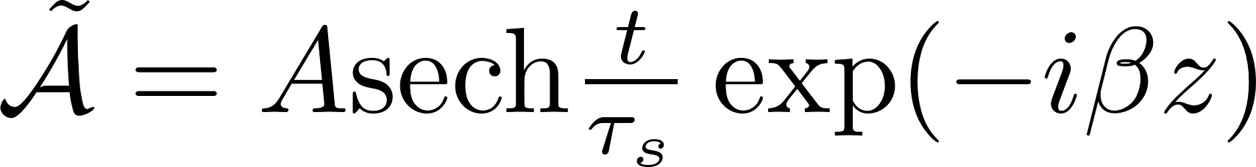
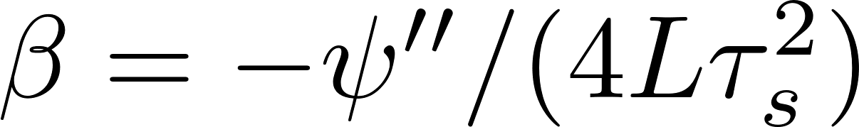
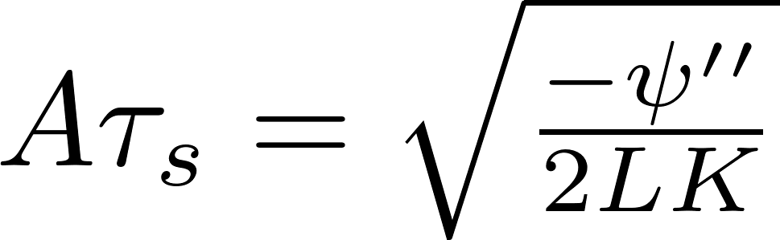

Slide 24
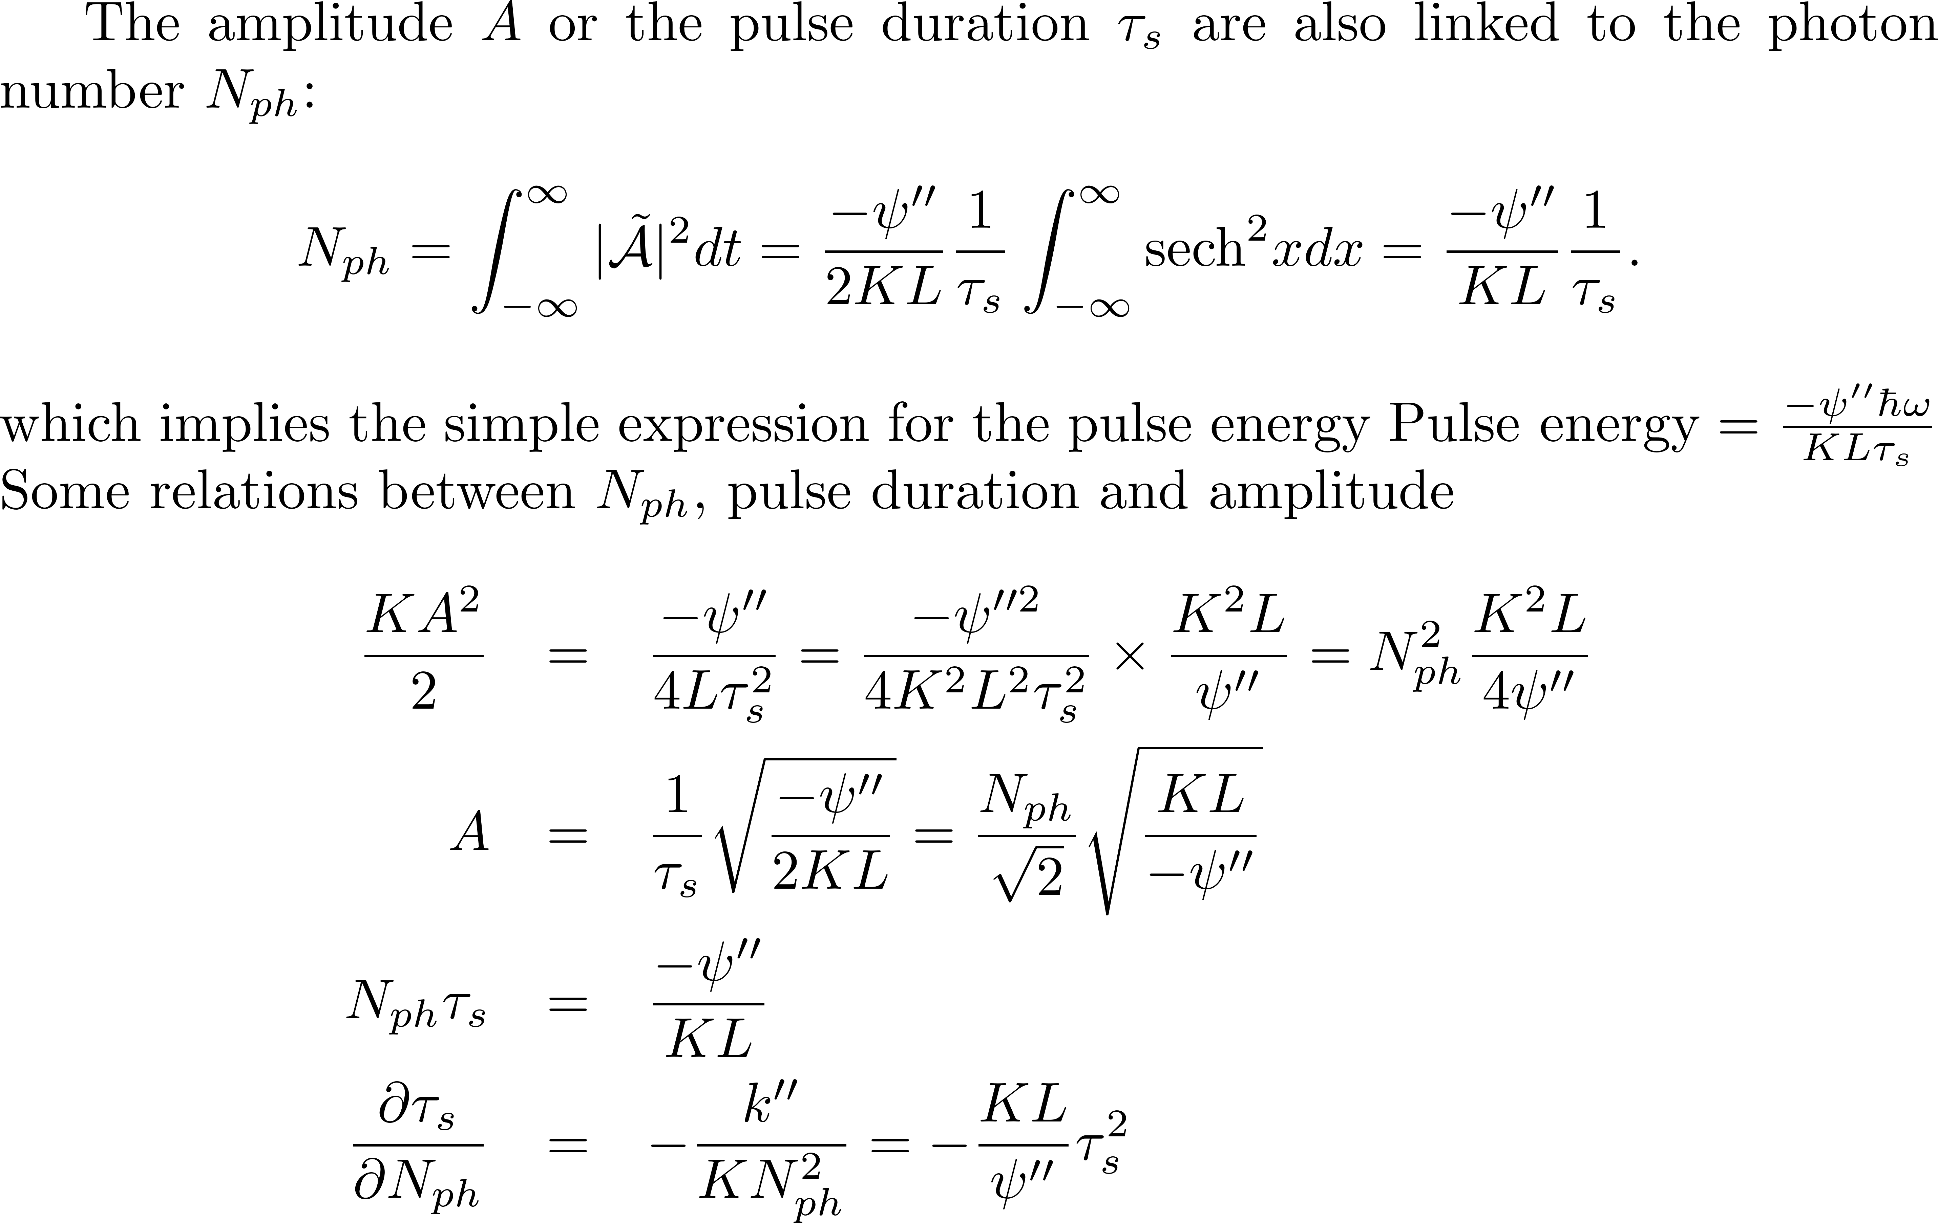
Links between all parameters

Slide 25
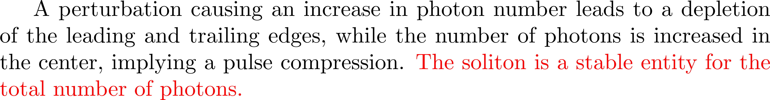
Conclusion of lengthy calculations…

Slide 26
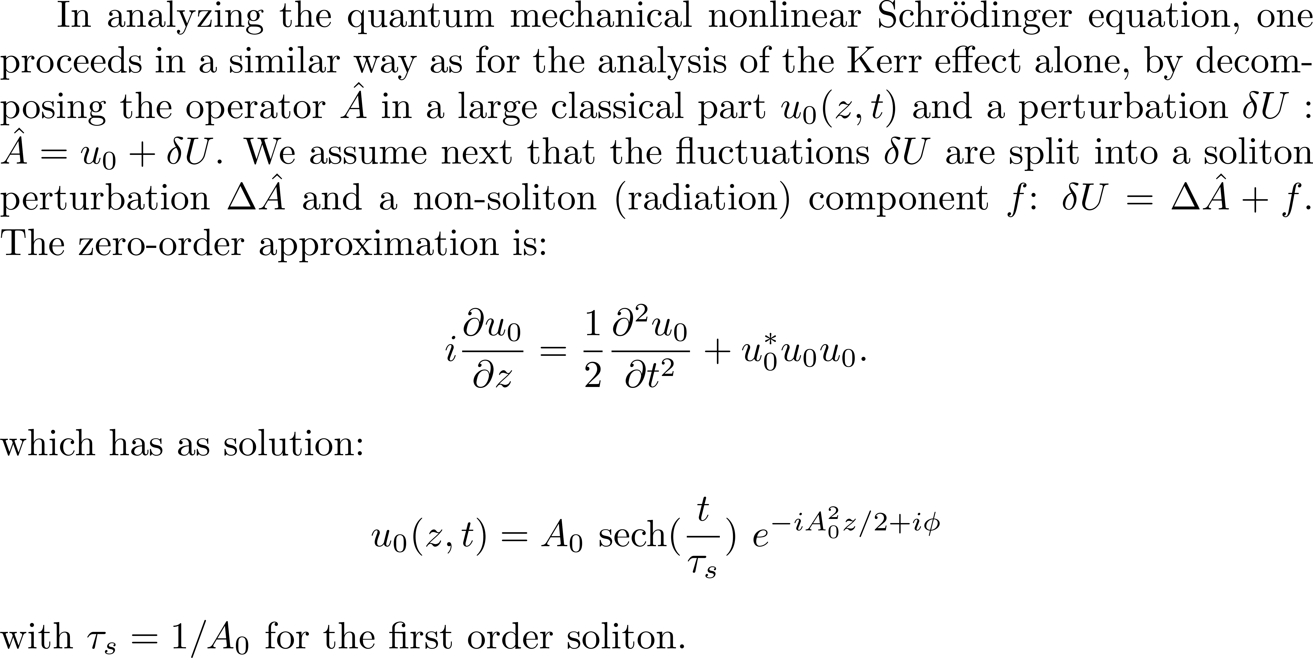
QUANTUM SOLITONS

